Slide 1



When OTs & Educators
Partner Well
A Practical Model for Building
Inclusive Early Childhood Programs Together
Brittni Winslow, MS, OTR/L
Owner/CEO · Emerge Pediatric Therapy · The Therapeutic Edge Collective
These three processes work together — a breakdown at any stage can affect how a child functions day-to-day.
Therapeutic Edge Collective Emerge Pediatric Therapy

Slide 2


Slide 3



ABOUT
BRITTNI
Our Mission
Helping children and their families thrive through evidence-based, sensory-informed, and relationship-centered care.
Occupational therapist since 2012
Owner, Emerge Pediatric Therapy (2018)
Comprehensive pediatric therapy services built on connection and evidence-based practice.
Founder, The Therapeutic Edge Collective
Sensory Specialist & Mom of 3
Professional development courses & resources empowering practitioners with cutting-edge tools.
Relationship-based, regulation-first approach
These three processes work together — a breakdown at any stage can affect how a child functions day-to-day.
Therapeutic Edge Collective Emerge Pediatric Therapy

Slide 4
The Problem: When Good Intentions Aren't Enough
"We both care so much about this child. Why does it feel like we're pulling in different directions?"
Let's start here:
How are you currently collaborating with OT?
What does that partnership look like day-to-day?
These three processes work together — a breakdown at any stage can affect how a child functions day-to-day.
Therapeutic Edge Collective Emerge Pediatric Therapy

Slide 5



Where Partnerships Break Down
Misaligned Expectations
No Shared Language
No Structured Joint Planning Time
Each partner assumes the other knows their role, without ever saying it aloud.
Clinical terms and classroom language describe the same child in incompatible ways.
Collaboration gets squeezed into hallway conversations and email threads.
These three processes work together — a breakdown at any stage can affect how a child functions day-to-day.
Therapeutic Edge Collective Emerge Pediatric Therapy

Slide 6

The Reframe: From Problem to Possibility
The Old Pattern
The New Powerful Partnerships Framework
OT and educators think together, not in sequence
Shared language, shared observation, shared planning
Family serves as a co-creator
OT gives recommendations; teacher tries to implement
Each works in their own lane
Family receives information, not part of the partnership
These three processes work together — a breakdown at any stage can affect how a child functions day-to-day.
Therapeutic Edge Collective Emerge Pediatric Therapy

Slide 7
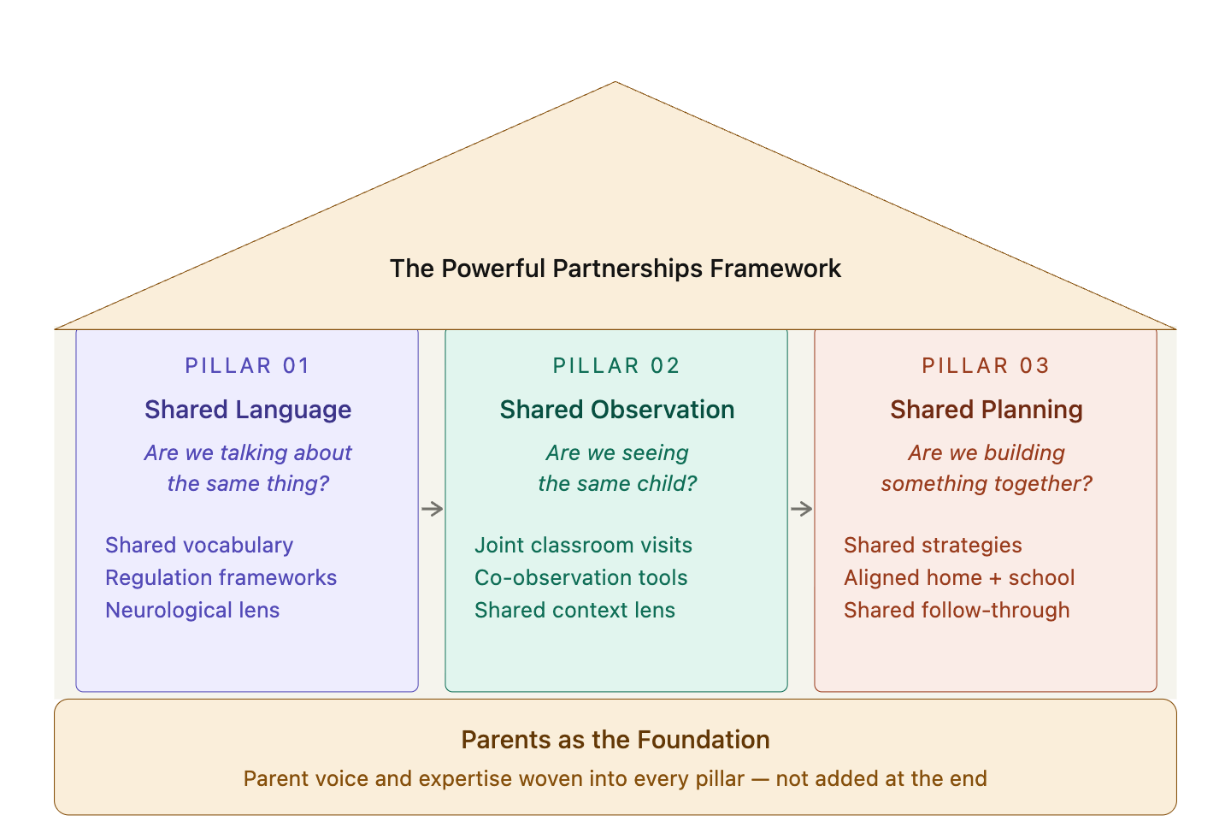
These three processes work together — a breakdown at any stage can affect how a child functions day-to-day.
Therapeutic Edge Collective Emerge Pediatric Therapy

Slide 8
The Logic of Sequencing
1
Shared Language
You can't observe together if you're describing different things. Aligning vocabulary is the foundation.
2
Shared Observation
Once you're speaking the same language, you can watch the same child and interpret what you're seeing together.
3
Shared Planning
Only then can you build a plan that both partners actually own.
These three processes work together — a breakdown at any stage can affect how a child functions day-to-day.
Therapeutic Edge Collective Emerge Pediatric Therapy

Slide 9
PILLAR ONE
Shared Language
"Are we talking about the same thing?"
Meet Theo
Parent says: "He is just a kid and doesn’t have problems at home."
Teacher says: "He's disruptive and not following directions."
OT says: "He's showing signs of a dysregulated vestibular system seeking proprioceptive input."
Same child. Three different conversations.
These three processes work together — a breakdown at any stage can affect how a child functions day-to-day.
Therapeutic Edge Collective Emerge Pediatric Therapy

Slide 10
Building a Vocabulary Bridge
Clinical Language (OT) | Classroom Language (Teacher)
Vestibular dysregulation | Difficulty sitting still, movement-seeking
Proprioceptive seeking | Crashing into things, rough play, chewing things
Tactile defensiveness | Avoids certain textures, bothered by clothing or touch
Executive function deficit | Trouble starting tasks, shifting activities, or organizing materials
Sensory over-responsivity | Gets overwhelmed by noise, crowding, transitions
These three processes work together — a breakdown at any stage can affect how a child functions day-to-day.
Therapeutic Edge Collective Emerge Pediatric Therapy

Slide 11
Core Reframe: Behavior as Nervous System Communication
Behavior is not a choice, it is a message from the child’s nervous system.
Old lens
New lens
"He's not listening."
"She's being defiant."
"He's always acting out.”
"His nervous system is overwhelmed."
"She needs help co-regulating."
"His body is trying to communicate."
Shared language starts with a shared belief about what the behavior means.
These three processes work together — a breakdown at any stage can affect how a child functions day-to-day.
Therapeutic Edge Collective Emerge Pediatric Therapy

Slide 12

Interactive Reflection
Think about a word or phrase you use regularly to describe a child's behavior or needs.
Share it with a partner and then discuss: how might the other role interpret it differently?
Words like: "sensory," "regulated," "avoidant," "engaged," "behavior plan," "inclusion"
How does your partner's role shape what they picture when they hear that word?
Where is there natural alignment? Where is there potential misread?
Consider:
⏱ 5 minutes
These three processes work together — a breakdown at any stage can affect how a child functions day-to-day.
Therapeutic Edge Collective Emerge Pediatric Therapy

Slide 13



PILLAR TWO
Shared Observation
"Are we seeing the same child?"
In the Clinic
In the Classroom
Structured 1:1 setting
Controlled sensory environment
Child is performing for an adult
OT holding the task demands
Group dynamics and peer proximity
Unpredictable sensory landscape
Child navigating real social demands
Teacher managing 18+ children
These three processes work together — a breakdown at any stage can affect how a child functions day-to-day.
Therapeutic Edge Collective Emerge Pediatric Therapy

Slide 14

Why Observation Comes Before Planning
"I don't have time for the OT to come observe. I'll just describe what I'm seeing."
The time concern is real. Here's why joint observation is still worth it:
One shared 20-minute observation prevents months of misaligned intervention.
The OT sees sensory and motor details that don't translate into words.
The teacher sees social and relational dynamics the OT misses in a 1:1 clinic session.
Together, you build a picture no one person can hold alone.
These three processes work together — a breakdown at any stage can affect how a child functions day-to-day.
Therapeutic Edge Collective Emerge Pediatric Therapy

Slide 15
Joint Observation Protocol
OT Brings
Teacher Brings
Sensory processing lens
Postural and motor observation
Attention and regulation patterns
Environmental sensory load assessment
Behavioral baseline knowledge
Peer comparison and social context
Routine and transition history
What's already been tried
Together: Debrief within 48 hours. Document what you each noticed.
These three processes work together — a breakdown at any stage can affect how a child functions day-to-day.
Therapeutic Edge Collective Emerge Pediatric Therapy

Slide 16

Shifting the Dynamic
From OT Telling
To Making Sense Together
TO
OT reports findings; teacher listens
Both partners share observations and build meaning together
Recommendations handed off in written form
Strategies co-developed in real conversation
Teacher implements; OT checks back in
Both monitor outcomes and adjust together
This shift is cultural, and it requires intentional structure to sustain.
These three processes work together — a breakdown at any stage can affect how a child functions day-to-day.
Therapeutic Edge Collective Emerge Pediatric Therapy

Slide 17

PILLAR THREE
Shared Planning
“Are we building something together?”
The File Plan
The Classroom Plan
Clinical language
Lives in the IEP or OT report
Teacher may never read it
Updated once a year
Built for compliance
Plain language the teacher can use
Posted or accessible during the day
Co-built with the teacher
Living document
Built for the child
These three processes work together — a breakdown at any stage can affect how a child functions day-to-day.
Therapeutic Edge Collective Emerge Pediatric Therapy

Slide 18
Example: A Co-Developed Regulation Plan
Child & Context
What You Might See
Try This First
Then Try
When to Consult OT
Theo, age 5
Circle time, transitions
Leaves carpet
Makes noise
Disrupts peers
Offer a wiggle cushion or preferred seat spot
Give a 2-min movement break before transition
If behavior escalates beyond what tools can address
Maya, age 4
Art & sensory tables
Refuses activity
Cries at textures
Covers ears
Offer tool options (brush, gloves, spoon)
Allow watching first — don't force participation
If avoidance is consistent and limiting participation
This plan is written for the teacher to use independently (no clinical background required).
Built together. Owned by both. Revisable by either.
These three processes work together — a breakdown at any stage can affect how a child functions day-to-day.
Therapeutic Edge Collective Emerge Pediatric Therapy

Slide 19
Meeting Structure: A Living Document
30-Minute Partnership Meeting Agenda
5 min
Child update
What has each partner noticed since we last met?
5 min
What's working
Celebrate strategies that are working.
10 min
What needs adjusting
Review current plan: Update language, strategies, or goals.
5 min
Family loop
What do we want to share with or learn from the family?
5 min
Next steps + date
Who does what before we meet again?
These three processes work together — a breakdown at any stage can affect how a child functions day-to-day.
Therapeutic Edge Collective Emerge Pediatric Therapy

Slide 20

Sustainability: Review Cycles
Brief check-ins (5 min hallway, email). Focus: is anything urgent? Flag early before it escalates.
Weekly
30-minute meeting using the shared agenda. Review, adjust, celebrate. Update the living plan.
Monthly
Deeper look: Is our partnership working? Is the child making progress? Does our plan still fit the child's current needs?
Quarterly
Tip: Put recurring meetings on the calendar at the start of the school year instead of scheduling ad hoc.
These three processes work together — a breakdown at any stage can affect how a child functions day-to-day.
Therapeutic Edge Collective Emerge Pediatric Therapy

Slide 21
Small Group Activity: Case Scenario
The Scenario
Jordan is a 4-year-old in a community preschool. Jordan frequently leaves group activities, hides under tables, and puts hands over ears during music. The classroom teacher describes Jordan as "emotionally fragile and easily dysregulated." Jordan has not yet been referred for OT services.
In your group, identify:
One language shift you would make in how Jordan's behavior is described
One observation you would want to conduct jointly and what each role would focus on
One concrete planning action. What would go into a classroom regulation support plan?
⏱ 10 minutes → group share
These three processes work together — a breakdown at any stage can affect how a child functions day-to-day.
Therapeutic Edge Collective Emerge Pediatric Therapy

Slide 22

Debrief: Group Sharing
1. What language shifts came up in your group?
2. What did you notice about the observation piece? Were there any surprises?
3. What sticking points emerged when you tried to build the plan?
4. What felt most transferable to your own setting right now?
These three processes work together — a breakdown at any stage can affect how a child functions day-to-day.
Therapeutic Edge Collective Emerge Pediatric Therapy

Slide 23


The Family Layer
"Powerful Partnerships"
Families know the child in ways neither the OT nor the teacher can replicate.
Disconnected messaging from school and clinic erodes family trust.
When families are brought in as co-creators, outcomes improve for everyone.
The family is not just a recipient of information, they are the third partner.
The strongest OT–educator partnerships don't stop at the classroom door.
These three processes work together — a breakdown at any stage can affect how a child functions day-to-day.
Therapeutic Edge Collective Emerge Pediatric Therapy

Slide 24
Practical Strategies to Incorporate Family Voices
Pillar 1
Shared Language
Pillar 2
Shared Observation
Pillar 3
Shared Planning
Send home a simple glossary of terms you use to describe classroom behaviors
Ask: 'How do you describe this at home?'
Use their language in your documentation
Share a 2–3 sentence observation summary after each joint obs
Ask: 'Does this match what you see at home?'
Invite families to observe
Include a 'home strategies' section in the regulation support plan
Send the classroom plan home in plain language
Co-create goals at the family conference
The goal: Families feel seen, heard, and genuinely involved and not just notified.
These three processes work together — a breakdown at any stage can affect how a child functions day-to-day.
Therapeutic Edge Collective Emerge Pediatric Therapy

Slide 25
Your Call to Action
Before you leave today, identify ONE specific, doable step you will take in the next two weeks.
Language
Observation
Share one vocabulary bridge card with your partner this week.
Schedule a 20-minute joint observation before the end of the month.
Planning
Family
Co-create one classroom regulation support plan together.
Add a family question to your next co-planning meeting agenda.
Small steps, taken consistently, are what make partnerships last.
These three processes work together — a breakdown at any stage can affect how a child functions day-to-day.
These three processes work together — a breakdown at any stage can affect how a child functions day-to-day.
Therapeutic Edge Collective Emerge Pediatric Therapy
Therapeutic Edge Collective Emerge Pediatric Therapy

Slide 26
Q&A
Questions? Comments?
These three processes work together — a breakdown at any stage can affect how a child functions day-to-day.
Therapeutic Edge Collective Emerge Pediatric Therapy
Notes:
Vocabulary Bridge Card
Observation Protocol
Regulation Support Plan Template

Slide 27

Where to Learn More
The Therapeutic Edge Collective
The Out-of-Sync Child
Professional Development
Book
Carol Stock Kranowitz
thetherapeuticedge.com
Sensational Kids
No Longer a Secret
Book
Dr. Lucy Jane Miller
Book
Dr. Lucy Jane Miller
The STAR Institute for Sensory Processing
Emerge Pediatric Therapy
Organization
Clinical Services
sensoryhealth.org
emergepediatrictherapy.com
These three processes work together — a breakdown at any stage can affect how a child functions day-to-day.
Therapeutic Edge Collective Emerge Pediatric Therapy

Slide 28




Thank You
Let's Stay Connected!
Brittni Winslow, MS, OTR/L
website: brittniwinslow.com
email: brittni@emergepeds.com
Have questions? Want to collaborate?
These three processes work together — a breakdown at any stage can affect how a child functions day-to-day.
Therapeutic Edge Collective Emerge Pediatric Therapy

