Slide 1

Getting Unstuck:
Pyramid Model Strategies for When Behavior Challenges Adults
Lindsay N. Giroux and Leiha Knecht
2026 International Early Childhood Inclusion Institute
Notes:
Lindsay & Leiha: Introduce ourselves here.

Slide 2
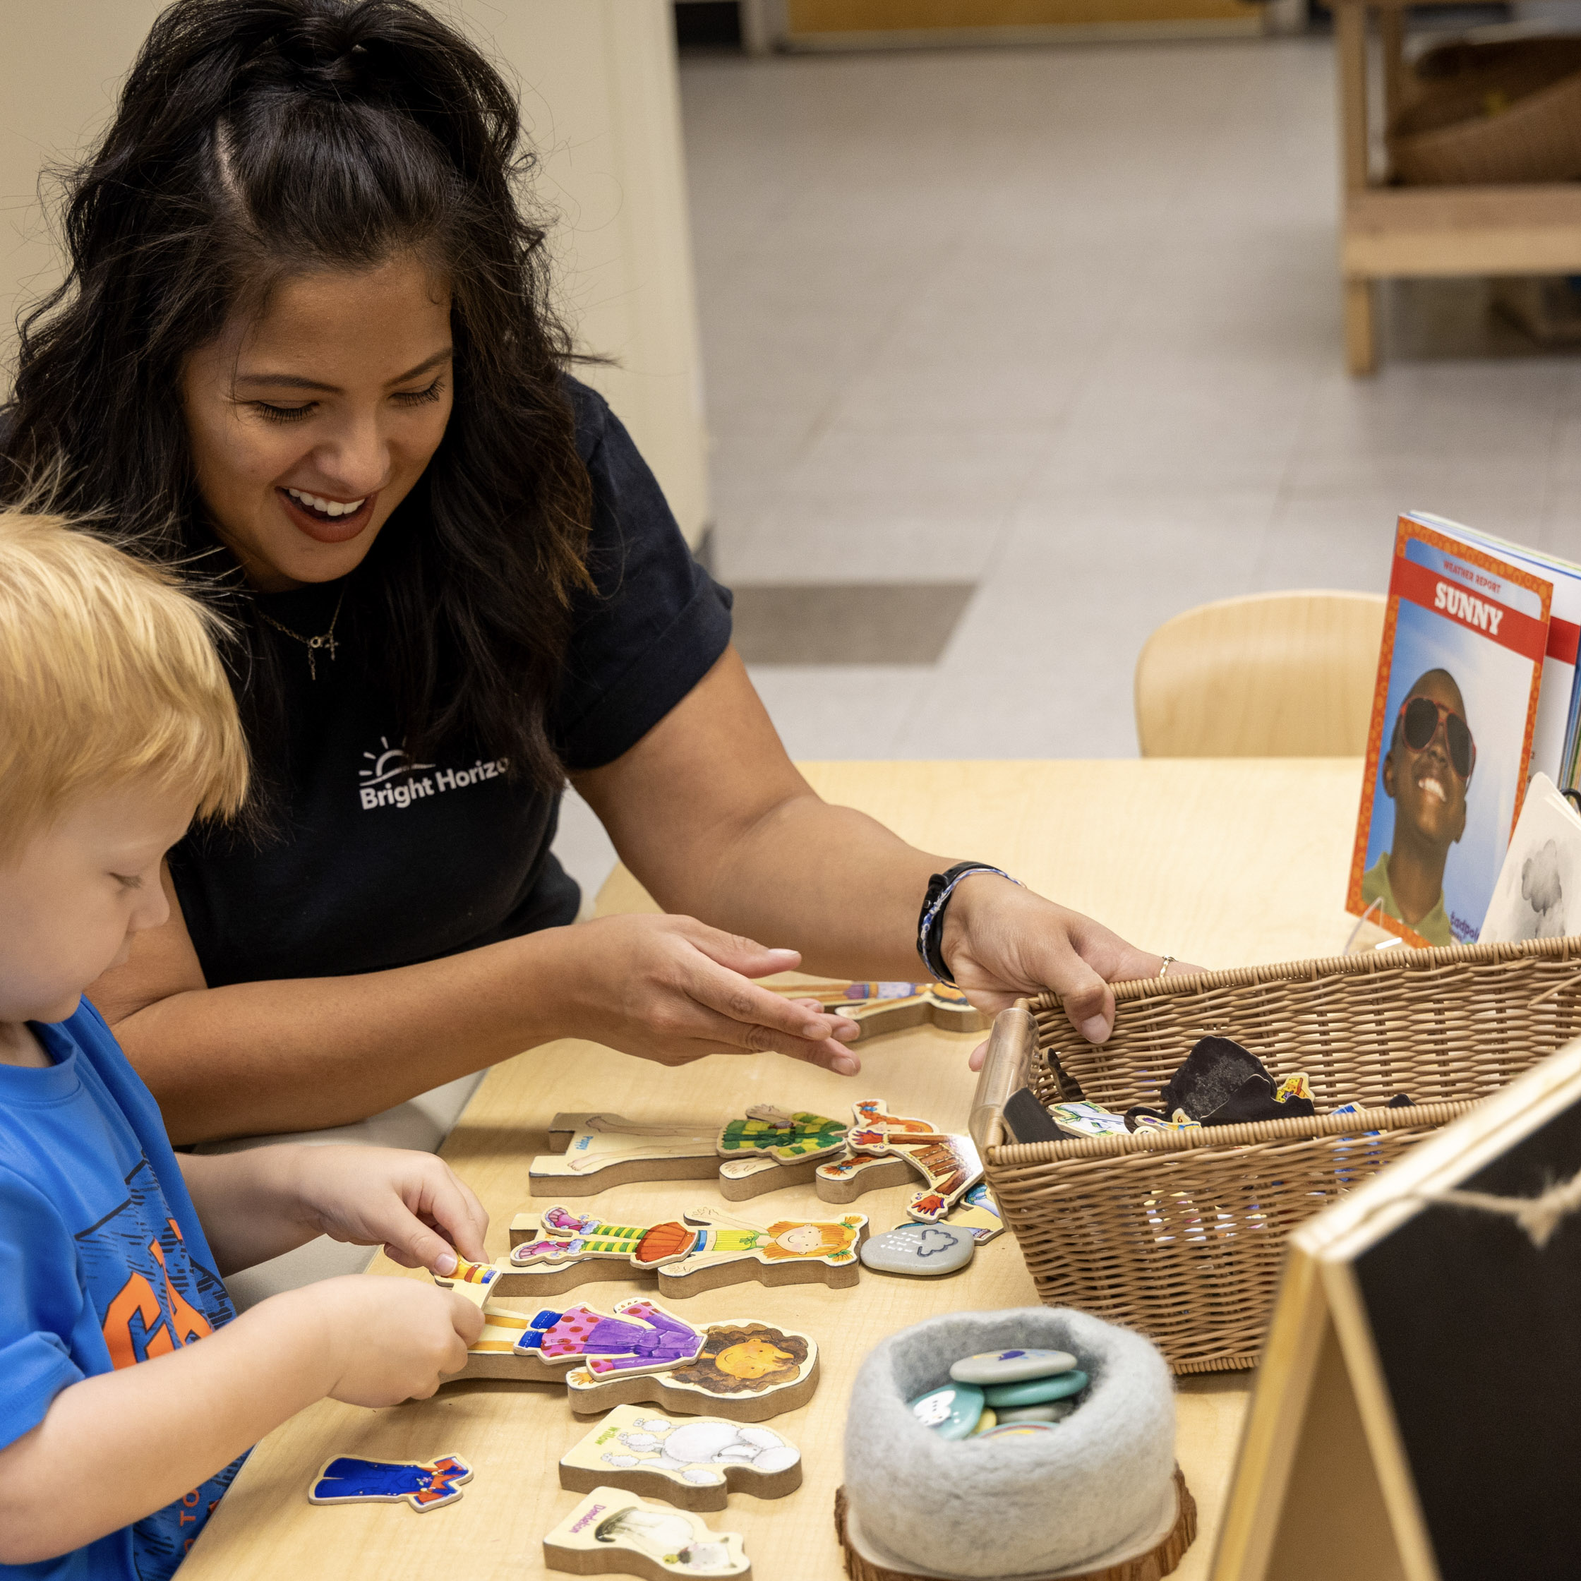


Who is here today?
I work directly with children.
I support the adults who work with children.
I support the systems that support the adults who work with children.
© 2026, Bright Horizons Family Solutions LLC
Notes:
Leiha- ask people to self identify in one of the three categories.
Working directly with children (including those who are identifying as a family member, although I’m not sure we’ll have too many family members in the audience)
Supporting adults who work with children (coaches, professors, etc.)
Supporting the systems that support the adults (those who run programs)
(If there's only 15 we might have time to have everyone actually introduce themselves with their name and their role and which category!)

Slide 3
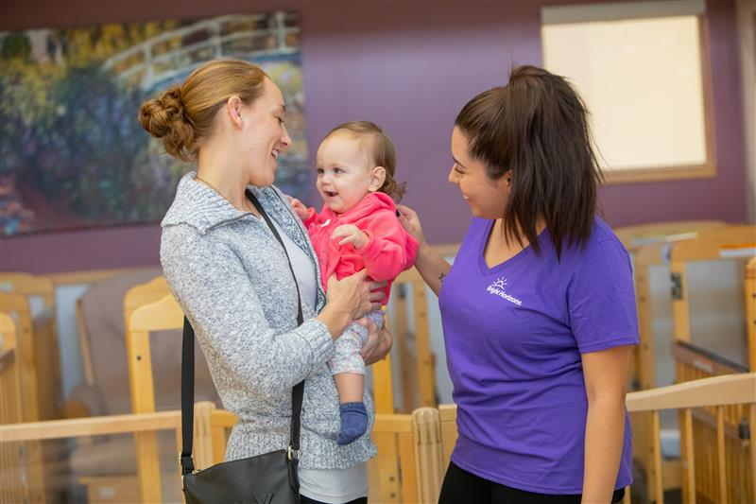
A note about language…
Bright Horizons current language norms include-
People first language as the default
Asking families and children for their preferred language
Respecting preferences of families
Broad interpretation of families and teachers & educators
© 2026, Bright Horizons Family Solutions LLC
Notes:
Leiha- how do you feel about doing this slide? I think it might be better for flow! Families instead of parents to be more inclusive
Similarly teachers and educators means any adult working to educate a child- including therapists and classroom teachers and support staff

Slide 4
Outcomes
Examine our own beliefs and create routines to neutralize implicit bias
Plan targeted social-emotional instruction to prevent behaviors that challenge adults
Identify new resources and multisensory supports for social-emotional instruction
Develop a plan of ideas and tools to bring back to your setting
© 2026, Bright Horizons Family Solutions LLC
Notes:
Leiha

Slide 5
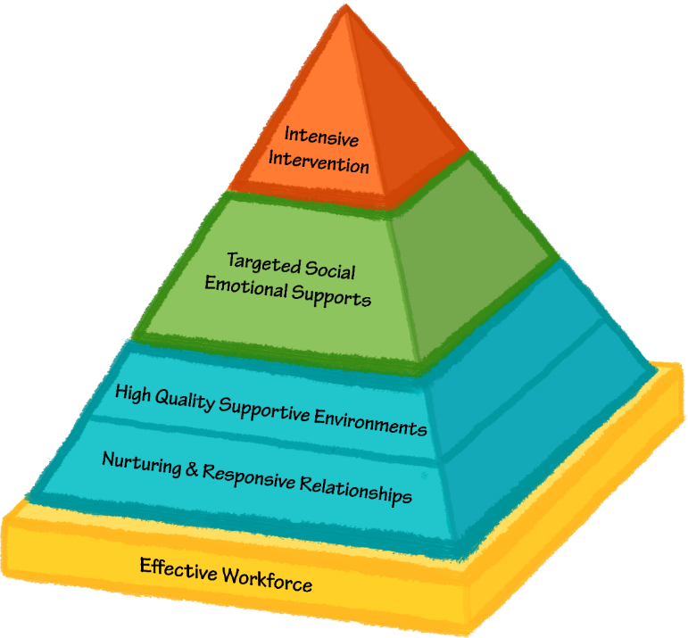
Overview of the Pyramid Model
For a few children
For some children
For all children
Pyramid Model for Promoting Social and Emotional Competence in Infants and Young Children. From National Center for Pyramid Model Innovations at the University of South Florida, www.challengingbehavior.org. Reprinted with permission.
© 2026, Bright Horizons Family Solutions LLC
Notes:
Lindsay

Slide 6
Pyramid Model Foundation
Policies, Training, and Support
© 2026, Bright Horizons Family Solutions LLC
Notes:
Lindsay

Slide 7
Pyramid Model Tier I
Schedules, Expectations, Activities, Daily SE Teaching
Relationships with Children, Families, Teammates
© 2026, Bright Horizons Family Solutions LLC
Notes:
Lindsay

Slide 8
Pyramid Model Tier II
Individualized and Systematic Social-Emotional Teaching
© 2026, Bright Horizons Family Solutions LLC
Notes:
Lindsay

Slide 9
Pyramid Model Tier III
Functional Behavior Analysis
© 2026, Bright Horizons Family Solutions LLC
Notes:
Lindsay

Slide 10
Pyramid Model Focus
Intentional Instruction
Our Responses & Classroom Structures
© 2026, Bright Horizons Family Solutions LLC
Notes:
Lindsay

Slide 11

Examining Our Own Beliefs
Developing Neutralizing Routines
© 2026, Bright Horizons Family Solutions LLC
Notes:
Lindsay

Slide 12
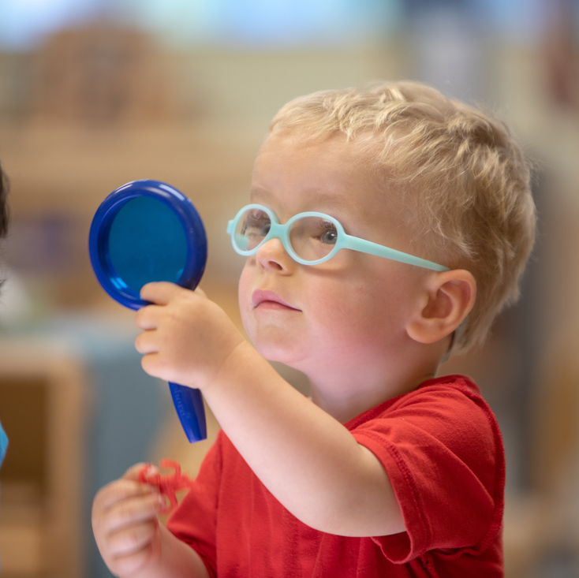
Curiosity without Judgment
What do I notice in my body?
What is this feeling?
Why does this bother me?
What can I do to regulate?
© 2026, Bright Horizons Family Solutions LLC
Notes:
Lindsay

Slide 13
Are you bothered?
throwing
ignoring
whining
biting
spitting
talking back
crying
hitting
something else
© 2026, Bright Horizons Family Solutions LLC
Notes:
Lindsay

Slide 14
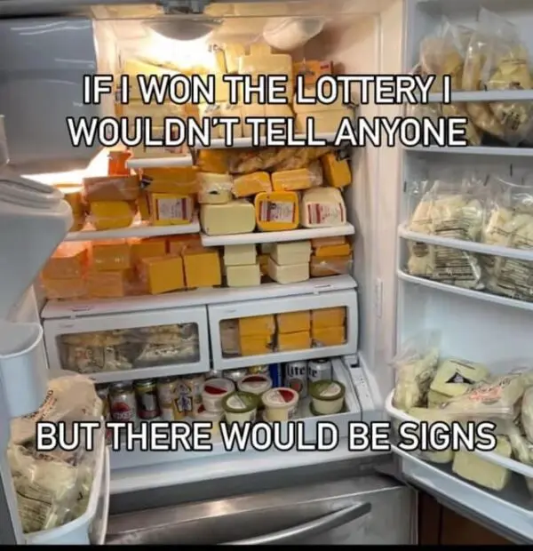
“There would be signs…”
Physiological signs of stress
Tone of voice
Facial expression
Sensory needs
“I opened my mouth and my mother came out.”
Meme Citation
© 2026, Bright Horizons Family Solutions LLC
Notes:
Lindsay

Slide 15
Neutralizing Routines
Brief instructional response
Neutralizes the effect of implicit bias on your decision–making
Intentionally developed outside of the moment
Aligns our response with our values
If/then
Clear steps
Doable
Space between behavior/response
© 2026, Bright Horizons Family Solutions LLC
neutralizing routines are proactive, calming strategies for caregivers to avoid reacting emotionally to challenging behavior, often involving a "pause" to reframe, deep breathing, or a planned, positive instructional response. These routines help caregivers stay calm, ensuring they act intentionally rather than impulsively when faced with challenging behavior
Notes:
Leiha- what is a neutralizing routine? Why would we use it?
Neutralizing routines are proactive, calming strategies for caregivers to avoid reacting emotionally to challenging behavior, often involving a "pause" to reframe, deep breathing, or a planned, positive instructional response. These routines help caregivers stay calm, ensuring they act intentionally rather than impulsively when faced with challenging behavior

Slide 16
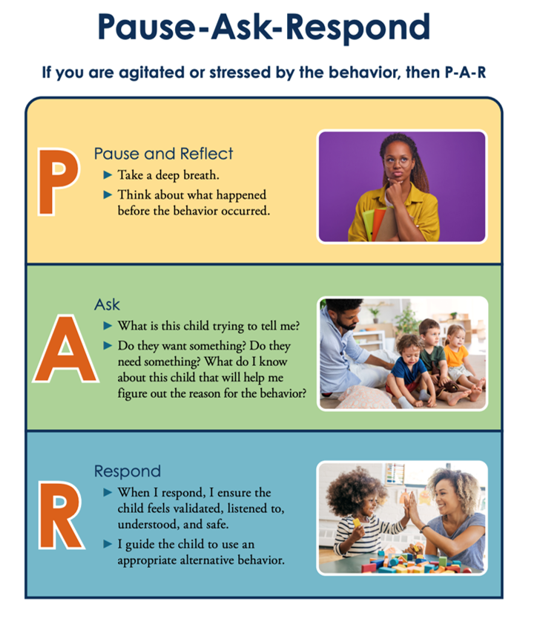
NCPMI’s Developing a Neutralizing Routine
National Center for Pyramid Model Innovations. (2023, September 26). Developing a neutralizing routine. [Tip Sheet]. https://challengingbehavior.org/document/developing-a-neutralizing-routine/
© 2026, Bright Horizons Family Solutions LLC
Notes:
Leiha- walking through the NCPMI neutralizing routine document

Slide 17
Developing Your Neutralizing Routine
Use Pair-Share: My Neutralizing Routines worksheet.
Build your own neutralizing routine.
Then we'll pair up and share.
Remember: the child is having a hard time, not giving you a hard time.
Consider what you need to be your best self and see the best in children.
© 2026, Bright Horizons Family Solutions LLC
Notes:
What situations tend to dysregulate you?
Child crying for extended periods
Aggressive behavior (hitting, biting, kicking)
Challenging conversations with families
Feeling judged by others
Being short staffed
Constant noise
Multiple children needing attention at once
Unexpected schedule changes
Reflection Questions
What do you notice in your body?
What thoughts go through your mind?
How do you usually respond?
The 60-Second Reset Challenge
Participants practice a one-minute routine:
3 deep breaths
Drop shoulders
Unclench jaw
Positive statement
Smile softly
Debrief
“How different do you feel after just one minute?”
You cannot co-regulate a child if you are dysregulated yourself.
Leiha

Slide 18

Snack Break
© 2026, Bright Horizons Family Solutions LLC
Notes:
Snack Break (check snack timing on Sched & adjust if needed)
10-10:30 (don’t have to do the whole thing but should aim to take at least a fifteen minute break in here for snacks)

Slide 19
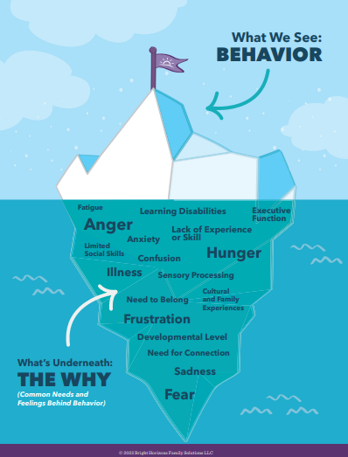
Behavior as a Missing Skill
I felt this way and didn’t know how to tell you…
The task needed skills I didn’t have yet…
I needed help and didn’t know how to get it…
© 2026, Bright Horizons Family Solutions LLC
Notes:
*Behavior Iceberg*
Lindsay

Slide 20
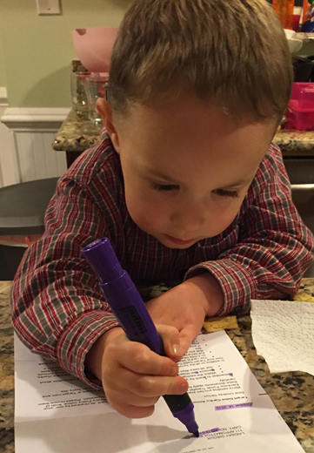
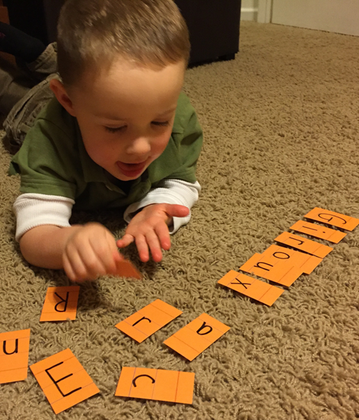
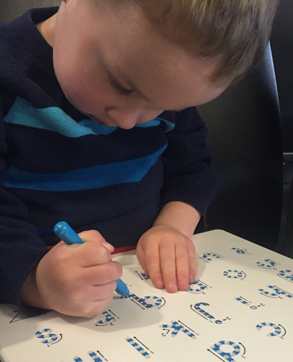
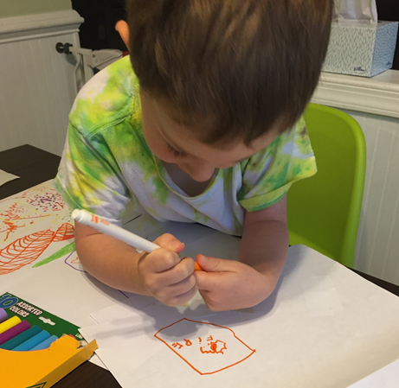
Pretend…
© 2026, Bright Horizons Family Solutions LLC
Notes:
Intentional Skill Building- DAPPER Slides (pinwheel/flower breathing)– whole set of slides here.
Lindsay

Slide 21
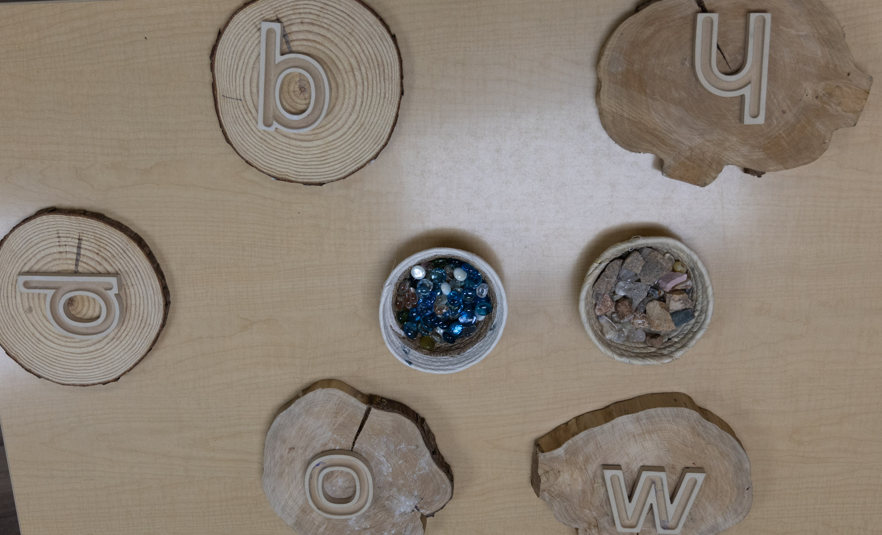
You might…
Show the letter visual
Describe what the letter looks like and how to make it
Tie to something important to the child
Model writing it
Look for the letter and point it out when you see it
Use music, movement, or sensory experiences
© 2026, Bright Horizons Family Solutions LLC
Notes:
Intentional Skill Building- DAPPER Slides (pinwheel/flower breathing)– whole set of slides here.
Lindsay

Slide 22

When it comes to social and emotional skills…
© 2025, Bright Horizons Family Solutions LLC

Slide 23
You might do the same things.
Show the letter visual
Describe what the letter looks like and how to make it
Tie to something important to the child
Model writing it
Look for the letter and point it out when you see it
Use music, movement, or sensory experiences
© 2026, Bright Horizons Family Solutions LLC
Notes:
Intentional Skill Building- DAPPER Slides (pinwheel/flower breathing)– whole set of slides here.
Lindsay

Slide 24
Reframing Behaviors that Challenge Us
Behavior that challenges us
Possible missing skill
What precise skill are we going to teach
© 2026, Bright Horizons Family Solutions LLC
Notes:
Lindsay

Slide 25
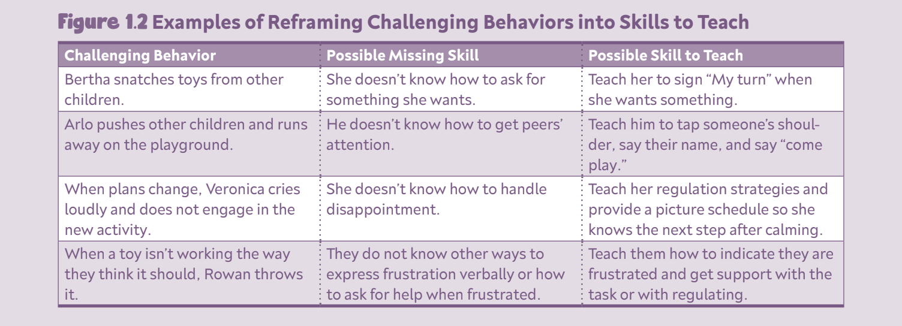
Reframing Behaviors into Skills
From Create an Emotion-Rich Classroom by Lindsay N. Giroux, Free Spirit 2022.
© 2026, Bright Horizons Family Solutions LLC
Notes:
Lindsay

Slide 26
Framework for Teaching Social-Emotional Skills
DAPPER from Create an Emotion-Rich Classroom
D- demonstrate and describe (model, narrate your actions and thoughts
A- animate (use signs and gestures to bring the concept to life)
P- practice (student structured practice with teacher feedback and support)
P- planned opportunities (planned experiences and materials to encourage the skill)
E- extend (generalizing to other contexts and people, like outside and home)
R- reinforce and reflect (positive descriptive feedback and reflection questions)
© 2026, Bright Horizons Family Solutions LLC
Notes:
Lindsay

Slide 27
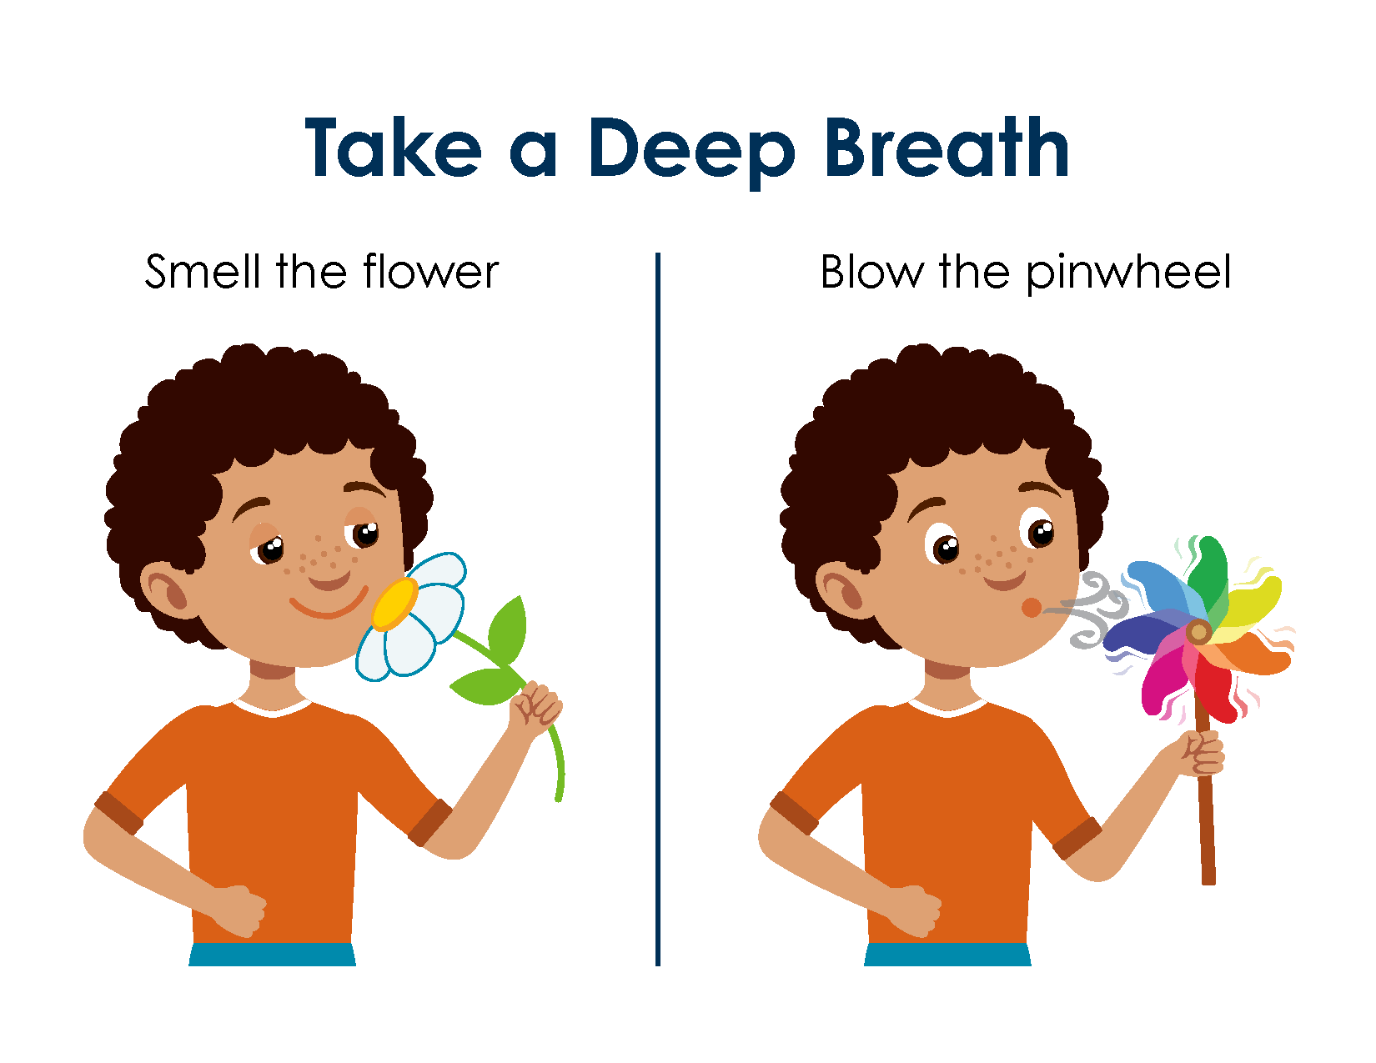
Demonstrate and Describe
How do you use it?
How does it help?
Where does it “live” in the classroom for children to access?
https://challengingbehavior.cbcs.usf.edu/docs/Smell-Blow.pdf
© 2026, Bright Horizons Family Solutions LLC
Notes:
Lindsay

Slide 28
Animate
What visual will you use to teach the skill?
What signs or gestures will you use to represent the skill?
https://challengingbehavior.cbcs.usf.edu/docs/Smell-Blow.pdf
© 2026, Bright Horizons Family Solutions LLC
Notes:
Lindsay

Slide 29
Practice
How will you have children practice the skill?
Ideas:
Practice as a transition strategy
Partner practice
Role play or puppet play
https://challengingbehavior.cbcs.usf.edu/docs/Smell-Blow.pdf
© 2026, Bright Horizons Family Solutions LLC
Notes:
Lindsay

Slide 30
Planned Opportunities
When else will children need to use the skill?
Consider:
Small group activities
Active games or movement activities
Whole group times
https://challengingbehavior.cbcs.usf.edu/docs/Smell-Blow.pdf
© 2026, Bright Horizons Family Solutions LLC
Notes:
Lindsay

Slide 31
Extend to New People & Places
Where else will children need to use the skill?
With whom will children need to use the skill?
https://challengingbehavior.cbcs.usf.edu/docs/Smell-Blow.pdf
© 2026, Bright Horizons Family Solutions LLC
Notes:
Lindsay

Slide 32
Reinforce & Reflect
Positive descriptive feedback- “You noticed you were frustrated and you found a calming tool!”
What happened when you used the pinwheel?
How did you know you needed it?
https://challengingbehavior.cbcs.usf.edu/docs/Smell-Blow.pdf
© 2026, Bright Horizons Family Solutions LLC
Notes:
Lindsay

Slide 33
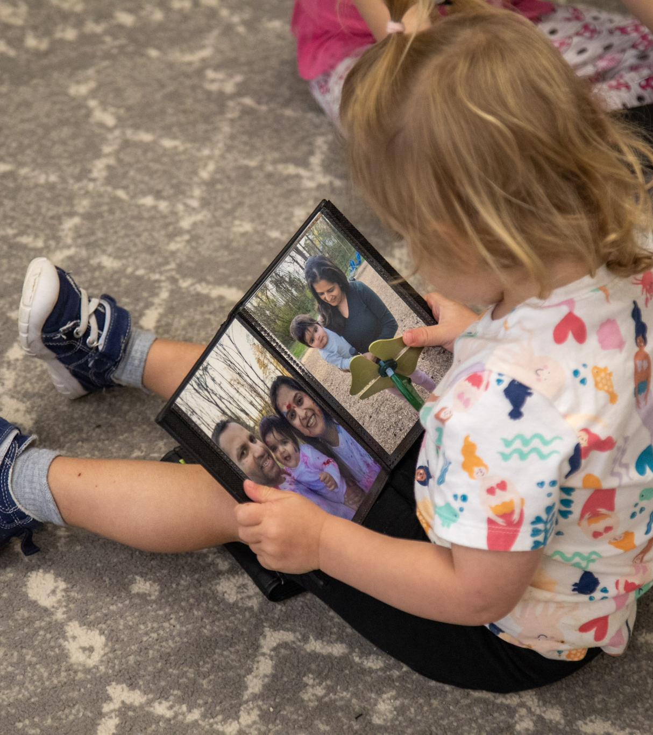
Mystery Date with a Book
© 2026, Bright Horizons Family Solutions LLC
Notes:
Lindsay

Slide 34
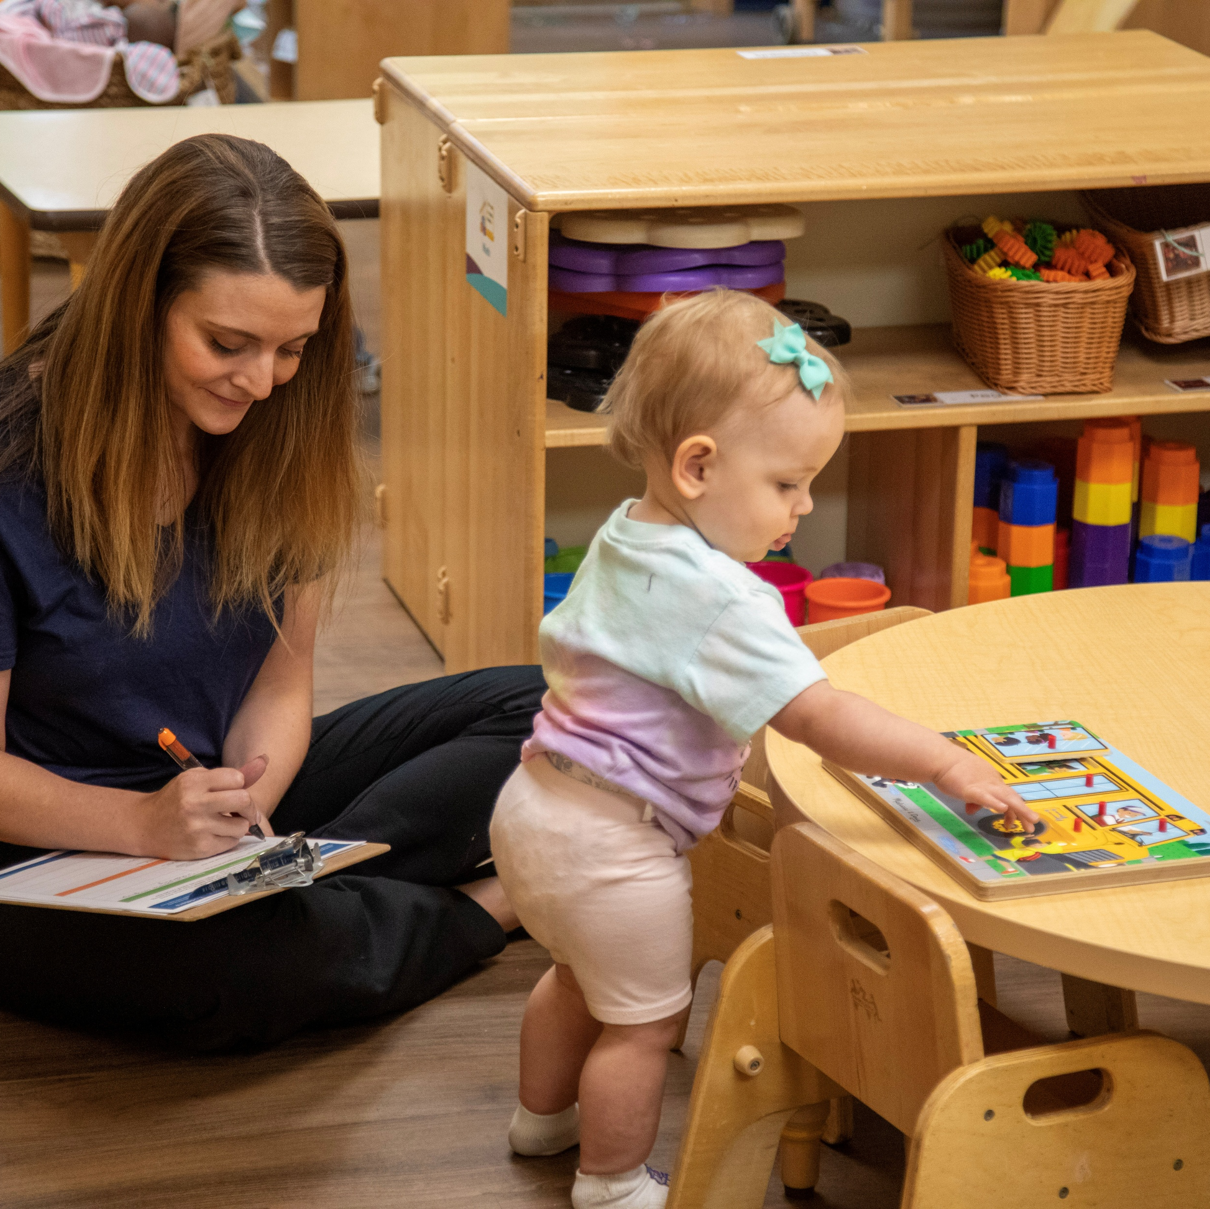
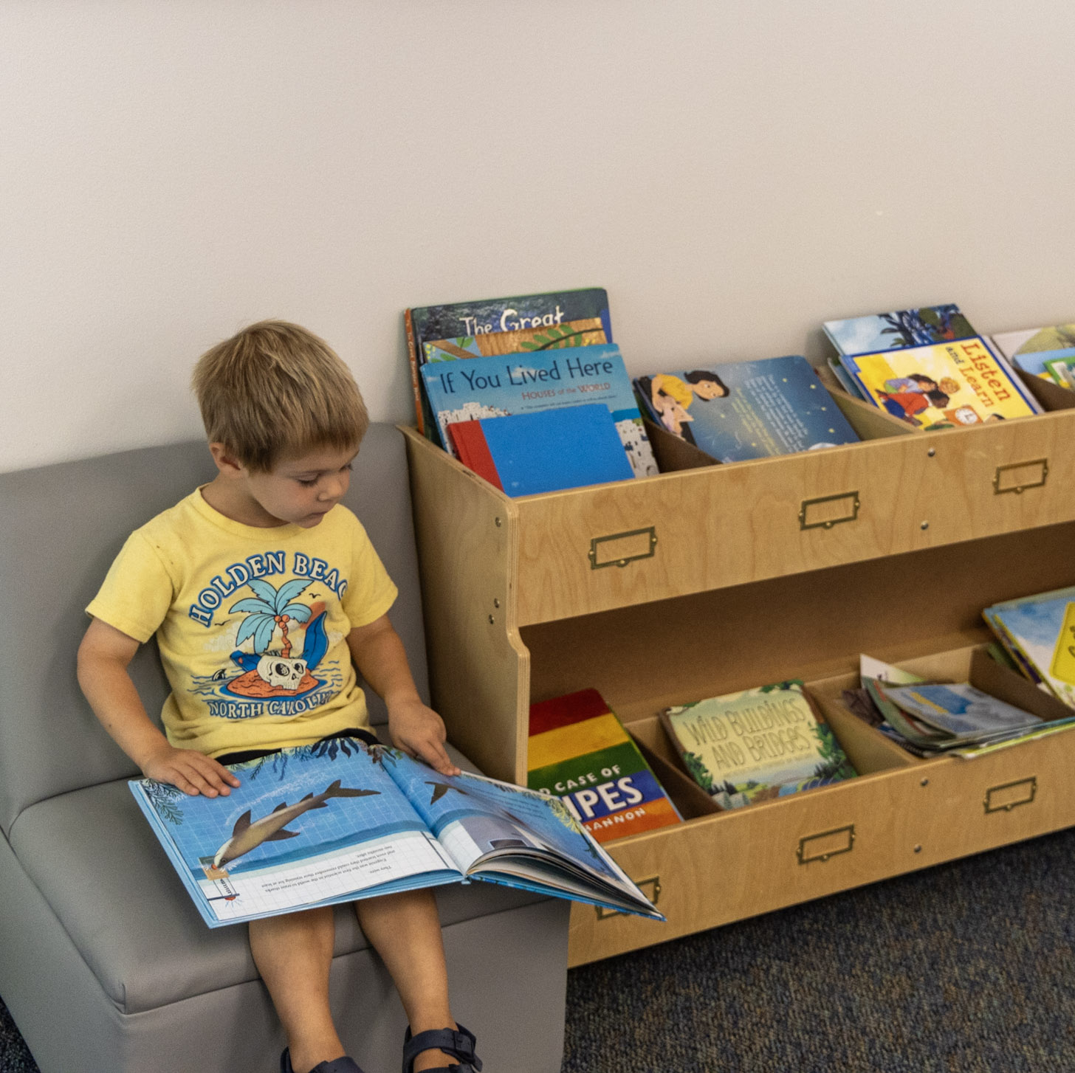
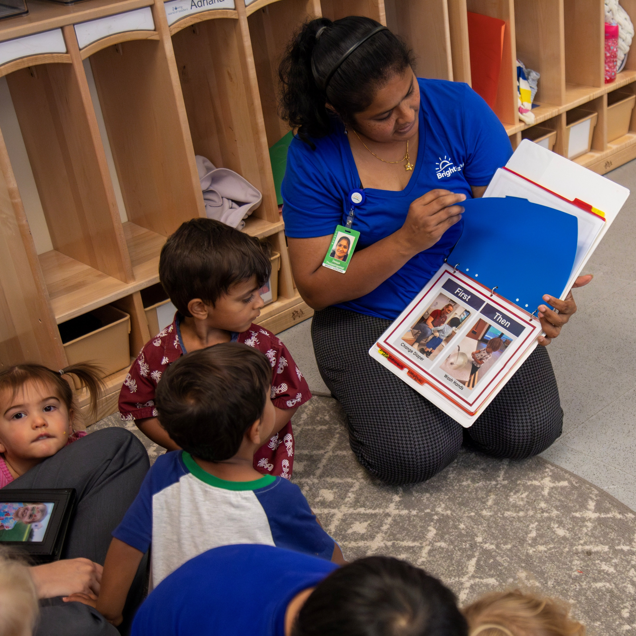
Activity Directions
Choose a skill to support.
Choose a mystery book that will support the skill.
Make a DAPPER plan for how you might teach the skill.
© 2026, Bright Horizons Family Solutions LLC
Notes:
Lindsay- activity directions

Slide 35
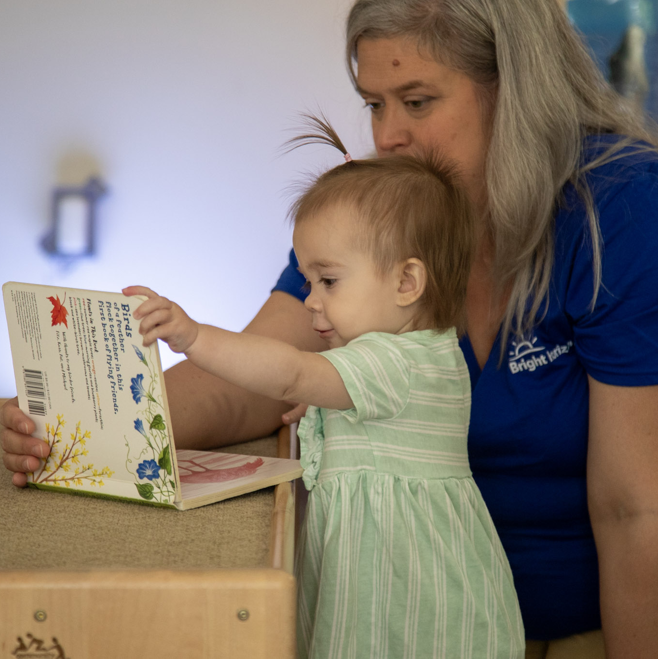
60-Second Book Review
1.
Name the skill.
2.
Describe how the book supports this.
3.
Share your “practice” and “planned opportunities” from your DAPPER plan.
© 2026, Bright Horizons Family Solutions LLC
Notes:
Lindsay: Depending on time have one group or speed date and share with multiple groups

Slide 36
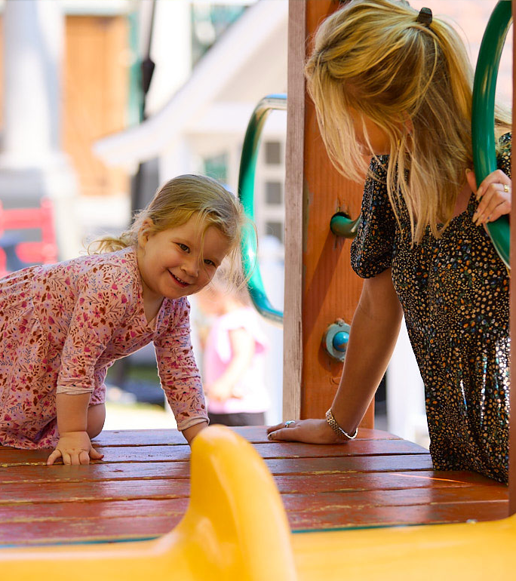
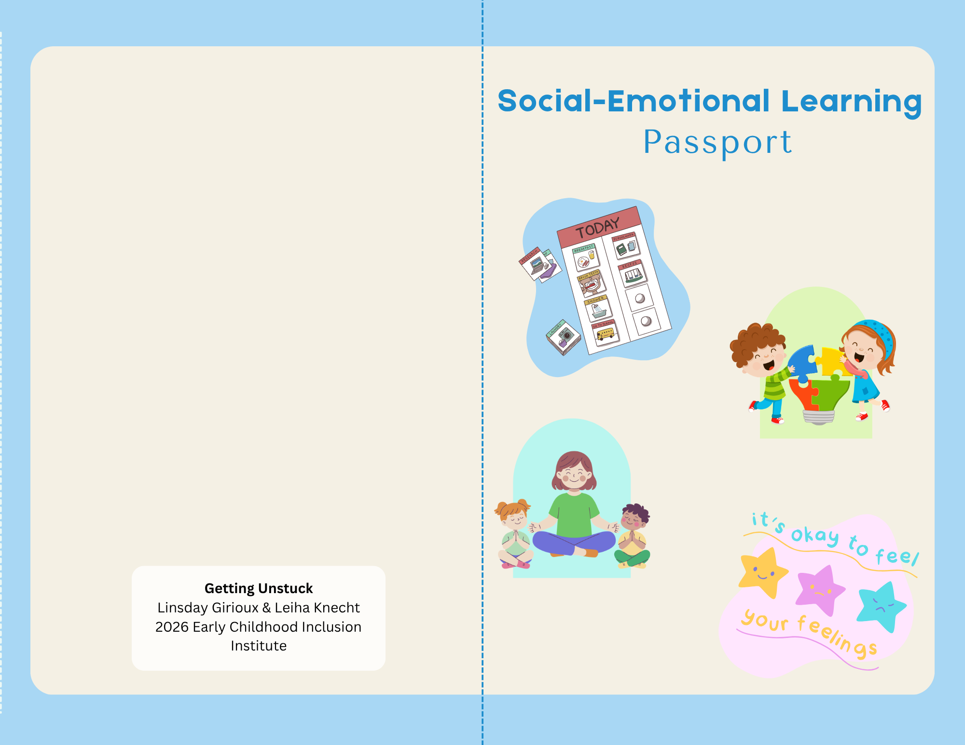
Pyramid Passports
© 2026, Bright Horizons Family Solutions LLC
Notes:
Leiha- explaining the passport (we can add a photo of it here) & any facilitation directions

Slide 37
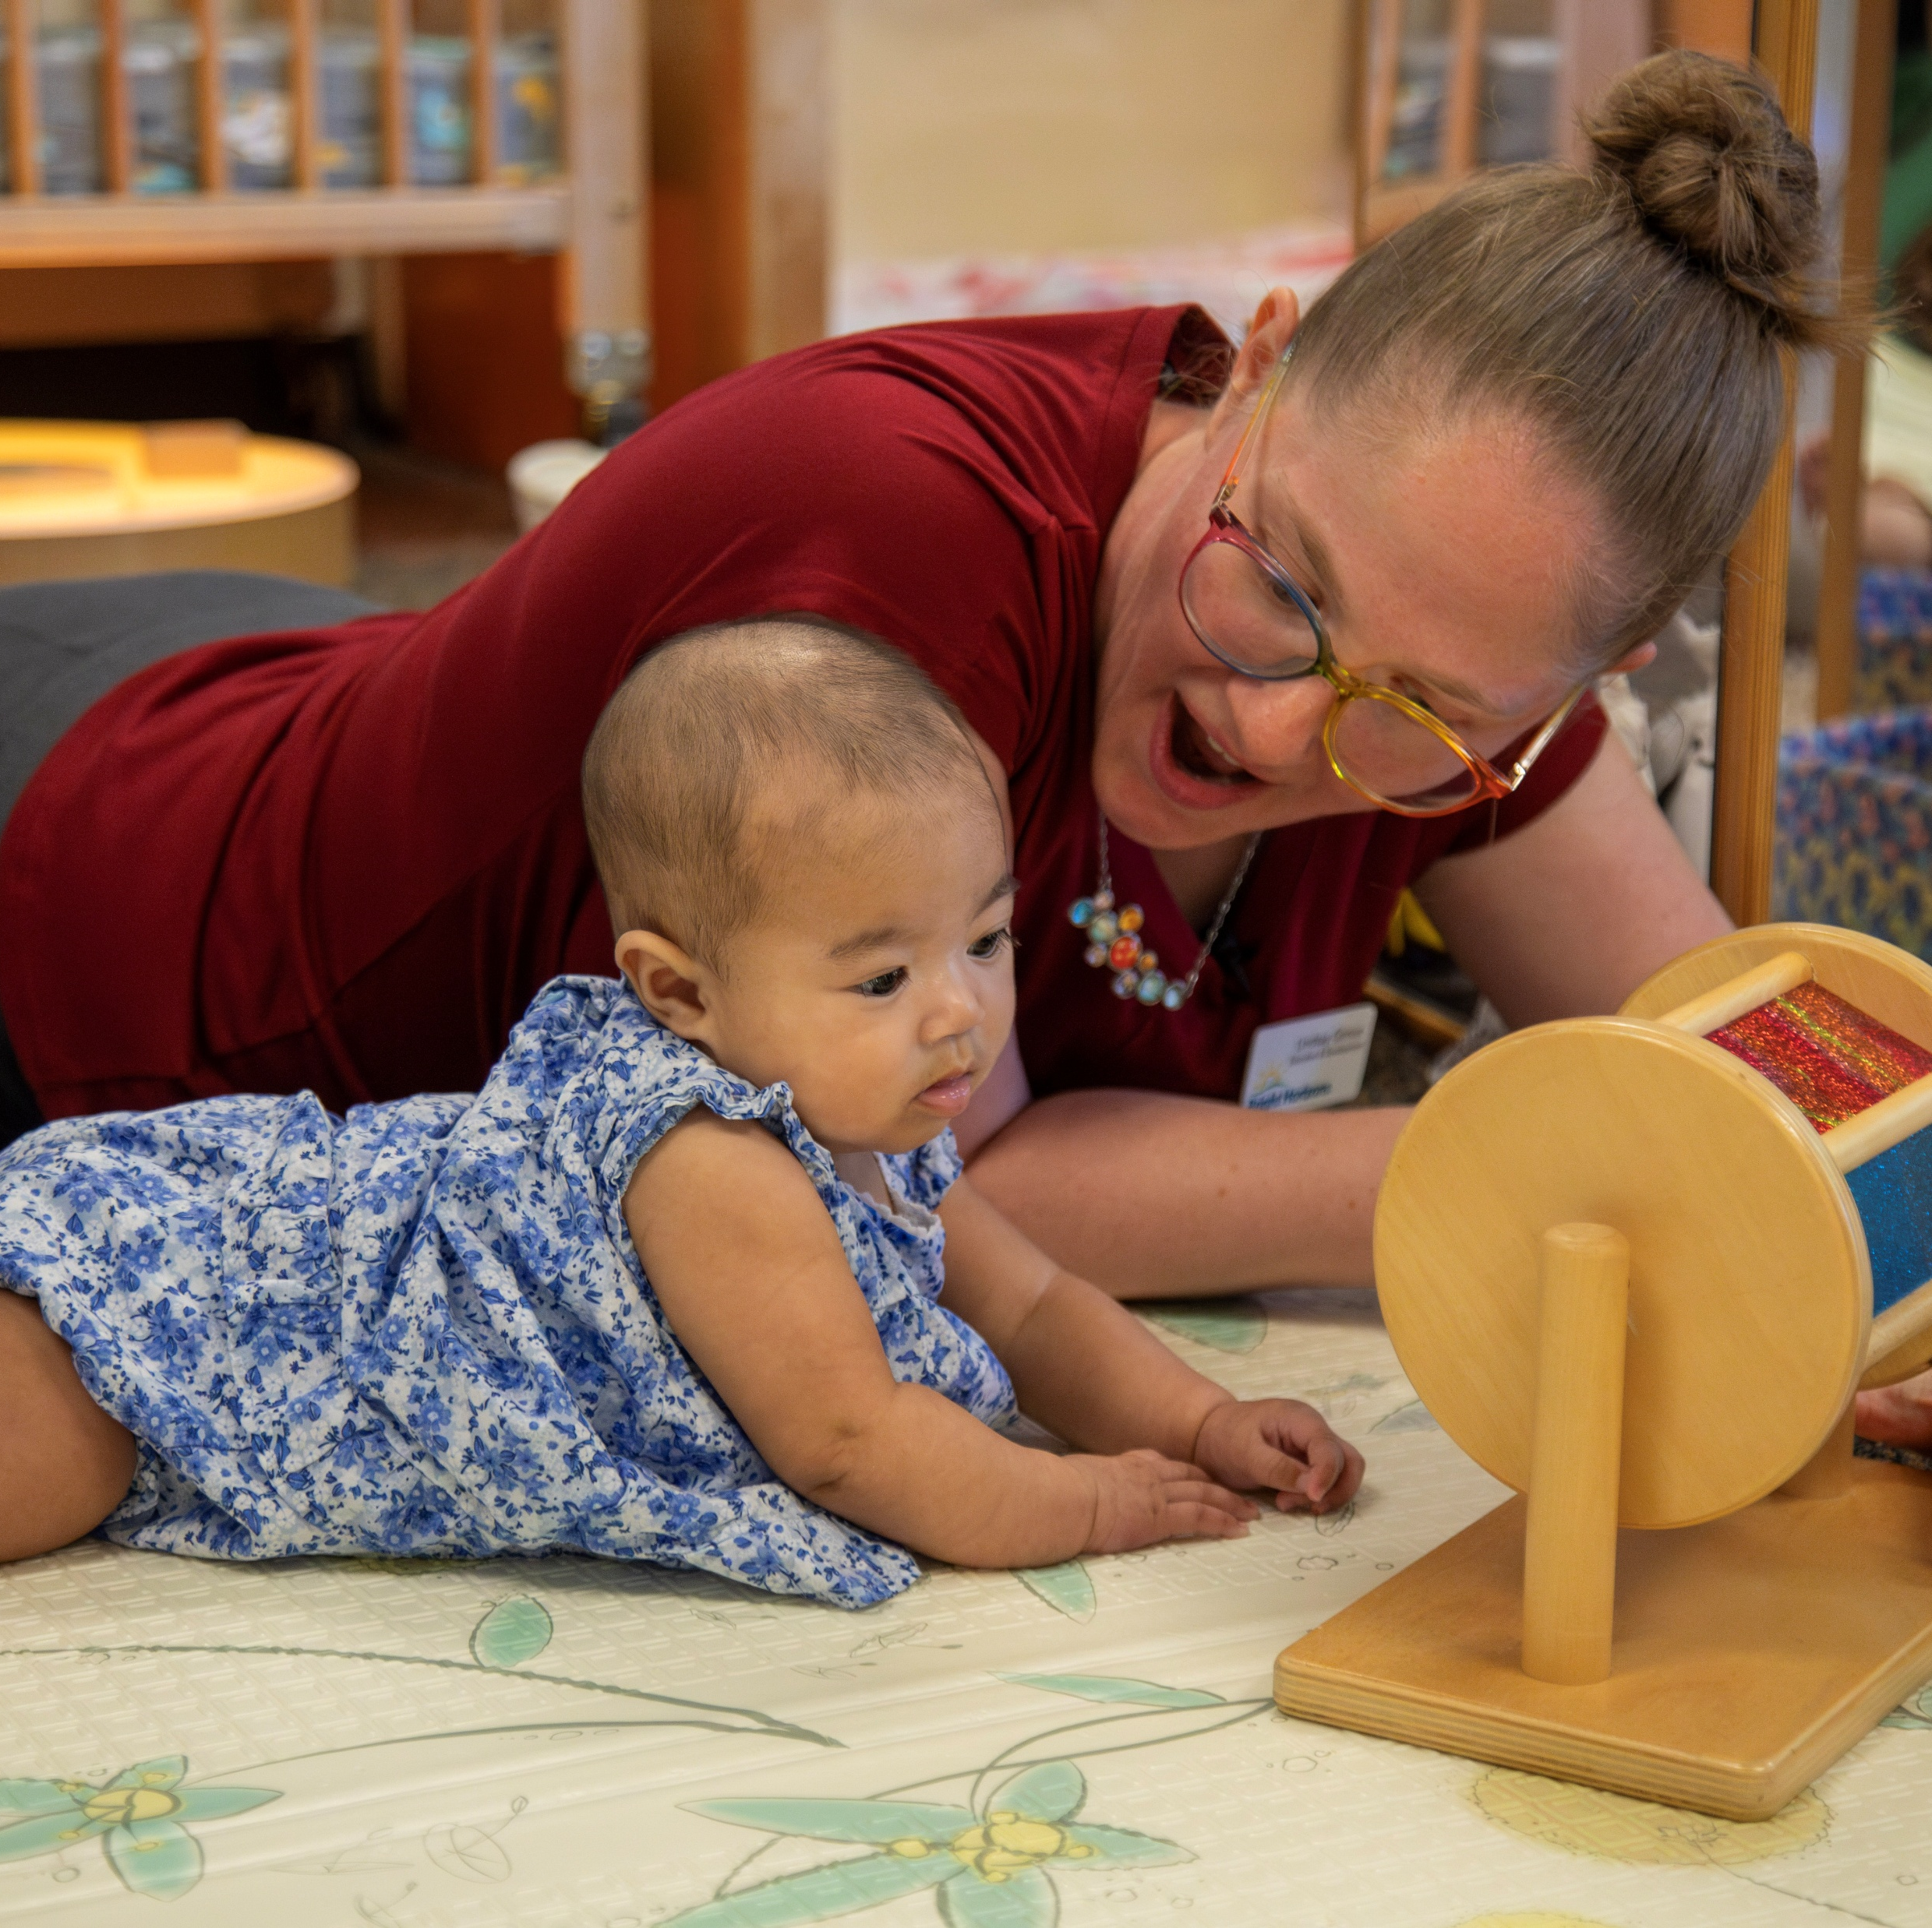
Pyramid Skills and Strategies
Supporting Children’s Understanding of Schedules & Routines
Encouraging Children’s Interactions with Peers & Problem-Solving
Building Children’s Emotional Literacy
Providing Hands-On Strategies for Regulation
© 2026, Bright Horizons Family Solutions LLC
Notes:
Leiha- setting up the activity- explaining the categories (these four skill areas plus make and take)

Slide 38
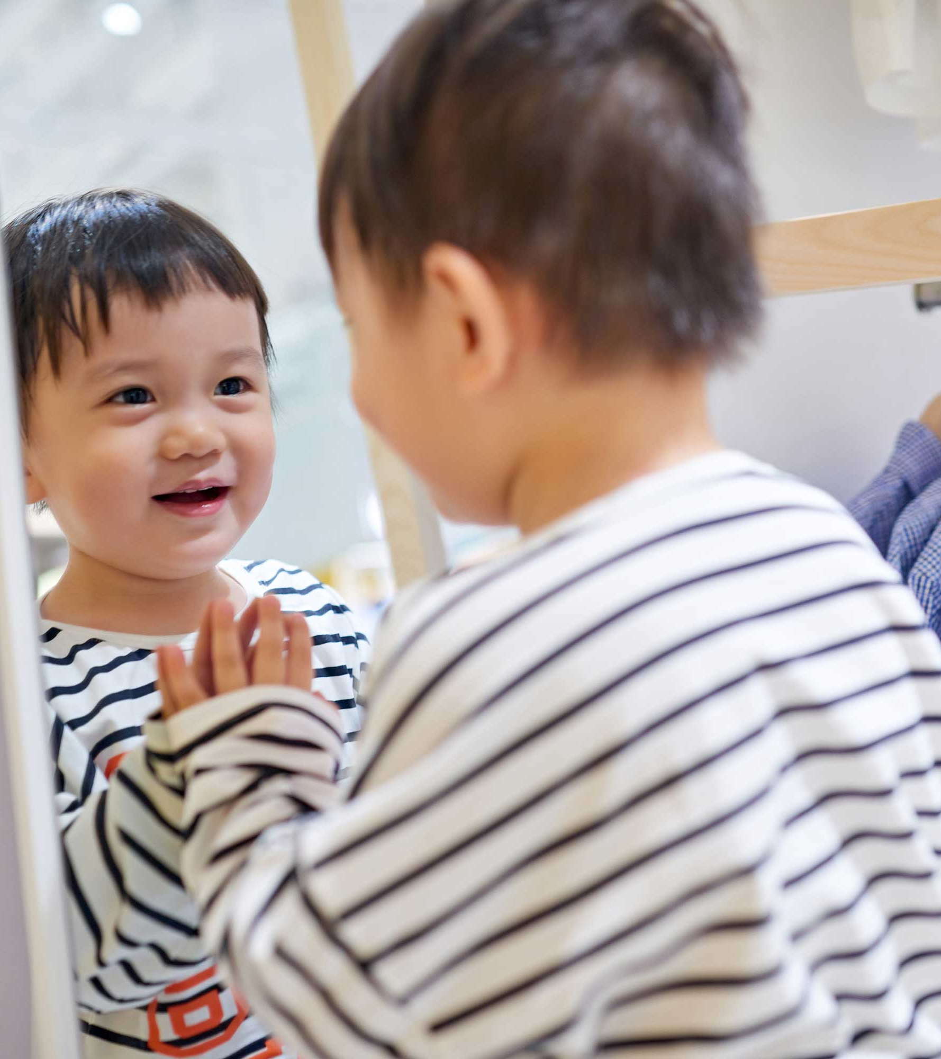
Closing Reflections
© 2026, Bright Horizons Family Solutions LLC
Notes:
Closing Reflections- Leiha

Slide 39
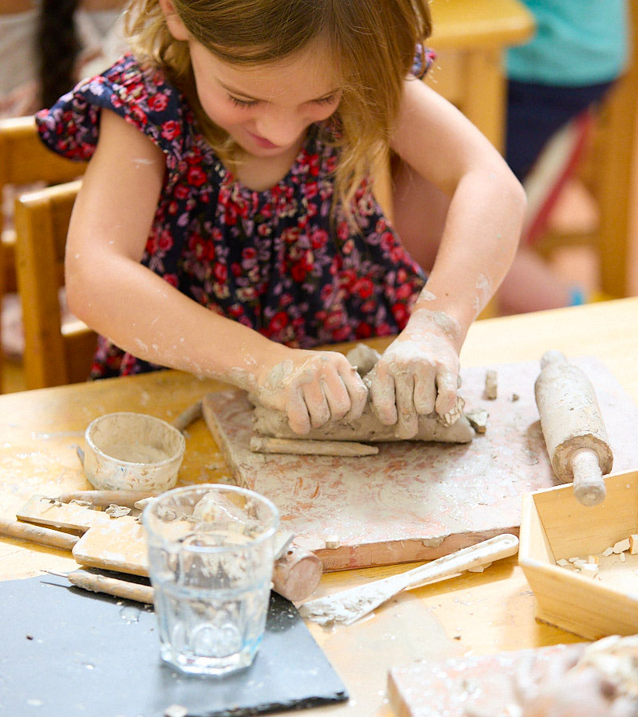
Questions?
© 2026, Bright Horizons Family Solutions LLC
Notes:
Lindsay

Slide 40
Thank you!
© 2026, Bright Horizons Family Solutions LLC

