Slide 1


More than supporting roles: Partnering with fathers of young children with disabilities
2026 International Early Childhood Inclusion Institute
University of North Carolina at Chapel Hill
Nadya Pancsofar, Ph.D.
Professor, The College of New Jersey
Joshuah Carlani, MAT, BCBA, LBA
Supervisor of Special Education, South Brunswick School District
Adjunct Professor, School of Education, The College of New Jersey

Slide 2

Orientation Towards Family Diversity
All family compositions and configurations have value and no family structure is better or worse than any other.
Inclusive Focus:
Designed for families with one or more father or father figure.
  Widens the home-school partnership lens beyond traditional mother-professional collaboration.

Slide 3
Resources & Agenda
Today’s Agenda:
Quotes from Fathers of Young Children with Complex Disabilities
Research Takeaways
Strategies for Supporting Father Involvement

Slide 4

Voices of Fathers: Opening Reflection
Using the QR code or link below, open the Padlet and read the three father quotes.
Choose one or two that resonate with you and leave a comment with your initial reaction or reflection.
We’ll take about 3-4 minutes before we debrief together.
Padlet Link: bit.ly/fathers2026

Slide 5

Fathers and child development
Diverse Vocabulary
Fathers who used a more diverse vocabulary during play activities and book reading have been found to have children with stronger expressive language skills (Pancsofar & Vernon-Feagans, 2006; Pancsofar et al., 2010; Tamis LeMonda et al., 2012).

Slide 6

Fathers and child development cont.
Interactive Questioning
Fathers who used more open-ended questions during play had children with stronger vocabulary and verbal reasoning skills (Reynolds et al., 2018; Rowe et al., 2017).

Slide 7

Fathers and child development cont. (2)
Linguistic Complexity
Fathers with more complex language had children with more advanced vocabulary (Baker et al., 2015)

Slide 8

Key Takeaway 1
Father-child interactions play an important role in early child development and learning.

Slide 9


Stress and Father-Child Interaction
Depression & Fathering
Fathers’ depression during the early childhood period has been associated with a lower frequency of father engagement with their young children (Bronte-Tinkew et al., 2007) and less frequent play, caregiving and home literacy activities with their young children (Baker, 2014; Paulson et al., 2009).
Depressed fathers have also been found to use less complex and more negative and critical utterances with their infants, when compared with nondepressed fathers (Sethna, et al., 2012; Malin et al, 2012).

Slide 10

Stress and Father-Child Interaction cont.
Positive Relationship Impact: Fathers in harmonious, satisfied relationships show more positive attitudes and engagement with infants (Baker, 2014; Cabrera et al., 2007;Kitzmann, 2000).
Marital Satisfaction: Higher levels of satisfaction correlate with longer utterances during play session (Pancsofar et al., 2008).
Conflict Resolution: Lower conflict levels in family relationships lead to use of more diverse vocabulary with children (Pancsofar et al., 2008).

Slide 11
Key Takeaway 2
Father-child interactions play an important role in early child development and learning.
Professionals need to help alleviate, not add to, father’s stress levels.

Slide 12

Addressing the Research Gap:
Fathers of children with Disabilities
This body of research has largely omitted the perspectives of fathers of children with disabilities
Fathers of children with disabilities have been found to be just as involved with their children’s care, nurturing, and playtime as fathers of children without disabilities (Potter, 2017; Varghese & Wachen, 2016).
The verbal responsiveness of fathers of young children with Autism was found to be associated with more advanced child language skills (Flippin & Watson, 2015).
Fathers’ involvement in interventions for children with disabilities or developmental delays has been associated with more positive child behavioral outcomes (Bagner, 2013).

Slide 13
Key Takeaway 3
Father-child interactions play an important role in early child development and learning.
Stress and wellbeing directly affect the quality of father-child interaction.
Emerging research on the experiences of fathers of children with disabilities shows they are important figures in their development and learning.

Slide 14

Mothers may take a more primary role with professionals for pragmatic family reasons
Indirect Involvement
In some families, fathers of children with complex disabilities engage in important indirect school involvement through their financial support, gainful employment, and support for their co-parent (Pancsofar et al., 2019).

Slide 15
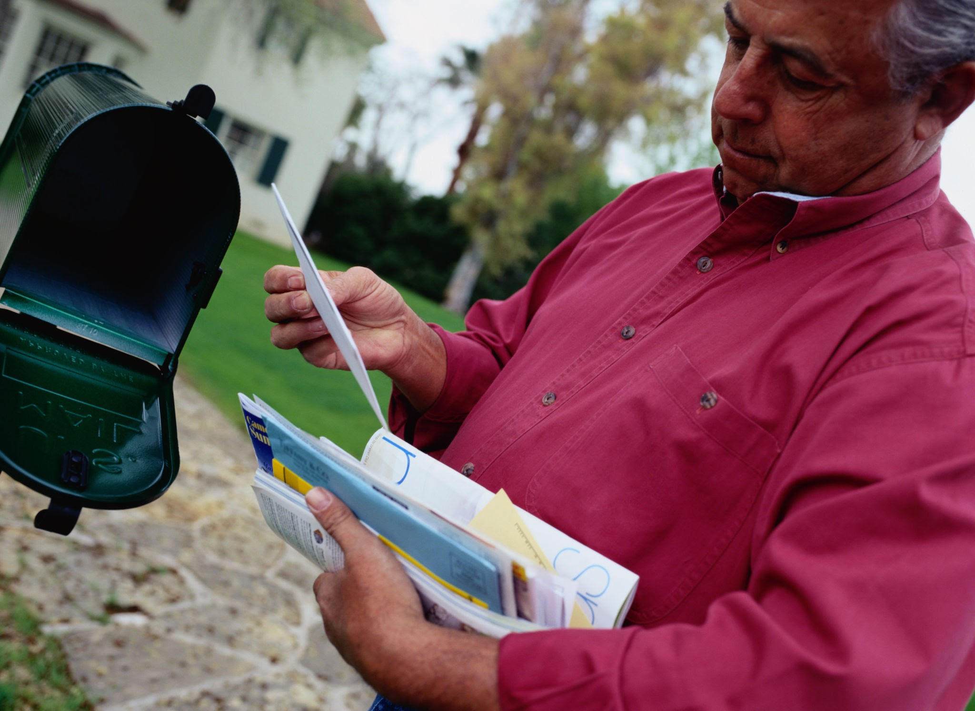
Mothers may take a more primary role with professionals for pragmatic family reasons cont.
Financial Responsibility
Some families may experience more extensive and longer-term financial demands related to their children’s complex learning and developmental needs and some fathers’ view their work was one way through which their families could meet these unique financial needs (Pancsofar et al., 2019; Pancsofar et al., 2022).

Slide 16

Mothers may take a more primary role with professionals for pragmatic family reasons cont. (2)
Conflicting Demands
These fathers articulated challenges in addressing multiple, sometimes conflicting responsibilities, including emotional demands of parenting, with more practical demands of their jobs.

Slide 17
Key Takeaway 4
Father-child interactions play an important role in early child development and learning.
Stress and wellbeing directly affect the quality of father-child interaction.
Fathers of children with disabilities are equally important figures in development and learning.
Even when fathers play more of a secondary role in this area in their families, they matter and want to be involved.

Slide 18


Fathers face unique challenges in family-school partnerships
Institutional Exclusion
Fathers often feel left out of the educational system and their child’s IEP team. (Mueller & Buckley, 2014)
Gendered School Environments
Some fathers feel it is easier for mothers to be involved in schools due to a perceived unique expertise of mothers and school environments that were more welcoming to mothers (Hart, 2011; Pancsofar et al., 2019)

Slide 19

Fathers face unique challenges in family-school partnerships, cont.
Communication Barriers
Fathers of children with deaf-blindness have reported having lower levels of knowledge around how to communicate effectively with their child’s teachers and how to volunteer at their child’s school(Pancsofar et al., 2020).
Burden of Collaboration
The responsibility to foster positive home-school communication often falls to the father/family.(Pancsofar et al., 2022)

Slide 20

What can happen to the “odd men out” (Pancsofar et al., 2019)
Incomplete Information
Fathers don’t always receive all info, affecting their ability to participate fully.
Co-Parenting Tension
Lack of clear information can lead to confusion and increased tension between parents.
Snowball Effect of Distance
Over time, fathers may grow increasingly distanced from their children's educational experiences.
Communication Challenges
Being "out of the loop" makes it difficult to communicate with their own children.

Slide 21
Key Takeaways 5
Father-child interactions play an important role in early child development and learning.
Stress and wellbeing directly affect the quality of father-child interaction.
Fathers of children with disabilities are equally important figures in development and learning.
Even when fathers play a secondary role, they matter and want to be involved.
Early childhood professionals must use intentional strategies when collaborating with fathers.

Slide 22
Takeaway Summary
Fathers play a meaningful role in their children’s early development and learning – including for children with complex disabilities.
When fathers are excluded or overlooked in family-school partnerships, the consequences extend to the whole family.
Early childhood professionals must use intentional, specific strategies to ensure fathers are informed, heard, and welcomed as full partners in their children’s education.

Slide 23


What do fathers of children with complex disabilities ask professionals to do when partnering?
“Men are just as affected”
Understand the emotional needs of fathers.
“Hear the whole family”
Listen to fathers’ concerns, input, and needs.
“Try to reach out to fathers too”
Improve communication efforts directly.
Intentional Involvement
Direct invitations and questions directed at fathers can be especially helpful.
Pancsofar, N., et al. (2022)

Slide 24
Strategies for Effective Father Engagement
Frequent Connection
Reach out to fathers and check in with them often.
Prioritize Fathers' Needs
Focus on the specific priorities and concerns of fathers.
Direct Information
Provide information and services directly to fathers.
Stress Management
Develop specific stress management strategies for fathers.
Validation & Recognition
Validate fathers' contributions to family and child development.
Cultural Responsiveness
Engage in culturally responsive partnership practices.
Pancsofar, N., et al. (2022)

Slide 25
Re-Centering Father’s Voices
The Odd Man Out:
“I’ve had to go back and say ‘I’m a part of this too. I get the right to know about my kids.’ I shouldn’t have to remind them of that. I shouldn’t have to fight for that.”
The Emotional Lives of Fathers:
“Men are just as affected by having a child with a disability as women are.”
Work, Indirect Involvement, and Sacrifice:
“If you’re working, how do you balance that with working with your job, but also working with your child? That’s probably, at least for me, that’s been the toughest thing.”

Slide 26
Thank you!
Today’s slides can be found in the Sched app.
Feel free to contact us:
Joshuah Carlani
carlanj1@tcnj.edu
Nadya Pancsofar
pancsofa@tcnj.edu

Slide 27
References
Bagner, D. M. (2013). Father’s role in parent training for children with developmental delay. Journal of Family Psychology, 27, 650–657. https://doi.org/10.1037/a0033465
Baker, C. E. (2014). African American fathers’ depression and stress as predictors of father involvement during early childhood. Journal of Black Psychology, 40, 311–333. https://doi.org/10.1177/0095798413486480
Baker, C. E., Vernon-Feagans, L., & The Family Life Project Investigators. (2015). Fathers’ language input during shared book activities: Links to children’s kindergarten achievement. Journal of Applied Developmental Psychology, 36, 53–59. https://doi.org/10.1016/j.appdev.2014.11.0090193-3973
Bronte-Tinkew, J., Moore, K. A., Matthews, G., & Carrano, J. (2007). Symptoms of major depression in a sample of fathers of infants. Journal of Family Issues, 28, 61–99. https://doi.org/10.1177/0192513X06293609
Cabrera, N. J., Shannon, J. D., & Tamis-LeMonda, C. (2007). Fathers’ influence on their children’s cognitive and emotional development: From toddlers to pre-K. Applied Developmental Science, 11, 208–213. https:// doi.org/10.1080/10888690701762100
Flippin, M., & Watson, L. R. (2015). Fathers’ and mothers’ verbal responsiveness and the language skills of young children with Autism Spectrum Disorder. American Journal of Speech-Language Pathology, 24, 400–410.
https://doi.org/10.1044/2015_AJSLP-13-0138

Slide 28
References cont.
Hart, R. (2011). Parental involvement in the statutory assessment of special needs students. Educational Psychology in Practice, 27(2), 155–174. https://doi.org/10.1080/02667363.2011.567094
Kitzmann, K. M. (2000). Effects of marital conflict onsubsequent triadic family interactions and parenting. Developmental Psychology, 36, 3–13. https://doi.org/10.1037/0012-1649.36.1.3
Malin, J. L., Karberg, E., Cabrera, N. J., Rowe, M., Cristaforo, T., & Tamis-LeMonda, C. S. (2012). Father-toddler communication in low-income families: The role of paternal education and depressive symptoms. Family Science, 3, 155–163. https://doi.org/10.1080/19424620.2012.779423
Mueller, T. G., & Buckley, P. C. (2014). Odd man out: How fathers navigate the special education system. Remedial and Special Education, 35, 40–49. https://doi.org/10.1177/0741932513513176
Pancsofar, N. (2020). Fathers’ language input and early child language development. In H. E. Fitzgerald, K. von Klitzing, N. Cabrera, T. Skjothaug, & J. Scarano de Mendonca (Eds.), Handbook of Fathers: Prenatal to Pre-K. (pp. 448-470) Springer.
Pancsofar, N., Petroff, J. G., & Carlani, J. (2021). Collaborative strategies for supporting the well-being of fathers of young children with complex disabilities. Young Exceptional Children, 25(4), 184-194. https://doi.org/10.1177/10962506211006060

Slide 29
References cont. (1)
Pancsofar, N., Petroff, J., & Lewis, A. (2017). Father friendly classrooms: Making a space for dads of children with disabilities. Teaching Exceptional Children, 49, 309-317. doi:10.1177/0040059916681826
Pancsofar, N., Petroff, J. G., Rao, S., & Mangel, A. (2019). “What I want to do as a father is be there:” Constructions of school involvement for fathers of children with complex disabilities. Research and Practice for Persons with Severe Disabilities, 44, 153-168. doi: 10.1177%2F1540796919843147
Pancsofar, N., Petroff, J. G., & Schleppy, M. (2021). School involvement experiences of fathers of children with deafblindness. British Journal of Visual Impairment, 39(3), 239-250. https://doi.org/10.1177/0264619620921900
Pancsofar, N., & Vernon-Feagans, L. (2006). Mother and father language input to young children: Contributions to later language development. Journal of Applied Developmental Psychology, 27, 571–587. https://doi.org/10.1016/j.appdev.2006.08.003
Pancsofar, N., Vernon-Feagans, L., & The Family Life Project Investigators. (2010). Fathers’ early contributions to children’s language development in families from low-income rural communities. Early Childhood Research Quarterly, 25, 450–463. https://doi.org/10.1016/j.ecresq.2010.02.001
Pancsofar, N., Vernon-Feagans, L., Odom, E., & Roe, J. R. (2008). Family relationships during infancy and later mother and father vocabulary use with young children. Early Childhood Research Quarterly, 23, 493–503. https://doi.org/10.1016/j.ecresq.2008.07.001

Slide 30
References cont. (2)
Pancsofar, N., Petroff, J. G., Rao, S., & Mangel, A. (2019). “What I want to do as a father is be there:” constructions of school involvement for fathers of children with complex disabilities. Research and Practice for Persons with Severe Disabilities, 44, 153–168. https://doi.org/10.1177/1540796919843147
Paulson, J. F., Keefe, H. A., & Leiferman, J. A. (2009). Early parental depression and child language development. Journal of Child Psychology and Psychiatry, 50, 254–262. https://doi.org/10.1111/j.1469-7610.2008.01973.x
Potter, C. A. (2017). Father involvement in the care, play and education of children with Autism. Journal of Intellectual and Developmental Disability, 42, 375–384. https://doi.org/10.3109/13668250.2016.1245851
Rao, S., Pancsofar, N., & Monaco, S. (2020). Effective practices for collaborating with families and caregivers of children and young adults with disabilities. In U. Sharma & S. Salend (Eds.), The Oxford Encyclopedia of Inclusive and Special Education. Oxford University Press. https://oxfordre.com/education/view/10.1093/acrefore/9780190264093.001.0001/acrefore-9780190264093-e-1017
Reynolds, E., Vernon-Feagans, L., Bratsch-Hines,M., Baker, C. E., & The Family Life Project Key Investigators. (2018). Mothers’ and fathers’ language input from 6 to 36 months in rural two-parent-families: Relations to children’s kindergarten achievement.Early Childhood Research Quarterly, 47, 385–395.https://doi.org/10.1016/j.ecresq.2018.09.002
Rowe, M. L., Leech, K. A., & Cabrera, N. (2017). Going beyond input quantity: Wh- questions matter for toddlers’ language and cognitive development. Cognitive Science, 41, 162–179. https://doi.org/10.1111/cogs.12349

Slide 31
References cont. (3)
Sethna, V., Murray, L., & Rachandani, P. G. (2012). Depressed fathers’ speech to their 3-month-old infants: A study of cognitive and mentalizing features in paternal speech. Psychological Medicine, 42, 2361–2371. https://doi.org/10.1017/S0033291712000487
Tamis-LeMonda, C., Baumwell, L., & Cristofaro, T. (2012). Parent-child conversations during play. First Language, 32, 413–438. https://doi.org/10.1177/0142723711419321
Varghese, C., & Wachen, J. (2016). The determinants of father involvement and connections to children’s literacy
and language outcomes: Review of the literature. Marriage & Family Review, 52, 331–359. https://doi.org/10.1080/01494929.2015.1099587

