Slide 1
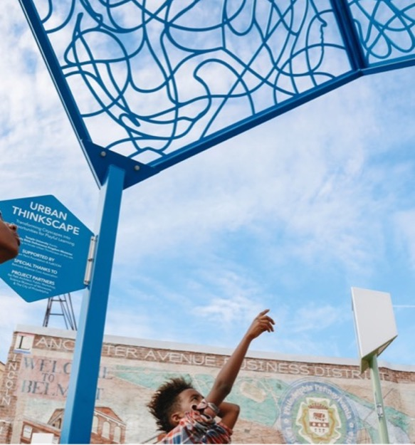
Playful Learning Landscapes

Slide 2
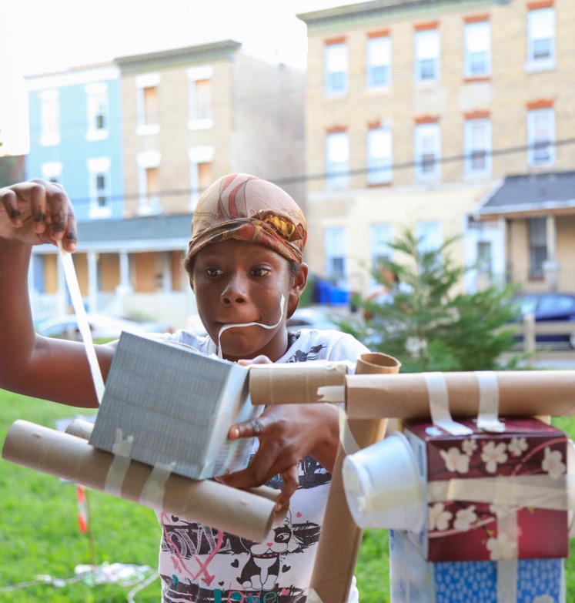
When was the last time you played? What did you do?

Slide 3

Children in Public Spaces

Slide 4
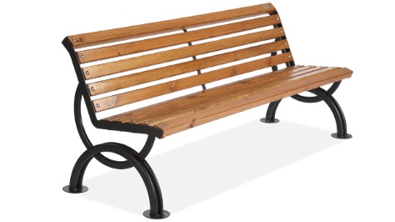
When is a bench not a bench?

Slide 5
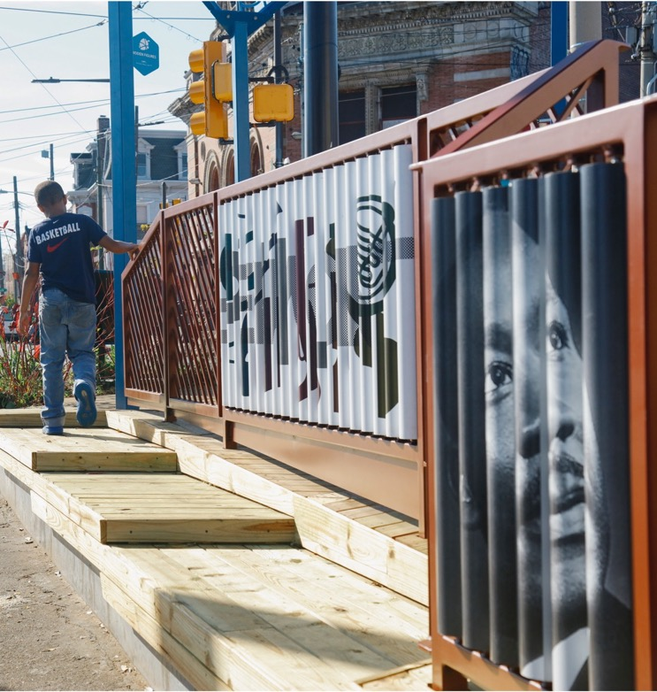
When it’s a Playful Learning Landscape

Slide 6
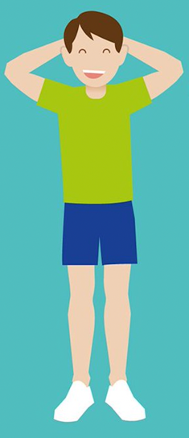

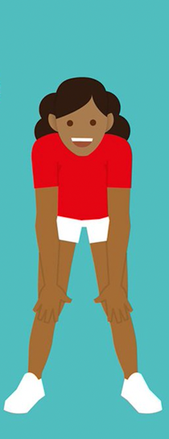

Heads, Shoulders, Knees, and Toes!

Slide 7
Heads and Shoulders
Shoulders
Head

Slide 8
Heads and Shoulders – Play!

Slide 9
Knees and Toes
Toes
Knees

Slide 10
Knees and Toes – Play!

Slide 11


Put it all Together
Shoulders
Head
Toes
Knees

Slide 12
Put it all Together – Play!

Slide 13
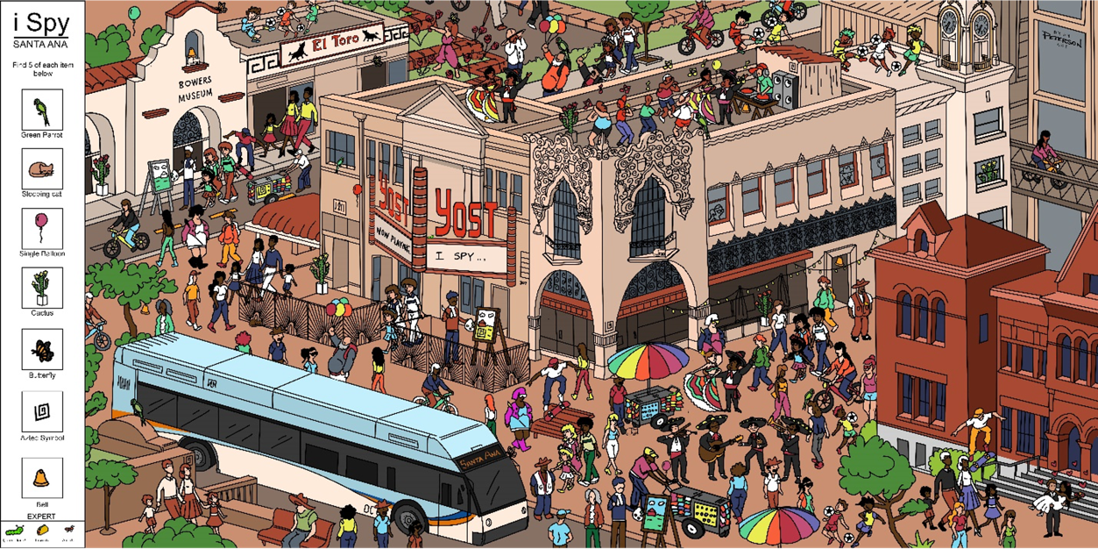
Playful Learning Mural

Slide 14
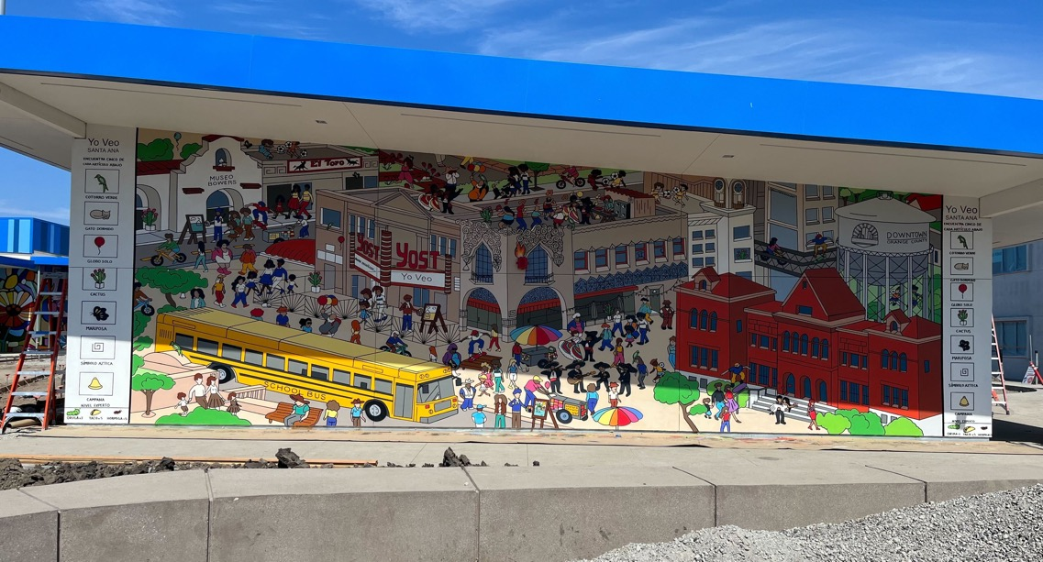
Playful Learning Mural in Real Life

Slide 15
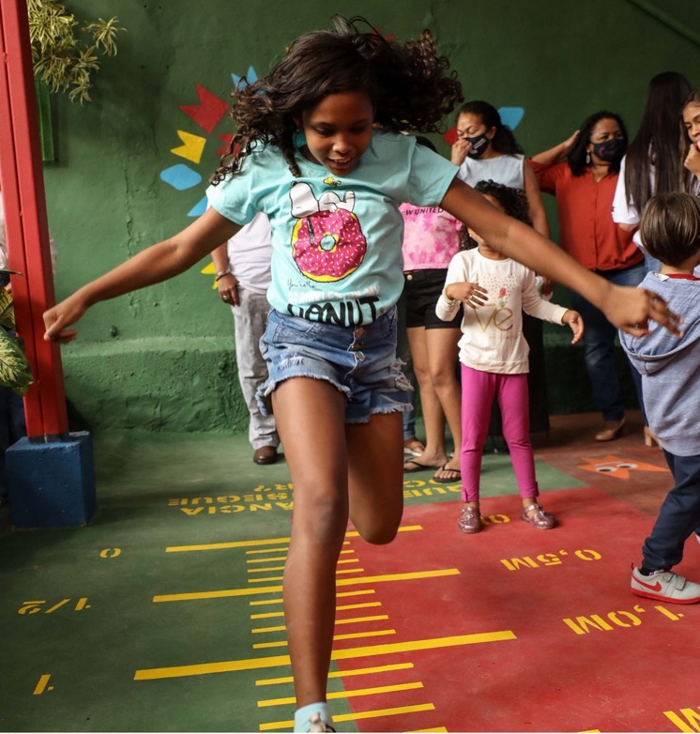
Playful Learning is… Play that is guided by an adult or the environment toward a specific learning goal

Slide 16
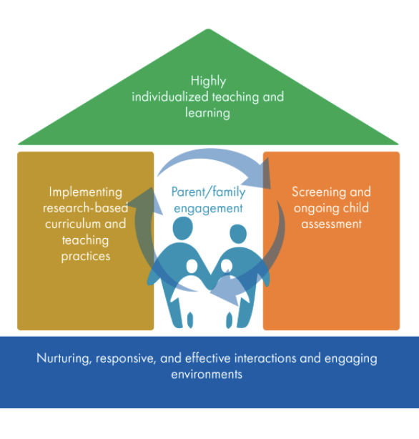
The House Framework

Slide 17
The House Framework – Today’s Focus

Slide 18
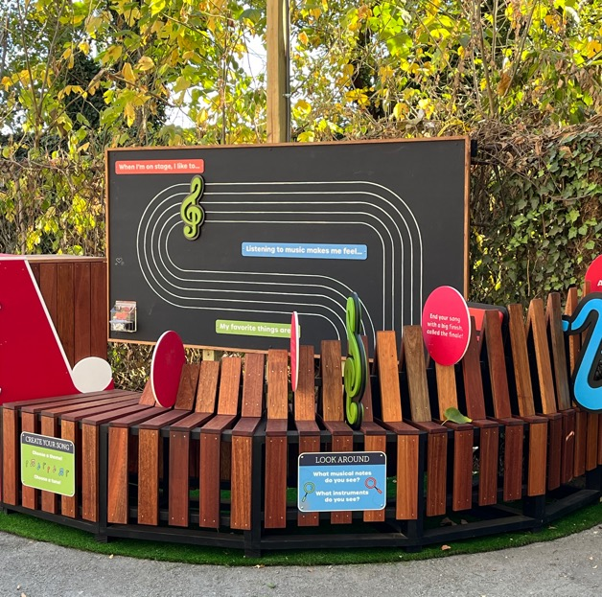
Creating Playful Learning Environments for Children and Families

Slide 19
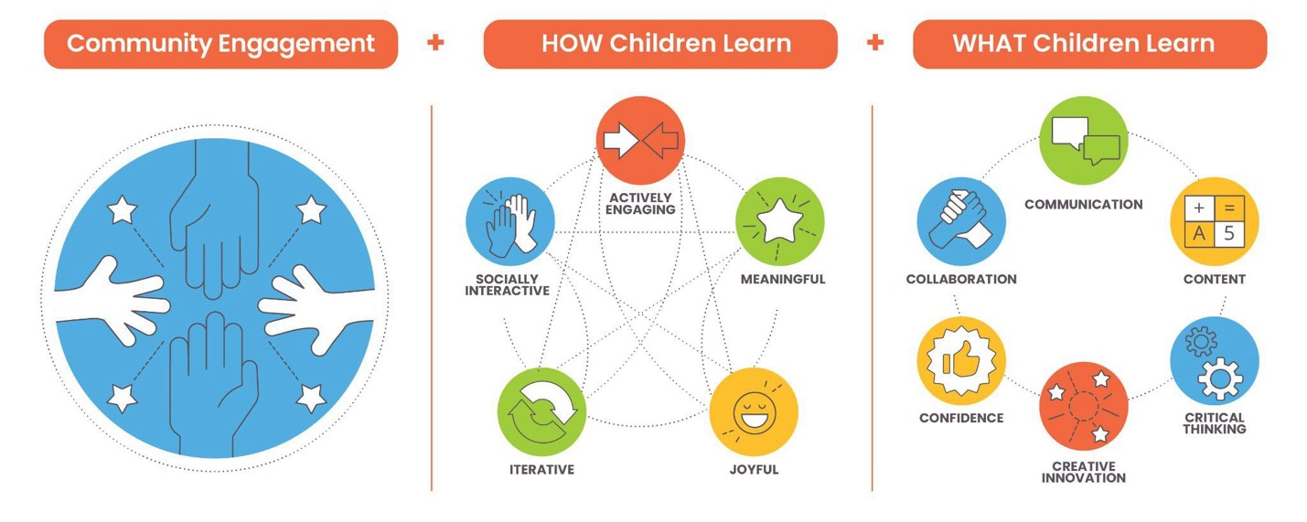
Playful Learning Design Formula

Slide 20
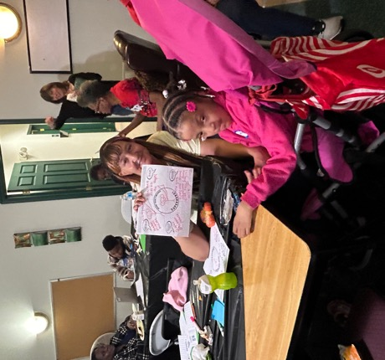
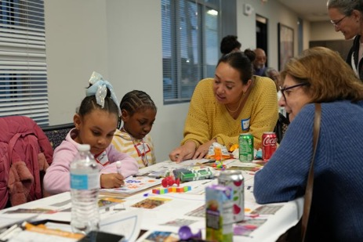
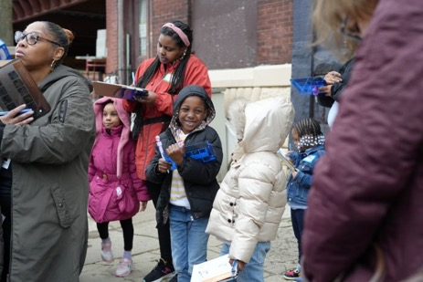
Community-Centered Design

Slide 21
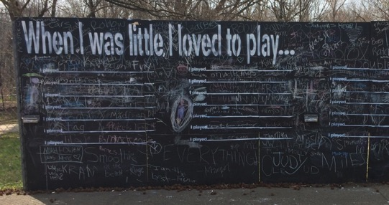
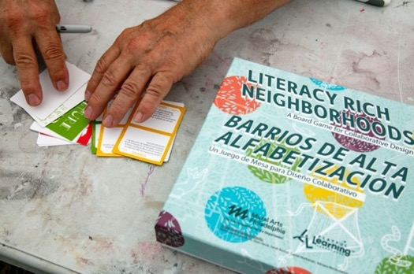
Playful Learning Design Games
You are the DJ for a neighborhood party. What’s on your playlist? What kind of mood are you trying to create?
Meaning

Slide 22
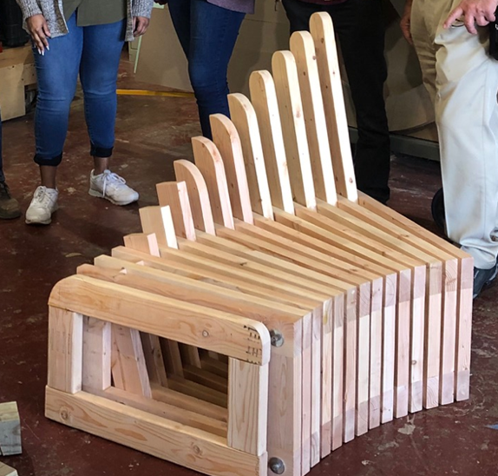
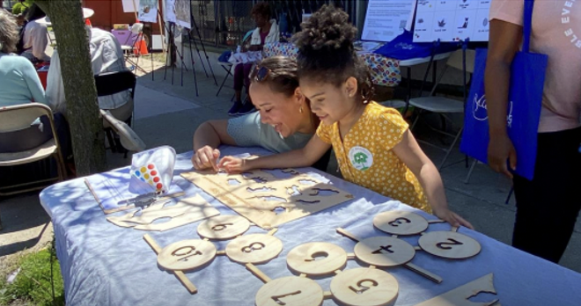
Prototype Testing

Slide 23
Think About Your Community
What is one thing you want to celebrate about your community?
What is one dream or hope that you have for your child?

Slide 24
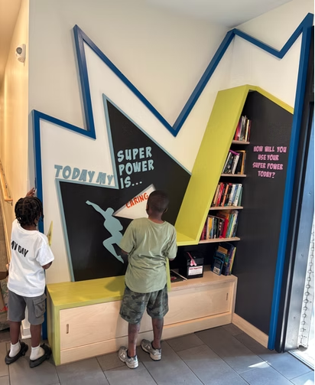
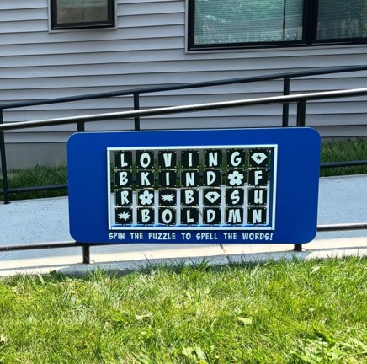

Customized Designs

Slide 25
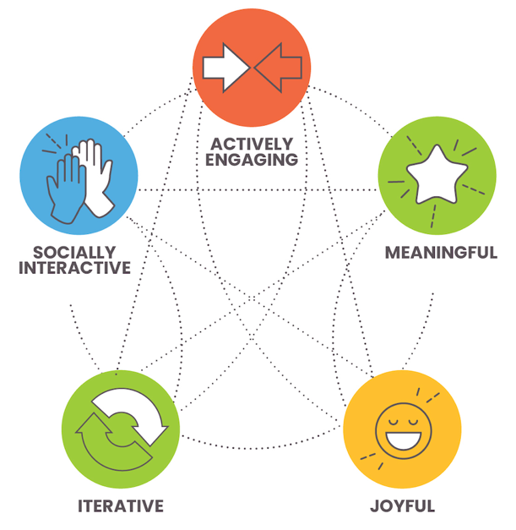
HOW Children Learn

Slide 26
Play = Learning
When was the last time you played? What did you do?

Slide 27
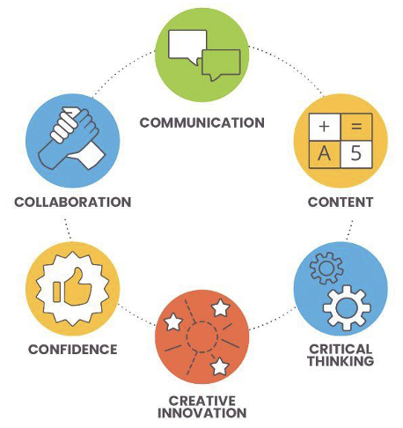
WHAT Children Learn

Slide 28
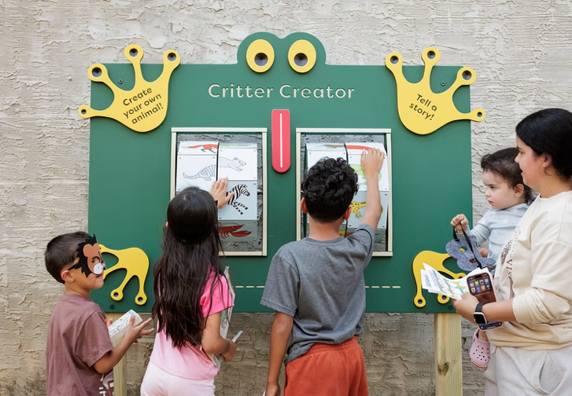
#1: Which C do you see?

Slide 29
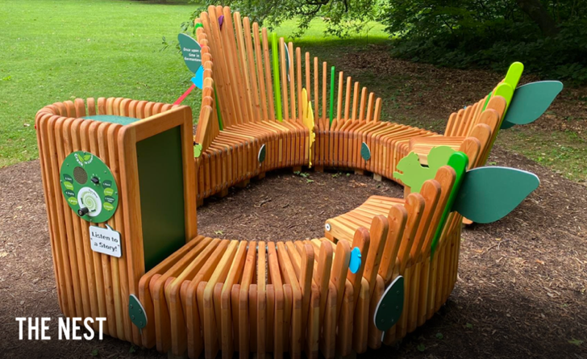
#2: Which C do you see?

Slide 30
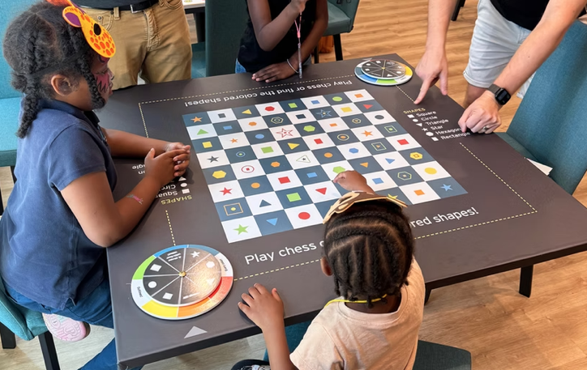
#3: Which C do you see?

Slide 31
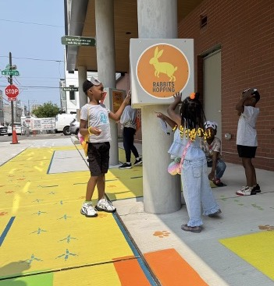
Flexible Designs for a Variety of Spaces

Slide 32
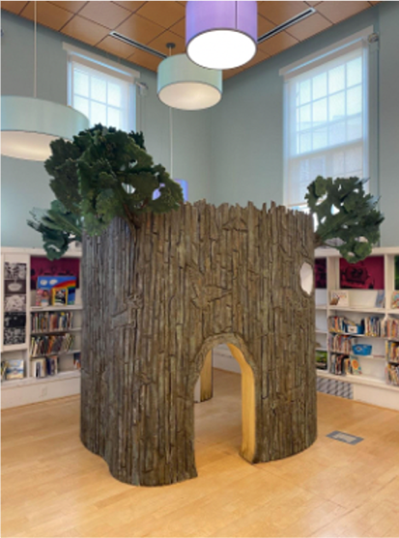
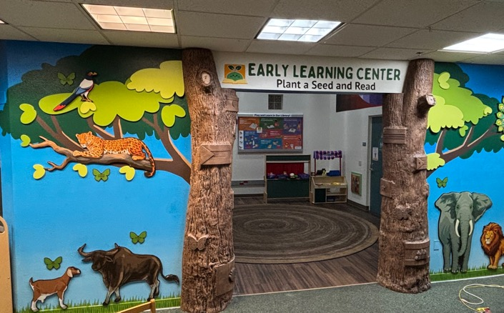
Playful Learning… LIBRARIES
San Diego, CA
Philadelphia, PA

Slide 33
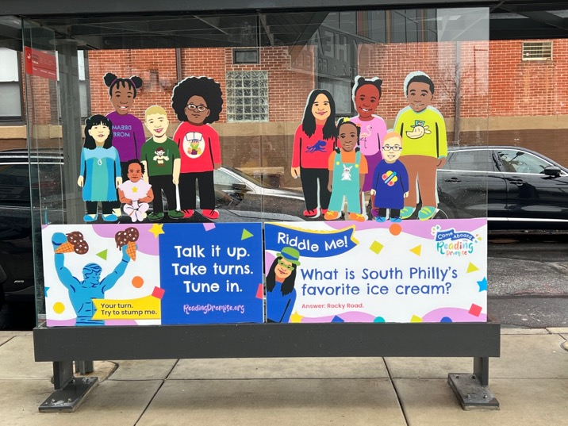
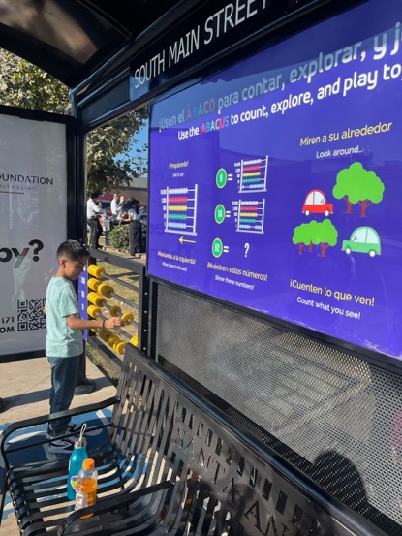
Playful Learning…BUS STOPS
Santa Ana, CA
Philadelphia, PA

Slide 34

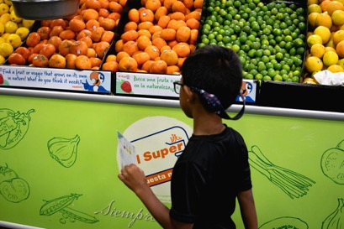
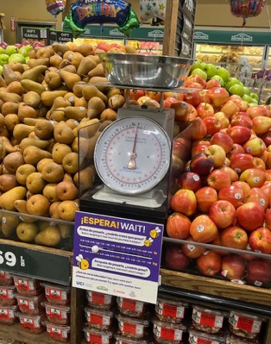
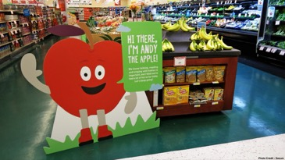
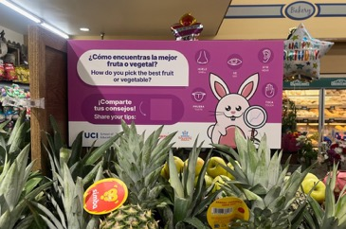
Playful Learning…GROCERY STORES
San Diego, CA
Santa Ana, CA
Tulsa, OK

Slide 35
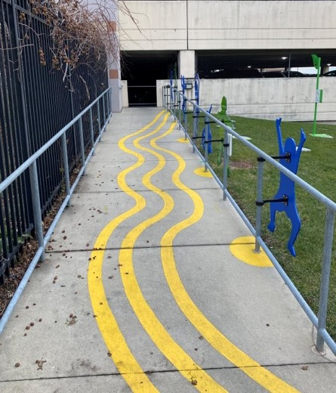
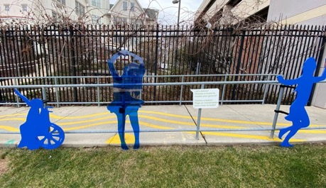
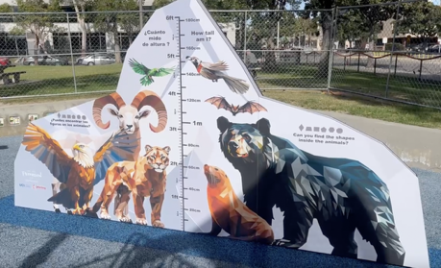
Playful Learning…PARKS
Santa Ana, CA
Philadelphia, PA

Slide 36
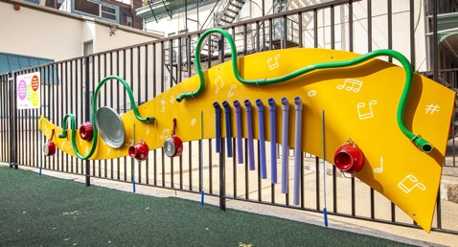
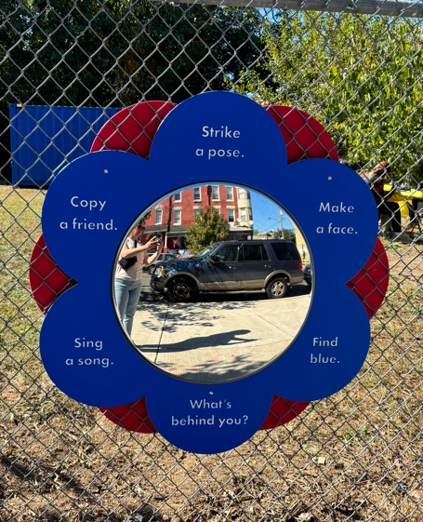
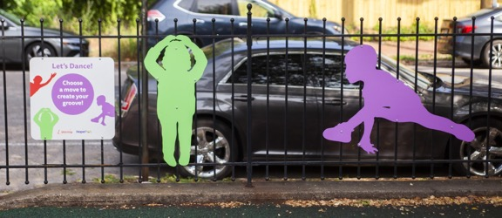
Playful Learning…FENCES
Philadelphia, PA

Slide 37
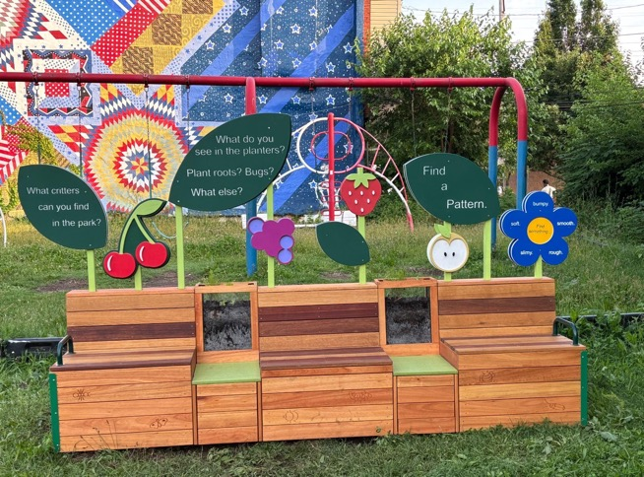
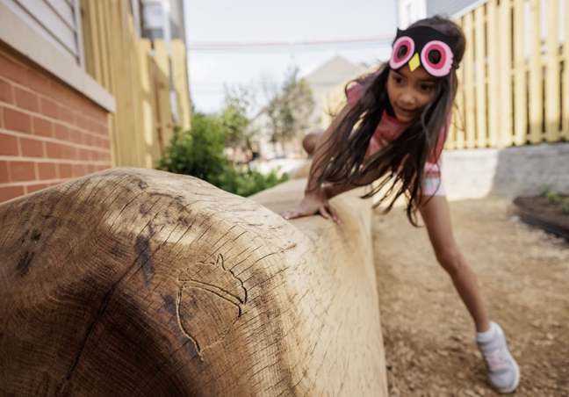
Playful Learning…BENCHES
Philadelphia, PA

Slide 38
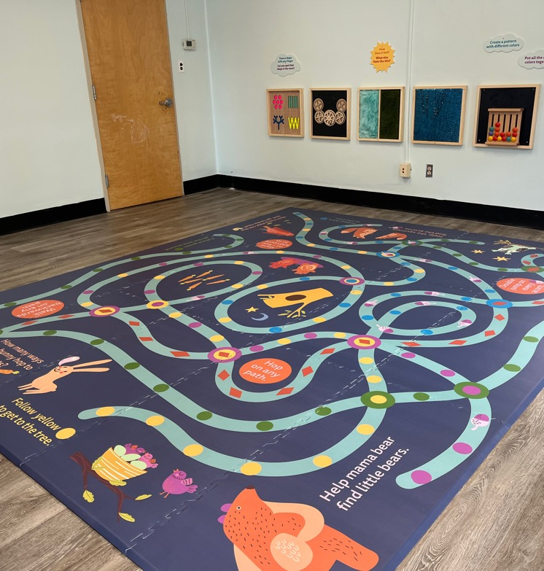
Research-Based and Effective

Slide 39
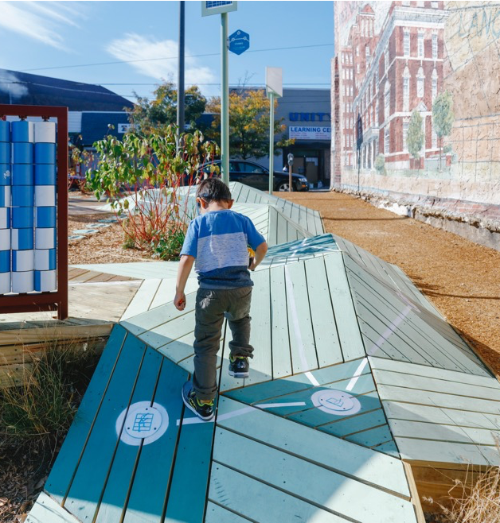
Example of PLL research results 1
Caregiver-child interactions increased
24%
after installation

Slide 40
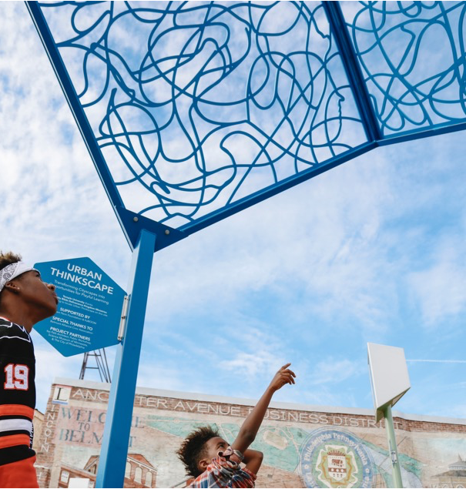
Example of PLL research results 2
34%
of families talked more about STEM than at a local playground

Slide 41
Your Playful Learning Environment
What areas of your environment are not designed for children?
Are there ways to make your environment more tailored to children’s interests and culture?
How can you incorporate the HOW and WHAT of learning into your environment?
Be the designer of your environment!

Slide 42
Wrap Up
What are 3 important points you heard today?
What is something that squared or agreed with your thinking?
What is still circling in your head?

Slide 43
Creating joyful learning opportunities for all children
playfullearninglandscapes.com

