Slide 1
Introduction to Embedded Learning Frameworks and Their Use
Inclusion Institute 2026
Patricia Snyder, Tara McLaughlin, & John Forster
June 24, 2026

Slide 2
Acknowledgments
Embedded Instruction for Early Learning and Embedded Learning Support are based, in part, on research funded by the Institute of Education Sciences (Project Numbers: R324A070008, R324A150076, R324A200044, R324A210081) and the Florida Department of Health, Children’s Medical Services, Early Steps Program (Contact COQXY).
The opinions expressed are those of the learning facilitators ,not the funding agency, and no official endorsement should be inferred.

Slide 3

WELCOME and INTRODUCTIONS

Slide 4
Overview of Part 1
By the end of today’s Part 1 session, you will be able to
Describe the rationales for the embedded learning support frameworks, their key parts, and the practices they include
Discuss key ”drivers” and strategies that have been shown to support effective implementation
Analyze modifications and adaptations made over time based on 26+ years of implementation experiences, user feedback, and research studies
Share ways the framework and practices have been used successfully in local and state contexts in the U.S.

Slide 5
Background and Rationales for the Embedded Learning Support Frameworks, Parts, and Practices

Slide 6

What is Embedded Instruction or Embedded Learning?
Learning opportunities for priority skills in everyday activities, routines, and transitions by people who regularly interact with the child to support engagement and learning and other desired distal outcomes
(e.g., belonging, friendships, self-determination, quality of life)

Slide 7





3Rs of Early Learning, Relationships, Repetition, Routines
™️
RELATIONSHIPS
Nurturing and responsive
interactions
REPETITION
Making neural connections by embedding learning in everyday activities and routines
ROUTINES
Predictable activities in everyday activities and routines that engage and motivate

Slide 8
Inclusion and Inclusive Practices
Inclusion (noun)
Action or state of being
included within a group or structure
  “Access”
Inclusive Practices (verb)
Actions or behaviors of people to support participation and engagement in group or structure
  “Engagement”
Access
Participate/
Engage
Embedded Learning Opportunities
Learn Priority Skills
Achieve Desired Outcomes

Slide 9
Additional Rationales
Recommended practice¹
Substantial empirical evidence²
Supports “participation”
Often not implemented as intended in routine practice without professional learning supports³
(¹ Division for Early Childhood, 2014; ² Balikci et al., 2026; Gulboy et al., 2023; Pretorius, McLaughlin et al., 2025; Snyder et al., 2015; Snyder et al., 2018; Snyder et al., 2026, ³US DHHS & DOE, 2015)

Slide 10
Embedded Frameworks
Historical and Contemporary Images

Slide 11
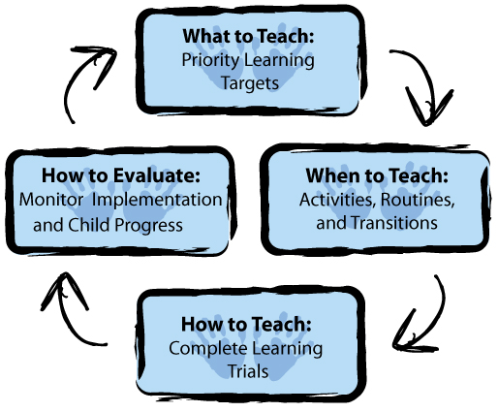
Initial Embedded Instruction for Early Learning Framework

Slide 12
Adapted Embedded Instruction for Early Learning Framework for Classroom Contexts

Slide 13
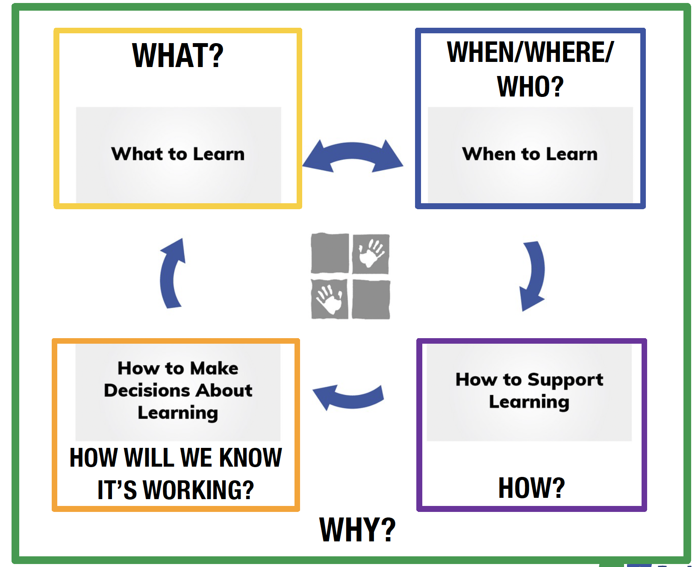
Adapted Framework for Classroom-Home Collaborations
Bishop, C. et al. (2020). Embedded instruction for early learning: Tools for families.

Slide 14
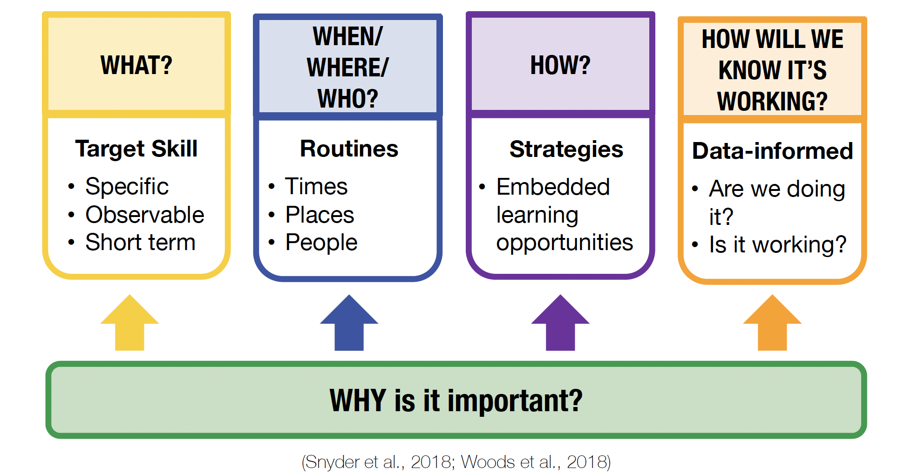
Adapted Framework for Early Intervention:
Home and Community

Slide 15
Embedded Practices

Slide 16
Adaptations to Practices:
14 Initial to 6 “Essentials” (see Handouts)

Slide 17
Six “Essential” Embedded Learning Practices
Identify and align target skills.
Write high-quality priority learning targets.
Use high-quality activities to provide multiple, meaningful, motivating (M3) embedded learning opportunities.
Develop and use activity matrices to guide when, where, with whom, and how many learning opportunities are embedded within and across activities.
Collect and analyze data about implementation and child progress to inform instructional decisions.
Implement embedded learning opportunities as complete A-B-C learning links (complete learning trials).

Slide 18
“Tools” to Support Implementation
Implementation “Drivers” and Strategies

Slide 19
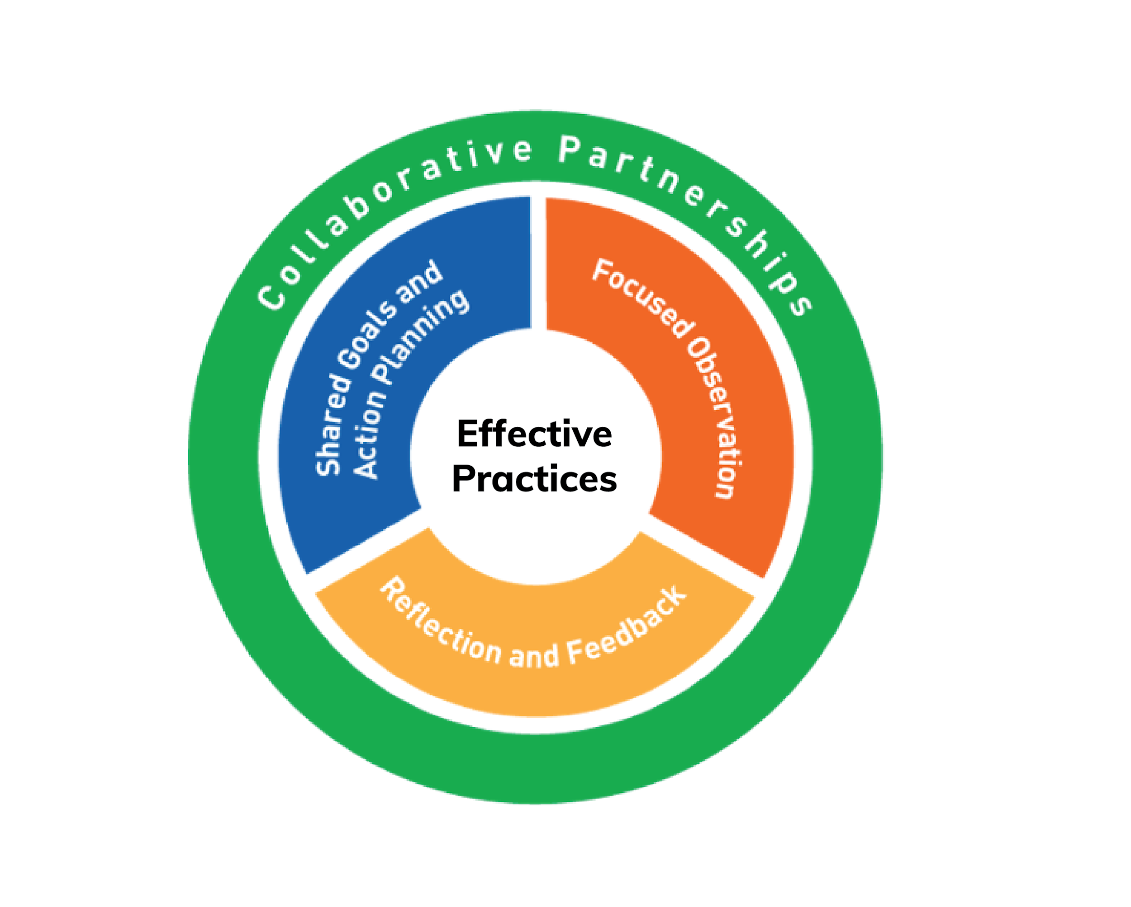
Implementation Supports:
“Tools” for Teachers, Providers, and Families
Snyder, P. A., Hemmeter, M. L., & Fox, L. (Eds.). (2022). Essentials of practice-based coaching: Supporting effective practices in early childhood. Brookes.

Slide 20
Sharing Implementation Stories and Experiences

Slide 21
References and
Back-Home Resources

Slide 22
Acknowledgments and Contact Information
We thank and acknowledge the contributions of our research and implementation partners, the practitioners, coaches, family members, program leaders, and local, regional, state, and national administrators, university faculty, training and technical assistance personnel, and policymakers who have collaborated and provided ongoing support, input, and feedback.
patriciasnyder@coe.ufl.edu
T.W.McLaughlin@massey.ac.nz
john.forster@noahsarkinc.org.au

