Slide 1

Better Together:
Partnering with Child Care Providers for Inclusive Experiences
Lindsay N. Giroux and Leiha Knecht
2026 International Early Childhood Inclusion Institute
Notes:
Lindsay & Leiha: Introduce ourselves here.

Slide 2

A note about language…
Bright Horizons current language norms include-
  People first language as the default
  Asking families and children for their preferred language
  Respecting preferences of families
© 2026, Bright Horizons Family Solutions LLC
Notes:
Lindsay

Slide 3
Outcomes
Understand current realities about the child care work force
Practice explaining your work to meet the needs of child care
Identify current barriers to partnership
Create a plan for both what to share with providers and what to ask of providers
© 2026, Bright Horizons Family Solutions LLC
Notes:
(I believe our style guide has child care as two words but I will check since it consistently comes up as incorrect.)
Leiha

Slide 4

You’re invited… to a dinner party!
1.
Find someone you do not know.
2.
Share what you do professionally without saying your role. Consider who you support and the skills you support with. Can they guess your role?
3.
Switch when you hear the cue.
© 2026, Bright Horizons Family Solutions LLC
Notes:
Lindsay

Slide 5

Inclusion in Early Childhood & Childcare Across the U.S.
© 2026, Bright Horizons Family Solutions LLC
Notes:
About Child Care--- slide 1
Nationally, research continues to demonstrate that while inclusive early childhood education improves developmental and social outcomes for children with and without disabilities, systemic barriers—including inadequate educator preparation, workforce shortages, and fragmented collaboration between therapists and childcare providers—continue to limit meaningful inclusion in community-based childcare settings.

Slide 6

The Challenge
1 in 6 children with developmental disabilities
Inclusion rates largely unchanged
Workforce shortages
Limited educator preparation
© 2026, Bright Horizons Family Solutions LLC
Notes:
About Child Care--- slide 2
Prevalence & Access
Nearly 1 in 6 children in the United States has a developmental disability.
Despite this prevalence, only about:
3.7% of infants/toddlers receive IDEA Part C services
4% of preschoolers receive IDEA preschool special education services.
Inclusion Has Stalled Nationally
Federal data show that the percentage of preschool children with disabilities served in inclusive early childhood settings has remained largely unchanged for decades.
Workforce & Training Barriers
National inclusion guidance identifies:
insufficient professional development,
staffing shortages,
lack of coordinated systems,
and limited collaboration across agencies
as major barriers to inclusion.

Slide 7

What Works
Embedded supports
Therapist–teacher collaboration
Professional development
Community-based inclusion
© 2026, Bright Horizons Family Solutions LLC
Notes:
About Child Care--- slide 3
Childcare Providers Need More Support
National recommendations for improving inclusion specifically call for:
increased training and technical assistance,
stronger partnerships between therapists and childcare programs,
and better support for community-based childcare settings.
Collaboration Improves Outcomes
A multi-state evaluation of inclusive early education programs found that:
3 out of 4 families reported positive impacts from inclusive settings,
and collaborative partnerships improved:
communication,
consistency,
access to services,
and teacher confidence.
The issue is not whether inclusion benefits children—we already know it does. The challenge is whether our systems, training models, and collaborative practices are strong enough to support it consistently in real childcare settings

Slide 8

The Piano Lesson Metaphor
The Lesson
The Skilled Teacher
The Practice Outside of the Lesson
© 2026, Bright Horizons Family Solutions LLC
Notes:
Lindsay

Slide 9
Heard from the Field
"She really likes working with the blonde lady who comes on Wednesdays."
What's your name and job and what do you work on?
"It could be early intervention or maybe the family hired him."
How do families access your services?
"Should I invite her to small group time when her therapist is here?"
How involved do you want to be in the classroom?
"I wasn't sure if I could ask for the transition cards for the other tricky parts of the day."
How can you support me in helping this child?
© 2026, Bright Horizons Family Solutions LLC
Notes:
Lindsay

Slide 10
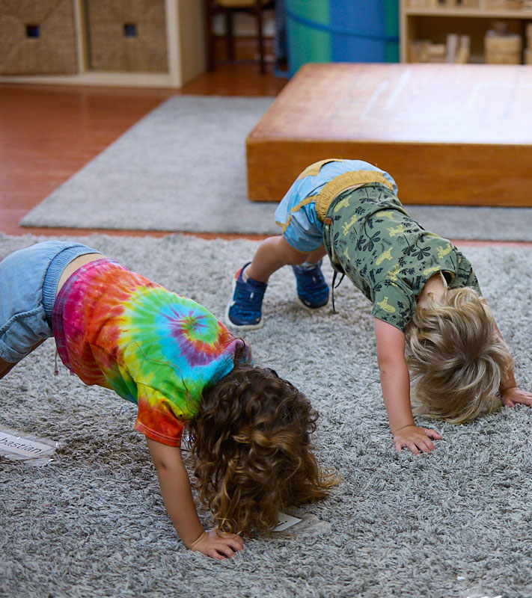
Pause & Reflect
What do you currently share?
What might you add to what you share?
© 2026, Bright Horizons Family Solutions LLC
Notes:
Lindsay will set up the activity- reflect alone and then share with a person next to you

Slide 11
What are the barriers to partnering with child care providers?
© 2026, Bright Horizons Family Solutions LLC
Notes:
Leiha- need input on best way to set this up. I like asking for barriers and then sharing my story. Go through multi disciplinary teams and have them share ideas on how to take dowm barriers. If the next slide isn't what you were looking for and more steps to be taken, let me know.
I think this works- lets just think about whether we want people to write them on post its or share out or some other mechanism. :) If we have the ability to write down what is said, the share out could work (unless there are 200 people in there LOL) How would the post-it notes work? Did you like either of the quick activities below? One better than the other?
Barrier
Goal: Problem-solve real challenges
On board or slide:
List barriers:
Ratios
Time
Training gaps
Communication
Ask:
“What can YOU do as a therapist to reduce this barrier?”
Have participants shout out ideas
OR
Barrier to Solution Brainstorm
Purpose:
Identify common collaboration challenges and generate practical solutions.
Small Group Prompt:
“What gets in the way of successful collaboration between therapists and child care providers?”
Common Barriers:
Limited teacher training in disability and inclusion
Time constraints
Therapy jargon
Recommendations that don’t fit classroom realities
Lack of administrative support
Group Task:
Barrier Practical Solution
Teachers are overwhelmed Prioritize one easy strategy to start
Recommendation requires special equipment Adapt using classroom materials
Limited communication Use a simple one-page communication form
Clinical Language Teacher friendly language
When therapists shift from isolated service delivery to collaborative, classroom-based partnerships, they transform inclusion from a theoretical goal into a practical reality within private childcare settings.

Slide 12
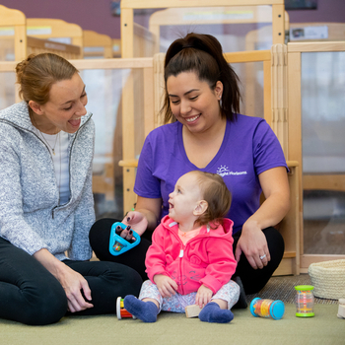
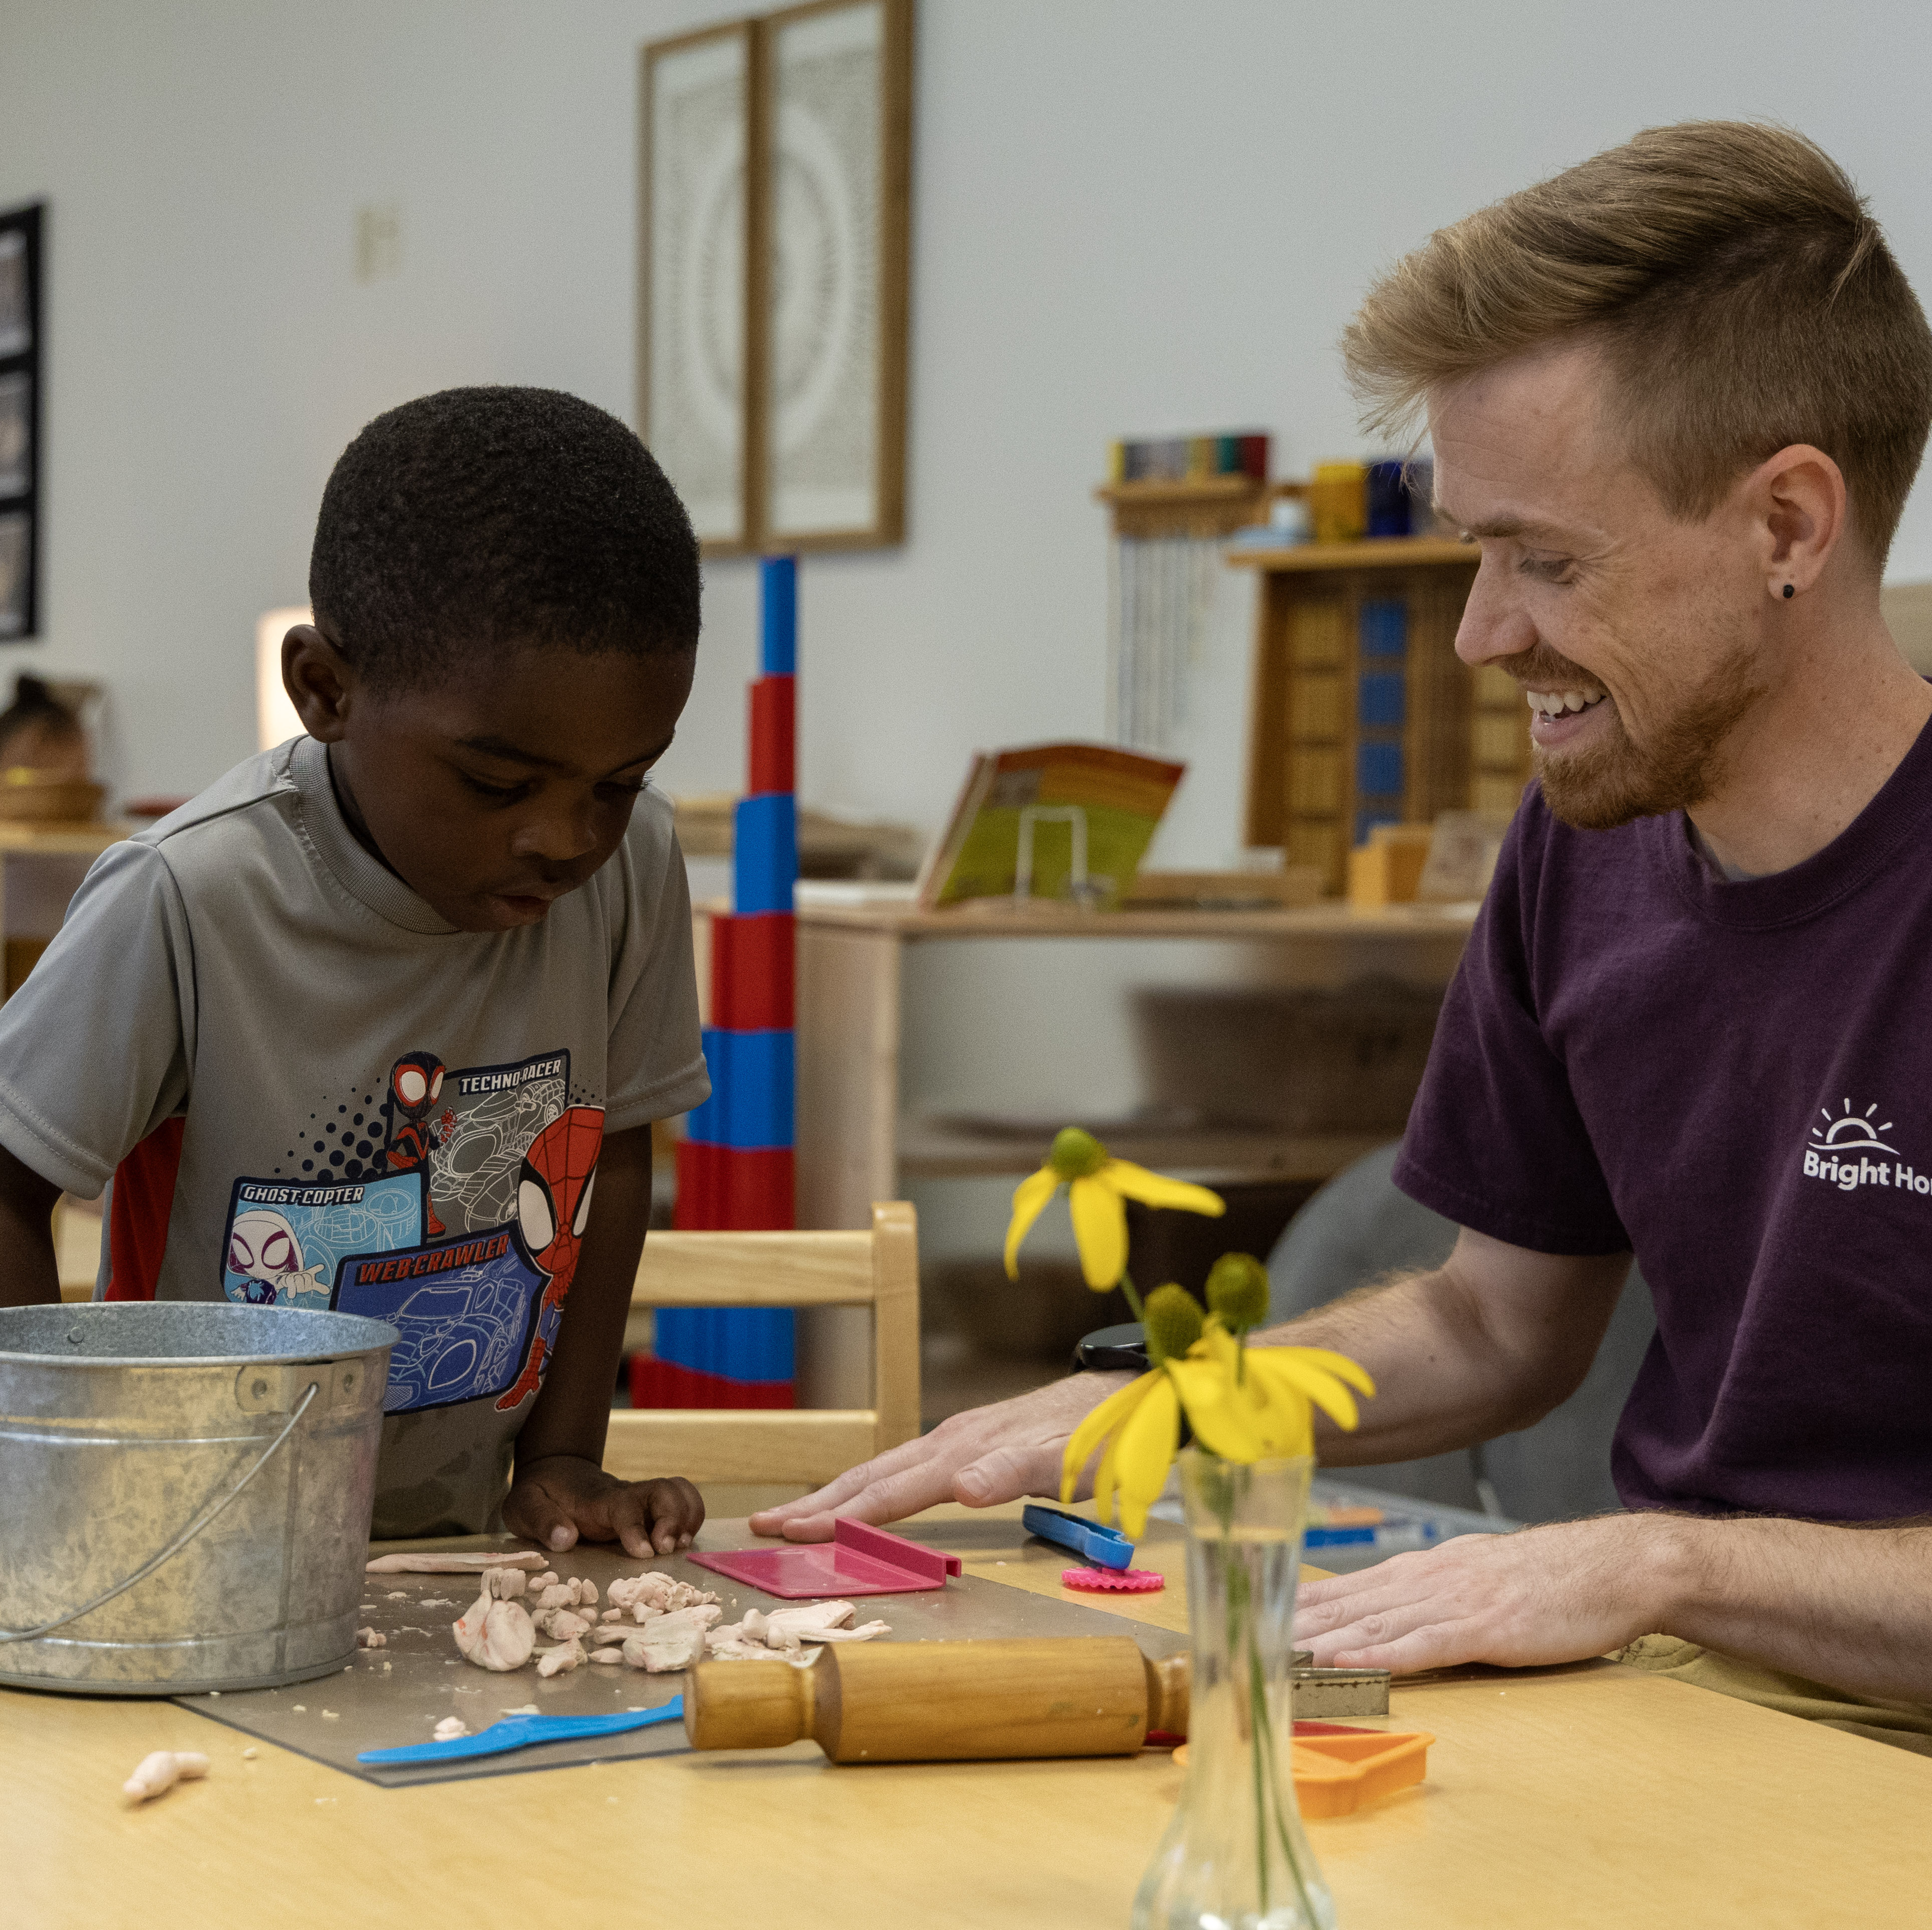

Child Care: An Essential Partner on the Team
Collaboration
Capacity Building
Child-Centered Outcomes
Combines expertise across developmental domains and creates a whole-child understanding.
Embeds supports into daily routines and
builds teacher and family capacity.
Promotes inclusion and belonging and
improves child outcomes.
© 2026, Bright Horizons Family Solutions LLC
Notes:
Perhaps use this slide to highlight key collaboration points in Leiha’s example. (NOT SURE WHAT PICS TO PUT)--> I do think that everyone knows that MDTs are essential.... but I think your BIG point is "MDTs are essential.... and child care should be a part of that!" So I'd lean into that here very intentionally. Might want to adjut the slide title to include that Adjusted the heading, what do you think?
In early childhood, no single professional has all the knowledge needed to fully support a young child’s development. Children grow across multiple domains—communication, motor skills, cognition, social-emotional development, sensory regulation, and adaptive behavior. A multidisciplinary team (MDT) brings together professionals with different expertise to create a more complete understanding of the child and develop coordinated, meaningful supports.
The most effective therapy is not what happens during a 30-minute session—it is what happens all day long when therapists, teachers, and families work together.

Slide 13

Reflection
What questions do you want to bring with you into a child care setting about partnering together?
© 2026, Bright Horizons Family Solutions LLC

Slide 14

Final Reflection
What’s one word that represents the thoughts you are leaving here with today?
© 2026, Bright Horizons Family Solutions LLC

Slide 15

Questions?
© 2026, Bright Horizons Family Solutions LLC

Slide 16

References
U.S. Department of Education & Department of Health and Human Services Policy Statement on Inclusion of Children with Disabilities in Early Childhood Programs
Start Early – Building Inclusive State Child Care Systems
WestEd – Expanding Access to Inclusive Early Education for Children with Disabilities
NIEER – Practical Guide for State Teams to Increase Inclusion in Early Childhood Programs
© 2025, Bright Horizons Family Solutions LLC

Slide 17
Thank you!
© 2025, Bright Horizons Family Solutions LLC

