Slide 1
Healing Generations: Family-Centered Care for Addiction and Trauma at UNC Horizons
Hendrée E Jones, PhD, LP
Professor, Department of Obstetrics and Gynecology
Senior Advisor, UNC Horizons, School of Medicine, The University of North Carolina at Chapel Hill
Haley Dixon
Childcare Director, UNC Horizons, School of Medicine, Dept. of Obstetrics & Gynecology, University of North Carolina at Chapel Hill

Slide 2
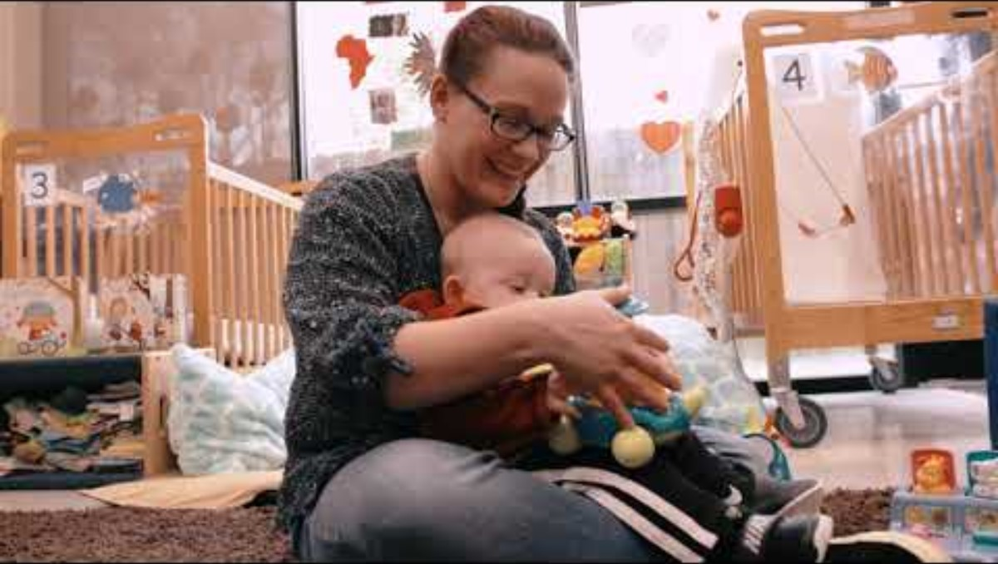

Slide 3

Substance Use Treatment Services
Residential
Outpatient
Group
Child Services
Childcare
Parenting Education
Child Therapy
Medical Services
OBGYN
Psychiatry
Pediatrics
Justice Involved Services
Assessments
Case Management

Slide 4
Defining Substance Use Disorders & Treatment
Understanding Substance Use Disorder
Barriers in addiction for pregnant and parenting women
Common misconceptions

Slide 5
11 Signs of Substance Use Disorders
Impaired control
Physiological
Impaired social functioning and relationships
Hazardous use
Mild: 2-3
Moderate: 4-5
Severe: 6-11
SUBSTANCE USE DISORDER IS A PEDIATRIC ILLNESS

Slide 6
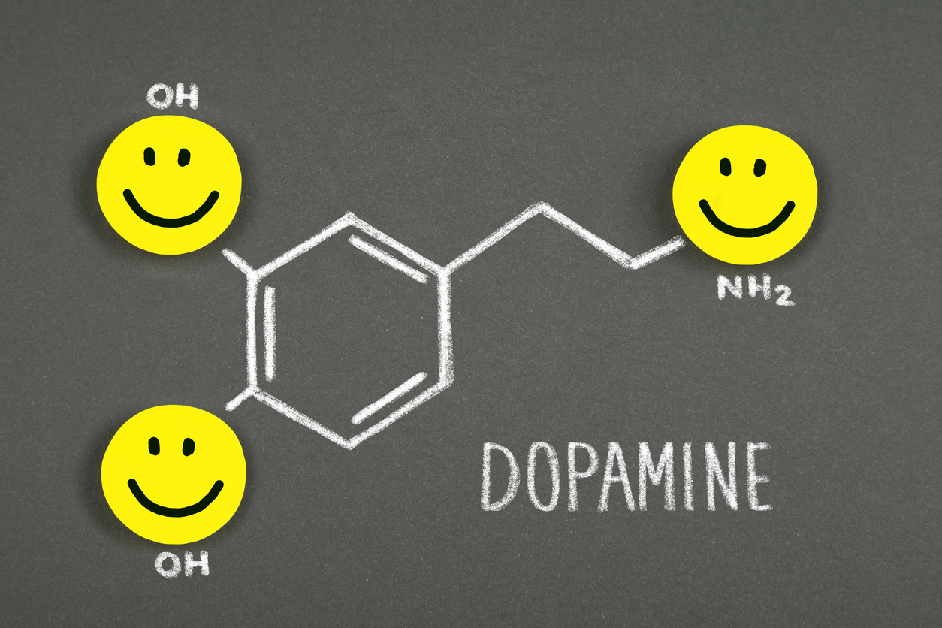

Why Dopamine Matters
Nanograms/deciliter | Day
40 | worst
50 | average
60 | great
500-1,100 | drugs

Slide 7
Understanding Brain and Behavior
Repeated Drug Use
nanograms/deciliter of dopamine
500- 1,100
250
50
10
Craving
Survival Mode
Primal Action
Low Dopamine

Slide 8


3 days without water
Relative Size of Craving in the Brain
This Photo by Unknown Author is licensed under CC BY-SA

Slide 9


5 days without food
Relative Size of Craving in the Brain
https://pixabay.com/photos/people-food-restaurant-dine-men-2602736/

Slide 10

A week without drugs
Relative Size of Craving in the Brain

Slide 11
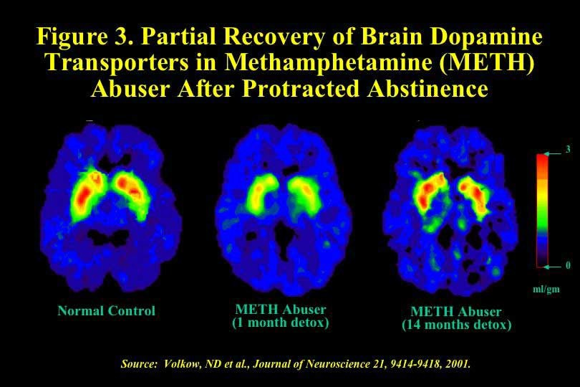
No Substance Use Disorder
Methamphetamine Use Disorder
Methamphetamine Use Disorder

Slide 12

Question
What barriers do pregnant and parenting women face in seeking care and treatment for substance use disorders?

Slide 13
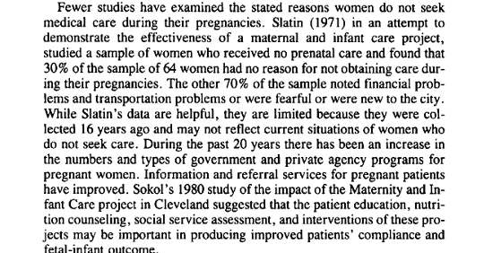
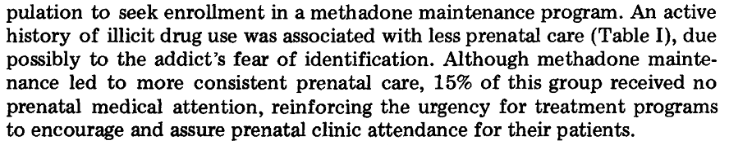
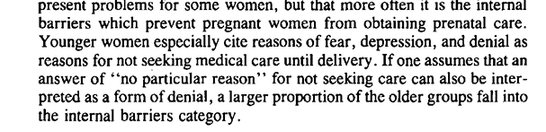
Barriers to Care
1971
FEAR is the biggest and most common answers
Fear of loss of custody
Fear about stigma and privacy
Fear over not wanting to be away from children/partner
Other barriers to treatment
Lack of childcare
Lack of transportation
1977
1983
Frazer, Z., McConnell, K., & Jansson, L. M. (2019). Treatment for substance use disorders in pregnant women: Motivators and barriers. Drug and alcohol dependence, 205, 107652
Joyce, K., Diffenbacher, G., Greene, J., & Sorokin, Y. (1983). Internal and external barriers to obtaining prenatal care. Social work in health care, 9(2), 89–96..
Kandall, S. R., Albin, S., Gartner, L. M., Lee, K. S., Eidelman, A., & Lowinson, J. (1977). The narcotic-dependent mother: fetal and neonatal consequences. Early human development, 1(2), 159–169.

Slide 14
Treatment Access and Effectiveness
Barriers
Capacity is inadequate
Perinatal specific SUDS care is limited
Barriers to Medications
Poverty/rural/
underinsured
Evidence Based Recommendations
Prenatal care
Substance Use Care
Patrick, S. W., & Schiff, D. M. 2017. Pediatrics, 139(3)
Notes:
Capacity is often far below population needs – OBGYN bupe providers
Capacity is inadequate
Only 15% of treatment centers offer specified services
Access is limited
For those in poverty, rural areas, uninsured, or insured through Medicaid
Quality of treatment ranges dramatically
Barriers in treatment for opioid use disorder
Engagement in prenatal care is effective regardless of continued drug use
- 19 states have either created or funded drug treatment programs specifically targeted to pregnant women, and 17 states and the District of Columbia provide pregnant women with priority access to state-funded drug treatment programs
- 10 states prohibit publicly funded drug treatment programs from discriminating against pregnant women
- Continued engagement – “I’ll ask about drug use or if they want to talk about it once if they say no, I don’t ask further. The most important thing is for the pregnant person to return for prenatal care.” Terplan

Slide 15

Recovery: Healthy Mothers and Healthy Families
Parent Recovery
Nurturing parenting
Social support
Connections/resources
Economic stability
Mental health
No problem with substance use
Family Recovery
Basic needs met
Employment
Housing
Childcare
Transportation
Family communication
Child Well Being
Developmental health
Emotional security
School readiness
Trauma treatment and prevention
Recovery is not:
Treatment Completion
Negative Drug Tests
https://pixabay.com/vectors/hands-family-newborn-celebration-7107606/
Help families increase Positive Childhood Experiences
https://www.samhsa.gov/sites/default/files/family_treatment_paper508v.pdf

Slide 16
Question:
How Do You Define Trauma?

Slide 17

Defining Trauma
“An event, series of events, or set of circumstances that is experienced by an individual as physically or emotionally harmful or threatening, and that has lasting adverse effects on the individual's functioning and physical, social, emotional, or spiritual well-being.”
SAMHSA, 2014
Event(s)
Experience
Effects
= TRAUMA
Being alone with it makes it worse

Slide 18
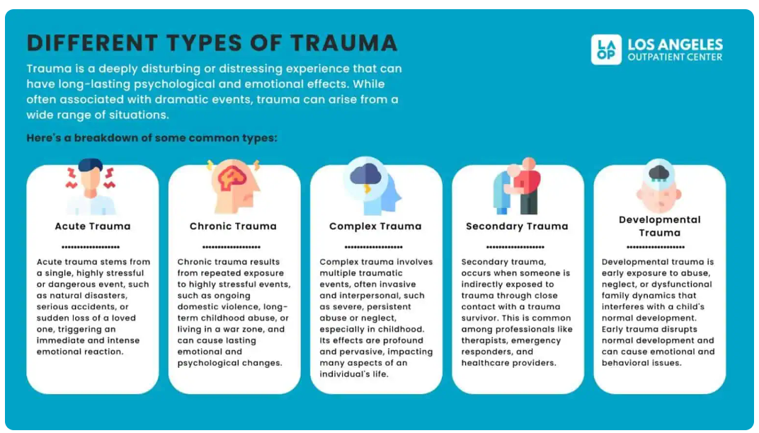
Trauma Types
Notes:
Reminder – not big “event” Give examples:

Slide 19
Trauma Signs and Symptoms For Adults
Hypervigilance
Intrusive Memories
Flashbacks
Severe Anxiety
Nightmares
Emotional Numbing
Avoidance
Notes:
Intrusive Memories: these are recurrent, unwanted, distressing memories of the traumatic event and can occur at any time and disrupt daily activities.
Flashbacks: Reliving the traumatic event as if it were happening again, sometimes accompanied by physical sensations like sweating or heart palpitations. Reminders of the trauma, such as sounds, smells, or visual cues, trigger flashbacks.
Severe Anxiety: Persistent and overwhelming feelings of anxiety, which can manifest as panic attacks, restlessness, and an inability to relax. Anxiety related to trauma often includes feelings of dread and hyperarousal.
Nightmares: Disturbing dreams related to the traumatic event, which can disrupt sleep and lead to insomnia or sleep disturbances. Nightmares can cause significant distress and exacerbate feelings of fear and helplessness.
Emotional Numbing: Feeling detached from others, a lack of interest in previously enjoyable activities, and an inability to experience positive emotions. Emotional numbing serves as a coping mechanism to avoid the pain associated with trauma.
Avoidance: people struggling with trauma avoid places, activities, or people that remind them of the traumatic event. It limits their daily functioning and social interactions, as individuals may go to great lengths to avoid triggers.
Hypervigilance: it is a feeling of being easily startled, feeling tense or “on edge,” and constantly looking out for potential threats. This state of heightened alertness leads to chronic stress and fatigue, affecting overall well-being.
Other symptoms include:
Irritability and Anger
Difficulty Concentrating
Headaches
Stomachaches and other unexplained physical problems
These somatic symptoms are often a manifestation of the stress and anxiety associated with trauma.

Slide 20


Trauma Mind and Body
The Brain Does Not Process Trauma As The Past
The result: You feel stressed and frightened even when you know you’re safe
The brain attaches details, like sights or smells, to that memory
These become triggers. They act like buttons that turn on your body’s alarm system.
When one of them is pushed, your brain switches to danger mode.
This may cause you to become frightened and your heart to start racing.
The sights, sounds, and feelings of the trauma may come rushing back.
Notes:
Intrusive Memories: these are recurrent, unwanted, distressing memories of the traumatic event and can occur at any time and disrupt daily activities.
Flashbacks: Reliving the traumatic event as if it were happening again, sometimes accompanied by physical sensations like sweating or heart palpitations. Reminders of the trauma, such as sounds, smells, or visual cues, trigger flashbacks.
Severe Anxiety: Persistent and overwhelming feelings of anxiety, which can manifest as panic attacks, restlessness, and an inability to relax. Anxiety related to trauma often includes feelings of dread and hyperarousal.
Nightmares: Disturbing dreams related to the traumatic event, which can disrupt sleep and lead to insomnia or sleep disturbances. Nightmares can cause significant distress and exacerbate feelings of fear and helplessness.
Emotional Numbing: Feeling detached from others, a lack of interest in previously enjoyable activities, and an inability to experience positive emotions. Emotional numbing serves as a coping mechanism to avoid the pain associated with trauma.
Avoidance: people struggling with trauma avoid places, activities, or people that remind them of the traumatic event. It limits their daily functioning and social interactions, as individuals may go to great lengths to avoid triggers.
Hypervigilance: it is a feeling of being easily startled, feeling tense or “on edge,” and constantly looking out for potential threats. This state of heightened alertness leads to chronic stress and fatigue, affecting overall well-being.
Other symptoms include:
Irritability and Anger
Difficulty Concentrating
Headaches
Stomachaches and other unexplained physical problems
These somatic symptoms are often a manifestation of the stress and anxiety associated with trauma.

Slide 21

Understand the Prevalence and Impact of Trauma
Among Horizons patients 86% of the new clients consistently report at least one form of interpersonal violence (physical abuse, sexual abuse/assault, and/or domestic violence)
PTSD in pregnant birthing persons has been associated with:
Shorter gestation
Lower birth weight (Seng et al., 2011)
Negative effects on maternal self care and infant emotional and cognitive development (Murray, 1992)
Difficulty with maternal attachment
Pregnant women with PTSD have higher rates of suicidal thoughts and psychiatric comorbidity than non pregnant women with PTSD (Smith et al., 2006)
PTSD affects birthing person/child bonding
Photo by 🇻🇪 Jose G. Ortega Castro 🇲🇽 on Unsplash
Notes:
Add exposure statistic

Slide 22
Trauma and the Developing Brain
Prefrontal Cortex
(decision making, impulse control)
Hippocampus
(memory)
Amygdala
(fear)

Slide 23
What symptoms and signs do you see?
Trauma effects decision making, learning, behavior, health, and relationships
Difficulty identifying and regulating emotions
“Big behaviors” (aggression, fleeing, hiding)
Regression in skills
Anxiety regarding caregivers
Struggles with transitions
Sensory input (over or under-stimulated)
Isolation and withdrawal
Trauma in Early Childhood
Their behavior is communication!

Slide 24
Stress Response Cycle
Stressors or trigger occurs
Internal
alarm
Escalation /
Crisis
Exhaustion
Recovery
Internal
Emotional
Sensory
Social
Environmental
Trauma
Triggers:

Slide 25
What Helps?

Slide 26


Keys To Identify Trigger Responses
Anger or Irritability Key to identify: overreaction
Mood Key to identify: unexplained changes in mood
Dissociation Key to identify: the mind’s distance from the body
Anxiety Key to identify: evaluation and control
Notes:
Anger or Irritability – Key to identify: overreaction
Bothered by small things
Sensory sensitivity – easily overstimulated, bothered by noises or body sensations that don’t always bother you (e.g. touch from others, tags on clothing)
Anger feels sudden and uncontrollable
Mood – Key to identify: unexplained changes in mood
Sudden changes, more changes than usual
Low mood, feeling blue, intense sadness, grief
Hypomania – seeking disruption, novelty, or change
Hopelessness, feeling or belief that future is doomed in some way
Thoughts/feelings of worthlessness
Dissociation – Key to identify: the mind’s distance from the body
Feeling foggy, blurry, floaty
Confusion and/or forgetting, unusual for you and only in certain situations
Disconnection from time/place
Derealization – colors seem brighter, world seems fake, like a movie or video game
Depersonalization – don’t recognize self in mirror, hard to recognize age/current life
Don’t notice/late to notice bodily cues for hunger, thirst, pain, bathroom
Re-experiencing through flashbacks, nightmares, intrusive thoughts, intrusive remembering
Daydreaming
Anxiety – Key to identify: evaluation and control
Rumination – your mind running over the same worries, memories, interactions, ideas repetitively
Feeling as though something is wrong
Starting a new project with self-imposed pressure/perfectionism
Intrusive thoughts around death
Intrusive thoughts around rejection
Hyperstartle reflex, jumpiness
Intellectualization – focusing on researching/understanding without feeling or action
Fight/flight symptoms like heart racing/palpitations, shortness of breath
Trouble sleeping
Minimizing trauma “wasn’t that bad”, “others have it worse”, “is it really trauma”

Slide 27
Trauma-Informed Environments & Classrooms
Environment: calm spaces to “escape”, soft lighting, organized spaces, natural and soft furnishings.
Predictable routines and visual schedules = sense of safety and predictability
Guidance with transitions & repetition (e.g., in 2 minutes... choose one more activity before... this THEN that)
Relationship building, co-regulating strategies (children learn to self-regulate through exposure and mirroring!)
Social-emotional and regulation support (visuals, materials, lessons)
Resources to support sensory overload or under-load
Limit setting, boundary setting

Slide 28
Tiered Trauma-Responsive Supports
Tier 1:
Universal Supports
Trauma-informed environment
Professional development
Standardized protocol for considering trauma-exposure.
Modeling and naming emotions
Intentional & positive interaction
Inclusive and culturally responsive environment
Social-emotional lessons
Identifying triggers
Strategies for self-regulation/self-soothing
Advance notice during transitions
Tier 2:
Targeted Supports
Tier 3:
Intensive
Supports
Family partnerships
Temporary adjusted academic/behavioral expectations
Individualized behavior support plans
Outreach/referrals

Slide 29
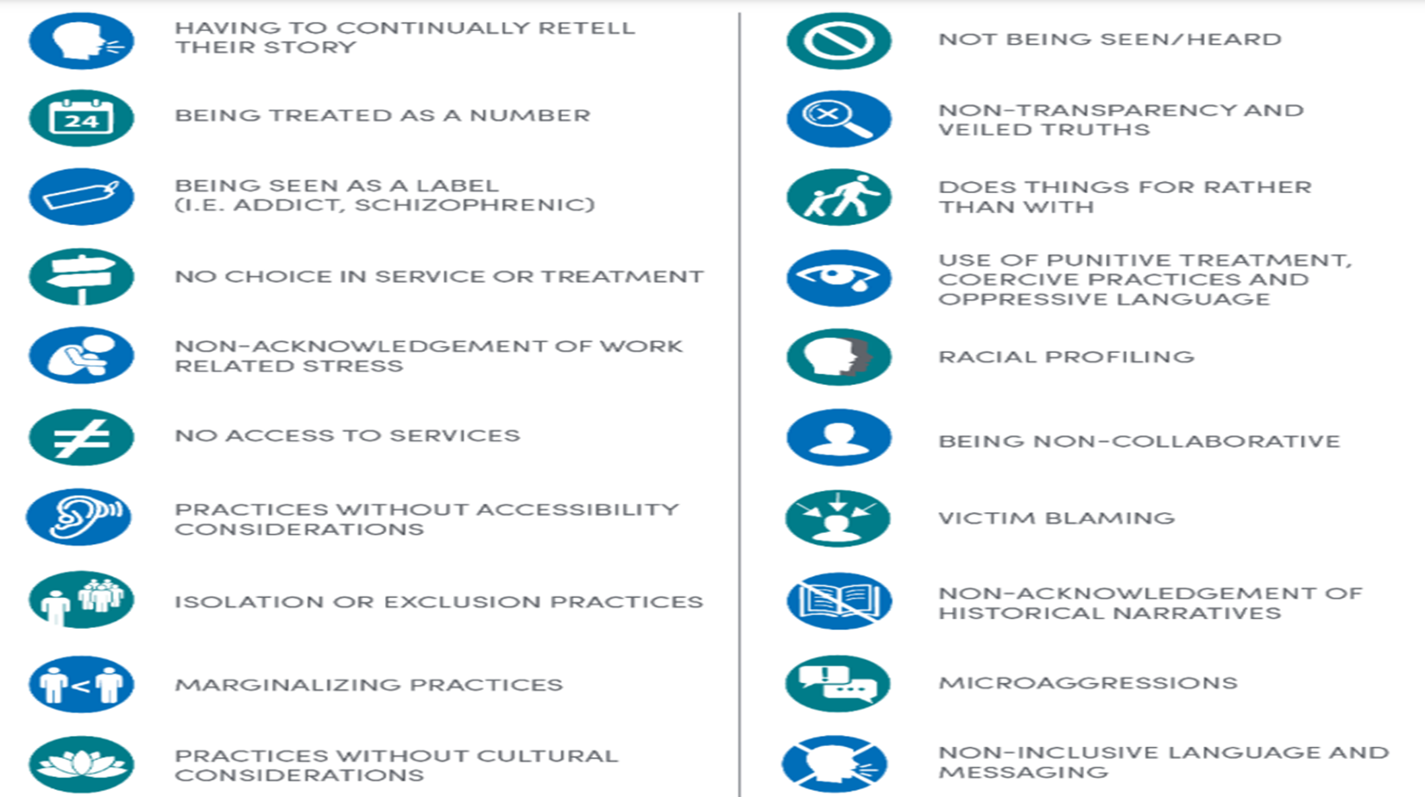
Avoiding Re-traumatization

Slide 30
Avoiding Re-traumatization in the classrooms
USE Trauma-sensitive Interactions and language
AVOID Interaction and language that triggers previous traumas
Language and tone that give the child a sense of belonging
Language that names emotions
Language and interactions that support co-regulation and self-regulation
Intentional breathing, calm voice, naming emotions, modeling strategies to calm down
Language that connects
“I see you, I hear you”, “you are safe”
Language that provides collaboration and choice
Disciplinary methods that result in isolation or humiliation
Language and tones that can trigger shame, anxiety, or fear
“You’re fine”, “what’s wrong with you?”, “stop crying, you’re not a baby”, “if you don’t...”
Abrupt changes to routine without notice or explanation

Slide 31
Creating a Trauma-Informed Environment using the following five principles
Safety
Choice
Empowerment
Collaboration
Trust
Creating areas that are calm and comfortable
Providing options for the individual
Noticing capabilities in the individual
Making decisions together,
Co-regulating
Providing clear and consistent information

Slide 32
De-Escalation Strategies during active crisis
Stay Regulated
Validate
Offer a quiet space
Reduce language, avoid “problem-solving”
Intentional body language
Offer physical space without abandonment
After the crisis: reiterate validations, invite reflection, offer supports, mend relationship (when applicable)

Slide 33
Substance Use Treatment Services
Residential
Outpatient
Group
Child Services
Childcare
Parenting Education
Child Therapy
Medical Services
OBGYN
Psychiatry
Pediatrics
Justice Involved Services
Assessments
Case Management

Slide 34
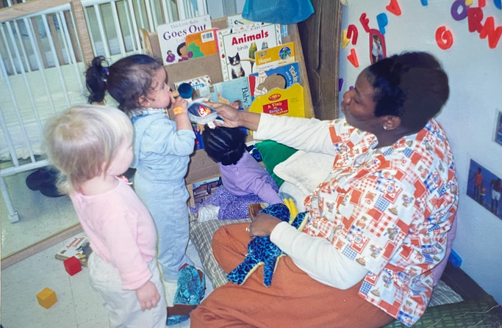


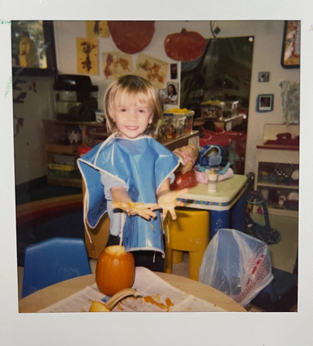

UNC Horizons
Child Development Center:
Our Beginnings and Who We Are Today
Notes:
We’re a child development center and early education program
5-star licensed facility with the state
What does 5-star mean?
Lower teacher:child ratios/smaller classrooms,
Higher standards for (1) teachers’ qualifications/education, (2) the curriculum and developmental tracking tools we use and (3) Family and Community Engagement
We serve ages 6 weeks to 5 years old
Divided into 5 classrooms (Infant classrooms through preK classroom)
We have five classrooms (2 infant, 2 toddler, 1 preschool)
Capacity: 41 students
Hours: 7:30am-5:30pm

Slide 35
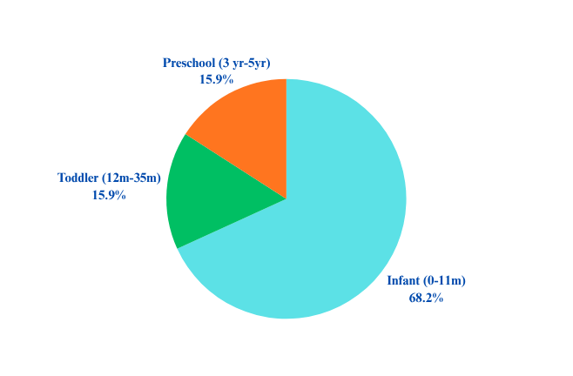
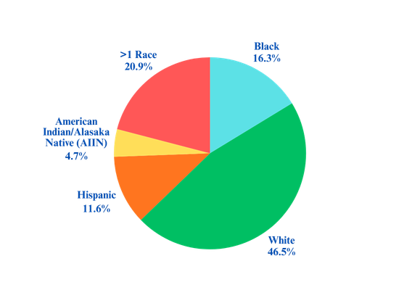



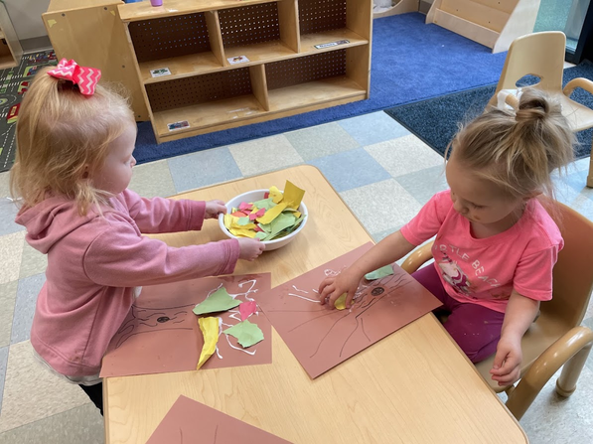




Who we served in 2025-2026:
44 Children and Counting!
Age at Enrollment
Race and Ethnicities
ACES score
Medicaid Eligibility

Slide 36
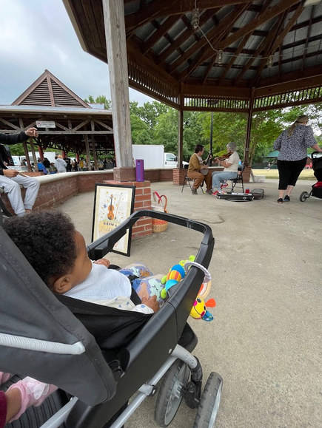

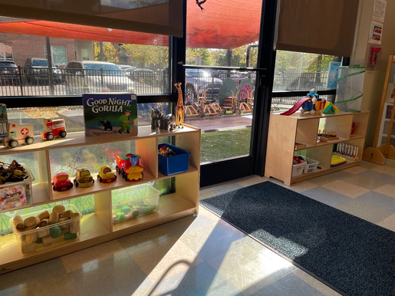
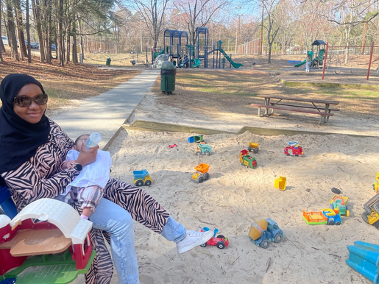

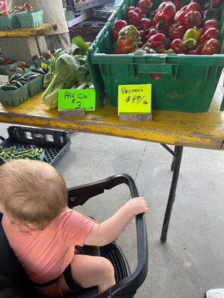
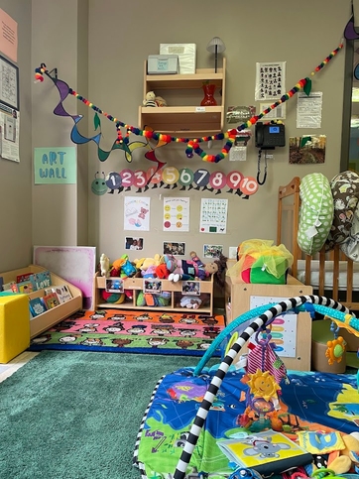





5-star licensed center
Serve children 6 week through 5 years old
Five classrooms, 42 child capacity
Located in the same building as our group rooms and other services
Serve children whose parents are active clients in our program and graduated parents
Designed trauma-informed classrooms and intentional instruction
Prioritize developmental tracking and early intervention during their time with us
Participation with local community (library, nature trails, parks, farmers market)

Slide 37
Early Intervention Services
Occupational Therapy
Physical Therapy
Speech and Language Pathology
Family & Play Therapy

Slide 38
Testimonies – Ms. CJ
Ms. CJ grew up in a middleclass, military background. She attended UNC Chapel Hill. In her junior year she was introduced to crack-cocaine. This led to 15 years of use. In 2008, she reached out to Horizons for help with her 18-month-old.
“I felt like a regular person going to a regular child care, not like a recovering addict.”
“You are not looking at what’s going on, you may not see it - the early evaluations helped lead to acceptance of learning disabilities.
“This over here (the Child Development Center), motivates that over there (the group rooms), I see my kid is fine and happy - it makes me want to go over there and fix this and heal our family ”
“…Opportunities to do fun stuff with our children and bond with them, make the family bond… I had never done tie dye before!”
Notes:
Wonderful, as a client and as an employee and as a grandparent - never felt stigmatized, we felt comfortable with talking to the director/teachers, it was done in a caring and loving way. If u use ur children may have developmental delays and your pro child and pro parent - supportive. Comes from a loving and caring way. You have the option to accept it or not (services). To see the impact
You are not looking at whats going on, you may not see it - the early evaluations helped lead to acceptance of learning disabilities.

Slide 39
Testimonies – Ms. CJ
Today, Ms. CJ has been drug free for 18 years. She has worked at UNC Horizons for 15 years as a Residential Advisor.
“I want to give back what was given to me”
Notes:
Her oldest daughter that she had during active addiction was client at Horizons. Her daughter attended out child development center, and continues to see our OT years beyond graduation.
Our OT used to be a teacher at Horizons, she wasa Ms. CJs daughter’s teacher and now she is her granddaughter’s Occupational Therapist

Slide 40
Support For Our Families Beyond Horizons
EMPOWERING program
CARA 2.0
CARA 3.0
CHERISH
Assistance with finding new child care and housing
SLP and OT travel with child (within Orange, Durham, and Chatham Co.)
Continued pediatric support
Access to our perinatal clinic

Slide 41

What We Hope You Walk Away With...
When you see a family struggling, reflect and approach with empathy. How can we support rather than surveil?
Pause - If you were in this situation, how would you want to be treated?
Ask yourself
What is needed in this situation?
What can I say right now that can make the person feel seen, valued and heard?
Remember that anger is fear
A child’s behavior = communication
Creating a trauma-responsive environment benefits ALL
93% rule

Slide 42
Resources
Trainings of addiction, trauma, and crisis
Mental Health First Aid
Crisis Prevention Intervention
Sesame Street Toolkit - Carly (Parental addiction)
Include resources that are accessible to parents
NC DHHS Help Line
NC Disability Rights - includes services for both children and adults
Additional resources:
SAMHSA: Substance Abuse and Mental Health Services Administration
The National Child Traumatic Stress Network - Child Trauma Toolkit for Educators
NCIMHA: NC Infant Mental Health Association
1800-for-baby warm line for connecting to out-patient services for those who are pregnant with a substance use disorder

Slide 43
How to Refer a Patient to UNC Horizons
OBGYN Care only
Available to any woman who is pregnant and has a substance use disorder (past and/or present)
No formal referral is needed
Call 984-974-7005 to request appointment with Elisabeth Johnson
Clinic occurs on Monday AM and Thursday AM/PM
Residential Care
Available to women who are pregnant and/or custody of a child 11 or younger
Patient/provider may call 919-966-9803 to complete a screen and request to be considered for residential treatment.
If the patient is eligible for services, a staff person will help the patient navigate the process.
If the patient is not eligible for services or if the UNC Horizons program does not have any available beds, a staff person will provide information on treatment options.
Outpatient Care (SACOT/SAIOP)
Available to women who can attend group treatment. Currently, UNC Horizons does not provide a stand-alone SAIOP.
Patient may call 919-966-9803 to complete a screen and request to be considered for outpatient group treatment. If the patient is eligible for services, a staff person will assigned to helping the patient navigate the process. If the patient is not eligible for services or if the UNC Horizons program does not have any available beds, a staff person will provide information on treatment options.

Slide 44
Connect With Us!
Our Website:
www.med.unc.edu/obgyn/horizons/
Our Child Development Center Email:
HorizonsCDC@med.unc.edu

