Slide 1
Inclusion Institute Statewide Implementation Retrospective

Slide 2
Welcomes and Introductions
Panelists:
Ann Kremer- Director of Early Choices Illinois
Meredith Villines- Oregon Part B 619 Coordinator
Moderators:
Alissa Rausch
Megan Vinh

Slide 3
WIII4U
Embolden your passion for the work of inclusion.
Identify potential partners in the work.
Identify leverage points for micromovements, short-term, and long-term outcomes.
Identify different ways in which inclusion can be measured.
Reflect on how the system influences every aspect of the work.
Remind yourself why you do it anyway.

Slide 4
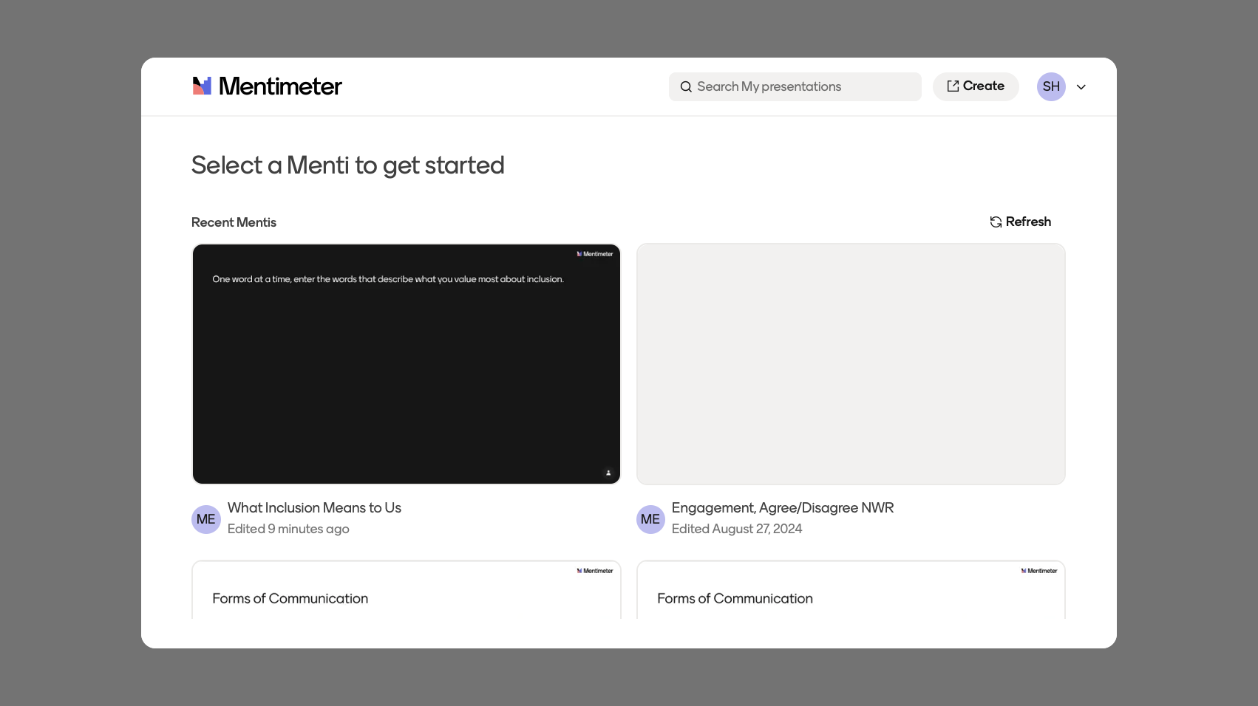
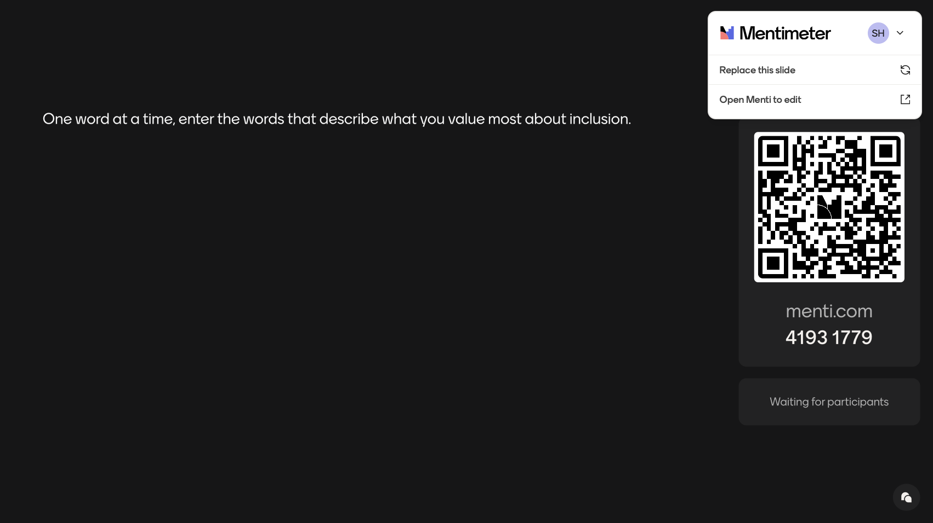
One word at a time, enter the words that describe what you value most about inclusion.

Slide 5
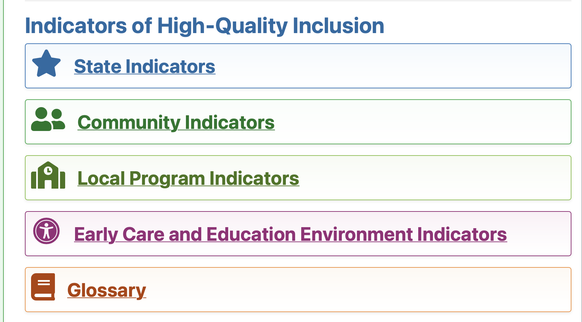
The Inclusion Indicators
The Inclusion Indicators are intended to:
Respond to the evolving needs of the early childhood education system.
Be used as a capacity building tool rather than a performance checklist or assessment.
Help teams implement inclusive practices at all system levels: state, community, local program, and environments where children receive care.
Help teams discuss barriers to inclusion and develop effective solutions.
Act as a coaching tool once implementation plans are developed.

Slide 6
Technical Assistance for Statewide Scale Up of Inclusion
Changing minds, beliefs, attitudes and values: increase understanding of the importance of high-quality preschool inclusion
Changing state implementation infrastructure: implementing funding, personnel, professional development, and other actions that promote high-quality preschool inclusion
Changing practice: implementing high- quality inclusion practices within ECE environments
Essential Support Structures
  State Leadership Team
  Professional Development Network of Program Implementation Coaches
  Community Inclusion Teams
  Implementation Sites
  Data Evaluation Systems
“values, policies, and practices”
“access, participation, and supports”

Slide 7
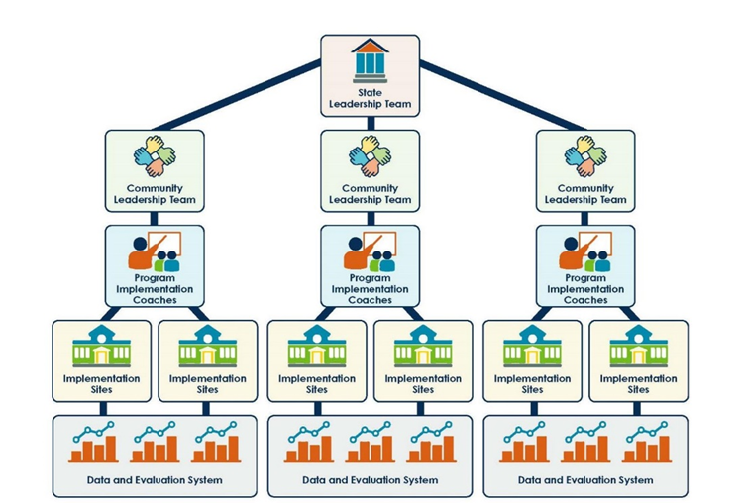
Notes:
A state professional development network of Program Implementation Coaches (i.e., systems coaches or training and technical assistance providers) who can provide training and coaching to community inclusion teams and local implementation site leadership teams leading to high fidelity implementation of equitable and effective inclusion practices. The professional development network of Program Implementation Coaches will be instrumental in scale-up as the state continues this work after the intensive TA and expands the number of communities and programs that are providing effective and equitable inclusive options to preschool children.
2-3 Community Inclusion Teams across the state. The Community Inclusion Team (CIT) is comprised of LEA administrators, community program administrators, program staff, family members, and others as appropriate who implement action plans, using the Community Indicators of High-Quality Inclusion, to guide and support the availability of effective and equitable inclusive early care and education environments. The state will continue to recruit CITs after the intensive TA is completed to expand the number of communities and programs providing equitable and effective inclusion.
At least 2 local implementation sites within each community. The CIT establishes a minimum of 2 local implementation sites to implement the Early Care and Education Environment indicators, which include critical teaching practices needed to maximize the access, meaningful participation, belonging, and developmental outcomes of young children with disabilities in early care and education environments.
Data decision-making tools are used to evaluate fidelity of implementation, outcomes, and data-based decision-making strategies.
Written plans and budgets to scale up and sustain these efforts over time at both the State and community levels.

Slide 8
State Level Prompts
Related to inclusion, describe the most resilient and fragile state structures, policies, or processes.
Describe the state collaborations that have been cross-sectoral in nature. Describe that work that is siloed.
Reflect on the statewide nature of the implementation. Who and where have you documented the most growth and positive outcomes? Which areas remain challenged?

Slide 9
Large Group Discussion and Q and A
Notes:
10 minutes

Slide 10
Community Level Prompts
Describe any shifts in community-wide awareness of inclusion for children with disabilities from birth through age 5.
Describe the most impactful (formal and/or informal) community partnerships that support inclusion.
Which aspects of community implementation of inclusion are most challenging?

Slide 11

Reflection Activity for Online Participants
You can work in a small group, by joining a breakout room with other participants.
You can work alone by turning off your audio and video and remaining in this room.
Please record your reflections on the discussion board here.
Notes:
Post on wall. Facilitators organize into categories or themes during break.
7 minutes

Slide 12
Reflection Activity for In-Person Participants
Use sticky notes to record your reflections and post them on the corresponding easel paper around the room. You can use the following questions to prompt your discussion:
What resonated most with you from what was shared today, and how does it connect to your own work or experiences?
As you reflect on your setting or practice, where do you see the greatest opportunities for growth, change, or impact?
What support, resources, or unanswered questions are still important for you as you move forward from this conversation?

Slide 13
Local Program and Environment Prompts
Describe the capacity of local program administrators and directors to implement inclusive programs.
Which aspects of implementation have been the easiest to begin? Which segregated processes and policies have been the most difficult to stop?
Describe the data that has been used in local programs to demonstrate inclusion.
Describe provider shifts in knowledge, skills and dispositions including confidence and competence and shifts in attitudes and beliefs.
Describe the supports that most impacted provider implementation.

Slide 14
Reflection Activity for Online Participants
You can work in a small group, by joining a breakout room with other participants.
You can work alone by turning off your audio and video and remaining in this room.
Please record your reflections on the discussion board here.
Notes:
Post on wall. Facilitators organize into categories or themes during break.
7 minutes

Slide 15
Reflection Activity for In-Person Participants
Use sticky notes to record your reflections and post them on the corresponding easel paper around the room. You can use the following questions to prompt your discussion:
What resonated most with you from what was shared today, and how does it connect to your own work or experiences?
As you reflect on your setting or practice, where do you see the greatest opportunities for growth, change, or impact?
What support, resources, or unanswered questions are still important for you as you move forward from this conversation?

Slide 16
Considerations for the Future
Describe your most persistent ongoing barriers.
Name one “If I knew then what I know now…” experience.
2 years from now, how would you describe ongoing success in implementation?

Slide 17
Large Group Discussion and Q and A
Notes:
10 minutes

Slide 18
Thank you for attending.

