Slide 1

Meeting Children Where They Are: Adapting Instruction for Preschool Children
Kimberly Terry
Shana LeGrant
Office of Exceptional Children

Slide 2



DEC Recommended Practices

Slide 3

Developmental Patterns
Sequences of development are typically the same for most children.
Variations exist in how a child moves through a developmental progression.
Development advances when children are challenged just beyond current mastery and provided many opportunities to practice.

Slide 4
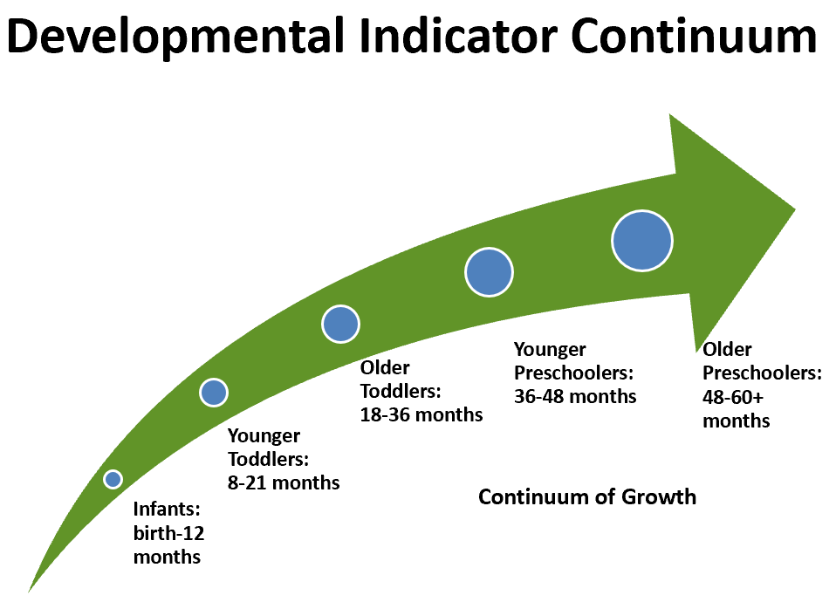

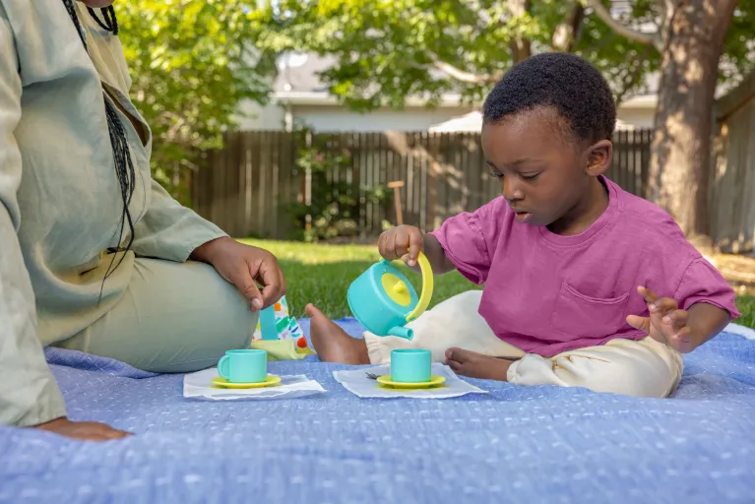



Developmental Progressions
Younger
Preschoolers:
36-48 months
Older
Preschoolers:
48-60
months
Older
Toddlers:
16-36 month
Younger
Toddlers:
8-18 months
Infants:
birth-9
months

Slide 5
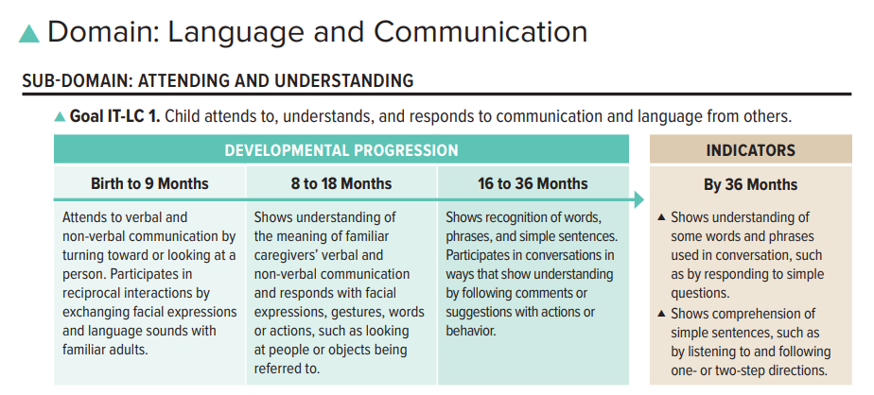

Early Learning Outcomes Framework
Head Start Early Learning Outcomes Framework: Ages Birth to Five

Slide 6
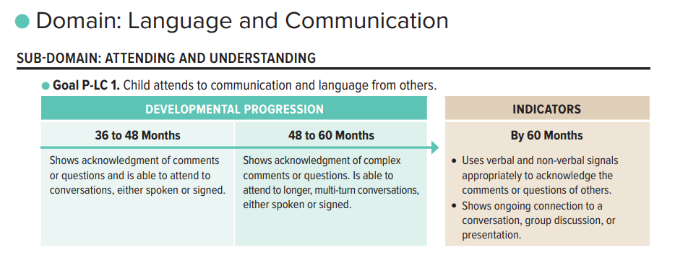
Early Learning Outcomes Framework: Preschool
Head Start Early Learning Outcomes Framework: Ages Birth to Five

Slide 7
A Process for Supporting All Early Learners

Slide 8
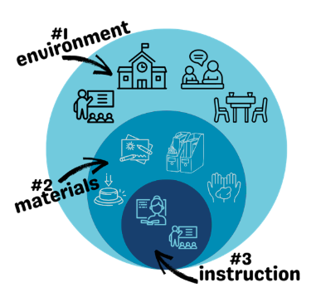
A Process of Support
Assess
Make a Plan and Implement
Monitor and Revise
What’s Happening?
for all and & for the individual
When?
activity or routine
What?
domain or skill
The Inclusion Framework
How’s it Going?
Do we need further adaptations?
Adapted from STEMIE Guide to Adaptations

Slide 9
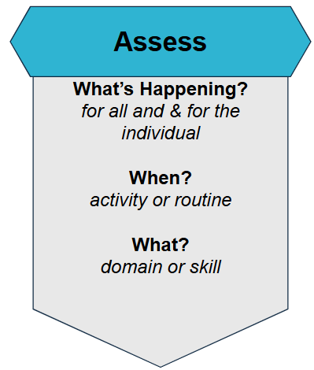
Assess: What’s happening?
It all starts with expectations!
At this specific time, or activity, what is it that I am expecting of all students?
What is happening with individual students?

Slide 10
Assess: When? and What?
When?
Which activity or routine does the mismatch in expectations most frequently occur?
What?
What domain or skill do we think is most impacting the student’s ability to engage and participate in the activity/routine of concern?

Slide 11

Meet Joshua

Slide 12
Small Group Math Activity
Small groups of students (3-4) will use a variety of materials to explore the concept of patterns. The teacher will:
explicitly teach the vocabulary of “pattern.”
present linear strings of tangrams (or other manipulatives) to teach students to identify which strings a pattern and which ones are not a pattern (A/B) .
support students to continue an A/B pattern by asking “What’s next?” and providing scaffolded support.
support students in creating their own A/B pattern using a variety of manipulatives.

Slide 13
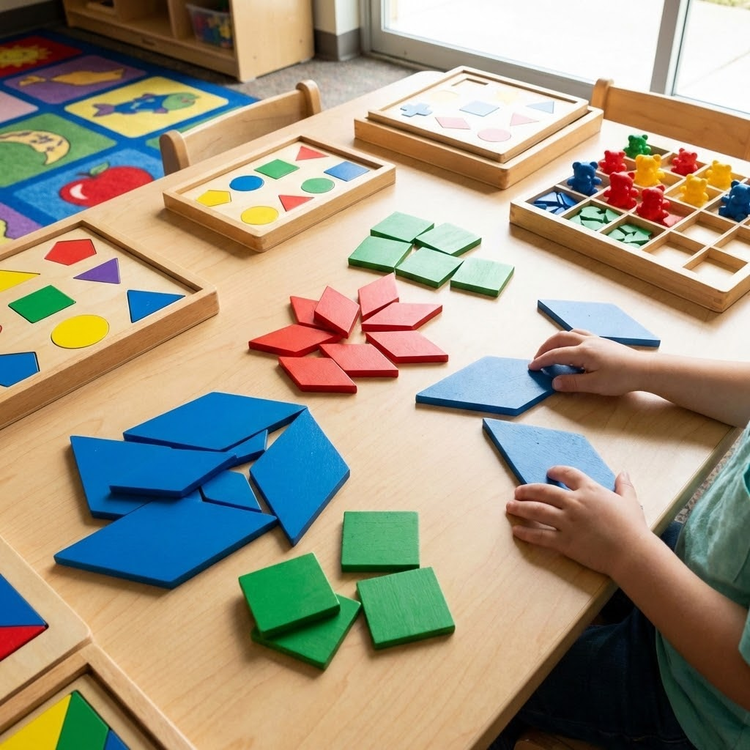
How Did Joshua Do?
He required 1:1 support to join his group at the table.
Joshua watched and listened as teacher demonstrated examples of patterns.
He correctly identified one example of a pattern in ten attempts, and successfully answered “what is next” questions in 10% of opportunities.
When students were asked to create their own patterns, Joshua hoarded a large portion of the tangrams and refused to give any to peers, yelling “mine!” Alternative materials were given to peers.
With those tangrams, Joshua began to independently sort into piles by shape and color (blue rhombus, red rhombus, green squares, etc.) but did not engage in patterning activities.

Slide 14
Assess In Action (part 1)
What’s happening?
What are my expectations for all students during this time?
participate in brief teacher directed activity, engaging by responding to questions, using manipulatives, share a set of materials and create their own patterns

Slide 15
Assess In Action (part 1) cont.
What is happening with this individual student?
unable to identify or continue simple patterns
not yet demonstrates understanding of patterning concepts
difficult transitioning and getting settled
grabbing and hoarding materials
can sort by two criteria-shape and color

Slide 16
Assess In Action (part 2)
When?
What activity or routine is most impacted?
What?
What domain or missing skill is most likely impacting the student’s participation?
transitions (using data from case study and routines)
teacher directed activities when Joshua is asked to share materials
social and communication: transitioning and sharing materials

Slide 17
Plan and Implement
Make a Plan and Implement
The Inclusion Framework

Slide 18
Plan and Implement:
The Inclusion Framework
Least Intrusive to Most Intrusive
Adapted from STEMIE Guide to Adaptations

Slide 19
Inclusion Framework: Environment

Slide 20
Differentiating Using the
Inclusion Framework: Environment
Arrangement
Location
Schedule
Routines
Picture Cues
Adapted from STEMIE Guide to Adaptations

Slide 21
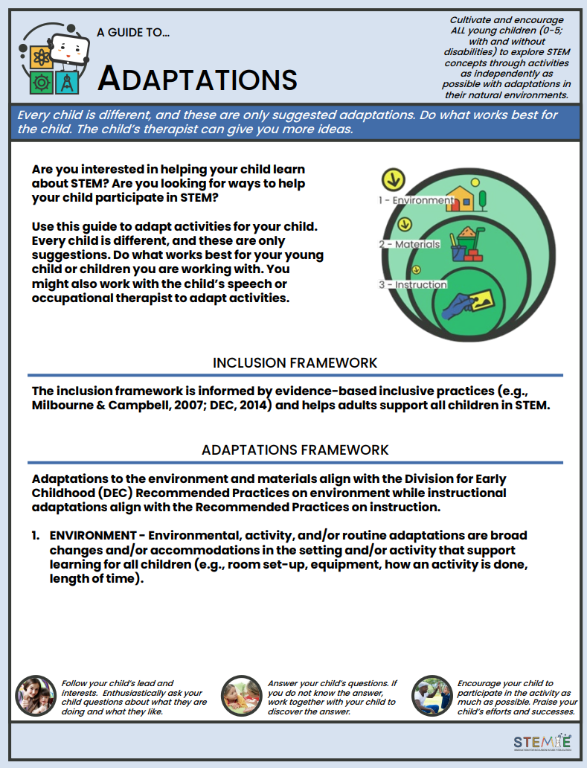


Guide to Adaptations
https://go.ncdpi.gov/568ak

Slide 22
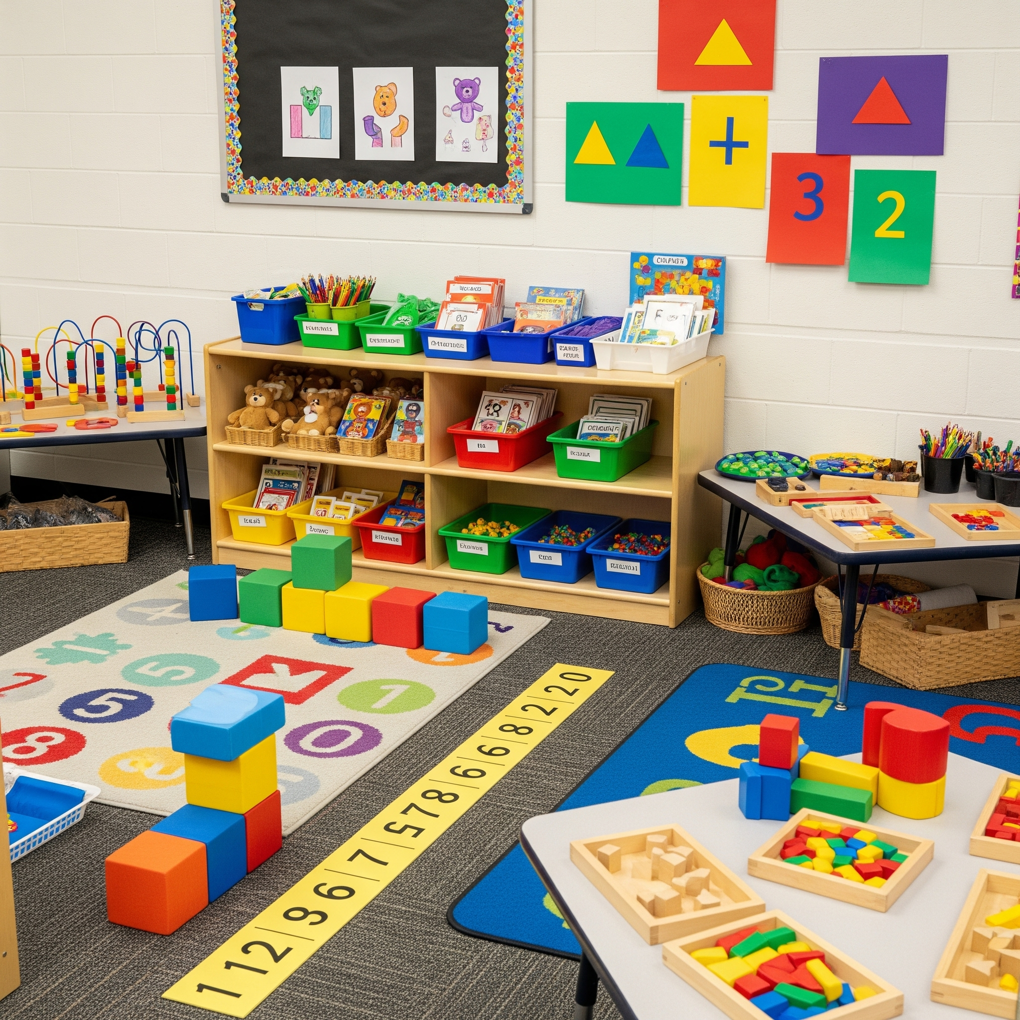

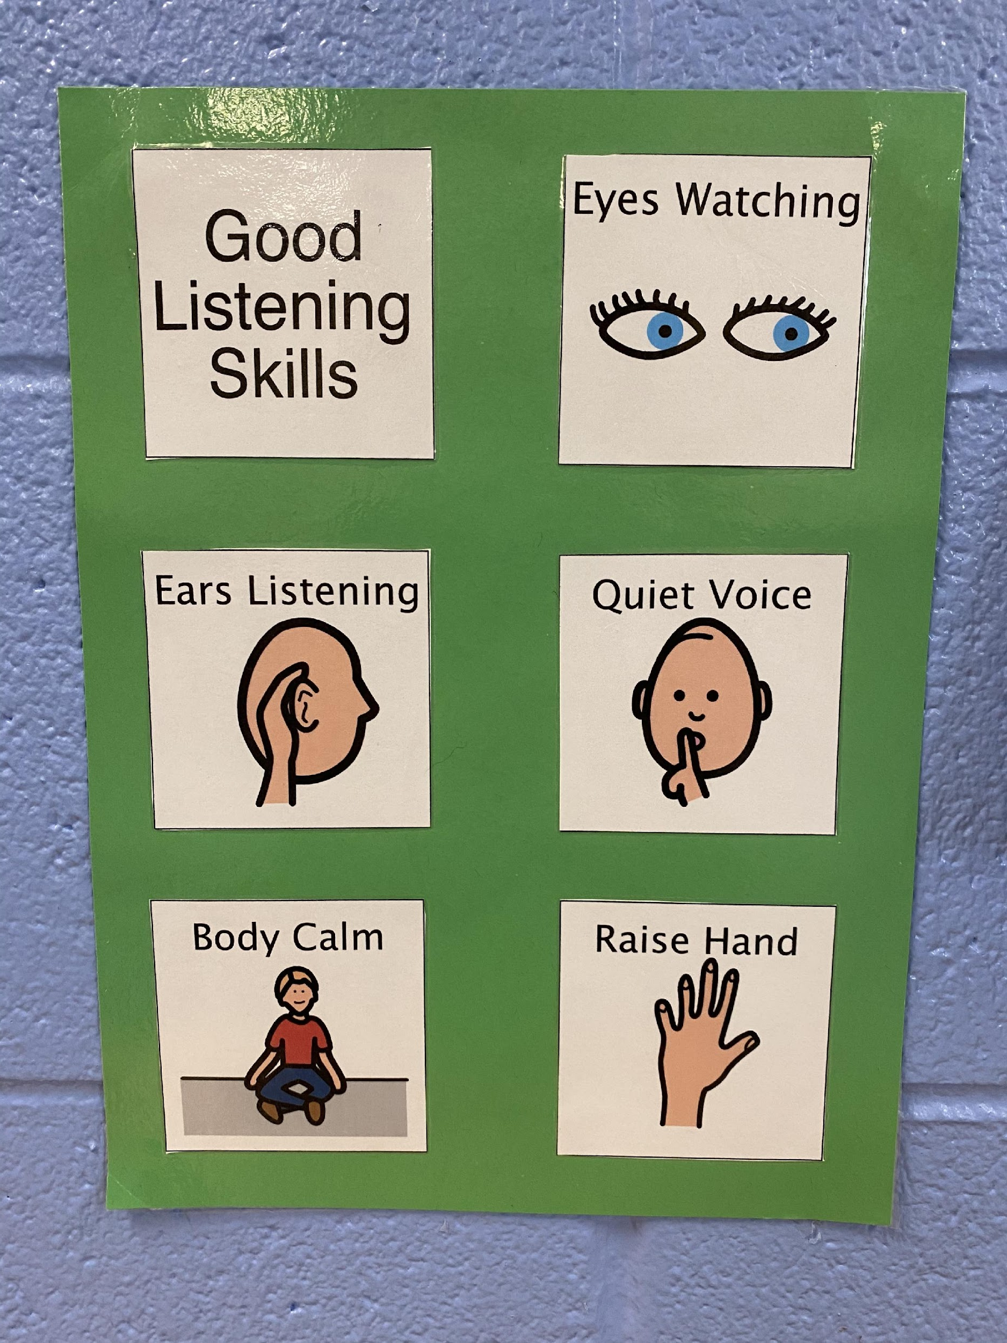
Environmental Adaptations: Physical
Location, Arrangement, & Visual Supports
Area and Space
Within Reach
Picture Cues
From STEMIE

Slide 23
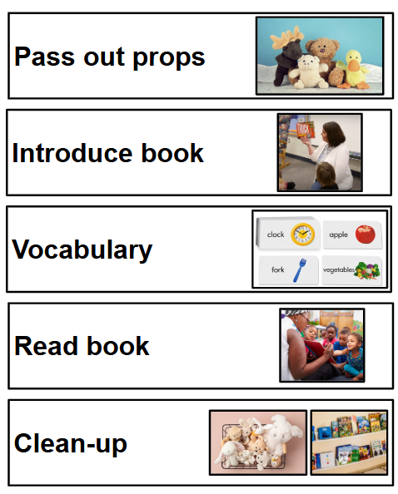
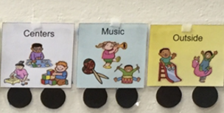
Environmental Adaptations: Temporal
Schedules & Routines
Schedule
Routines
(Sandall & Schwartz, 2008)

Slide 24
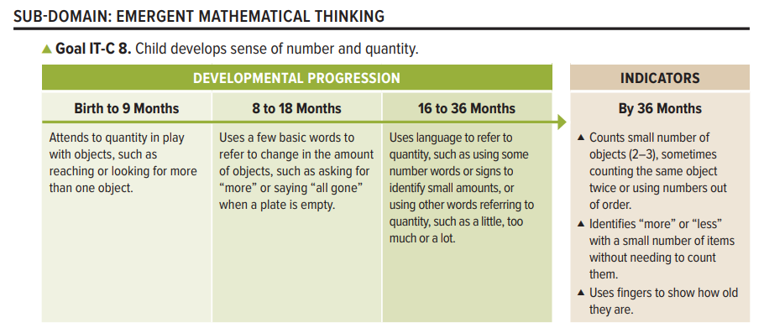
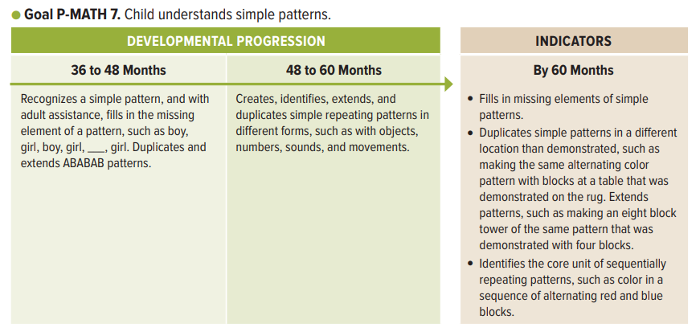
Emergent Math Skills

Slide 25
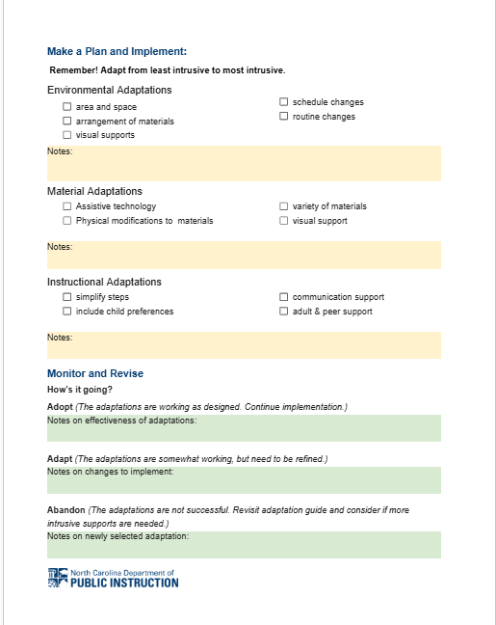
Environmental Adaptations: Small Groups
Environmental Adaptations
physical area and space
arrangement of materials
visual supports
change in schedule
change in routine

Slide 26
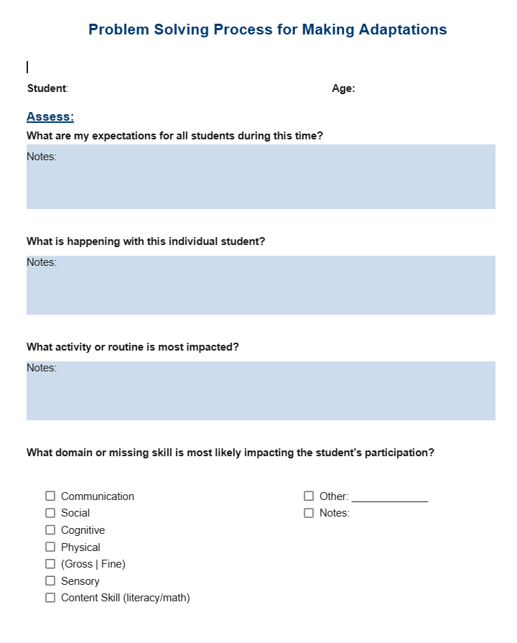
Environmental Adaptations: Instructional Small Groups

Slide 27



Environmental Adaptations Examples
(1 of 2)
highlighting materials
defined space for activities
flexible seating

Slide 28
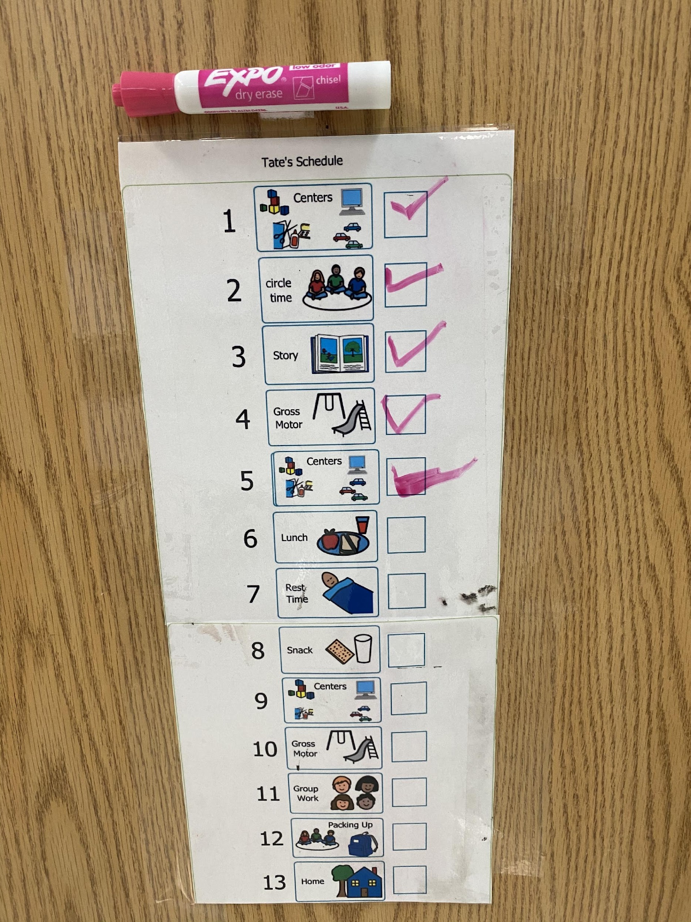
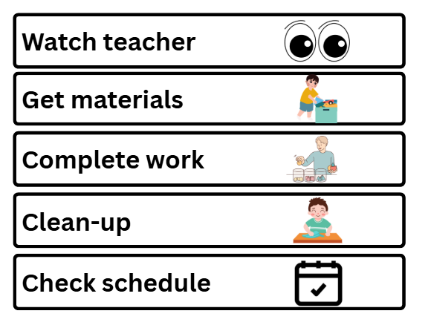
Environmental Adaptations Examples
(2 of 2)
visually supported individual schedule
visual routine for activity period

Slide 29
Using The Inclusive Framework: Materials
Assistive Technology
Physical Modifications
Variety of Materials
Visual Supports
Adapted from STEMIE Guide to Adaptations

Slide 30

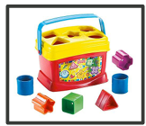
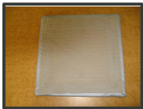
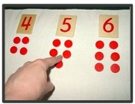
Material Adaptations
Assistive Technology
Physical Modifications
Variety of Materials
Visual Supports

Slide 31
Emergent Math Skills
Revisited

Slide 32
Material Adaptations: Small Groups
Material Adaptations
assistive technology
physical modifications to materials
variety of materials
visual supports

Slide 33
Material Adaptations: Instructional Small Groups

Slide 34



Materials Adaptations Examples
variety of materials
visual supports

Slide 35
Differentiating Using The Inclusive Framework: Instruction
Simplify Steps
Child Preference
Communication Support
Adult and Peer Support
Adapted from STEMIE Guide to Adaptations

Slide 36




Instructional Adaptations
Simplify Steps
Child Preference
Communication Support
Adult/Peer Support
Image credit: ASL in ECE

Slide 37
Instruction Application Activity

Slide 38



Instructional Adaptation Examples
child preference- favorite materials
___ ___ ___
peer support & peer mediated strategies
simplify steps

Slide 39
What Is “Explicit” Instruction?
Explicit instruction is:
engaging students in learning,
providing a clear model or demonstration,
being clear about content (unambiguous), and
scaffolding content with supports for success and fading supports over time.
Think of explicit instruction as “I do. We do. You do.”

Slide 40

Visualizing Explicit Instruction
Photo Credit: NC DPI OEL

Slide 41
Key Takeaways:
The Inclusion Framework
Adapted from STEMIE Guide to Adaptations

Slide 42
Monitor and Revise
Monitor and Revise
How’s it Going?
Do we need further adaptations?

Slide 43
How Is It Going?
adopt
adapt
abandon
The change was successful and should be implemented more broadly.
A part of the adaptation was successful and other parts need to be modified due to shortcomings.
The change was unsuccessful and should be discontinued.
PDSA Cycles: Implementation and Improvement

Slide 44
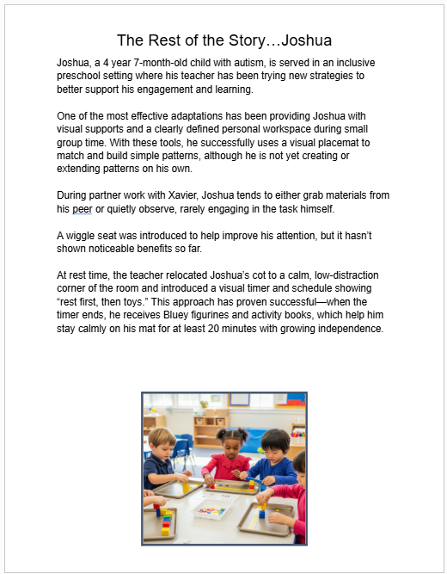
The Rest of the Story…Joshua

Slide 45
Application Activity
Read “The Rest of the Story…Joshua”
Determine which adaptations you would adopt, adapt, or abandon.
Are there further adaptations that need to be made? If so, describe.
Make notes on your problem solving guide.

Slide 46

Reflections and Questions

Slide 47
References
CAST (2024). Universal Design for Learning Guidelines version 3.0. Retrieved
from https://udlguidelines.cast.org
Division for Early Childhood. (2014). DEC recommended practices in early
intervention/early childhood special education 2014. http://www.dec-sped.org/dec-recommended-practices
Kennedy, S., & Jackson, K. R. (2022). PDSA cycles: Improvement and
implementation. National Implementation Research Network. https://nirn.fpg.unc.edu/blog/pdsa-cycles-improvement-and-implementation/
North Carolina Foundations Task Force, (2013). North Carolina foundations for
early learning and development. Raleigh: Author.

Slide 48
References Continued
Sandall, S. R., & Schwartz, I. S. (2008). Building blocks for teaching preschoolers
with special needs (2nd ed.). Paul H. Brookes Publishing Company.
Waters, V., West, T., Lim, C.-I., & Vinh, M. (2021). A guide to adaptations (STEM
Innovation for Inclusion in Early Education Center). University of North Carolina at Chapel Hill. https://stemie.fpg.unc.edu/guide-adaptations

