Slide 1

Pediatrics and Child Welfare: Partnering to Support Families Experiencing Heightened Adversities
Darneshia Allen
Training/Technical Assistance Integration Manager, Safe Babies
Natalie Tackitt
HealthySteps Coordinator

Slide 2


Our mission is to ensure that all babies and toddlers have a strong start in life.

Slide 3
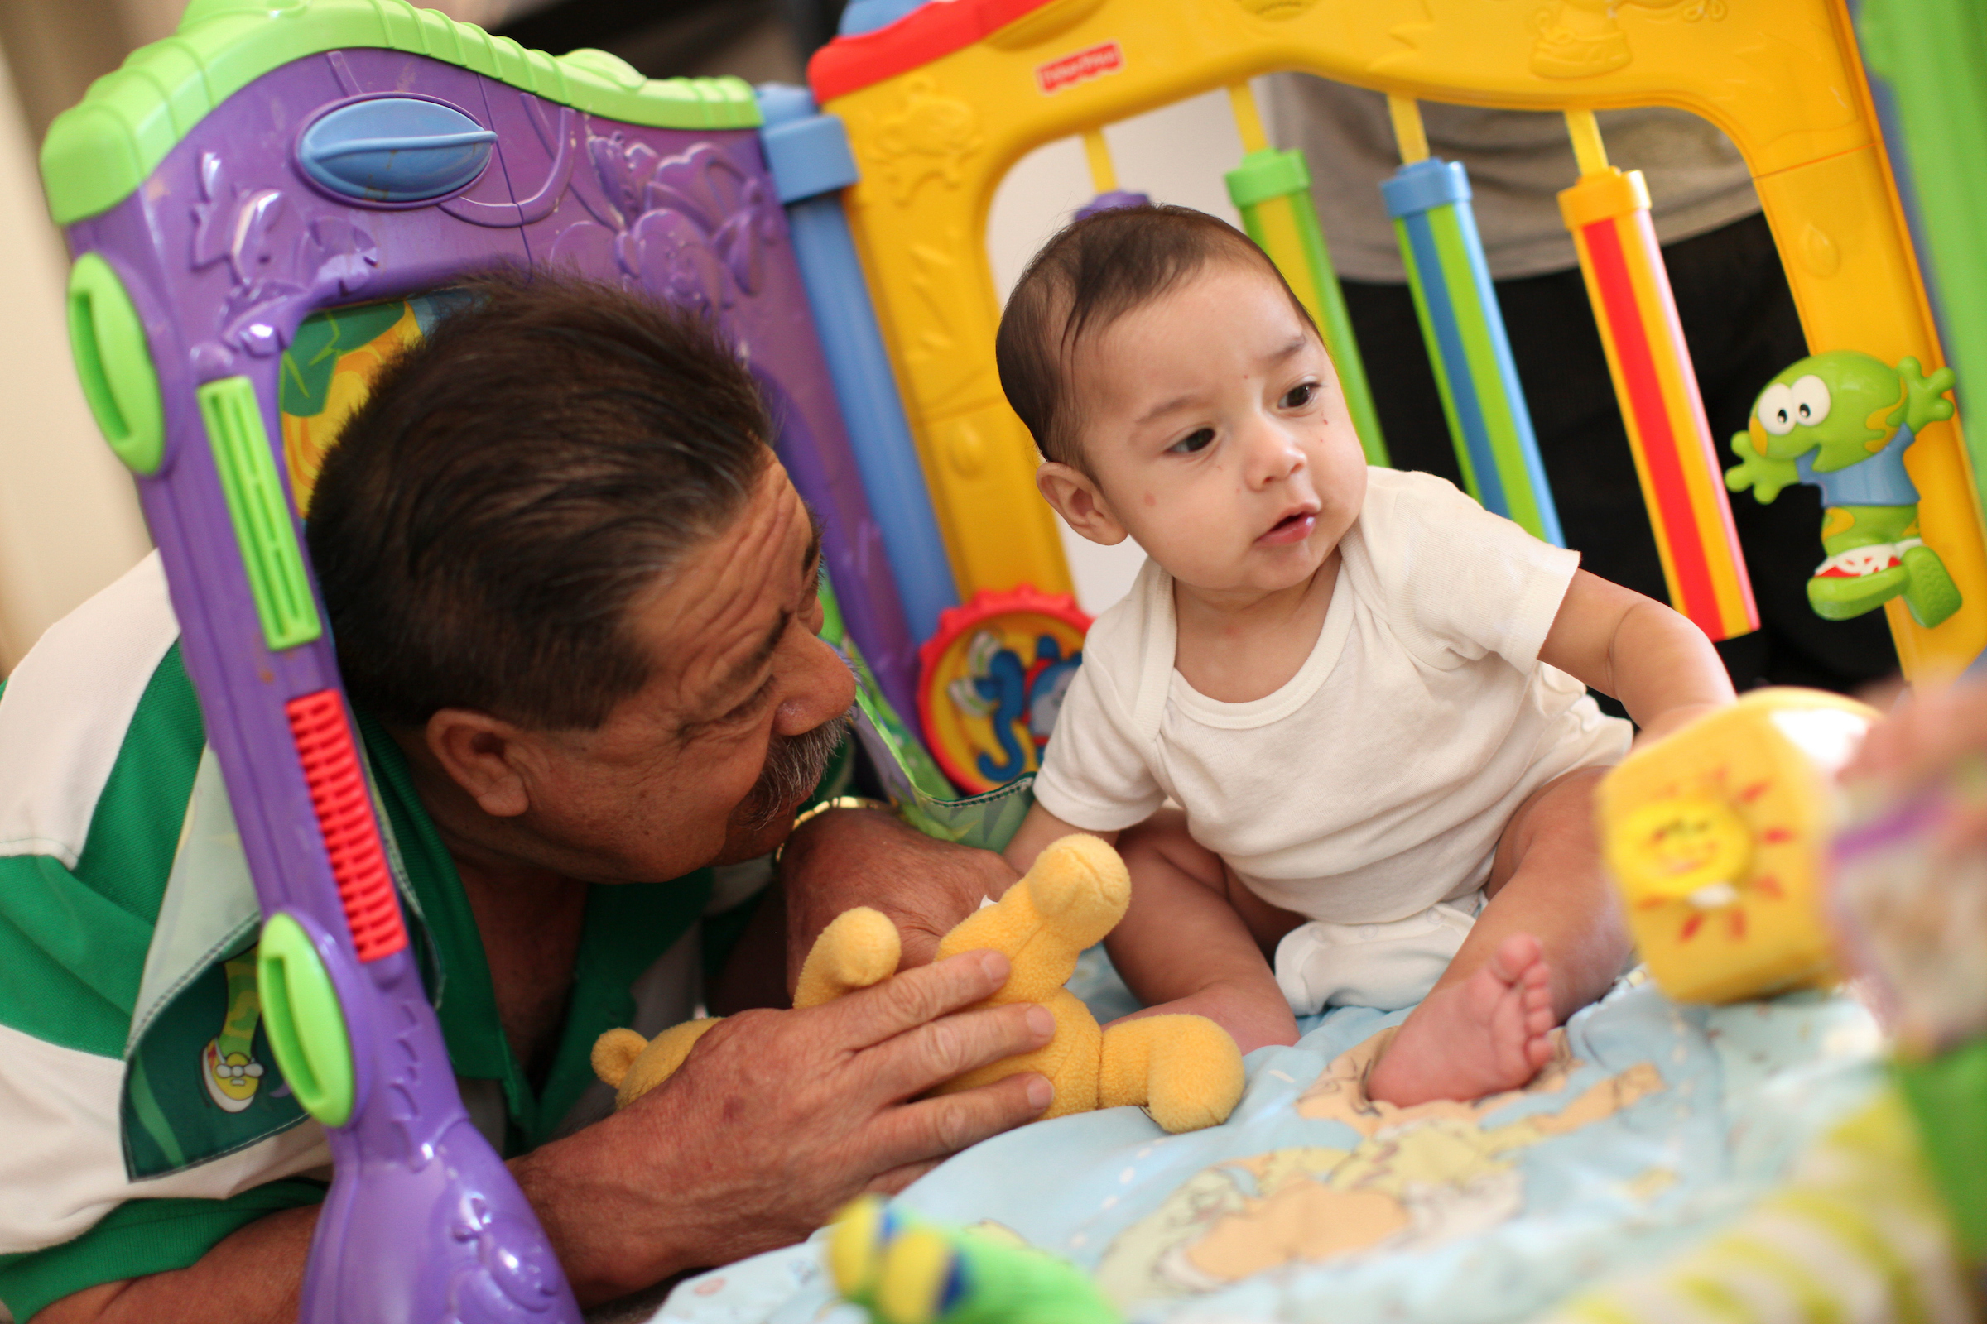

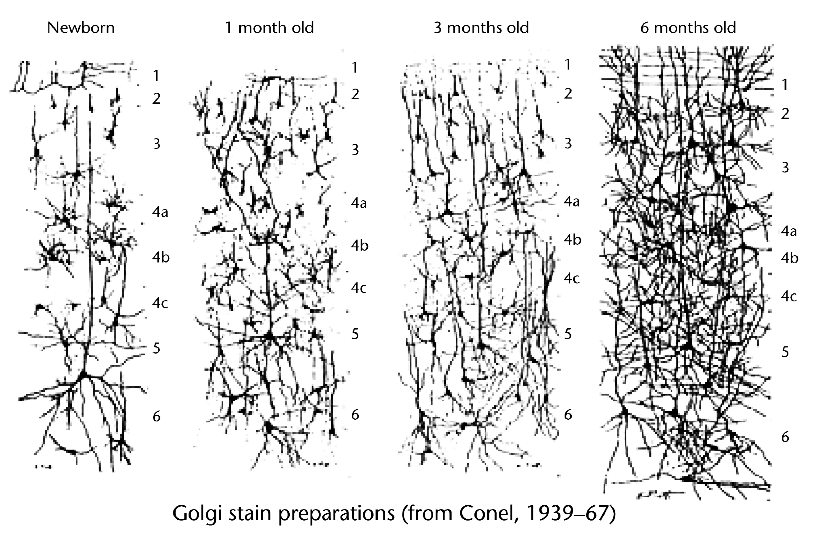
In a child’s early years, every second counts—
1 million new connections are made every second!
Newborn
1 Month
3 Months
6 Months

Slide 4
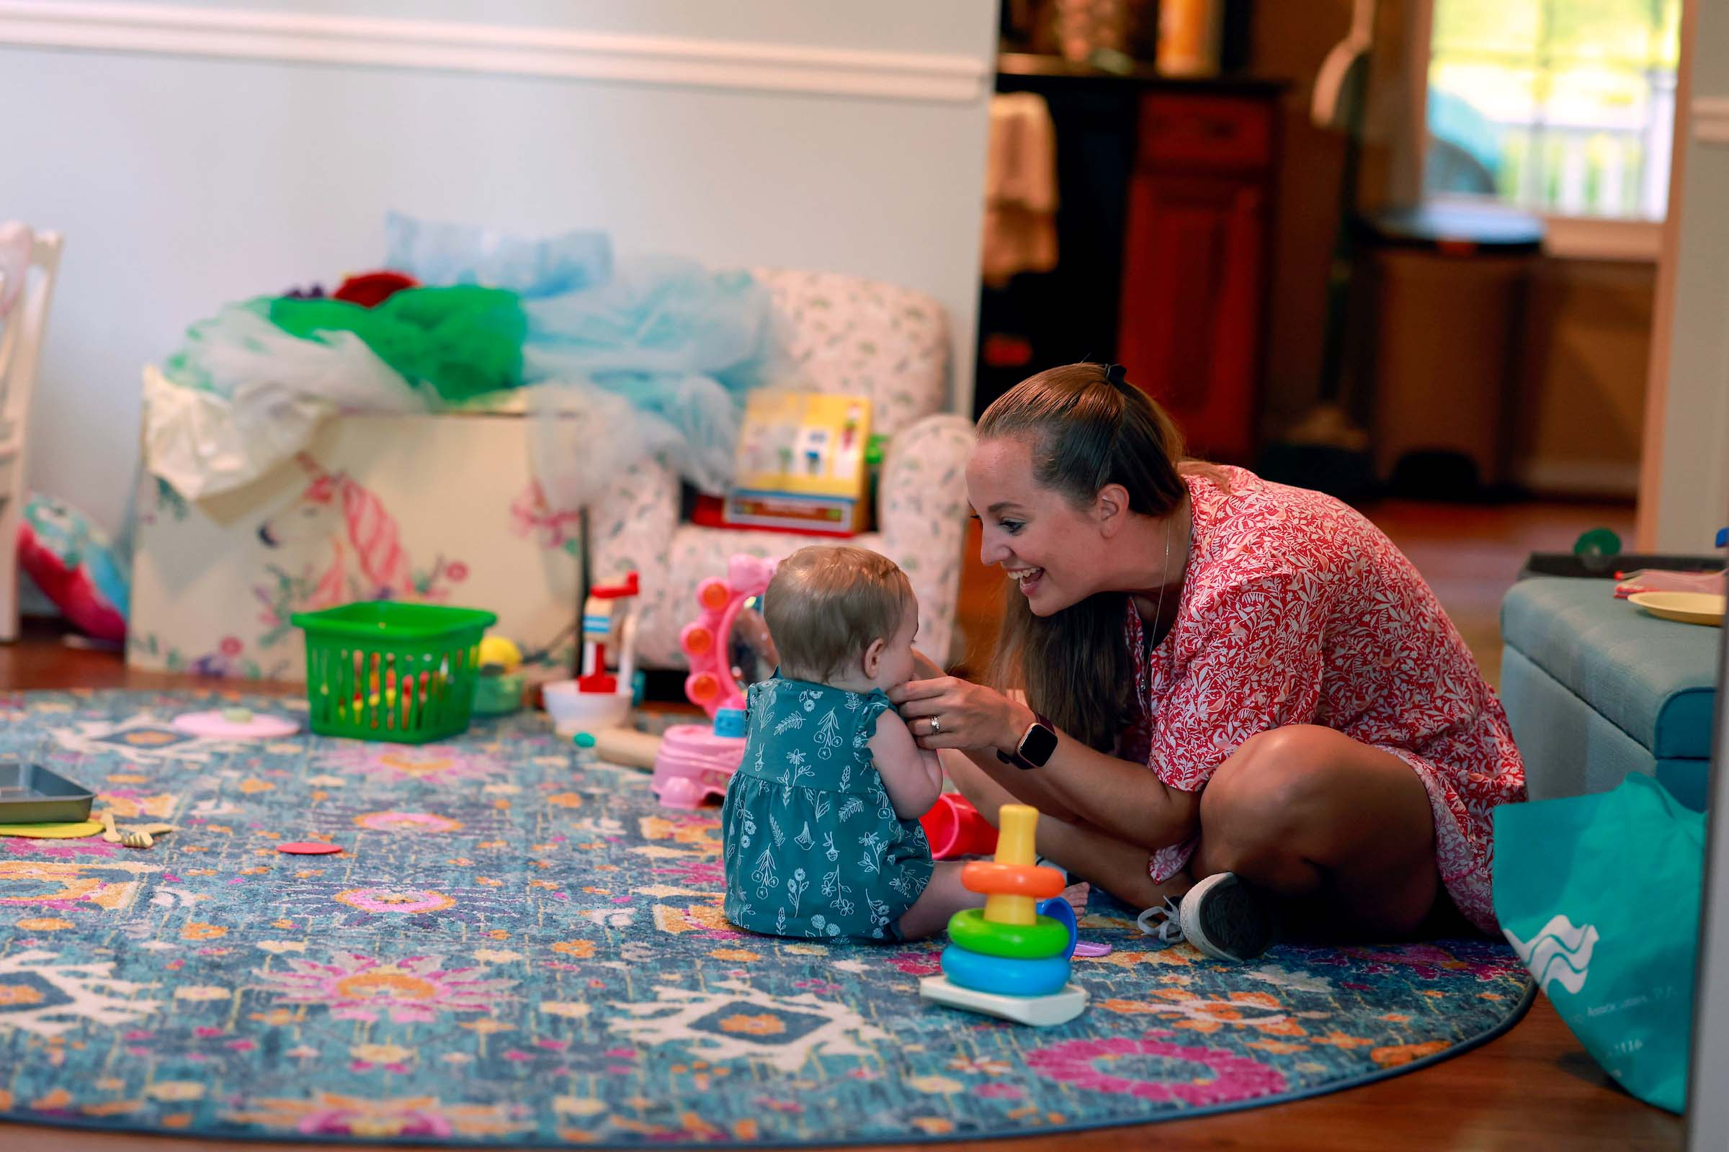
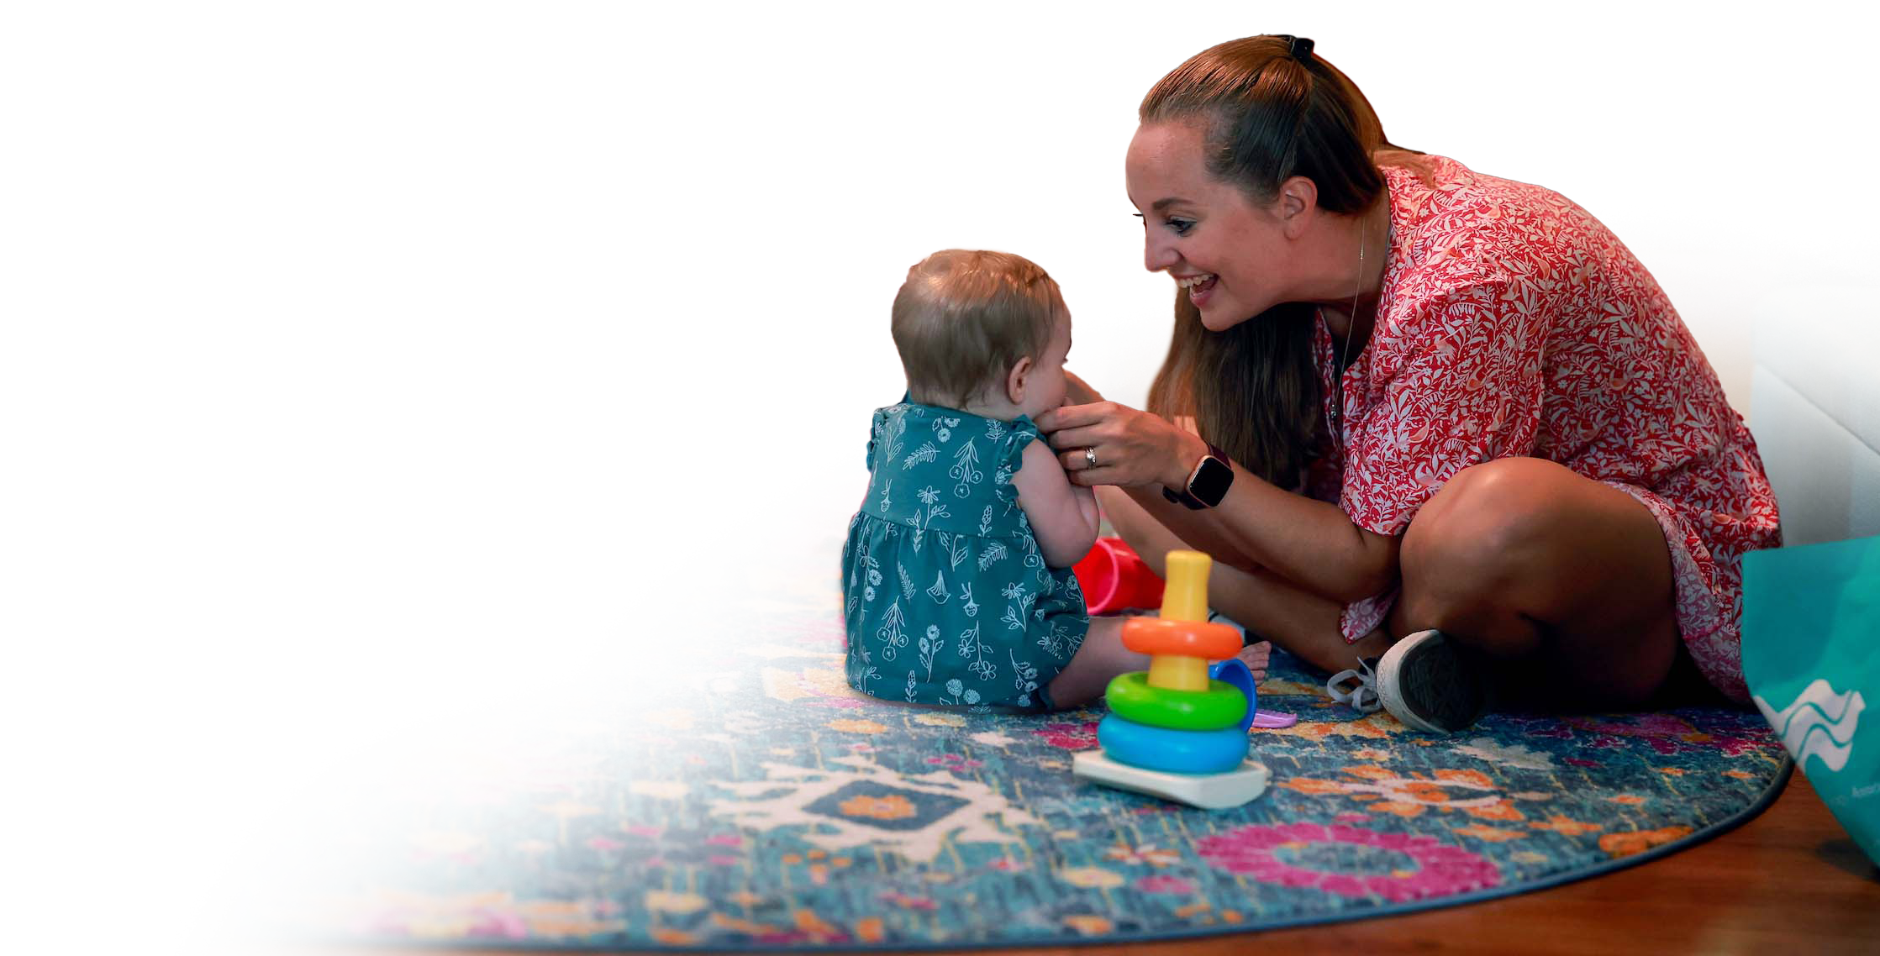
During these first
three formative years, emotionally nourishing relationships lay the foundation for lifelong health and well-being.
Years 0-3 are critical for development.

Slide 5










Driving change
for children and their families, shaping a brighter future for all.

Slide 6
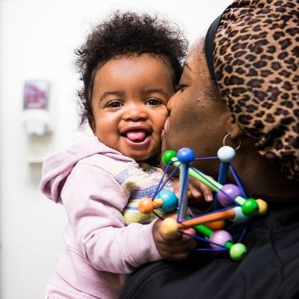
An evidence-based, interdisciplinary pediatric primary care program that promotes nurturing parenting and healthy development for babies and toddlers, particularly in areas where there have been persistent inequities for families of color or with low incomes.
What is
HealthySteps?
HealthySteps Specialists are integrated into the pediatric team to provide short-term behavior/development consultation and referrals, intensive services when needed, and support practice screening efforts.
6

Slide 7
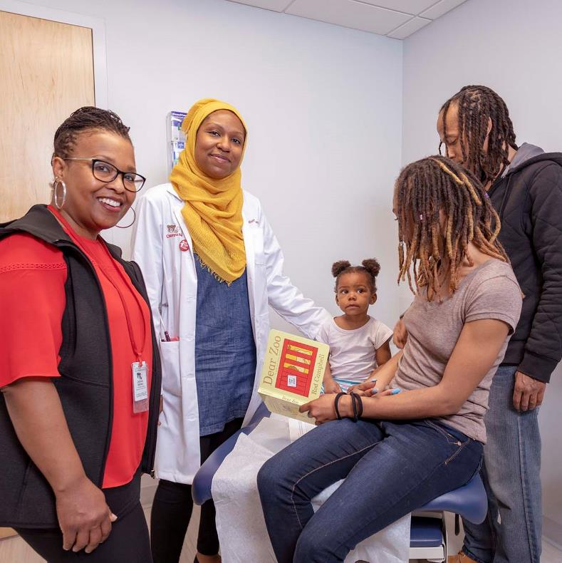

Pediatric Setting
Almost all families take their babies to see a pediatric primary care provider
ACCESS
TRUST
Parents trust their pediatric primary care provider
ACCEPTED
The pediatric office is a non-stigmatizing setting
FREQUENT
New parents attend 12-13 well-child visits within the first 3 years of life; half occur in the first year
7

Slide 8
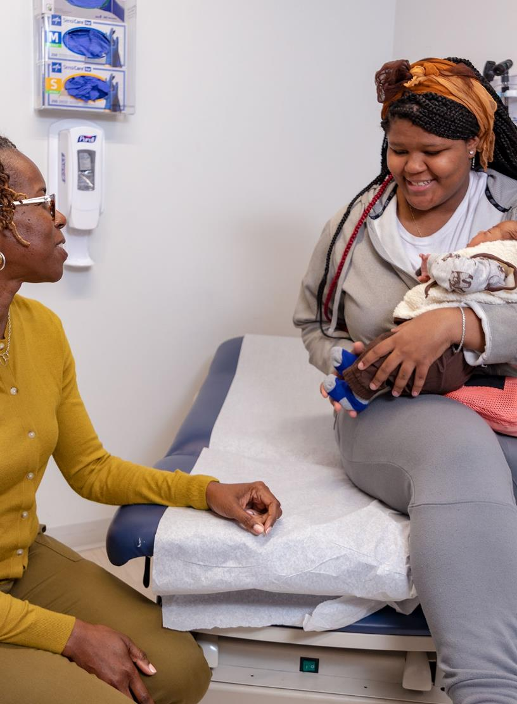
1. Child Developmental, Social-Emotional, & Behavioral Screenings
5. Care Coordination & Systems Navigation
2. Screenings
for Family Needs
e.g., PPD, other risk factors, SDOH
6. Positive Parenting Guidance & Information
Core Components
3. Family Support Line
e.g., phone, text, email,
online portal
7. Early Learning Resources
4. Child Development & Behavior Consults
8. Ongoing, Preventive Team-Based
Well-Child Visits
8
Copyright © 2019 HealthySteps. All rights reserved.
8

Slide 9
Tiers of Service Delivery
1. Child developmental, social-emotional & behavioral screenings
TIER 1
2. Screening for family needs
-MATERNAL DEPRESSION
-OTHER RISK FACTORS
-SOCIAL DETERMINANTS OF HEALTH
UNIVERSAL SERVICES
3. Family support line
-PHONE, TEXT, EMAIL, ONLINE PORTAL
TIER 2
All Tier 1 services, plus…
4. Child development & behavior consults
5. Care coordination & systems navigation
6. Positive parenting guidance & information
7. Early learning resources
SHORT-TERM SUPPORT
SPECIFIC, TIME-LIMITED CONCERNS
TIER 3
All Tier 1 & 2 services, plus…
8. Ongoing, preventive team-based well-child visits
COMPREHENSIVE SERVICES
FAMILIES MOST AT RISK
9

Slide 10
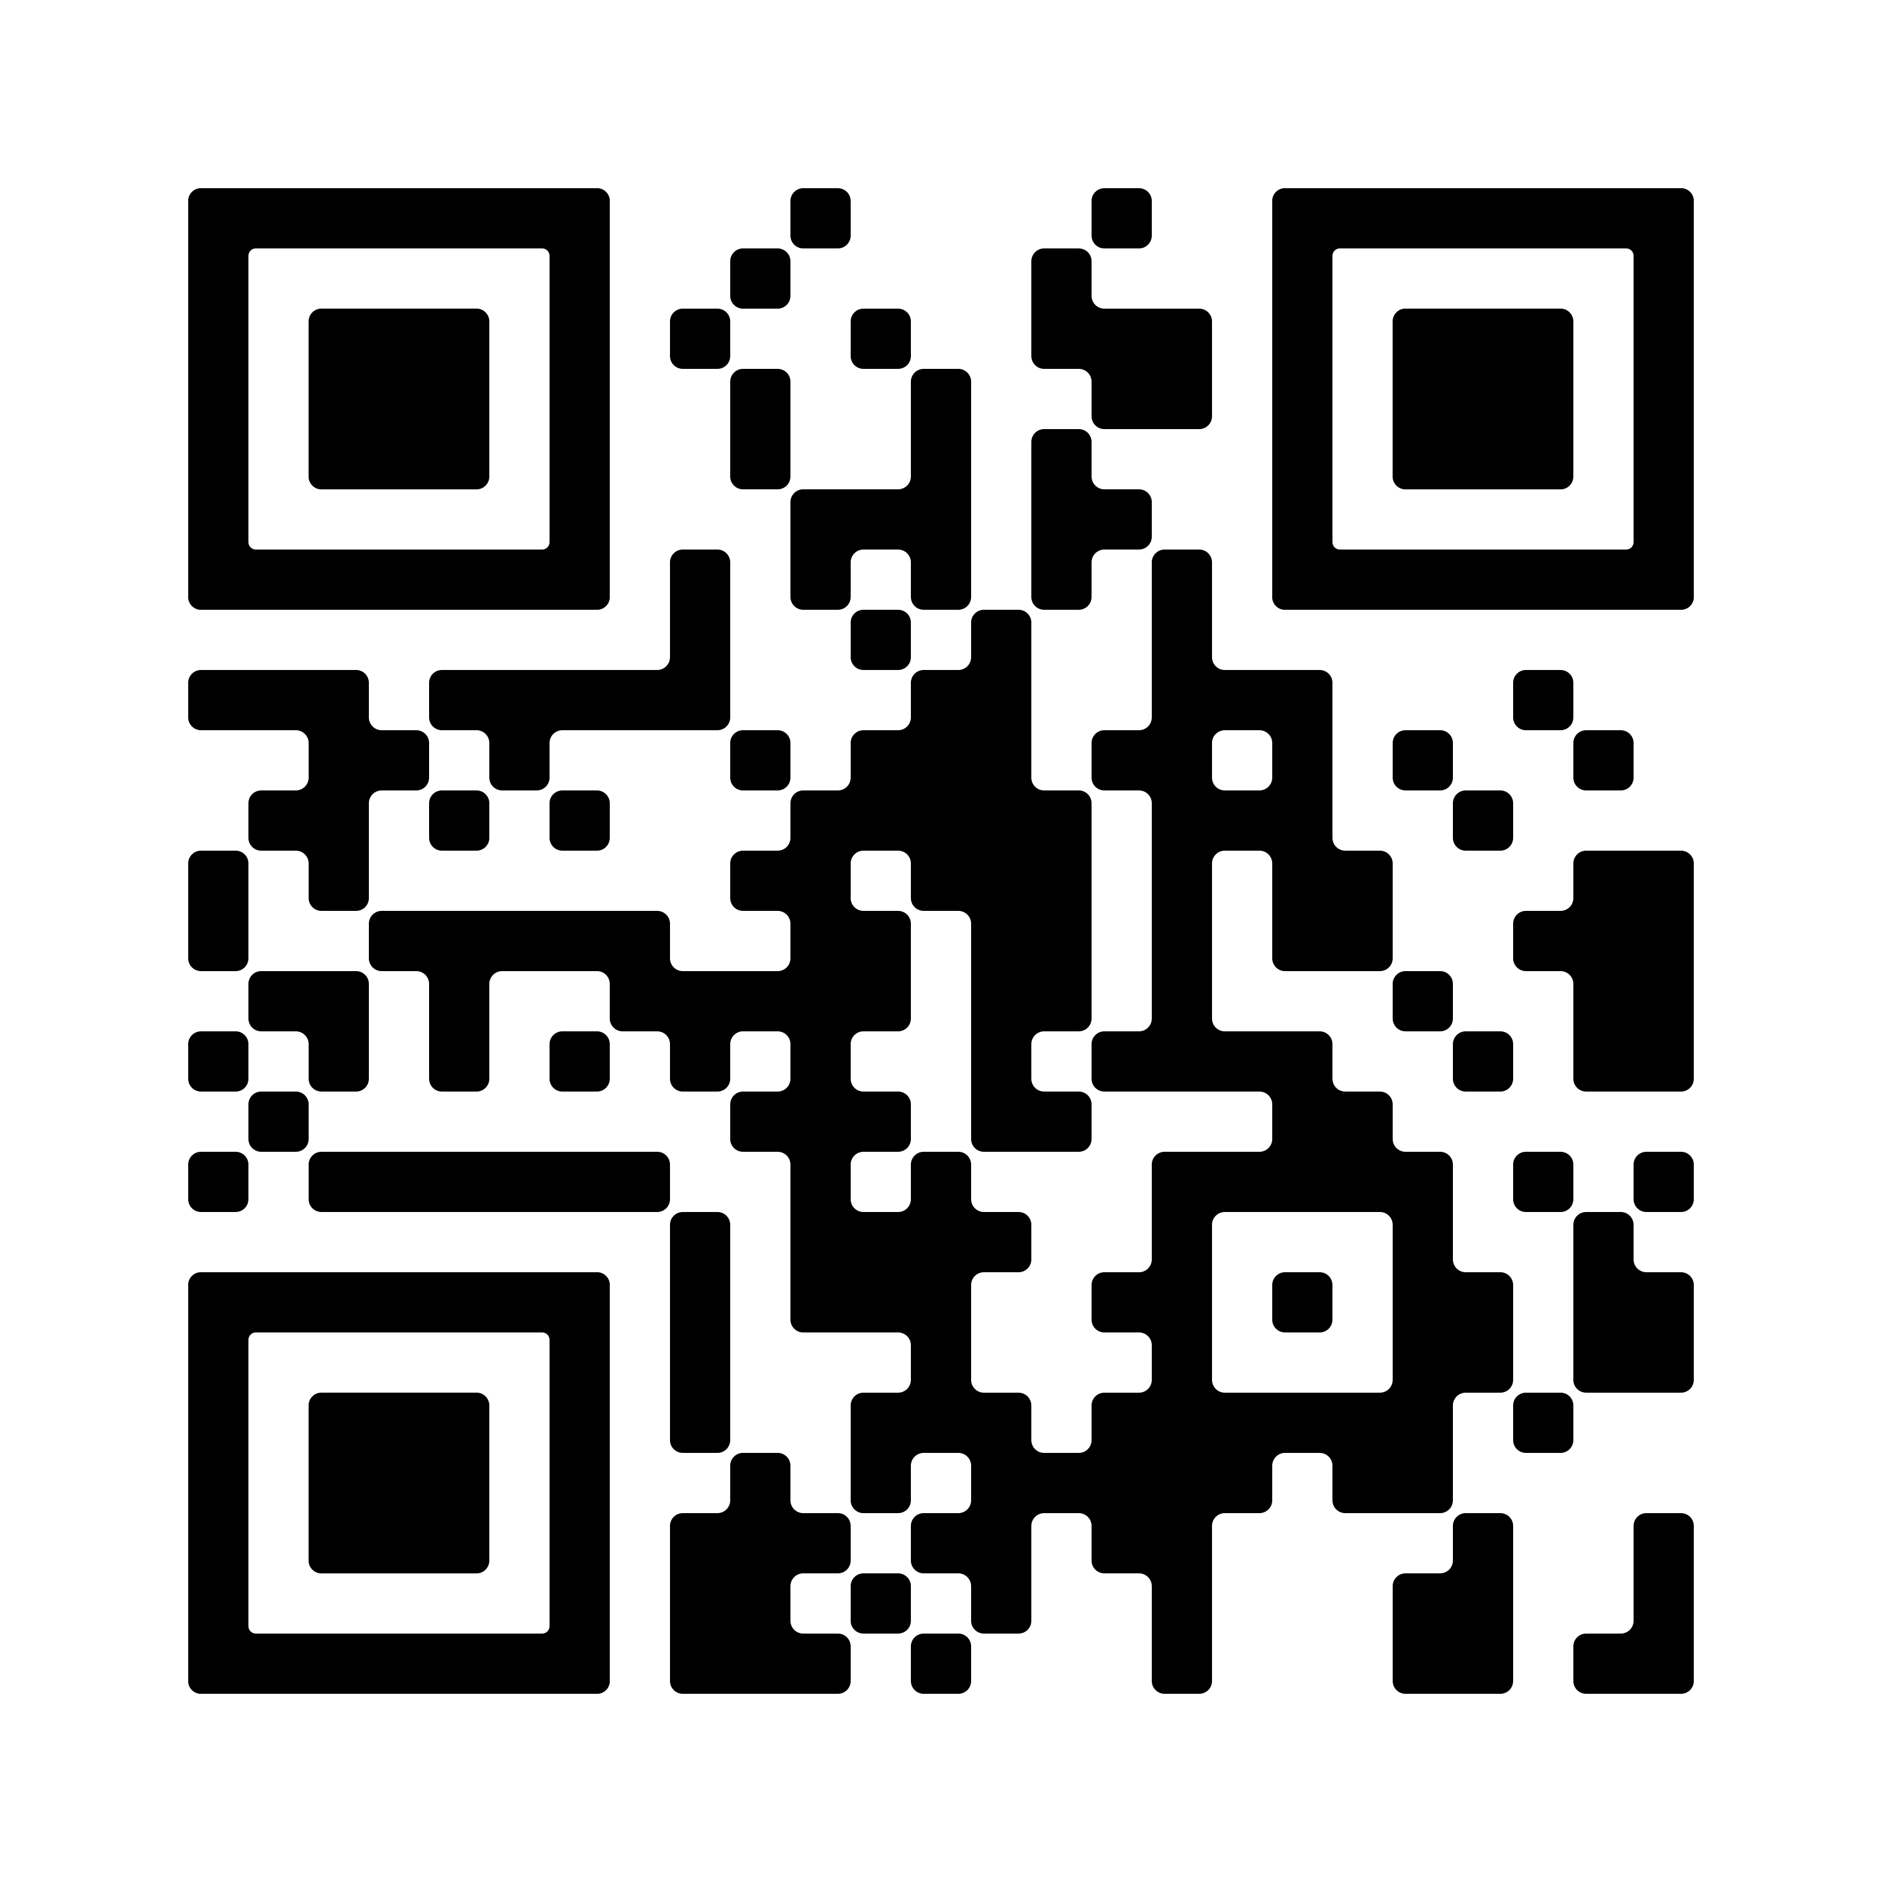
HealthySteps Advances Health Equity
Ensures more frequent screenings, opportunities for prevention, and supports treatment for maternal depression.
Provides age-appropriate nutritional guidance
Strengthens early social-emotional development
Connects families to early intervention services
Helps mothers find success with breastfeeding
Increases attendance at Well Child Visits (WCV)
10

Slide 11
Screening and Connection to Services
Addressing Child Needs
Early identification of child and family needs
Improved connection to services
HS children were 8x more likely to receive a developmental assessment and had significantly higher rates of developmental and other nonmedical referrals.^{4,5,6}
A network of three HS sites (two with dedicated community health workers) found nearly 90% of families were successfully connected with needed community services⁷
One HS site with a dedicated family services coordinator quadrupled its early intervention (EI) successful referral rate after implementing HS⁸
Among HS children with Medicaid, receipt of any developmental screening was 1.4x higher for HS children; screening rates for Hispanic and Black HS children were 1.6 – 1.7x higher than their counterparts.³
Among children with Medicaid, HS children had higher rates EI service receipt (14% vs. 9%) which also held true for Hispanic HS children compared with their counterparts (17% vs. 11%).³
Addressing FAMILY Needs
HS mothers had significantly higher rates of maternal depression referrals and were 4x more likely to receive information on community resources.⁴
HS mothers with Medicaid had higher rates of receipt of family planning services and postpartum care.³
Emerging evidence includes research that has not yet been published in a peer-reviewed journal or presented at an academic/scientific conference.

Slide 12
Screening and Connection
to Services
Practice and Provider Impacts
Timely/ Continued Care and Vaccinations
Maternal Depression
HealthySteps Outcomes
Breastfeeding
and Age-Appropriate Early Nutrition
Social-Emotional Development
Child Safety and Risk Factors for Child Abuse and Neglect
Early Literacy and School Readiness
12

Slide 13
A Closer Look at Safe Babies

Slide 14
The Safe Babies approach is driven by a vision of prevention, where systems work together to strengthen the family, and prioritize the need to protect and build safe, stable and nurturing early relationships at the center of all decision-making.

Slide 15

Our Focus in Safe Babies
Safe Babies works upstream on crucial promotion and prevention efforts within communities.
Safe Babies partners with communities and states to keep families together to minimize the need for babies and toddlers to enter out-of-home care.
Safe Babies partners with communities and states to strengthen the services and supports families need so they can experience healing and less involvement with courts and the child welfare system.
Parents with lived experience inform all levels of Safe Babies as Parent Leaders. Parent Leaders are integral members of the team, creating systems change through their engagement and leadership.

Slide 16
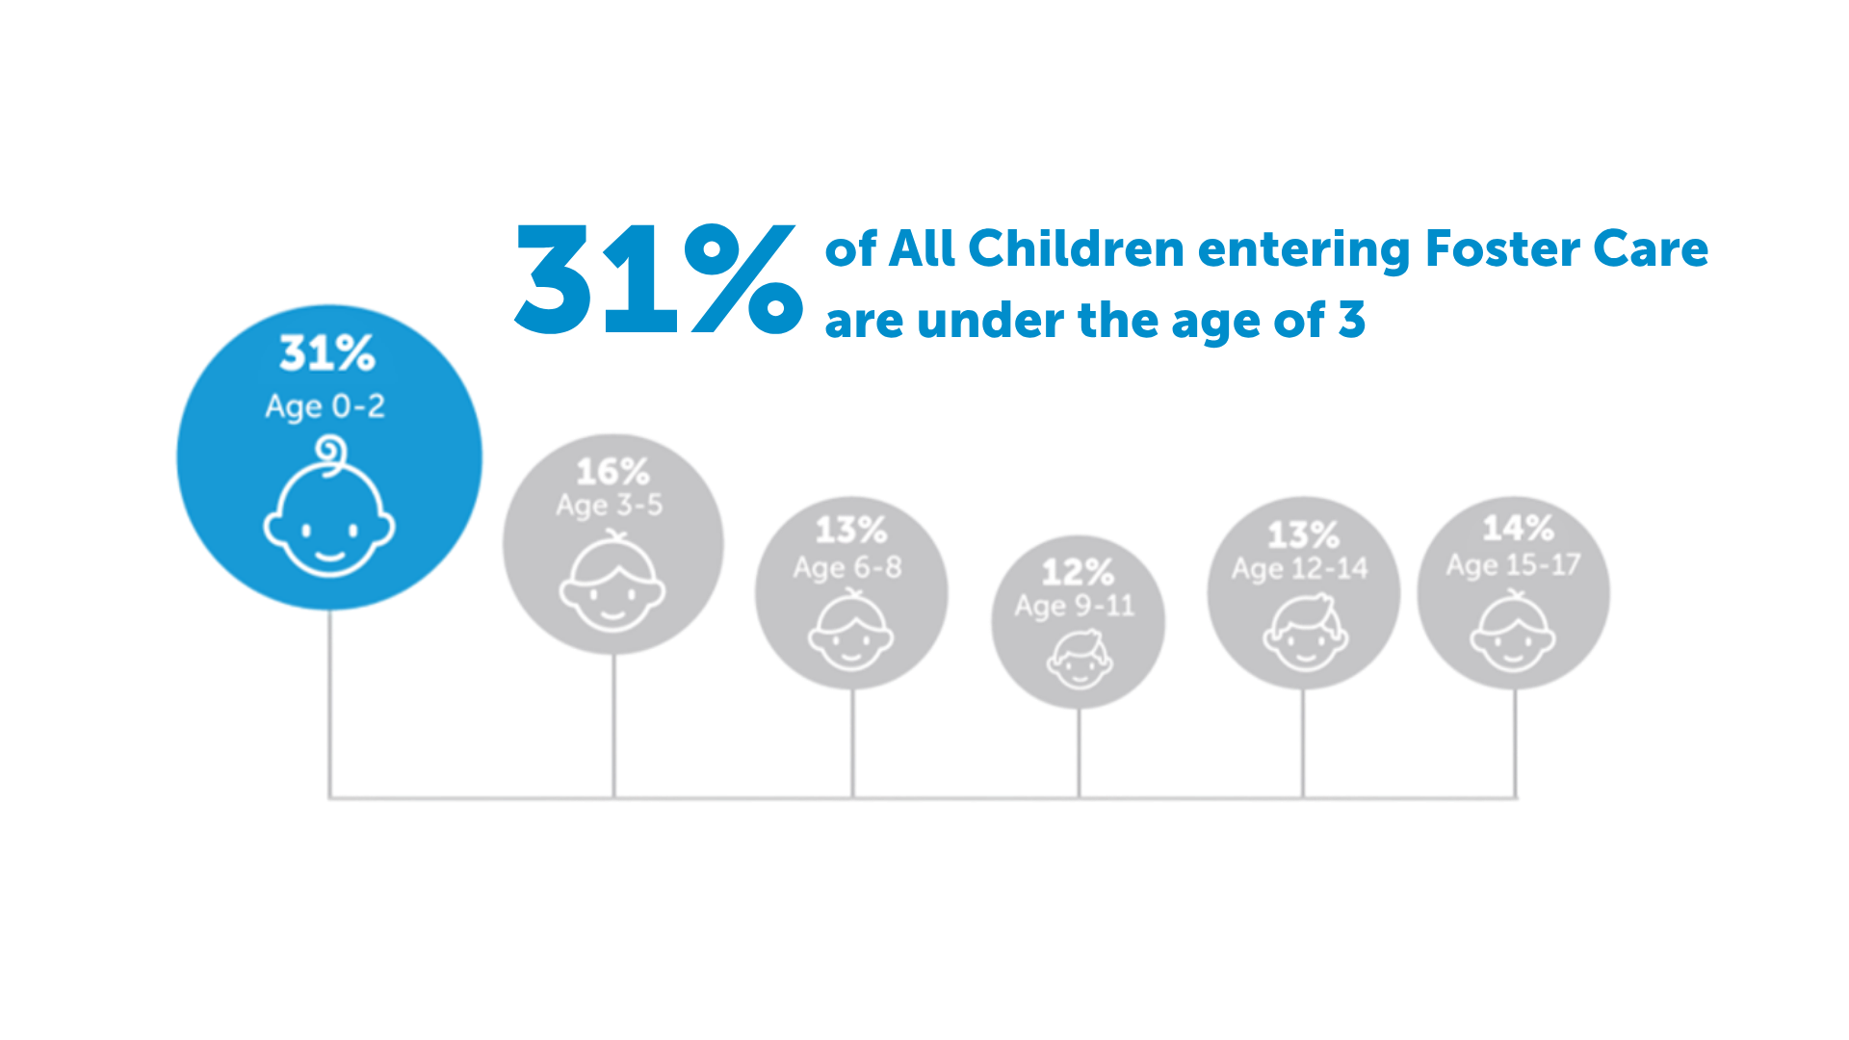
Children Entering Foster Care
Source: AFCARS Dashboard

Slide 17
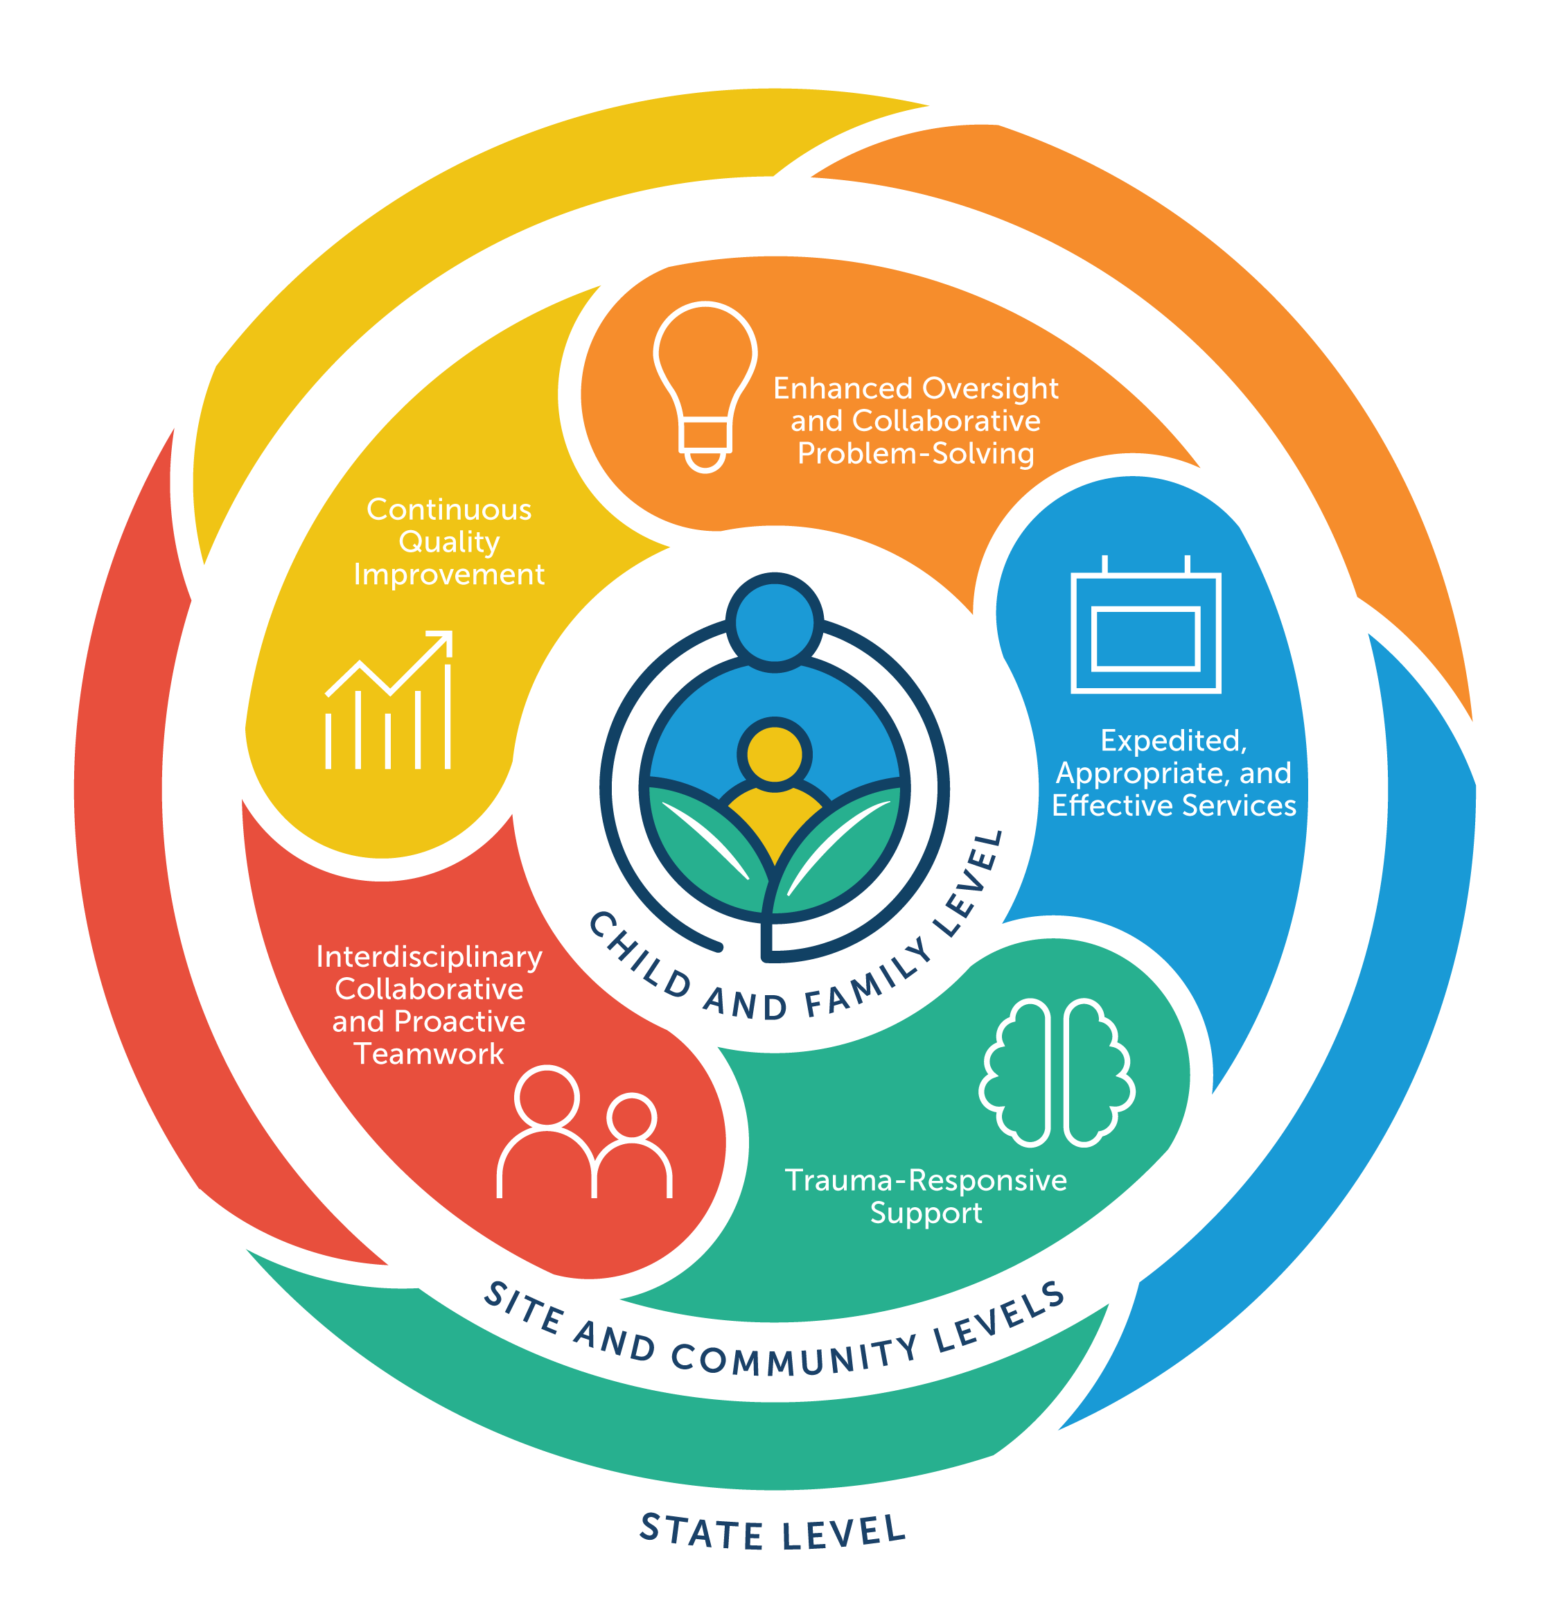
The Safe Babies Approach
Areas of Focus:
Rooted in IECMH
Safe Babies, a program of ZERO TO THREE, uses an innovative, team-based approach to apply developmental science and infant-early childhood mental health (IECMH) principles to meet the urgent needs of babies and toddlers under court jurisdiction. The centering of the baby’s emotional and developmental needs transforms child welfare into a system that strengthens child and family well-being

Slide 18





The Safe Babies Approach – Core Components
Judicial, Child Welfare and Attorney Leadership
Community Coordinator
Active Community Team
Family Team Meetings
Parent Leadership
Connecting Infants, Toddlers and their Families to a Continuum of Wraparound Servies
7. Partnering with Families
8. Nurturing Parent Relationships and Building Social Supports
in the Community
9. Frequent, Quality Family Time
10. Concurrent Planning
11. Continuous Quality Improvement

Slide 19
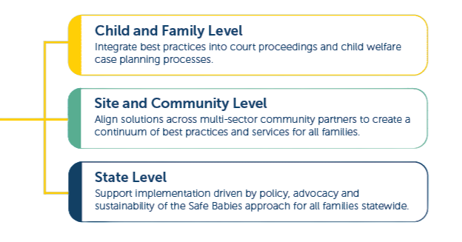
The Infant Toddler Court Program
National Resource Center
Targeted TA
Constituency Focused TA
Universal TA
National Webinars
Regional and National Convenings
Communities of Learning/ Practice
Community Coordinator Academy
Reflective Practice
Leadership Team calls
Site Visits
Consultation
Peer-To-Peer Support
Trainings
IMPACT:
The ITCP National Resource Center provides technical assistance to support implementation of Safe Babies to meet the immediate needs of babies and toddlers by holding their urgent developmental needs at the center of all planning and decision-making to strengthen early relationships with parents and caregivers and to create safe, stable, and nurturing environments .

Slide 20
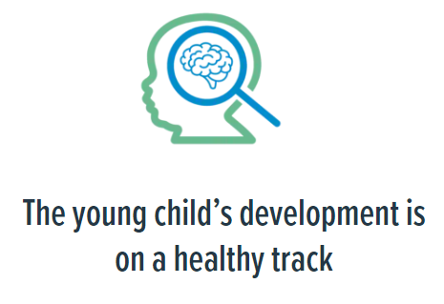
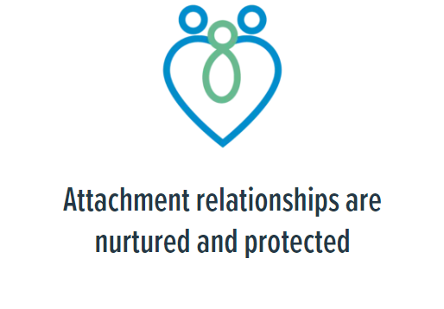
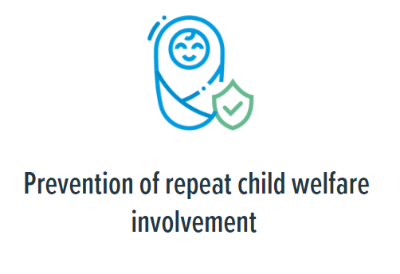
Safe Babies Long Term Health Related Outcomes

Slide 21
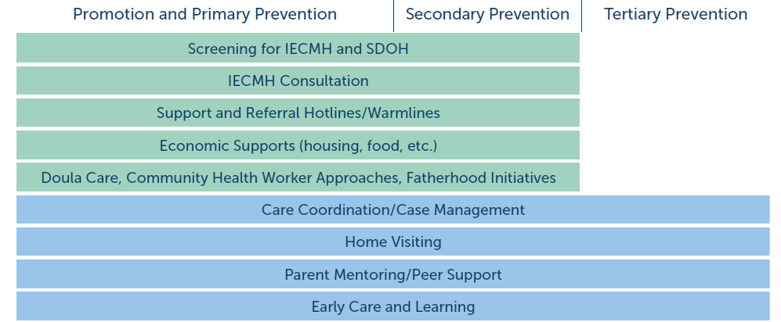
Safe Babies: Across A Prevention Continuum
Rooted in and guided by IECMH Guiding Principles and Best Practices
Promotion and Primary Prevention | Secondary Prevention | Tertiary Prevention

Slide 22


Promotion and Primary Prevention | Secondary Prevention | Tertiary Prevention

Slide 23




Slide 24
Driving change
for children and their families, shaping a brighter future for all.

Slide 25

Making Connections and Nurturing Relationships

Slide 26
Shared Spaces Where We Meet Families
Primary Prevention | Tier 1
All families regardless of risk or involvement in child welfare
Receiving help with screenings and access to family support
Tertiary | Tier 3
Connecting with families experiencing intense crisis and removal from their home
On-going family engagement with team-based support
Secondary Prevention | Tier 2
Families who may have been referred to Child Welfare but screen out or involved with CPS but at home
Shorter term window of support needed to address mild concerns with care coordination and systems navigation.

Slide 27
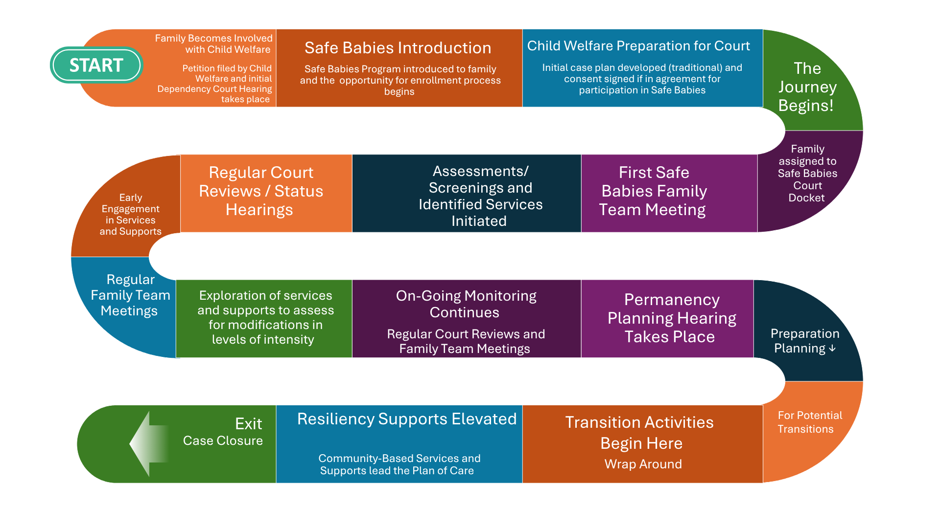


Slide 28

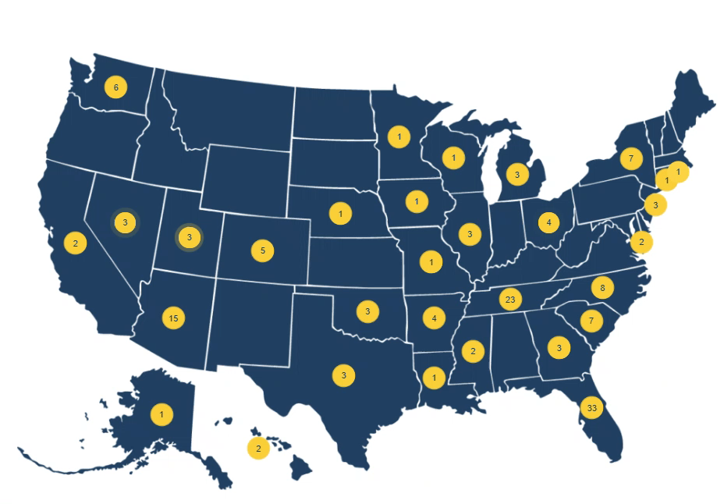
Safe Babies National Network
153 Sites in 31 states
Expand reach and impact in priority states
Build the evidence base
Achieve state-level policy and practice change
Ensure financial sustainability

Slide 29
© 2026 ZERO TO THREE
HealthySteps National Network
388
sites
ACROSS
26
states
+ Washington, DC
1 – 4 sites
5 – 10 sites
11 – 14 sites
29
15+ sites

Slide 30

Opportunities Captured Along the Way
Explore and expand a prevention focused collaboration
Engage parent leaders to provide meaningful input that enhances service delivery and policies in early childhood systems.
Building out bi-directional pathways to increase information sharing and awareness.
Enhance inclusion and cross-sector trainings
Building on the intersection with AAP chapters for both programs.

Slide 31

“You have helped me take myself apart and put it back together. I’m all nuts and bolts.
This has been a very good process for both of us. It took a long time, but it was worth it. I didn’t think it was going to happen.”
-Safe Babies Father
Thank You!

