Slide 1

An Introduction to the Role of the
Itinerant Early Childhood Special Educator
RUTH GALLUCCI MAY 20, 2026
ALISSA RAUSCH
Notes:
Ruth

Slide 2

Who’s Here
Family Members
Teachers/Providers
Program Administrators
Community Partners
State Leaders
IHE
Other
Notes:
Ruth

Slide 3
Agenda
What are Itinerant Early Childhood Special Education Services?
What are Itinerant Early Childhood Special Education Services?
The Role of the Itinerant ECSE Teacher (IECSE)
The Role of the General EC Teacher
The Planning Matrix
First Step in Implementation
Notes:
Ruth

Slide 4
What are Itinerant Early Childhood Special Education Services?
Notes:
Ruth

Slide 5


What is your dream for young children with disabilities?
https://app.sli.do/event/1WVdi1sWdyqszHaQDjtXVd
Notes:
Ruth

Slide 6

North Star
Each and every young child has access to a high-quality general early childhood education where they are provided the necessary individualized support to meet high expectations, participate and belong.
Notes:
Ruth

Slide 7
Itinerant services have been designed to help us reach this goal.
Notes:
Ruth

Slide 8
What are Itinerant Early Childhood Special Education Services (IECSE)?
A research-based service delivery model for providing special education services within the general EC environment
Bring services to children, providing an alternative to pulling them out of the classroom to separate spaces, classes, programs, or schools
Allows the itinerant teacher to provide specialized instruction within the general classroom routines and activities, where we want children to use their skills
Allows the EC teachers to embed instruction throughout the week after collaboration with the itinerant.
Allows services/supports to be provided seamlessly within the child’s natural environment without unnecessary transitions
Benefits all children
Notes:
Ruth

Slide 9

Where is the magic?
IECSE-
Specializes Instruction
General Education Teacher & TA-
Provides Embedded Instruction
IECSE-
Facilitates Collaboration/ Coaching
Notes:
Ruth

Slide 10
The Evidence Behind the Model
Distributed Instruction
Embedded Instruction
Notes:
Ruth
n\

Slide 11
Distributed Instruction
The IECSE Model allows for instruction to be distributed across the day and throughout the week.
How does distributed instruction differ from massed instruction?
Massed Instruction
Distributed Instruction
Notes:
Ruth

Slide 12
Embedded Instruction
Embedded instruction involves multiple, brief teaching interactions between a teacher and child during everyday classroom activities.
Teachers can help children learn new skills for participating in classroom activities throughout the day by:
  identifying functional skills (target skills)
  Identifying intentional teaching practices (ITPs)
  selecting classroom activities to embed ITPs
Notes:
Ruth

Slide 13
The Research is Clear
Instruction is most effective when opportunities to acquire and practice skills occur throughout the day/every day, rather than at a single point during the week.
(Dinnebeil & McInerney, 2011; Hemmeter, 2000; Sandall & Schwartz, 2002; Spino, 2013; Wolery, 2000; Wolery, Ault, & Doyle, 1992)
Notes:
Ruth

Slide 14

Itinerant services are designed to increase access to learning opportunities, which are distributed throughout the day and embedded into the general EC classroom routines and activities.
Notes:
Ruth

Slide 15

IECSE is not one size fits all!
IEPs must be individualized to meet each child’s need for specialized instruction and the degree of collaboration between educators/families.
Notes:
Ruth

Slide 16
The Role of the
Itinerant ECSE Teacher (IECSE)
Notes:
Alissa

Slide 17
Who Can Provide IECSE Services
Special Education Teachers
SLPs
OTs
PTs
Vision Teachers
Teachers of the Deaf
Any special education or related service provider…
Notes:
Alissa

Slide 18
What Do IECSE Teachers Do
Specialized Instruction (SI)
Collaboration/Coaching (individual, ongoing, and scheduled meetings that include the IECSE, EC teacher, and families)
* Variations in direct and indirect service delivery.
Notes:
Alissa

Slide 19
Providing Specialized Instruction
Get to know the child
Determine and refine interventions
Model for the EC teacher
Monitor and assess progress
Notes:
Alissa

Slide 20
Facilitating Collaboration/Coaching with the General EC Teacher (& Families)
Collaborative meetings provide the opportunity for the IECSE, general EC teacher, and, whenever possible, the families to collaboratively identify the necessary intentional teaching practices and the activities in which they will be embedded.
Planned and ongoing
Facilitated by the IECSE
Partnering with EC
Target Skills & Intentional Teaching Practices
IEP Development
Planning Matrix
Implementation Cycle
Notes:
Alissa

Slide 21
How Collaboration, Coaching, and Consultation Support the IECSE process
  Collaboration: relationship-based, embedded activities supportive of families' existing capacity over time and matched to the learning needs of the child (Dinnebiel & McInerney, 2023)​
  Coaching: Collaborative skill building with specific components of 1) partnerships, 2) action planning, 3) focused observation, 4) reflection and feedback, and 5) action (Snyder et al, 2011)​
  Consultation: Voluntary problem-solving professional development process between professionals and families to design and deliver individualized intervention (Schultz et al, 2015)
Notes:
Alissa

Slide 22
Why is Collaboration/Coaching Important
Coaching engages providers in the development and learning process, using their unique insights and deep connection with the child to foster development in real-time, everyday interactions.
Building on capacity
Fostering consistency
Building on relationships
Personally and contextually relevant
Notes:
Alissa

Slide 23
Ongoing Steps to Facilitating the Collaboration/Coaching Process
(Implementation Cycle)
What are you going to do?
(Implementation Steps)
Are you able to do what was planned?
(Implementation Fidelity)
Did it work?
(Progress Monitoring)
Notes:
Alissa

Slide 24
So, there’s specialized instruction & collaborative meetings, but…
Where is the magic??
IECSE Specializes Instruction
General Education Teachers& TA
Provides Intentional & Planned Instruction Embedded into Daily Classroom Routines & Activities
IECSE Collaboration/ Coaching
Notes:
Alissa

Slide 25
Itinerant Service Delivery is NOT:
Resource model only for children with limited support needs
Pulling a child out of the routine- to the back of the room
Co-teaching, where 2 teachers (gen educ/spec educ) teach in one classroom all day
Integrated preschool special education class with 1 teacher assuming both roles
Itinerant services take place in multiple environments where children would typically attend if not for their disability.
Itinerant teachers do the traveling, not the children.
Notes:
Alissa

Slide 26
Think-Pair-Share
How is an IECSE teacher’s role different than
an ECSE classroom teacher’s role?
Notes:
Alissa

Slide 27
The Role of the
General EC Teacher
Notes:
Alissa

Slide 28
Who Provides General Education Support
General education teachers
Teaching assistants
Paraprofessionals
Notes:
Alissa

Slide 29
What General Education Teachers do and How They Do It
Implement the General Education Curriculum
Participate in Collaboration/Coaching
Embed Instruction (Intentional Practices)
Support IEP Development and the Implementation Cycle
Notes:
Alissa

Slide 30
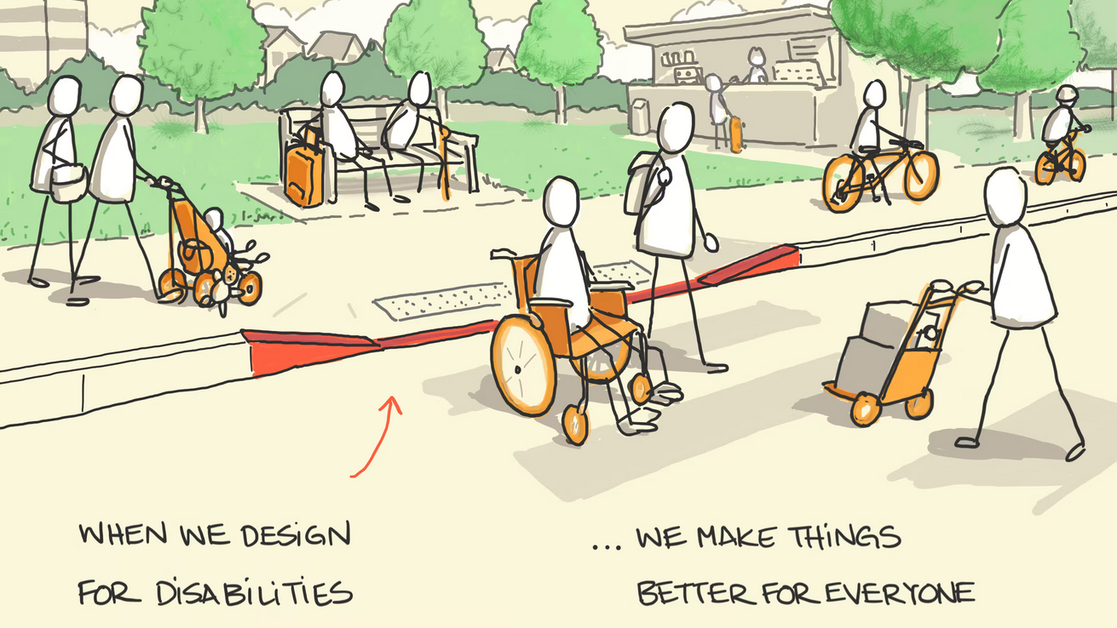
Children with disabilities are general education students first.
https://sketchplanations.com/the-curb-cut-effect
Notes:
Alissa
Children with disabilities are general education students first.

Slide 31

Universal Design for Learning and Embedded Instruction
Notes:
Alissa

Slide 32
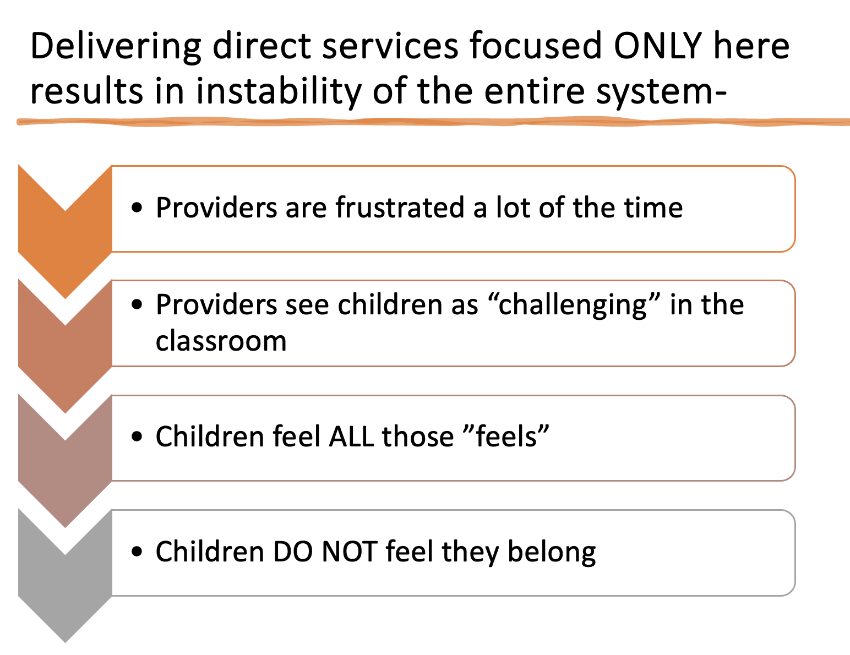
What Non-Collaborative Services Do
Universal Supports
Targeted Supports
Individualized Supports
Notes:
Alissa

Slide 33
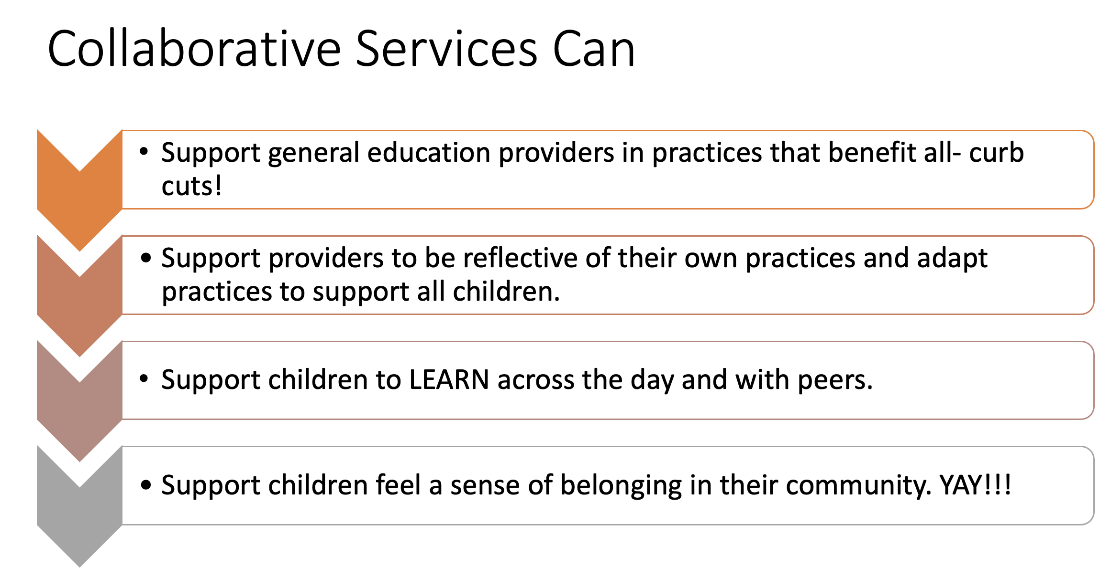
What Collaborative Services CAN Do
Individualized Supports
Targeted Supports
Universal Supports
Notes:
Alissa

Slide 34
How General EC Educators Can Support All Children
Visual schedules
Pictures or images to support communication (receptive and expressive)
Modeling and “I do, We do, You do”
Scaffolding
Opportunities to respond in multiple ways- with words, with actions, with materials
Flexible grouping
Notes:
Alissa
Children with disabilities are general education students first. Tiers are not placements.

Slide 35
Not MORE…INTENTIONAL from the start
WHAT IS PROPOSED
WHAT ELSE CAN BE DONE
Inquiry Project about community parks. The goal of the unit/project is for children to collaborate, represent their ideas of parks in community, and explore physical engineering.
• Read a book about a park and asks the children to sit
in a 15-minute circle time to "brainstorm" what belongs
in a park.
• Draw a picture of a park to be put in their portfolio.
• Build "The Park" using standard wooden unit blocks.
Children bring in pictures of park features. Pictures are posted on the same board that children brainstorm.
Take a picture of a favorite park structure. Describe why they love it. Teacher records.
Build features of a park with playdough, popsicle sticks, etc.
Notes:
Alissa

Slide 36
GEs Support with Embedded Instruction and Intentional Practices
Embedded instruction involves multiple, brief teaching interactions between a teacher and child during everyday classroom activities.
Teachers can help children learn new skills for participating in classroom activities throughout the day by:
  identifying functional skills (target skills)
  Identifying intentional teaching practices (ITPs)
  selecting classroom activities to embed ITPs
Notes:
Alissa

Slide 37
Teacher Roles & Responsibilities
IECSE Teacher:
Identifying specialized instruction/ intentional teaching practices
Facilitating collaboration/ coaching
Monitoring implementation of embedded instruction
Monitoring progress on IEP goals
EC Teacher:
Creating a high-quality EC environment, learning activities and routines
Ensuring all children experience full membership and belonging
Embedding intentional teaching practices into everyday activities and routines
Participating in collaborative meetings
Notes:
Alissa

Slide 38
The Planning Matrix
Notes:
Ruth

Slide 39
What is a Planning Matrix?
Is a form created by the ECSE and gen EC teacher at a collaborative meeting
Identifies specific target skills & the intentional teaching practices that supports the child’s learning
Allows all adults in the room to understand when to embed the intentional teaching practices.
A single planning matrix provides a “road map” for all intentional teaching practices.
Notes:
Ruth

Slide 40
Planning Matrix
Daily Schedule | Target Skill #1: | Target Skill #2: | Target Skill #3: | Target Skill #4: | Target Skill #5:
 | ITP: | ITP: | ITP: | ITP: | ITP:
Notes:
Ruth

Slide 41
Planning Matrix- Intentional Practices
Daily Schedule | Target Skill #1: Follows classroom Routine | Target Skill #2: Counts objects to 5 | Target Skill #3: Responds to questions w/ 3-word phrase | Target Skill #4: Manipulates class materials to build strength | Target Skill #5:
 | ITP: Visuals | ITP: Gestural prompt | ITP: Sentence strip w/ photos | ITP: Adult or peer model | ITP:
Arrival | First, hang backpack Then, choose breakfast seat
Breakfast |  | Count 5 plates & cups to pass out to friends | What do you want for breakfast? I want _______.
Morning Meeting | First, go to on mat Then, pick song |  |  | Clip name tag on attendance board
Centers |  |  | What are you making? I made ______. | Playdoh kneading, cutting, Paper punch
Outdoor Play |  | Count 5 objects to bring outside
Lunch |  | Count 5 plates & cups to pass out to friends | What do you want for lunch? I want _______. | Open food container
Naptime | First, go to nap mat Then, pick book/quiet toy
Centers |  |  | Where do you want to go? I want _______. | Water plants with spray bottle
Snack |  | Count 5 plates & cups to pass out to friends
Outdoor Play | First, line up Then, pick outdoor activity |  |  | Crab-walk, bear walk games
Notes:
Ruth

Slide 42

ACTIVITY- Creating a Planning Matrix
With a partner or small group:
Identify a target skill in column #5
Identify the Intentional Teaching Practices (ITPs)
Identify the times and vehicles for embedding the ITP throughout the day
Notes:
Ruth

Slide 43
First Step in Implementation
Notes:
Ruth

Slide 44
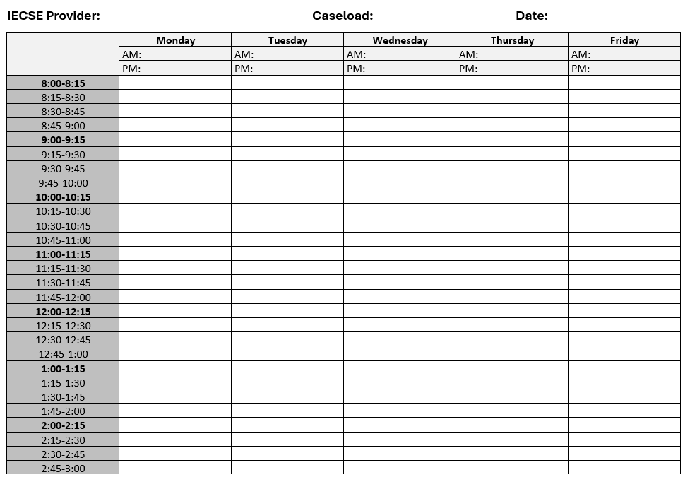
IECSE Schedule
Notes:
Ruth

Slide 45

IECSE Schedules
  Team Meeting Day
  Days at EC Programs
  Collaborative Meetings
  Specialized Instruction
  Travel
  Lunch
  Prep
Notes:
Ruth

Slide 46
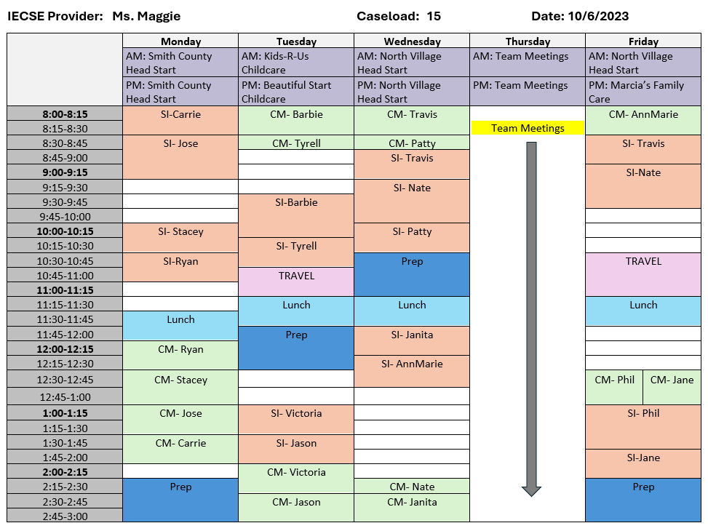
Schedule-Prep
Notes:
Ruth

Slide 47
Special Education Team Daily Rotation Example
Week 1 | Monday | Tuesday | Wednesday | Thursday | Friday
Morning | Classroom 1 support | Classroom 1 support | Planning with Classroom 2, other activities | Classroom 1 support | Classroom 1 support
Afternoon | Other activities | Other activities |  | Other activities | Other activities
Week 2
Morning | Classroom 2 support | Classroom 2 support | Planning with Classroom 3, other activities | Classroom 2 support | Classroom 2 support
Afternoon | Other activities | Other activities |  | Other activities | Other activities
Notes:
Alissa

Slide 48
Weekly Rotation Example
 | Week 1 | Week 2 | Week 3 | Week 4
Classroom 1 | ECSE | Related service providers | Open | Para or floater
Classroom 2 | Para or floater | ECSE | Related service providers | Open
Classroom 3 | Open | Para or floater | ECSE | Related service providers
Toddler room | Related service providers | Open | Para or floater | ECSE
Notes:
Alissa

Slide 49
Keep Your Eye on the Prize
Each and every young child has access to a high-quality general early childhood education where they are provided the necessary individualized support to meet high expectations, participation, and belonging.
North Star
Notes:
Alissa

Slide 50
“Equal opportunity is one of America’s most cherished ideals. Being fully included as a member of society is the first step to equal opportunities throughout life and is every person’s right—a right supported by our laws.”
https://sites.ed.gov/idea/files/policy-statement-on-inclusion-11-28-2023.pdf
Notes:
Alissa

Slide 51

Questions/Comments
Thank you for coming! ruthgallucci@outlook.com
Alissa.Rausch@du.edu
Notes:
Alissa

