Slide 1
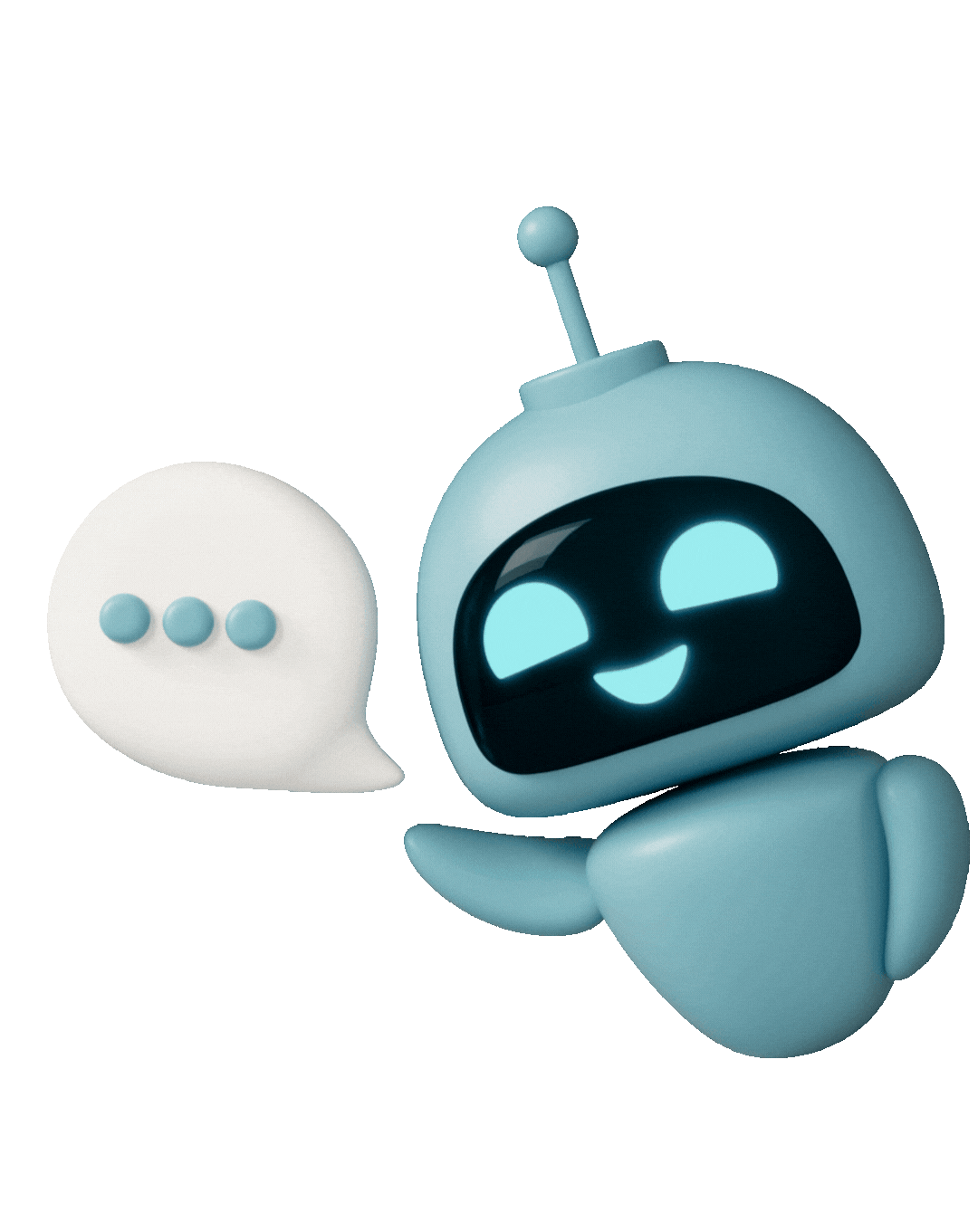

Foster Human-in-the-Loop Critical Thinking
By: Haylee Anderson & Ben Miller

Slide 2
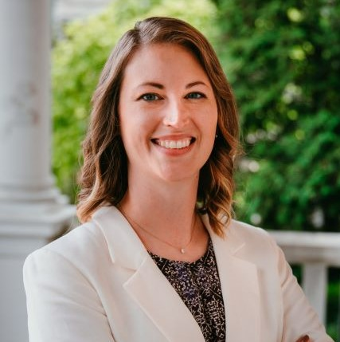
Haylee Anderson
eMINTS National Center
University of Missouri, College of Education and Human Development
Education Instructional Specialist
andersonh@emints.org

Slide 3

Ben Miller
eMINTS National Center
University of Missouri, College of Education and Human Development
Learning Designer
bmiller@emints.org

Slide 4



Session Outcomes
Learn four practical strategies that help learners use AI to think more critically…not just rely on it for answers.
Engage with AI as a thought partner, spot misinformation, promote ethical use, and strengthen human‑in‑the‑loop reasoning.
Apply ready‑to‑use strategies that bring responsible, ethical, and creative AI informational literacy to your learning space.

Slide 5


Today’s Agenda:
Opener: Open Mic
Activity 1: Human-in-the-Loop
Activity 2: Ethical Use
Activity 3: Spotting Misinformation
Activity 4: AI as a Thought Partner
Closer: Open Mic
Connect with Us!

Slide 6


Opener:
Open Mic
What are some skills that every employer is looking for in today’s workforce?

Slide 7
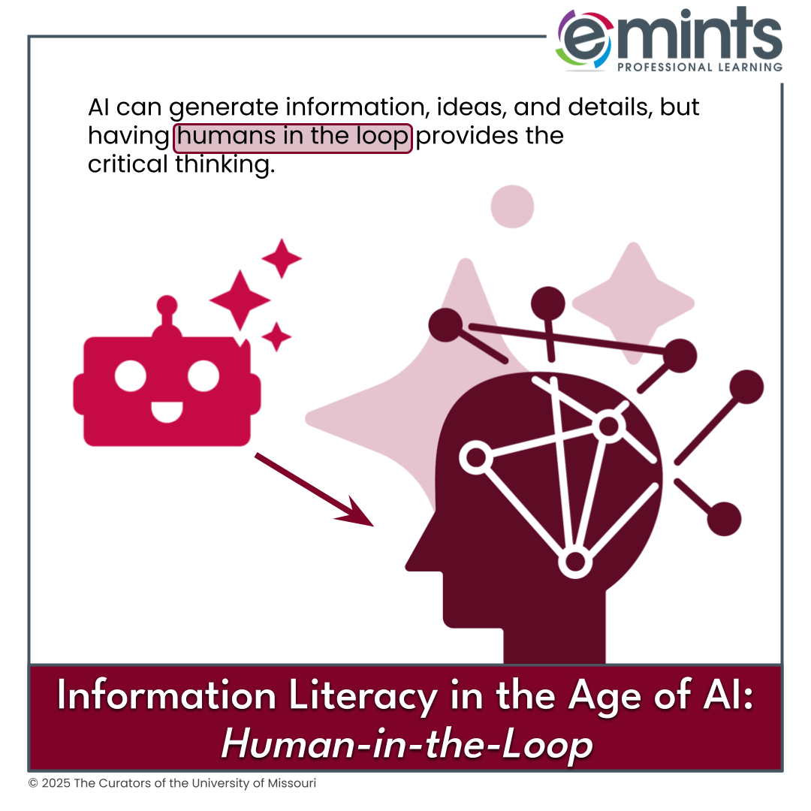

Human-in-the-Loop
AI can generate information, ideas, and details, but having humans in the loop provides the critical thinking.
Students must to be able to:
Identify/analyze credibility.
Revise/strengthen AI content.
Critique AI outputs for gaps or bias.
…
What else?

Slide 8

Let’s Try It:
Good morning graduates, families, faculty, and friends. As I look out at all of you today, I'm struck by something simple but profound: we made it. We're sitting here in these caps and gowns not because the path was easy, but because when it got hard, we kept going. Today isn't just about celebrating what we've learned—it's about recognizing who we've become in the process.
But here's the thing about graduations: they're not really endings at all. Yes, we're closing this chapter, but we're also standing at the edge of something vast and uncertain and genuinely exciting. So today, as we celebrate how far we've come, let's also talk about where we're going—and how we're going to get there together.
To the right is an AI-generated graduation speech (Claude, 2025).
Think about:
  How credible is it? Why? Who might the primary audience be?
  How could we revise and strengthen the content?
  What gaps or biases might there be in the output? Whose voices or perspectives might be missing?
Let’s revise it together.
“Graduation Speech” write me a short, 2-paragraph introduction to a graduation speech, then, make it just a little shorter. Claude, Sonnet 4.5 (free account), Anthropic, 27 Jan. 2026, https://claude.ai/.

Slide 9
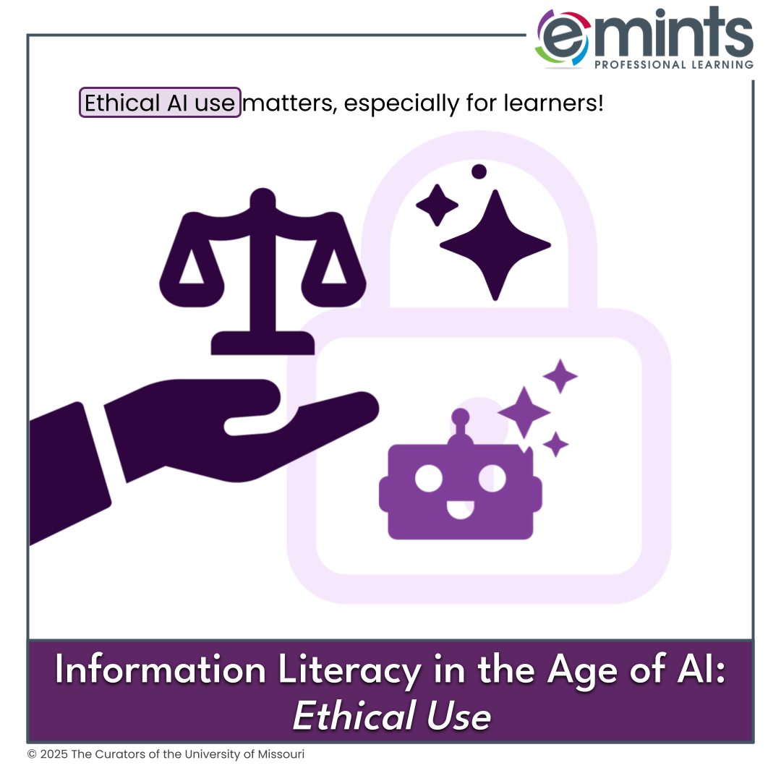
Ethical AI Use
Ethical AI use matters, especially for learners!
How might we teach these ethics
to learners?
When AI use is appropriate?
How to cite
Class norms
AI Stoplight
…
What has worked for you?

Slide 10
Let’s Try It: Cite Your Output!
Choose an AI tool to generate something you will need in the
near future.
Cite your output using a style of your choice.
Add your citation to the materials where you will use the AI-generated content.
Here’s how (in MLA):
"Description of prompt" prompt. Name of AI tool, version of AI tool (if known, plus account type, if known), Company, Date of chat, URL.
Example (in MLA):
“Graduation Speech” write me a short, 2-paragraph introduction to a graduation speech, then, make it just a little shorter. Claude, Sonnet 4.5 (free account), Anthropic, 27 Jan. 2026, https://claude.ai/.

Slide 11
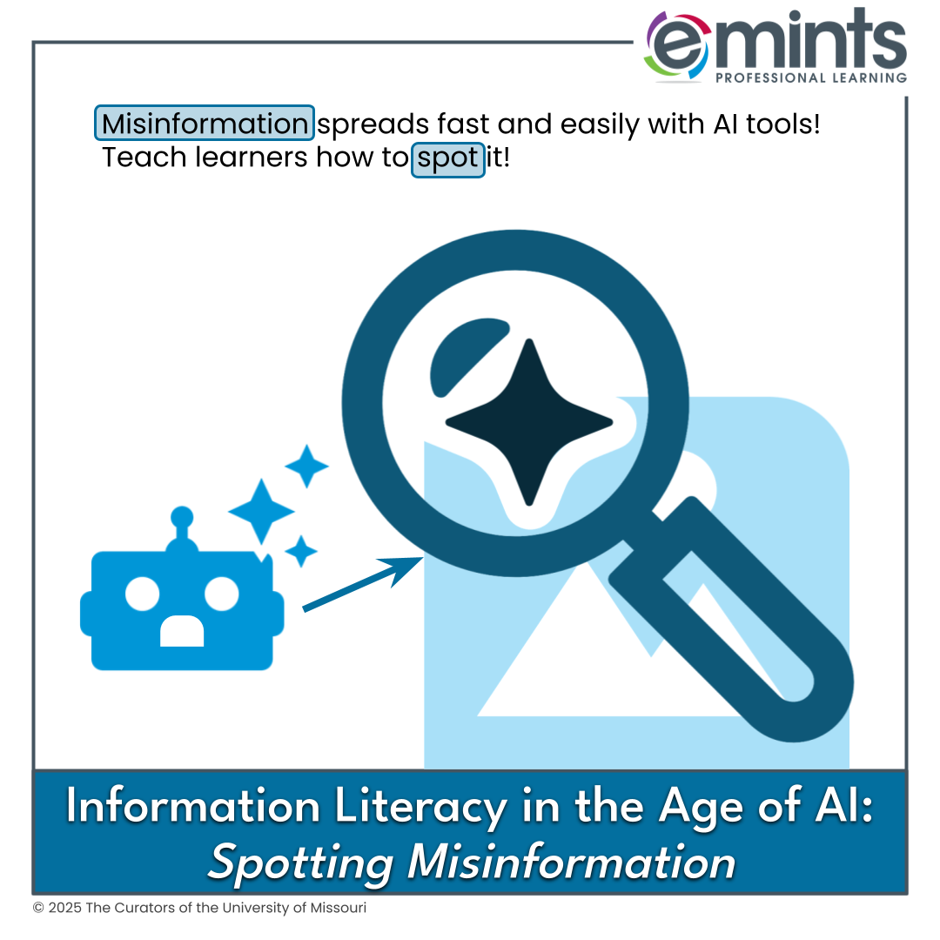
Spotting Misinformation
Misinformation spreads quickly and easily with AI tools! Teach learners how to spot it!
How could learners practice spotting misinformation?
Source-checking
SIFT Method (Stop, Investigate, Find, Trace)
…
What strategies might you add?

Slide 12


Let’s Try It: Deepfake Contest
We’ll split the room to form two teams.
On the next three slides, you’ll see two side-by-side images.
Come to a consensus: Can you spot which is the fake?

Slide 13

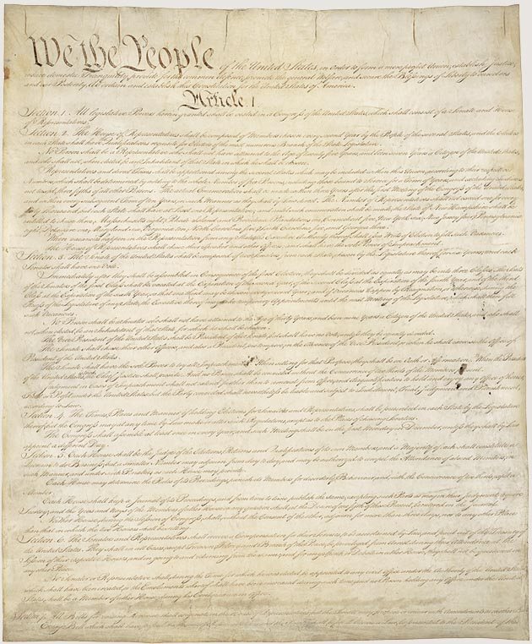
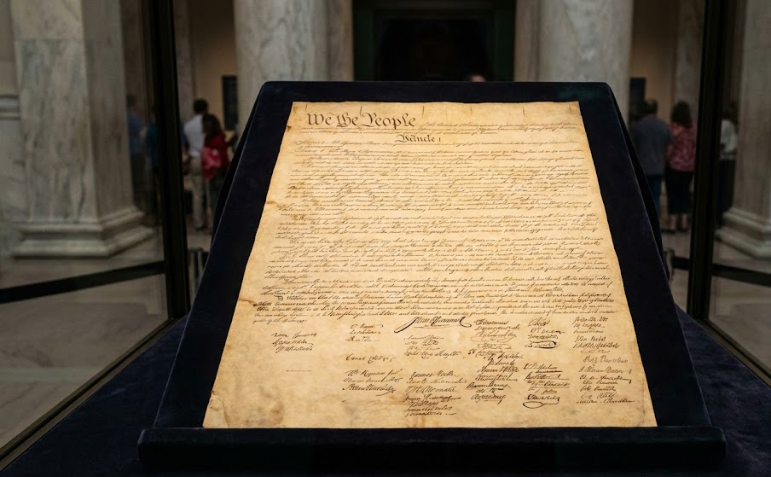
#1
Which is the fake?
REAL - National Archives. (2018, November 16). The Constitution of the United States. National Archives; The U.S. National Archives and Records Administration. https://www.archives.gov/founding-docs/constitution
FAKE - AI generated this! (via Google Gemini, prompt: “Generate a photo-realistic color photo of the United States Constitution”)
Left
Right

Slide 14
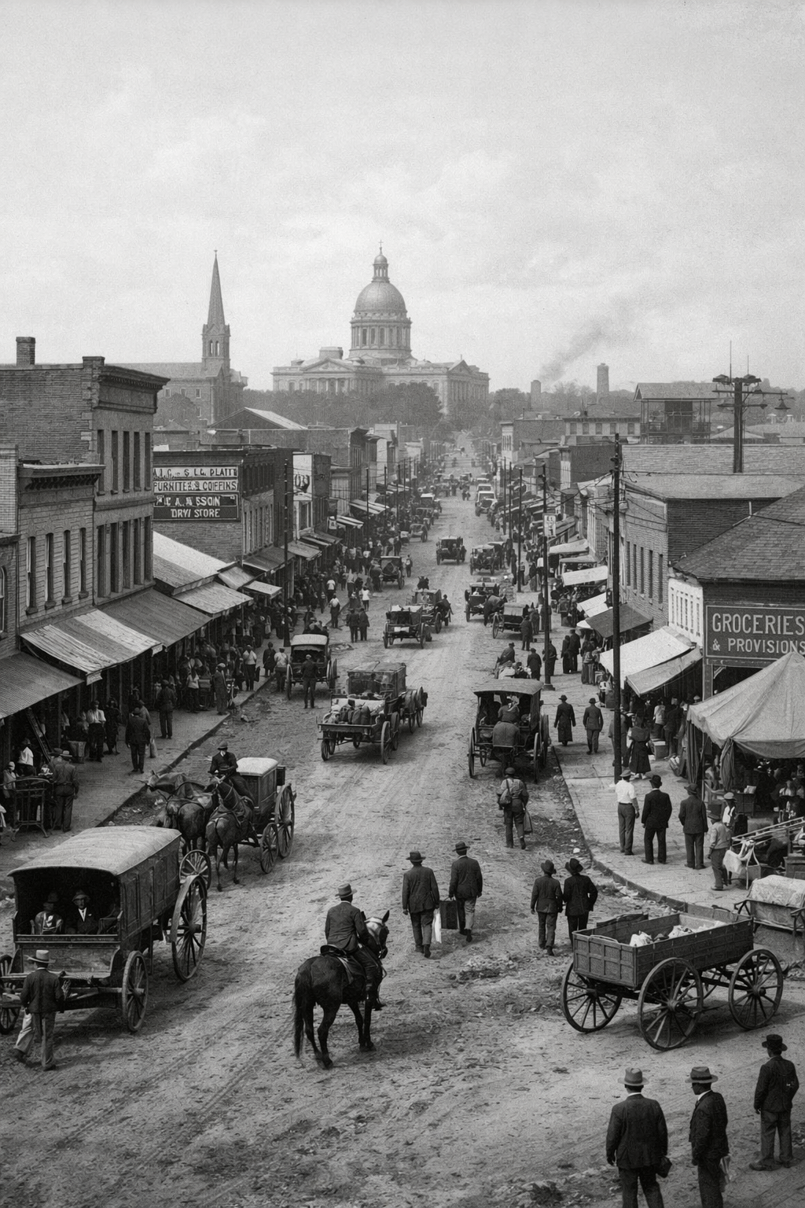
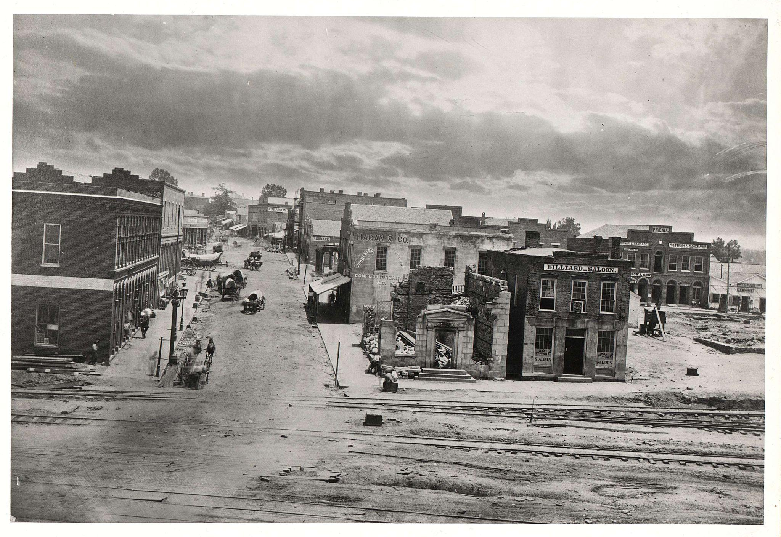
#2
Which is the fake?
REAL - 165-SC-46; Atlanta, Georgia; Selected Views from “Photographic Views of Sherman’s Campaign” by George N. Barnard, Photographer, 1862–1865; Records of the War Department General and Special Staffs, Record Group 165; National Archives at College Park, College Park, MD. [Online Version, https://docsteach.org/document/atlanta-georgia-civil-war-barnard/, January 27, 2026]
FAKE - AI generated this! (via ChatGPT, prompt: “Generate a photo-realistic, black-and-white photo of downtown Atlanta, Georgia in the 1800s”)
Left
Right

Slide 15


#3
Which is the fake?
REAL - Help Your Country; ca. 1914-1918; Naval Records Collection of the Office of Naval Records and Library, Record Group 45. [Online Version, https://docsteach.org/document/help-your-country/, January 23, 2026]
FAKE - AI generated this! (via ChatGPT, prompt: “Generate a poster from 1915 that recruits people to join the US Navy. Include a painted-style sea with a naval ship sailing on it in the center and red text that says ‘Help Your Country!’”)
Left
Right

Slide 16
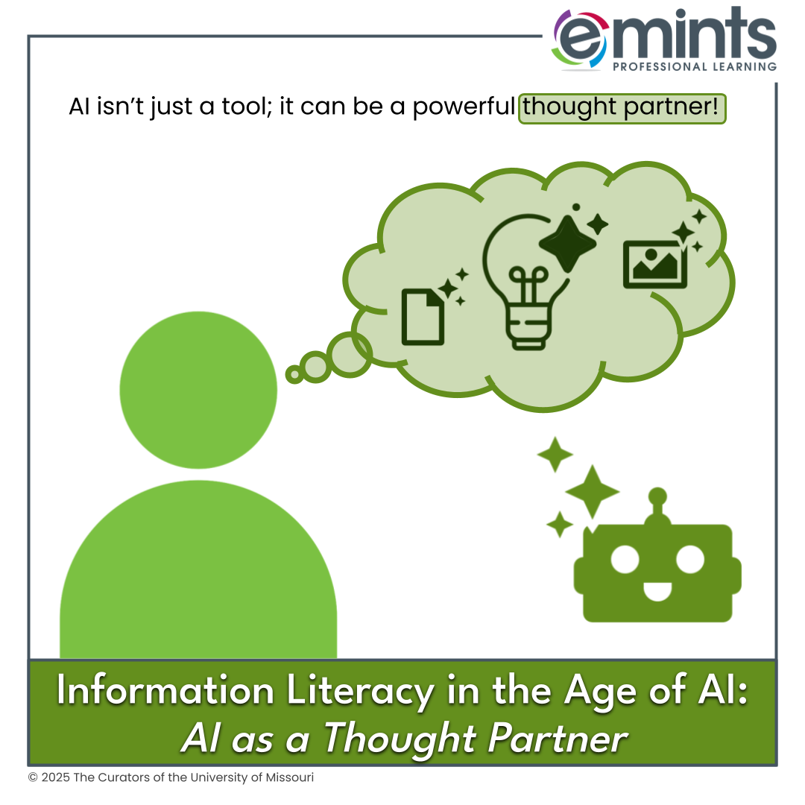
AI as a Thought Partner
AI isn’t just a tool; it can be a powerful thought partner.
In what ways might AI be a thought partner for you/your learners?
Brainstorming
Asking clarifying questions
Exploring beginning concepts.
…
What else?

Slide 17



Let’s Try It: Curate, Annotate, Iterate
Your Prompt: What is one thing that every human should know about AI Today?
Curate - In a Google Doc or note, add your response to the above question. Then, generate an AI response to the same question.
Annotate - Mark up the mistakes on the AI response.
Iterate - Use AI as a thought partner to combine both your original ideas and the AI-generated output.

Slide 18
Closer:
Open Mic
What are some things that humans can do that AI will never be able to?

Slide 19


Power Up Your Pedagogy!
Creation and Curation: Using AI for High-Quality Lesson Design
How much valuable teacher time and creative energy can you gain by learning to unlock AI workflows that can save hours of lesson planning each week?
Join the eMINTS National Center one-day workshop to discover how AI can streamline lesson planning, spark ideas, and align goals.
You will leave with a ready-to-use, high-quality lesson for your classroom!
One Location / One Day Only!
Saint Louis Region
Aug. 5, 2026 - 9 am-3 pm,
MU Extension Office in St. Charles County, MO (260 Brown Rd., St. Peters, MO 63376)
Learn More - eXpedition.emints.org/learn
Seats are limited,
so register today!
© 2026 - The Curators of the University of Missouri

Slide 20
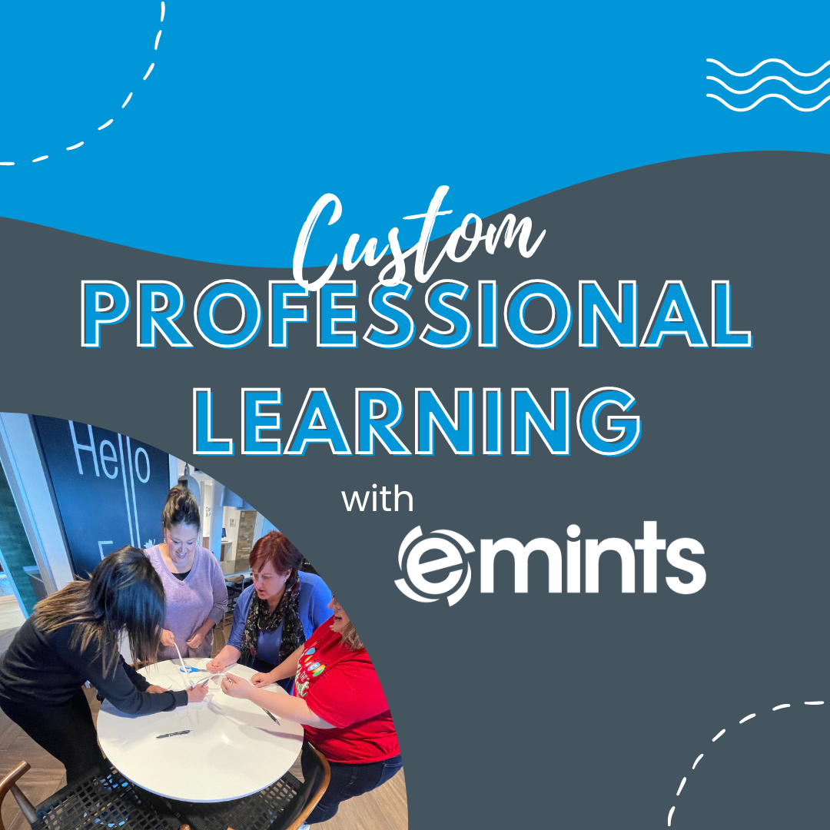
Connect with Us!
Bring eMINTS to you!
Reach out:
emints.org/contact/

