Slide 1
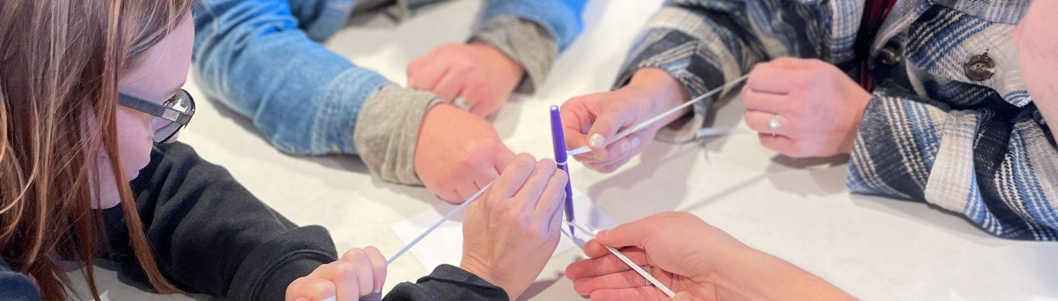

From Gloom to Bloom: Four Strategies to Cultivate an Emotionally Upbeat Learning Space
Gloom to Bloom: Four Strategies to Cultivate an Emotionally Upbeat Learning Space
Upbeat Classroom
Access the slides:

Slide 2
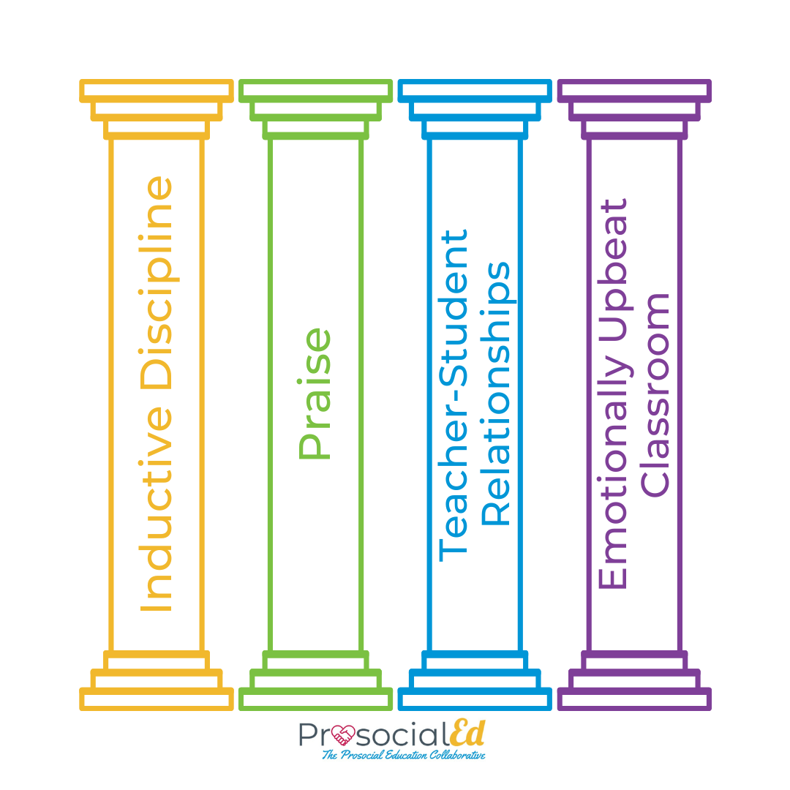
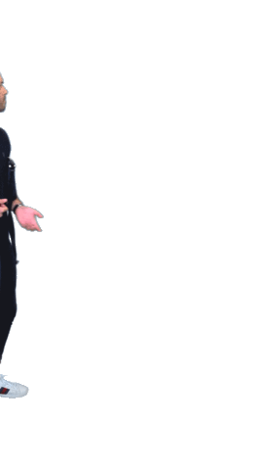
WHAT
In this session, you will:
Learn about The Emotionally Upbeat Classroom.
Understand research behind creating one.
Walk away with four new strategies to help build one.

Slide 3
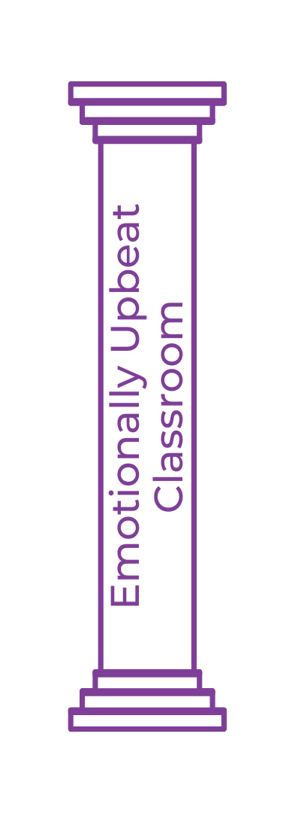

WHY
Introduction
Negative emotions block thinking, learning, and rational thought. Positive emotions catalyze creativity, problem-solving, and critical thinking. Happy people learn more and are more prosocial; and the more prosocial learners are, the more positive and upbeat the classroom climate will be (Bergin, 2018).
Theory Behind Practice
All eMINTS materials are based on best practices in educational research. ​
eMINTS Community of Learners Competencies
Designing a Prosocial Classroom
Digging Deeper
Bonus: Graphic

Slide 4

HOW
Agenda
Opener: Tell Me Something Good
Activity 1: Smiling
Activity 2: Gratitude
Activity 3: Emotions
Activity 4: Humor
Closer: Emoji Kitchen

Slide 5
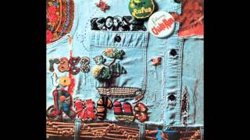
Opener:
Tell Me Something Good
Think about something good that’s happened to you recently.
Unmute your mic or drop in the chat what you’re thinking about.

Slide 6
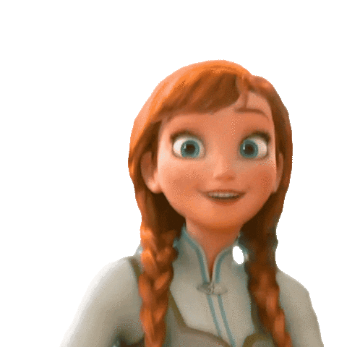
Smiling
Connections - Smiling can:
Increase well-being and general happiness (Harker & Keltner, 2001).
Prolong lifespan (Abel & Kruger, 2010).
Communicate happiness across languages and cultures (Ekman, 1986).
Be contagious to others and make them feel good (Lundqvist, 1995).
Make us feel better (Ekman, 2009).
Retrain and stimulate our brain (Hennenlotter et. al., 2009).
Reduce stress, increase endorphins, and lower blood pressure
(Abel, 2002).
Help us appear more likable, courteous, and competent to others
(Grandey et. al., 2005).
Notes:
How much power does a smile hold? According to Ron Gutman, smiling is one of the most basic, biologically uniform, and universal expressions of all humans (Gutman, 2011).

Slide 7

Activity 1: Smiling
Think about: What makes you smile.
In a breakout room, share your ideas.
Debrief.
Share your thoughts. What did you notice?
How do you feel now?

Slide 8
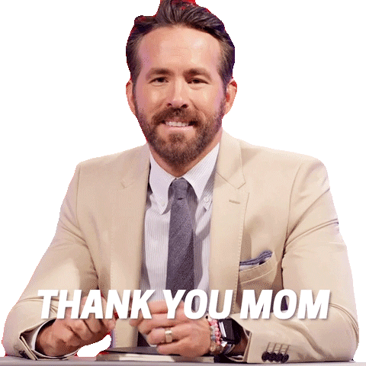
Gratitude
Connections - Gratitude can:
Increase happiness.
Reduce depression.
Strengthen resilience.
Reduce blood pressure.
Lessen chronic pain.
Increase energy.
Lengthen lives.
Promote self-esteem.
Positively rewire our brains.
(The Science of Gratitude, 2016)
Notes:
(The Science of Gratitude, 2016)

Slide 9
Activity 2: Gratitude
Send an uplifting message of gratitude (email, text, DM) to someone.
Tell them why you appreciate them. Be specific and sincere.
Either drop in the chat or unmute your mic and share.
Describe your text, how you felt, & any reactions from the recipient.

Slide 10
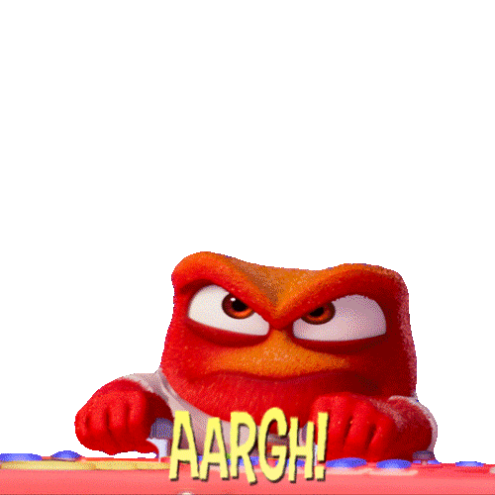
Emotions
Connections
The ability to correctly label emotions helps learners regulate their emotions better (Bergin, 2018, pp. 171-172).
Talking about emotions gives:
Time to get emotions under control.
Information about why people behave
the way they do.
Opportunity to learn
coping strategies.
Greater awareness
of emotions.
Increased emotional
vocabulary and
competency.

Slide 11

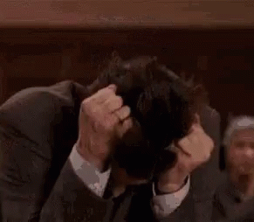
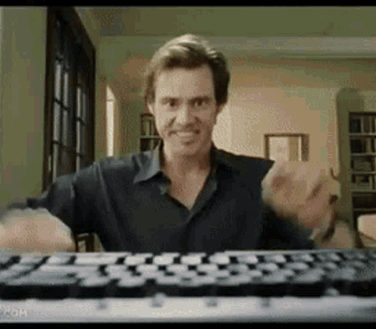
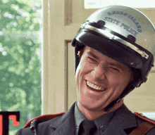
Activity 3: Emotions
What level of Jim are you?
1. 2. 3. 4.
Share in the chat or unmute your mic.
Why might you have chosen the level of Jim that you did?

Slide 12
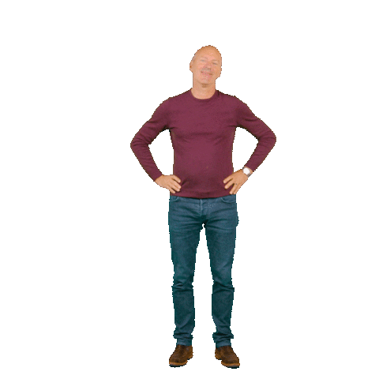
Humor
Connections
Humor facilitates learning, enhances attention, and makes learning fun
(Bergin, 2018).

Slide 13
Activity 4: Humor
Think about or find a funny (and clean) one-liner joke.
In a breakout room, share your joke with your colleagues.
Tell your jokes to each other (& more if you have them). Discuss your thinking so far.

Slide 14
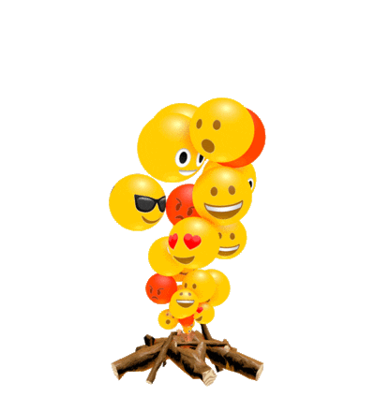
Closer:
Emoji Kitchen
Go to Emoji Kitchen. Click “Get cooking.”
Combine 2 emojis to represent your answer
How are you feeling using these strategies, AND
What are you looking forward to the rest of the school year?
Copy and paste your emoji on the next slide.

Slide 15













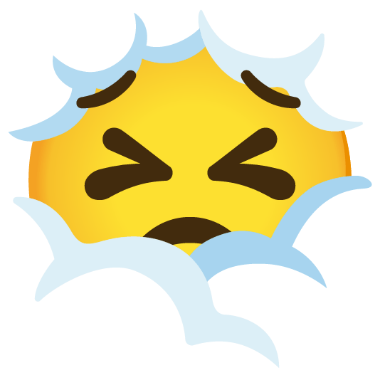





Add your new emojis here:
Notes:
Explain to a partner your 2 choices and then share or add a comment on the side for others to view

Slide 16




Connect with MINTS:

Slide 17
Ashby, F. G., Isen, A. M., & Turken, A. U. (1999). A neuropsychological theory of positive affect and its influence on cognition. Psychological Review, 106(3), 529-550
Fredrickson, B. L. (2001). The role of positive emotions in positive psychology: The broaden-and-build theory of positive emotions. American Psychologist, 56(3), 218-226.
Gable, P. A., & Harmon-Jones, E. (2008). Approach-motivated positive affect reduces breadth of attention. Psychological Science, 19(5), 476-482.
Huntsinger, J. R., (2013). Does emotion directly tune the scope of attention? Current Directions in Psychological Science, 22(4), 265-270. Doi: 10.11177/0963721413480364
Nadler, R. T., Rabi, R., & Minda, J. P. (2010). Better mood and better performance: Learning rule-described categories is enhanced by positive mood. Psychological Science, 21(12), 1770-1776.
Valiente, C., Swanson, J., & Eisenberg, N. (2012). Linking students’ emotions and academic achievement: When and why emotions matter. Child Development Perspectives, 6(2), 129-135.
Digging Deeper: Positive Emotions Promote Learning

Slide 18
Brock, L. L., Rimm-Kaufman, S. E., Nathanson, L., & Grimm, K. J. (2009). The contributions of “hot” and “cool” executive functions to children’s academic achievement, learning-related behaviors, and engagement in kindergarten. Early Childhood Research Quarterly, 24(3), 337-349.
Compton, R. J., Robinson, M. D., Ode, S., Quandt, L., Fineman, S. L., & Carp, J. (2008). Error monitoring ability predicts daily stress regulation. Psychological Science, 19(7), 702-708.
Digging Deeper: Negative Emotions Hinder Learning

Slide 19
Bergin, C. (1987). Prosocial development in toddlers: The patterning of mother-infant interactions. In M. E. Ford & D. H. Ford (Eds.), Humans as self-constructing Living Systems: Putting the framework to work (pp. 121-143). Hillsdale, NJ: Erlbaum.
Bergin, C., Bergin, D. A., & French, E. (1995). Preschoolers’ prosocial repertoires. Parents’ perspectives. Early Childhood Research Quarterly, 10, 81-103.
Bergin, C., Talley, S., & Hamer, L. (2003). Prosocial behaviours of young adolescents: A focus group study. Journal of Adolescence, 26, 13-32.
Denham, S. A., McKinley, M., Couchoud, E. A., & Holt, R., (1990). Emotional and behavioral predictors of preschool peer ratings. Child Development, 61, 1145-1152.
Eisenberg, N., Fab es, R. A., Karorn, M., Murphy B. C., Wosinski, M., Polazzi, L., …Junke, C. (1996). The relations of children’s dispositional prosocial behavior to emotionality, regulation, and social functioning. Child Development, 67, 974-993.
Digging Deeper: Happy = More Prosocial

Slide 20
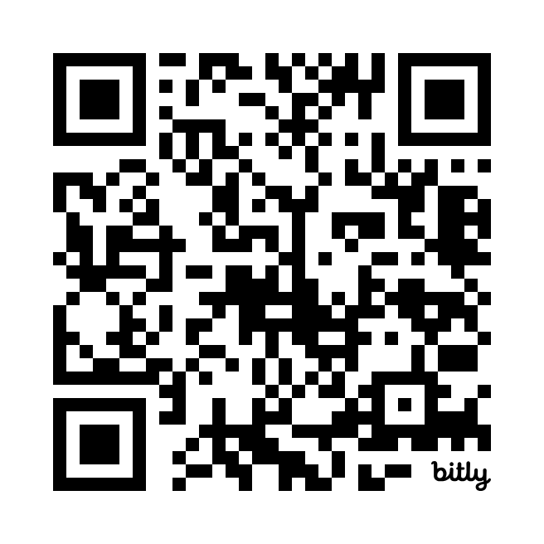
From Gloom to Bloom: Four Strategies to Cultivate an Emotionally Upbeat Learning Space
Gloom to Bloom: Four Strategies to Cultivate an Emotionally Upbeat Learning Space
Upbeat Classroom
Access the slides:
bit.ly/eMINTS-TheEUC

Slide 21
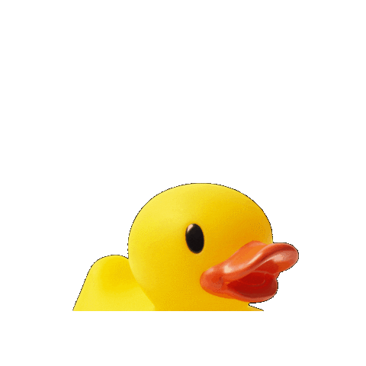
Opener:
Tell Me Something Good
1. Grab a sticky note.
2. Write 3 positive things on the sticky note about
your duck.
3. Pair up with the person whose duck is most like yours, & share your 3 things.
4. When the song is over, return to your home base.

Slide 22

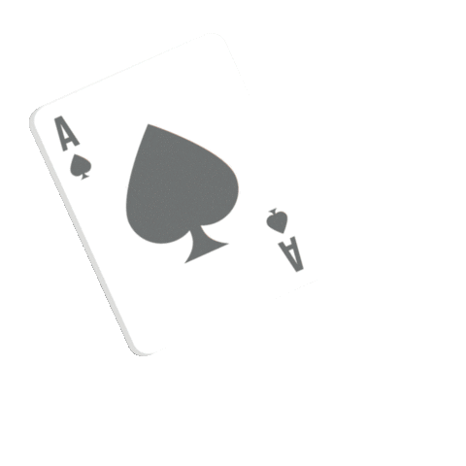
Activity 1: Smiling
Think about: What makes you smile.
Find a partner with the same color card, & discuss.
When the song ends, migrate back to your home.
Share your thoughts. What did you notice?
How do you feel now?

Slide 23
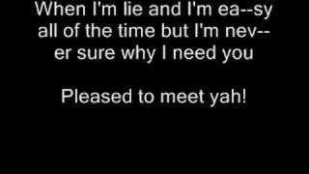
Activity 2: Gratitude
Send an uplifting message of gratitude (email, text, DM) to someone.
Tell them why you appreciate them. Be specific and sincere.
Find a partner with the same suit card, & discuss.
When the song ends, migrate back to your home.
Describe your text, how you felt, & any reactions from the recipient.

Slide 24
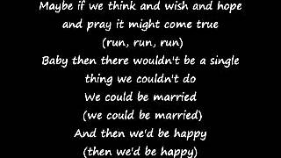
Activity 3: Emotions
What level of Jim are you?
1. 2. 3. 4.
Find a partner with the opposite color card, & discuss.
When the song ends, migrate back to your home.
Why might you have chosen the level of Jim that you did?

Slide 25
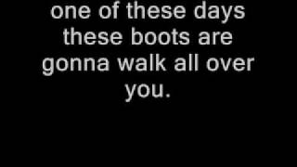
Activity 4: Humor
Think about or find a funny (and clean) one-liner joke.
Find a partner with a card of a different suit with whom you have not yet worked, & discuss.
When the song ends, migrate back to your home.
Tell your jokes to each other (& more if you have them). Discuss your thinking so far.

Slide 26
ProsocialEd
A Brief History

Slide 27

Outcomes & Results
Did implementing ProsocialEd strategies take away from or add to instructional time?
Add: 72%
No difference: 20%
Didn’t implement: 7%
How much did it add per week?
Median: 30 minutes
Range: 0 to 100 minutes
Significant improvement in:
Prosocial behavior of
  Self
  Peers
  Teacher
Teacher-student relationships

Slide 28
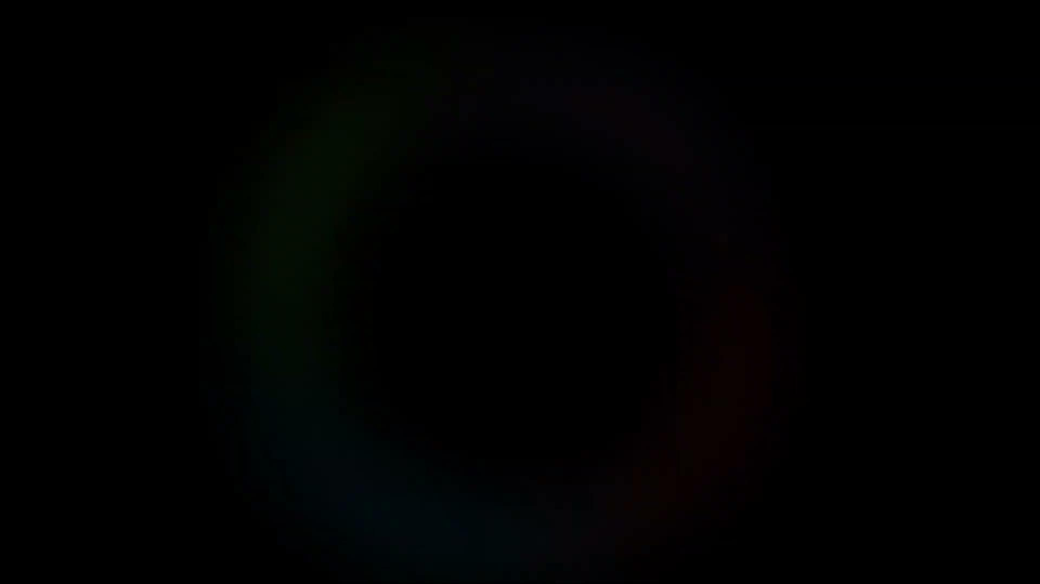
What ProsocialEd Teachers are Saying

Slide 29

Testimonials
“I'm not having to discipline or correct students nearly as often. This is allowing more teaching and learning to take place!”
“ProsocialEd has really helped one of my students who was labeled a "frequent offender" Now I just have to ask him once, maybe twice and he complies!! He doesn't do that with some of his other teachers, so I can't wait to share more about prosocial classrooms with them.”

Slide 30
$8M EIR Mid-Phase Grant
About the grant
PAL 2.0 Grant Recruitment Information
PAL 2.0 Abstract
PAL 2.0 is designed to continue helping teachers enhance their classroom learning environment and increase student engagement by strengthening relationships and helping students to learn the skills necessary to collaborate
with others.
Notes:
info@emints.org

Slide 31
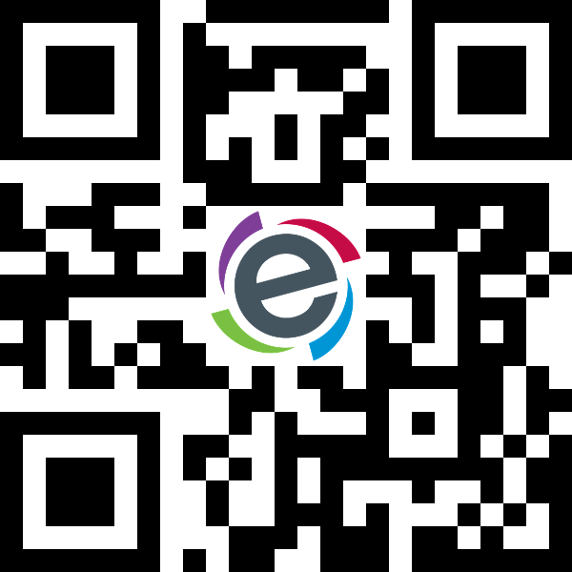


We’re recruiting! Learn More →
Prosocial and Active Learning (PAL) 2.0
Who?: Middle Schools
What?: Prosocial Education Research Study
Where?: Nationwide
Why?: Improve school climate & culture, and help reduce teacher stress & burnout.
Talk to Read© Collaborative
Who?: 2nd-grade Teachers
What?: Literacy Recovery Research Study
Where?: Missouri and Surrounding States
Why?: Address post-pandemic literacy challenges.
LEGACY
Who?: 6-8th Grade Teachers
What?: Expand civic education
Where?: Missouri and Surrounding States
Why?: Prepare the next generation of civic leaders in celebration of America’s 250th anniversary
Send me more information! → emints.org/grants

Slide 32
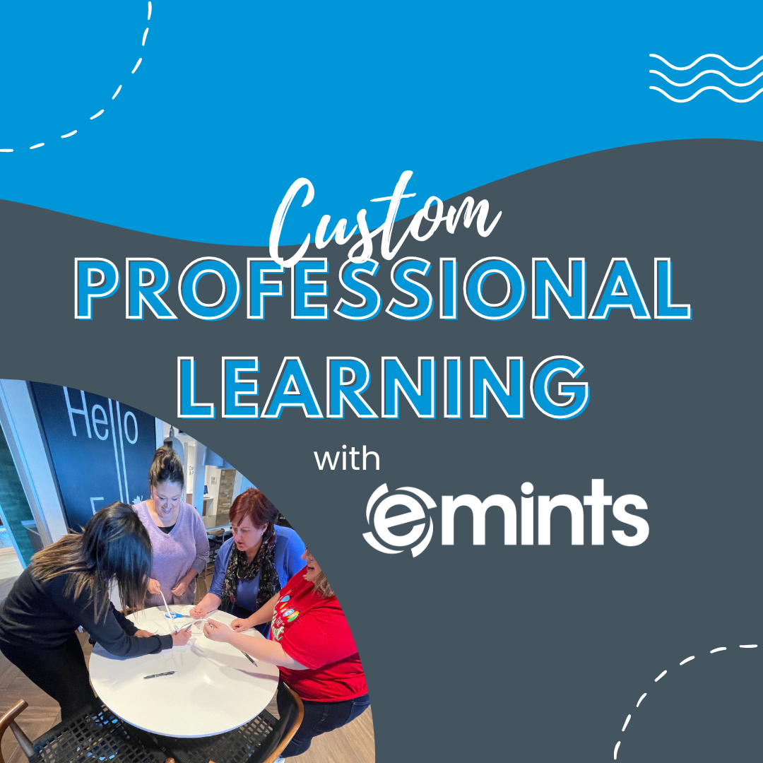
Bring MINTS to You!
Reach out to our staff:
  info@emints.org
Fill out this interest form:
  emints.org/contact-us/

Slide 33
Connect with MINTS:

Slide 34
Ashby, F. G., Isen, A. M., & Turken, A. U. (1999). A neuropsychological theory of positive affect and its influence on cognition. Psychological Review, 106(3), 529-550
Fredrickson, B. L. (2001). The role of positive emotions in positive psychology: The broaden-and-build theory of positive emotions. American Psychologist, 56(3), 218-226.
Gable, P. A., & Harmon-Jones, E. (2008). Approach-motivated positive affect reduces breadth of attention. Psychological Science, 19(5), 476-482.
Huntsinger, J. R., (2013). Does emotion directly tune the scope of attention? Current Directions in Psychological Science, 22(4), 265-270. Doi: 10.11177/0963721413480364
Nadler, R. T., Rabi, R., & Minda, J. P. (2010). Better mood and better performance: Learning rule-described categories is enhanced by positive mood. Psychological Science, 21(12), 1770-1776.
Valiente, C., Swanson, J., & Eisenberg, N. (2012). Linking students’ emotions and academic achievement: When and why emotions matter. Child Development Perspectives, 6(2), 129-135.
Digging Deeper: Positive Emotions Promote Learning

Slide 35
Brock, L. L., Rimm-Kaufman, S. E., Nathanson, L., & Grimm, K. J. (2009). The contributions of “hot” and “cool” executive functions to children’s academic achievement, learning-related behaviors, and engagement in kindergarten. Early Childhood Research Quarterly, 24(3), 337-349.
Compton, R. J., Robinson, M. D., Ode, S., Quandt, L., Fineman, S. L., & Carp, J. (2008). Error monitoring ability predicts daily stress regulation. Psychological Science, 19(7), 702-708.
Digging Deeper: Negative Emotions Hinder Learning

Slide 36
Bergin, C. (1987). Prosocial development in toddlers: The patterning of mother-infant interactions. In M. E. Ford & D. H. Ford (Eds.), Humans as self-constructing Living Systems: Putting the framework to work (pp. 121-143). Hillsdale, NJ: Erlbaum.
Bergin, C., Bergin, D. A., & French, E. (1995). Preschoolers’ prosocial repertoires. Parents’ perspectives. Early Childhood Research Quarterly, 10, 81-103.
Bergin, C., Talley, S., & Hamer, L. (2003). Prosocial behaviours of young adolescents: A focus group study. Journal of Adolescence, 26, 13-32.
Denham, S. A., McKinley, M., Couchoud, E. A., & Holt, R., (1990). Emotional and behavioral predictors of preschool peer ratings. Child Development, 61, 1145-1152.
Eisenberg, N., Fab es, R. A., Karorn, M., Murphy B. C., Wosinski, M., Polazzi, L., …Junke, C. (1996). The relations of children’s dispositional prosocial behavior to emotionality, regulation, and social functioning. Child Development, 67, 974-993.
Digging Deeper: Happy = More Prosocial

Slide 37
From Gloom to Bloom: Four Strategies to Cultivate an Emotionally Upbeat Learning Space
Gloom to Bloom: Four Strategies to Cultivate an Emotionally Upbeat Learning Space
Upbeat Classroom
Access the slides:
bit.ly/eMINTS-TheEUC

Slide 38
Opener:
Tell Me Something Good
1. Grab a sticky note.
2. Write 3 positive things on the sticky note about
your duck.
3. Pair up with the person whose duck is most like yours, & share your 3 things.
4. When the song is over, return to your home base.

Slide 39
Activity 1: Smiling
Think about: What makes you smile.
Find a partner with the same color card, & discuss.
When the song ends, migrate back to your home.
Share your thoughts. What did you notice?
How do you feel now?

Slide 40
Activity 2: Gratitude
Send an uplifting message of gratitude (email, text, DM) to someone.
Tell them why you appreciate them. Be specific and sincere.
Find a partner with the same suit card, & discuss.
When the song ends, migrate back to your home.
Describe your text, how you felt, & any reactions from the recipient.

Slide 41
Activity 3: Emotions
What level of Jim are you?
1. 2. 3. 4.
Find a partner with the opposite color card, & discuss.
When the song ends, migrate back to your home.
Why might you have chosen the level of Jim that you did?

Slide 42
Activity 4: Humor
Think about or find a funny (and clean) one-liner joke.
Find a partner with a card of a different suit with whom you have not yet worked, & discuss.
When the song ends, migrate back to your home.
Tell your jokes to each other (& more if you have them). Discuss your thinking so far.

Slide 43
ProsocialEd
A Brief History

Slide 44
Outcomes & Results
Did implementing ProsocialEd strategies take away from or add to instructional time?
Add: 72%
No difference: 20%
Didn’t implement: 7%
How much did it add per week?
Median: 30 minutes
Range: 0 to 100 minutes
Significant improvement in:
Prosocial behavior of
  Self
  Peers
  Teacher
Teacher-student relationships

Slide 45
What ProsocialEd Teachers are Saying

Slide 46
Testimonials
“I'm not having to discipline or correct students nearly as often. This is allowing more teaching and learning to take place!”
“ProsocialEd has really helped one of my students who was labeled a "frequent offender" Now I just have to ask him once, maybe twice and he complies!! He doesn't do that with some of his other teachers, so I can't wait to share more about prosocial classrooms with them.”

Slide 47
$8M EIR Mid-Phase Grant
About the grant
PAL 2.0 Grant Recruitment Information
PAL 2.0 Abstract
PAL 2.0 is designed to continue helping teachers enhance their classroom learning environment and increase student engagement by strengthening relationships and helping students to learn the skills necessary to collaborate
with others.
Notes:
info@emints.org

Slide 48
We’re recruiting! Learn More →
Prosocial and Active Learning (PAL) 2.0
Who?: Middle Schools
What?: Prosocial Education Research Study
Where?: Nationwide
Why?: Improve school climate & culture, and help reduce teacher stress & burnout.
Talk to Read© Collaborative
Who?: 2nd-grade Teachers
What?: Literacy Recovery Research Study
Where?: Missouri and Surrounding States
Why?: Address post-pandemic literacy challenges.
LEGACY
Who?: 6-8th Grade Teachers
What?: Expand civic education
Where?: Missouri and Surrounding States
Why?: Prepare the next generation of civic leaders in celebration of America’s 250th anniversary
Send me more information! → emints.org/grants

Slide 49
Bring MINTS to You!
Reach out to our staff:
  info@emints.org
Fill out this interest form:
  emints.org/contact-us/

