Slide 1

Lightspeed Classroom
Managing Digital Student Instruction and Behavior
Everything you need to know hit the ground running with Lightspeed Classroom
participants guide
*Professional Learning for 2026-2027 School Year - Starts July 2026

Slide 2


Slide 3
Vision & Mission
VISION
The District shall be a premier choice in education where success begins with every student, every teacher, every day!
Spring ISD prepares students to be lifelong learners, critical thinkers, and responsible citizens who are ready to contribute, compete, and lead in today's global society.
MISSION

Slide 4
Session Agenda
1 |  | Welcome & Do Now
2 |  | Accessing / Login
3 |  | Class Dashboard
4 |  | Scheduling
5 |  | Classroom Monitoring
6 |  | Q&A
Notes:
Read the slide.

Slide 5
Session Objectives
By the end of this session, participants will be able to…
Explain the purpose of Lightspeed Classroom and how it connects to 2026–2027 instructional priorities.
Identify key expectations for implementation of Lightspeed Classroom.
Apply the learning to implement the creation of scheduled times in the Lightspeed system.
Access post presentation resources and walkthrough materials.
*Professional Learning for 2026-2027 School Year - Starts July 2026

Slide 6

Accessing Lightspeed

Slide 7
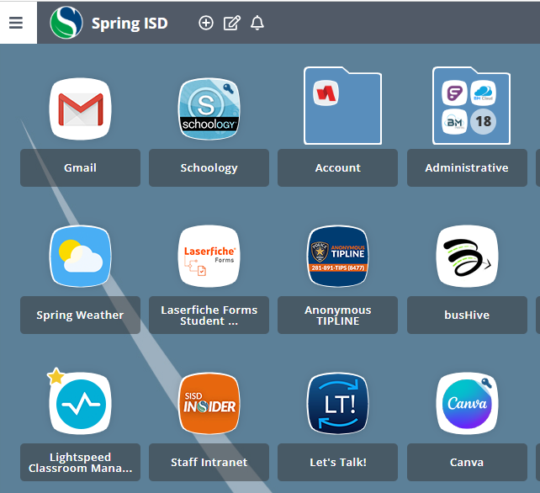
Where is Lightspeed?
Spring ISD Portal
•Using your login credentials, access your Spring ISD portal.
•Look for the blue and white Lightspeed logo.
•Star it to add it to Favorites below.
•Double click to open it.
*Professional Learning for 2026-2027 School Year - Starts July 2026

Slide 8
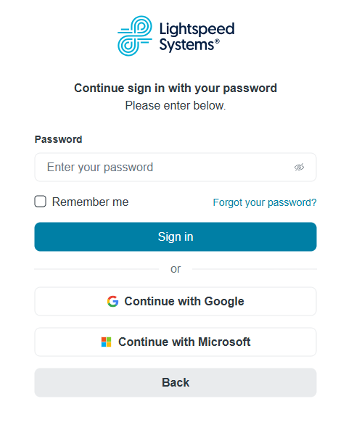
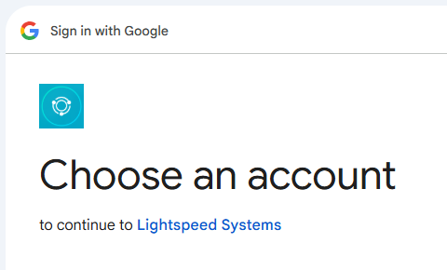
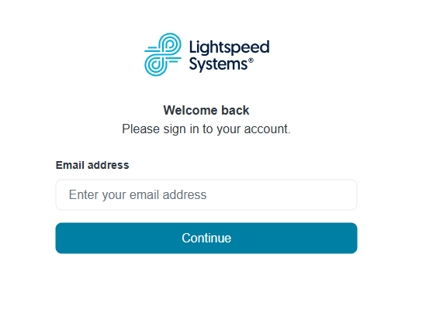
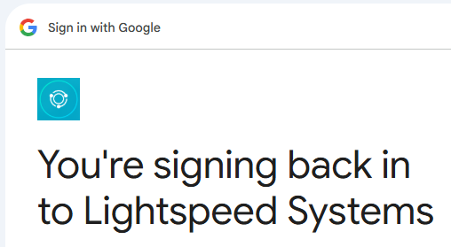
Logging into Lightspeed
Enter your Spring ISD email address and click continue.
On the password screen, use the “Continue with Google” button.
Select your work Google account, then click Continue to sign into Lightspeed Systems.

Slide 9
Classroom Settings

Slide 10
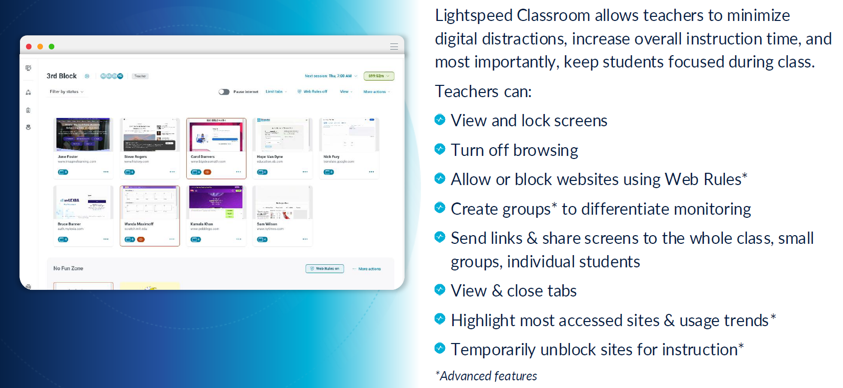
Overview
*Professional Learning for 2026-2027 School Year - Starts July 2026

Slide 11
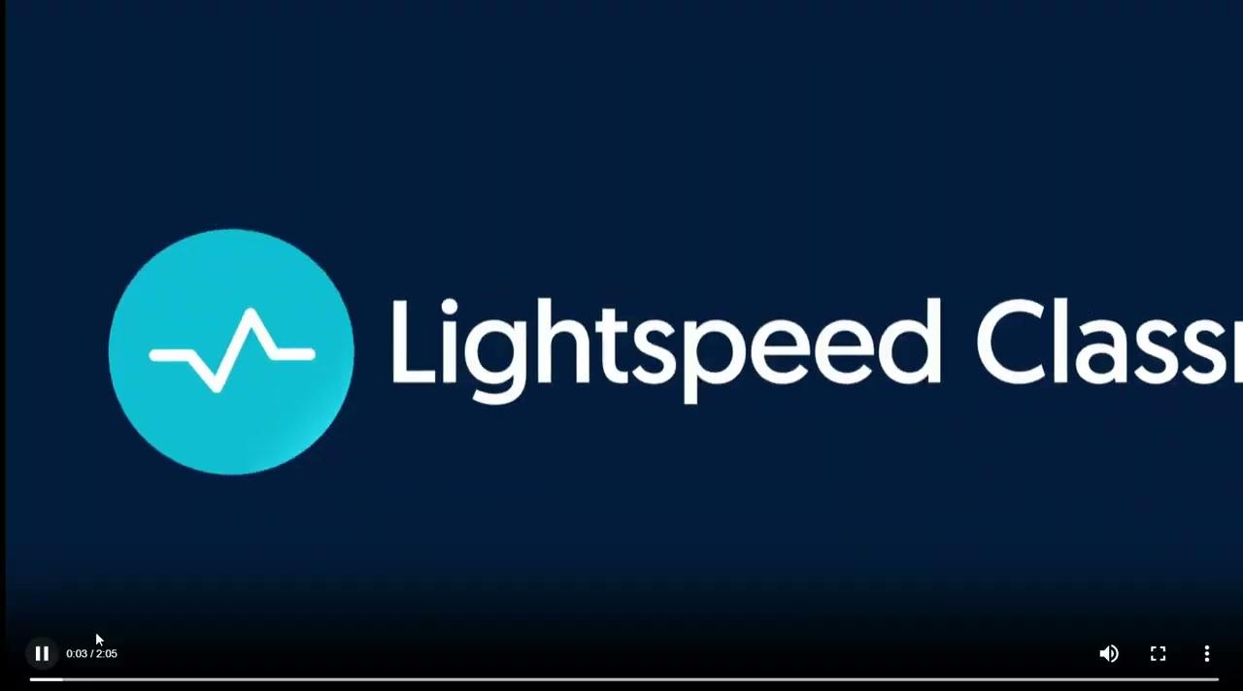
Quick Class Dashboard Video
Here’s a video overview of what Lightspeed will look like when you’re able to log in after schedules are loaded.
*Professional Learning for 2026-2027 School Year - Starts July 2026
Notes:
This is the Lightspeed Quick Class Dashboard Overview captured video.

Slide 12
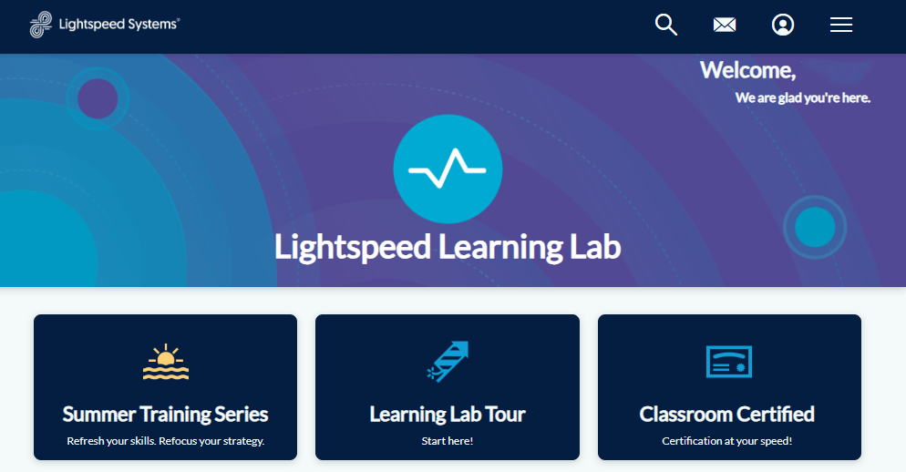

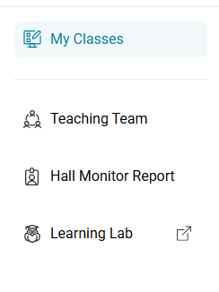
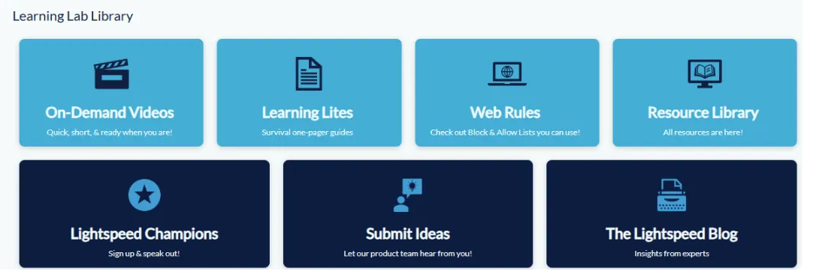
Learning Lab
Learning Lab is a one stop shop for how to videos and step by step instructions for skills inside Lightspeed.
*Professional Learning for 2026-2027 School Year - Starts July 2026
Notes:
The Learning Lab holds a variety of one pagers and short videos designed to be a quick resource for you within Lightspeed. One the left hand side of your dashboard screen, you’ll see Lightspeed Classroom with the short menu below it. Click on “learning lab” at the bottom to open the landing page. Once you scroll down a little bit, you should see the Learning Lab Library (try saying that 5 times fast!) and you can select the on demand videos or the learning lites one pagers. This is a perfect resource for those moments when your brain is stuck in neutral and your technology bestie is absent from school today!

Slide 13
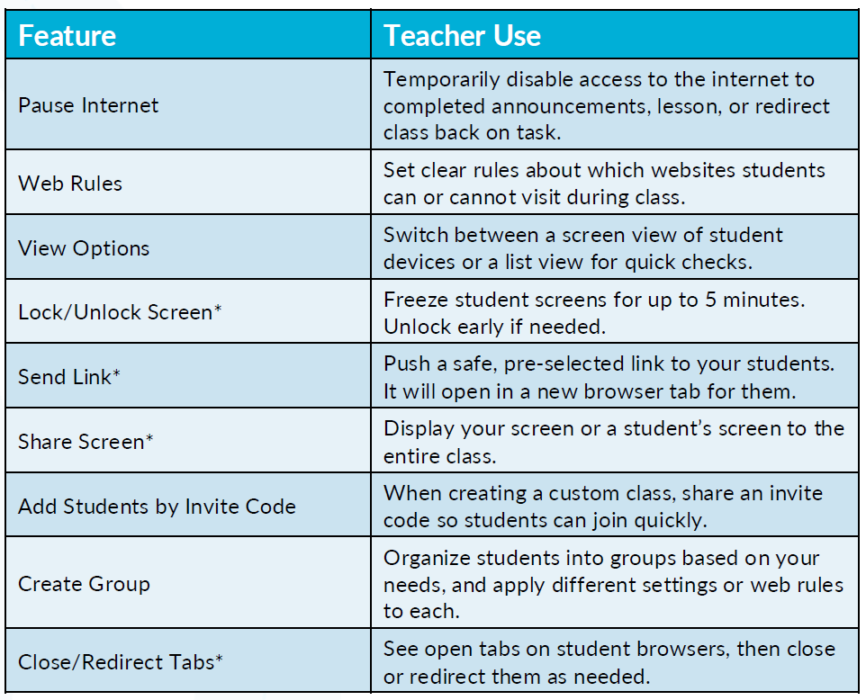
Default Classroom Settings
Features
•Features with an * indicates you can apply this to one student or the entire class.
•Features to Note:
Pause Internet
Lock/Unlock Screen
Share Screen
Close/Redirect Tabs

Slide 14
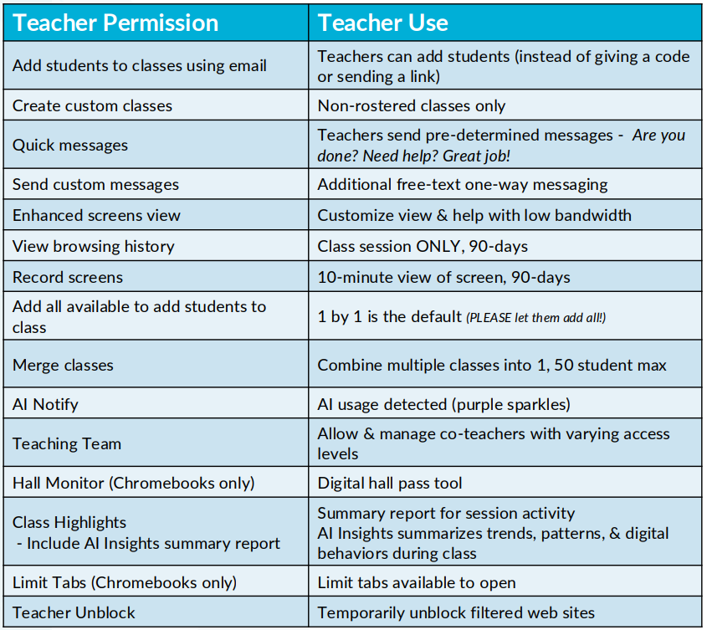
Classroom Instructional Tools
Features to Note:
Send custom messages
Additional free-text one-way messaging
View browsing history
Class session ONLY, 90-days
Record screens
10-minute view of screen, 90-days
AI Notify
AI usage detected (purple sparkles)
Teaching Team
Allow & manage co-teachers with varying access levels
Class Highlights (Include AI Insights summary report)
Summarizes trends, patterns, & digital behaviors during class
Limit Tabs (Chromebooks only)
Limit tabs available to open

Slide 15
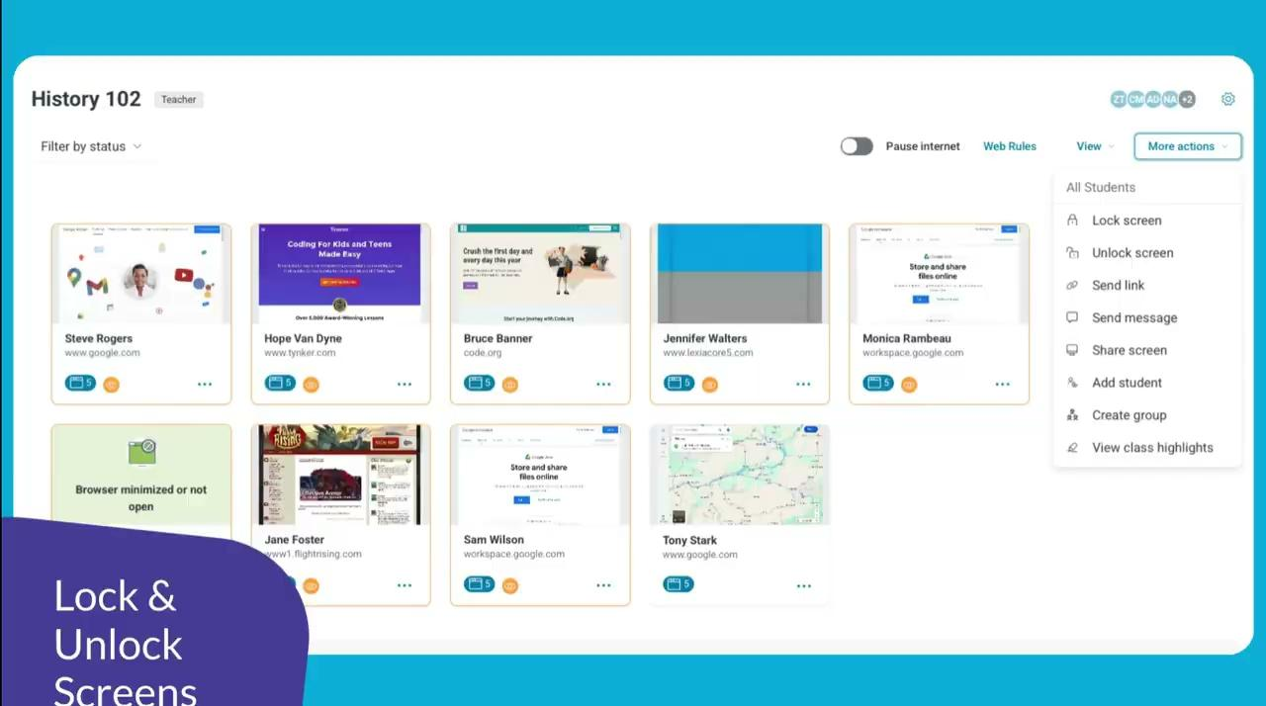
Lock Screen Feature
One feature that is included in the Learning Lab focuses on the ability to lock and unlock student screens. This can be done individually or as an entire class.

Slide 16
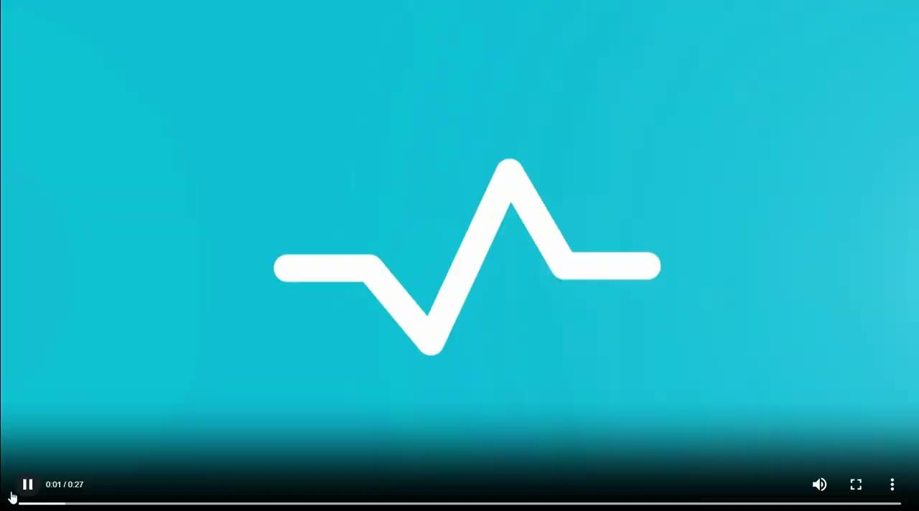
Pause Internet Feature
Pause Internet can be a valuable tool within Lightspeed to gain student attention and focus immediately.

Slide 17
Getting Started…

Slide 18
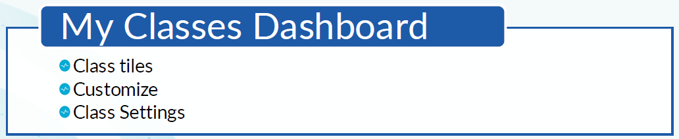
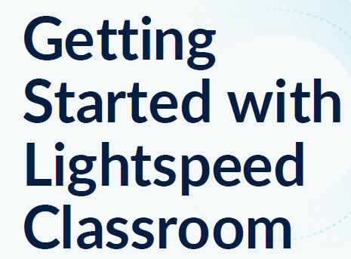
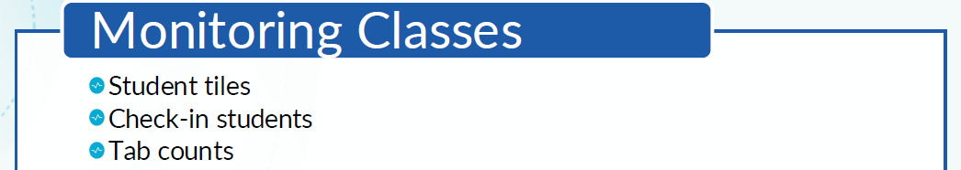
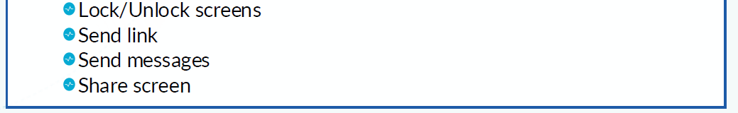

Slide 19
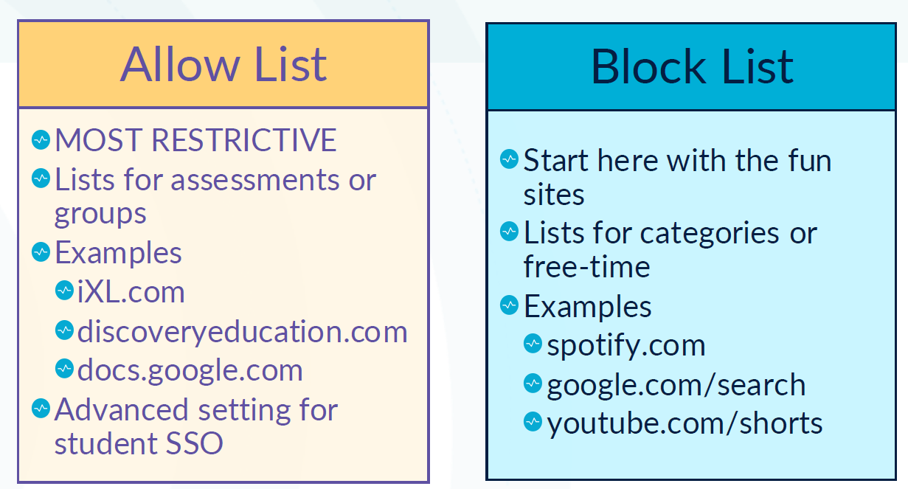
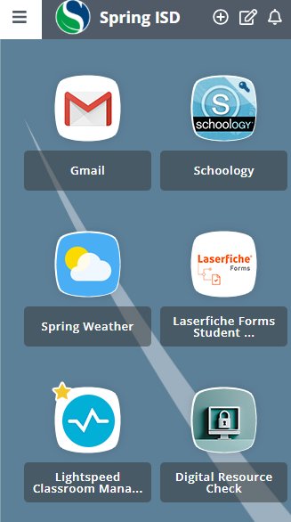
Web Rules: Allow vs Block Lists
Notes:
Using Web Rules, there are two primary tools: Block Lists and Allow Lists.
Block Lists are your best strategy for day-to-day management; they allow you to keep the web open for learning while quickly restricting the specific sites that might be distracting during your lesson.
While the Allow List option may seem like a better choice, it is often the most problematic. By design, it restricts students to only the specific sites you add, which can unintentionally block critical resources, hinder student research, and disrupt your lesson flow.
Use Block Lists for your standard classroom management, and reserve the Allow List only for highly specific, restricted activities where you truly need to limit students to a single, pre-approved resource.
While Lightspeed has lists within the Learning Lab of suggested websites to add to either list, please be cognizant that many of these programs cannot be used in our district because of Texas law. If you have questions, please go to the Digital Resources check in the Spring ISD portal.
Important: DO NOT block ANYTHING Google!! It creates many problems within our system.

Slide 20
My Classes Dashboard

Slide 21
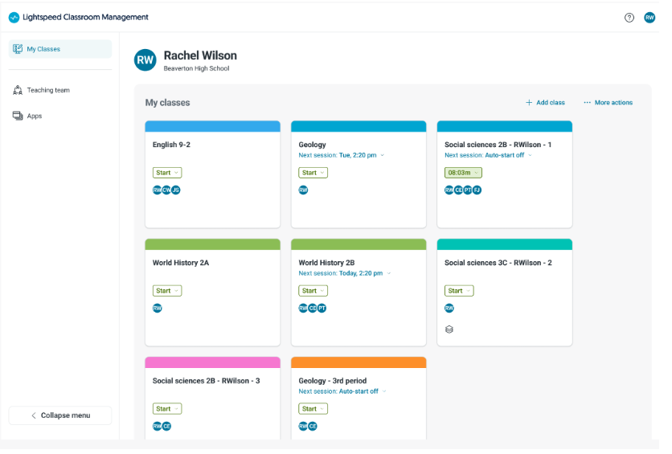
Lightspeed Teacher Dashboard
Classes
Displayed as tiles
Can see scheduled sessions
Auto start or manual start
Can customize colors and names
Ability to add custom class

Slide 22
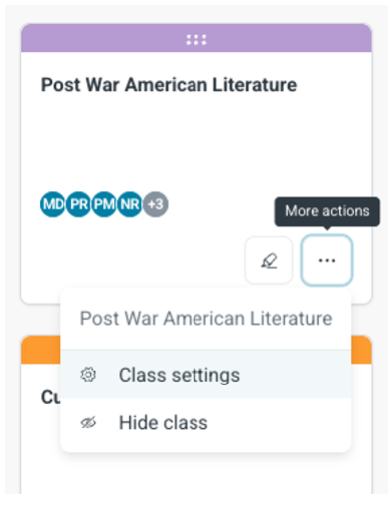
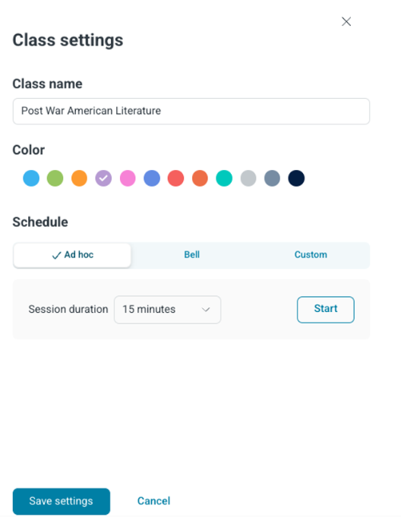
Lightspeed Teacher Dashboard
Customizing Tiles
Do NOT delete rostered classes; it is possible to “hide” them.
Drag and drop tiles in any order.
Change colors through More Actions, Class Settings.
Can customize colors and names.
Notes:
You can easily organize your view by dragging and dropping your class tiles into whatever order makes the most sense for your daily schedule.
If you have extra classes showing up that you don't need to see, do NOT delete them—instead, simply "hide" them.
To make your dashboard even more intuitive, you can use the "More Actions" menu under Class Settings to color code the tabs and rename the classes so they are easy to spot at a glance.

Slide 23
Scheduling

Slide 24
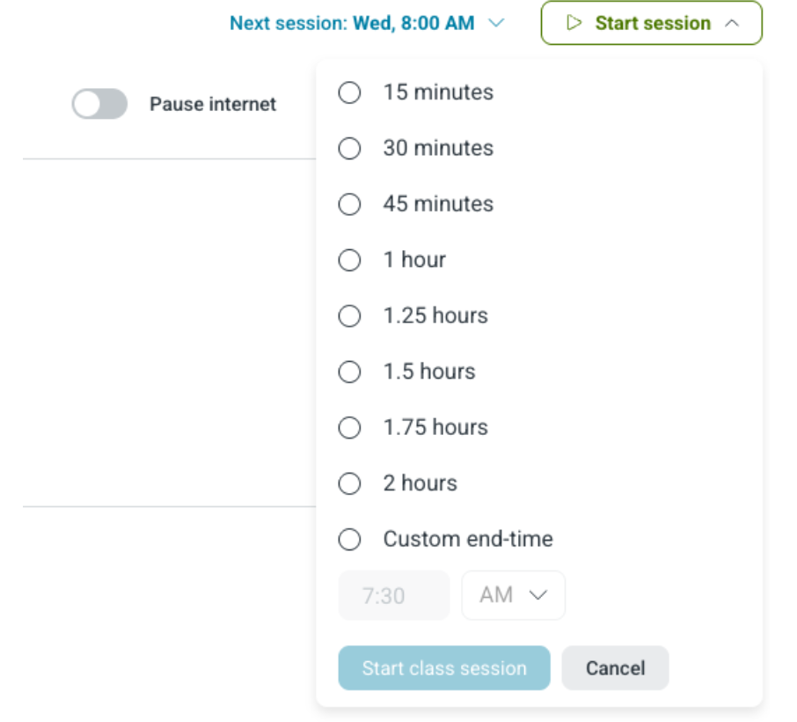
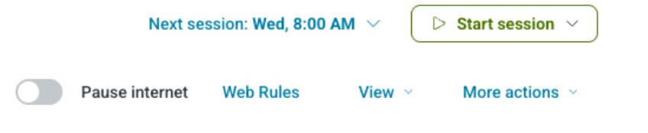
Start an On Demand Session
Individual Class
Click Start on the class tile
Click Start Session
Choose session length
  2 Hours Max
  Do NOT overlap times
Start Class session
Notes:
Sometimes you might need to launch a session on the fly, outside of your recurring schedule, or you may simply prefer to start sessions manually.
To do this, locate the specific class tile on your dashboard and click "Start."
From there, select your desired session duration. Please keep in mind that the maximum length for a single session is two hours.
It is also crucial to ensure you do not have overlapping sessions, as this can cause system conflicts. We would prefer that you don’t break Lightspeed!
Once you have verified your settings, click "Start Class Session" to begin.

Slide 25
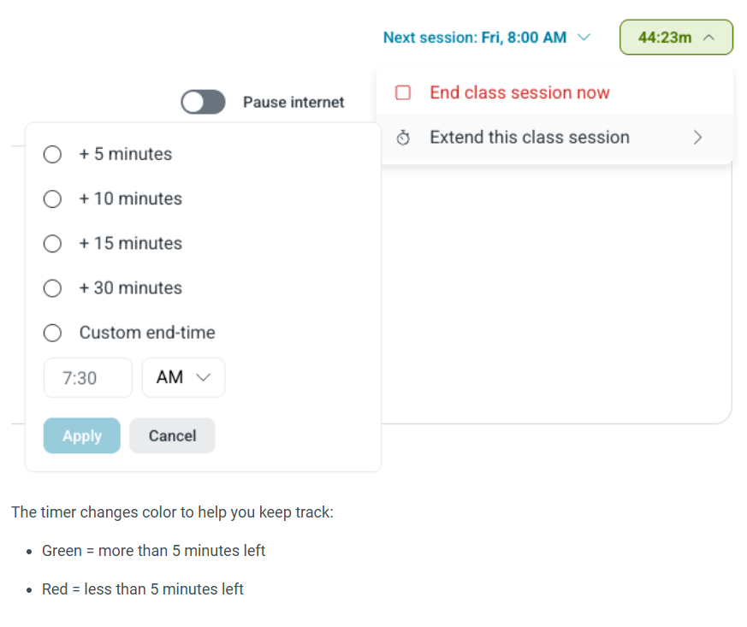
Extend or End a Session
Timers are color coded
  Green = 5+ minutes left
  Red = less than 5 minutes
Can add time to a class in increments
Able to end a session immediately
Notes:
As your class session progresses, keep an eye on your session timers to stay on track.
They are color-coded for your convenience: green indicates that you have five or more minutes remaining, while red warns you that you have less than five minutes left.
If you find that you need a little more time to wrap up your lesson, you can easily extend the session in increments.
Conversely, if your lesson finishes early or you need to stop for any other reason, you have the ability to end the session immediately at any point.

Slide 26
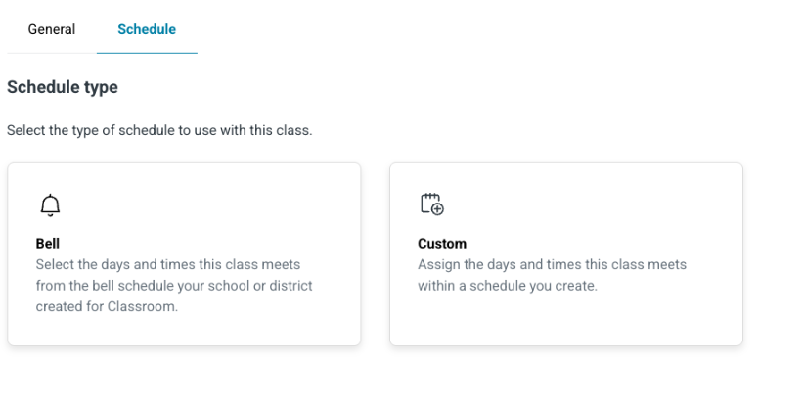

Bell and Custom Schedules
•Bell Schedules will not be loaded in Lightspeed because of the number of campuses with varying schedules.
•Teachers will need to create custom schedules.
•Custom Schedules allow you to make a personalized recurring schedule even for A/B days.
Notes:
Given the diversity of time structures across our campuses, the Lightspeed system will not come with pre-loaded bell schedules.
To bridge this gap, you will need to create custom schedules tailored to your specific teaching times. This feature is highly adaptable, allowing you to build personalized, recurring session patterns that align exactly with your instructional calendar, including complex A/B day rotations.

Slide 27
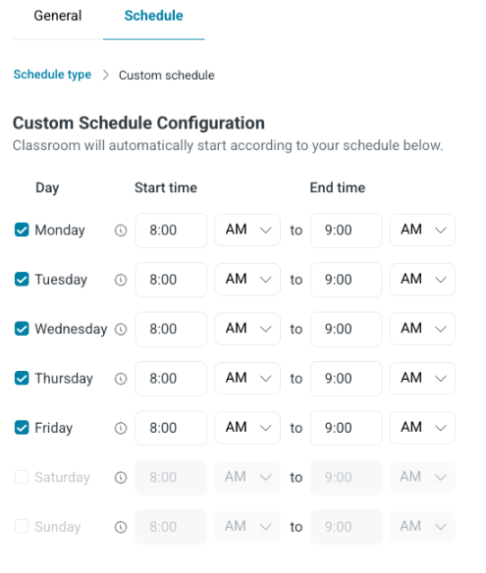
Custom Schedule Configuration
For each class, custom hours and days can be set for each course or section.
Warnings will be displayed for:
  Times over 2 hours/ exceeding maximum duration
  Starting outside allowed hours
  Overlapping with another session
Notes:
With custom schedules, you can designate specific hours and days for each of your courses or sections. To ensure your sessions are set up properly, the system includes built-in validation. You will see warning prompts if you accidentally create a session that exceeds the two-hour maximum, falls outside of permitted hours, or overlaps with another scheduled class. Pay close attention to these alerts, as they act as a safeguard to ensure your schedule is valid and error-free.

Slide 28
Classroom Monitoring

Slide 29
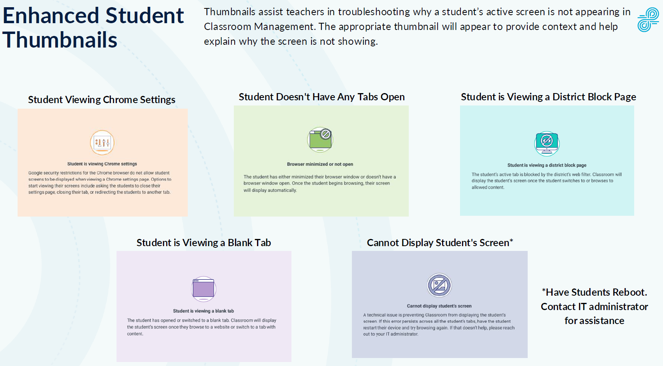
Student Screen Views

Slide 30
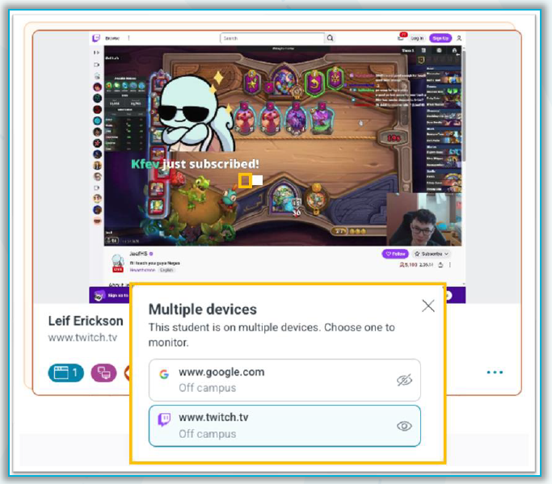
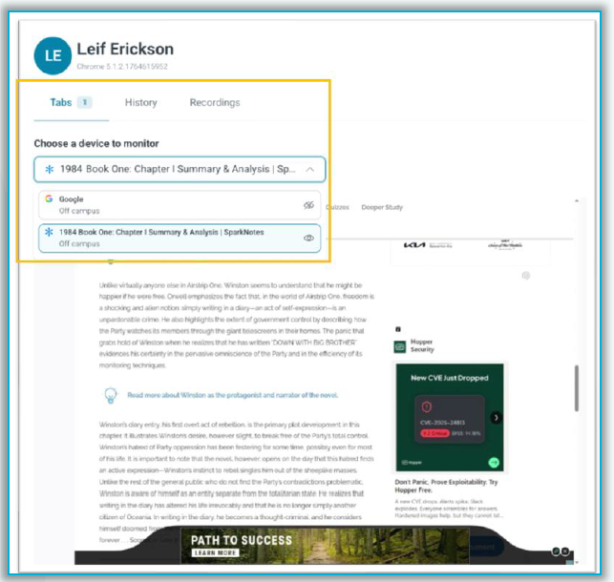
Multiple Devices Logged In
During an active class section, if a student is logged into multiple devices, teachers will see “stacked” tiles in the grid view along with a new device selection icon.This allows the teacher to choose which device to monitor.

Slide 31
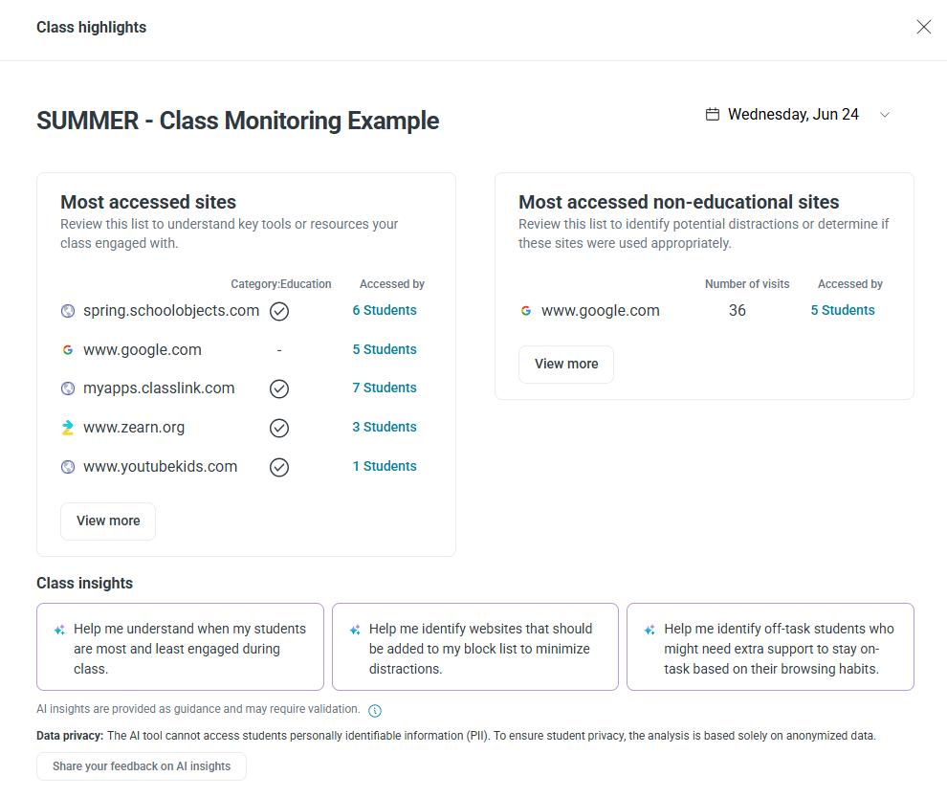
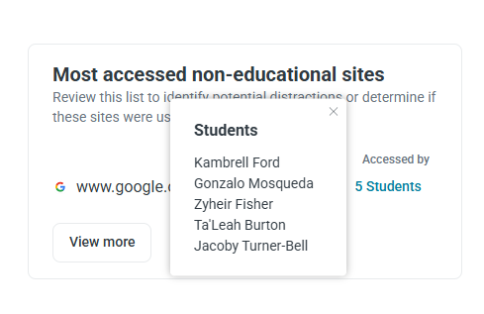
Class Highlights - Sites Accessed
Student A
Student B
Student C
Student D
Notes:
After your class session concludes, you can dive into the Class Highlights "Sites Accessed" view to review a detailed breakdown of the specific websites visited by your students throughout the period.
This is an excellent tool for verifying whether students engaged with your intended instructional resources or were diverted by other sites. Yes, you can cold bust your students right here. It can also provide sites to consider adding to your blocked list.

Slide 32
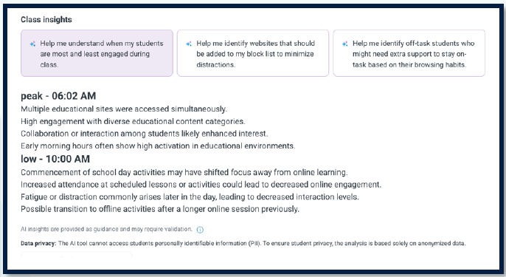
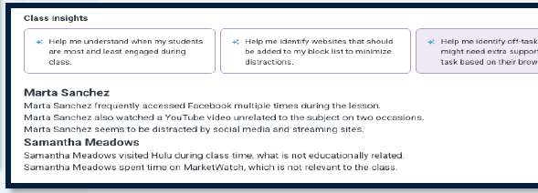
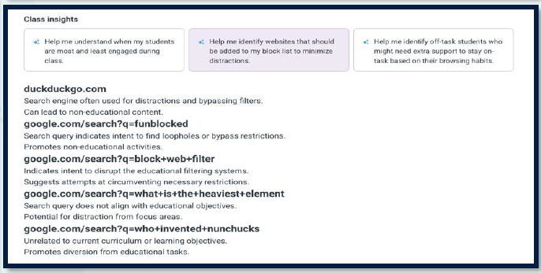
Class Highlights - Usage Trends

Slide 33

Need Additional Support?
https://bit.ly/StaffResourcesHub
*Professional Learning for 2026-2027 School Year - Starts July 2026
Notes:
We would appreciate it if you would take a few minutes to provide us feedback on the session. Thank you so much!

Slide 34
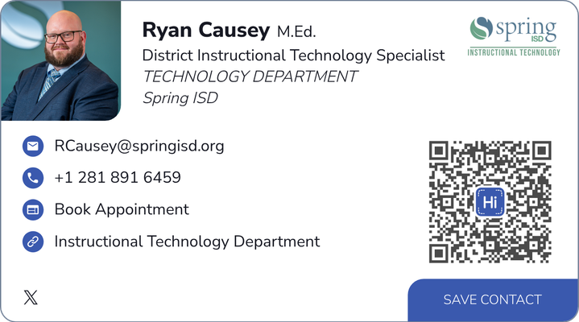
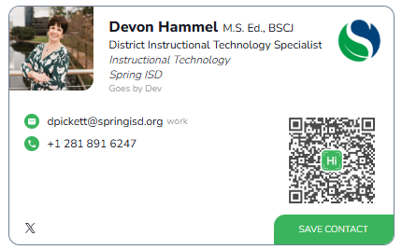
Contact Us
*Professional Learning for 2026-2027 School Year - Starts July 2026
Notes:
We would appreciate it if you would take a few minutes to provide us feedback on the session. Thank you so much!

Slide 35
Slide Heading (Montserrat 49)
Topic:
Category Three
Describe the key idea, strategy, or concept here. Keep it direct and impactful.
Describe the key idea, strategy, or concept here. Keep it direct and impactful.

Slide 36
Slide Heading (Montserrat 49)
Category One
Category Two
Category Three
Describe the key idea, strategy, or concept here. Keep it direct and impactful.
Describe the key idea, strategy, or concept here. Keep it direct and impactful.
Describe the key idea, strategy, or concept here. Keep it direct and impactful.

Slide 37

Session Survey
*Professional Learning for 2026-2027 School Year - Starts July 2026

Slide 38
Housekeeping Notes
Duplicate the slide before editing - we’ll then have fresh templates and consistency
Try to follow the fonts used on the title slide
  Heading: Arial 65 (bold)
  Subheading: Montserrat 35 (bold)
  Body: Poppins Normal - make it fit as large as possible
*Professional Learning for 2026-2027 School Year - Starts July 2026

Slide 39

*Professional Learning for 2026-2027 School Year - Starts July 2026

