Slide 1
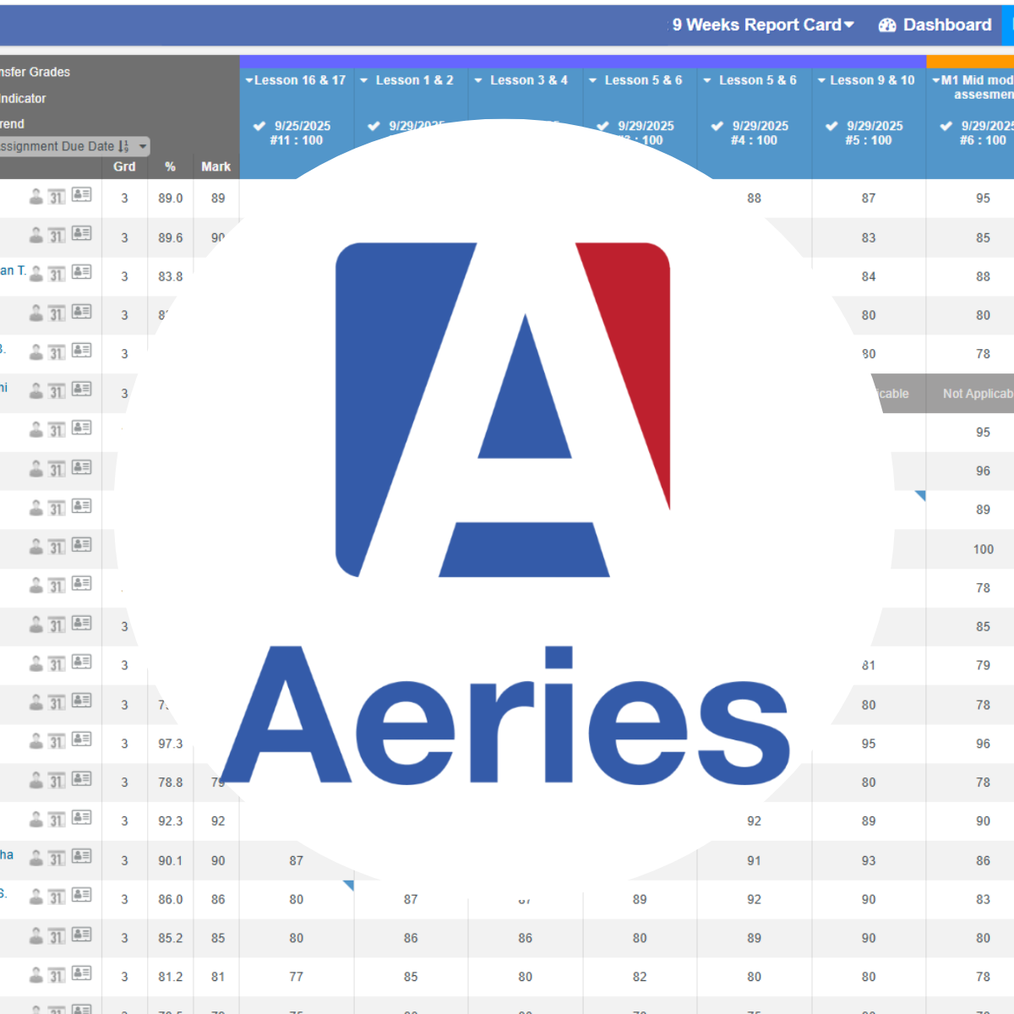
GRADEBOOK
Get Up & Running in Aeries:
Secondary Edition
Everything you need to know hit the ground running with Aeries!
participants guide
*Professional Learning for 2026-2027 School Year - Starts July 2026

Slide 2


Slide 3
Vision & Mission
VISION
The District shall be a premier choice in education where success begins with every student, every teacher, every day!
Spring ISD prepares students to be lifelong learners, critical thinkers, and responsible citizens who are ready to contribute, compete, and lead in today's global society.
MISSION

Slide 4
Session Agenda
1 |  | Welcome & Do Now
2 |  | Gradebook Essentials
3 |  | Teacher Reports 101
4 |  | Medical and Program Flags: PII
5 |  | Aeries Parent / Student Portal
6 |  | Q&A
Notes:
Read the slide.

Slide 5
Session Objectives
By the end of this session, participants will be able to…
Request access to Aeries through a ServiceNow ticket and supervisor approval process
Build a gradebook at the start of the year for semester and year-long courses.
Take attendance, run essential Teacher Reports, and navigate the Parent/Student Portal to support home-school communication.
Identify and know how to responsibly handle sensitive student information, including Medical and Program Flags and PII.
*Professional Learning for 2026-2027 School Year - Starts July 2026

Slide 6
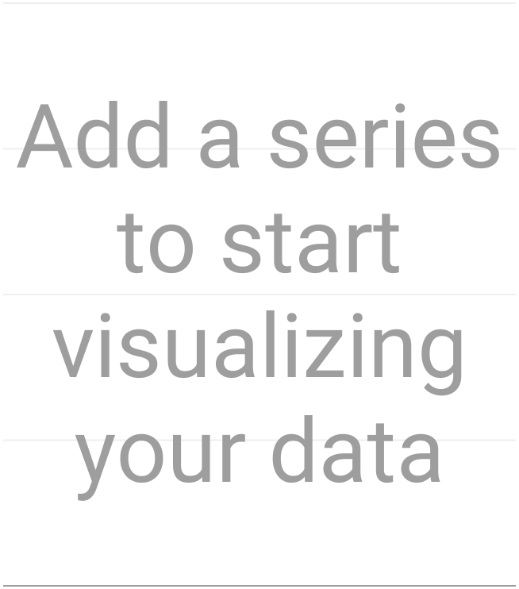
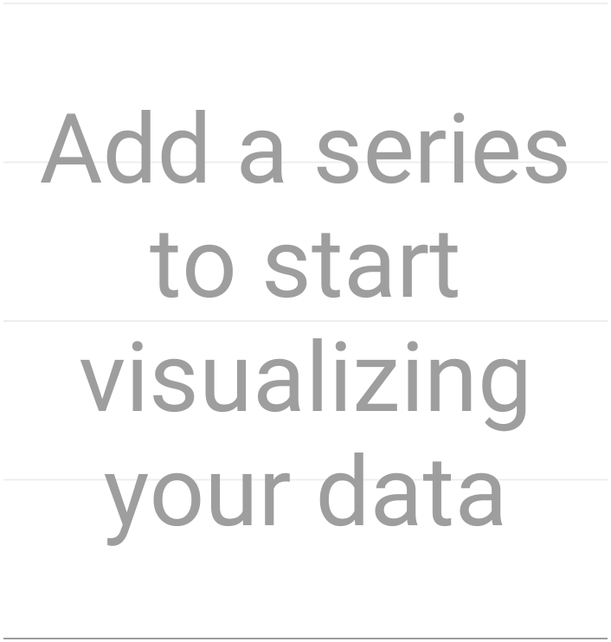
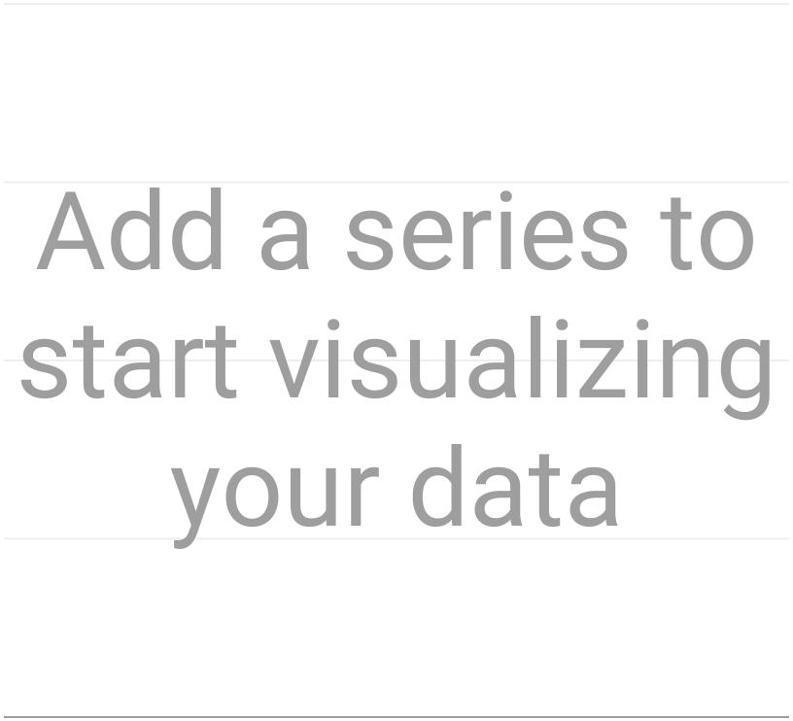
Do Now - Participant Results
*Professional Learning for 2026-2027 School Year - Starts July 2026
Notes:
Results from the Survey Response should load automatically. If Slide 7 does not refresh the slide.

Slide 7
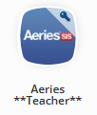

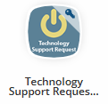
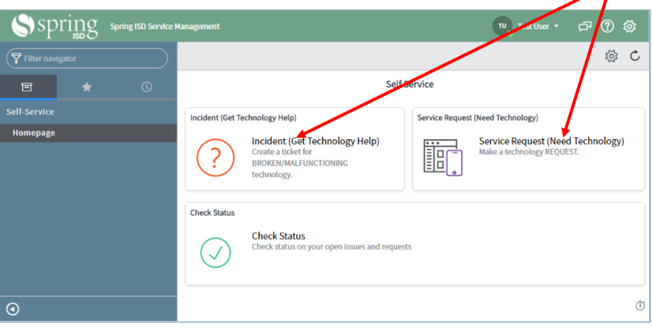
ServiceNow
No Aeries icon in your MySpring portal?
Here’s the steps to take:
Navigate to http://my.springisd.org — locate the “Help” Folder with the Technology Support Request icon.
Incident (Break/Fix) vs Service Request (Technology Request)
Call the Help Desk at x106357.
*Professional Learning for 2026-2027 School Year - Starts July 2026
Notes:
One skill we need all teachers at all levels to have is knowing how to submit technology tickets in ServiceNow. Believe it or not, sometimes names are missed for access to crucial programs, like Aeries, and putting in the technology ticket is the fastest way to correct the error. If you cannot see the Aeries teacher icon in your MySpring portal,you will need to navigate to the “Help” folder in order to click the Technology Support request icon to start the Process.
One important thing to note is the difference between an “incident” and a “service request.” Incidents are when something you presently have is not functioning correctly - it’s broken and needs fixing. A service request mean you don’t have access or need something you don’t have. Make sure you click the correct one because it will delay the response and potentially not be addressed.
Finally, write this number down or memorize it- 106357. This will put you in touch with our fabulous help desk folks who are great at troubleshooting with you in order to resolve your technical issues and challenges.

Slide 8

Gradebook Setup
Notes:
Once you have access to Aeries, and your Master Schedule has been set on your campus, you’ll be able to set up your gradebook for the school year. We have developed simple, short steps to make the process easier, so please follow our steps as outlined. Ready? Let’s go!

Slide 9





Getting Set Up
Mass Add Gradebook
Add/Drop Students
Manage Gradebook
A five step process that allows all gradebooks to be created for all courses assigned to a teacher.
The red button on the dashboard that must be addressed any time you see it.
Tread lightly! No extra
Only one section per gradebook. Do not modify!
Grades 6-12
Notes:
Going forward, all gradebooks will be created through the “Mass Add Gradebook” function on the gradebook dashboard. This is a five step process that will ensure that all gradebooks are set up correctly, all at the same time, and will not tempt you to get check mark happy and erroneously try to join gradebooks. Just say no to linking gradebooks!
(Click Iorad links to show Mass Add)
Next, Add/Drop students is a super important part of keeping your gradebook current and functioning correctly. Any time you see the red button on your gradebook dashboard, stop, drop and click. If you don’t, this can break the submission process for progress reports and report cards; that’s something you don’t want to be the cause of.
(Click Iorad link for Add/Drop Student)
Finally, there is a manage gradebook section within each course & section’s gradebook. We are going to encourage you to tread VERY lightly here and do not add extra check marks. Yes, you may have done it before, but it messes up the submission and recording system since every course has a different number. We understand that you want to have your gradebooks joined together for simplicity, but the need for simplicity wrecks the functionality and processing on the other side. Have you ever had to hand write in a whole class for verification or handwrite a report card? Extra check marks in this area are the cause of that. Don’t do it!
[Show the Iorads linked on this page. If a BenQ board is available, ask for a volunteer to do the interactive piece.]

Slide 10
Creating Assignments
Notes:
Once the course gradebooks have been created, we can move into Creating Assignments within each. This is where you can share assignments across courses when you teach more than one section of the same course.

Slide 11
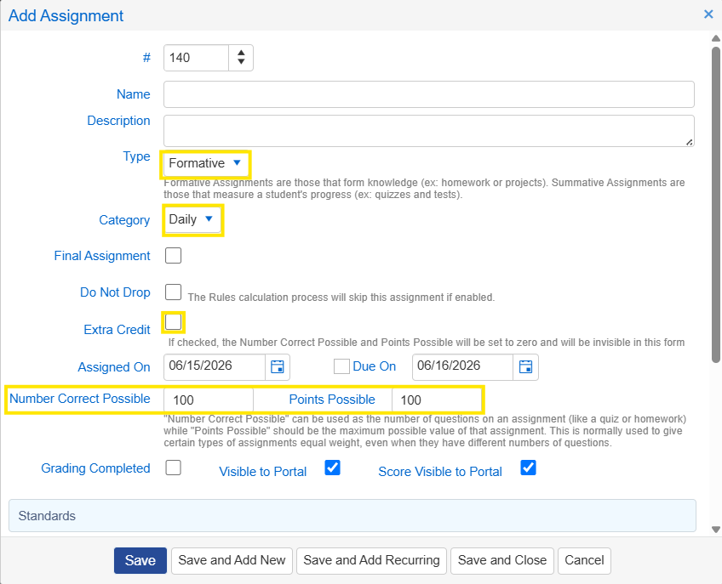
Creating Assignments
Things to Consider…
Formative vs Summative
Note: Is it practice or a check for mastery?
Categories: Daily and Major
Note: These are the only categories allowed.
Using Points- 100/100 to keep it simple.
Note: Assignment automatically defaults to Extra Credit if left Blank
Extra Credit
Note: Extra Credit box must be unchecked after creating assignment or will continue into subsequent entries.
*Professional Learning for 2026-2027 School Year - Starts July 2026
Notes:
A few things to keep in mind when you are creating assignments.
Consider the difference between an assignment that is a formative assessment versus a summative assessment. Formative grades guide learning and provide feedback during instruction, while summative grades measure and evaluate student mastery at the end of a learning period. In Aeries, this selection does not have a big impact at the secondary level, but does for elementary, so it’s just something for you to think about.
A step further - is this a daily grade or a major grade? You may not create any additional categories; this also applies to Schoology as it carries across into Aeries. Board policy and campuses will dictate the number of grades for each category.
Using points. Please, please, please keep your points to 100/100. There have been many, many instances where 90 was put in instead of 9 when total points available was 10 -- and it throws all of the calculations out of whack. Additionally, this is our #1 area to field phone calls from parents because they only see the single digit grade, not the single digit points possible. Also, if you leave the points possible and the number correct possible blank - it will treat it as an extra credit assignment and add those points to the average.
And speaking of extra credit, please proceed with caution. If you check the box to turn on extra credit, it will stay on until you uncheck it, potentially affecting all subsequent assignments and making averages way above 100. Be sure to uncheck it on your very next assignment!
[Show the Iorad linked on this page. Ask for volunteer, if possible]

Slide 12
Taking Attendance
Notes:
One of the most important things you will do every day is to take attendance of the students in your classes. Student attendance drives the funding that is received from the state, which in turn funds our paychecks.

Slide 13
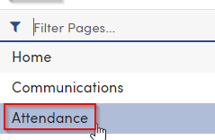

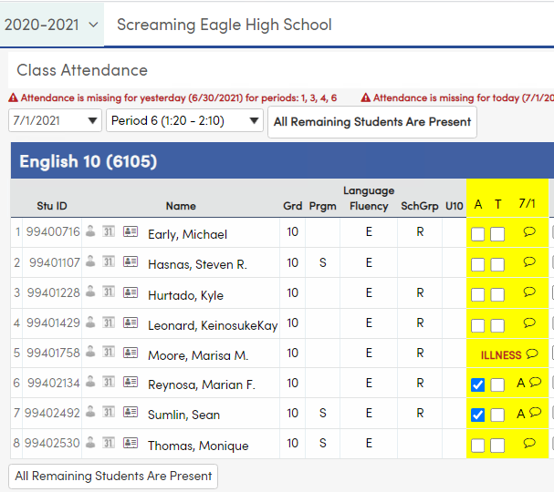
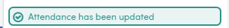
Attendance
Things to Consider…
Attendance is taken in Aeries.
ADA Time: Attendance MUST be taken during this short 10 minute window, 5 minutes on either side of the actual ADA time.
Note: Make sure to log-in to Aeries shortly before this window because the system will Times-Out after 10 mins and will not register your input even though the page will state that it has.
Do not leave the window while the program is saving the information.
Ensure you have a green “Attendance has been updated” message prior to leaving.
*Professional Learning for 2026-2027 School Year - Starts July 2026
Notes:
Attendance will always be taken in Aeries. There are exceptions: substitute teacher, network outage, etc. However, all of the information must eventually be keyed into Aeries for documentation purposes.
Be aware that ADA time is different from elementary to middle to high school and even campus to campus. Generally, the window lasts for 10 minutes and attendance MUST be entered into Aeries at this time. Memos of concern and a page having you, the teacher, document why attendance was not taken will be given if you have not properly followed attendance procedures. This is money!
Attendance will be taken by choosing the Attendance line in the left menu bar. Students who are not present will be checked in the “A” column to denote absence. You may see other notations put in by the front office for early dismissal or tardies; teachers, just focus on attendance. You want to ensure that you do not leave the window if the program is saving the information; wait until you have the green box saying “Attendance has been updated.”

Slide 14
Teacher Reports 101
Notes:
Let’s dig into some examples of helpful reports that you will need as the teacher of record.

Slide 15
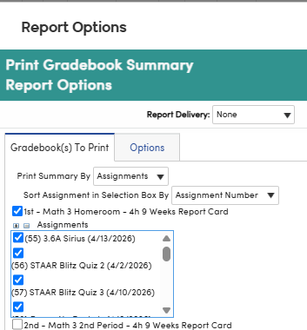
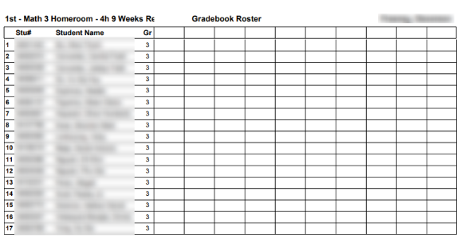
Teacher Reports 101
Gradebook Summary Export to Excel
Gradebook Roster
Allows teachers to download their gradebook into Excel for current terms and for previous.
An easy way to have a printable list of student names in spreadsheet form.
Notes:
Two of the reports that are quite helpful are the Gradebook Export to Excel and the Gradebook Roster. I don’t know of a teacher who doesn’t need a copy of their roster at one point or another, and Aeries allows you to print the roster in a variety of formats so you can utilize the information in multiple ways. And every quarter, you will need to upload your gradebook for the marking period, therefore, the gradebook export will be a valuable report to be familiar with.
[Show the Iorads linked on this page.Use a volunteer if possible.]

Slide 16
Medical and Program Flags: PII
Notes:
We are now going to jump into an area that has sensitive information about your students and how to handle it. PII has become a focus area for scrutiny in the last few months in the school district with some events that have occurred..

Slide 17
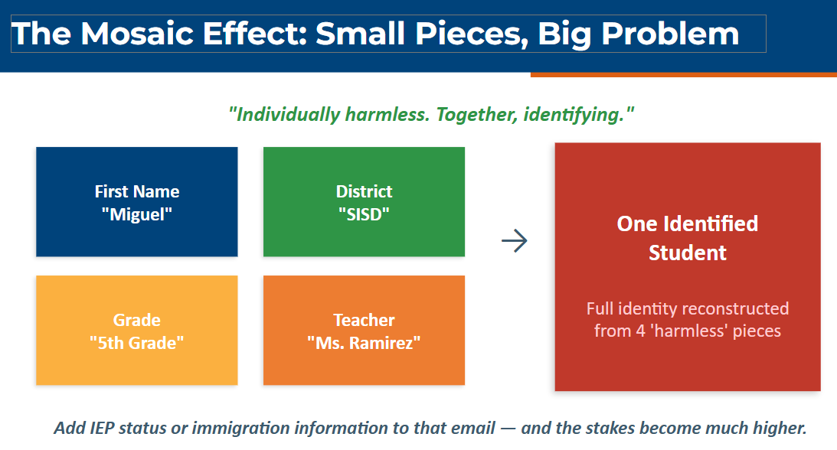
Medical and Program Flags: PII
Sensitive Information
•PII = any information that can identify a specific student — alone, or when combined with other data.
•As a teacher, you have access to medical information and can see program flags.
•This information should be treated as sensitive and not shared with others.
*Professional Learning for 2026-2027 School Year - Starts July 2026
Notes:
Read the slide.

Slide 18
Aeries Parent / Student Portal
Notes:
One part of Aeries that you may have to support as a teacher is how to access the parent and student portals.

Slide 19
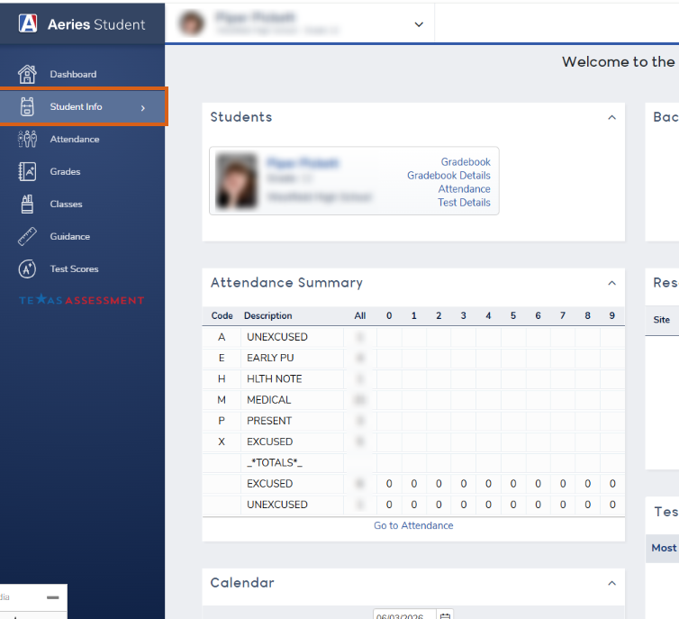
Parent / Student Portal
Secondary- BOTH Parents & Students
Students Grade 6-12 have access to the Aeries Student Portal inside their Spring ISD student portal.
The Aeries Parent Portal can be accessed through the Spring ISD portal using the Parent unique Username and Password.
Both groups can view Student Attendance, Grades, Classes, Test Scores, and Discipline information
* Schoology can also be accessed through the Spring ISD Portal.
*Professional Learning for 2026-2027 School Year - Starts July 2026
Notes:
Read the slide and show the iorad

Slide 20
Q&A
Notes:
This is your chance to ask any burning questions you may have!

Slide 21

Need Additional Support?
https://bit.ly/StaffResourcesHub
*Professional Learning for 2026-2027 School Year - Starts July 2026
Notes:
We would appreciate it if you would take a few minutes to provide us feedback on the session. Thank you so much!

Slide 22
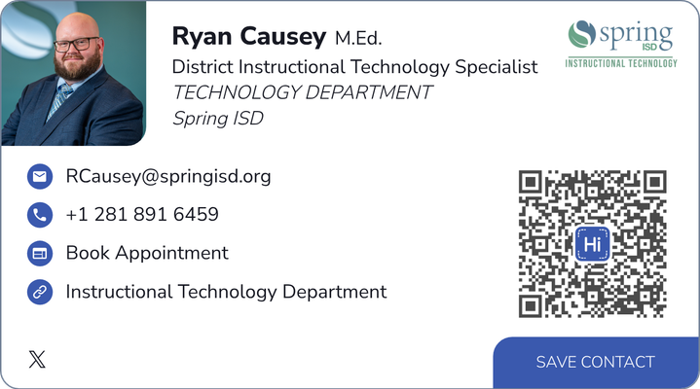
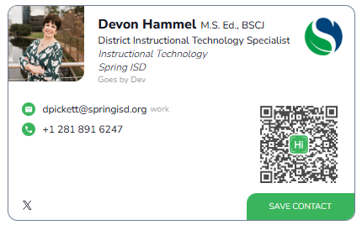
Contact Us
*Professional Learning for 2026-2027 School Year - Starts July 2026
Notes:
We would appreciate it if you would take a few minutes to provide us feedback on the session. Thank you so much!

Slide 23
Slide Heading (Montserrat 49)
Subheading
•Key Point One — write a clear, crisp statement here
•Key Point Two that provides important detail or context for this topic
•Key Point Three
•Key Point Four with a strong, direct takeaway
*Professional Learning for 2026-2027 School Year - Starts July 2026

Slide 24
Slide Heading (Montserrat 49)
Category One
Category Two
Category Three
Describe the key idea, strategy, or concept here. Keep it direct and impactful.
Describe the key idea, strategy, or concept here. Keep it direct and impactful.
Describe the key idea, strategy, or concept here. Keep it direct and impactful.

Slide 25
Slide Heading (Montserrat 49)
Topic:
Category Three
Describe the key idea, strategy, or concept here. Keep it direct and impactful.
Describe the key idea, strategy, or concept here. Keep it direct and impactful.

Slide 26

Session Survey
*Professional Learning for 2026-2027 School Year - Starts July 2026

Slide 27

*Professional Learning for 2026-2027 School Year - Starts July 2026

