Slide 1

Seeing the Forest Through the Weeds Inventory Through Polaris Weeding Workflows
Kristen Tait, Department Head of Access Services
Brandon Bolek-Toubeaux & Cameron Rooney-Crawford, Assistant Department Heads (TS & CS)
Sam Hollo, Library Assistant I
Baldwin Public Library (Birmingham, Michigan)

Slide 2
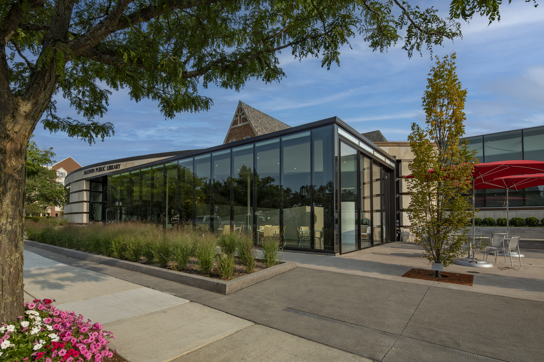

Background
+ Class V Library
+ 40,000 patrons
+ Polaris users since 2019
+ 100 staff

Slide 3
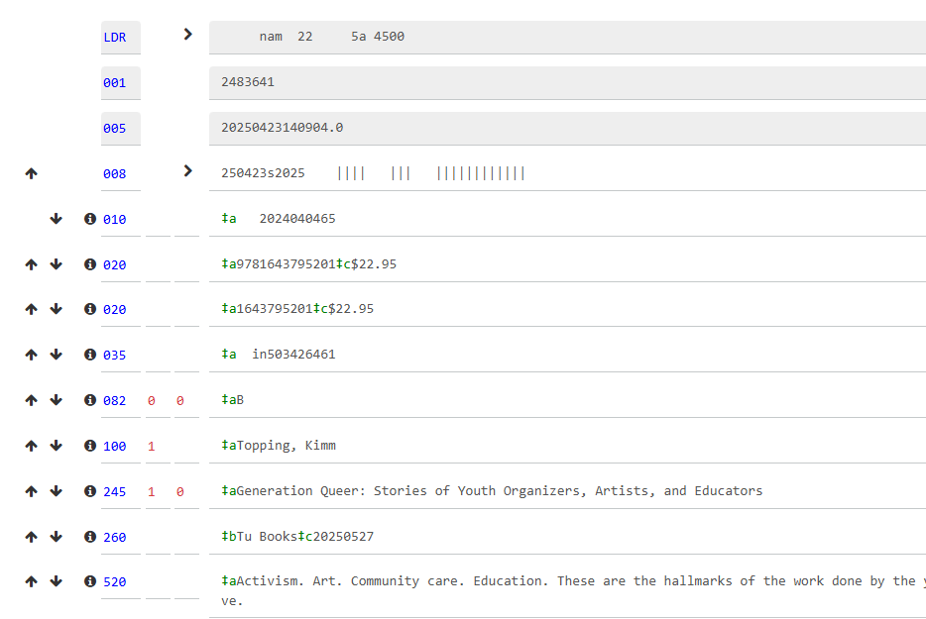
The State of the Catalog (ca. 2019)

Slide 4
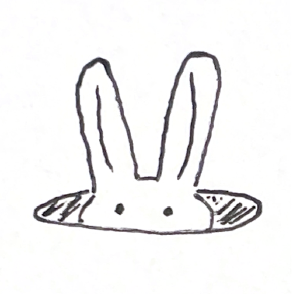
Disclaimers…

Slide 5
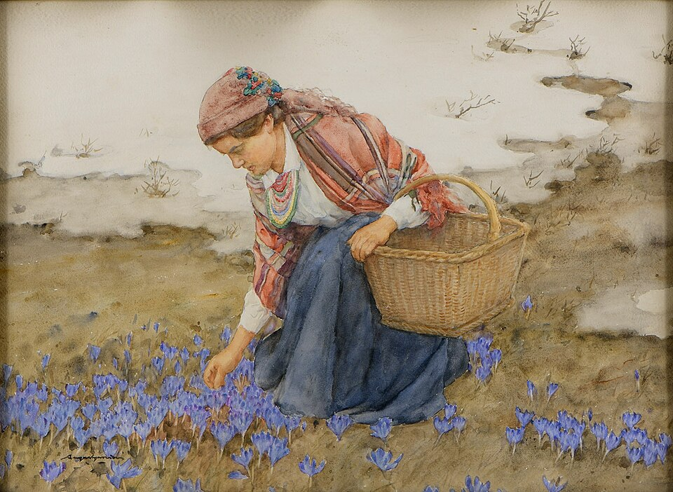
To weed, but not to weed: setting up weeding criteria, sans filters
Notes:
https://commons.wikimedia.org/wiki/File:Aleksander_Augustynowicz_Blumenm%C3%A4dchen.jpg
{{PD-US}}

Slide 6
Phase Structure
Phase 3 (Outliers)
Phase 2 (Roaming)
Phase 2.5 (Stamping)
Phase 1 (Generative)
Phase 0 (Foundation)

Slide 7
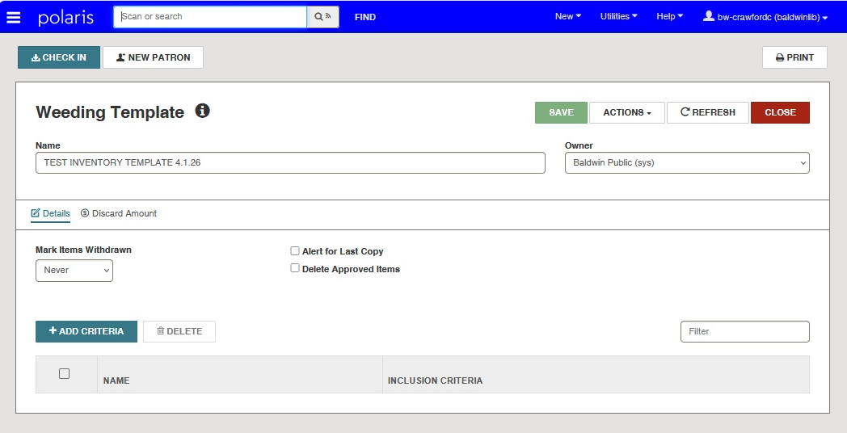
Phase 0: Generating a Weeding Template

Slide 8
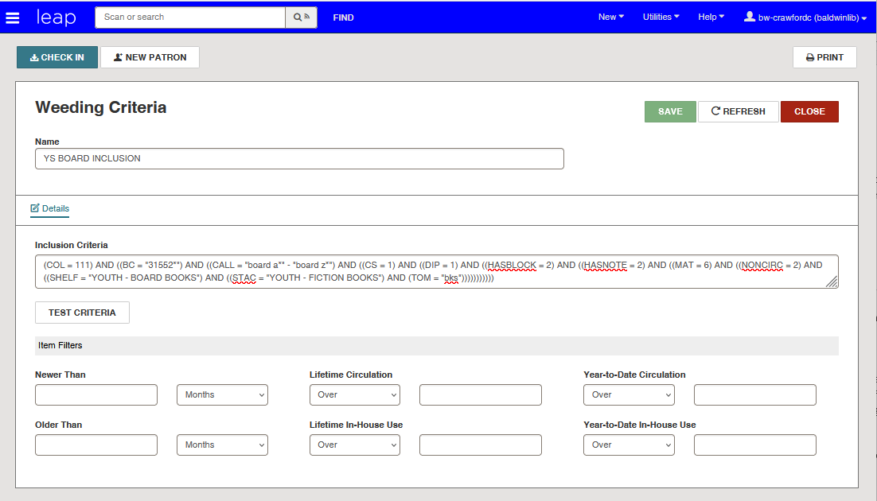
Phase 0 (continued): Adding Inclusion Criteria

Slide 9
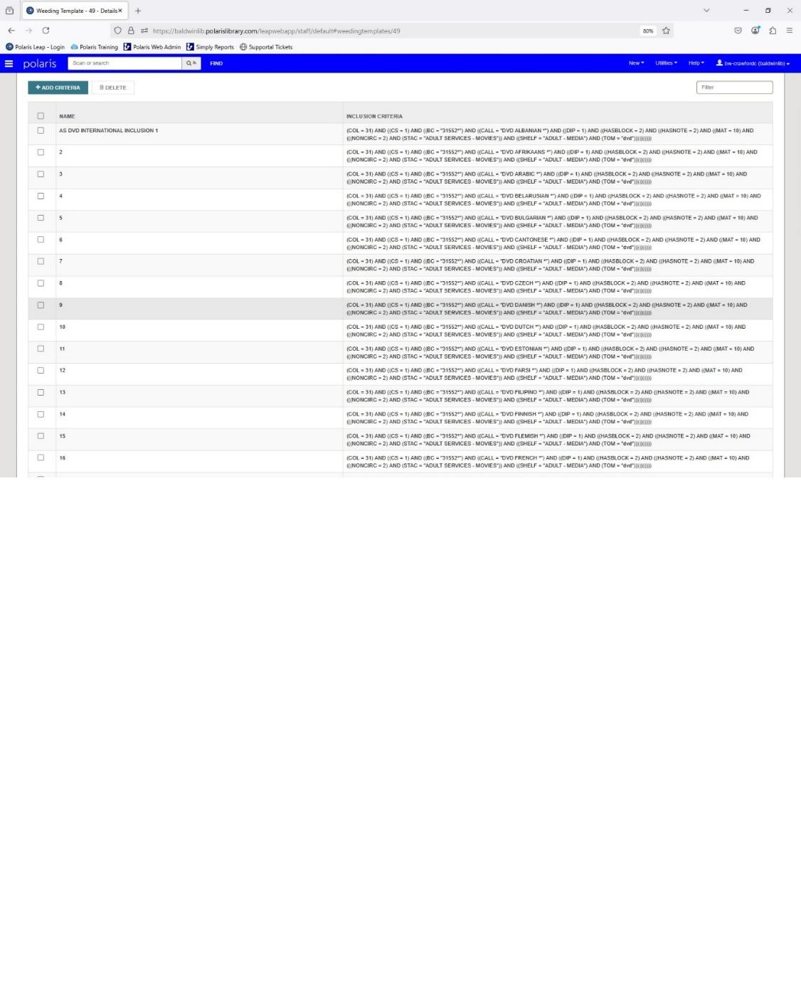
Inclusion criteria gone wild

Slide 10
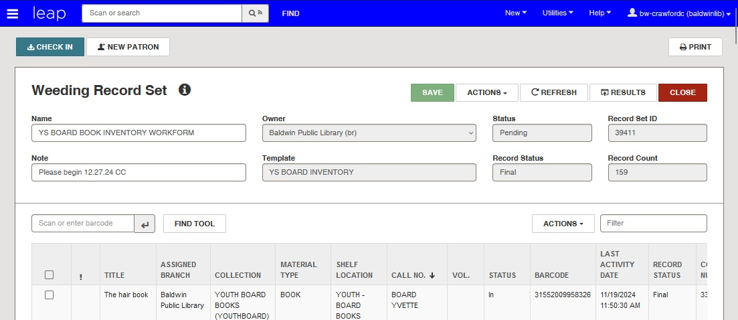
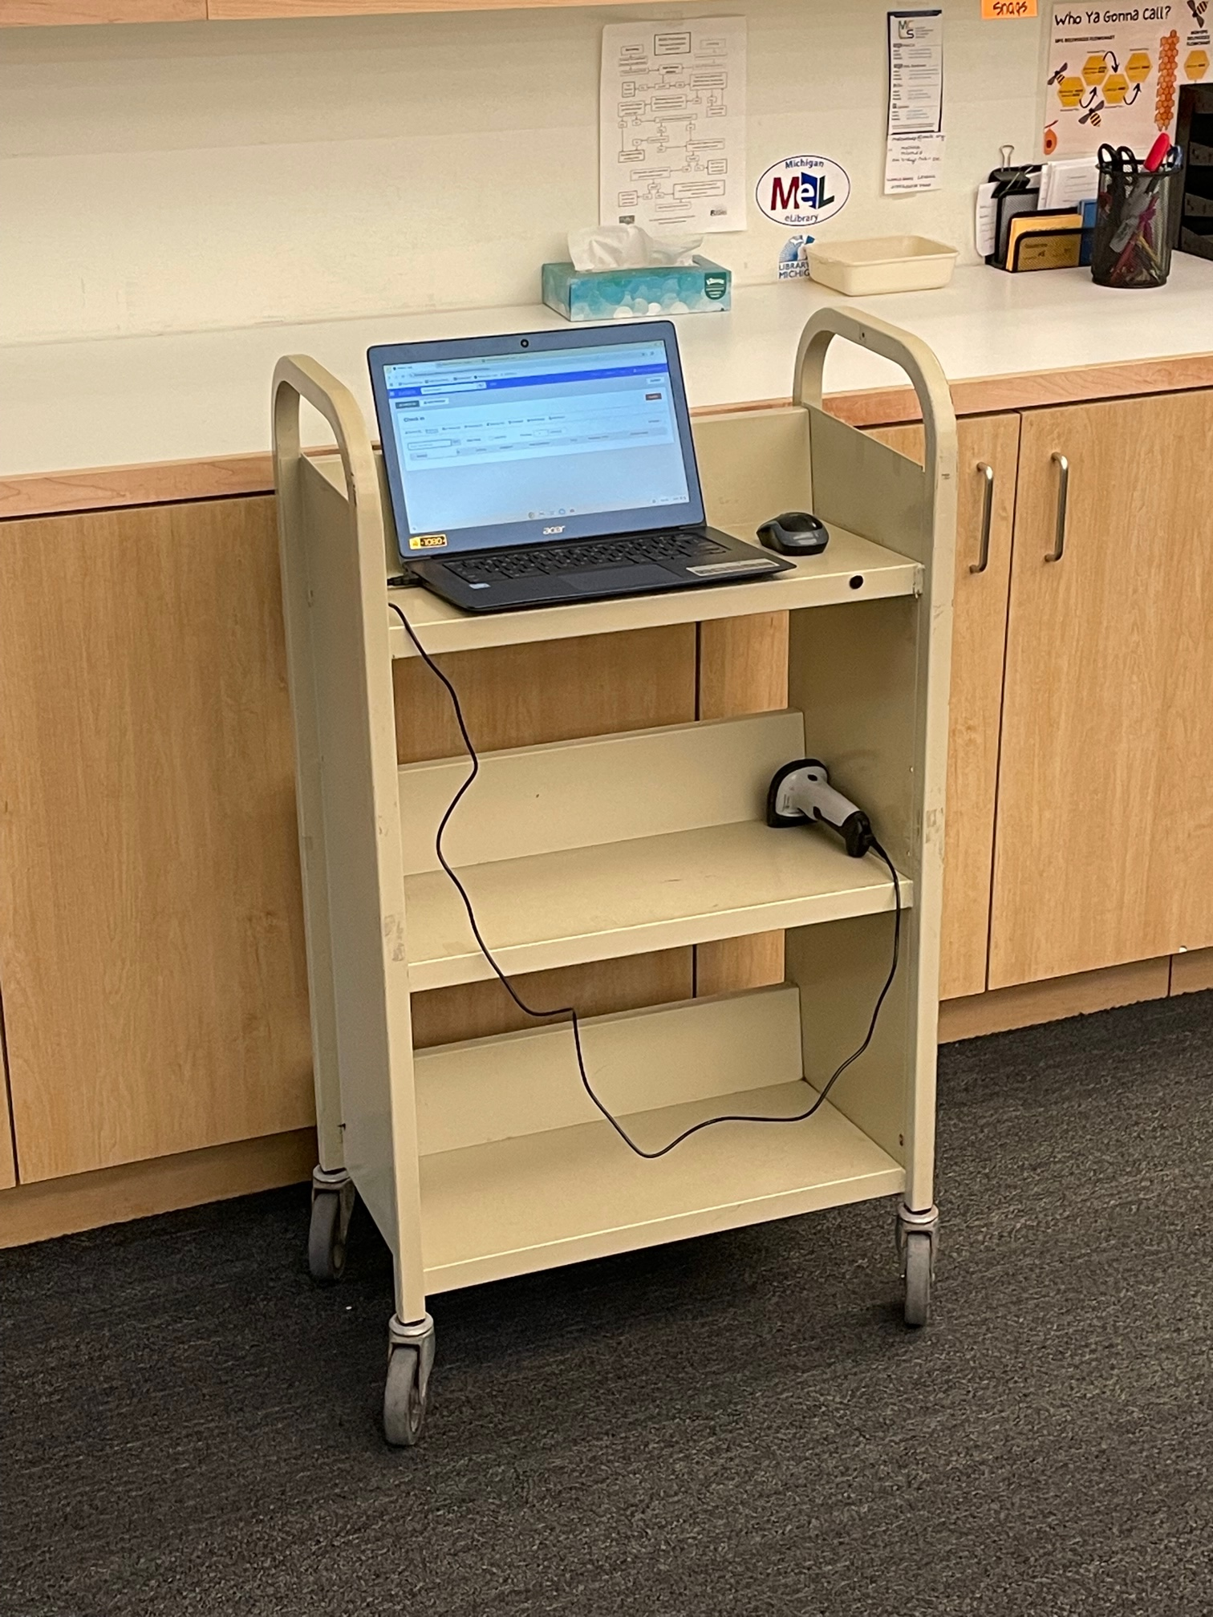

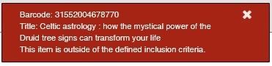
Phase 1: Inventory proper

Slide 11
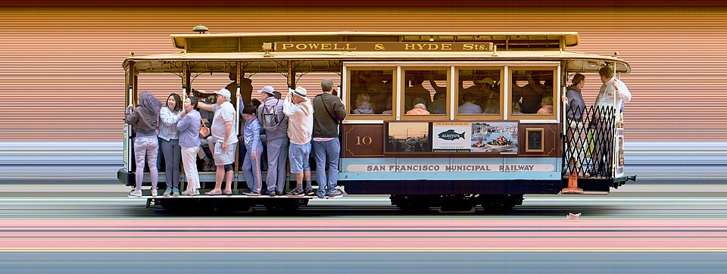
Wherefore art thou, ‘In’ status items? The search for roaming items
Notes:
https://en.wikipedia.org/wiki/File:Strip_photo_of_San_Francisco_Cable_Car_10.jpg

Slide 12
Phase 2 (diagram)
SQL Statement
Phase 2 Item Record Set
NOS Item Record Set
Weeding Record Set
AddFromFile_ErrorReport.txt

Slide 13

Shall I Compare Thee, to the Inventoried? Digital ‘stamping’ of inventory
Notes:
Photograph of a Swiss Trail Blazing sign, by Axel Tschentscher
https://commons.wikimedia.org/wiki/File:Swiss_Trail_Blazing_Sign_2019-08-31_13-00.jpg

Slide 14
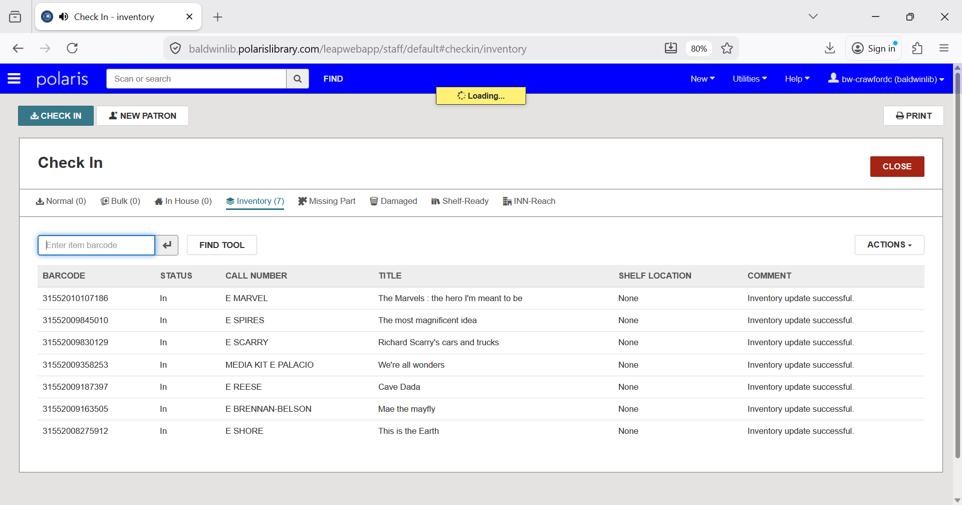
Phase 2.5 Inventory Check In

Slide 15
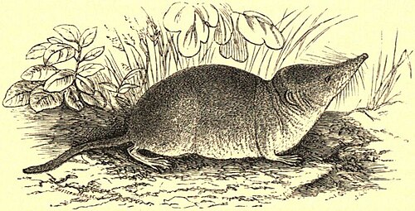
The taming of the few (left behind): catching the ‘out’-liers
Notes:
Image source: Encyclopædia Britannica, 9th ed., Vol. XXI, p. 843; reprinted in the 11th ed., Vol. XXIV, p. 1015.

Slide 16
Phase 3 (diagram)
Scheduled SQL Statement
Phase 3 Item Record Set
NOS Item Record Set
Weeding Record Set
AddFromFile_ErrorReport.txt

Slide 17
Considerations (and some relevant Idea Exchange)
+ Staff choice in error report output from ‘add from’ function
+ Greater specificity in weeding record set red toasts

Slide 18
Questions?
Comments? Suggestions?
Brandon Bolek-Toubeaux
brandon.bolek@baldwinlib.org
Sam Hollo
sam.hollo@baldwinlib.org
Cameron Rooney-Crawford
cameron.crawford@baldwinlib.org
Kristen Tait
kristen.tait@baldwinlib.org

