Slide 1


Slide 2

SQL Basics for Polaris
Matt Hammermeister
Pinnacle Library Cooperative
Download Course Resources: pinnaclelibraries.org/iug

Slide 3
Agenda
9:30 – 10:30
Theory / Structure
10:30
BREAK
10:45 – 12:00
Wrapping Up
12:00 – 1:30
1:30 – 2:30
2:30
2:45 – 3:30
Lunch
Building a Query / Examples
BREAK
Joins / Examples

Slide 4
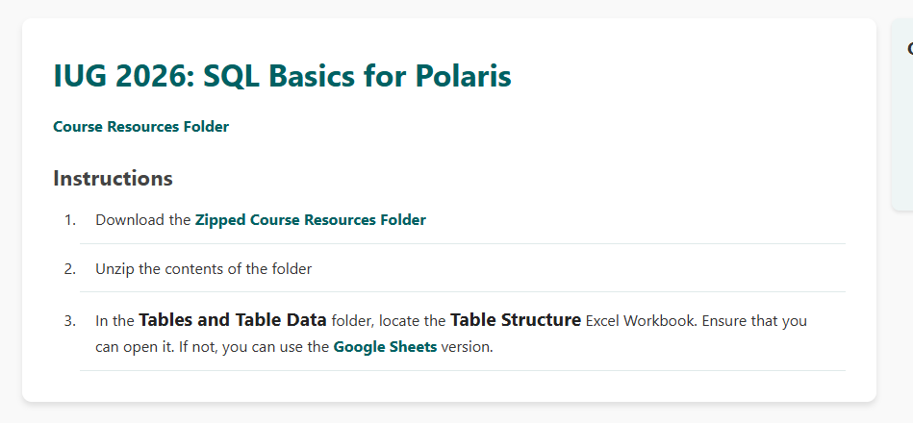
Course Resources
pinnaclelibraries.org/iug

Slide 5
Courses Resources Folder
Handouts
Cheat sheets. You have printed copies of these
Tables and Table Data
Table Structure – Excel workbook for Polaris data
PolarisDB – CHM file provided by Polaris. Not necessary for this workshop.
Example Queries
You have a printed copy of this

Slide 6
What is SQL?
“Structured Query Language”
International standard database language
Polaris
Database
SQL
Language to Talk to Polaris

Slide 7
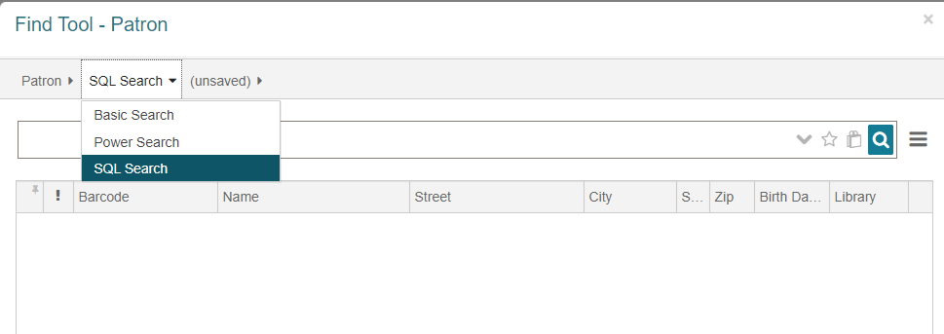
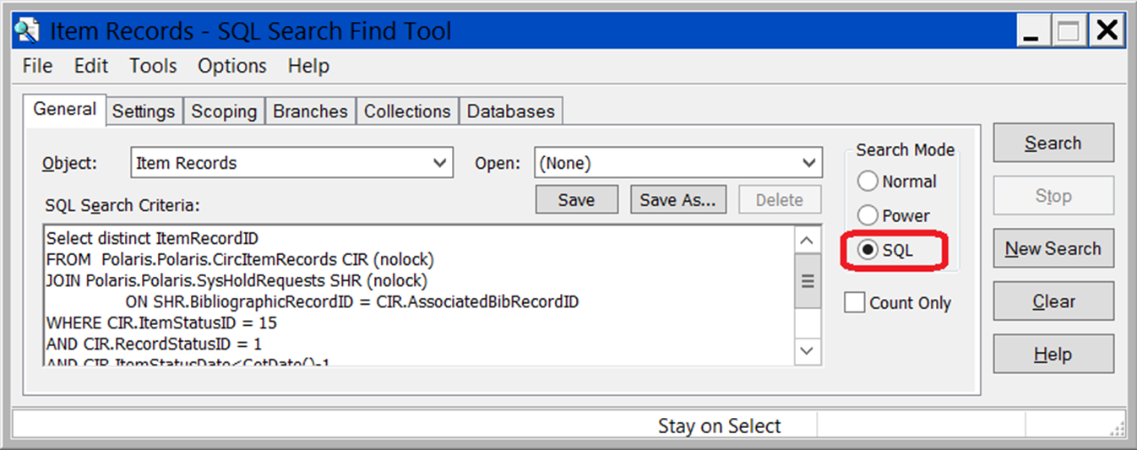
SQL in Polaris
In Polaris, SQL queries can be copied directly into the Find Tool:

Slide 8
Tables
Databases – Collection of several tables
Polaris has several hundred tables used to store library data.
All data in Polaris is stored somewhere in a table

Slide 9
RecordSets
RecordSetID
Name
ObjectTypeID
CreatorID
ModifierID
OrganizationOwnerID
CreationDate
(…)
BibRecordSets
BibliographicRecordID
RecordSetID
ItemRecordSets
ItemRecordID
RecordSetID
CircItemRecords
ItemRecordID
Barcode
ItemStatusID
LastCircTransactionDate
AssociatedBibRecordID
RecordStatusID
AssignedBranchID
MaterialTypeID
AssignedCollectionID
LastUsePatronID
(…)
ItemRecordDetails
ItemRecordID
OwningBranchID
CreatorID
ModifierID
CallNumberPrefix
ClassificationNumber
CutterNumber
(…)
BibliographicRecords
BibliographicRecordID
ModifierID
BrowseAuthor
BrowseTitle
BrowseCallNo
DisplayInPAC
ImportedDate
(…)
PatronCodes
PatronCodeID
Description
PatronRegistration
PatronID
LanguageID
NameFirst
NameLast
NameMiddle
PhoneVoice1
PhoneVoice2
EmailAddress
(…)
Patrons
PatronID
PatronCodeID
OrganizationID
CreatorID
ModifierID
Barcode
YTDCircCount
(…)
ItemRecordHistory
ItemRecordHistoryID
ItemRecordID
TransactionDate
ActionTakenID
OldItemStatusID
NewItemStatusID
AssignedBranchID
(…)
ItemRecordHistoryActions
ActionTakenID
ActionTakenDesc

Slide 10
Polaris Tables
Databases = Collection of tables
Tables used to build SQL queries

Slide 11
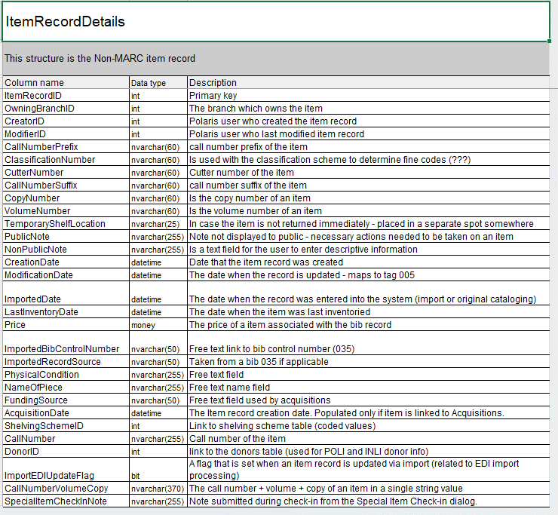
Polaris Tables Workbook
Excel workbook contains several tabs – each tab is a different table.
Only a snapshot. Polaris contains over 1000 tables
CHM file in shared drive
Column Name – the Polaris field
Data Type
Description

Slide 12
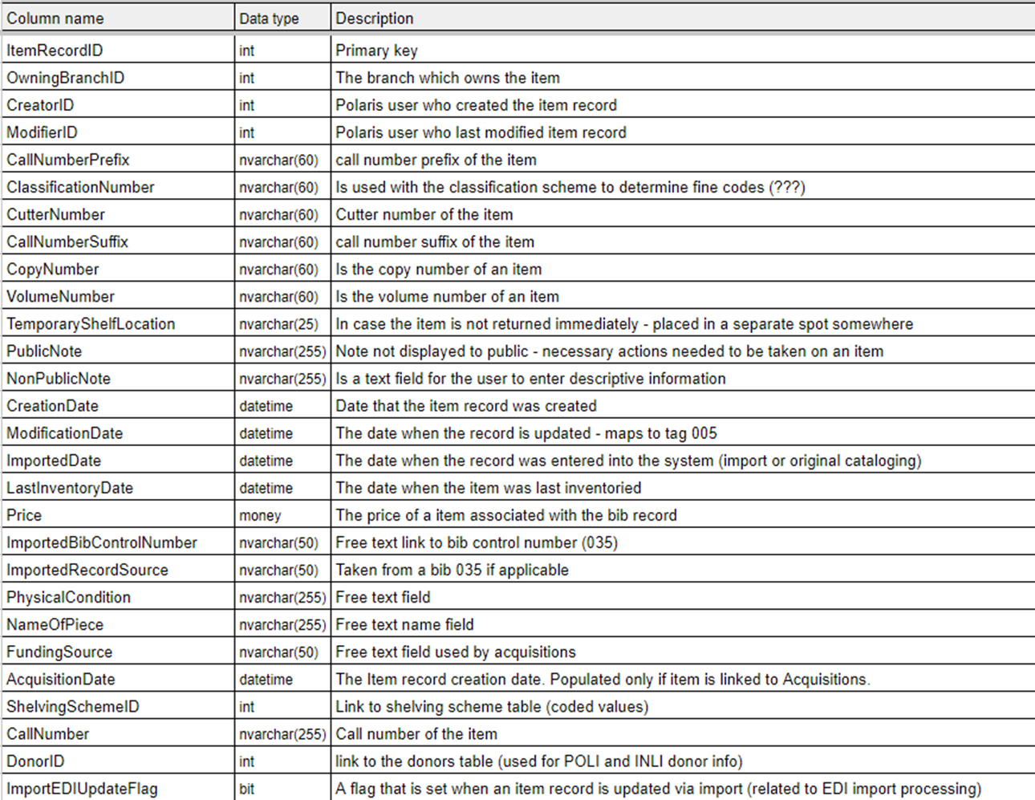
ItemRecordDetails
Item Record data
Free-text and note fields
Fields
Creator / Creation Date
Call Number Info
Public Note / Non Public Note
Price

Slide 13
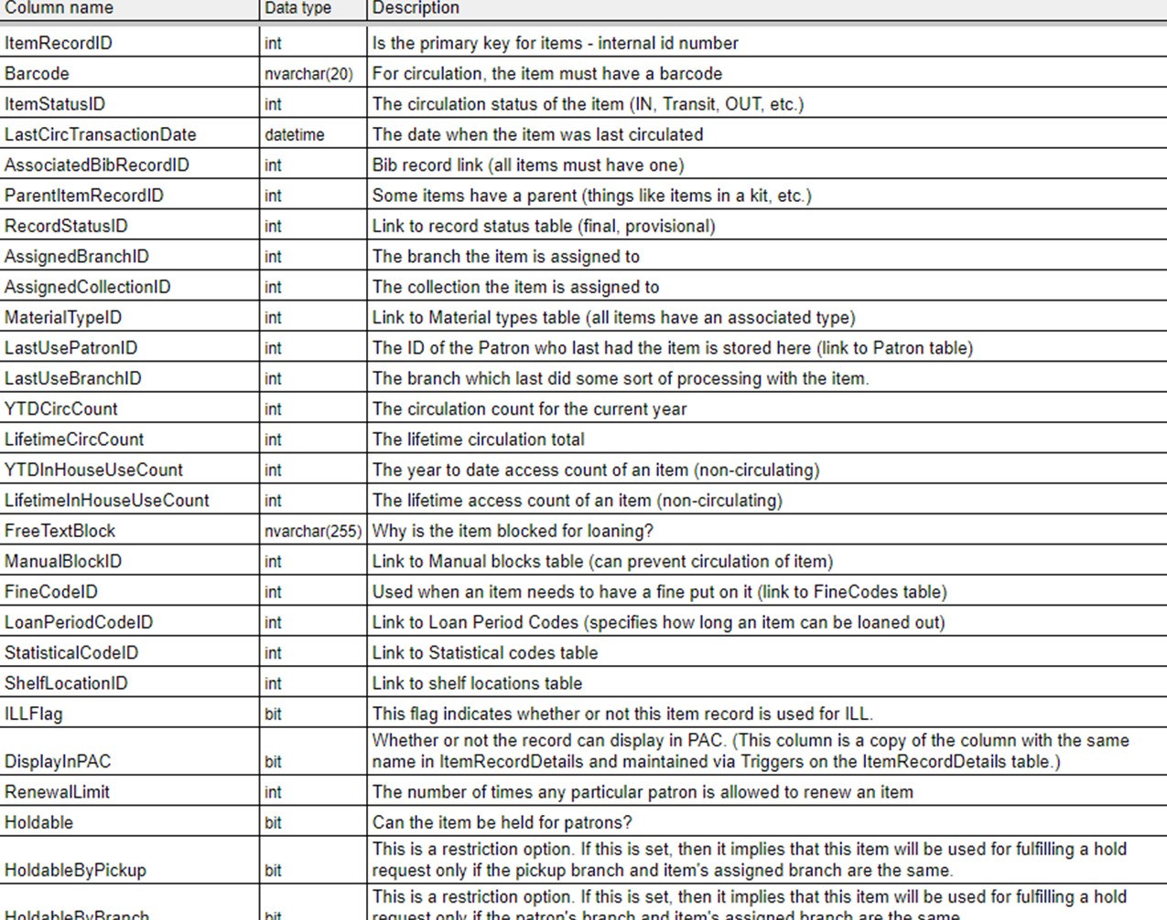
CircItemRecords
The other Item Record Table
Contains information used for circulation transactions
Fields
Barcode
Assigned Branch
Collection / Stat Code
Material Type
Loan Period / Fine Code

Slide 14
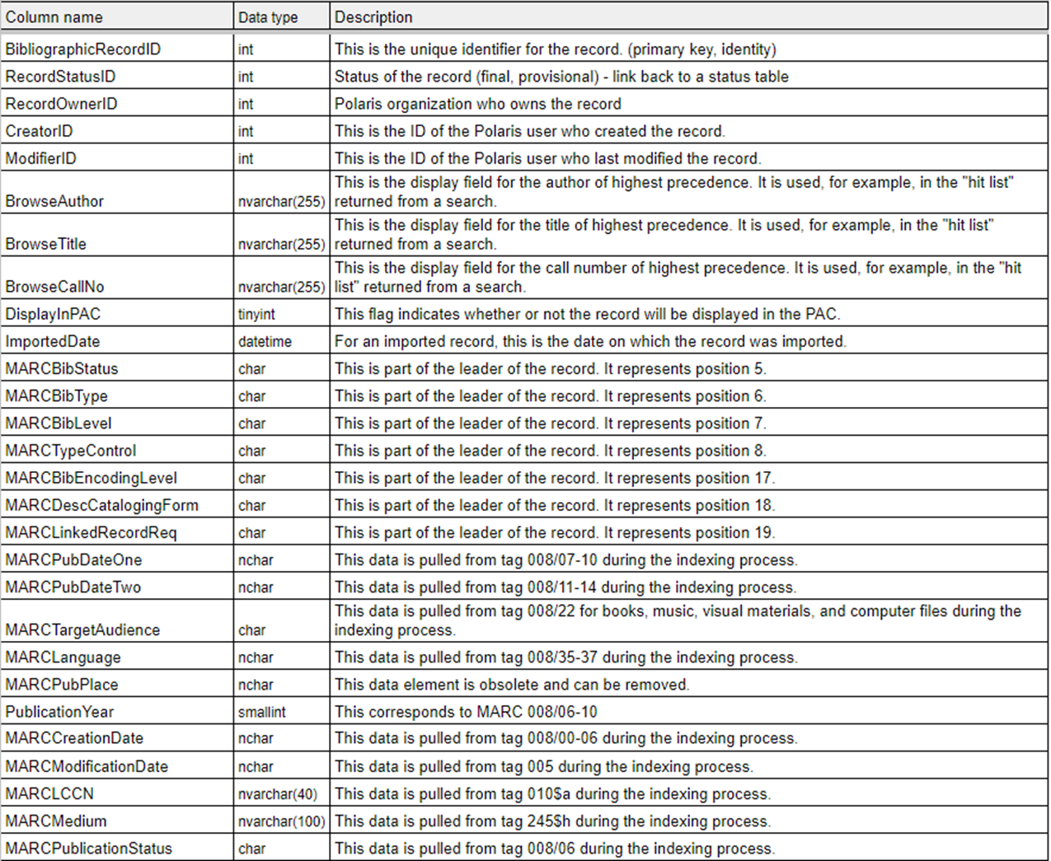
BibliographicRecords
Contains Non-MARC Bibliographic information
Fields
Record Status
Creation Date
Creator
Display In PAC
Other display fields generated from MARC tags (LDR, 00x, Browse Title)

Slide 15
Which Table Should I Use?
Item’s Assigned Branch
CircItemRecords
Author
BibliographicRecords
Call Number Prefix
ItemRecordDetails
Price
ItemRecordDetails
Audience Level
BibliographicRecords
Shelf Location
CircItemRecords

Slide 16
Patron Data
Stored in two different tables:
Patrons
PatronRegistration

Slide 17
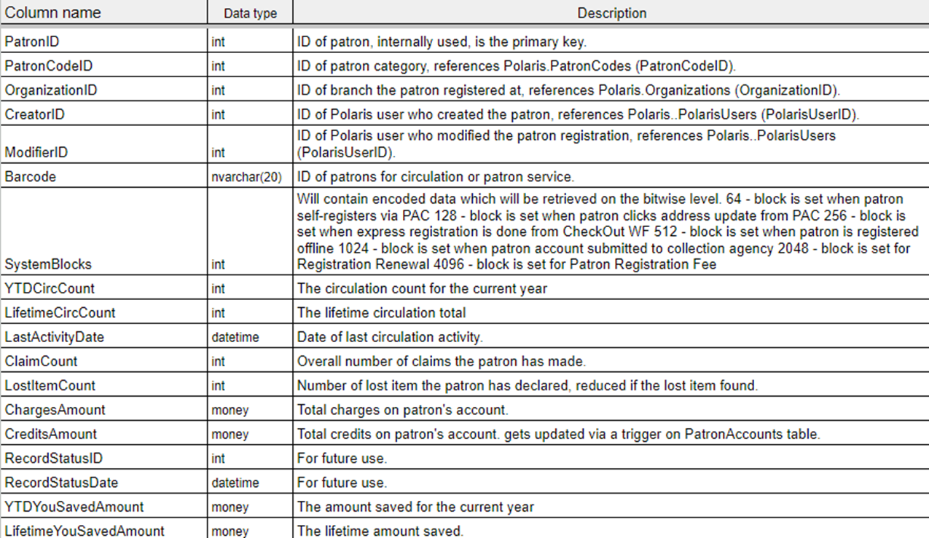
Patrons
One of the Patron Tables
Stores basic info about patron records
Fields
Patron Code
Registered Library
Barcode
Circ Counts
Account Charges

Slide 18
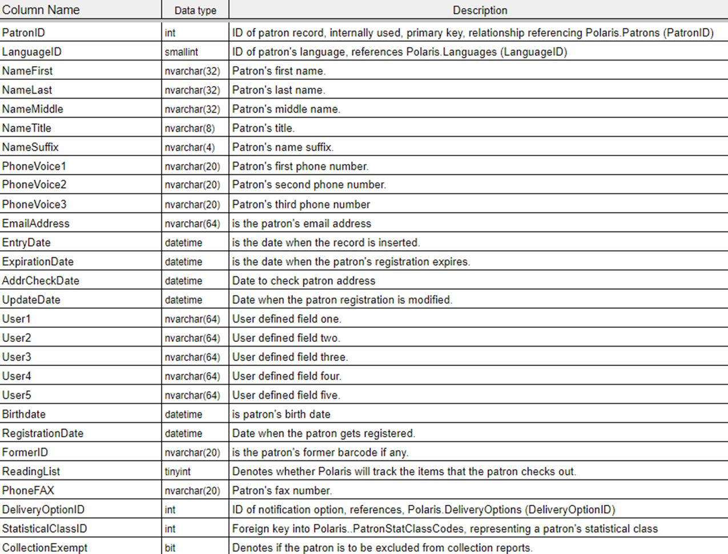
PatronRegistration
The other patron table
Personal information / registration data
Fields
Name
Phone
Email
Birthdate
User Defined Fields

Slide 19
Which Table Should I use?
FirstName
PatronRegistration
YTD Circ Count
Patrons
Patron Code
Patrons
Email
PatronRegistration
Barcode
Patrons
[UDF2]
PatronRegistration

Slide 20
Polaris Tables
ItemRecord
Details
CircItem
Records
Bibliographic
Records
Patrons
Patron
Registration
Item Information.
Free-text and note fields.
Item data used in circulation transactions
Non-MARC bib data
Patron data used for circulation transacitons.
Patron account information

Slide 21
How Is Data Stored?
Data Types and How to Query

Slide 22
Data types
Databases are capable of storing data in a variety of formats.
How the data is stored impacts how queries are written.
Numbers
Text
Dates / Time
Currency
Yes/No Values
Control Numbers
Patron Name
Call Number
First Available Date
Last Activity Date
Item Price
Holdable
Display in PAC
Renewal Limit
Account Charges

Slide 23
Data Types
Listed in the “Data type” column

Slide 24
Data Types: Integers
Whole Numbers
An actual number
RenewalLimit = 2
Numerical code that represents information stored in another table
ItemStatusID = 15
In Processing
OrganizationID = 6
Joliet Library – Ottawa St. Branch

Slide 25
Data types: VarChar
Variable Text – any number of characters up to a certain amount
Free-text and note fields
NonPublicNote = ‘Donation’
CallNumberPrefix = ‘J FIC’
Barcode = ‘21560000123456’

Slide 26
Data Types: Bit
Field that can be 1 or 0
1 = True / Yes
0 = False / No
Checkbox, Yes/No
DisplayInPAC
Holdable

Slide 27
Data Types - DateTime
Date and Time stamp of when something happened.
CreationDate = ‘1/31/2019 1:45 PM’
LastActivityDate > ‘4/1/2026’
If no time supplied, assumes midnight

Slide 28
Data types
Will be used later when we start building our queries.
For the most part:
Integers are written as numbers
AssignedBranchID = 7
PatronID = 99999
Text (varchar, dates, etc.) need single quotes
NonPublicNote = 'Purchased as part of a grant'
Barcode = '21560000123456'

Slide 29
How to Find information
Tables and Table Data

Slide 30
Two Kinds of Data
Database Structure
Table Names
Field Names
Library Database Codes
Organizations
Collections
Circulation Status Names

Slide 31
1. Database Structure
Table Structure Excel Workbook
Full list of tables available through CHM file.
Available from the Innovative Supportal – “Database Repository”

Slide 32
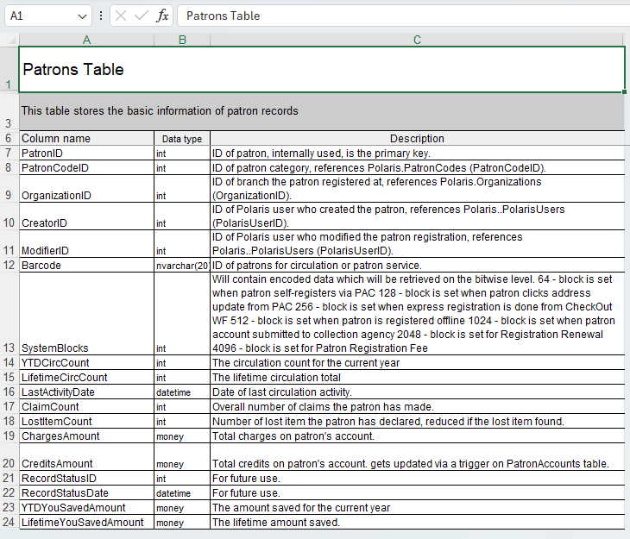

Slide 33
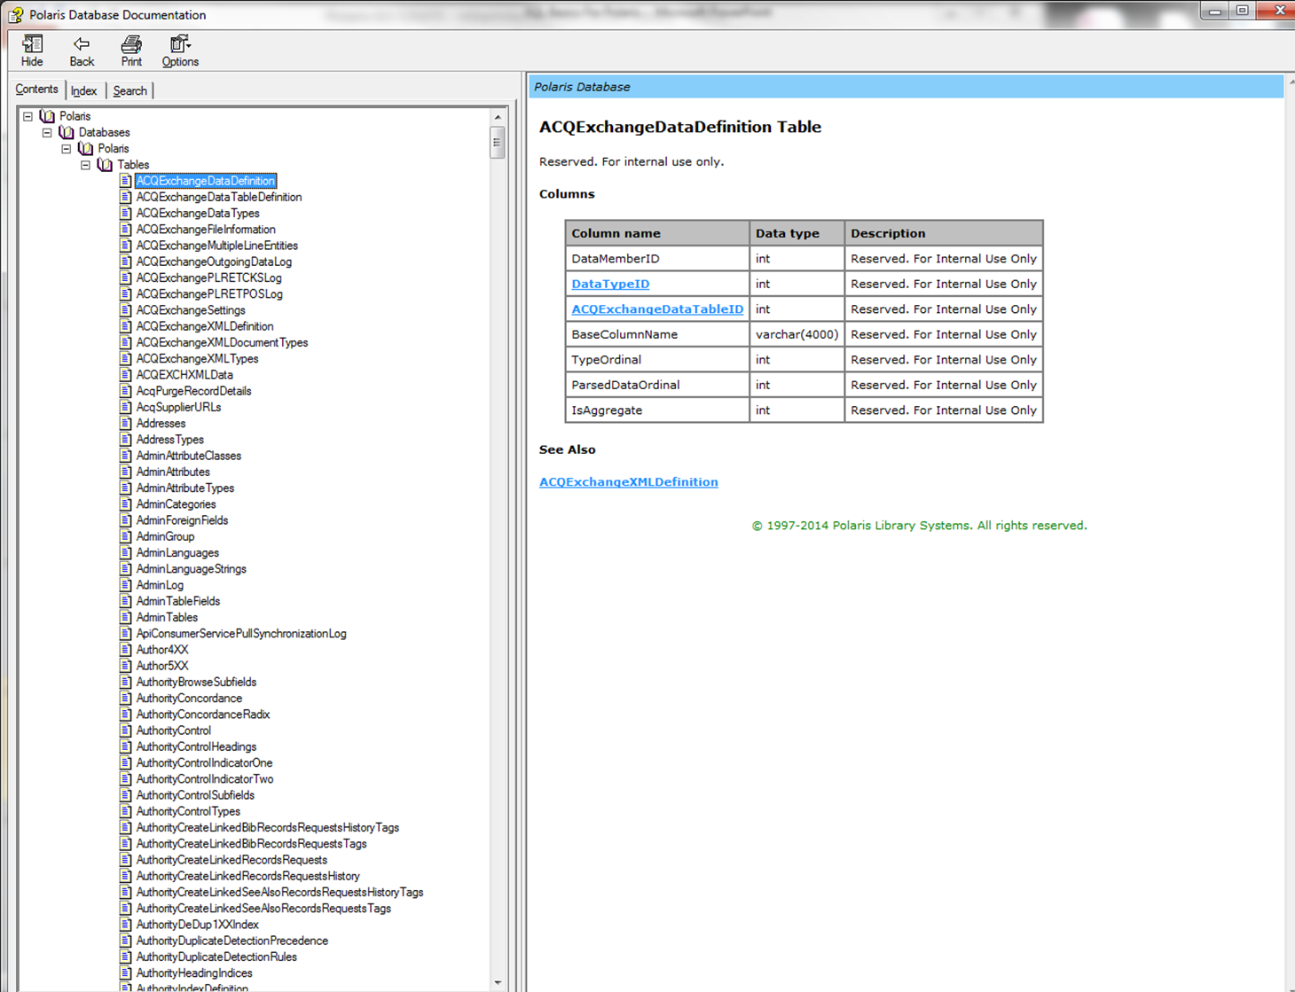

Slide 34
2. Library Database codes
Polaris Database Codes Excel Workbook
Lists Polaris data specific to your library

Slide 35
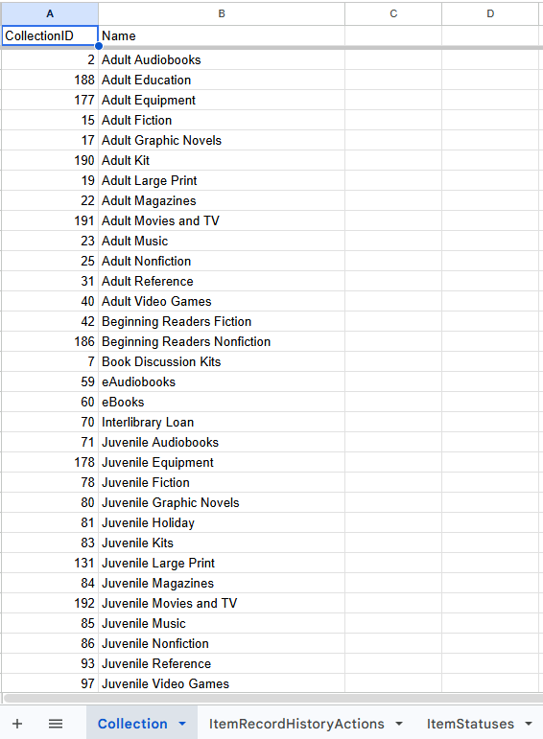

Slide 36
Reading an SQL Query

Slide 37
Simple Queries
SELECT BibliographicRecordID
FROM BibliographicRecords
WHERE PublicationYear = '2025'

Slide 38
Simple Queries
SELECT CIR.ItemRecordID
FROM CircItemRecords CIR
JOIN ItemRecordDetails IRD
ON CIR.ItemRecordID = IRD.ItemRecordID
WHERE CIR.AssignedBranchID = 6
AND IRD.CallNumberPrefix = 'Playaway J'

Slide 39
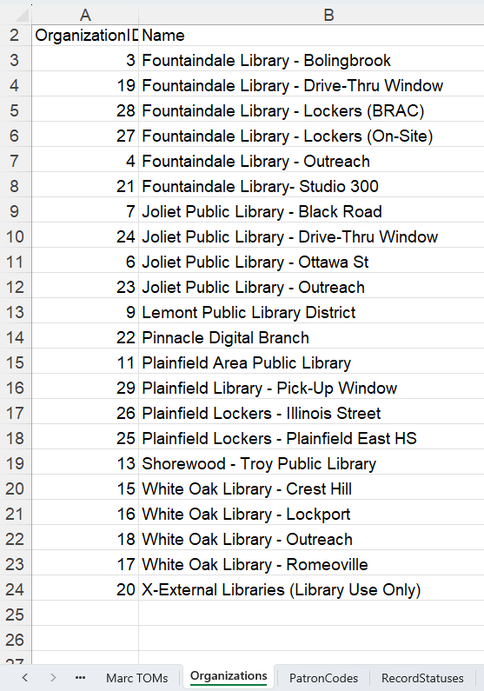
AssignedBranchID = 6
Joliet Public Library – Ottawa St

Slide 40
Modifying Existing Queries

Slide 41
Saved Queries
In Polaris/Leap, each find tool has a list of saved queries.
System-wide – everyone shares the same list
Your system may already have several helpful common queries

Slide 42
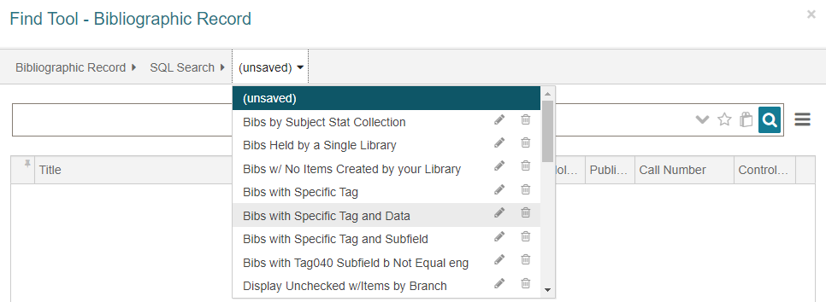
Saved Queries

Slide 43
Saved Queries
SELECT BR.BibliographicRecordID
FROM BibliographicRecords BR
JOIN BibliographicTags BT
ON BR.BibliographicRecordID = BT.BibliographicRecordID
JOIN BibliographicSubfields BS
ON BT.BibliographicTagID = BS.BibliographicTagID
WHERE BT.TagNumber = 250
AND BS.Subfield = 'b'
AND BS.Data LIKE '%'

Slide 44
Example search: GMDs
Using a saved search, find all bib records in the system with GMDs.
Tag: 245
Subfield: “h”
Open a bib Find Tool
Select the “Bibs with Specific Tag and Subfield” query.
Change the Tag/Subfield values

Slide 45
Example search: GMDs
SELECT BR.BibliographicRecordID
FROM BibliographicRecords BR
JOIN BibliographicTags BT
ON BR.BibliographicRecordID = BT.BibliographicRecordID
JOIN BibliographicSubfields BS
ON BT.BibliographicTagID = BS.BibliographicTagID
WHERE BT.TagNumber = 250
AND BS.Subfield = 'b'

Slide 46
Example search: GMDs
SELECT BR.BibliographicRecordID
FROM BibliographicRecords BR
JOIN BibliographicTags BT
ON BR.BibliographicRecordID = BT.BibliographicRecordID
JOIN BibliographicSubfields BS
ON BT.BibliographicTagID = BS.BibliographicTagID
WHERE BT.TagNumber = 245
AND BS.Subfield = 'h'

Slide 47
Building an SQL Query

Slide 48
What makes an SQL QUERY?
SELECT
FROM
WHERE

Slide 49
Select
Used to find and retrieve data from a database
The only type of query used in the Polaris Find Tool
We can’t add, delete, or change data in the find tool.
All queries we build will start with the word “SELECT”
In Polaris, SELECT is followed by a Control Number
ItemRecordID, PatronID, BibliographicRecordID, etc.

Slide 50
SELECT
SELECT [column_name]
SELECT ItemRecordID
SELECT BibliographicRecordID
SELECT PatronID
SELECT RecordSetID

Slide 51
Patrons
PatronID
PatronCodeID
OrganizationID
CreatorID
ModifierID
Barcode
YTDCircCount
(…)
PatronRegistration
PatronID
LanguageID
NameFirst
NameLast
NameMiddle
NameTitle
NameSuffix
PhoneVoice1
PhoneVoice2
EmailAddress
(…)
ItemRecordDetails
ItemRecordID
OwningBranchID
CreatorID
ModifierID
CallNumberPrefix
ClassificationNumber
CutterNumber
(…)
CircItemRecords
ItemRecordID
Barcode
ItemStatusID
LastCircTransactionDate
AssociatedBibRecordID
RecordStatusID
AssignedBranchID
MaterialTypeID
AssignedCollectionID
LastUsePatronID
(…)
BibliographicRecords
BibliographicRecordID
ModifierID
BrowseAuthor
BrowseTitle
BrowseCallNo
DisplayInPAC
ImportedDate
(…)

Slide 52
From
Specifies which table to use to look for the data
SELECT [column_name] FROM [table_name]
SELECT ItemRecordID FROM CircItemRecords
Specifies which table to use to look for the data
SELECT [column_name]
SELECT ItemRecordID

Slide 53
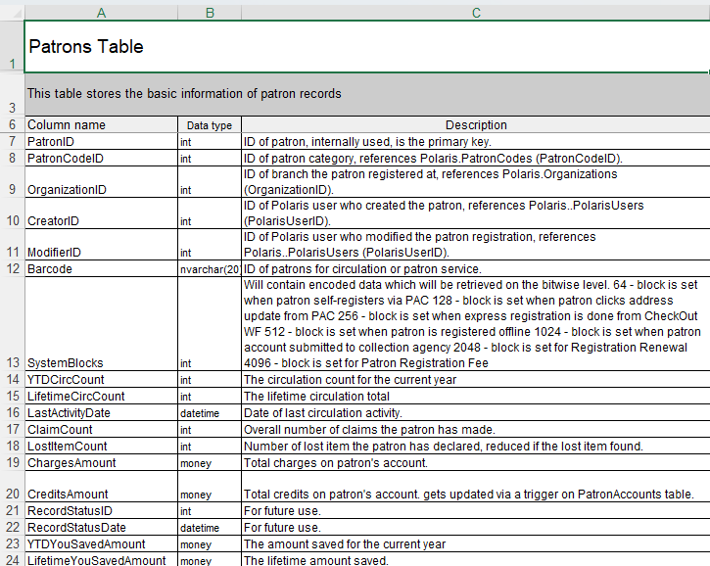
Table Name
(FROM)
Column Name
(Select)

Slide 54
Select -- From
ItemRecordID
SELECT _____________ FROM ItemRecordDetails
SELECT _____________________ FROM BibliographicRecords
SELECT ______________________ FROM CircItemRecords (bibs)
BibliographicRecordID
AssociatedBibRecordID

Slide 55
WHERE
Filters the search – only records that meet the criteria will be retrieved.
WHERE [column_name] [operator] [value]
WHERE AssignedBranchID = 6

Slide 56
Putting it all together
SELECT [column_name]
FROM [table_name]
WHERE [column_name] [operator] [value]
SELECT ItemRecordID
FROM CircItemRecords
WHERE AssignedBranchID = 6

Slide 57
Operators
Equal To | = | AssignedBranch = 6
Not Equal To | <> or != | RecordStatusID <> 1 RecordStatusID != 1
Greater than Greater than or equal to | > >= | Price > 100 Price >= 100
Less than Less than or equal to | < <= | BirthDate < ‘7/1/2010’ BirthDate <= ‘7/1/2010’
Between a range (inclusive) | Between … And … | ClassificationNumber BETWEEN ‘580’ AND ‘590’
Wildcard (1+ characters) | LIKE ‘…%’ | NonPublicNote LIKE ‘%Donation%’
Equal to one of many values | IN (…,…,…) | AssignedCollectionID IN (13,77,135)
Not equal to one of many values | NOT IN (…,…,…) | ItemStatusID NOT IN (15,13)
NULL | IS NULL | FirstAvailableDate IS NULL
Not NULL | IS NOT NULL | Barcode IS NOT NULL

Slide 58
Operators: Not Equal To
<>
!=
Retrieves records that do not match the criteria
RecordStatusID <> 1
RecordStatusID != 1

Slide 59
Operators: Greater Than / Less Than
> Greater Than
>= Greater Than or Equal to
< Less Than
<= Less Than Or Equal to
ChargesAmount > 100
ChargesAmount >= 100
BirthDate > ‘1/1/2006’
BirthDate >= ‘1/1/2006’

Slide 60
Operators: Between
BETWEEN … AND….
FirstAvailableDate BETWEEN '12/1/2025' AND '12/31/2025'
Retrieves records with values within a given range.
Values are “Inclusive”

Slide 61
Operators: Working With Dates
Be careful with Time.
If no time supplied, assumes Midnight of that day
FirstAvailableDate BETWEEN '12/1/2025' AND '12/31/2025'
BETWEEN ‘12/1/2025’ AND ‘12/31/2025 11:59:59 PM’
BETWEEN ’12/1/2025’ AND ‘1/1/2026’

Slide 62
Operators: LIKE (Wildcard)
LIKE ‘…%’
Matches any character 1 or more times
NonPublicNote LIKE '%Donation%'
ClassificationNumber LIKE '%092'

Slide 63
Operators: IN
IN (…, …, …, …)
Retrieves records that match any of the given values – separated by commas
MaterialTypeID IN (1,11)
CallNumberPrefix IN ('CD FIC', 'CD FICTION')

Slide 64
Operators: Not IN
NOT IN (…, …, …, …)
Retrieves records with any values that are not included in a set of given values
Opposite of “IN”
ItemStatusID NOT IN (15,13)
PrimaryMARCTOMID NOT IN (36,41)

Slide 65
Operators: IS NULL
IS NULL
Retrieves records where there is not data present
Different from zero or a space.
The absence of data
FirstAvailableDate IS NULL
Barcode IS NULL

Slide 66
Operators: IS NOT NULL
IS NOT NULL
Retrieves data where any data is present.
EmailAddress IS NOT NULL
Barcode IS NOT NULL

Slide 67
Multiple Criteria: AND
AND
Allows a search to combine multiple filters
Results must match all parts of the where clause

Slide 68
Multiple Criteria
SELECT [column_name]
FROM [table_name]
WHERE [column_name] [operator] [value]
AND [column_name] [operator] [value]
SELECT ItemRecordID
FROM CircItemRecords
WHERE AssignedBranchID = 6
AND AssignedCollectionID = 15

Slide 69
EXAMPLES
Creating a Basic SQL Query

Slide 70
Search 1: YTD Circ Count
Your library wants to run a promotion with your most active users. Find all patrons from your library that have more than 250 checkouts this year.
Select
From
Where
[Control Number for Patrons]
[One of the Patron Tables]
[Patron Library]
[Patron has more than 250 circs]

Slide 71
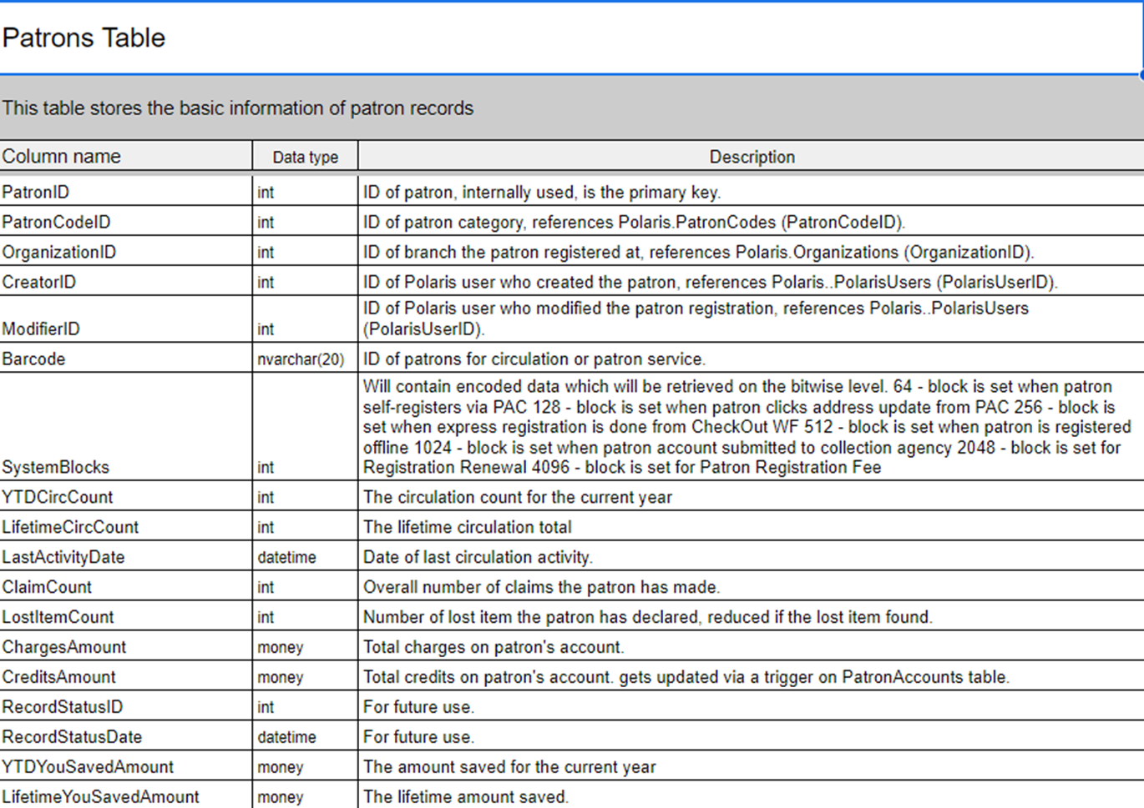
FROM
SELECT
WHERE

Slide 72
Search 1: YTD Circ Count
Select
From
Where
[Control Number for Patrons]
[One of the Patron Tables]
[Patron Library is my library]
[Patron has more than 100 circs]
Select
From
Where
PatronID
Patrons
OrganizationID = [Your Library]
YTDCircCount [is more than 250]

Slide 73
Search 1: YTD Circ Count
SELECT PatronID
From Patrons
WHERE OrganizationID ___ _____
AND YTDCircCount ___ _____
(Operator)
(Value)
(Operator)
(Value)

Slide 74
Search 1: YTD Circ Count
Look up OrganizationID in Organizations table

Slide 75
Search 1: YTD Circ Count
SELECT PatronID
From Patrons
WHERE OrganizationID ___ _____
AND YTDCircCount ___ _____
= 22
(Operator)
(Value)
> 250
(Operator)
(Value)

Slide 76
Search 2: New Shelf
Find items at your library that are in a “New” Shelf Location, but are older than 9 months.
Select
From
Where
[Control Number for Items]
[One of the Item Tables]
[Item Library]
[Shelf Location is a “New” Shelf Location]
[Item is older than 9 months]

Slide 77
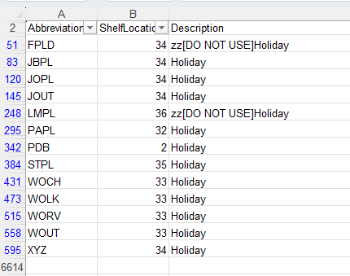
Search 2: New Shelf
In Polaris, Shelf Locations are branch specific.
Shelf Location IDs can vary between branches

Slide 78
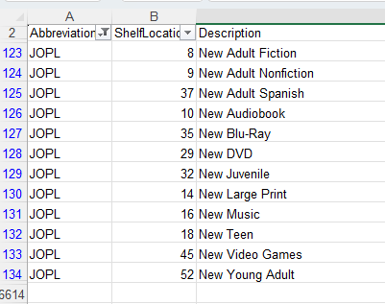
Search 2: New Shelf
Using the Excel Workbook
Filter Column A to one branch
Filter Column C to only those that contain “New”
Column B is all of the “New” Shelf Location IDs

Slide 79
Search 2: New Shelf
So Many Date Fields
CreationDate
ImportedDate
FirstAvailableDate
RecordStatusDate
OriginalCheckOutDate
FirstAvailableDate is the first time the item transitioned from “In Processing” to one of the circulating statuses.
The item left Tech Services

Slide 80
Search 2: New Shelf
Find items at your library that are in a “New” Shelf Location, but are older than 9 months
Select
From
Where
[Control Number for Items]
[One of the Item Tables]
[Item Library is my library]
[Shelf Location is a “New” Shelf Location]
[Item is older than 6 months]
Select
From
Where
ItemRecordID
CircItemRecords
AssignedBranchID
FirstAvailableDate
ShelfLocationID

Slide 81
Search 2: Shelf Locations
SELECT ItemRecordID
FROM CircItemRecords
WHERE AssignedBranchID = 6
AND ShelfLocationID IN (8,9,37,10,35,29,14,16)
AND FirstAvailableDate < '7/1/2025'

Slide 82
Search 3: Bibs with Audience “C”
Find bib records that have been cataloged but have “C” (pre-adolescent) in the Audience field.
Select
From
Where
[Control Number for Bibs]
[The Bib Table]
[The Audience is “C”]
[“It’s been Cataloged”]

Slide 83
Search 3: Bibs with Audience “C”
FirstAvailableDate is the first time the item transitioned from “In Processing” to one of the circulating statuses.
The item left Tech Services
“Has Been Cataloged”

Slide 84
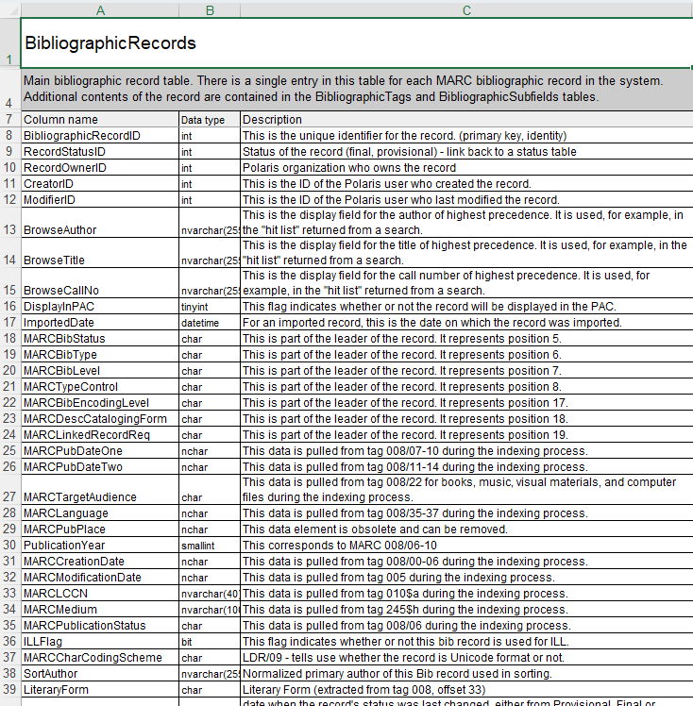
Audience
MARCTargetAudience

Slide 85
Search 3: Bibs with Audience “C”
SELECT BibliographicRecordID
FROM BibliographicRecords
WHERE MARCTargetAudience = 'c'
AND FirstAvailableDate IS NOT NULL

Slide 86


Search 4: Email Addresses
Find any patrons in the system who do not have an email address but do have an alternate email address
Patron Records
Data is present in one field, not present in another

Slide 87
Search 5: Dead on Arrival
A selector wants to identify items that are “Dead on Arrival” (6-12 months old, but have never checked out).
Pick a collection at your library and find items that are DOA.
Your Library/Collection/Material Type
6-12 months old (First Available Date)
Has never checked out

Slide 88
Search 6: Most Popular Movies
Use Bibliographic Records to find movies in the system with the most all time checkouts.
Bib Records Format = “Type of Material”
Most Checkouts: Lifetime Circ Count

Slide 89
Search 4: Email Addresses
Find any patrons in the system who do not have an email address but do have an alternate email address
Select
From
Where
[Control Number for Patrons]
[One of the Patron Tables]
EmailAddress IS NULL
AltEmailAddress IS NOT NULL

Slide 90
Search 4: Email Addresses
Select PatronID
From PatronRegistration
WHERE EmailAddress IS NULL
AND AltEmailAddress IS NOT NULL

Slide 91
Search 5: Dead on Arrival Items
A selector wants to identify items that are “Dead on Arrival” (6-12 months old, but have never checked out).
Pick a collection at your library and find items that are DOA.
Select
From
Where
[Control Number for Items]
[One of the Item Tables]
[Your Library]
[Collection/MaterialType]
[First Available Date]
[Has never Checked Out]

Slide 92
Search 5: Dead on Arrival Items
Select ItemRecordID
From CircItemRecords
WHERE AssignedBranchID = 6
AND AssignedCollectionID = 25
AND FirstAvailableDate BETWEEN '4/1/2025' and '10/1/2025'
AND LastCheckOutRenewDate IS NULL

Slide 93
Search 6: Most Popular Movies
Use Bibliographic Records to find movies in the system with the most all time checkouts.
Select
From
Where
[Control Number for Bibs]
BibliographicRecords
[MARC Type of Material]
LifetimeCircCount

Slide 94
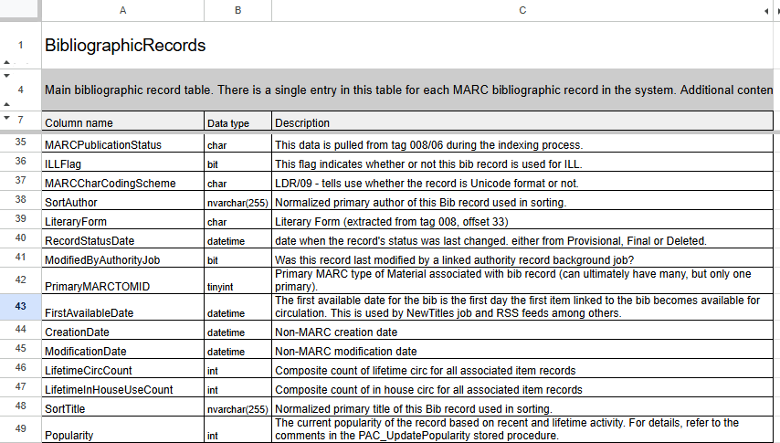
Search 6: Type of Material
Type of Material | ID
Abstract | 39
Archival/Mixed Materials | 7
Atlas | 47
Audio Book on Cassette | 53
Audio Book on CD | 52
Audio Books | 37
Blu-ray + DVD | 45
Blu-ray Disc | 40
Book | 1
Book + Cassette | 43
Book + CD | 42
Book + DVD | 46
Braille | 28
Cartographic Material | 3
Digital Collection | 38
DVD | 33
Eaudiobook | 41
Ebook | 36
Electronic Resources | 6
Emagazine | 50
Globe | 14
Kit | 23

Slide 95
Search 6: Most Popular Movies
Select BibliographicRecordID
From BibliographicRecords
WHERE PrimaryMARCTOMID IN (33,40)
AND LifetimeCircCount > 5000

Slide 96
Lunch Break
Reconvene at 1:30

Slide 97
SQL Basics for Polaris
Matt Hammermeister
Pinnacle Library Cooperative

Slide 98
What If We Need More than 1 Table?
PatronRegistration
PatronID
LanguageID
NameFirst
NameLast
NameMiddle
NameTitle
NameSuffix
PhoneVoice1
PhoneVoice2
EmailAddress
(…)
Patrons
PatronID
PatronCodeID
OrganizationID
CreatorID
ModifierID
Barcode
YTDCircCount
Lifetime Circ Count
LastActivityDate
ClaimCount
(…)

Slide 99
Joining Tables
Where it all comes together…

Slide 100
JOINs
Combines two tables together in a query
Tables are linked by a field shared by each (Primary Key)
Patrons
PatronID
PatronCodeID
OrganizationID
CreatorID
ModifierID
Barcode
YTDCircCount
Lifetime Circ Count
LastActivityDate
ClaimCount
(…)
Patrons
PatronID
PatronCodeID
OrganizationID
CreatorID
ModifierID
Barcode
YTDCircCount
Lifetime Circ Count
LastActivityDate
ClaimCount
(…)
PatronRegistration
PatronID
LanguageID
NameFirst
NameLast
NameMiddle
NameTitle
NameSuffix
(…)
PatronRegistration
PatronID
LanguageID
NameFirst
NameLast
NameMiddle
NameTitle
NameSuffix
(…)

Slide 101
Patrons
PatronID
PatronCodeID
OrganizationID
CreatorID
ModifierID
Barcode
YTDCircCount
(…)
PatronRegistration
PatronID
LanguageID
NameFirst
NameLast
NameMiddle
NameTitle
NameSuffix
PhoneVoice1
PhoneVoice2
EmailAddress
(…)
ItemRecordDetails
ItemRecordID
OwningBranchID
CreatorID
ModifierID
CallNumberPrefix
ClassificationNumber
CutterNumber
(…)
CircItemRecords
ItemRecordID
Barcode
ItemStatusID
LastCircTransactionDate
AssociatedBibRecordID
RecordStatusID
AssignedBranchID
MaterialTypeID
AssignedCollectionID
LastUsePatronID
(…)
BibliographicRecords
BibliographicRecordID
ModifierID
BrowseAuthor
BrowseTitle
BrowseCallNo
DisplayInPAC
ImportedDate
(…)

Slide 102


JOIN Syntax
Add new section to the query
JOIN … ON….
JOIN – What table are we adding?
ON – Which field appears in both tables?

Slide 103
JOIN Syntax
JOIN [2nd_table_name]
ON [1st_table_name].[column_name] = [2nd_table_name].[column_name]
Patrons
PatronID
PatronCodeID
OrganizationID
CreatorID
ModifierID
Barcode
YTDCircCount
(…)
PatronRegistration
PatronID
LanguageID
NameFirst
NameLast
NameMiddle
(…)

Slide 104
JOIN Syntax
Patrons
PatronID
PatronCodeID
OrganizationID
CreatorID
ModifierID
Barcode
YTDCircCount
(…)
PatronRegistration
PatronID
LanguageID
NameFirst
NameLast
NameMiddle
(…)
FROM [1st_table_name]
JOIN [2nd_table_name]
ON [1st_table_name].[column_name] = [2nd_table_name].[column_name]
FROM PatronRegistration
JOIN Patrons
ON PatronRegistration.PatronID = Patrons.PatronID

Slide 105
JOIN Syntax
Patrons
PatronID
PatronCodeID
OrganizationID
YTDCircCount
(…)
PatronRegistration
PatronID
LanguageID
NameFirst
(…)
SELECT [column_name]
FROM [1st_table_name]
JOIN [2nd_table_name]
ON [1st_table_name].[column_name] = [2nd_table_name].[column_name]
SELECT PatronID
FROM PatronRegistration
JOIN Patrons
ON PatronRegistration.PatronID = Patrons.PatronID

Slide 106
JOIN Syntax
SELECT Patrons.PatronID
FROM PatronRegistration
JOIN Patrons
ON PatronRegistration.PatronID = Patrons.PatronID
WHERE PatronRegistration.EmailAddress IS NULL
AND PatronRegistration.AltEmailAddress IS NOT NULL
AND Patrons.OrganizationID = 6

Slide 107
Join Item Tables
Table Names
ItemRecordDetails
Field in Common
ItemRecordID
CircItemRecords
ItemRecordDetails
ItemRecordID
OwningBranchID
CreatorID
ModifierID
CallNumberPrefix
ClassificationNumber
CutterNumber
(…)
CircItemRecords
ItemRecordID
Barcode
ItemStatusID
LastCircTransactionDate
AssociatedBibRecordID
RecordStatusID
AssignedBranchID
MaterialTypeID
AssignedCollectionID
LastUsePatronID
(…)

Slide 108
JOIN Item Tables
ItemRecordDetails
ItemRecordID
OwningBranchID
CreatorID
ModifierID
CallNumberPrefix
ClassificationNumber
CutterNumber
(…)
ItemRecordDetails
ItemRecordID
OwningBranchID
CreatorID
ModifierID
CallNumberPrefix
ClassificationNumber
CutterNumber
(…)
CircItemRecords
ItemRecordID
Barcode
ItemStatusID
LastCircTransactionDate
AssociatedBibRecordID
RecordStatusID
AssignedBranchID
MaterialTypeID
AssignedCollectionID
LastUsePatronID
(…)
CircItemRecords
ItemRecordID
Barcode
ItemStatusID
LastCircTransactionDate
AssociatedBibRecordID
RecordStatusID
AssignedBranchID
MaterialTypeID
AssignedCollectionID
LastUsePatronID
(…)
FROM [1st_table_name]
JOIN [2nd_table_name]
ON [1st_table_name].[column_name] =
[2nd_table_name].[column_name]
FROM ItemRecordDetails
JOIN CircItemRecords
ON ItemRecordDetails.ItemRecordID =
CircItemRecords.ItemRecordID

Slide 109
Join Item/Bib Tables
CircItemRecords
ItemRecordID
Barcode
ItemStatusID
LastCircTransactionDate
AssociatedBibRecordID
RecordStatusID
AssignedBranchID
MaterialTypeID
AssignedCollectionID
LastUsePatronID
(…)
CircItemRecords
ItemRecordID
Barcode
ItemStatusID
LastCircTransactionDate
AssociatedBibRecordID
RecordStatusID
AssignedBranchID
MaterialTypeID
AssignedCollectionID
LastUsePatronID
(…)
Table Names
CircItemRecords
Field in Common
BibliographicRecordID / AssociatedBibRecordID
BibliographicRecords
BibliographicRecords
BibliographicRecordID
ModifierID
BrowseAuthor
BrowseTitle
BrowseCallNo
DisplayInPAC
ImportedDate
(…)
BibliographicRecords
BibliographicRecordID
ModifierID
BrowseAuthor
BrowseTitle
BrowseCallNo
DisplayInPAC
ImportedDate
(…)

Slide 110
JOIN Item / Bib Tables
CircItemRecords
ItemRecordID
Barcode
ItemStatusID
LastCircTransactionDate
AssociatedBibRecordID
RecordStatusID
AssignedBranchID
MaterialTypeID
AssignedCollectionID
LastUsePatronID
(…)
BibliographicRecords
BibliographicRecordID
ModifierID
BrowseAuthor
BrowseTitle
BrowseCallNo
DisplayInPAC
ImportedDate
(…)
FROM [1st_table_name]
JOIN [2nd_table_name]
ON [1st_table_name].[column_name] = [2nd_table_name].[column_name]
FROM BibliographicRecords
JOIN CircItemRecords
ON BibliographicRecords.BibliographicRecordID = CircItemRecords.AssociatedBibRecordID

Slide 111
JOIN 3 Tables
CircItemRecords
ItemRecordID
Barcode
ItemStatusID
LastCircTransactionDate
AssociatedBibRecordID
RecordStatusID
AssignedBranchID
MaterialTypeID
AssignedCollectionID
LastUsePatronID
(…)
ItemRecordDetails
ItemRecordID
OwningBranchID
CreatorID
ModifierID
CallNumberPrefix
ClassificationNumber
CutterNumber
(…)
BibliographicRecords
BibliographicRecordID
ModifierID
BrowseAuthor
BrowseTitle
BrowseCallNo
DisplayInPAC
ImportedDate
(…)

Slide 112
JOIN 3 Tables
FROM [1st_table_name]
JOIN [2nd_table_name]
ON [1st_table_name].[column_name] = [2nd_table_name].[column_name]
JOIN [3rd_table_name]
ON [table_name].[column_name] = [3rd_table_name].[column_name]
FROM ItemRecordDetails
JOIN CircItemRecords
ON ItemRecordDetails.ItemRecordID = CircItemRecords.ItemRecordID
JOIN BibliographicRecords
ON BibliographicRecords.BibliographicRecordID = CircItemRecords.AssociatedBibRecordID

Slide 113
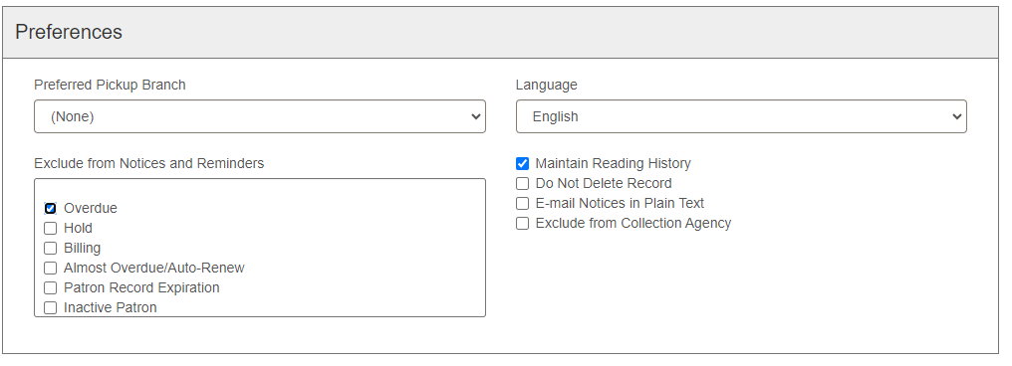
Search 7: Excluded from Overdues
Find Patrons from your library who have been excluded from receiving overdue notices

Slide 114
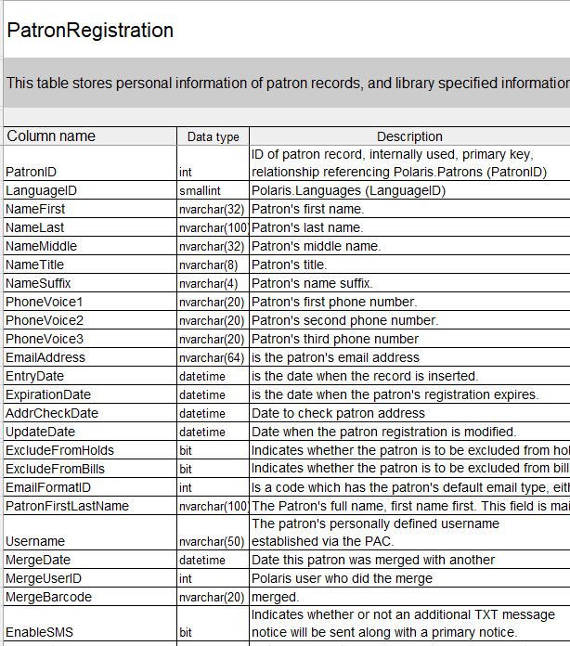
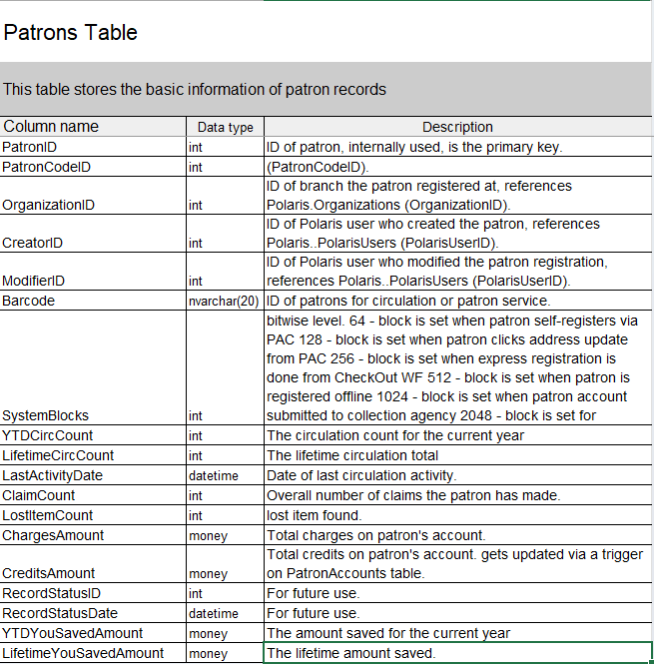

Slide 115
Search 7: Excluded From Overdues
FROM [1st_table_name]
JOIN [2nd_table_name]
ON [1st_table_name].[column_name] = [2nd_table_name].[column_name]
Patrons
PatronID
PatronCodeID
OrganizationID
CreatorID
ModifierID
Barcode
YTDCircCount
(…)
PatronRegistration
PatronID
LanguageID
NameFirst
NameLast
NameMiddle
(…)

Slide 116
Search 7: Excluded from Overdues
Select
From
Where
[Control Number for Patrons]
[One of the Patron Tables]
[Patron Library = Your Library]
Join
[The Other Patron Table]
[Excluded from Notices]

Slide 117
Search 7: Excluded From Overdues
SELECT Patrons.PatronID
FROM PatronRegistration
JOIN Patrons
ON Patrons.PatronID = PatronRegistration.PatronID
WHERE PatronRegistration.ExcludeFromOverdues = 1
AND Patrons.OrganizationID in (22)

Slide 118
Table Names
Once a search includes more than one table, need to use table names to distinguish between fields that appear in both tables.
[table_name].[column_name]
PatronRegistration.PatronID
Patrons.PatronID

Slide 119
Table Names
Select Patrons.PatronID
From PatronRegistration
JOIN Patrons
ON Patrons.PatronID = PatronRegistration.PatronID
WHERE PatronRegistration.ExcludeFromOverdues = 1
AND Patrons.OrganizationID in (5)

Slide 120
Table Alias
“Alias” – a shortened version of a table name.
Immediately follows table name in From/Join
Once defined, can be used anywhere else in place of the query name.
FROM [1st_table_name] [Alias]
JOIN [2nd_table_name] [Alias]
FROM CircItemRecords CIR
JOIN ItemRecordDetails IRD

Slide 121
Table Alias
Select Patrons.PatronID
From PatronRegistration
JOIN Patrons
ON Patrons.PatronID = PatronRegistration.PatronID
WHERE PatronRegistration.ExcludeFromOverdues = 1
AND Patrons.OrganizationID in (22)
Select Patrons.PatronID
From PatronRegistration PR
JOIN Patrons P
ON Patrons.PatronID = PatronRegistration.PatronID
WHERE PatronRegistration.ExcludeFromOverdues = 1
AND Patrons.OrganizationID in (22)
Select P.PatronID
From PatronRegistration PR
JOIN Patrons P
ON P.PatronID = PR.PatronID
WHERE PR.ExcludeFromOverdues = 1
AND P.OrganizationID in (22)

Slide 122
Item Tables ALIAS
ItemRecordDetails
ItemRecordID
OwningBranchID
CreatorID
ModifierID
CallNumberPrefix
ClassificationNumber
CutterNumber
(…)
CircItemRecords
ItemRecordID
Barcode
ItemStatusID
LastCircTransactionDate
AssociatedBibRecordID
RecordStatusID
AssignedBranchID
MaterialTypeID
AssignedCollectionID
LastUsePatronID
(…)
FROM [1st_table_name] [Alias]
JOIN [2nd_table_name] [Alias]
ON [1st_table_name].[column_name] = [2nd_table_name].[column_name]
FROM ItemRecordDetails IRD
JOIN CircItemRecords CIR
ON IRD.ItemRecordID = CIR.ItemRecordID

Slide 123
JOIN 3 Tables
FROM ItemRecordDetails
JOIN CircItemRecords
ON ItemRecordDetails.ItemRecordID = CircItemRecords.ItemRecordID
JOIN BibliographicRecords
ON BibliographicRecords.BibliographicRecordID = CircItemRecords.AssociatedBibRecordID

Slide 124
JOIN 3 Tables with Alias
FROM ItemRecordDetails IRD
JOIN CircItemRecords CIR
ON IRD.ItemRecordID = CIR.ItemRecordID
JOIN BibliographicRecords BR
ON BR.BibliographicRecordID = CIR.AssociatedBibRecordID

Slide 125
Search 8: Items with No Price
Find items from your library that don’t have a price.
Exclude eContent and ILL
Exclude Deleted Records

Slide 126
Search 8: Items with No Price
Select
From
Where
[Control Number for Items]
[One of the Item Tables]
[Item Branch = Your Library]
Join
[The Other Item Table]
[Item Has No Price]
[Item is not eContent or ILL]
[Item is not Deleted (RecordStatus)]

Slide 127
Search 9: Old Items, “New” shelf
The Library responded back to our search from Search 2. They don’t care about the item’s FAD - they want items that have a Publication Date older than 2023 but are still on the new shelf.
Modify the search from Search 2 to find items in a “New” Shelf Location but have a publication date 2022 or older.

Slide 128
Revisiting Search 2
Add To Query:
Bib Publication Year (before 2023)
SELECT ItemRecordID
FROM CircItemRecords
WHERE AssignedBranchID = 6
AND ShelfLocationID IN (8,9,37,10,35,29,14,16)
AND FirstAvailableDate < '7/1/2025'

Slide 129
Search 8: Items No Price
SELECT IRD.ItemRecordID
FROM ItemRecordDetails IRD
JOIN CircItemRecords CIR
ON IRD.ItemRecordID = CIR.ItemRecordID
WHERE CIR.AssignedBranchID IN (6)
AND IRD.Price IS NULL
AND CIR.AssignedCollectionID NOT IN (59,60,70,140)
AND CIR.RecordStatusID = 1

Slide 130
Search 9: New Shelf
SELECT ItemRecordID
FROM CircItemRecords CIR
JOIN BibliographicRecords BR
ON CIR.AssociatedBibRecordID = BR.BibliographicRecordID
WHERE CIR.AssignedBranchID IN (6)
AND CIR.ShelfLocationID IN (8,9,37,10,35,29,14,16)
AND BR.PublicationYear < 2023

Slide 131
Exploring More Tables

Slide 132
Adding More Tables
Polaris has lots more tables that store data
Hold Requests
SysHoldRequests
RecordSets
ItemRecordSets, BibRecordSets, PatronRecordSets
Item Record Transaction History
ItemRecordHistory, ItemRecordHistoryDaily

Slide 133
Item Record History
A log of all changes made to the item records recently*
The same information in the “History” tab of an item record

Slide 134
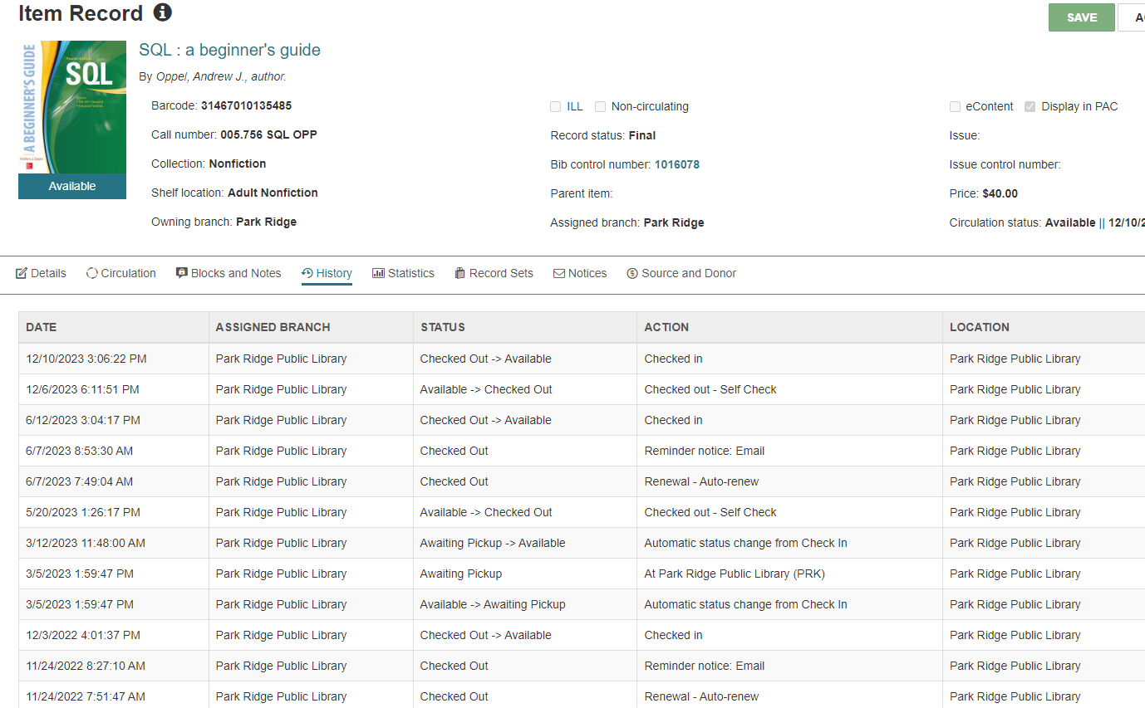

Slide 135
When an Item is checked out…
Polaris will record
Date of the transaction
Assigned Branch of the item
The Old Circulation Status / The New Circulation Status
The action that was performed
Transacting Branch
Workstation / Staff member Username performing the action
If relevant, the patron info
Stored in a table – ItemRecordHistory

Slide 136
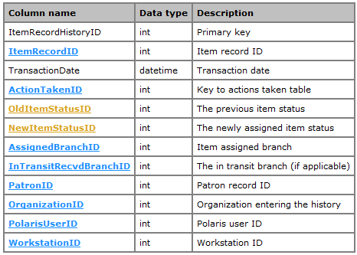
Item Record History
TransactionDate
ActionTakenID
OrganizationID
PolarisUserID

Slide 137
ItemRecord HistoryID | ItemRecord ID | TransactionDate | Action TakenID | OldItem StatusID | NewItem StatusID | Assigned BranchID | PatronID | OrganizationID | Polaris UserID | WorkstationID
128848097 | 3133520 | 9/15/22 11:06 AM | 22 | 6 | 1 | 22 | NULL | 22 | 626 | 770
128848096 | 3133520 | 9/15/22 11:06 AM | 9 | 6 | 6 | 22 | NULL | 22 | 626 | 770
128848087 | 3133520 | 9/15/22 11:05 AM | 22 | 4 | 6 | 15 | NULL | 22 | 626 | 770
128815719 | 3133520 | 9/14/22 12:43 PM | 66 | 4 | 4 | 15 | 302279 | 15 | 626 | 770
128815718 | 3133520 | 9/14/22 12:43 PM | 22 | 1 | 4 | 15 | NULL | 15 | 626 | 770
128815711 | 3133520 | 9/14/22 12:42 PM | 9 | 1 | 1 | 15 | NULL | 15 | 626 | 770
128720955 | 3133520 | 9/12/22 8:38 AM | 11 | 2 | 1 | 22 | 302279 | 22 | 626 | 770
128720954 | 3133520 | 9/12/22 8:38 AM | 13 | 1 | 2 | 22 | 302279 | 22 | 626 | 770
128105112 | 3133520 | 8/24/22 5:04 PM | 9 | 1 | 1 | 22 | NULL | 13 | 626 | 771
128105110 | 3133520 | 8/24/22 5:04 PM | 22 | 4 | 1 | 13 | NULL | 13 | 626 | 771
128104873 | 3133520 | 8/24/22 4:54 PM | 66 | 4 | 4 | 13 | 302279 | 13 | 626 | 771
128104872 | 3133520 | 8/24/22 4:54 PM | 22 | 1 | 4 | 13 | NULL | 13 | 626 | 771
128104871 | 3133520 | 8/24/22 4:54 PM | 9 | 1 | 1 | 13 | NULL | 13 | 626 | 771

Slide 138
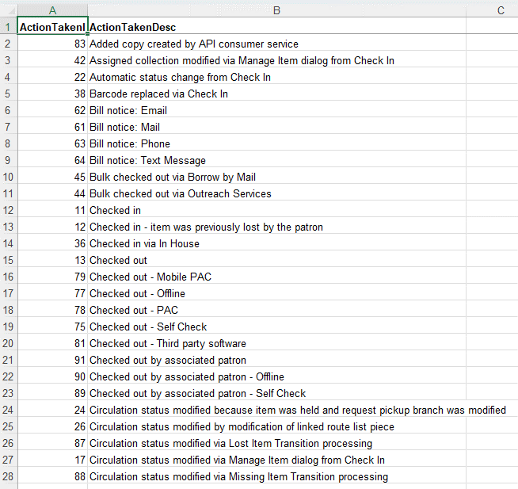
Item Record History Actions

Slide 139
Search 10: Item Record History
Find a list of items that were checked out last Thursday from 11:00 to 12:00?

Slide 140
Search 10: Item Record History
Select
From
Where
[Control Number for Items]
[A table, probably ItemRecordHistory]
[Happened yesterday]
[Item was checked out]
[Happened at My Library]

Slide 141
Search 10: Item Record History
SELECT ItemRecordID
FROM ItemRecordHistory
WHERE TransactionDate BETWEEN '4/9/2026 11:00 AM' AND '4/9/2026 12:00 PM' AND ActionTakenID IN (13,77,75,91,89)
AND OrganizationID IN (22)

Slide 142
Search 11: Patrons that Checkout Magazines
Your library has a new magazine database and would like to email all of your patrons about it. Can you generate a list of your patrons who have checked out a magazine at your library in the last 30 days and have email addresses in their account.

Slide 143
Search 11: Patrons that Check Out Magazines
Transaction Data
Checkout
Last 30 Days
Patron Data
Your Library
Has Email Address
Item Data
Magazine

Slide 144
ItemRecordHistory
ItemRecordHistoryID
ItemRecordID
TransactionDate
ActionTakenID
OldItemStatusID
NewItemStatusID
PatronID
(…)
PatronRegistration
PatronID
LanguageID
NameFirst
NameLast
NameMiddle
NameTitle
NameSuffix
PhoneVoice1
PhoneVoice2
EmailAddress
(…)
ItemRecordDetails
ItemRecordID
OwningBranchID
CreatorID
ModifierID
CallNumberPrefix
ClassificationNumber
CutterNumber
(…)
Patrons
PatronID
PatronCodeID
OrganizationID
CreatorID
ModifierID
Barcode
YTDCircCount
(…)
CircItemRecords
ItemRecordID
Barcode
ItemStatusID
LastCircTransactionDate
AssociatedBibRecordID
RecordStatusID
AssignedBranchID
MaterialTypeID
AssignedCollectionID
LastUsePatronID
(…)
BibliographicRecords
BibliographicRecordID
ModifierID
BrowseAuthor
BrowseTitle
BrowseCallNo
DisplayInPAC
ImportedDate
(…)

Slide 145
Search 11: Patrons that checkout magazines
Select IRH.PatronID
From ItemRecordHistory IRH
JOIN Patrons P
ON IRH.PatronID = P.PatronID
JOIN PatronRegistration PR
ON PR.PatronID = P.PatronID
JOIN CircItemRecords CIR
ON CIR.ItemRecordID = IRH.ItemRecordID
WHERE IRH.ActionTakenID IN (13,79,78,75,91,89)
AND IRH.TransactionDate > '3/1/2026'
AND P.OrganizationID IN (22)
AND PR.EmailAddress IS NOT NULL
AND CIR.MaterialTypeID IN (21)

Slide 146
Next Steps

Slide 147
Function
Date / Time Functions
GetDate() – Returns current date/time
DateAdd() – Returns date after adding to/subtracting from it
DateDiff() – Returns the difference between two dates
DATEADD(DAY,1,EOMONTH(GETDATE(),-2))
Beginning of Last Month
DATEADD(ms,-2,DATEADD(month,DATEDIFF(month,0,GETDATE()),0))
End of Last Month

Slide 148
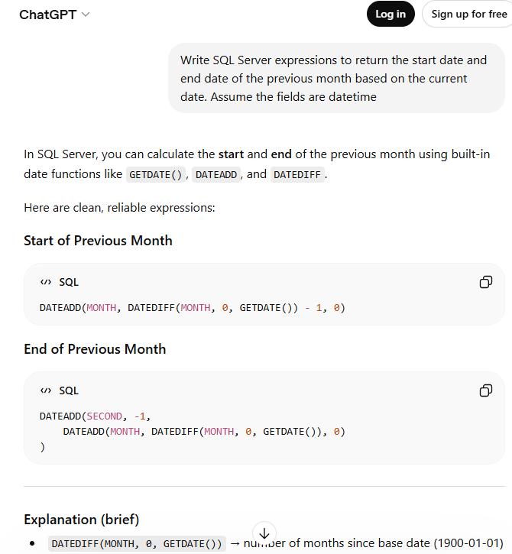

Slide 149
Subquery
A query within a query
AND CIR.AssociatedBibRecordID IN
(
SELECT CIR.AssociatedBibRecordID
FROM CircItemRecords CIR
JOIN ItemRecordDetails IRD
ON CIR.ItemRecordID = IRD.ItemRecordID
WHERE IRD.VolumeNumber IS NOT NULL
)
AND CIR.AssociatedBibRecordID IN
(1355227,1355251,1355286,1356114)

Slide 150
Subquery Example
Item Records with No Volume
SELECT CIR.ItemRecordID
FROM CircItemRecords CIR
JOIN ItemRecordDetails IRD
ON CIR.ItemrecordID = IRD.itemrecordID
WHERE CIR.AssignedBranchID IN (6,7)
AND CIR.RecordStatusID = 1
AND IRD.VolumeNumber is null
AND CIR.AssociatedBibRecordID IN
(
SELECT CIR.AssociatedBibRecordID
FROM CircItemRecords CIR
JOIN ItemRecordDetails IRD
ON CIR.ItemRecordID = IRD.ItemRecordID
WHERE IRD.VolumeNumber IS NOT NULL
)
On a Bib Record
Bib Records where Items Have Volume

Slide 151
SQL Server Management Studio
If you have access
Write SQL queries directly on the server
SELECT – choose which columns get displayed in the report
Different from Find Tool

Slide 152
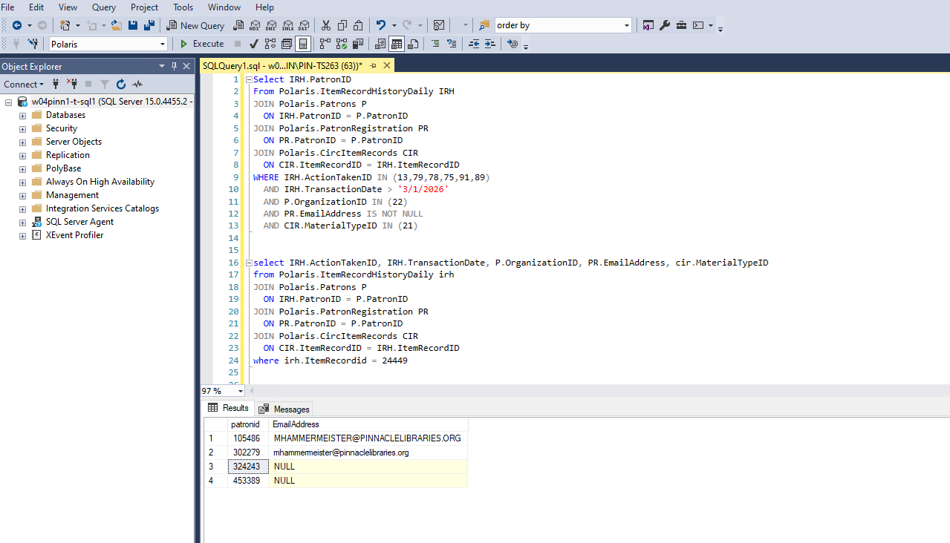

Slide 153
More SQL Sessions at IUG
Vibe Coding with SQL for Fun and “Profit”
Tuesday | 9:00
Getting the Most Out of Your Data Using SimplyReports and SQL in Leap
Tuesday | 10:30
Slightly More Advanced Polaris SQL: The Sequel to Absolute Beginner’s SQL
Wednesday | 10:30
SQL and the Find Tool
Wednesday | 2:40

Slide 154
Additional Resources
SQL is a common database language used outside of the library world.
Lots of resources about SQL available.
Will be more detailed than what we covered.
Might not all be applicable to the Find Tool, but still good practice
LinkedIn Learning: Introduction to Transact-SQL
SQL Murder Mystery: https://mystery.knightlab.com/

Slide 155
Polaris Community
IUG Forums - https://forum.innovativeusers.org/
IUG Discord - https://discord.com/invite/HwZVjN5wAn

Slide 156
Questions?
Matt Hammermeister
Director,
Pinnacle Library Cooperative
mhammermeister@pinnaclelibraries.org

