Slide 1


Slide 2

Building Permission Structures in Polaris:
The SHARE Approach
Dena Porter, SHARE Administrative Services Manager
April 14, 2026
Notes:
Good afternoon! Welcome to Building Permission Structures in Polaris: The SHARE Approach. My name is Dena Porter, I am the SHARE Administrative Services Manager (System Admin). In today’s session, I will be discussing how we structured permission groups to make our daily life as painless as possible!

Slide 3
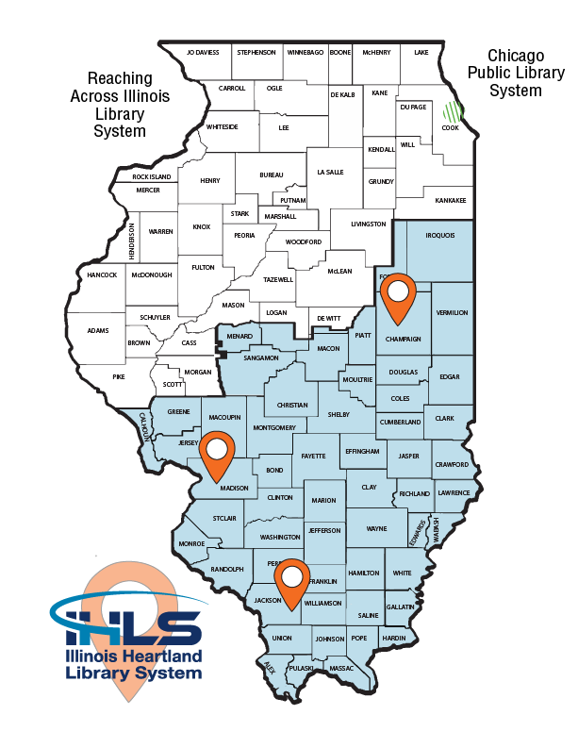

What is SHARE?
Sharing Heartland’s Available Resources Equally
339 libraries across 467 locations
Largest automation consortium in North America
Nearly 3,000 library staff members
1,300+ Permission Groups
Notes:
So, what is SHARE. SHARE is Sharing Heartland’s Available Resources Equally. We are the automated consortium for Illinois Heartland Library System. Curently, consortium membership consists of 339 libraries across 467 location. This makes us the largest automation consortium in North America. When I checked the numbers about two weeks ago, we have nearly 3,000 active staff members. And we have over 1,300 permission groups.
In Illinois, there are three library systems-Chicago Public Library, RAILS which is Reaching Across Illinois Library System, and IHLS. As you can see on the map, IHLS covers all the areas in blue. We have three regional hub locations: Champaign, Edwardsville, and Carbondale.

Slide 4
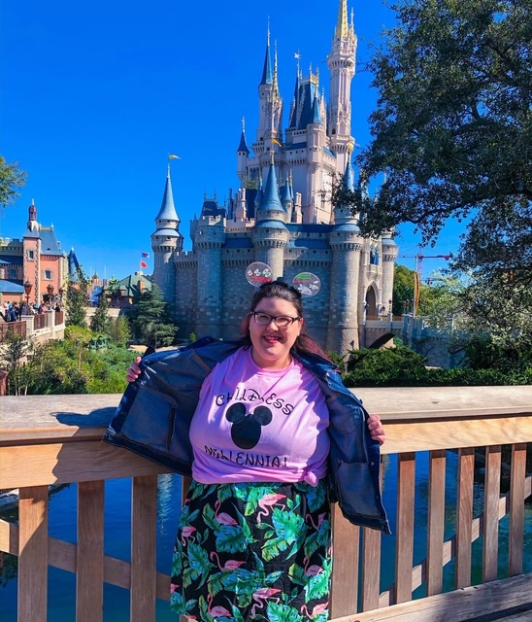

About Me
36 years library experience
  Circulation
  Cataloging
Notes:
Just a little bit about myself

Slide 5
Permission Groups
Administration-select SHARE staff
Circulation
Cataloging
  Barcoder-required course
  Full-Cataloger-required courses & review period, 2 years+
Serials-required course
Outreach Services
Acquisitions
Notes:
Presently, our consortium has close to 3,000 active staff members (650 school, almost 2200 at public, comm college, and special). With this large of a group, we need to keep our permission groups dialed in. Ours are broken down my Module. Administration, Circulation, Cataloging which as two separate designations, Serials, Outreach Services, and Acquisitions. I did not make individual slides for Administration, Serials, Outreach, and Acquisitions. For us, Circulation and Cataloging are our bread and butter modules.
For the Administration: We do not give non-SHARE staff Administration permissions. Any time a library wants to make a change, they must contact us.
Serials: We have a brief training session in Moodle, were they view the instructions, watch a training video we created in-house. Aft this has been completed, they must pass a quiz. Once the quiz has been successfully passed, the permissions will be issued.
Outreach & Acquisitions: Very few libraries (like in the single digits) use these modules, and honestly, we let them figure it for themselves. The handful of libraries that do use either or both of these modules, I can pretty much guarantee they are not using them correctly, or to their fullest potential, but whatever they are doing it works for them.

Slide 6

Circulation
All circulation permissions
Reports
Notes:
For Circulation. This permission is given to all library staff members, when we issue their username & password. As you can guess, this permission base gives staff the ability for checkin, check out, placing holds, paying fines, registering a new patron, etc. Along with access to all reports and SimplyReports.

Slide 7
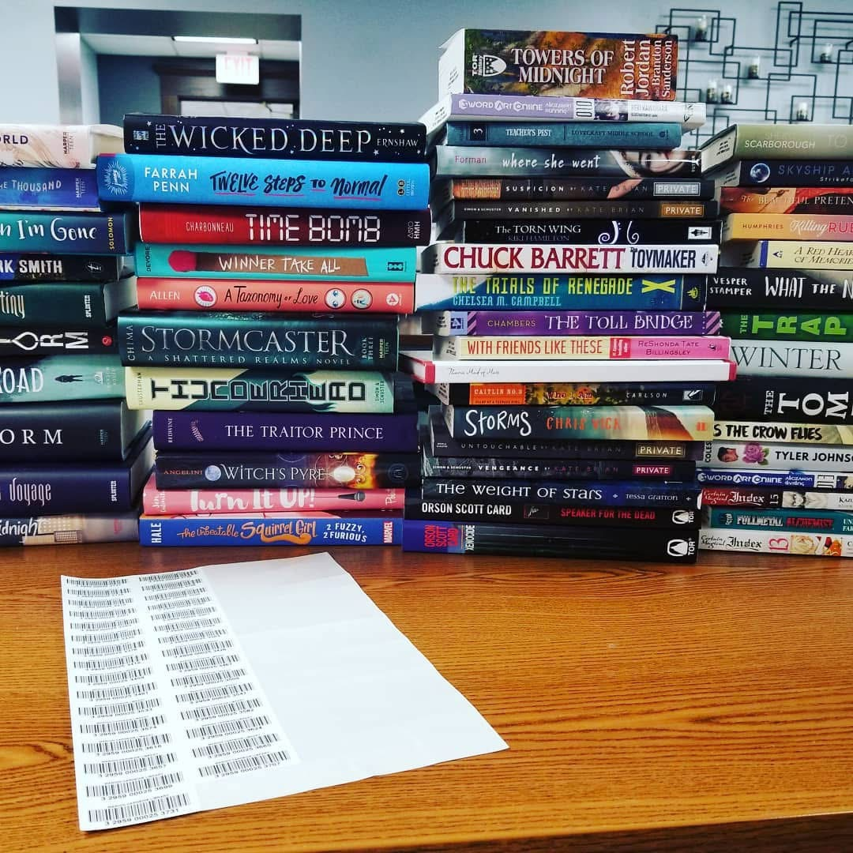
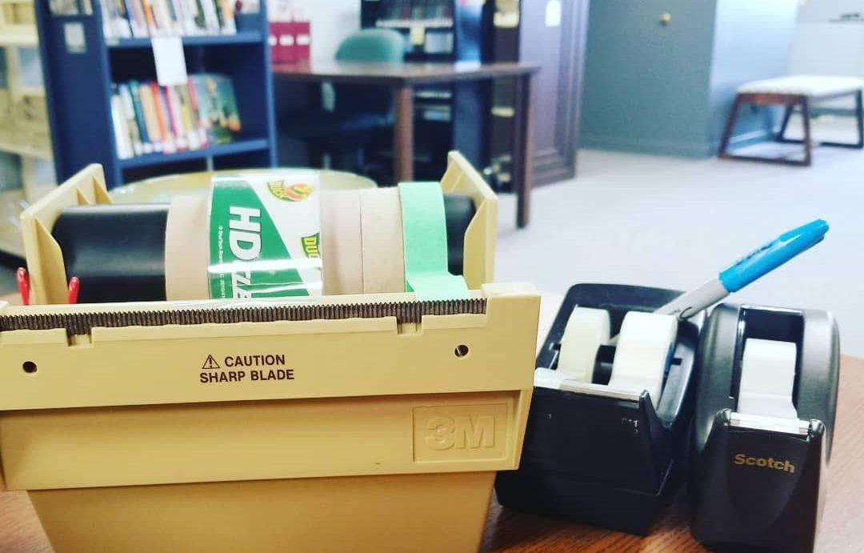
Barcoder
Contract
Required course with quizzes
Must recertify every two years
Create, Modify & Delete Item Records
No ability to modify Bibliographic Records
Notes:
For cataloging, we have things in two groups; Barcoder and a Full-Cataloger. For Barcoding: This option is open to all staff, but they must submit a contact signed by their Director, School District Librarian building Principle. They are also required to take a course in Moodle that covers searching the local database for a matching bibliographic record, as well as creating, editing, and deleting item records in the local database. No ability to make changes to a bib records.
This training can be completed asynchronously on the SHARE Training site which is Moodle, via Zoom (classes are scheduled quarterly), or in person with SHARE Staff (scheduled as needed/requested).
Barcoding Recertification Training
Barcoders are required to complete Barcoding Recertification Training every two years to maintain their barcoding status. If they do not complete the course in a very timely manner, thier barcoding permissions are removed until they have completed the recertification training.

Slide 8
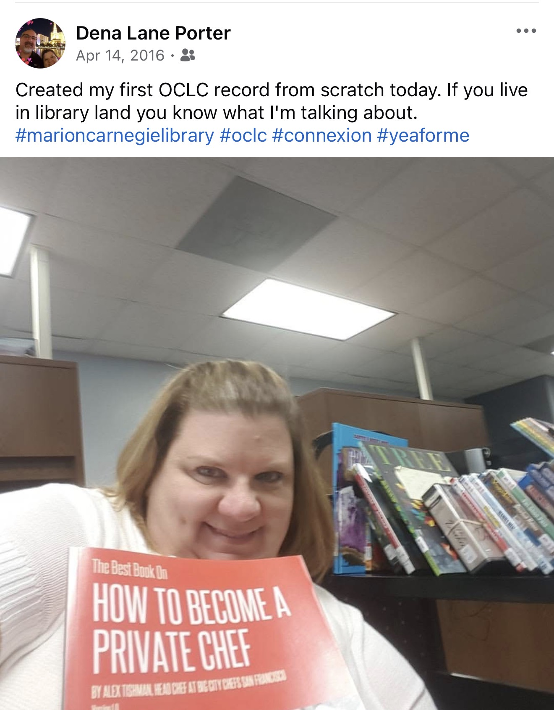
Full-Cataloger
Required courses
Barcoding
Cataloging Certification
Review Period
15 CE Hours
OCLC Membership & MARC Report
RDA Toolkit*
Notes:
For a full-cataloger:
SHARE Certified Catalogers are not required to do original cataloging but may create original records if desired.
Barcoding—As covered in previous slide, This course covers searching the local database for a matching bibliographic record, as well as creating, editing, and deleting item records in the local database.
Cataloging Certification course—This course is fully asynchronous and is hosted on the SHARE Training Site. Topics covered include:
Book Cataloging
Searching and Editing in OCLC
Introduction to Authority Records
Library of Congress Subject Headings
Dewey Decimal Classification
once coursework is completed, catalogers-in-training will be assigned to a SHARE Cataloger for their review period. This period will consist of reviewing bibliographic records for all formats in the following order.
Books
Audiobooks/CDs
DVDs
Videogames/Electronic Devices
Kits/Realia/etc.
They will not advance to the next format until their reviewer is confident in their ability to catalog the current format to the standards required by SHARE and OCLC.
Limited cataloger permissions will be assigned upon completion of the book cataloging review period. This limited set of permissions will allow staff to import book records, but nothing else. Once these permissions are assigned, the annual CE hour requirement will take effect. SHARE Certified Catalogers are required to meet the ongoing requirement of 15 hours of cataloging-related CE each fiscal year (July 1-June 30). We also require the library have an OCLC membership and they use MARC Report. While we do suggest RDA Toolkit, it is not a requirement.

Slide 9


Notes:
Our consortium is about half public libraries, half school libraries. We have a handful of community colleges and special libraries. Those are drama-free, but the schools and public libraries are another thing. After a random phone call with a school librarian a few years ago, I starting rethinking circulation permissions, like really rethinking. Because during the course of this conversation she mentioned she needed to get her student-helper a username and password. So I am thinking ok, it’s probably a student teacher. Wrong. Her student helper was a 7th grader.
I started to think about what I was like in 7th grade and let me tell you, 7th grade Dena was savage. There would have been no such thing as patron privacy. I would have been looking up everyone I know to see if they had a card, what they had checked out, if they had overdue fines, you name it.
In fact, here is 7th grade Dena in all her glory!

Slide 10

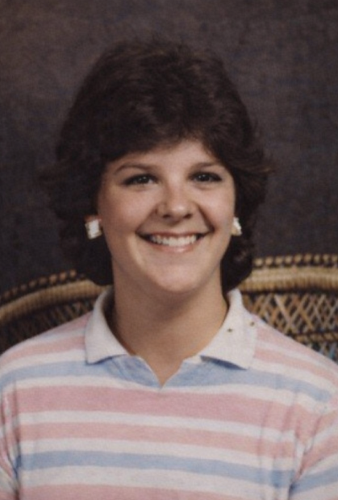
1984/1985
Notes:
I am telling my age, but this was the 1984/85 school year at Goreveille Schools. MTV was in its hay-day, we all were listening to Michael Jackson’s Thriller album, Madonna was exploding on to the music scene, my hair was feathered to perfection, it was a great time. But I digress.

Slide 11

Circulation Permissions 2.0
Schools
Their school/district only
Public Libraries
Only public library patrons
Notes:
So after that random telephone conversation and thinking about 7th grade Dena. I started deep diving thinking about how these permissions should look. I wanted to get settings in place where if you were at a school library, you would only see patrons from your school or district. We have quite a few school districts where all their schools are SHARE members. For example; Decatur Schools. They have 14 individual school buildings for various grade ranges, so library employees at Decatur Schools could see and access all their student/staff, but no one else. That means they could not see or access their public library card, see students at neighboring school districts, etc.
I also wanted the reverse of this. Public library employees would only see those cards issued at other public libraries. For example, a Public Library staff member would not be able to access their child’s library card that was issued by the school.
After a lot of tweaking, testing, tweaking again, testing again. This cycle went on for a while. I finally felt like I had thing in place, or at least in place for our schools. When things were ready, or when I felt they were ready, I simply updated their permission groups with no announcement or warning. As you imagine, that was fun. About a year later, after I regained full function of my brain again, I updated the permissions for those at public libraries. Again, we did not announce the change, we just did it.

Slide 12
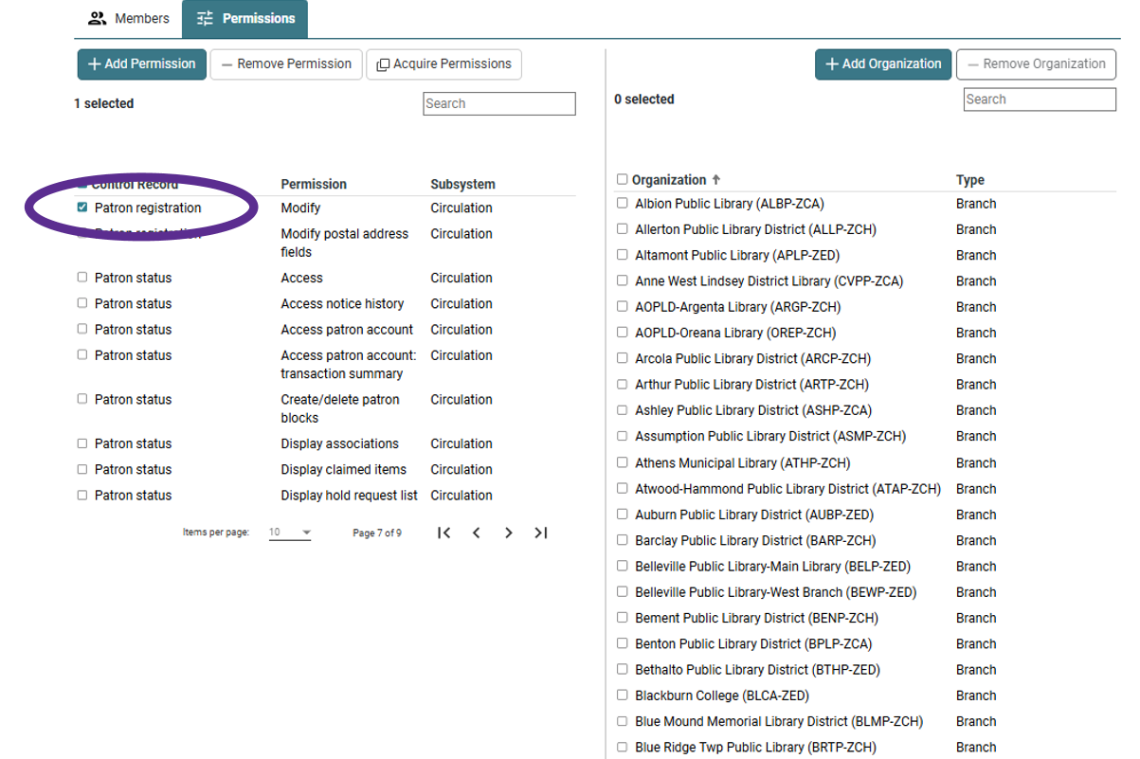
Basic Permission Base-Public Libraries

Slide 13
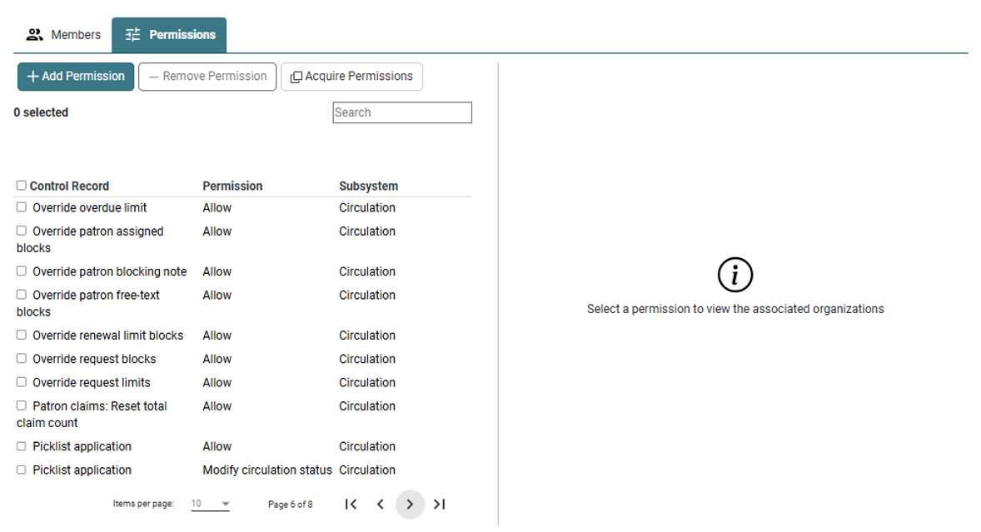
Basic Permission Base-Schools

Slide 14
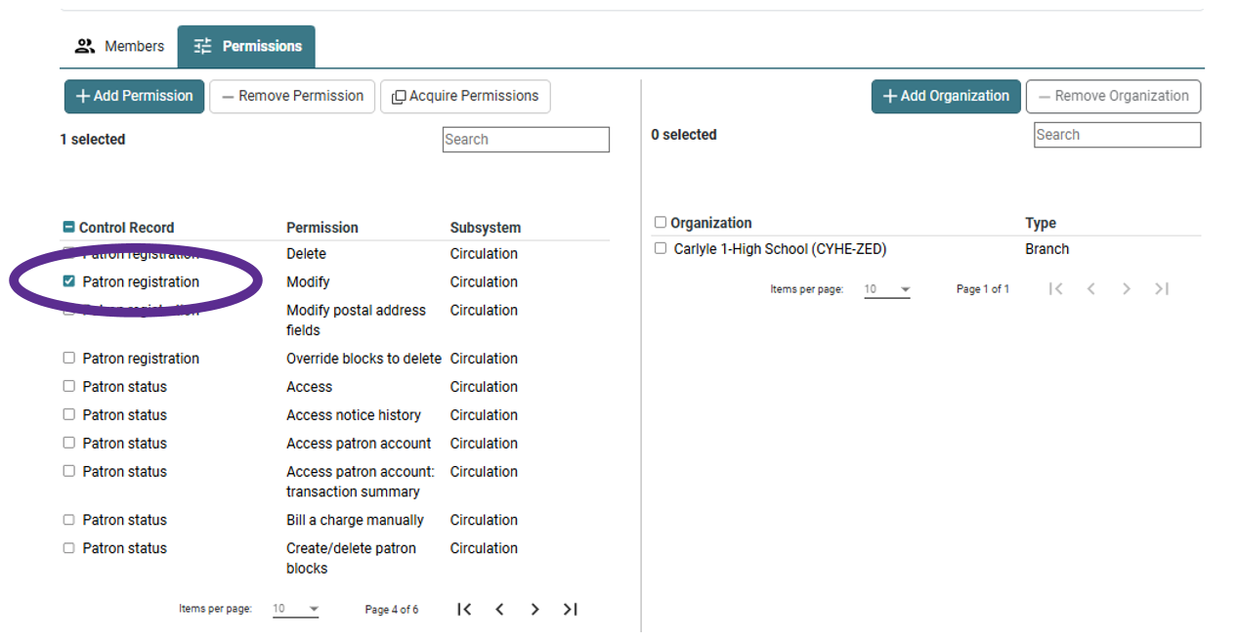
Basic Permission Base-Schools

Slide 15


One off permission groups because of a
training or disciplinary reasons.
Remove Quick-Circ
Remove On-The-Fly
Notes:
As you can imagine we do face challenges with getting all libraries and library staff on the same page, especially when it comes to not following our policies, procedures, and best practices. With that said, I will not create one-off permission groups of a library have a staff member or group of staff members that are doing things are not supposed to be doing. In almost every instance of this it is due to a training issue.
I will however create a base permission group that will remove On-The-Fly Permissions and the ability to create or do anything with Quick Circ.

Slide 16
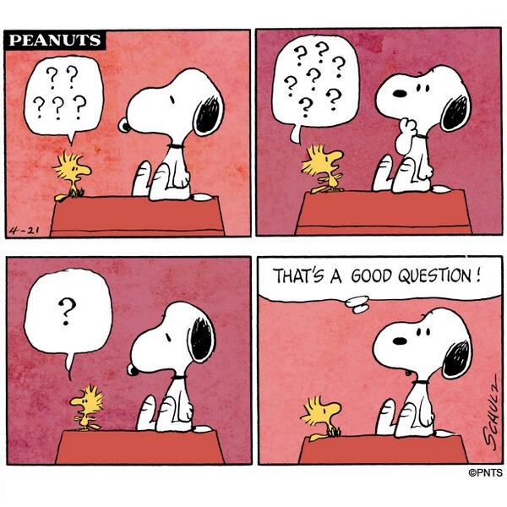
Questions?

Slide 17

Contact Information:
Dena Porter
SHARE Administrative Services Manager
dporter@illinoisheartland.org
618.619.2091

