Slide 1


Slide 2

MEEP Member Exclusive Enhancement Process
Katie LeBlanc Alex Vancina

Slide 3
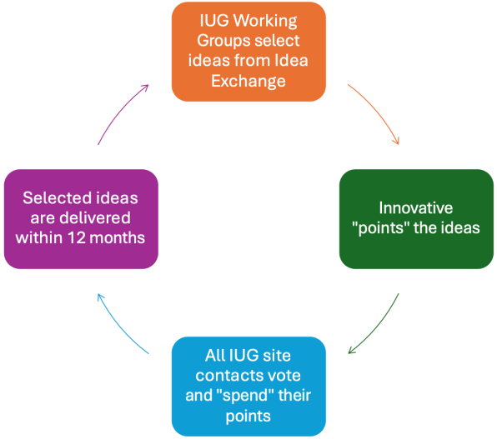

Life of an Idea
Idea Exchange
MEEP Working Groups
Election Process
Implementation
Notes:
How does this process work?
Working Groups select up to 20 idea candidates per year and clarify the requirements.
Product owners assign effort point values to each idea.
IUG members vote to prioritize ideas for implementation.
Innovative commits to deliver enhancements within 12 months.
Product owners will follow-up with Working Groups to ensure that enhancements meet the requirements laid out in the ideas.
.

Slide 4
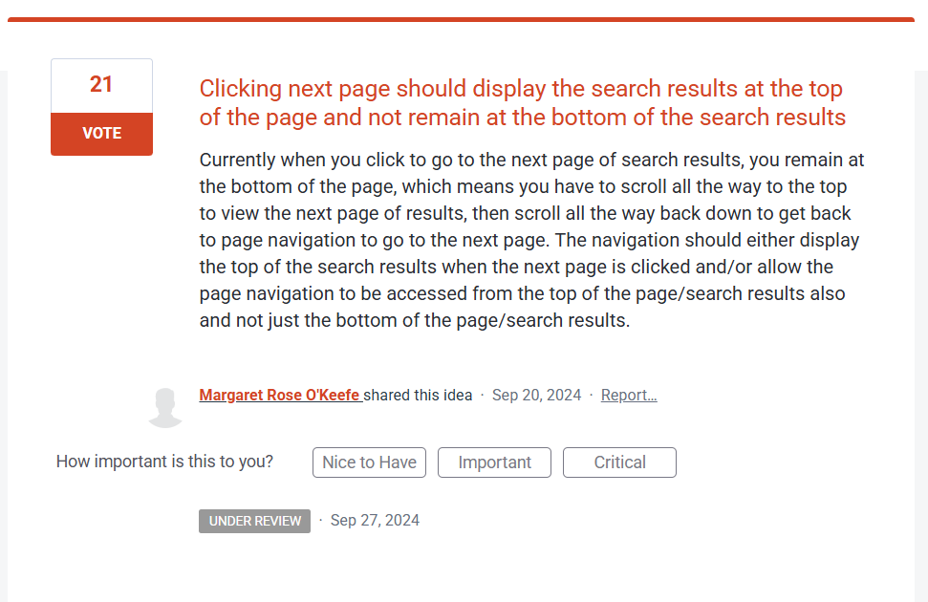
Idea Exchange
Be detailed
Broad appeal
Get buy in
Staff members from your organization or consortia
Discord
IUG Forums
Notes:
Details help the product manager know what you are asking for. Understand that other libraries are looking through these ideas and you want to appeal to all of them. Comments on ideas help show interest in the idea as well as how others might use the idea.

Slide 5
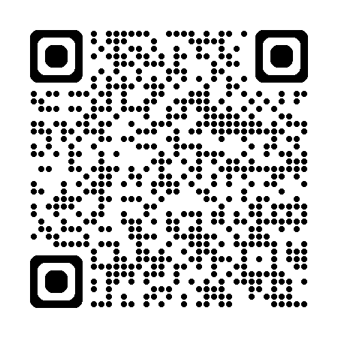
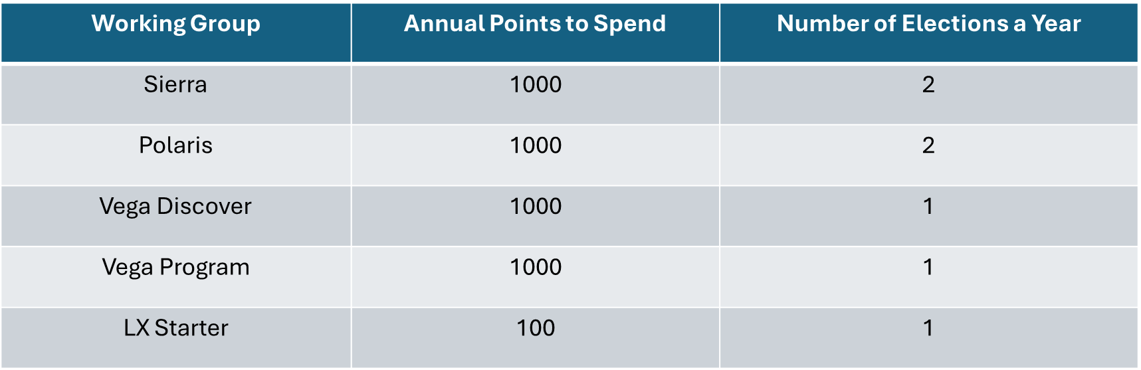
MEEP Working Groups
Notes:
How many people are there in each Working Group?
Between 6 and 12 people.
The Steering Committee will announce when we are recruiting for Working Groups.
Can more than one individual from the same member organization be on a Working Group?
Yes, we would consider multiple people or the same person from an organization for participating in one or more Working Groups.
However, If there were more people than slots available, part of the selection process might involve placing the person into only one of the Working Groups.

Slide 6
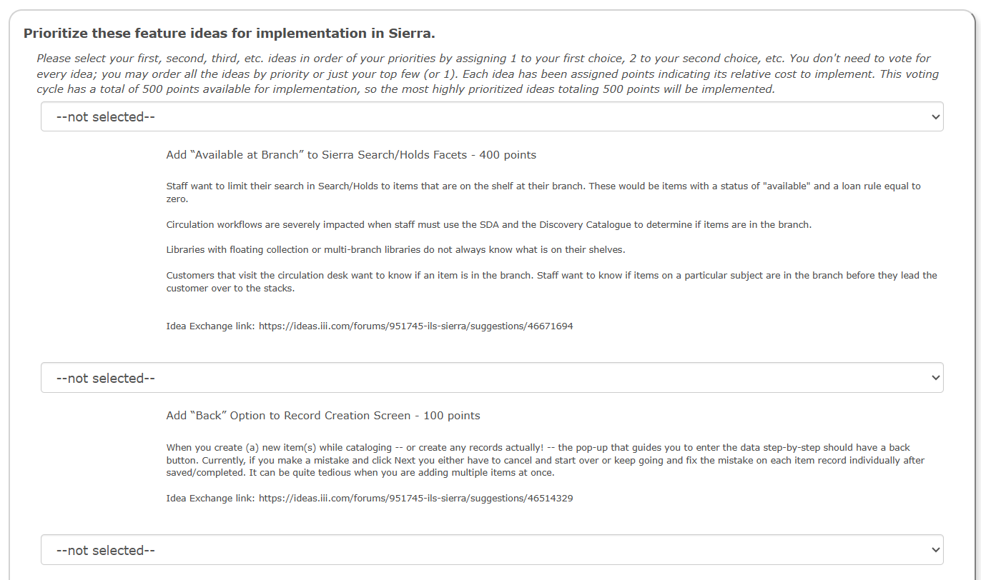
Election
Notes:
Voting runs on a rank choice vote. You do not need to rank ideas you are not interested in.
When election opens an email goes out to your site contact. Only that individual is able to vote. If you are interested in who your site contact is you can look this up by logging into IUG website, select members only and look for primary member on the left side under your contact information. If you don’t see primary member it is probably you.

Slide 7
Winning Ideas Since IUG 2025
Polaris 8.0
Better handling of “Display” items
Dated patron notes
Fix the Leap Bibliographic Find Tool Search to use Initial Articles
Polaris 8.1
Leap Find Tool window and New tabs from Find Tool in Leap
Stacked Sorting
Add ability to enter a reason when cancelling a hold
Return to where you were in your record set
Polaris 8.2
Ability to place holds on all items in a record set
Create Multiple Items in LEAP
Create a new status of lost and paid
Sierra 6.6
Ability to view history for item and volume records
Add permission to prevent user deletion of notice jobs
Sierra 6.7
Automatic SSL Certificate Renewal
Create Rest API that updates patron “last circ activity date”
Allow use of spine label print templates in Create Lists
Vega Discover
Accept initials or partial names in author searches
Remove Apply Step from Facet Use
Call Number Browse or Wildcard Search Options
Polaris Renewals Remaining in Account Portal
Unroll from Textual Works with New Material Type
Vega Promote
Autosave in Editor
Archive past and present campaigns
Vega LX Starter
Add message to account when “marked as spam”

Slide 8
Thanks to our 2025-2026 Working Groups!
LX Starter
Jennifer Moakler (Chair)
Julio Campa
Claudia Herrera
Andy Lechlak
Stacey McClain
Brittany Smith
Jeff Tate
Polaris
Susan Millwater (Chair)
Anne Barnard
Nicole Bovee
Kristine den Boon
Courtney DeSear
Mieko Fujiura-Landers
Matt Hammermeister
Justin Megahan
Alex Planchak
Erin Shield
Amy Spurrier
Sierra
Jeremy Goldstein (Chair)
Leslie Collie
Shawn Farrell
Xuemei Ge
Matthew Hill
Adam Hornsey
Linda Nilles
Carol Shaffer
Phil Shirley
Nicole Turzillo
Elizabeth Wright
Vega Discover
Allison Sartwell (Chair)
Sarah Albers
Alissa Dornink
Matthew Etzel
Moira Lynn
Sarah Kasprzak
Eileen Keller
Shelby O'Hara
Aaron Paap
Alison Pruntel
Bill Taylor
Aaron Thomas
Vega Promote
Michele Dimond (Co-Chair)
Jeremy Ljunggren (Co-Chair)
Jeff Garver
Julianne Smith

Slide 9

Interest in joining a working group?

Slide 10
THANK YOU!
Questions?
kleblanc@cmpl.org
avancina@helenplum.org
#IUG2026

