Slide 1

Creating a Circulation Statistics Dashboard Using SQL and LibInsights
Joel Tonyan
Director of User Experience,
Kraemer Family Library
jtonyan@uccs.edu

Slide 2
Objectives
Introduction
Itemized Checkouts Query
  Sample Output
  Overview of the Query
LibInsights Dashboard
Building the Dataset
Analyzing the Dataset
Building the Dashboard
Questions?

Slide 3
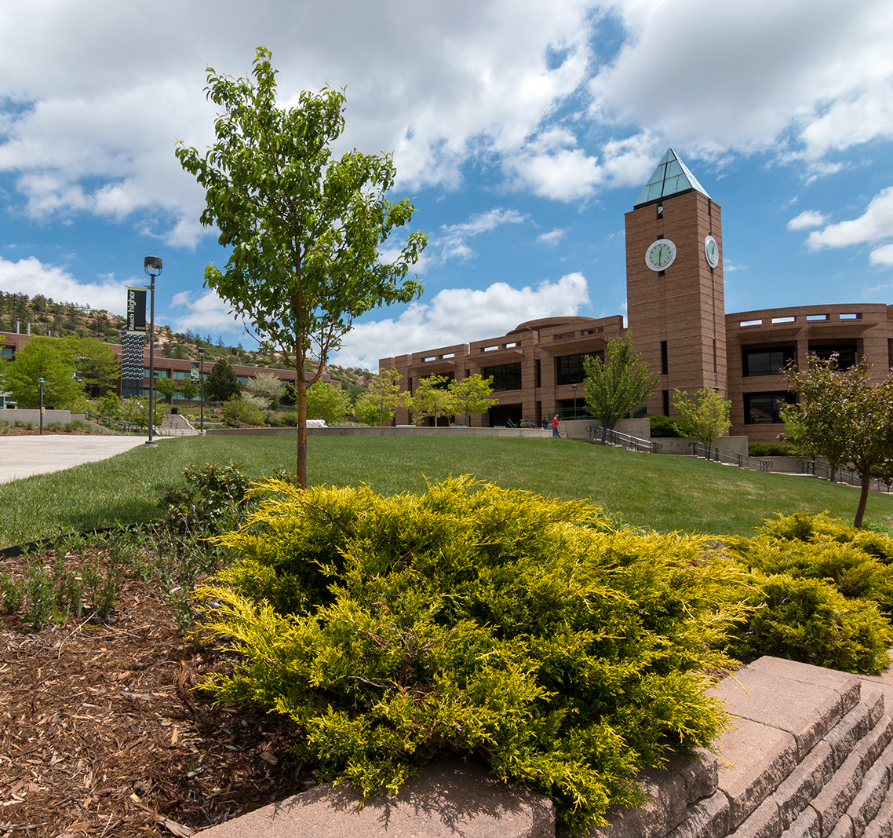
Introduction
About the Kraemer Family Library
Academic library that serves 11,000 users, including students, faculty, and staff, as well as members of the greater community
Participates in Prospector via INN-REACH, a consortia borrowing program in Colorado and Wyoming
  Net lender on Prospector

Slide 4

Introduction, contd.
Information Need
The Kraemer Family Library needed a dashboard of our circulation statistics that displayed a monthly report of checkouts by patron type, shelving location, item type, fund code, and call number prefix that allowed us to track checkouts by time of day and day of week.
Solution
Custom Sierra SQL query to produce monthly spreadsheets that listed listed each checkout for the prior month and the required information for each transaction
Import spreadsheets into a custom dataset in SpringShare’s LibInsight product
Custom Dashboard in LibInsight to visualize needed data

Slide 5
Itemized Monthly Checkouts Query

Slide 6
Querying the Circulation Transactions Table
By Default, the Circulation Transaction Table in Sierra SQL only retains two weeks of transaction data.
If you contact Innovative, depending on the size of your library and the number of transactions it does a day, they will increase you the retention period up to 180 days.
Regardless, you will need to be capturing circ data periodically, before the retention period passes.

Slide 7
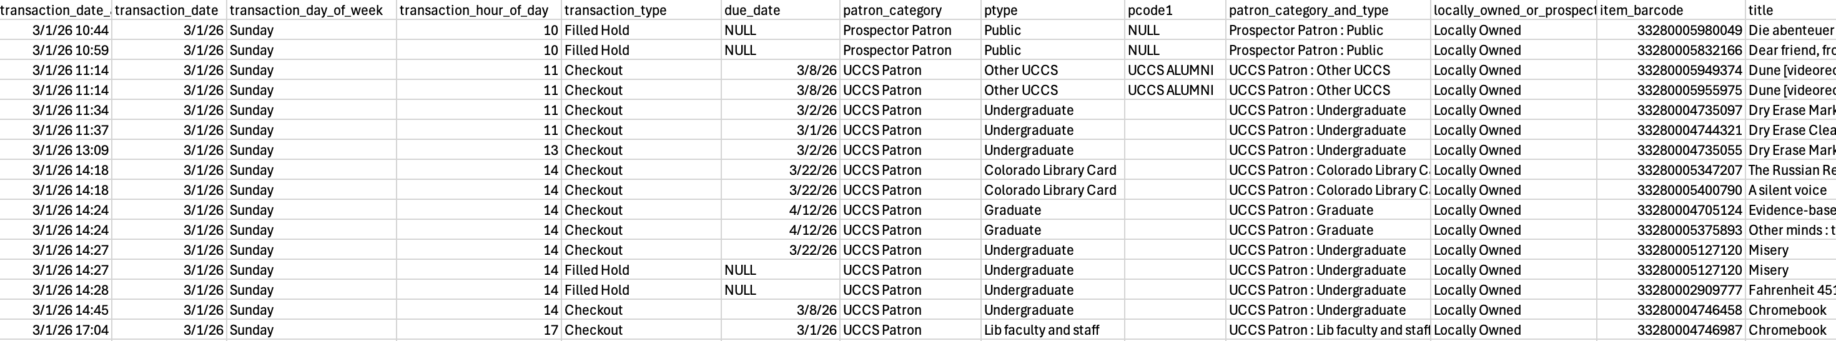
Itemized Checkouts Query: Sample Output
https://tinyurl.com/iug2026sampleout

Slide 8
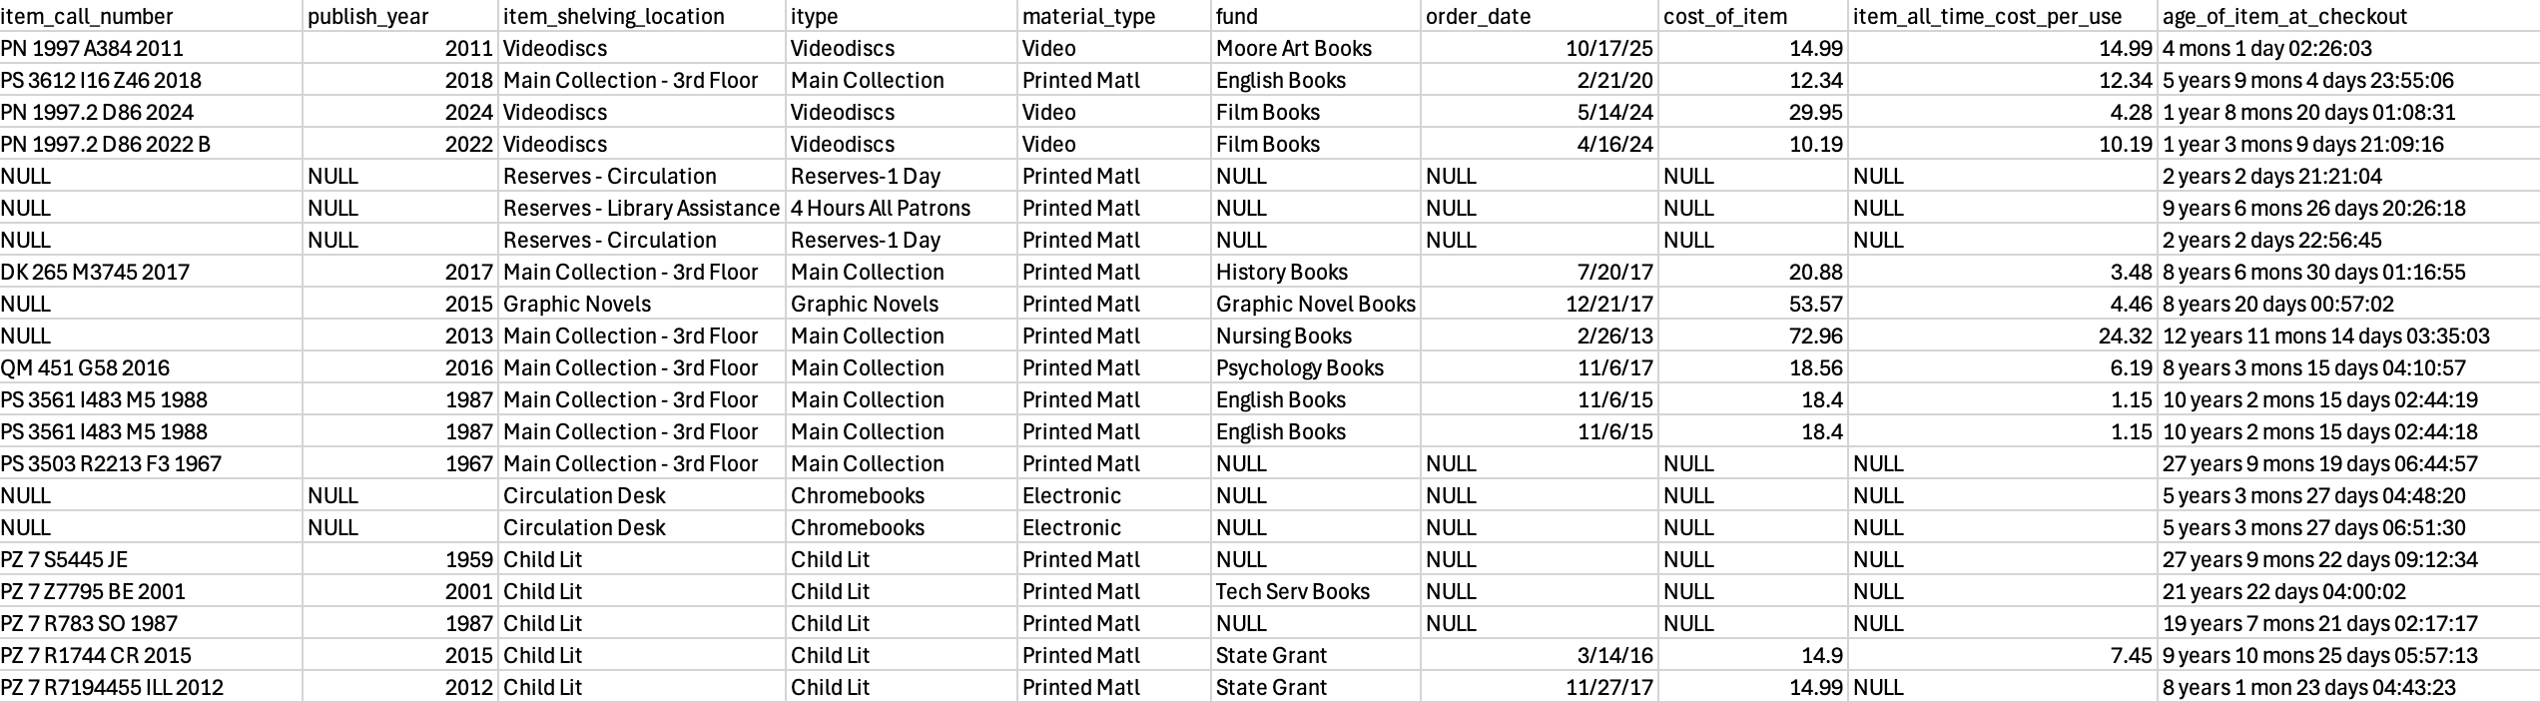
Itemized Checkouts Query: Sample Output, contd.

Slide 9
Itemized Monthly Checkouts Query
Available at:
https://tinyurl.com/iug2026circquery

Slide 10
Query: Limiting results to transactions from prior month
base_transactions AS (
SELECT DISTINCT ON (ct.transaction_gmt, irp.barcode)
ct.transaction_gmt,
ct.op_code,
ct.application_name,
ct.stat_group_code_num,
ct.due_date_gmt,
ct.patron_record_id,
ct.item_record_id,
ct.bib_record_id,
irp.barcode
FROM sierra_view.circ_trans ct
LEFT JOIN sierra_view.item_record_property irp
ON ct.item_record_id = irp.item_record_id
WHERE ct.transaction_gmt::date >= date_trunc('month', current_date - interval '1 month')
AND ct.transaction_gmt::date < date_trunc('month', current_date)

Slide 11
Query: Extracting Time-Related Data and Transaction Type
transaction_details AS (
SELECT
bt.*,
-- Date and time formatting
to_char(bt.transaction_gmt, 'YYYY-MM-DD HH24:MI') as transaction_date_and_time,
to_char(bt.transaction_gmt, 'YYYY-MM-DD') as transaction_date,
to_char(bt.transaction_gmt, 'Day') as transaction_day_of_week,
extract(hour from bt.transaction_gmt) as transaction_hour_of_day,
-- Transaction type mapping
(CASE
WHEN bt.op_code = 'o' THEN 'Checkout'
WHEN bt.op_code LIKE 'n%' THEN 'Hold'
WHEN bt.op_code = 'f' THEN 'Filled Hold'
WHEN bt.op_code = 'i' THEN 'Checkin'
WHEN bt.op_code = 'r' THEN 'Renewal'
WHEN bt.op_code = 'u' THEN 'Internal Use Count'
ELSE bt.op_code
END) as transaction_type,

Slide 12
Query: Distinguishing between Local and INN-REACH Patrons
patron_info AS (
SELECT
td.*,
pr.id as patron_anonymized_id,
pr.home_library_code,
-- Patron category classification
(CASE
WHEN pr.home_library_code = 'circ' THEN 'UCCS Patron'
WHEN pr.home_library_code IS NULL THEN 'Internal Use Count'
ELSE 'Prospector Patron'
END) as patron_category,
-- Home library display
(CASE
WHEN pr.home_library_code = 'circ' THEN 'Kraemer Family Library'
ELSE pr.home_library_code
END) as home_library,
ppn.description as ptype,
udpm.name as pcode1

Slide 13
Query: Determining Local vs. INN-REACH checkouts and Calculating Age of Item at Checkout
item_details AS (
SELECT
pc.*,
ir.checkout_total,
ir.virtual_item_central_code_num,
ir.itype_code_num,
ir.location_code,
irp.call_number,
irp.call_number_norm,
irm.creation_date_gmt as item_creation_date,
-- Local vs Prospector classification
(CASE
WHEN ir.virtual_item_central_code_num = 0 THEN 'Locally Owned'
ELSE 'Prospector'
END) as locally_owned_or_prospector_item,
-- Age of item at checkout
age(pc.transaction_gmt, irm.creation_date_gmt) as age_of_item_at_checkout

Slide 14
Query: Grabbing Bib Call Number
call_number_data AS (
SELECT
bd.*,
brcnp.call_number_prefix as bib_call_number_prefix,
loc_a.content as loc_a,
loc_b.content as loc_b,
-- Combine LOC A and B subfields for full call number
(CASE
WHEN loc_a.content IS NOT NULL AND loc_b.content IS NOT NULL
THEN CONCAT(loc_a.content, ' ', loc_b.content)
ELSE NULL
END) as bib_call_number,

Slide 15
Query: Grabbing Order Record Info
order_info AS (
SELECT
lat.*,
o.order_date_gmt,
fmu.name as fund,
irl.paid_amt
FROM location_and_types lat
LEFT JOIN sierra_view.bib_record_order_record_link brorl
ON lat.bib_record_id = brorl.bib_record_id
LEFT JOIN sierra_view.order_record o
ON brorl.order_record_id = o.record_id
LEFT JOIN sierra_view.order_record_cmf orc
ON o.id = orc.order_record_id
LEFT JOIN sierra_view.fund_master fm
ON CAST(orc.fund_code AS int) = fm.code_num
LEFT JOIN sierra_view.fund_myuser fmu
ON fm.id = fmu.fund_master_id
LEFT JOIN sierra_view.record_metadata orm
ON o.id = orm.id
LEFT JOIN sierra_view.invoice_record_line irl
ON orm.id = irl.order_record_metadata_id
),

Slide 16
Query: Calculating Cost Per Use
-- Calculate total cost per item using proper aggregation
ROUND(SUM(DISTINCT oi.paid_amt), 2) as cost_of_item,
-- Calculate cost per use (only if item has checkouts and cost data)
(CASE
WHEN oi.checkout_total > 0 AND COUNT(oi.paid_amt) > 0
THEN ROUND(SUM(DISTINCT oi.paid_amt) / oi.checkout_total, 2)::text
ELSE NULL
END) as item_all_time_cost_per_use

Slide 17
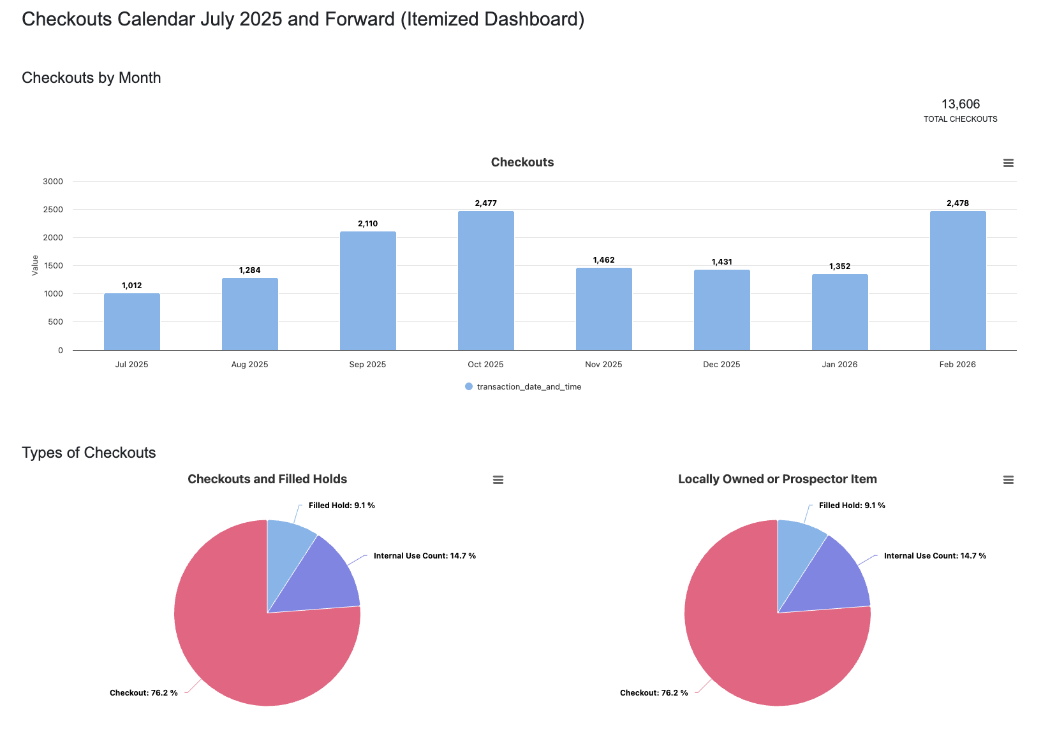
LibInsight Dashboard
Publicly available at: https://uccs.libinsight.com/kflcircstats25onward
Displays monthly and total circulation statistics
Distinguishes between local and INN-REACH checkouts
Breaks down circulation stats by patron type, shelving location, fund code, call number range, time of day, day of week, etc.

Slide 18
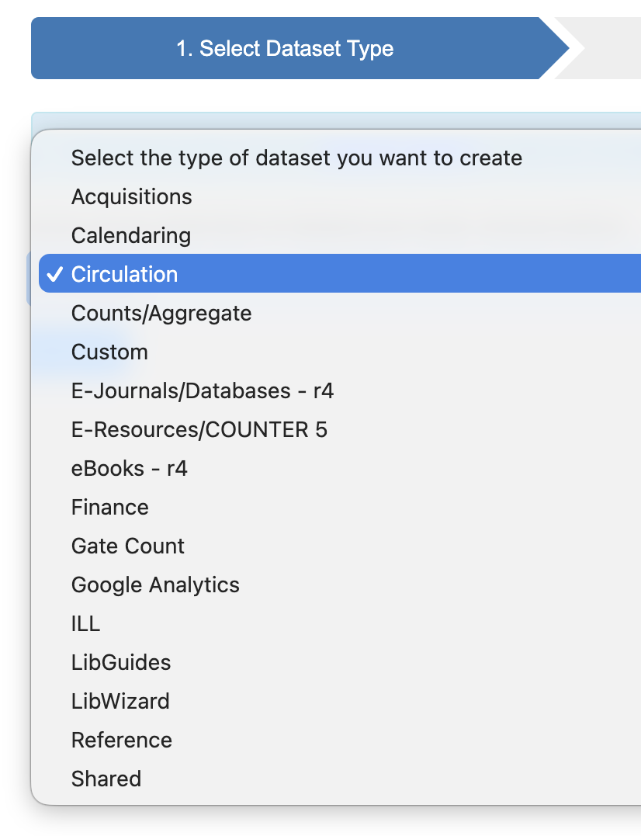
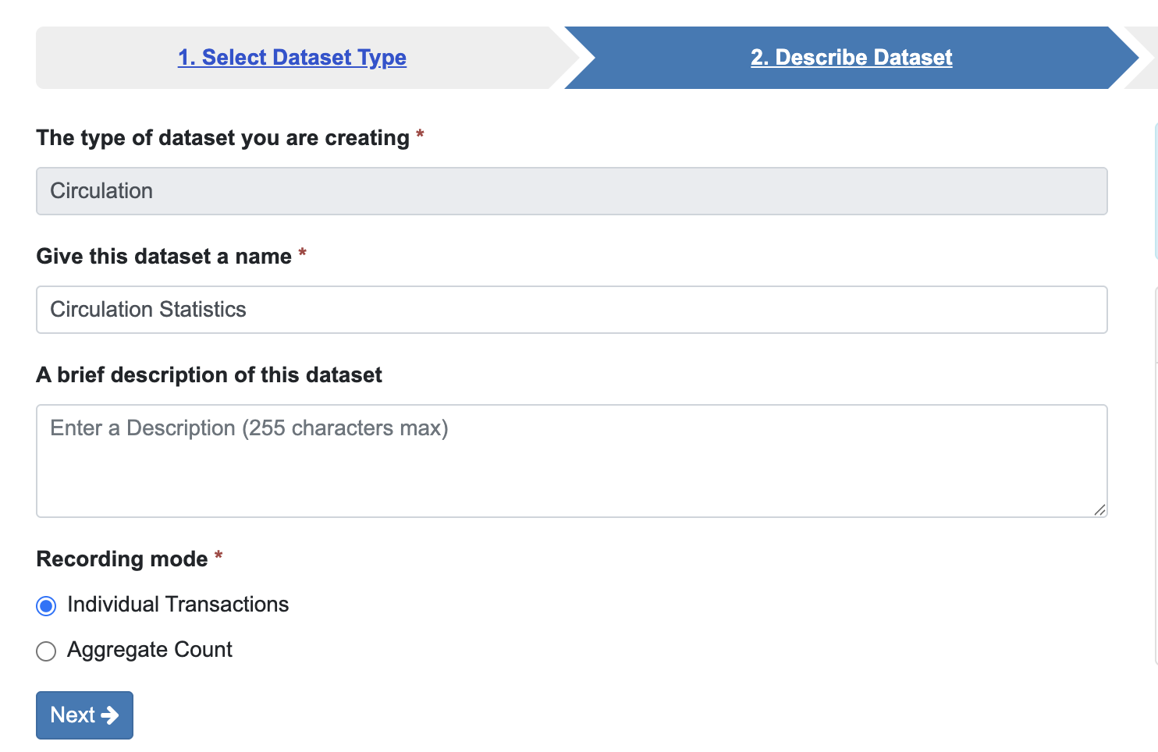
Building the Dataset in LibInsight:
Creating a New Dataset

Slide 19
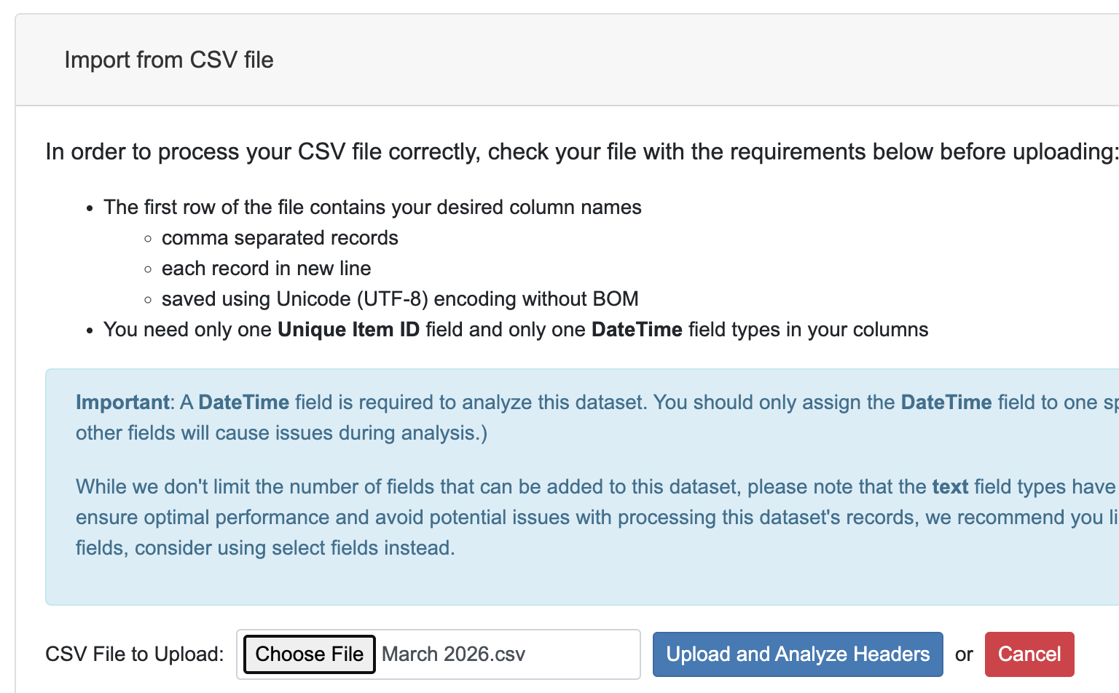
Building the Dataset in LibInsight: Importing a CSV to Map Columns to in Dataset Fields

Slide 20
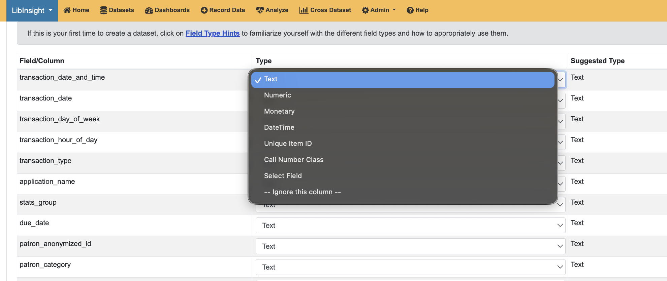
Building the Dataset in LibInsight:
Assigning a Data Type for each Field

Slide 21
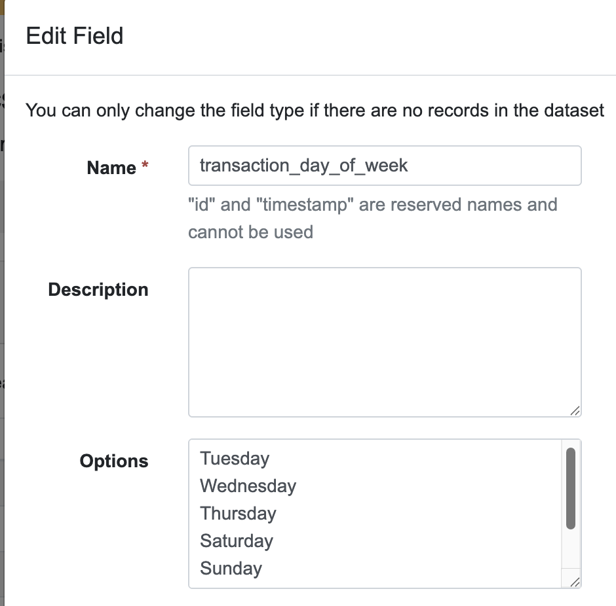
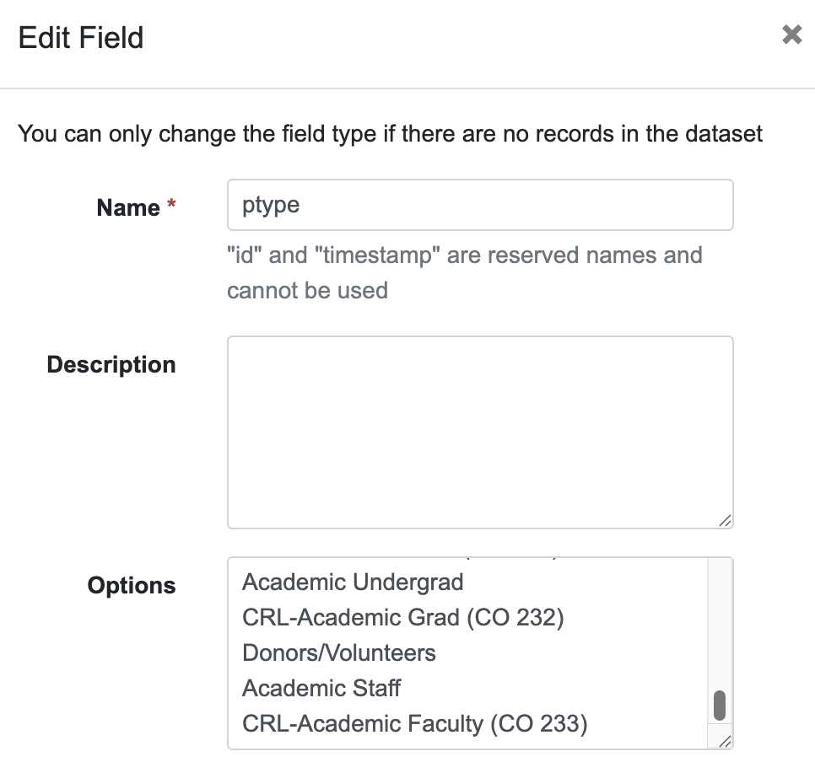
Defining Select Fields

Slide 22
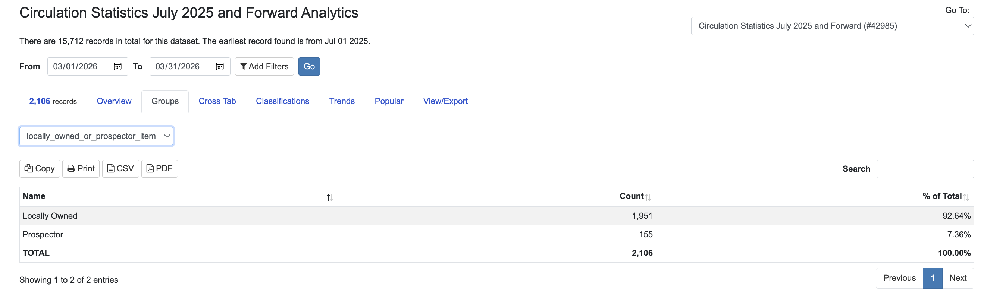
Analyzing the Dataset in LibInsight:
Viewing the Data for an Individual Field

Slide 23
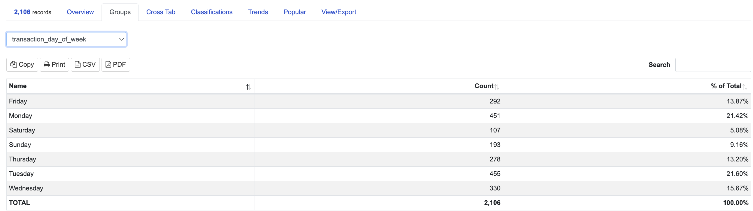
Analyzing the Dataset in LibInsight:
Viewing the Data for an Individual Field, contd.

Slide 24
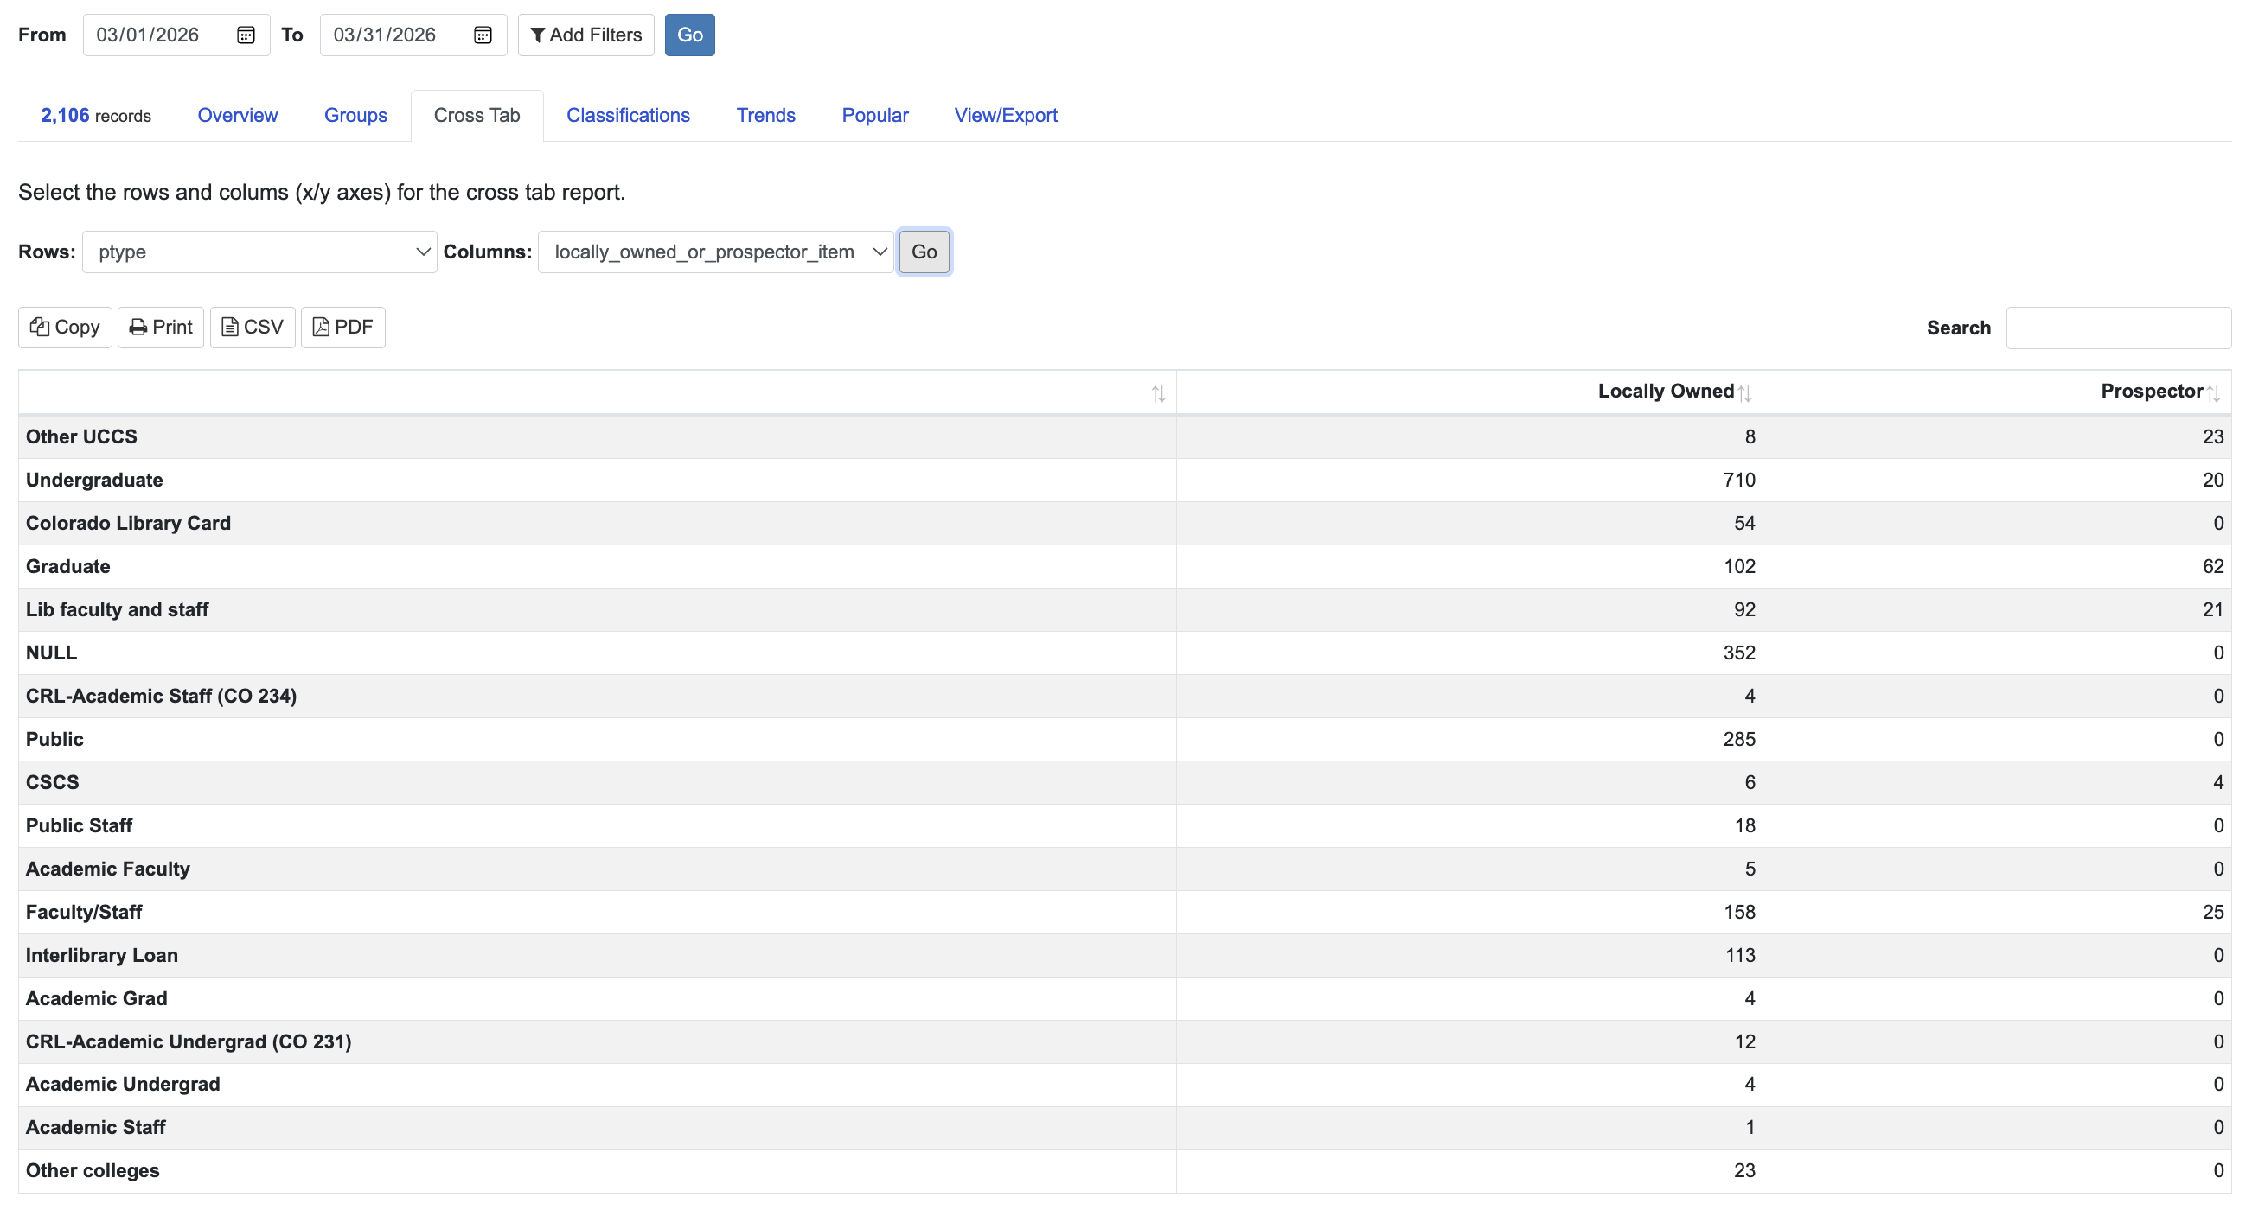
Analyzing the Dataset in LibInsight: Crosstabs

Slide 25
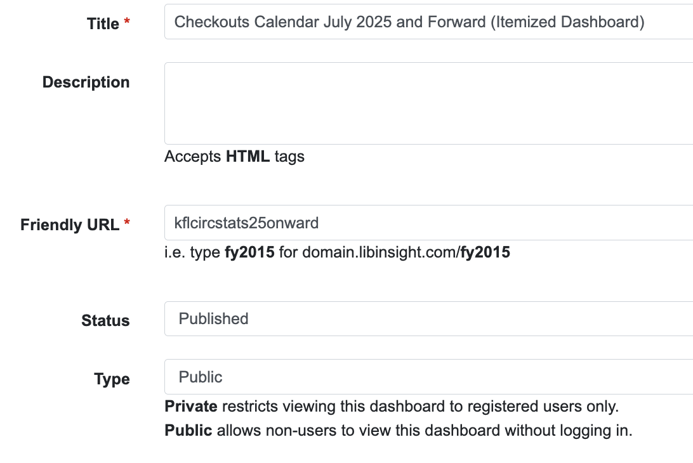
Building the Dashboard in LibInsight:
Creating a New Dashboard

Slide 26
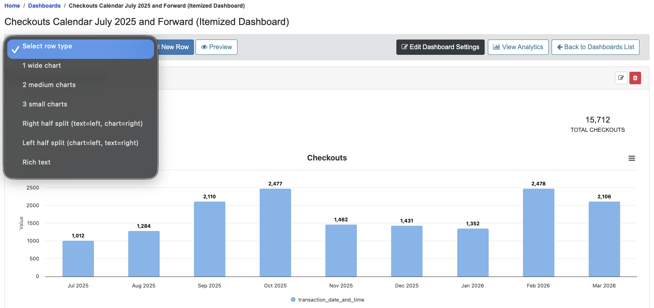
Building the Dashboard in LibInsight:
Creating a Row

Slide 27
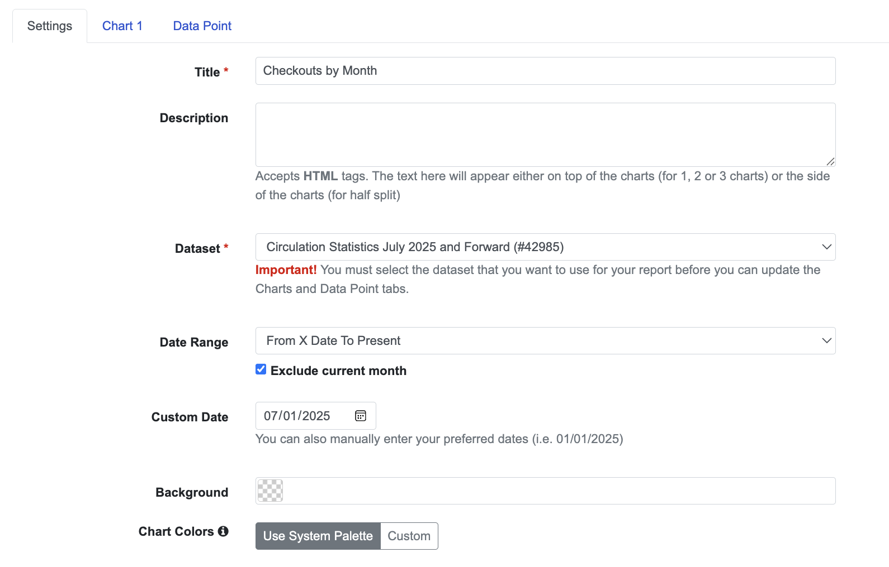
Building the Dashboard in LibInsight:
Creating a Row, contd.

Slide 28
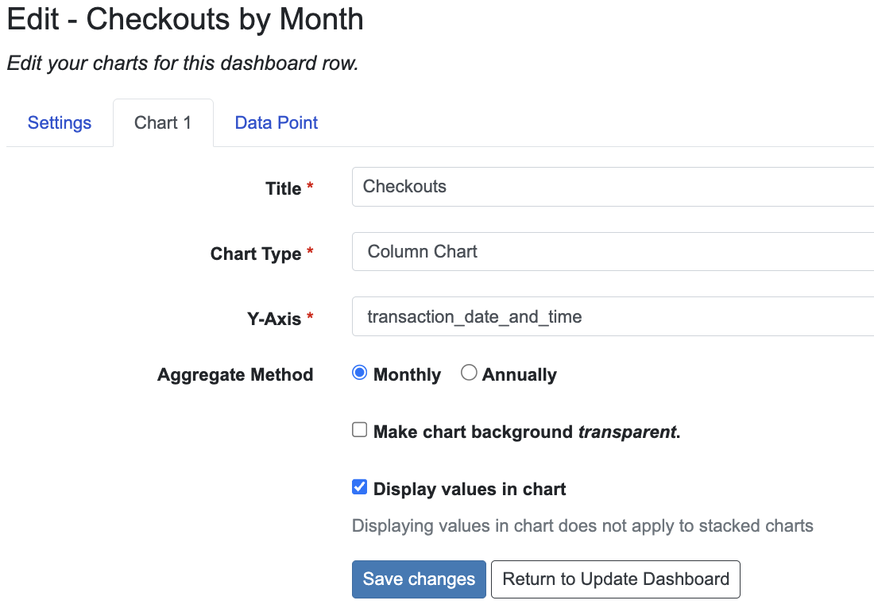
Building the Dashboard in LibInsight:
Creating a Row, contd.

Slide 29
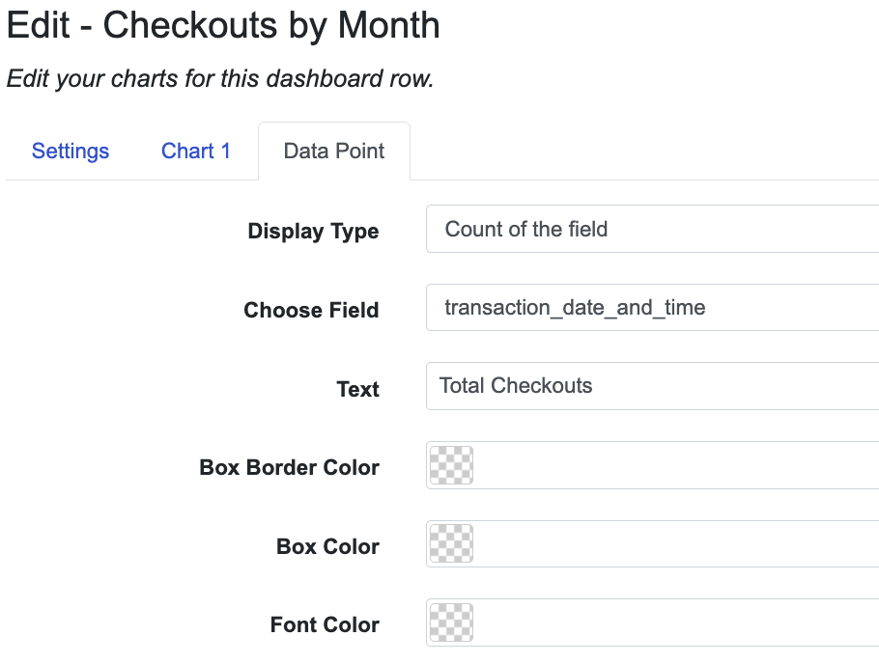
Building the Dashboard in LibInsight:
Creating a Row, contd.

Slide 30
Thank you!
Questions?
  Joel Tonyan
  jtonyan@uccs.edu

