Slide 1

Curtains for Encore; Discovering Vega
Stephanie Ruhe
Springfield-Greene County (MO) Library

Slide 2

What we’ll cover:
Introductions/about SGCL
Choosing to adopt Vega
Go-live preparation and process
Successes and challenges – first year+ in review
Looking ahead
Questions/discussion?

Slide 3
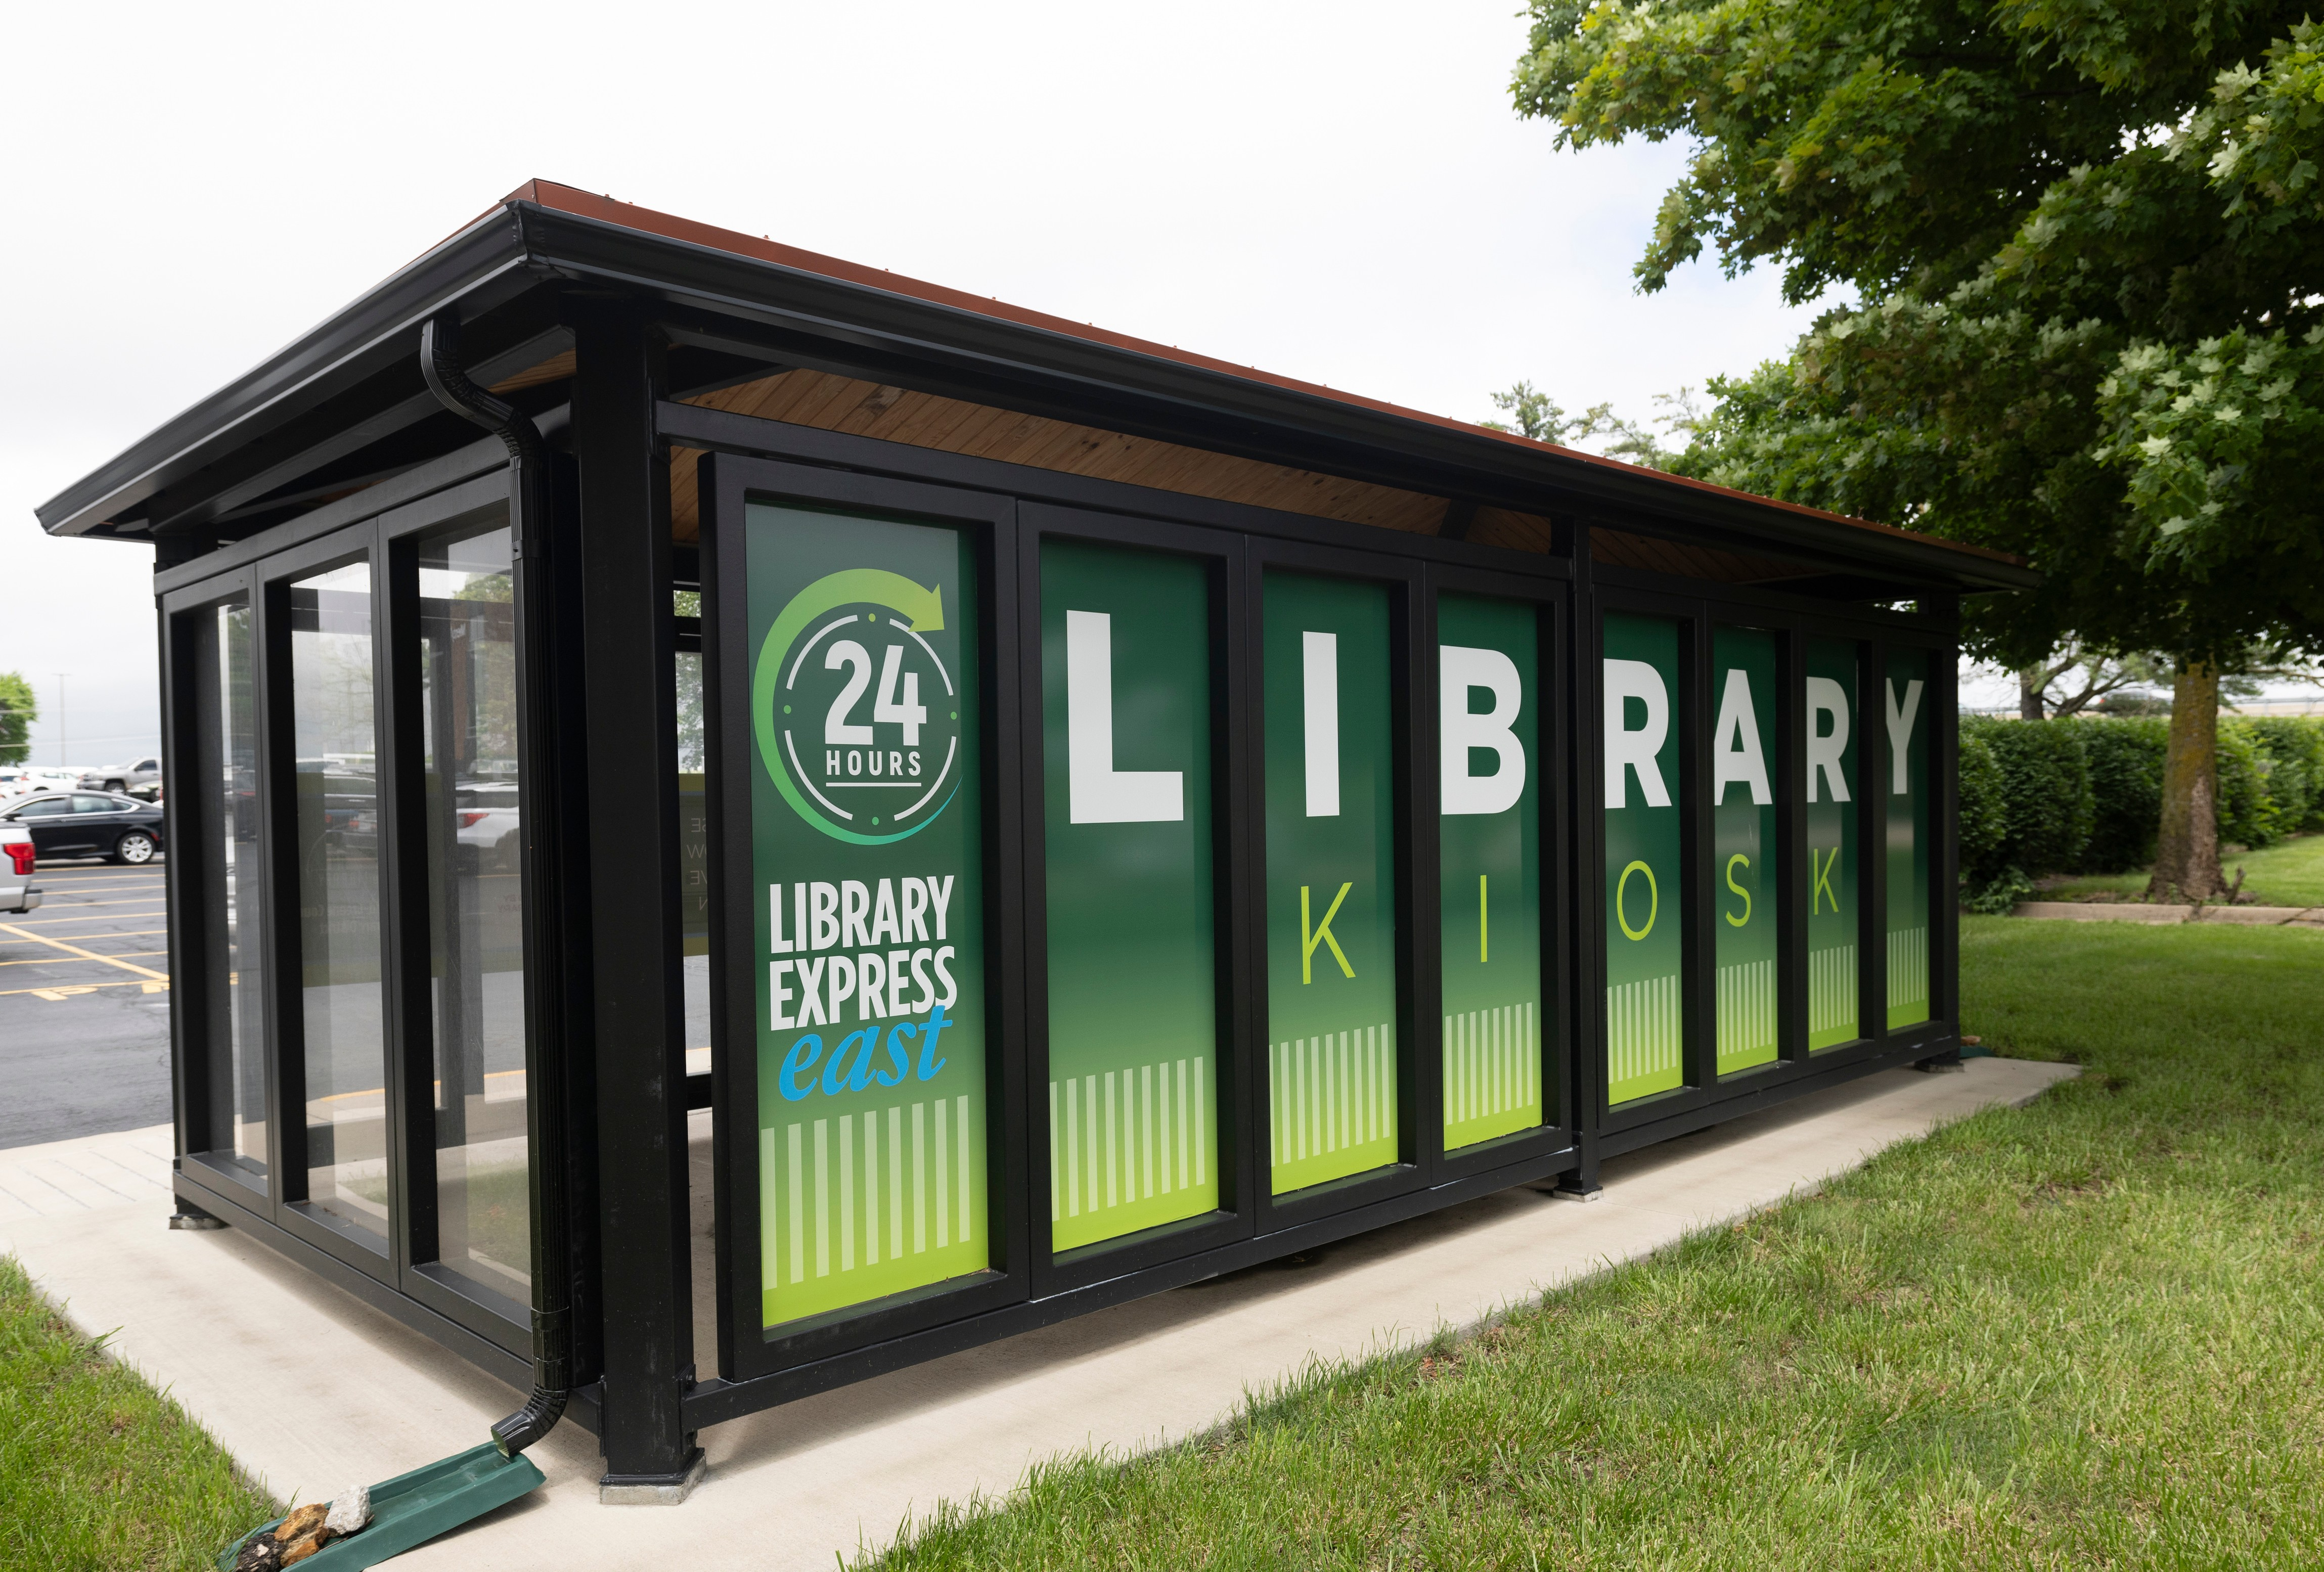
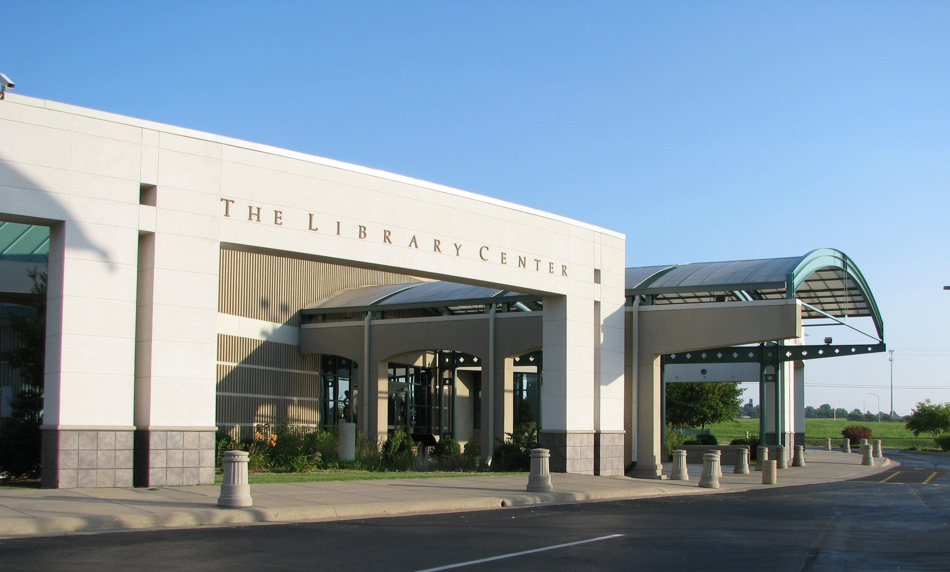
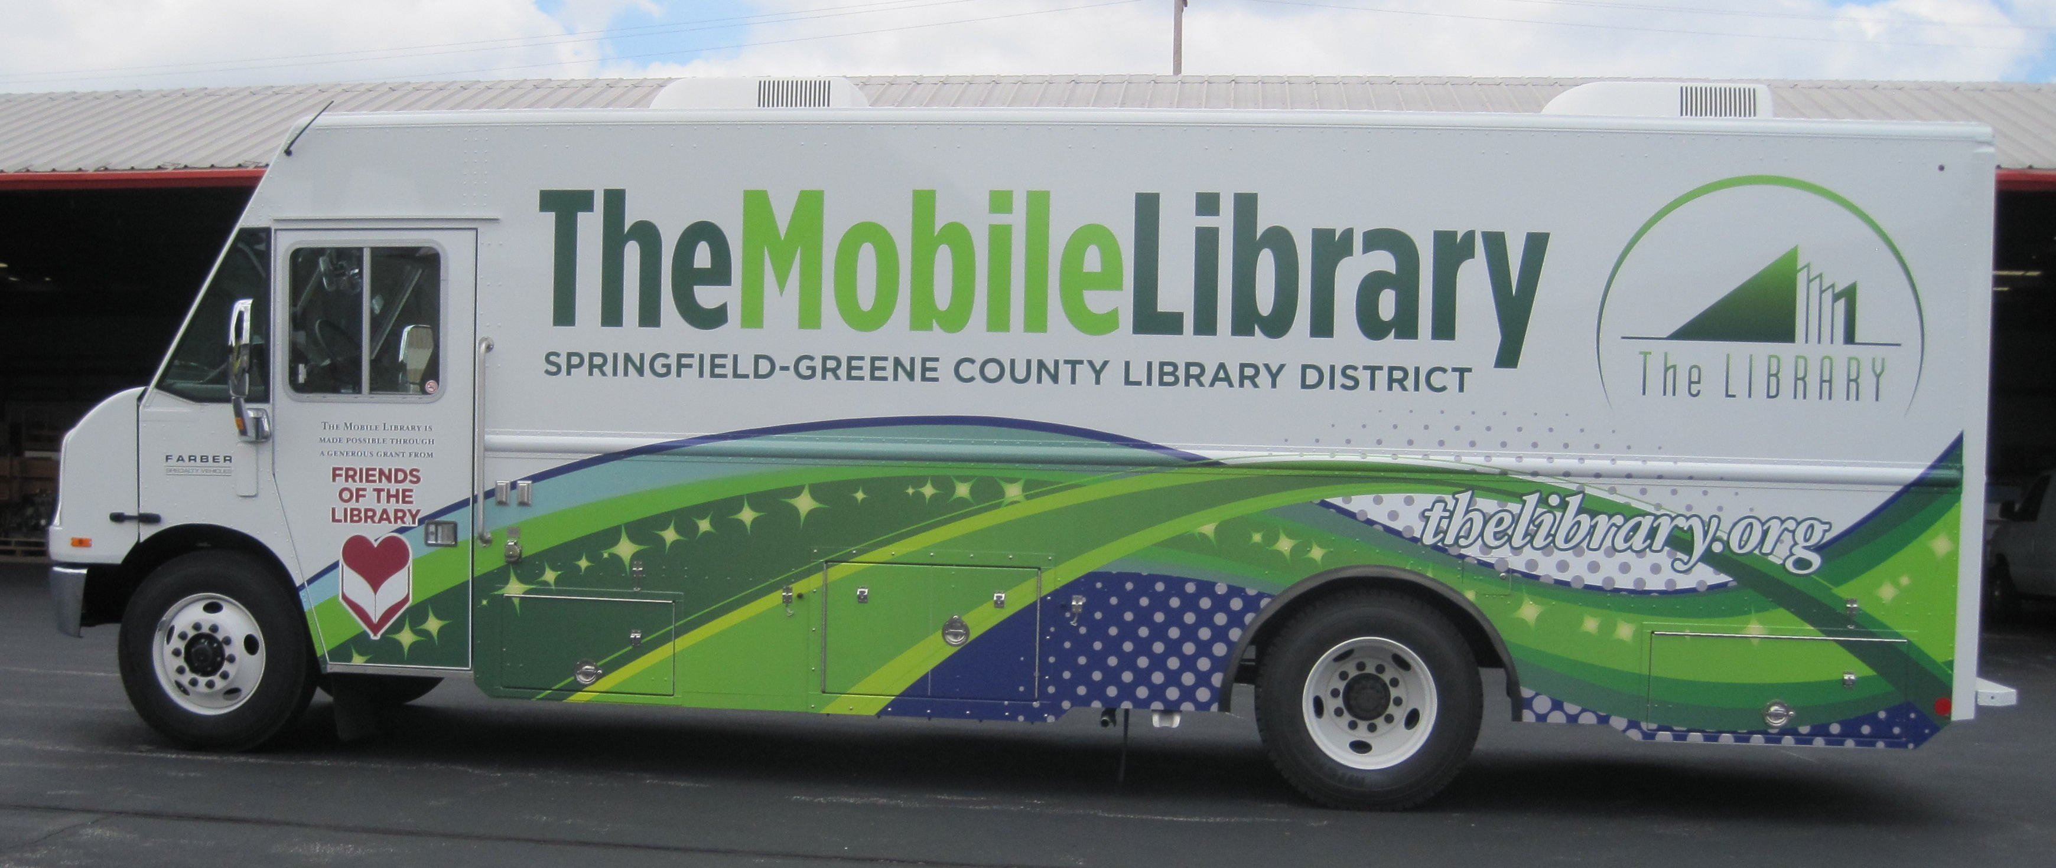

Slide 4
About SGCL
Service population of approximately 300,000; mix of urban and rural; 10 physical branches, Mobile Library, two 24/7 kiosks
Shared Sierra server with one additional public library district and two small special libraries, but no direct borrowing between systems or shared records
Live on Vega Discover (and WebBuilder) in November 2024, migrating from Encore and in-house website solution

Slide 5

Why Vega, why then?
More on WebBuilder -
Wednesday, 10:30:
Right opportunity at the right time – time to update, but no pressing external circumstances
Participated in development partner program
Eventually added WebBuilder to the mix, which in turn influenced our final timeline for public launch

Slide 6

The (long and winding) road to go-live

Slide 7
Had the luxuries of time and development partner program
Lessons learned from Encore launch(es)
Ensuring availability of key features
Careful preparation and communication, training

Slide 8
Early (development partner) stage
Provided a small group of staff from different areas of the district access to Discover
Used feedback and questions from pilot group to inform discussion with product team
Early feedback informed training approach and setting go-live requirements

Slide 9
The “must-haves”
Collection sites
Critical for SGCL to be able to scope access properly for patrons in multi-system setup
Bulk holds workflow (lesson learned from Encore)
Without, staff and patrons consistently defaulted to webpac/classic catalog, defeating purpose.
Sierra OPAC message display
BISAC/Dewey mash-up; used as wayfinding info for NF
Notes:
Example of OPAC message on next slide

Slide 10
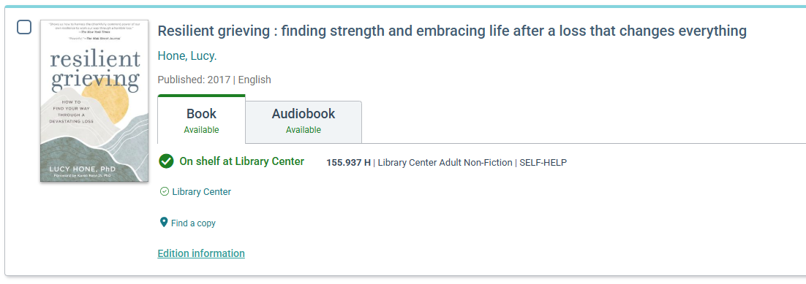
OPAC message field display

Slide 11
Waiting, but not wasting time
Stayed engaged in strategic partner meetings, continued providing direct feedback
Optimizing configuration, cataloging
Discover exposed some areas of inconsistency
Finding solutions
Notes:
Had access to instance, so worked internally to fine-tune what was there
Cataloging inconsistences – age group and literary form facets showed us some issues with our 008s;
Identify solutions to challenges we encountered – Discover handling things differently from the legacy platforms

Slide 12
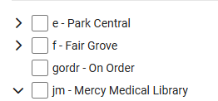
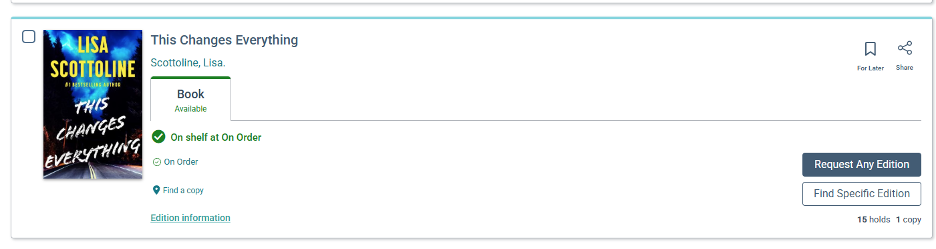
Created bib/item location for “on order” materials to allow them to display in Discover and patrons to join hold queue prior to release.

Slide 13
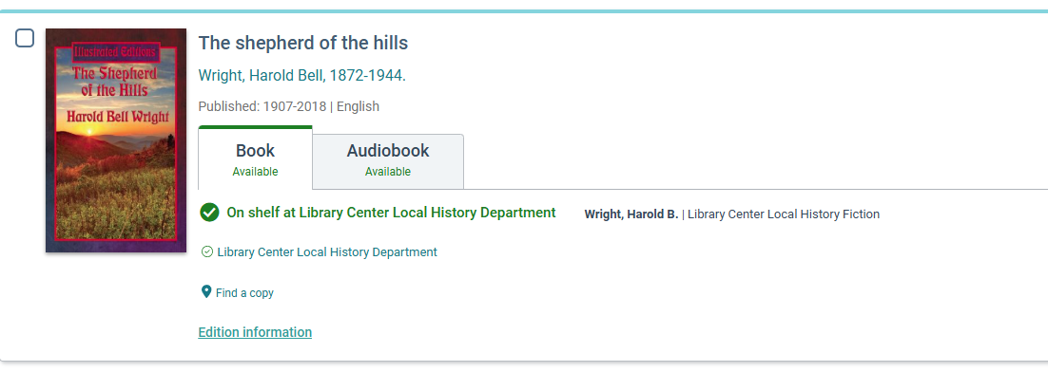
Adjusted location hierarchy structure to improve visibility for special collections

Slide 14
Bringing it together
As development evolved, began designing internal training
Large number of staff to reach and limited resources a challenge
Asynchronous format – video, documentation, on-demand in-person

Slide 15
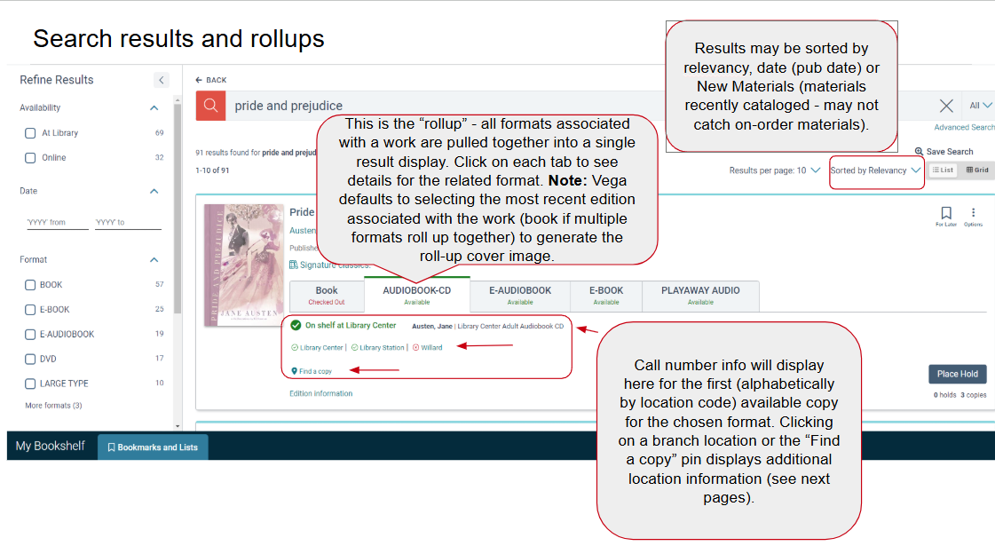
Example from training documentation

Slide 16
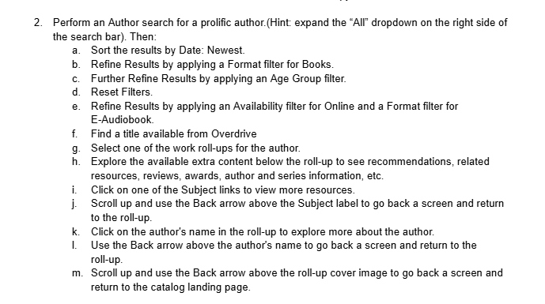
Example from practice exercises

Slide 17
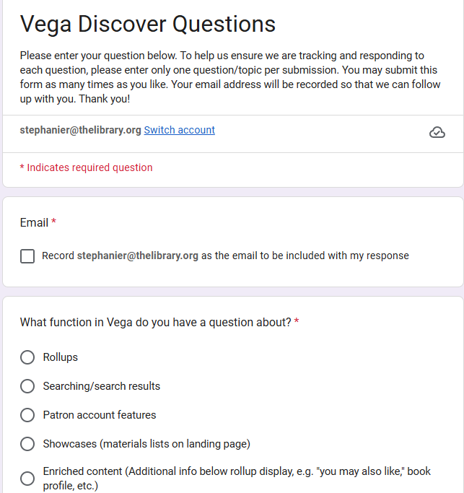
Created feedback/question form with results populating a spreadsheet – extremely helpful in ensuring questions didn’t disappear in inboxes as well as helping us spot common points of confusion.

Slide 18
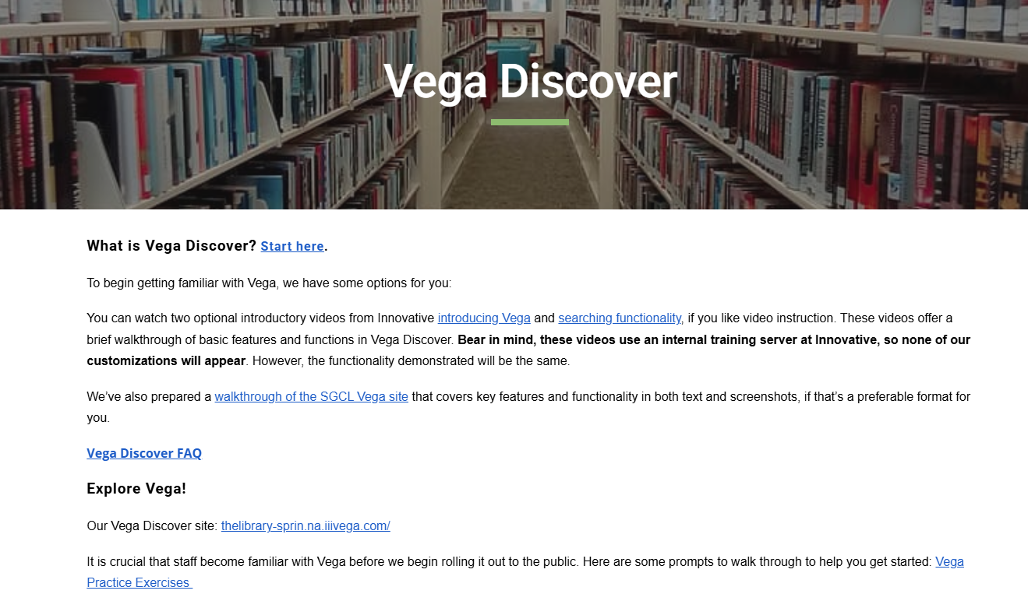

Slide 19

In the rearview – first year (plus) in review
Notes:
In the end, staff had about three months of full access to Discover before we launched to the public alongside WebBuilder.

Slide 20
General notes about go-live process
Exercise in change management
Resistance from some, left webpac linked as alternative option for now
Staff preparation generally seemed adequate, but fell short on public side
Offered feedback email and was able to provide targeted support to some patrons who struggled
Choosing one “do-over” – more advance publicity for patrons, multiple formats

Slide 21
The wins
Modern look and standards; homepage builder
Roll-ups and enriched content/Syndetics integration
Collection sites and custom cover images
Changes and enhancements directly tied to feedback
Improvements to roll-up logic and metadata ingesting/display
UX improvements to Edition Info
Account Portal

Slide 22
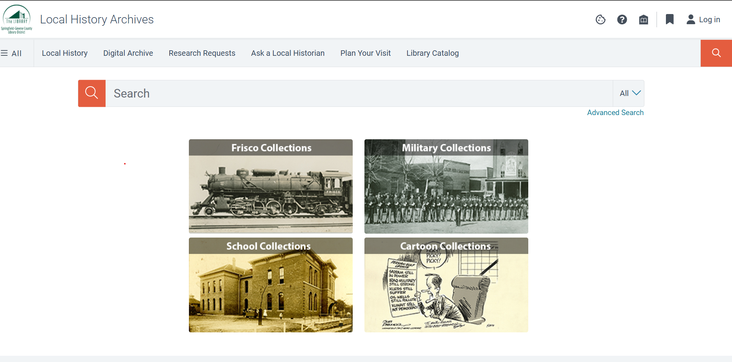

Slide 23
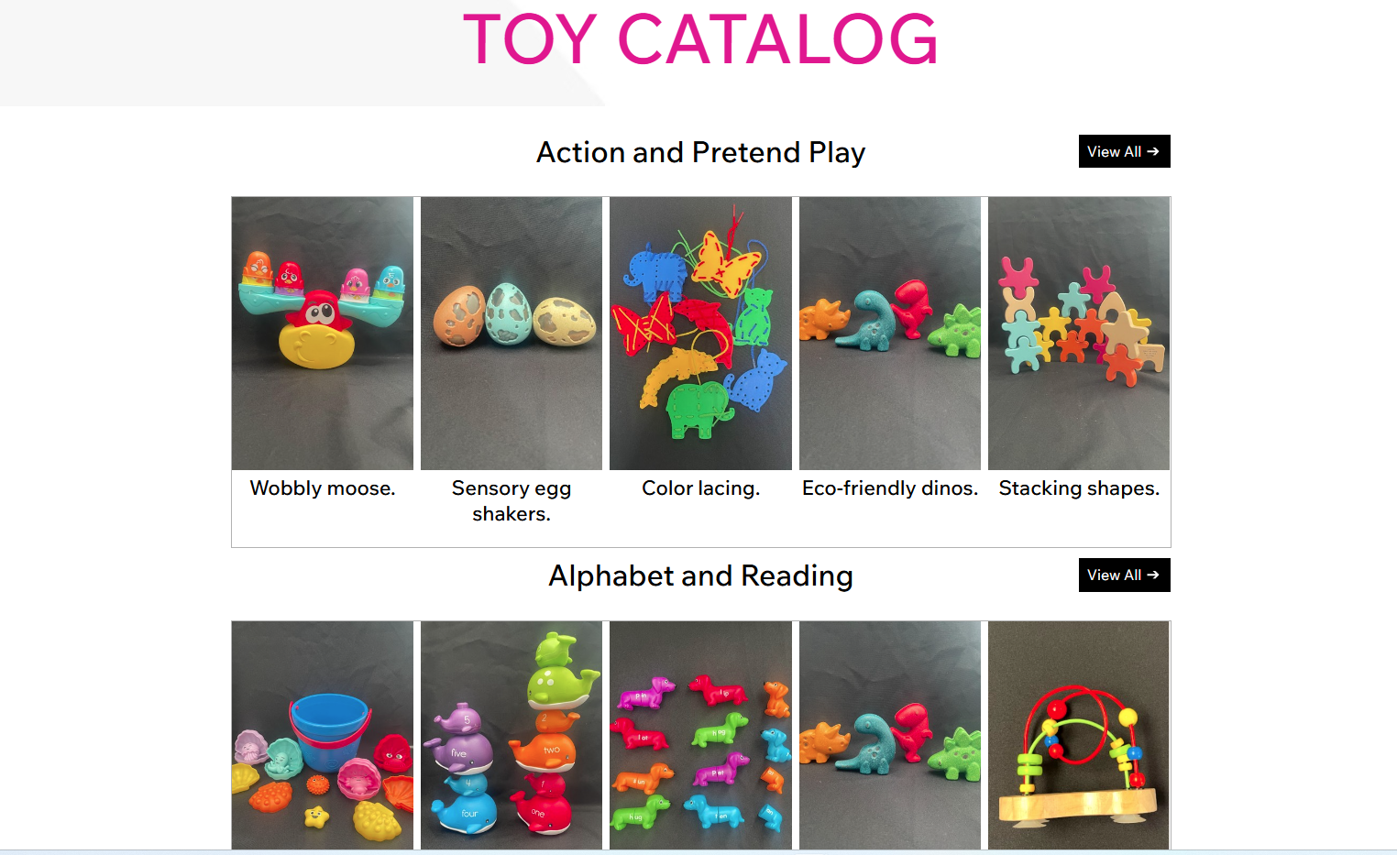

Slide 24
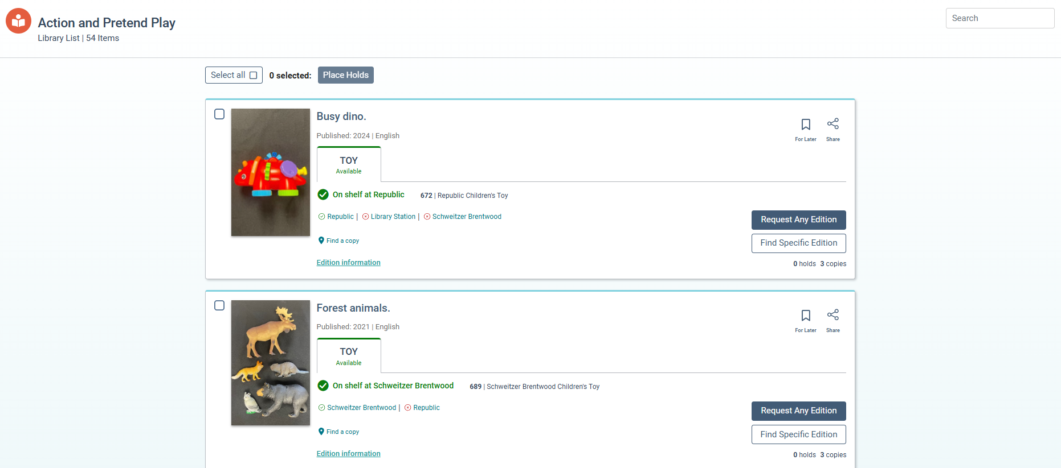

Slide 25
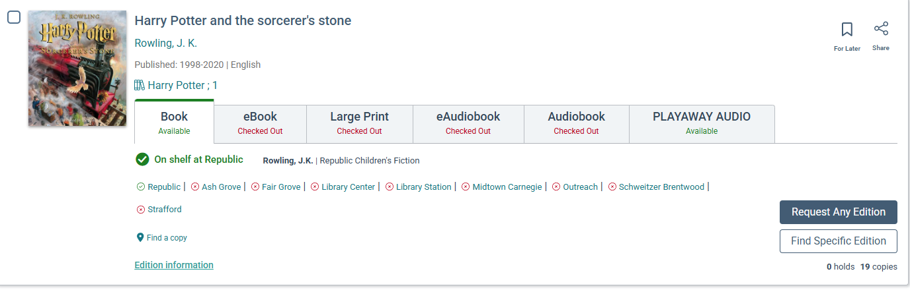

Slide 26
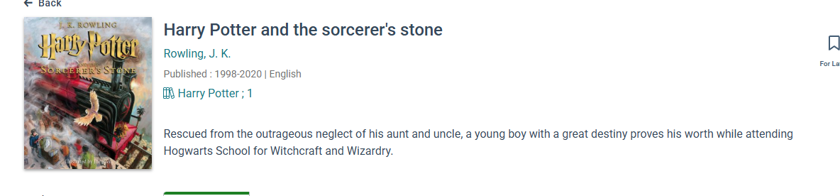
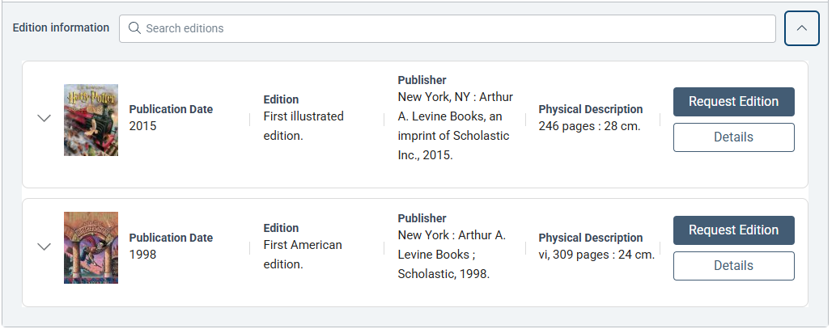

Slide 27

The pain points
Modern look and standards – except…
Enriched content/Syndetics integration (still a little clunky for collection sites)
Collection sites (see above, plus…)
Roll-ups (some love ‘em, some hate ‘em; sometimes require workarounds)
Changes and enhancements directly tied to feedback (love to see it; can be challenging to manage)
Vega Rollups…
Wednesday, 3:00

Slide 28

What’s next?
Kiosk sites for branches – someday
Premium?
Excited about upcoming development:
Improvements to author searching
Patron registration
Facet UX improvement
Product Board – Vega Discover

Slide 29

Hopes and dreams
In no particular order – some of our favorites in Idea Exchange:
Message field in patron account (Sierra) display in Discover
Genre facet (655 field)
Display all series associated with titles
Ability to create custom rollup rules
Allow patrons to remove titles from Reading History
… and more!
Idea Exchange – Vega Discover

Slide 30


Questions/discussion?
Vega Discover Year in Review
Tuesday, 3:00
All Things Vega Forum
Wednesday, 1:30

Slide 31
Thank you!
Stephanie Ruhe
ILS Administrator, Springfield-Greene County (MO) Library
stephanier@thelibrary.org

