Slide 1


Slide 2

Two Sierra Tricks
Lloyd Chittenden
Sarah Furger
Carol Hassler

Slide 3

Marmot Library Network
We are a consortium of 36 libraries on 2 Sierra servers.
  7 Academic Libraries
  3 School Districts
  26 Public Libraries

Slide 4
First Trick – PuTTY Map
A lot of functions are still in the text-based admin system accessible via PuTTY.
It can be hard to keep track of where to find various functions because Sierra documentation never tells you how to access any functions in text-based.
I simply copied the text of all the pages of my text-based into a document to create a keyword searchable map of my system so I can find things.

Slide 5
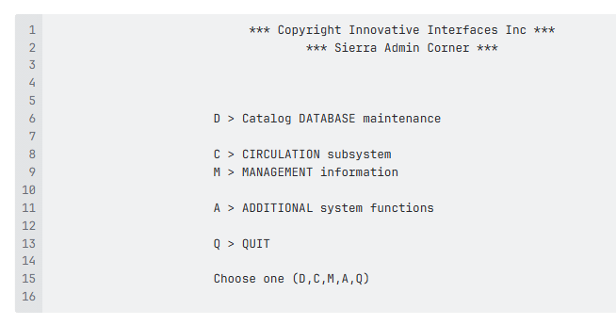

Slide 6
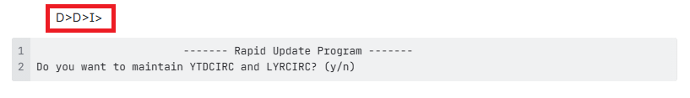
Note the path to each screen as you paste it
Link to Marmot PuTTY maps

Slide 7

Questions about PuTTY map

Slide 8
Second Trick – Search for bad diacritics
Records should be loaded in Sierra in UTF8
If a MARC8 file is loaded, the diacritics come out very bad
Mistakes happen
MARC8 records get loaded
Some vendors won’t send UTF8 at all
It is easy to make a mistake in MarcEdit and create a MARC8 file
Lots of sources of MARC8 and bad diacritics

Slide 9
Note: fix your load profile
If you have a vendor who only supplies MARC-8, it is possible to set your profile to load them correctly:
  Disable the line that looks to LDR bit 9 for UTF status:
    #|||0|0| | |0|n|G|0|@leader_utf8="y“
  Include these lines to set MARC-8:
    |||0|0| | |0|n|G|0|@diac=""
    |||0|0| | |0|n|G|0|@diac_sub_table="win1252"

Slide 10
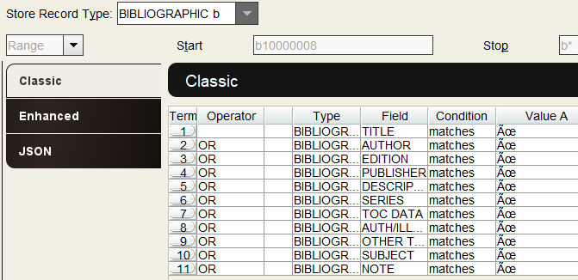
Brute Force Method
JSON for this search can be downloaded from the Sched page for this presentation

Slide 11
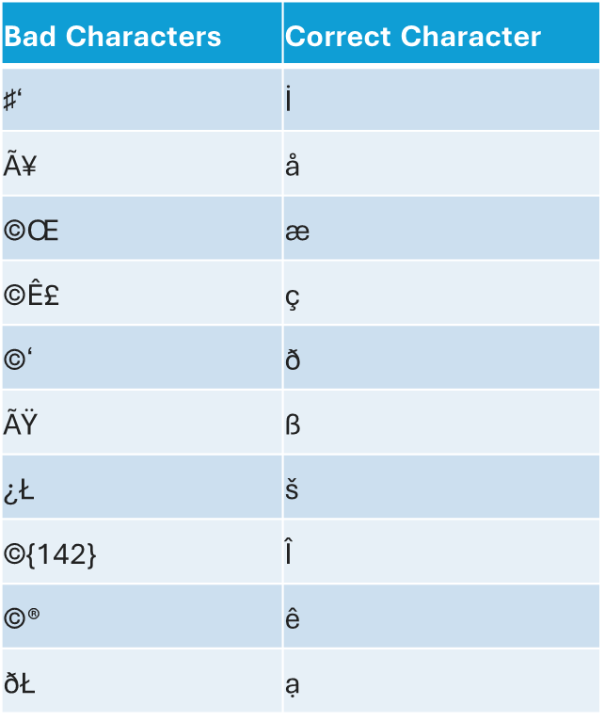
Examples Problems
Bad Characters | Could be:
Ã | à or ©
©ℓ | ß or à
℗þ | " or '
ℓ́ℓ | " or ' or --
©Œ | æ or ŏ
Word Doc

Slide 12
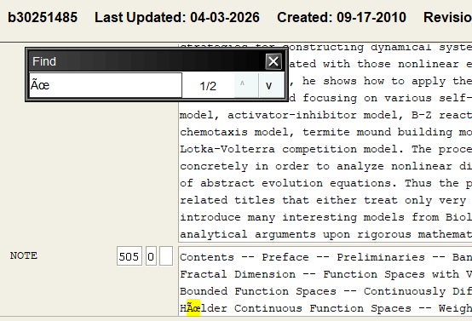
Open a record
CTRL-f to search

Slide 13
Find the correct character
Look for the string in the doc
Search the ISBN online or OCLC

Slide 14
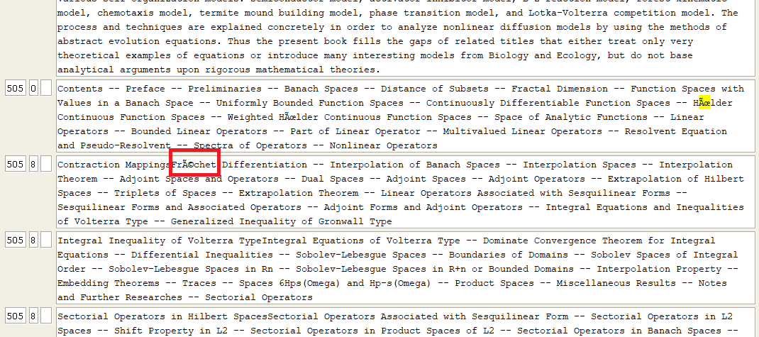
Search for other bad strings in the same record

Slide 15
Find the correct replacement for new strings
Search them in the doc
  If they are not in the doc, add them when you find the correct character
Search the book online or OCLC to find the correct character
    From Sierra:
    OCLC

Slide 16
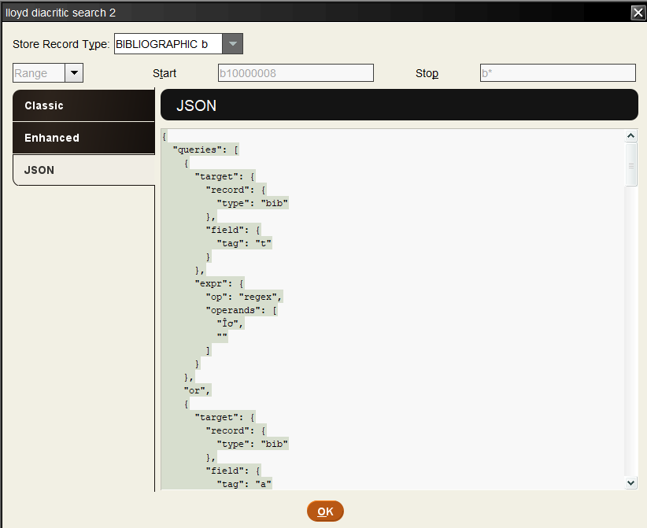
Search for the new string
Copy the JSON

Slide 17
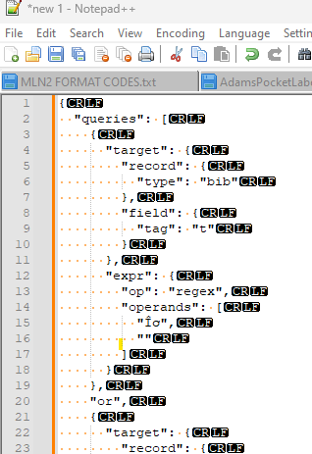
Paste in Notepad++

Slide 18
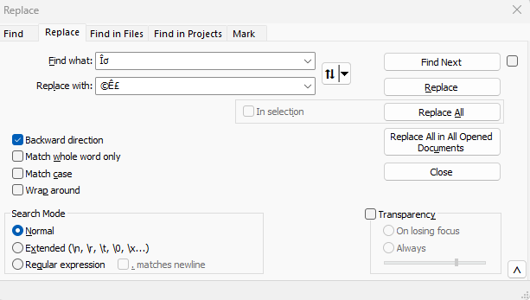
Find and Replace previous string for next one

Slide 19
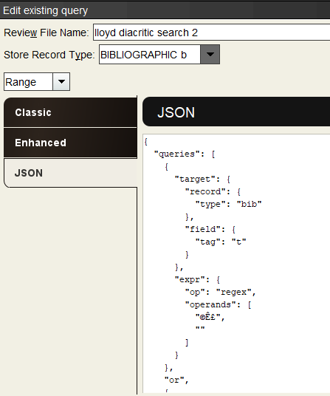
Paste the new version back into Create Lists

Slide 20
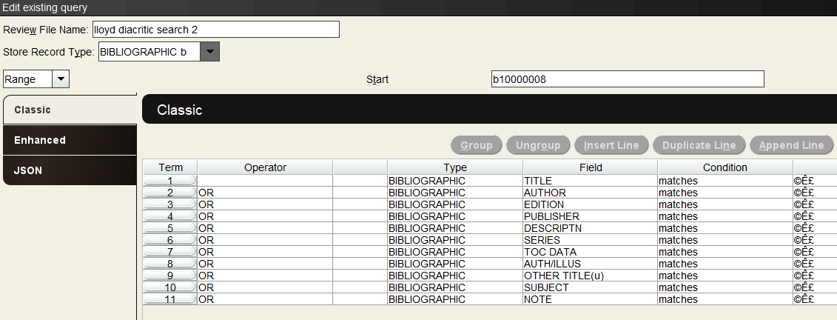
Now the search will find the next string

Slide 21
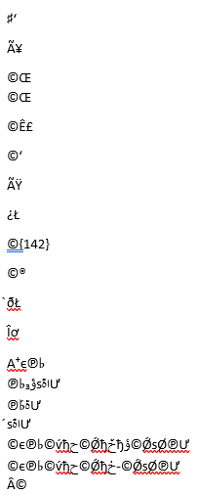
Repeat for all known strings in the doc

Slide 22
Questions?

