Slide 1

Get Involve with IUG
You’re Already a Member. Now What Can you Do?

Slide 2

THE CONFERENCE IS THE LAUNCH PAD
"You're in the room.
Now make it count, not just this week, but when you get home."
Being here IS involvement
But the real work happens between conferences
Peer sessions, Q&As with Clarivate, hallway conversations, absorb it all.
The conference is a launching pad, not the finish line.

Slide 3


SHAPE THE SOFTWARE YOU USE EVERY DAY
Idea Exchange
MEEP Working Groups
The Member Exclusive Enhancement Process takes strong ideas further by refining proposals and pushing them to Clarivate.
Submit, discuss, and prioritize Sierra & Polaris enhancements. This is where it goes if a feature is missing and workflow limitation that has been driving you crazy.
CHECK OUT THIS LINK FOR MORE INFORMATION →
CHECK OUT THIS LINK FOR MORE INFORMATION →
https://www.innovativeusers.org/idea_exchange_-_faq.php
https://www.innovativeusers.org/member_exclusive_enhancement_p.php

Slide 4


STAY CONNECTED YEAR-ROUND
IUG Forum
Monthly IUG Forums
A monthly forum to discuss topics of interest. Anything from technical deep dive to Festivus - The Airing of Grievances.
Next IUG Forum: 5/21/2026
• IUG Forum: "And another thing..." IUG conference follow up
The same people you're meeting this week are on the IUG forum.
Ask questions, share solutions, and keep the conversation going long after you leave Chicago.
A repository of locally developed resources shared by libraries like yours:
• Presentations, Guides, Tutorials, and Best Practices
CLICK HERE TO FIND OUT MORE →
forum.innovativeusers.org

Slide 5
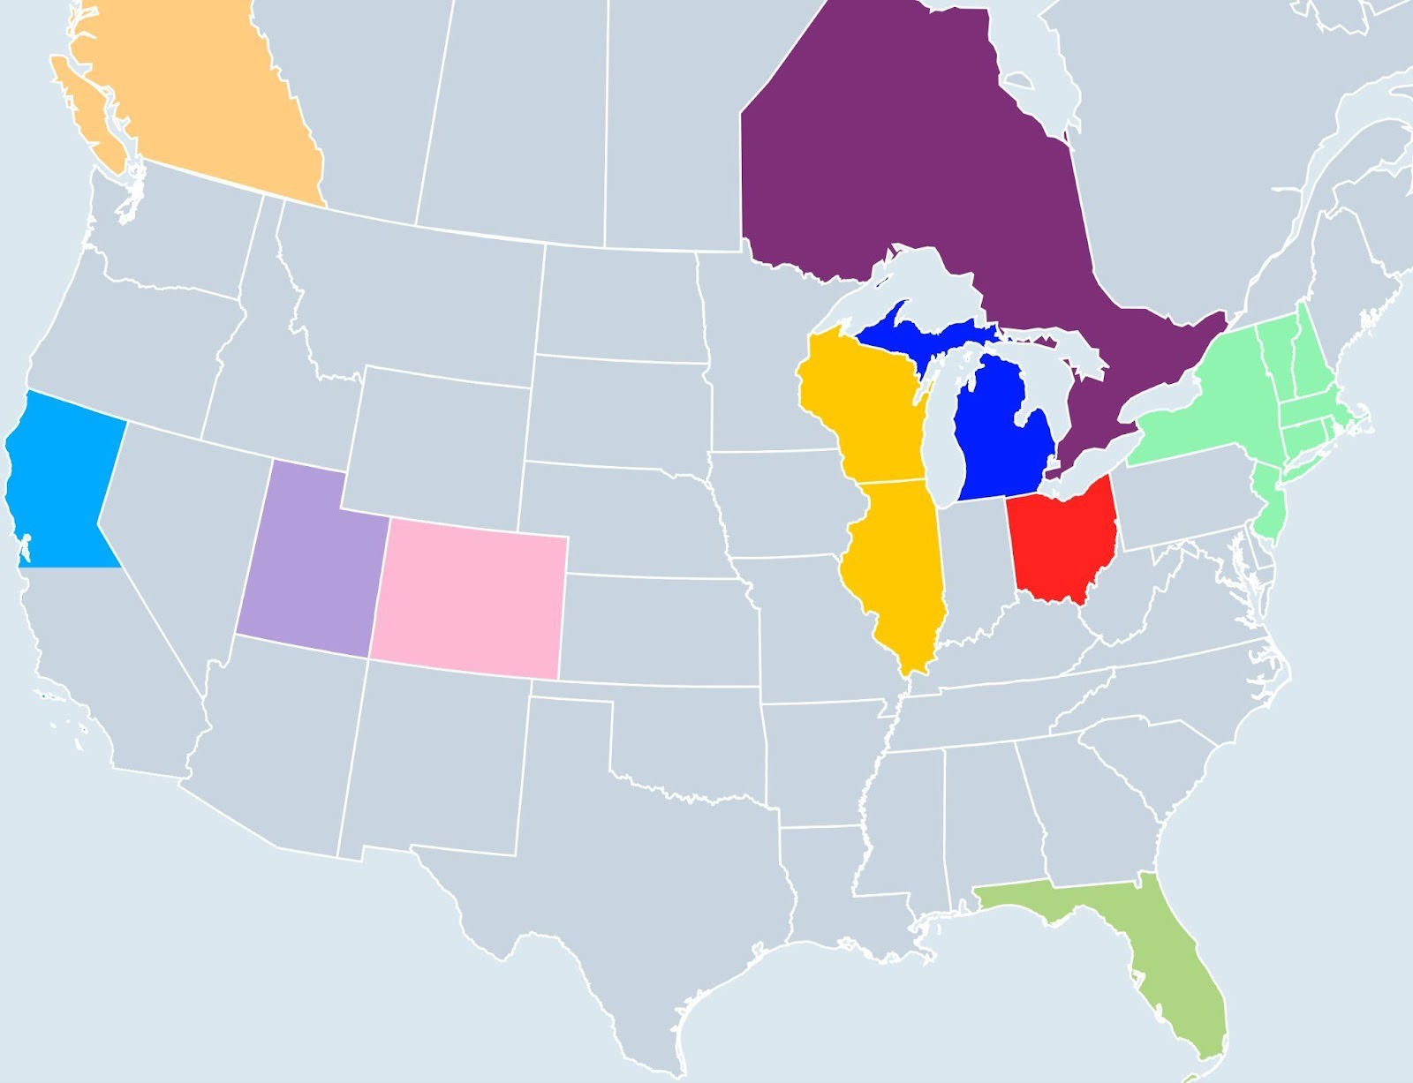
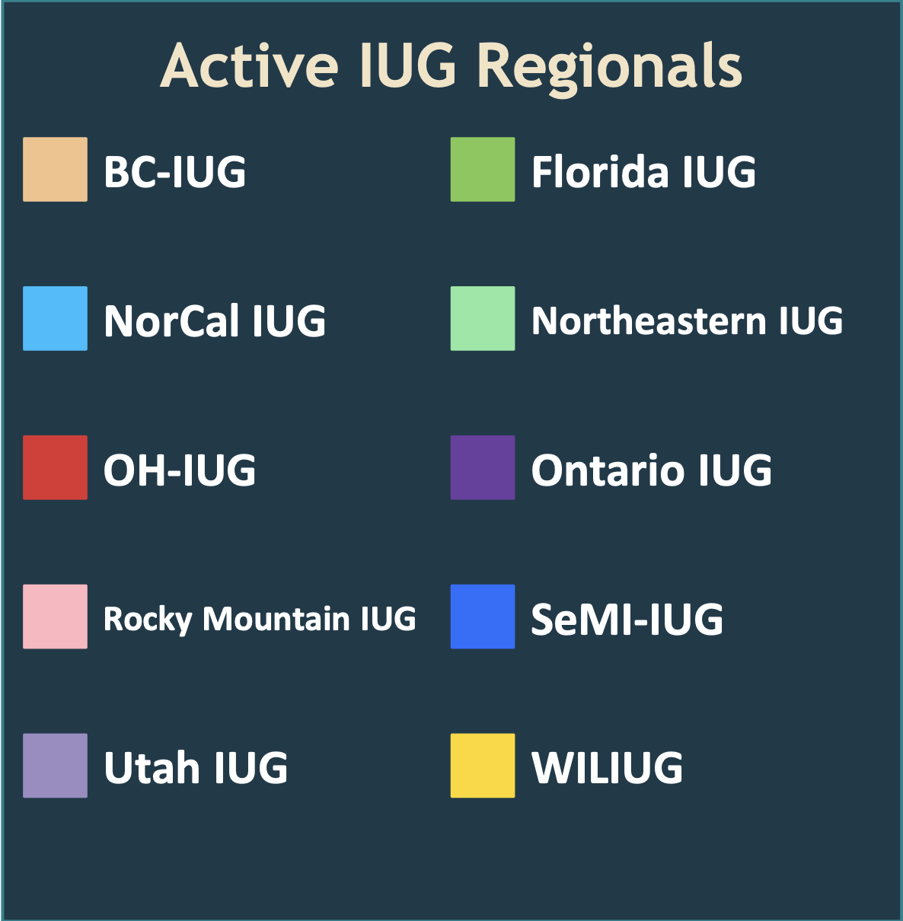
FIND YOUR COMMUNITY CLOSER TO HOME

Slide 6

Present at IUG 2027
Every session you've attended this week was led by a peer. Someone at a library just like yours.
1
2
3
Your library has solved problems
It elevates your profile
The community needs your voice
If you've streamlined a workflow, navigated a tough transition, or found a creative solution. That's a session.
Presenting builds your professional reputation.
The conference is only as good as the people willing to share. Be one of them.
ACTION: Before you leave Chicago, write down one thing your library does well. That's your presentation proposal.

Slide 7

HELP LEAD THE ORGANIZATION
The Steering Committee
Working Groups & Committees
Chair, Vice Chair/Chair Elect, Past Chair, Secretary/Treasurer, and 5 Members at Large
All positions are elected by the general membership
Every committee member is a volunteer.
Elections happen annually.
Lower commitment than Steering Committee but a great on-ramp
Have real influence on IUG's direction and priorities
Multiple groups active across product lines and topics
Browse working groups at members.innovativeusers.org
Introduce yourself to a Steering Committee member. They're around all week and they want to hear from you.

Slide 8

Pick One Thing.
Then do it before you get back to the office.
Jump into the MEEP
Find your regional group
Check innovativeusers.org/regional
Start your session proposal
What does your library do well?
The community and relationships you’re building this week is the whole point. · innovativeusers.org

