Slide 1

Dynamic Mocking for Event-Driven APIs: A Cloud Native Approach With Kubernetes
Harshvardhan Parmar, YosemiteCrew &
Anushka Saxena, Google
@MICROCKSIO

Slide 2
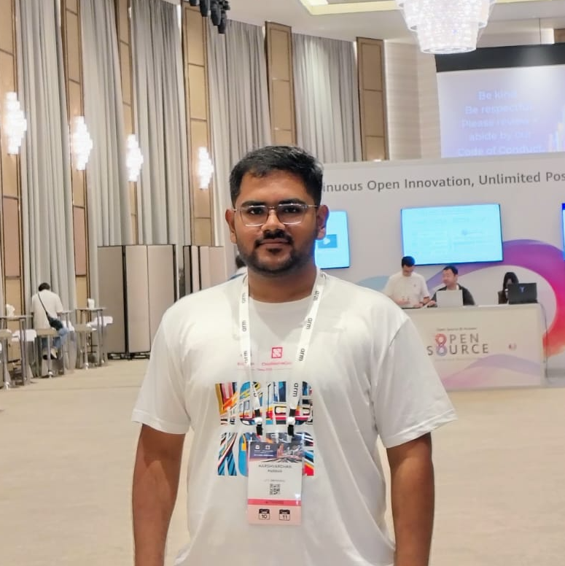
Harshvardhan parmar - @harsh4902
A Software Engineer with passion and addiction for Open Source
Engineering @Yosemite Crew and Maintaining @Microcks-CLI
Everything should run on Scale!
Music lover🎶….

Slide 3
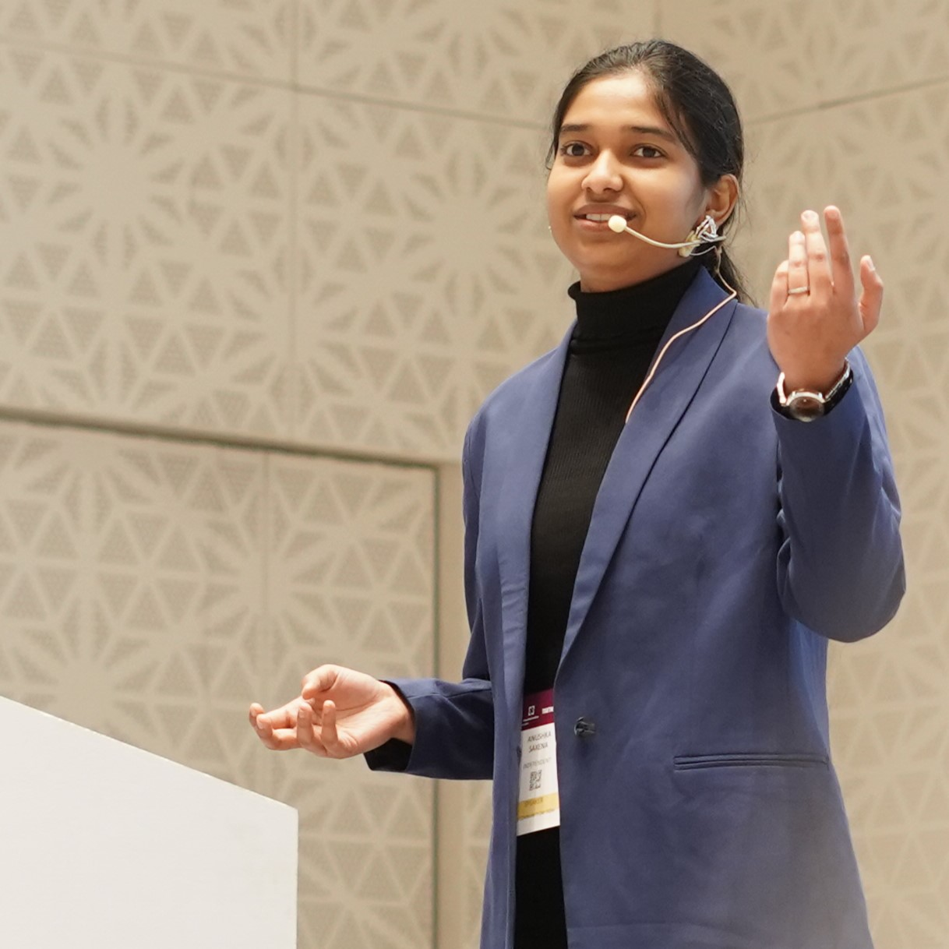
Anushka saxena - @SaxenaAnushka102
A Software Application Development Apprentice at Google
AsyncAPI mentorship Program 2024
LFX mentee @CloudNativePG
I’m always on Cloud(9) 😎

Slide 4
@MICROCKSIO
Messages everywhere.
The rise of event-driven API- but why?

Slide 5

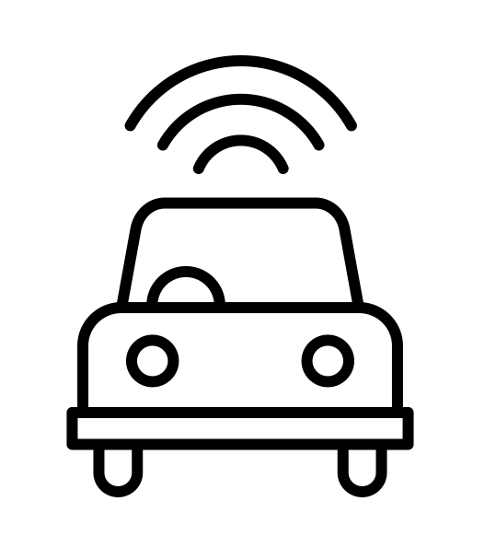

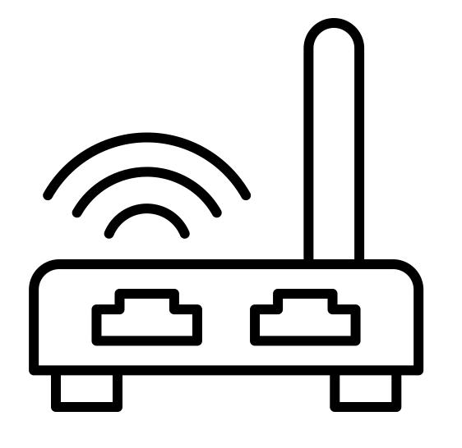


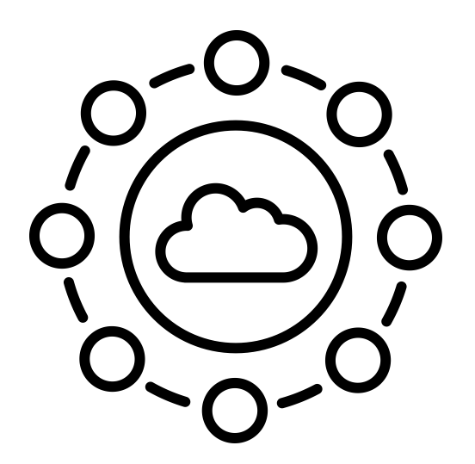
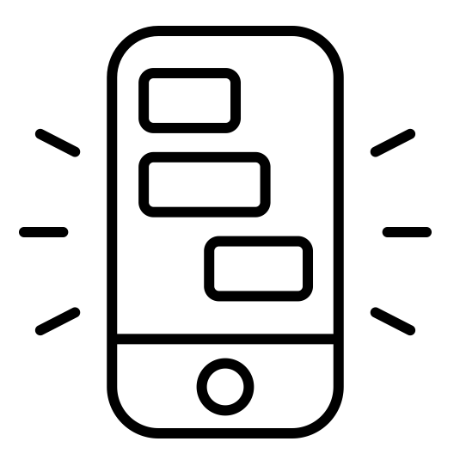
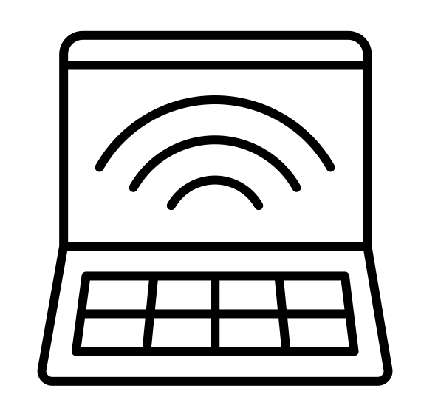

Because of distributed systems !
@MICROCKSIO

Slide 6
The Shift to Event-Driven Architectures (EDA)
The Trend: Why is everyone moving away from pure REST?
Drivers: Decoupling, scalability, and real-time responsiveness.
The Ecosystem: Kafka, MQTT, and AMQP- the "new backbone”.
The Catch:Great for production, but a headache for local development and CI/CD.
@MICROCKSIO

Slide 7
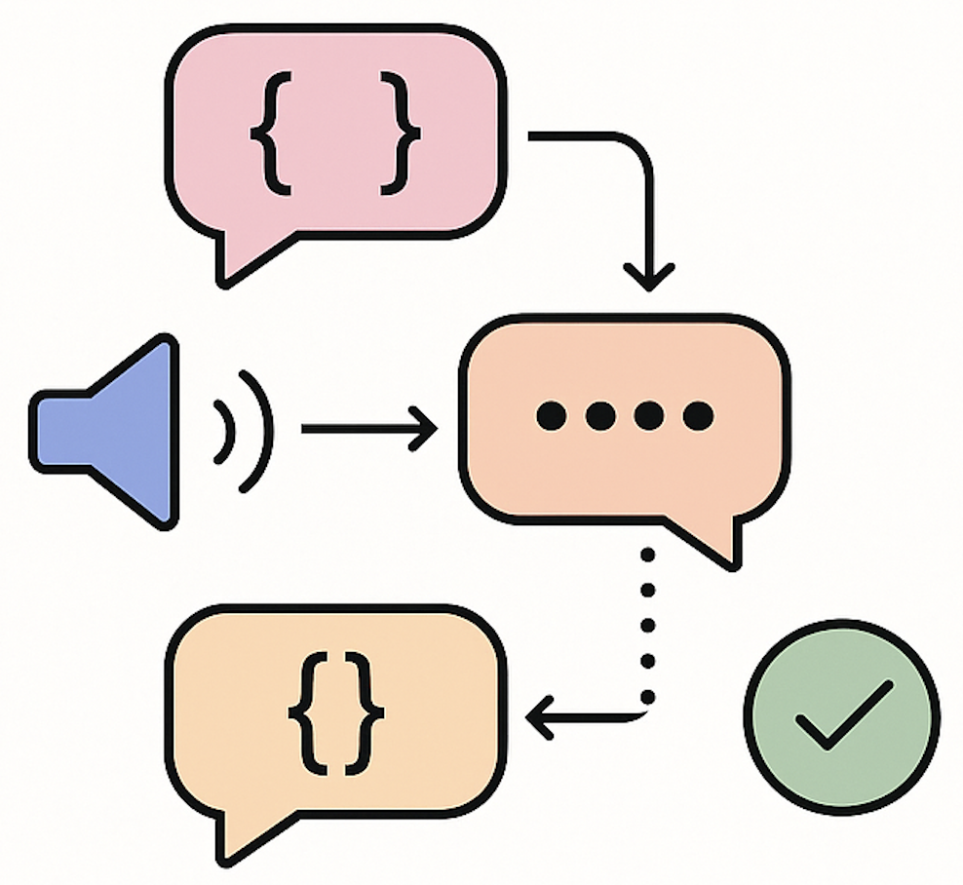
The Challenge of Mocking Event-Driven APIs
Messages are contextual: depend on system state or sequence
Producers and consumers operate independently
Message schemas evolve over time (contracts drift)
Order, timing, and correlation are hard to reproduce
Static mocks can’t reflect real event behavior
@MICROCKSIO

Slide 8

AsyncAPI: The Contract for the Async World
AsyncAPI = Open standard for event-driven APIs
Defines channels, messages, payloads, bindings
Enables shared understanding between producers and consumers
Drives mock generation, validation, and documentation
Foundation for contract-first event development
@MICROCKSIO

Slide 9

Mocks That Behave Like Real Systems
Go beyond payloads — simulate behavior
Reproduce producer–consumer interaction
Maintain stateful message flow
Support event chaining and topic dependencies
Enable integration testing before real services exist
@MICROCKSIO

Slide 10
Making Mocks Smart and Context-Aware
Use schema-driven templates to generate messages
Inject context variables — IDs, timestamps, correlation keys
Support conditional or randomized payloads
Enable scenario-based mocking (happy path, errors, edge cases)
Use examples or rules from AsyncAPI for realistic data
@MICROCKSIO

Slide 11
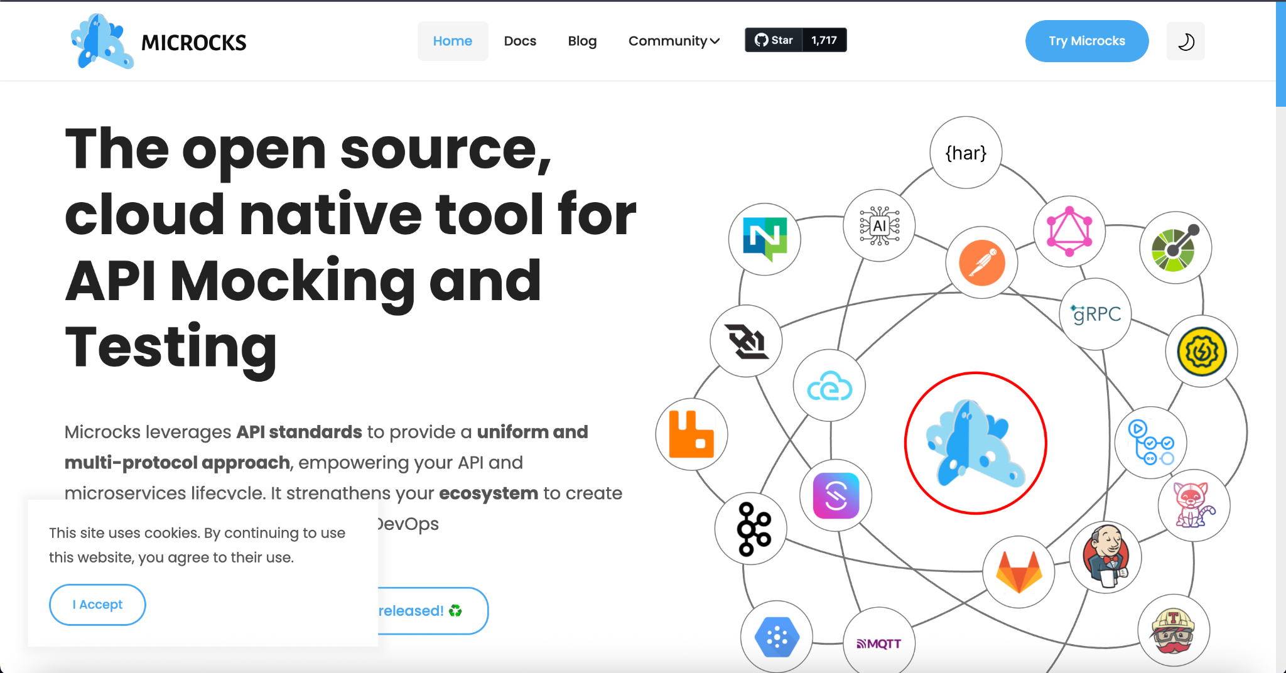
Microcks - Dynamic Mocking for Event-Driven APIs
@MICROCKSIO

Slide 12
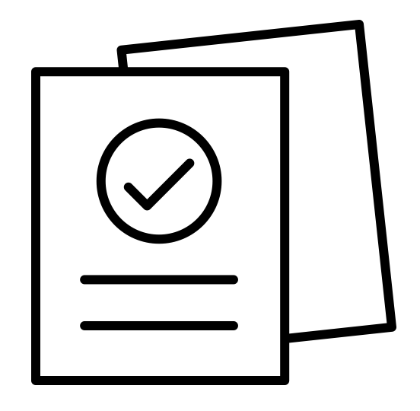
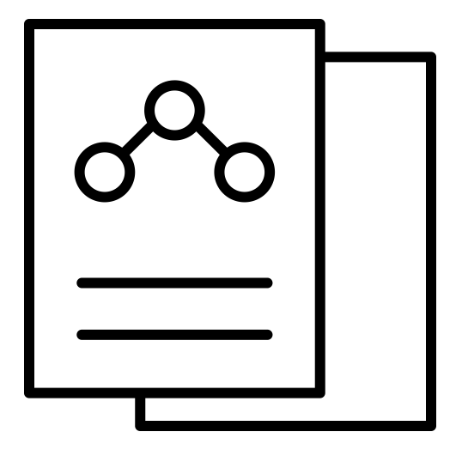

Microcks uses
CONTRACT and EXAMPLES
RANDOM
EXAMPLES
RANDOM REAL-LIFE
MOCKS
& TESTS
BUSINESS EXPECTATIONS
EXECUTABLE SPECIFICATIONS
@MICROCKSIO

Slide 13









Multi-protocols Uniform Approach
Kafka broker
MQTT broker
WebSocket server
AWS SQS
broker
AWS SNS
broker
AMQP/RabbitMQ broker
NATS broker
Google PubSub broker
@MICROCKSIO

Slide 14
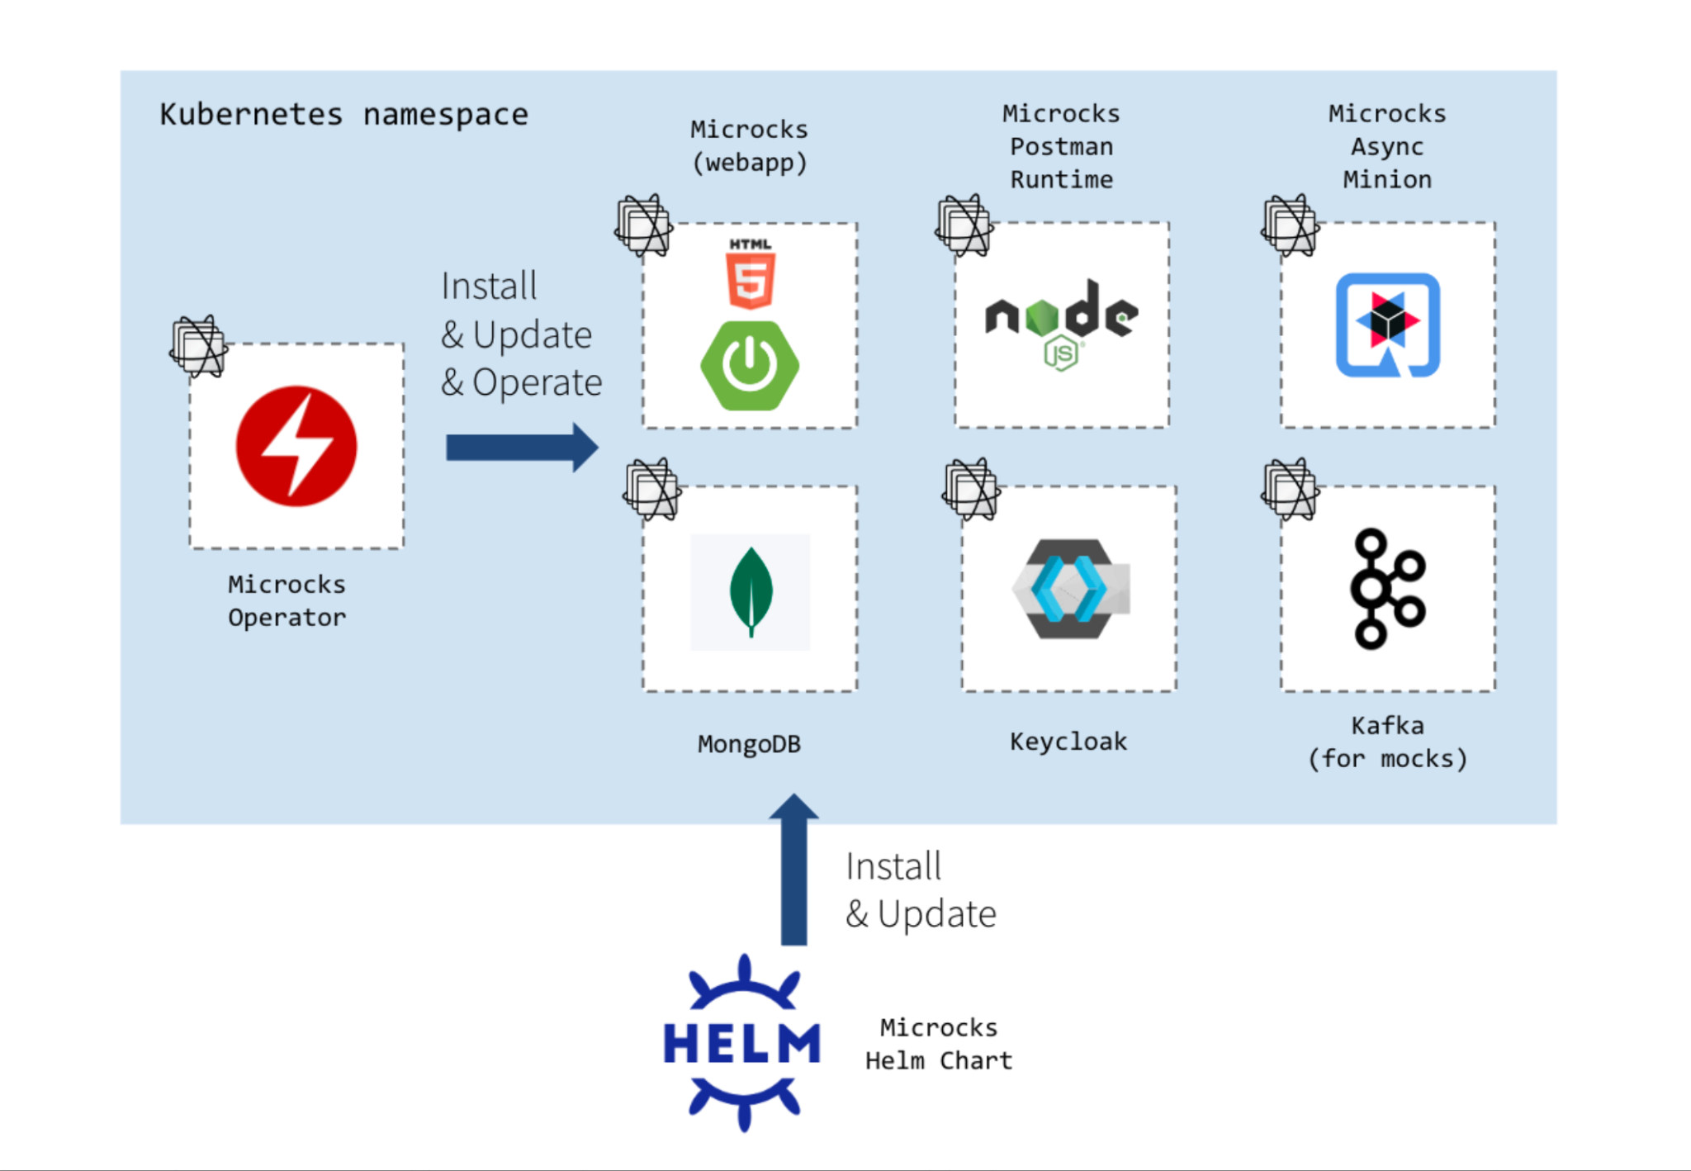
MICROCKS ARCHITECTURE IN KUBERNETES
@MICROCKSIO

Slide 15

Real-World Example: Mocking Kafka Streams with Microcks
@MICROCKSIO

Slide 16
Key Takeaways
Static mocks ≠ real event systems
Embrace AsyncAPI for contracts
Use behavioral + temporal mocking for realism
Explore Microcks and other open tools
Make mocking a core part of your async dev workflow
Mocks can directly sit inside you cloud-native environemnt

Slide 17
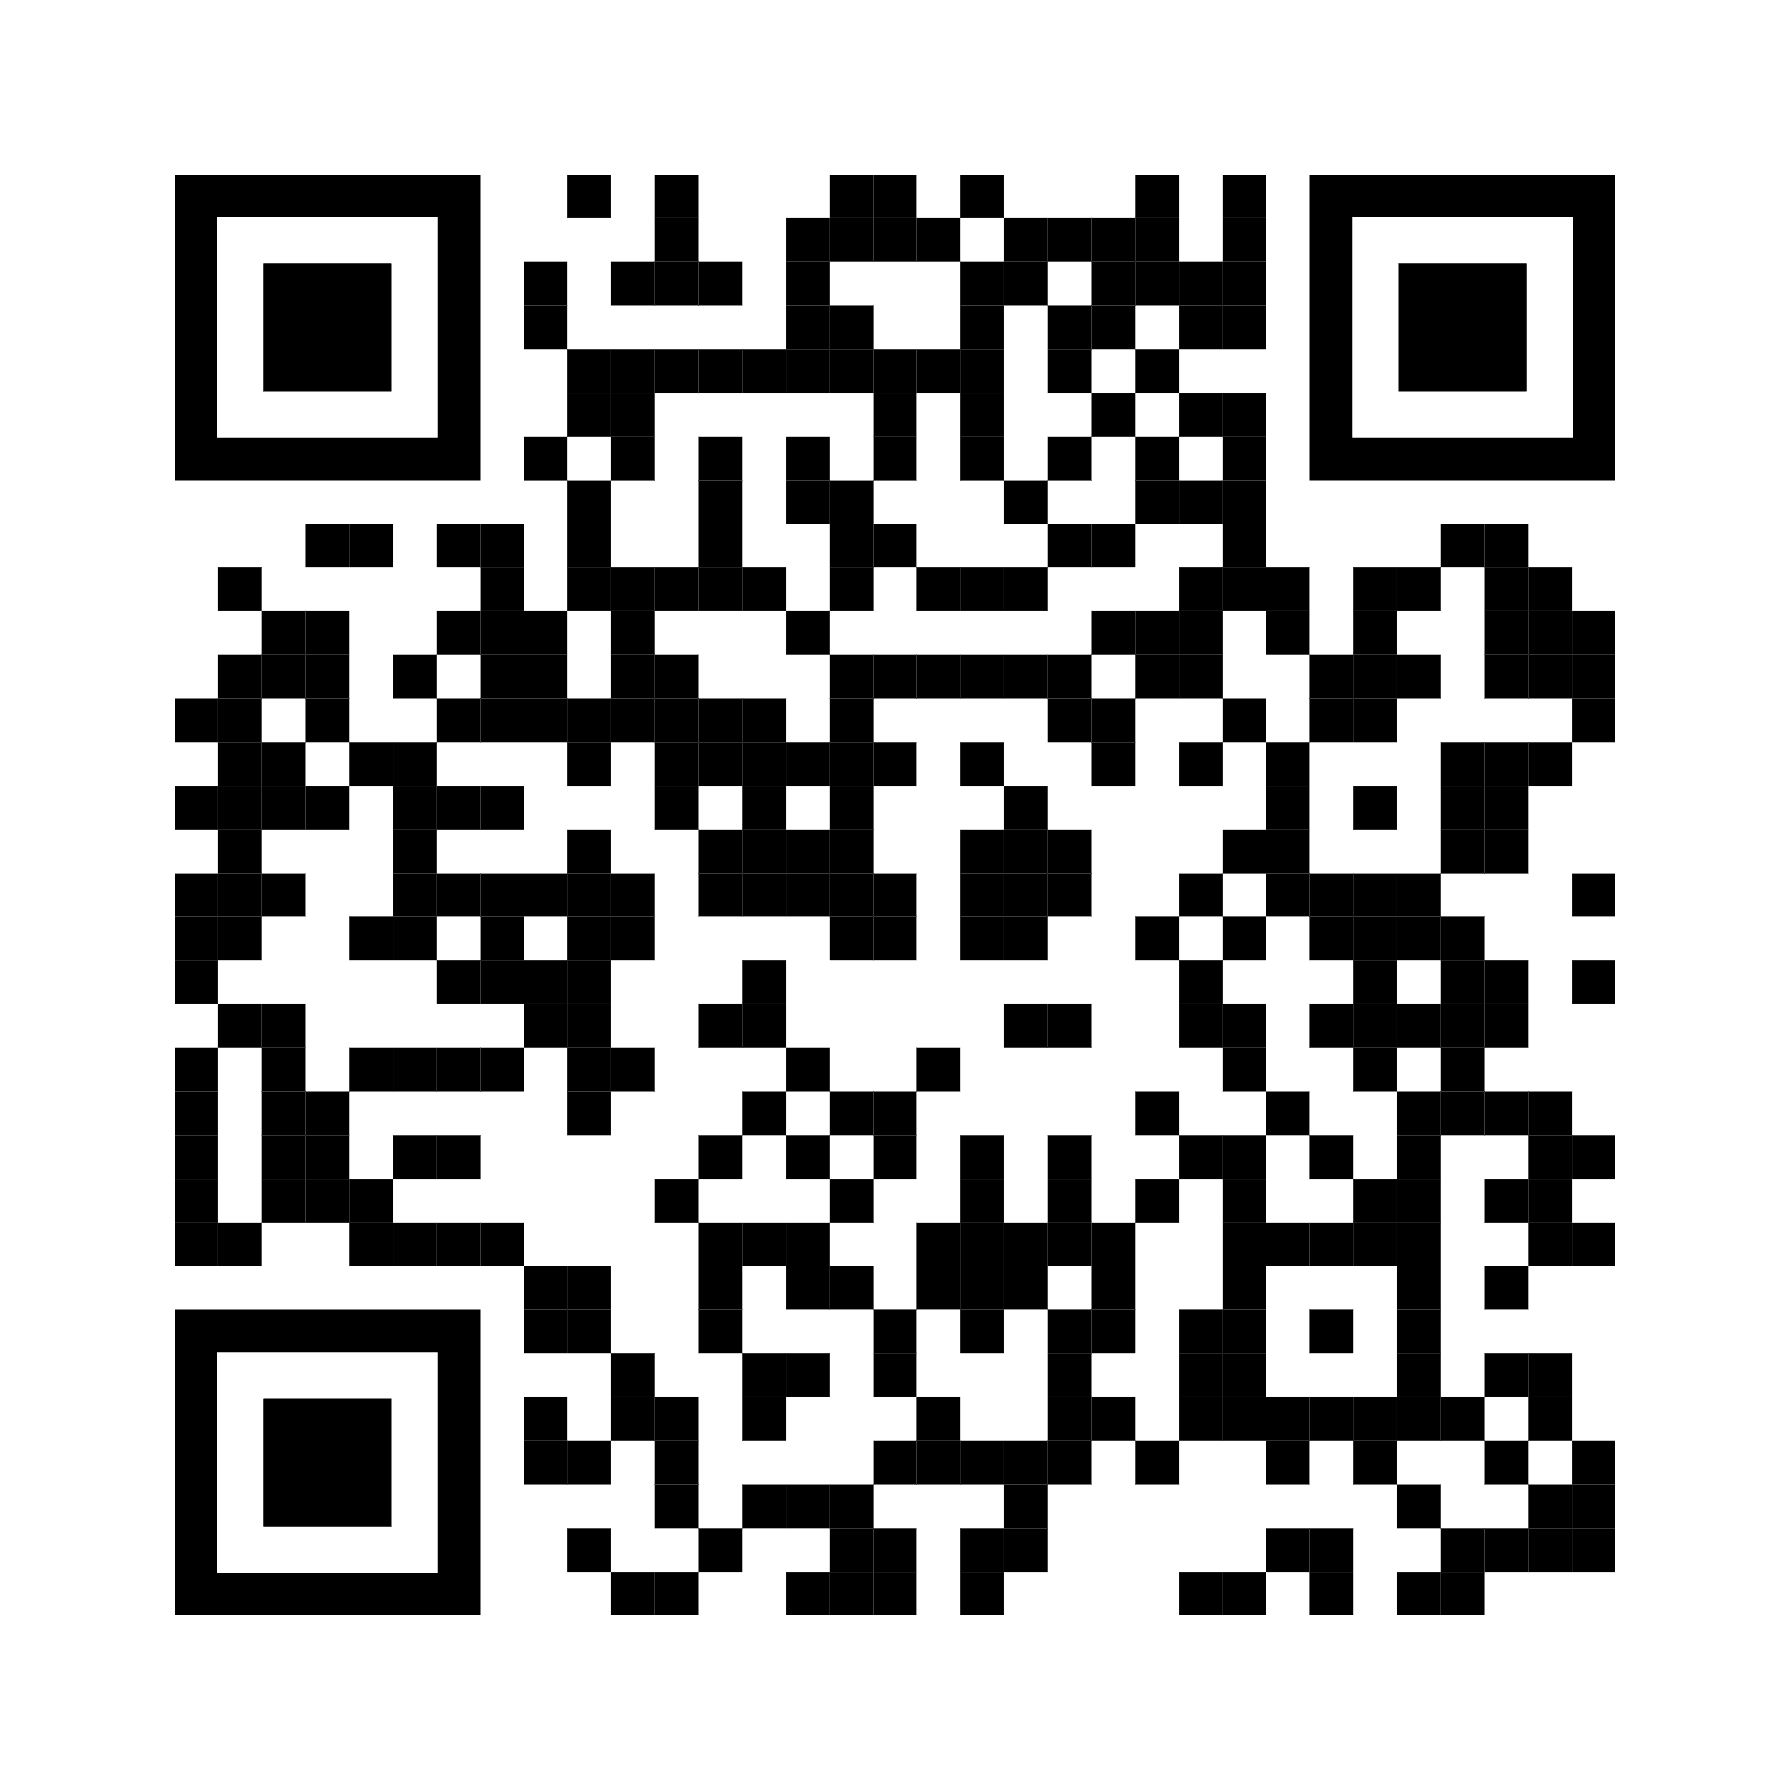
Demo- GitHub Repo
@MICROCKSIO

Slide 18



Let’s Build Better Mocks Together
Try Microcks (microcks.io) !
Follow us on Twitter @microcksio,
Chat on Discord microcks.io/discord-invite
Distribute & if you like it.
It’s a 100% Open Source project.
And if you love it, contribute !
@MICROCKSIO

Slide 19


