Slide 1

Scaling Large Clusters with Valkey

Slide 2
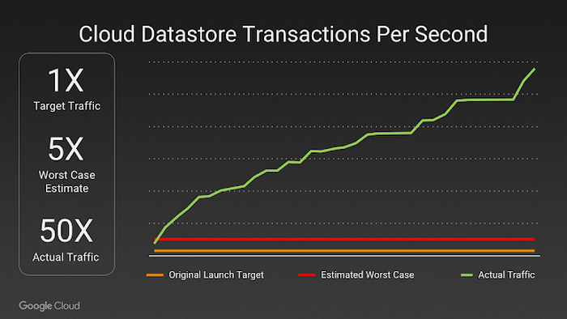
https://cloud.google.com/blog/products/containers-kubernetes/bringing-pokemon-go-to-life-on-google-cloud

Slide 3
You shouldn’t run a 2000 node Valkey cluster,
but you might have to.

Slide 4


Fully compatible with Redis OSS 7.2
Vendor Neutral
BSD-3 Licensed
Built by contributors in the open source community

Slide 5
Valkey distribution modes
Standalone
Cluster

Slide 6
SHARD 1
Primary
Replica
Shard 2
Shard 3
Primary
Replica
Primary
Replica

Slide 7
Primary
Primary
Primary
Replica

Slide 8
Primary
Primary
<Dead>
Replica

Slide 9
Primary
Primary
<Dead>
Primary

Slide 10
Primary
Primary
Replica
Primary
Notes:
Talk about connection storms

Slide 11
Zone a
Primary
Zone b
Primary
Replica
Zone c
Primary
Notes:
Talk about connection storms

Slide 12
CLUSTER SLOTS
Node
Notes:
Talk a little bit about the operator. Try it out and make sure it works as expected.

Slide 13
1) 1) (integer) 0
2) (integer) 5460
3) 1) "127.0.0.1"
2) (integer) 30001
3) "09dbe…"
4) 1) hostname
2) "host-1.valkey.example.com"
3) availability-zone
4) "zone-a"
4) 1) "127.0.0.1"
2) (integer) 30004
3) "821d8c…"
4) 1) hostname
2) "host-2.valkey.example.com"
3) availability-zone
4) "zone-a"
Node
Notes:
Talk a little bit about the operator. Try it out and make sure it works as expected.

Slide 14
1) 1) (integer) 0
2) (integer) 5460
3) 1) "127.0.0.1"
2) (integer) 30001
3) "09dbe…"
4) 1) hostname
2) "host-1.valkey.example.com"
3) availability-zone
4) "zone-a"
4) 1) "127.0.0.1"
2) (integer) 30004
3) "821d8c…"
4) 1) hostname
2) "host-2.valkey.example.com"
3) availability-zone
4) "zone-a"
Node
Notes:
Talk a little bit about the operator. Try it out and make sure it works as expected.

Slide 15
1) 1) (integer) 0
2) (integer) 5460
3) 1) "127.0.0.1"
2) (integer) 30001
3) "09dbe…"
4) 1) hostname
2) "host-1.valkey.example.com"
3) availability-zone
4) "zone-a"
4) 1) "127.0.0.1"
2) (integer) 30004
3) "821d8c…"
4) 1) hostname
2) "host-2.valkey.example.com"
3) availability-zone
4) "zone-a"
Node
Notes:
Talk a little bit about the operator. Try it out and make sure it works as expected.

Slide 16
1) 1) (integer) 0
2) (integer) 5460
3) 1) "127.0.0.1"
2) (integer) 30001
3) "09dbe…"
4) 1) hostname
2) "host-1.valkey.example.com"
3) availability-zone
4) "zone-a"
4) 1) "127.0.0.1"
2) (integer) 30004
3) "821d8c…"
4) 1) hostname
2) "host-2.valkey.example.com"
3) availability-zone
4) "zone-a"
Node
Notes:
Talk a little bit about the operator. Try it out and make sure it works as expected.

Slide 17
Client best practices
Use connection pooling
Limit connection retries
Limit topology refresh
Proxies (like envoy!) can help with connection limits

Slide 18
CLUSTER SLOT-STATS
Node
Notes:
Talk a little bit about the operator. Try it out and make sure it works as expected.

Slide 19
> CLUSTER SLOT-STATS ORDERBY KEY-COUNT LIMIT 2 DESC
1) 1) (integer) 12426
2) 1) "key-count"
2) (integer) 45
3) "cpu-usec"
4) (integer) 0
5) "network-bytes-in"
6) (integer) 0
7) "network-bytes-out"
8) (integer) 0
2) 1) (integer) 13902
2) 1) "key-count"
2) (integer) 20
3) "cpu-usec"
4) (integer) 0
5) "network-bytes-in"
6) (integer) 0
7) "network-bytes-out"
8) (integer) 0
Node

Slide 20
Resource management
Co-locate caches with CPU intensive workloads
Never touch the hottest slots, move the second hottest slots
Valkey 9.0 has built in migration tooling (finally!)
Notes:
Most caching scales on memory, not CPU. So co-locate caches. Avoid setting CPU limits, because that will cause latency spikes!
Think about noisy neighboards.

Slide 21
Can Valkey scale?
Notes:
The big question – can valkey scale?

Slide 22
We Tested A Lot!
Multi-Primary failures upto 50% of the primary
Single AZ Failure
Up To 1B RPS Write Workload
TLS/Non-TLS Clusters
Multiple Client Libraries
1 Primary 1 Replica / 1 Primary 2 Replica Setups
Notes:
--- We spent few months
1. We started with trying to fail one primary node to upto 499 primaries. Why 499? Because in a 1000 primary cluster, we need atleast 501 primaries to atleast maintain a quorum
2. We failed single AZ (incl repl and primaries) in a 3AZ setup, so roughly 666 nodes.
3. We started off with 100M TPS and scaled it upto 1B TPS
4. We tested with TLS and non-TLS clusters
5. We tested with popular client libraries like valkey-py, valkey-glide, valkey-go, iovalkey, redission
6. We tested with 1 primary 2 replica and 1 Primary 1 Replica setup

Slide 23
What worked?
Notes:
Now I will talk about the weird issues we ran into while testing at scale

Slide 24
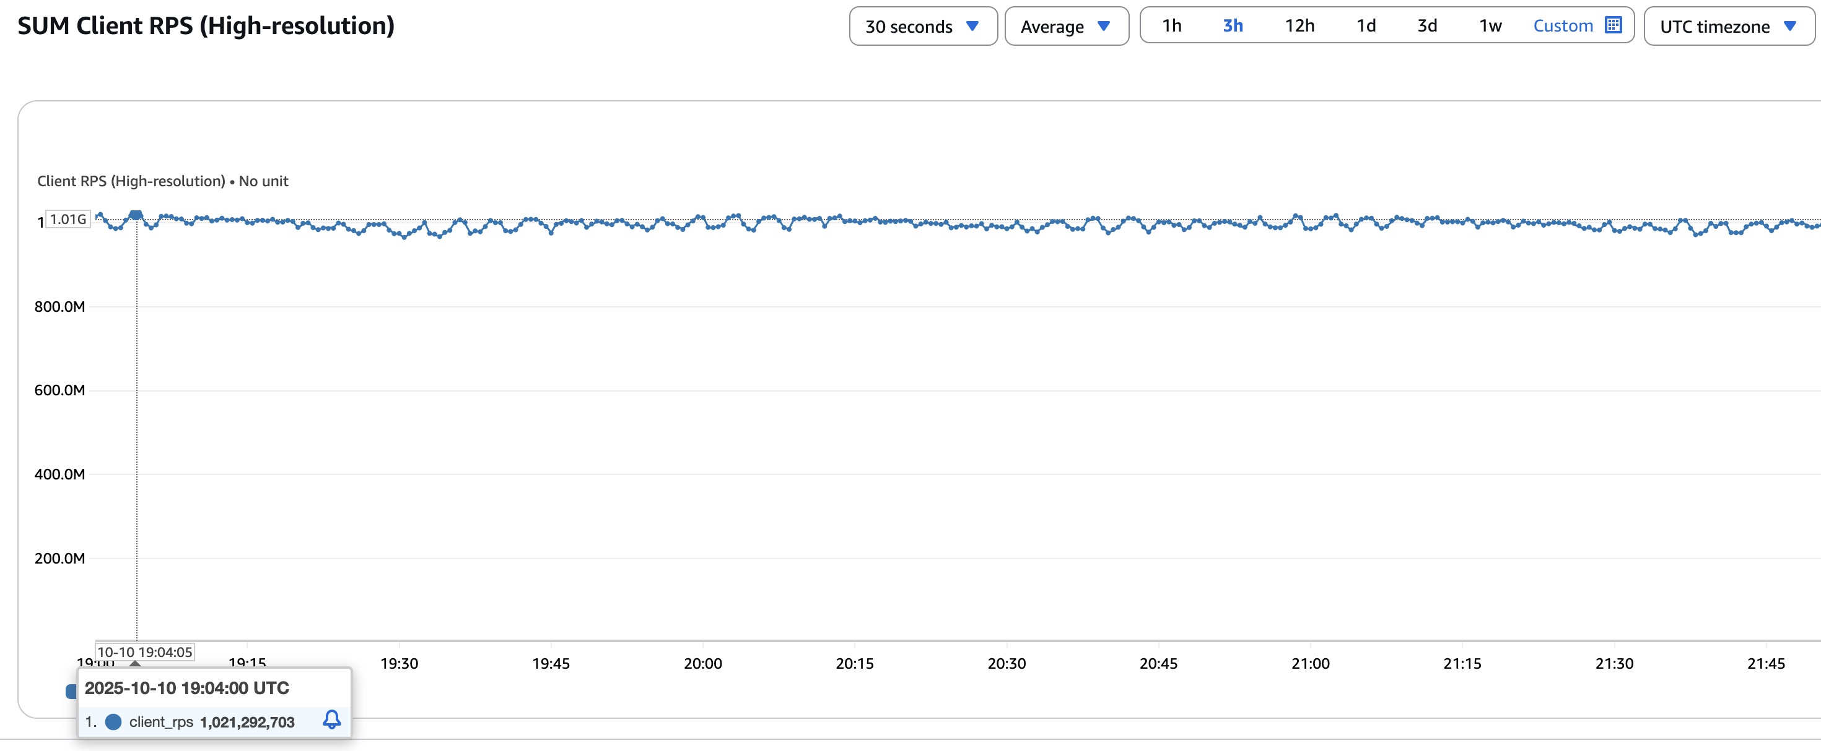
One Billion Requests Per Second
 | Command | Data Size
Workload | SET | 512 Bytes
Notes:
improvement w iothread - 1M RPS
replicate with 1000 primaries - and there we have it?!

Slide 25
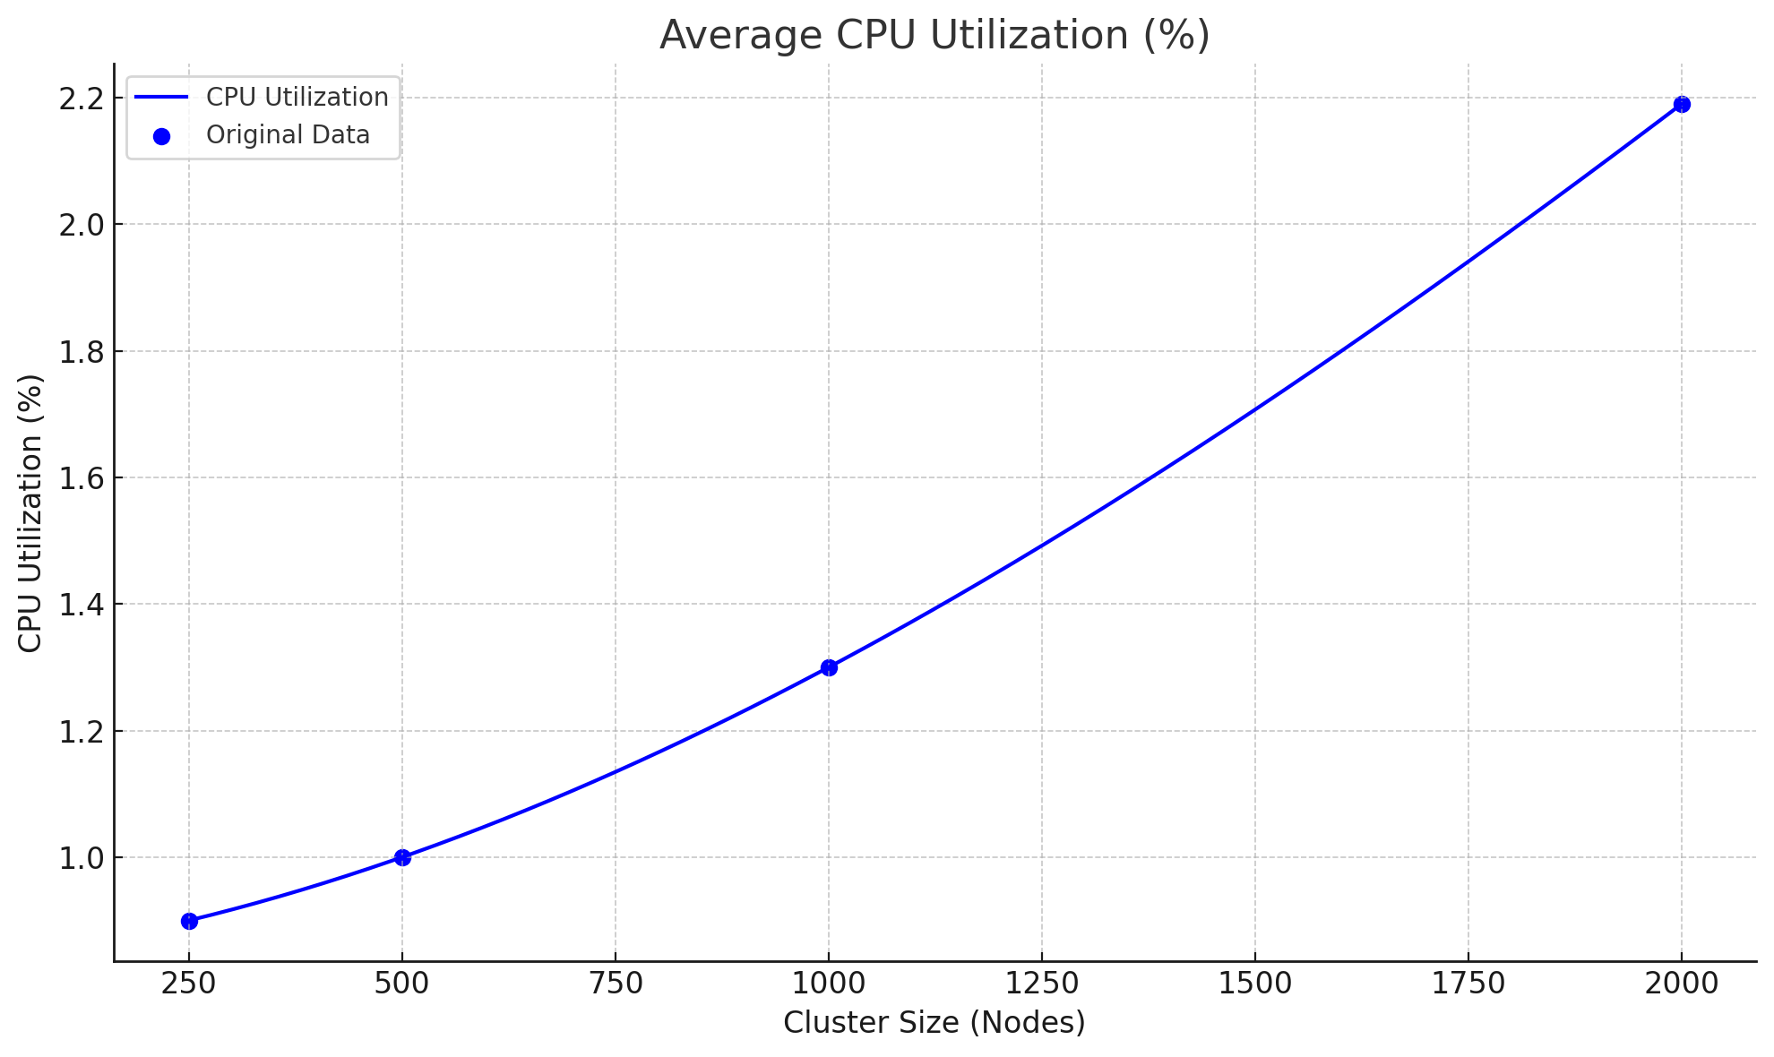
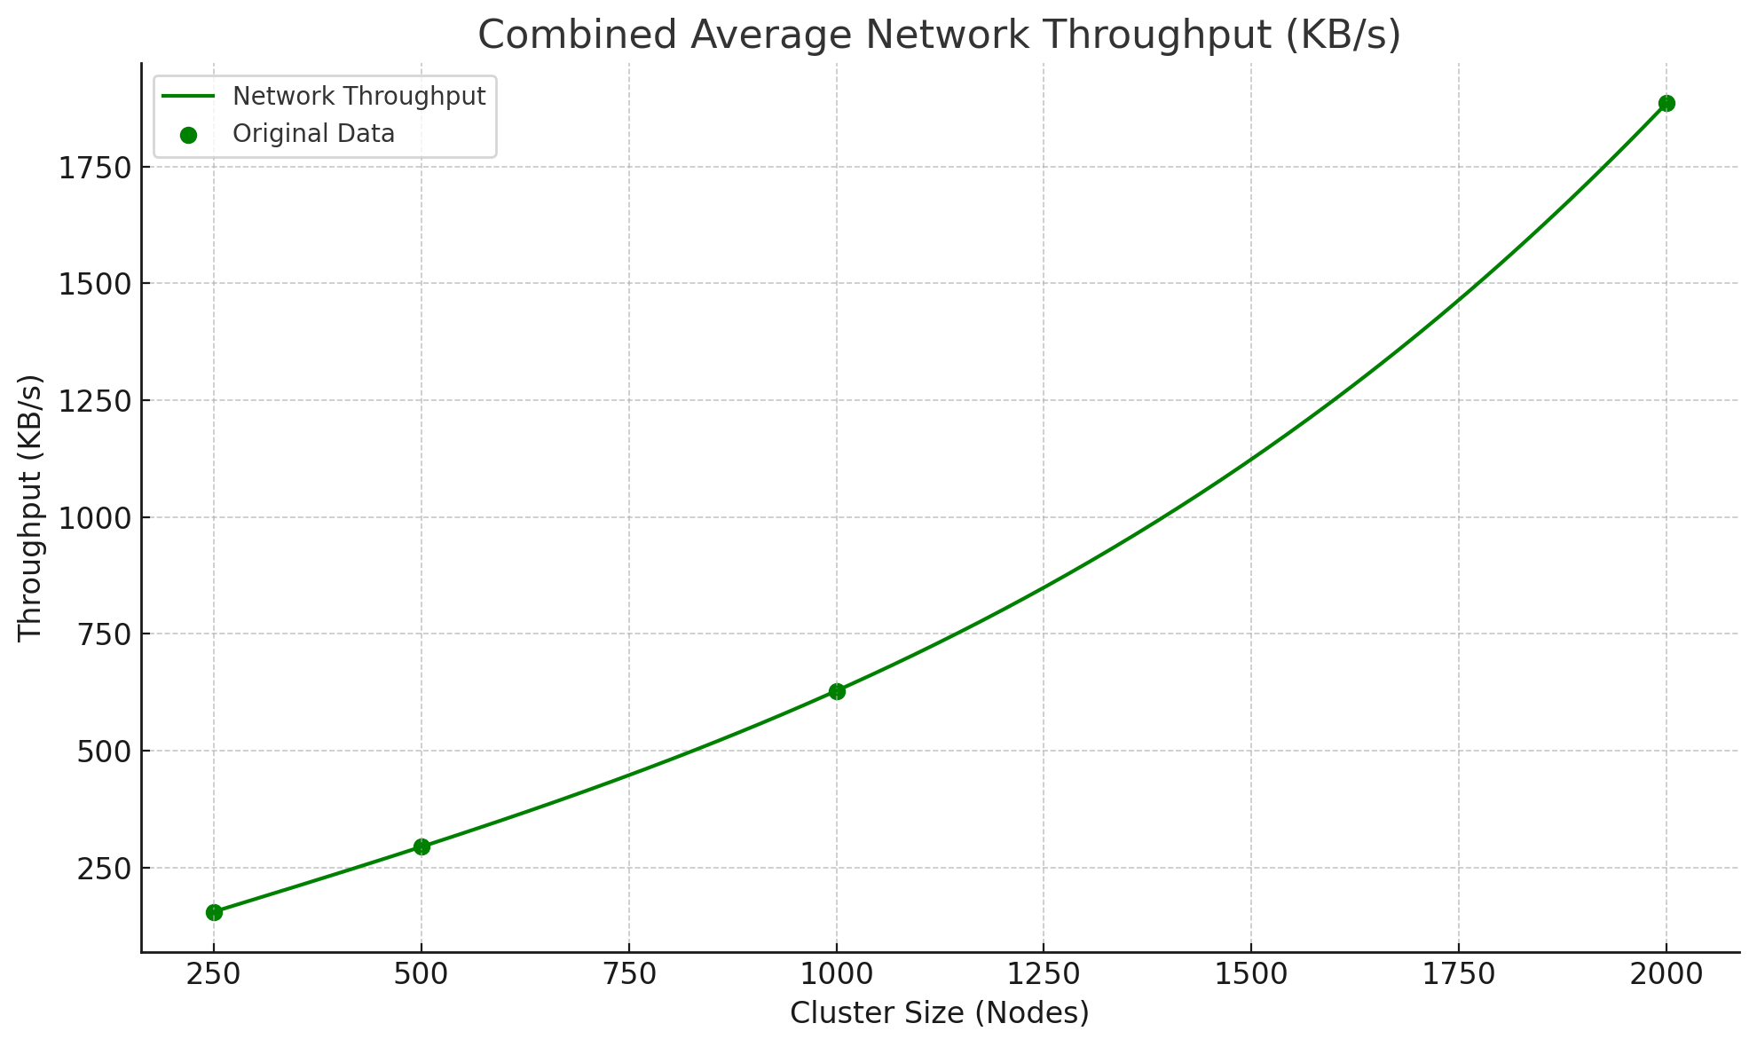
Resource Utilization
Notes:
as cluster increases, there is a increase in gossip messages so we expected the resource utilization to increase linearly
and it did.
these are the steady-state metrics for compute

Slide 26
What did we really break?
Notes:
Now I will talk about the weird issues we ran into while testing at scale

Slide 27
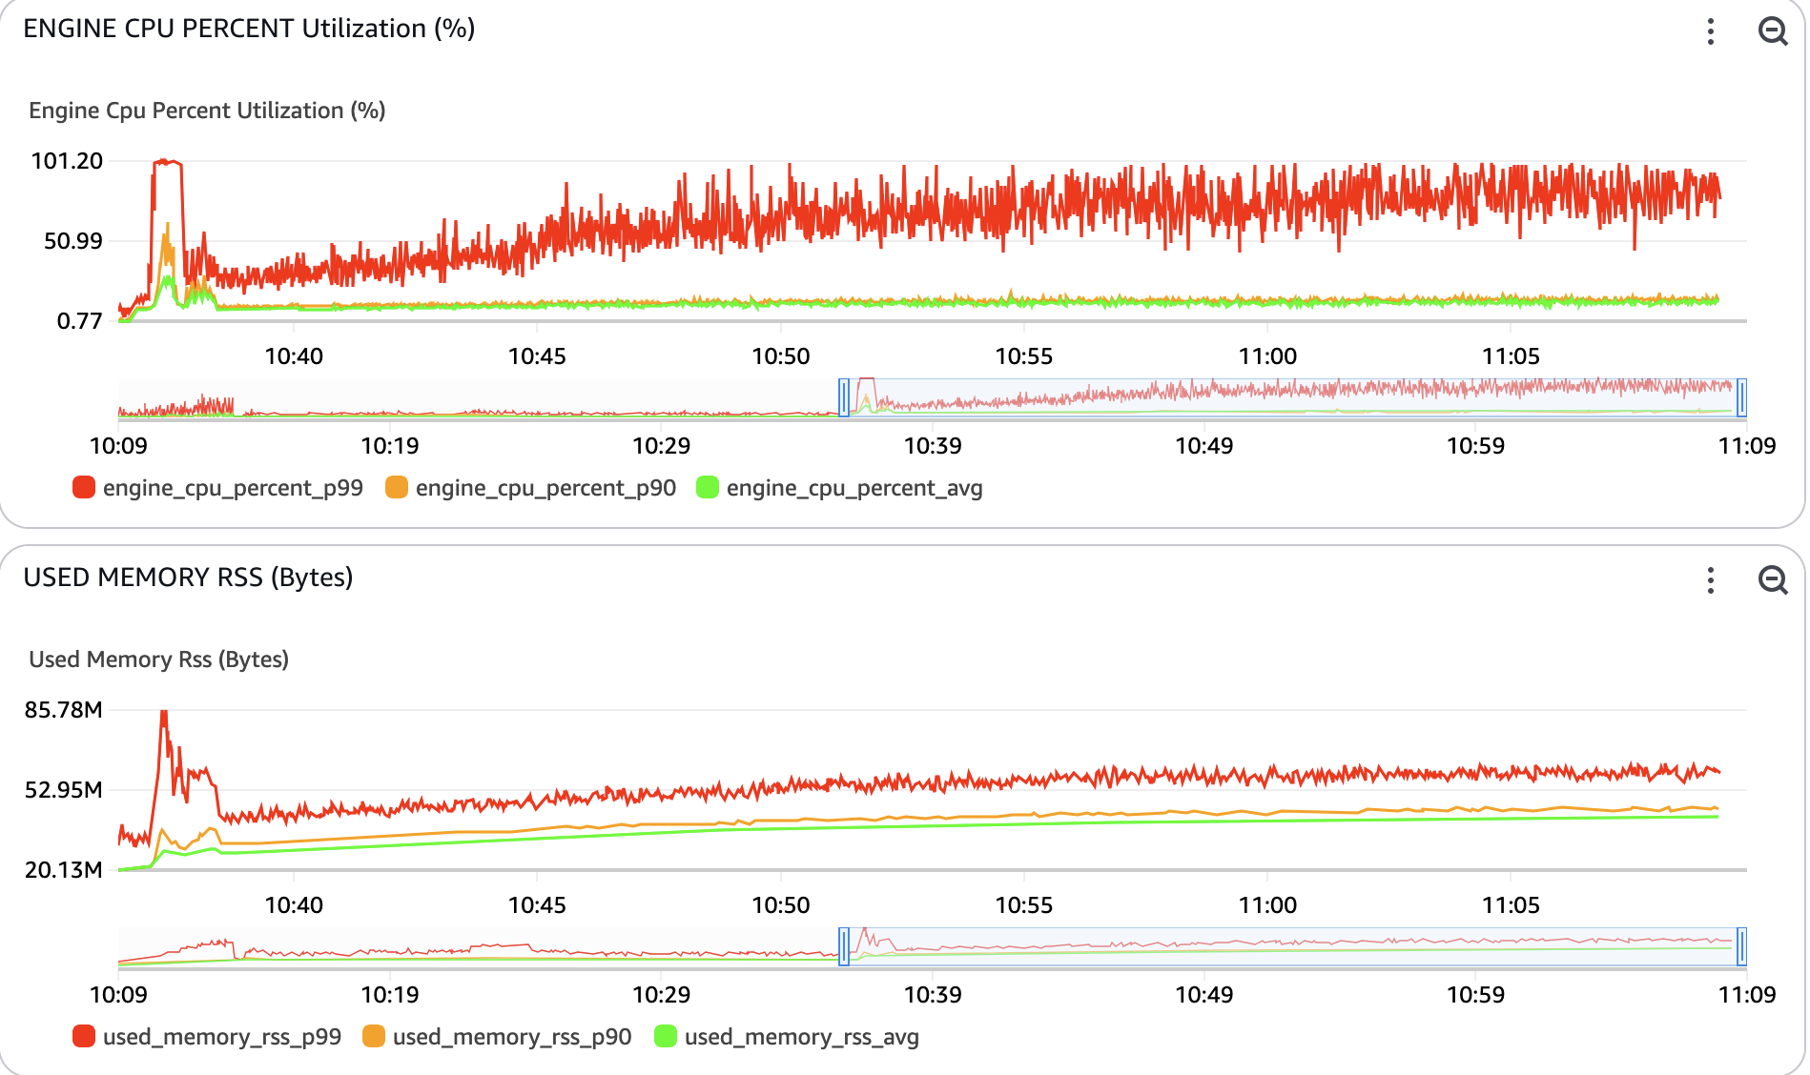
Reconnection Storms
Notes:
One of the issues we faced was that a lot of compute was being churned in trying to reconnect with the failed node.
The compute was consistently 100% for at atleast 5% of the nodes at a time.
Specially in cases where we failed anything north of 450 primaries, the cluster was almost never able to recover. When we profiled it, we saw that all these reconnections are exhausting the compute.

Slide 28
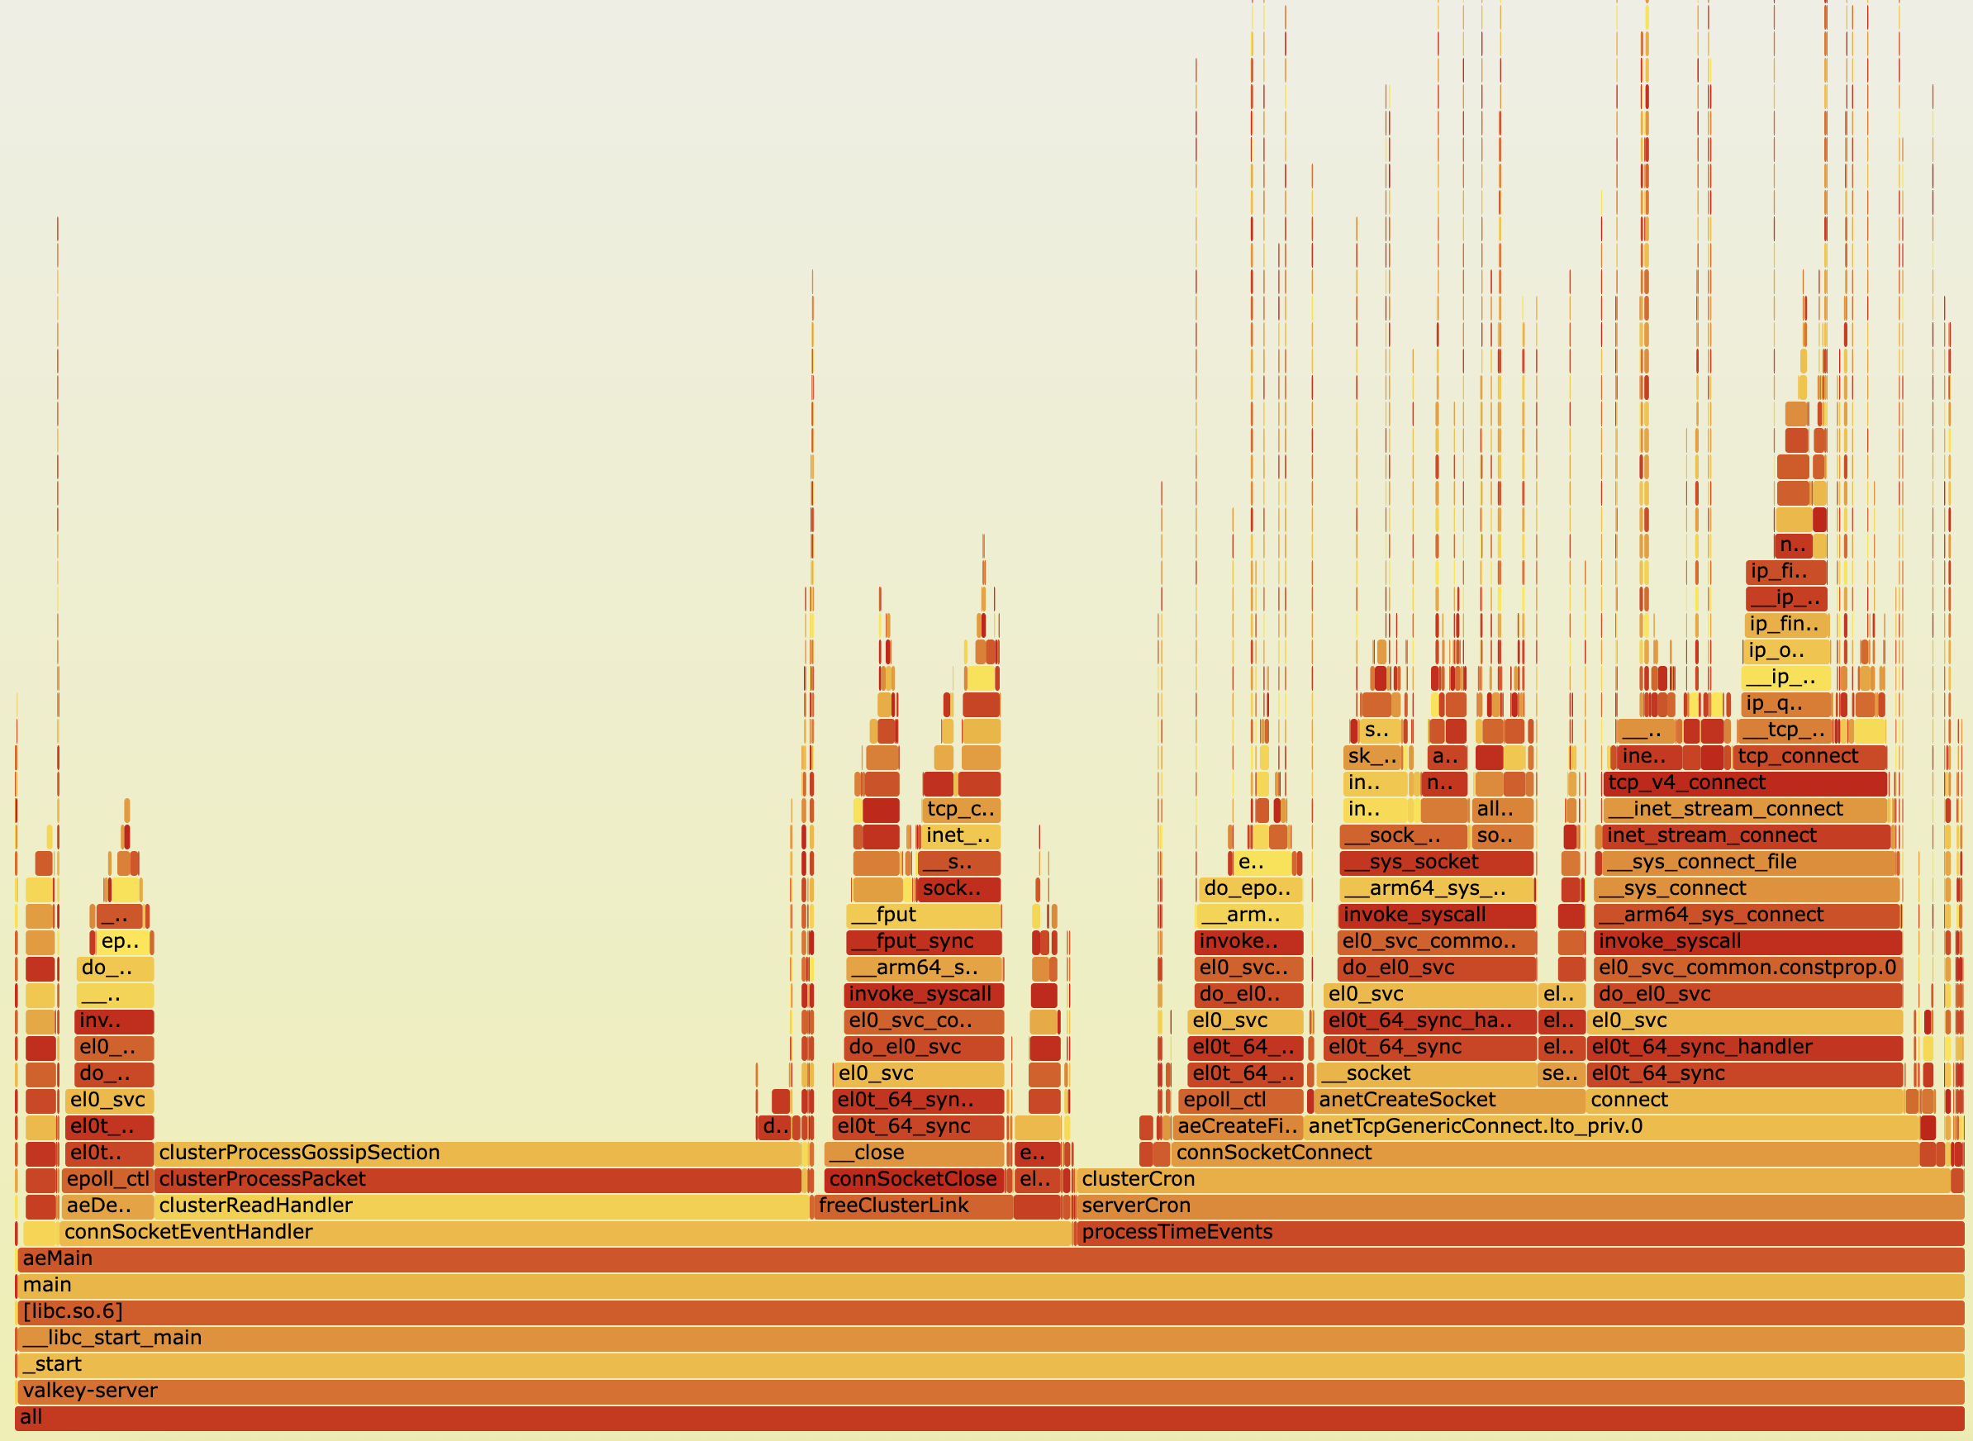
Reconnection Storms
Notes:
One of the issues we faced was that a lot of compute was being churned in trying to reconnect with the failed node.
The compute was consistently 100% for at atleast 5% of the nodes at a time.
Specially in cases where we failed anything north of 450 primaries, the cluster was almost never able to recover. When we profiled it, we saw that all these reconnections are exhausting the compute.

Slide 29
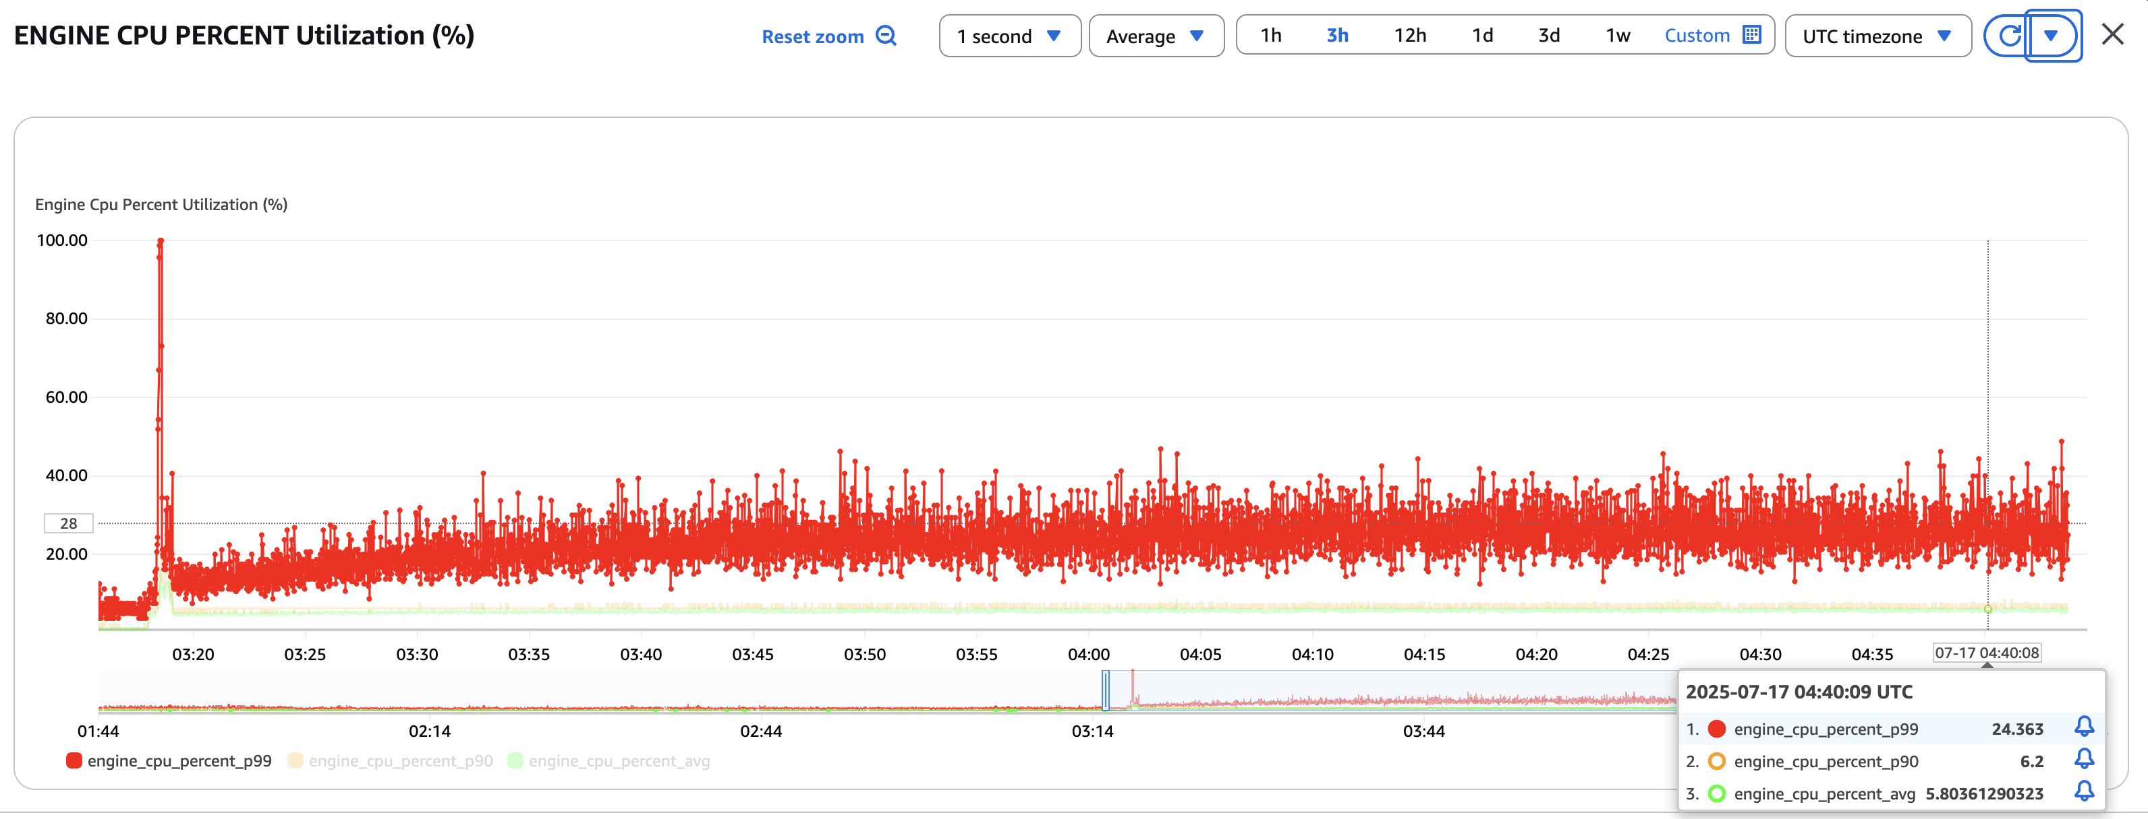
Connection Throttling
Notes:
To mitigate this, we introduced a smart throttling mechanism, where we limit the number of retries for a particular node within a node timeout.
The exact number of retries will depend on the node timeout, but this ensures every failed node gets a fair chance without exhausting the compute.
And the result, the engine CPU stays limited at 40% instead of going upto 100%.

Slide 30
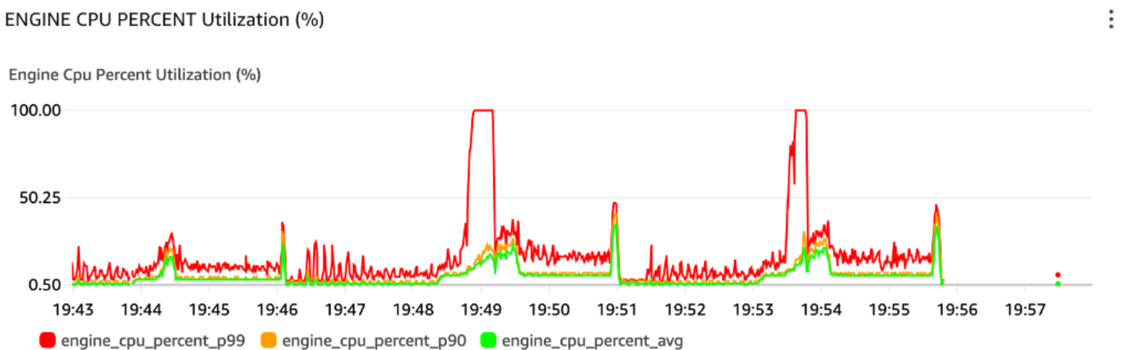
Node Failure Tracking
Notes:
Next interesting issue I will talk about is the redundant failure reports.
the surviving nodes spend a significant amount of time processing and cleaning up redundant failure reports. For example, after 499 out of 2000 nodes were killed, the remaining 1501 nodes continued to gossip about each failed node and exchange reports, even after those nodes had already been marked as failed

Slide 31
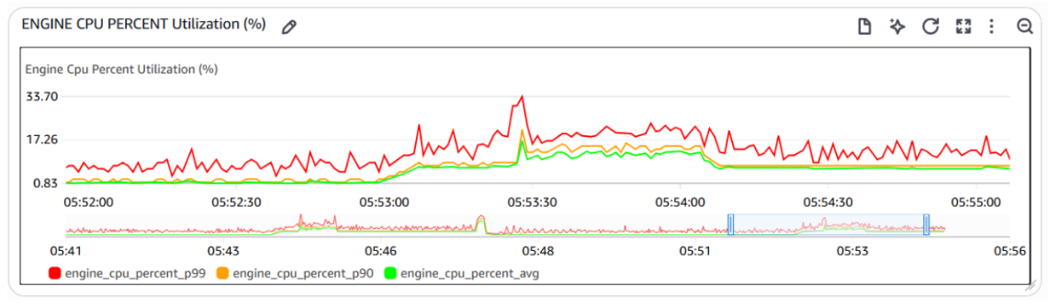
Optimized Failure Reports RAX
Notes:
To mitigate this, we improved failure tracking mechanism to a radix tree, radix tree to store the failure report time information rounded to every second and group multiple report together.
This helps with cleaning up expired failure report efficiently as well.

Slide 32
Shard Vote Problem
SHARD 5
Primary
Replica
SHARD 1
SHARD 4
Primary
Replica
Primary
Replica
SHARD 2
SHARD 3
Primary
Replica
Primary
Replica

Slide 33
Shard Vote Problem
SHARD 5
Primary
Replica
SHARD 1
SHARD 4
Primary
Replica
Primary
Replica
SHARD 2
SHARD 3
Primary
Replica
Primary
Replica

Slide 34
Shard Vote Problem
SHARD 5
Primary
Replica
Votes
Shard 2
SHARD 1
SHARD 4
Primary
Replica
Primary
Replica
t1
t1
t1
SHARD 2
SHARD 3
Primary
Replica
Primary
Replica
Votes
Shard 2
Shard 4

Slide 35
Shard Ranking Mechanism
Order
SHARD 5
Shard 1
Votes
Primary
Replica
Shard 2
Shard 3
Shard 4
New Primary
t1
Shard 5
SHARD 1
SHARD 4
Primary
Replica
t1
Primary
Replica
t2
t1
t2
SHARD 2
SHARD 3
Primary
Replica
t2
Primary
Replica
Votes
Shard 2
Shard 4
New Primary
Shard 5

Slide 36
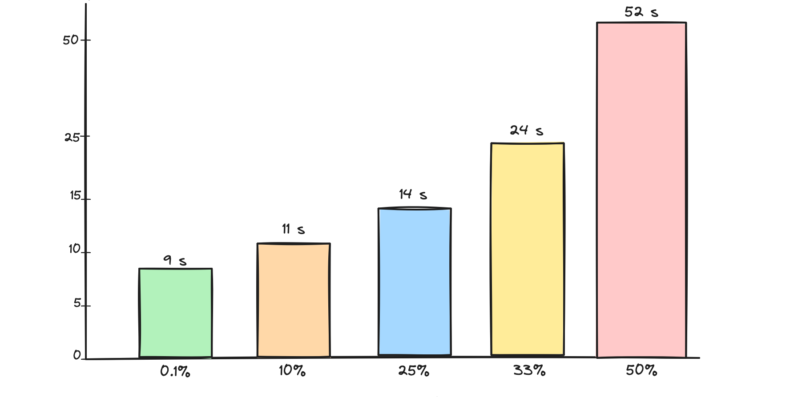
Cluster Recovery
Recovery Time (s)
1 Primary
100 Primary
250 Primary
330 Primary
499 Primary
Primary Failure Rate (%)
Recovery Time vs Primary Failure Rate (1000 Primary / 1000 Replica)
Notes:
We talked about how we tried to fail upto 499 nodes, and in our experiments, we saw that even that cluster is able to reliably recover in less than a minute.

Slide 37
Pub/Sub Light Weight Message Header
100B
Message Header
2 KB
Pub - Sub
Message
Pub / Sub Traffic
Pub / Sub Traffic
Light Weight Message Header
16 Bytes
Message Header
Cluster Bus
Notes:
Before Valkey 9, the community made some other important improvements, which helped valkey scale.
2. Cluster bus system is also used for pub/sub operations to provide a simple interface for a client to publish data to any node and subscribers to receive data on any connected node. However, the metadata overhead of each packet is roughly 2 KB which is quite large for small pub/sub messages. It is huge because it has slot ownership information, which is irrelevant for the pub sub messages. Roshan introduced a light weight message header, which helped scale pubsub with large clusters.

Slide 38
Conclusion
Valkey Cluster can scale up to 2000 nodes and 1 Billion RPS
Make sure to follow best practices, so your cluster scales when you need it
Valkey Operator is being developed to support large Valkey clusters with Kubernetes
Consider switching to Valkey if you are running Redis ;)
Notes:
Recent improvements around failover has better serialization

Slide 39


Help Us Build the Valkey Operator
valkey.io/slack
#valkey-k8s-operator
valkey-io/valkey-operator
Notes:
We’d love you to come join the project.

Slide 40

Get involved in the project
valkey.io
valkey/valkey
github.com/valkey-io
Notes:
We’d love you to come join the project.

