Slide 1
KV-Cache Wins You Can Feel
Prefix-Cache Scheduling, Offloading, and Scaling with llm-d
Maroon Ayoub, IBM Research
Tyler Michael Smith, RedHat
Kay Yan, DaoCloud
Nili Guy, IBM Research
Vita Bortnikov, IBM Research

Slide 2
Two LLMs walk into a bar.
The first orders a beer - the bartender goes “that’ll be $3.”
The second says: “beer, but I’m paying cache.”
Notes:
This joke captures a part of the essence of this talk, we’ll dive into what paying with cache means and why it is important
You’re transforming your cash bills to cache hits in compute

Slide 3
The 10x Cost Problem
“The KV-cache hit rate is the single most important metric for a production-stage AI agent. It directly affects both latency and cost.”
- Manus, Context Engineering for AI Agents
Mainstream AI API Pricing:
OpenAI GPT-5: $1.25 per 1M input tokens vs $0.125 per 1M cached input tokens
Anthropic Claude Sonnet: $3 per 1M input tokens vs $0.3 per 1M cached input tokens
This talk: how standard (Kubernetes) load-balancing destroys these savings, and what we can do about it
Notes:
I’ll start with what’s out there in mainstream providers
What we’re about to present really affects your bottom-line, without this optimization, you pay 10x and under-use your resources

Slide 4
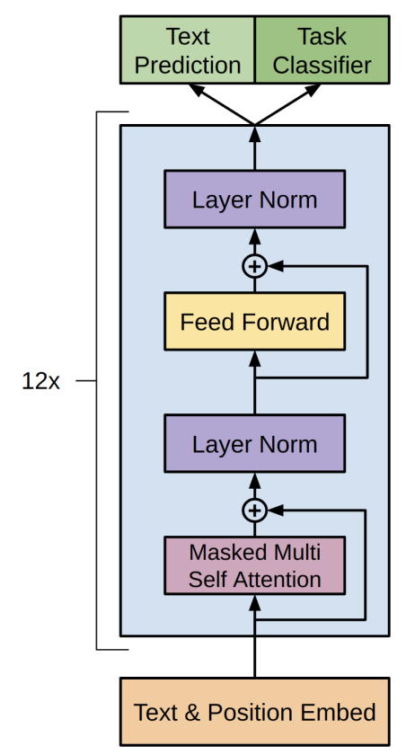
What is a Transformer?
Attention is an essential ingredient of a decoder transformer architecture
Each layer has two major components
  Attention followed by Feed Forward
Attention
  Mixes tokens
  Cost grows quadratically with sequence length
  Stateful
Feed Forward
  Processes each token independently
  Linear transformations + nonlinearities
Radford, et al. Improving Language Understanding by Generative Pre-Training (GPT1)

Slide 5
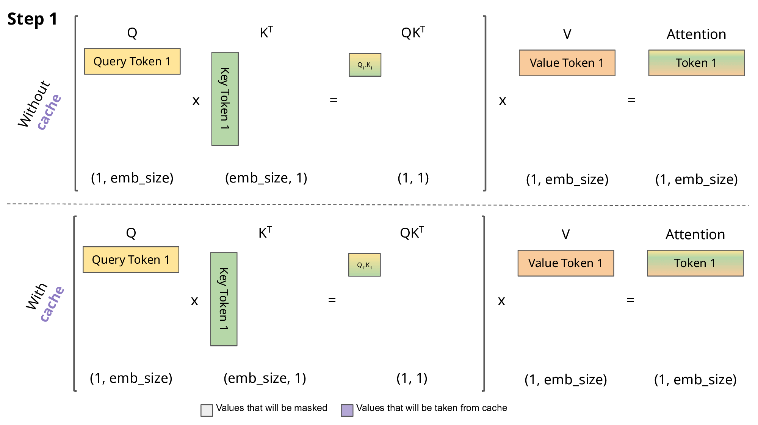
What is a Attention?
KV Cache encodes the state of the state of the previous tokens
Notes:
10 seconds slide

Slide 6
Paged Attention
vLLM manages KV cache blocks like virtual memory
Physical KV blocks
Block Table
computer | scientist | and | mathe- matician
Artificial | Intelli- gence | is | the
renowned
future | of | tech- nology
Alan | Turing | is | a
Block Table
Request
A
Request
B
Logical KV blocks
Logical KV blocks
Alan | Turing | is | a
computer | scientist | and | mathematician
renowned
Artificial | Intelli- gence | is | the
future | of | tech- nology

Slide 7
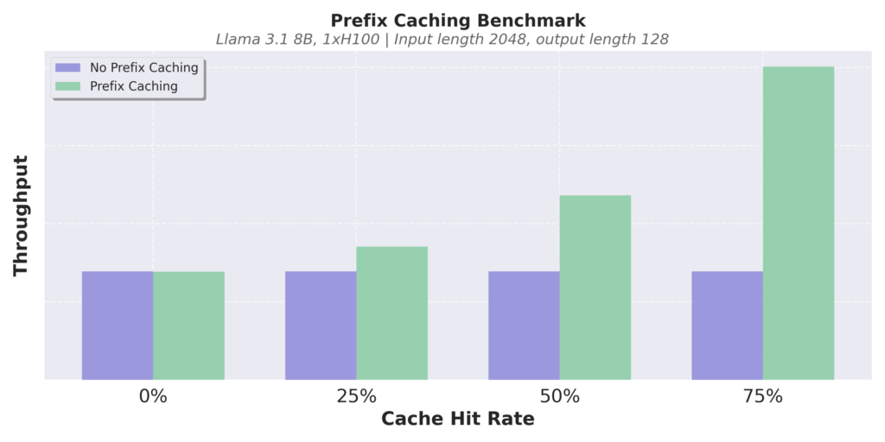
Automatic Prefix Caching
vLLM skips prompt processing by automatically reusing KV cache blocks across requests
Example: Multi-turn conversation
Prompt (round 1)
Human: What's AI?
LLM Result (round 1)
LLM: AI is technology that simulates human intelligence, like Siri or Google Maps.
Cached
Prompt (round 2)
Human: What's AI?
LLM: AI is technology that simulates human intelligence, like Siri or Google Maps.
Human: Cool, thanks!
LLM Result (round 2)
LLM: No problem!

Slide 8
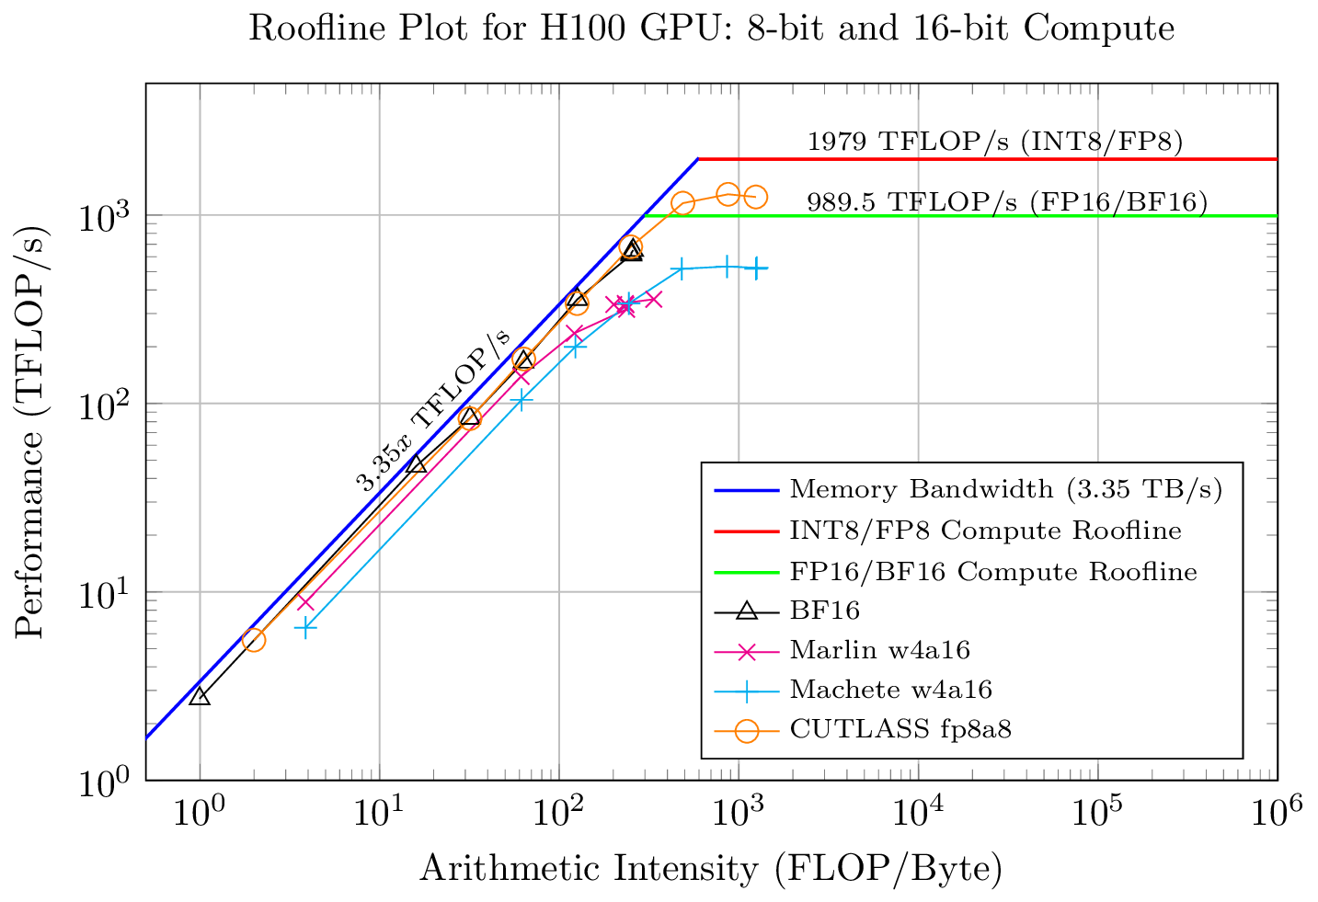
Prefill and Decode
Two Phases of LLM Inference - different computational regimes
Decodes are limited by VRAM Bandwidth!
Prefills are compute-bound!
Prefill - Prompt Processing
All tokens processed in one pass
Reads the KV Cache once
Compute-intensive
Attention: Matrix-matrix multiplication
Decode - Token Generation
Each token processed sequentially
KV cache is loaded each forward pass
Bandwidth-limited
Attention: Matrix-vector multiplication

Slide 9
“Well-lit” Paths
llm-d provides “well-lit” paths for running LLM inference workloads
Intelligent Inference Scheduling
P/D Disaggregation
Wide Expert Parallelism
KV Cache Management

Slide 10



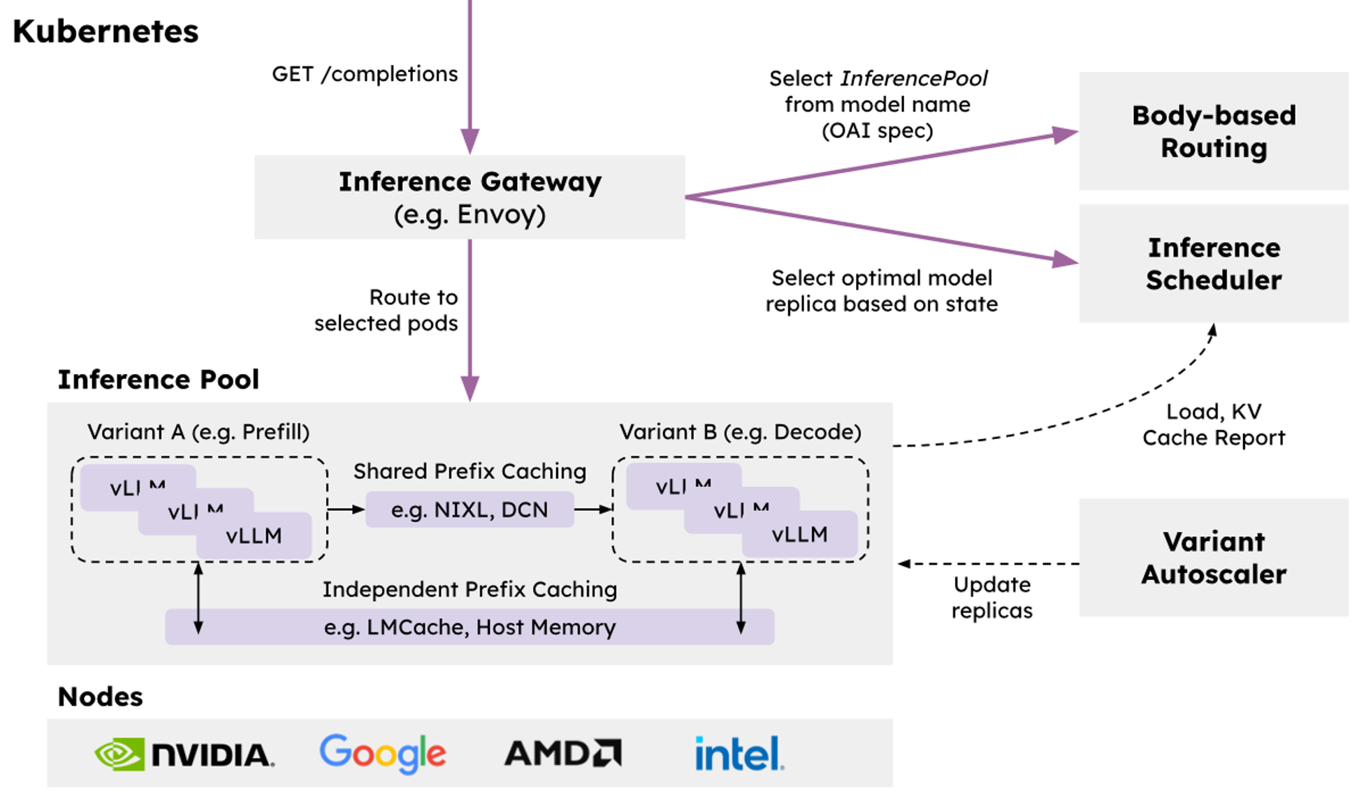

🤝
🤝
Operationalizability
Modular and resilient architecture with native integration into Kubernetes via Inference Gateway API
Flexibility
Cross-platform with extensible implementations of key composable layers of the stack
Performance
Leverage distributed optimizations like prefix-aware routing and disaggregation to achieve the highest throughput while meeting SLOs

Slide 11
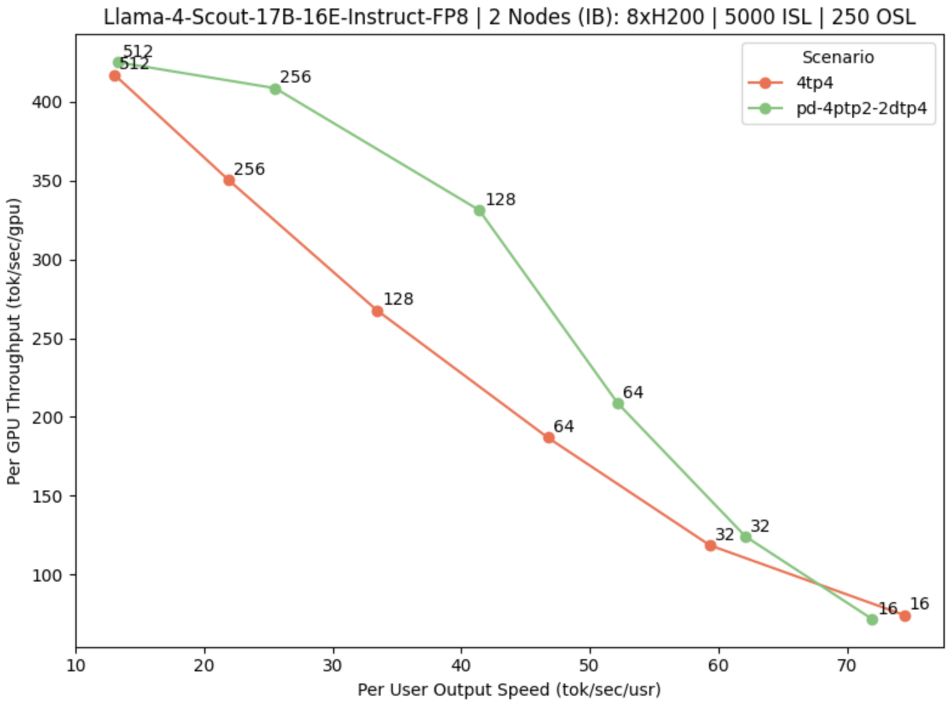
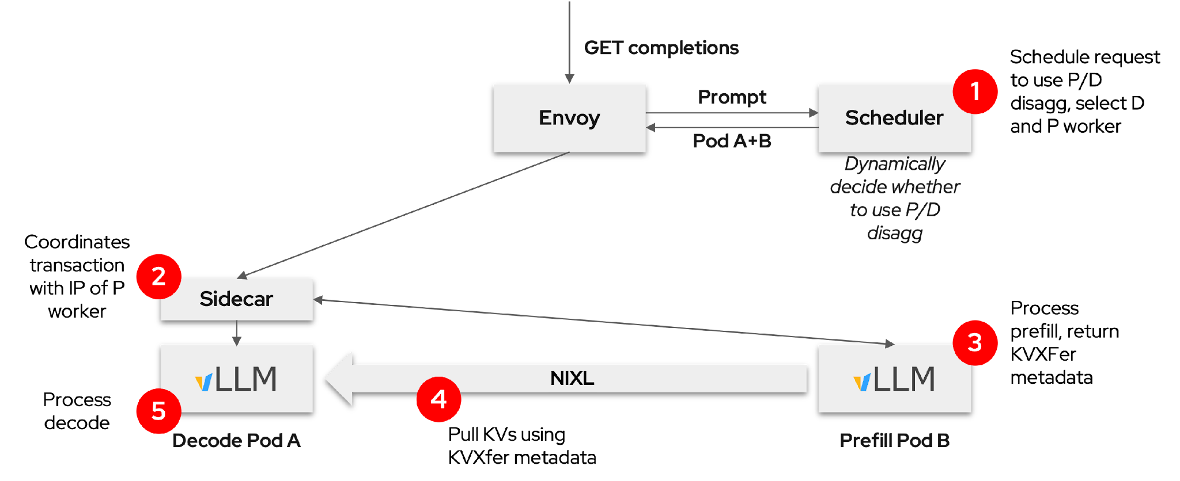
“Well-lit” Path: Prefill/Decode Disaggregation
llm-d composes vLLM and Gateway to enable P/D disaggregation
Separate prefill and decode
Allows specialization
Dynamically decided
Easier to meet TTFT and ITL SLO requirements
Best for “medium” server load
Typical: small prefillers, large decoders
P/D benefits are most clear when jointly optimizing efficiency and interactivity
https://llm-d.ai/blog/llm-d-v0.2-our-first-well-lit-paths

Slide 12


“Well-lit” Path: Wide Expert Parallelism
llm-d’s K8s-native design integrates EP implementation directly with the broader system, including DP-aware load balancing
GET completions
Prompt
EPP
*Composes with other scorers*
Pod D
LeaderWorkerSet
Expert-Parallel MLP
Pod A
(DP-0)
Pod B
(DP-1)
Pod C
(DP-2)
Pod D
(DP-3)
Pod E
(DP-4)
Pod F
(DP-5)
Pod G
(DP-6)
Pod H
(DP-7)

Slide 13
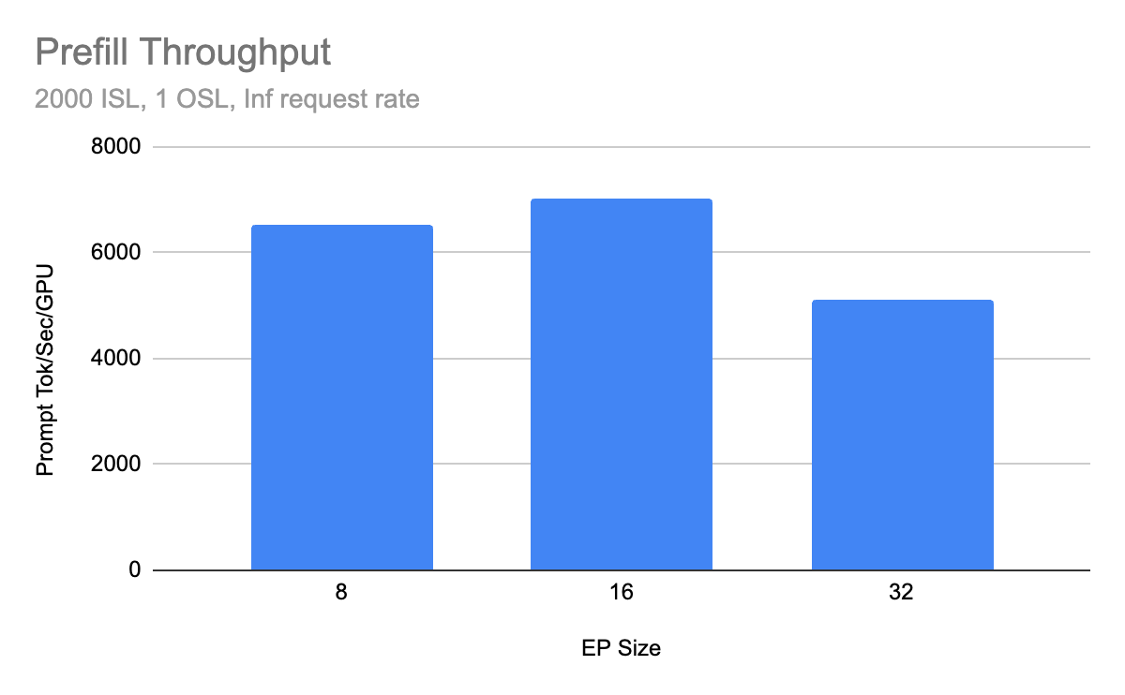
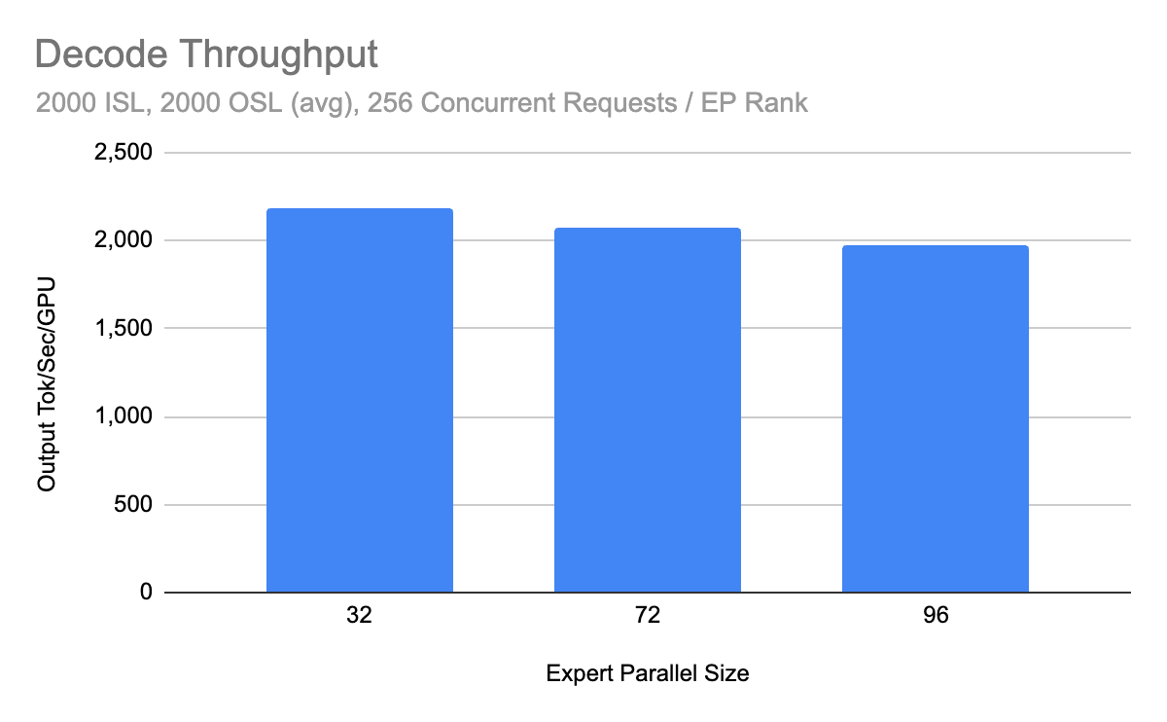
“Well-lit” Path: Wide Expert Parallelism
Reached 2.2k tokens/s per H200 GPU for DeepSeek-R1 in community benchmarks on H200 clusters
State-of-The-Art performance from deep GPU and scheduler optimizations across the full inference stack
https://llm-d.ai/blog/llm-d-v0.3-expanded-hardware-faster-perf-and-igw-ga

Slide 14
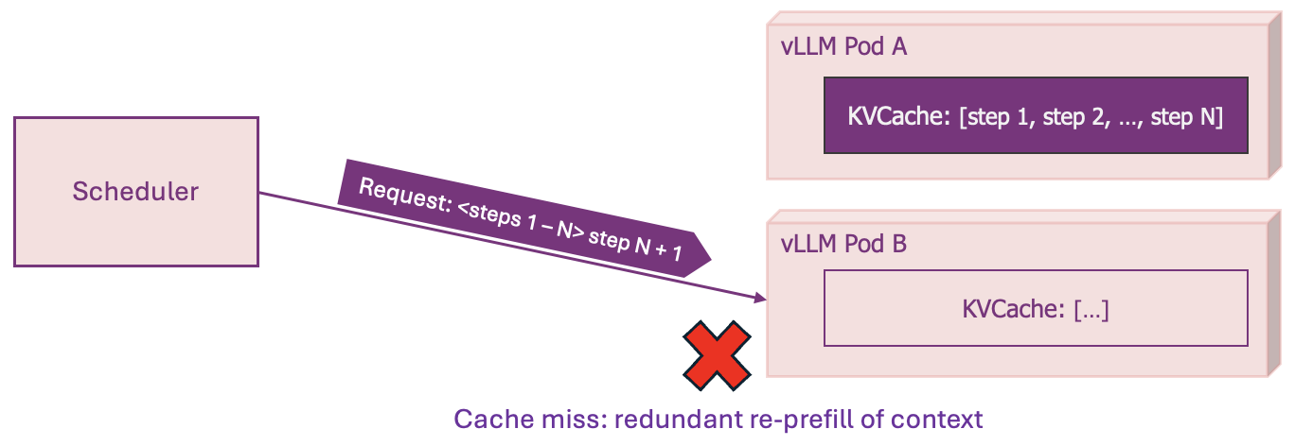
Where Standard Load-Balancing Fails
Production AI inference involves multiple vLLM instances and replicas
The once unified KV-cache becomes disaggregated
Naive load-balancing distributes traffic evenly across the pods -> destroying cache optimizations
Notes:
THE SCALEOUT CHALLENGE
This single routing decision triggers a cascade of failures:
Cache Miss: The warm cache benefit on Pod A is completely lost
Duplicated Work: The most expensive computation is needlessly performed twice
Increased Latency: Users experience significantly higher Time to First Token (TTFT)
Wasted GPU Resources: Expensive hardware is tied up re-doing work instead of serving new requests, lowering overall system throughput
In a production environment with thousands of concurrent requests, this isn't a rare event; it's the default behavior. The result is a system that is significantly slower and more expensive than it should be

Slide 15
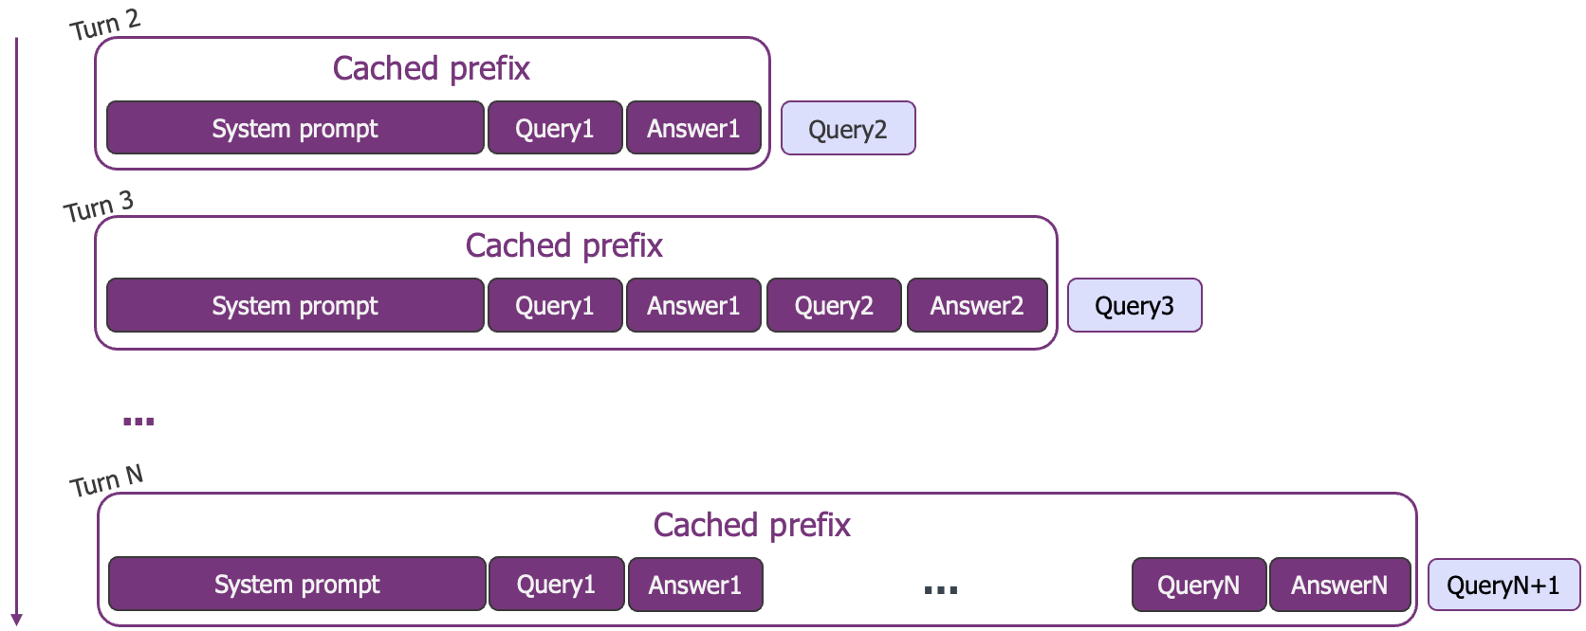
Prefix-Cache Reuse in Production
Multi-Turn Chat
Notes:
Key point: KV-cache reuse goes beyond the forward pass or an attention phase, it is actually prevalent and useful in standard AI workloads

Slide 16
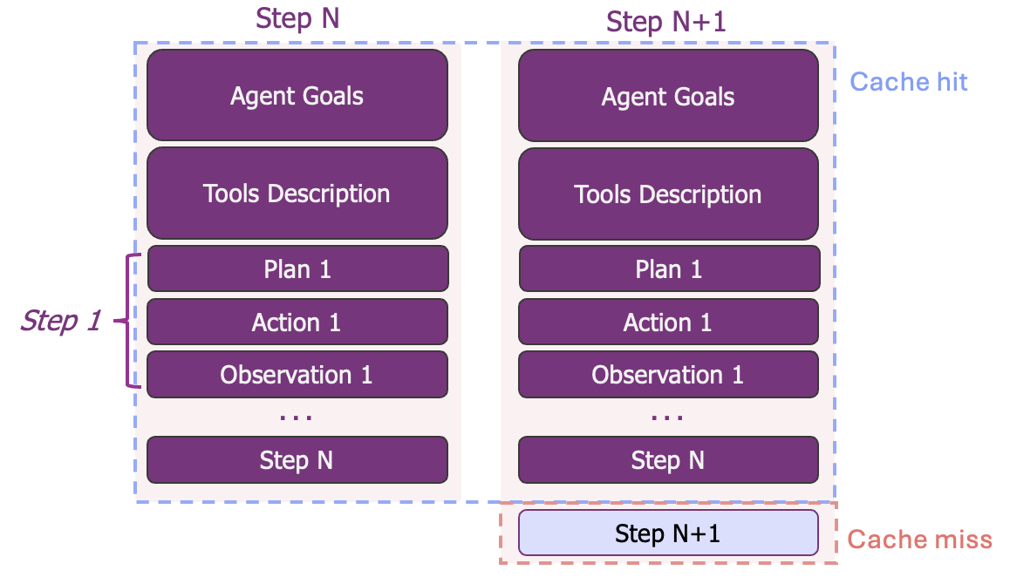
Prefix-Cache Reuse in Production
Linear Agents – Multi-Turn Tool Use
Notes:
the prefix contains the agent's goals, tool definitions, and a long history of actions and observations. Production data shows this can lead to input-to-output ratios exceeding 100:1
Reusing context at every step makes agents computationally viable.

Slide 17
Prefix-Cache Reuse in Production
Advanced Agentic Patterns
cache hit
cache miss
One shared prefix
Top-level orchestrator
Agent Goals + Tools + Context
Orchestrator
full context
Branch 1
Branch 2
Branch N
Child 1
Child 2
Child N
Shared prompt
retrieved docs
tool schema
Shared prompt
retrieved docs
tool schema
Shared prompt
retrieved docs
tool schema
Shared Context
Shared Context
Shared Context
...
...
Search Facts
Compare Options
Validate Answers
Collect Evidence
Call Tool + Verify
Write Results
30-100k shared tokens, N parallel requests
Latency = slowest child. Batch completion semantics.
Notes:
REFER TO THE AGENTIC PAUSE
Left: Tree-of-Thought / Parallel Branching
Deep research agents (Perplexity Pro, OpenAI Deep Research, Google Gemini Deep Research) — user asks a question, agent spawns N search-and-analyze branches exploring different angles, then synthesizes. The shared prefix is the research question + tool definitions + accumulated findings so far.
Best-of-N verification — generate N candidate solutions to a coding/math problem, verify each independently, pick the best. Common in reasoning-heavy pipelines (e.g., AlphaCode-style).
Multi-source RAG — agent queries N different retrieval sources in parallel with the same context. Each branch gets the same system prompt + user query + schema, just different retrieval targets.
Right: Hierarchical Swarm
Claude Code / Codex / OpenHands — orchestrator plans, spawns sub-agents for search, edit, test. Each child inherits the full project context + conversation history, adds its own narrow task.
Manus — explicitly uses this pattern. Orchestrator plans, children execute in browser/code/shell. The blog post you cited on slide 4 is literally about this.
Enterprise workflow automation — orchestrator triages a customer request, spawns specialized agents (billing, technical, compliance). Each shares the customer record + conversation, adds domain-specific tools.
Bottom line across the slide: "Standard load-balancing scatters these across pods — destroying the shared prefix."

Slide 18
“Well-lit” Path: Intelligent Inference Scheduling
vLLM-aware load-balancing enables smarter request routing that improve SLOs
Prefix-Aware Routing
Load-Aware Routing
GET completions
GET completions
Prompt
EPP
Prompt
EPP
Pod A
Pod A
Prefix-tree.
“Pod A has hit”
Scrape metrics. “A has low load”
KV Events
/metrics
Pod A
Pod B
Pod C
Pod A
Pod B
Pod C
Dramatically increase prefix-cache hit rate
Load-balancing based on actual replica state

Slide 19
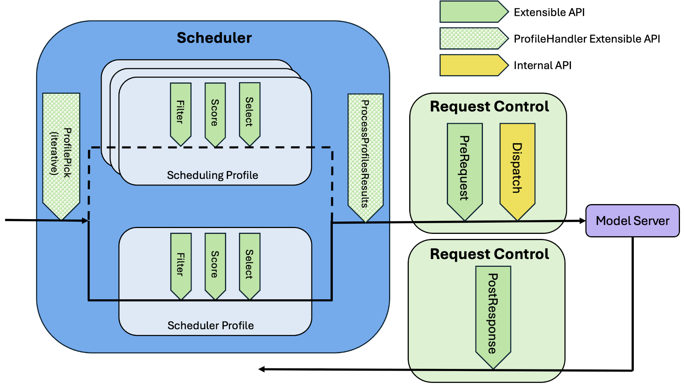
Intelligent Inference Scheduling
llm-d’s pluggable architecture enables first-class composing and extending
Scorers → Apply weights to signals
  Configure relative weights
  Add custom scorers as needed
Filters → filter specific pods
Request Control → queue requests until the server load is ready

Slide 20
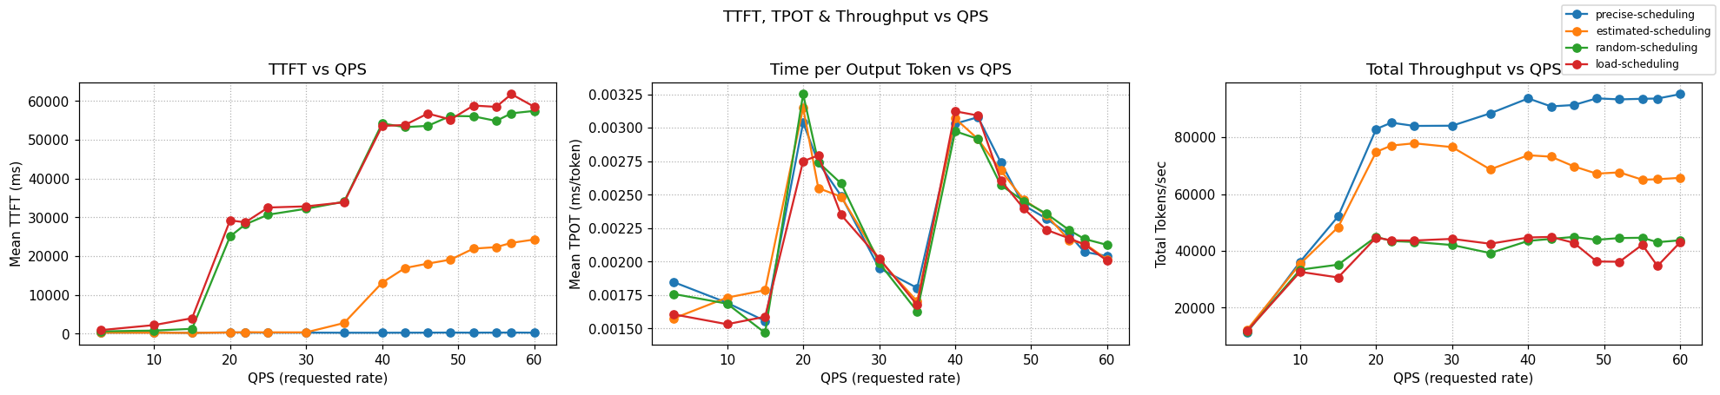
Intelligent Inference Scheduling
Inference scheduling is a no-brainer optimization which can have huge impacts on repeated prompts
    llm-d provides different levels of prefix-cache aware scheduling capabilities in our guides
    In a workload that demands only 73% of a 16 H100 GPUs KV-cache capacity, optimal performance is achieved:
  x57 faster response time than naive scheduling
  x2 throughput than load-aware scheduling
Notes:
Emphasize squeezing performance on identical hardware

Slide 21
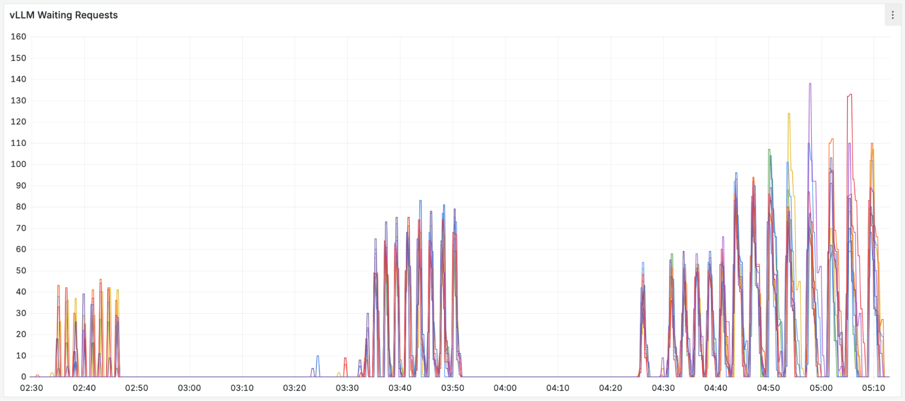
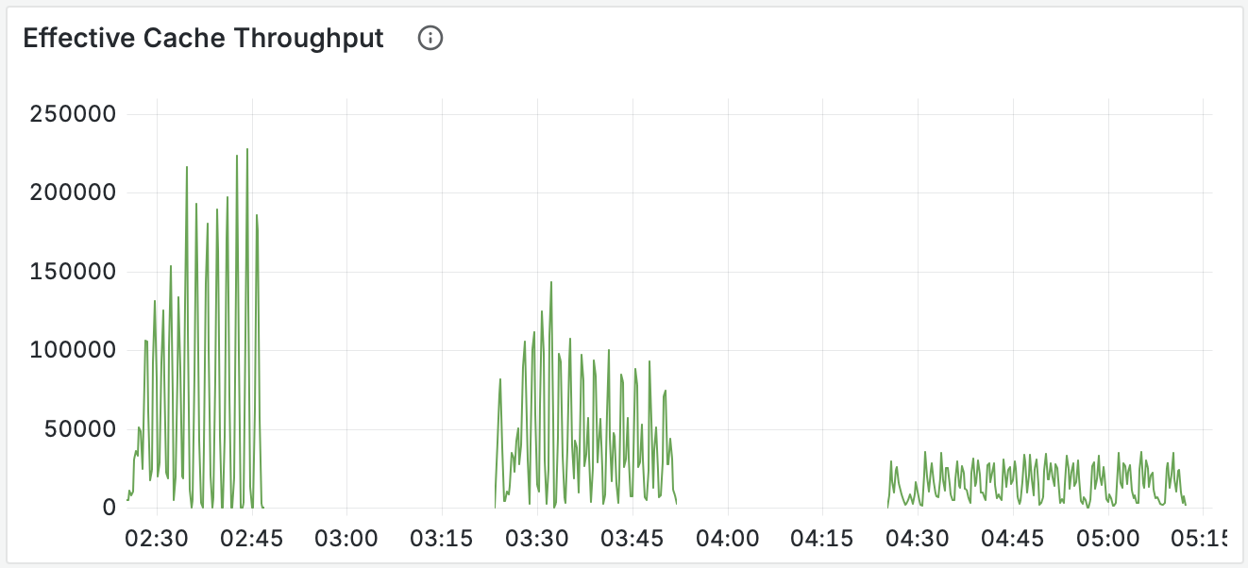
Precise Prefix-Cache Aware Scheduling
Inference scheduling is a no-brainer optimization which can have huge impacts on repeated prompts
Notes:
This metric quantifies the computational work the GPUs avoided. A high value means the system is consistently saving massive amounts of expensive prefill computation.
Precise, then approximate, then random

Slide 22
“Well-lit” Path: KV Cache Management
Leverage all system resources to maximize prefix cache hit rate within the cluster
North/South KV Management
East/West KV Management
GET completions
GET completions
Gateway
Prompt
EPP
Gateway
Prompt
EPP
Pod A
Pod A
KV Index
KV Index
CPU RAM
CPU RAM
CPU RAM
CPU RAM
Remote
Storage
CPU RAM
KVEvents
KVEvents
Pod A
Pod B
Pod C
Pod A
Pod B
Offload KV caches to local memory with global index
Offload KV caches to global shared remote storage
Notes:
We discussed efficient orchestration - but it is gapped by the scarce GPU memory
North-south: expand the KV-cache of a single instance to available memory tiers
East-west: compute once, reuse anywhere through an extended tier of shared storage

Slide 23
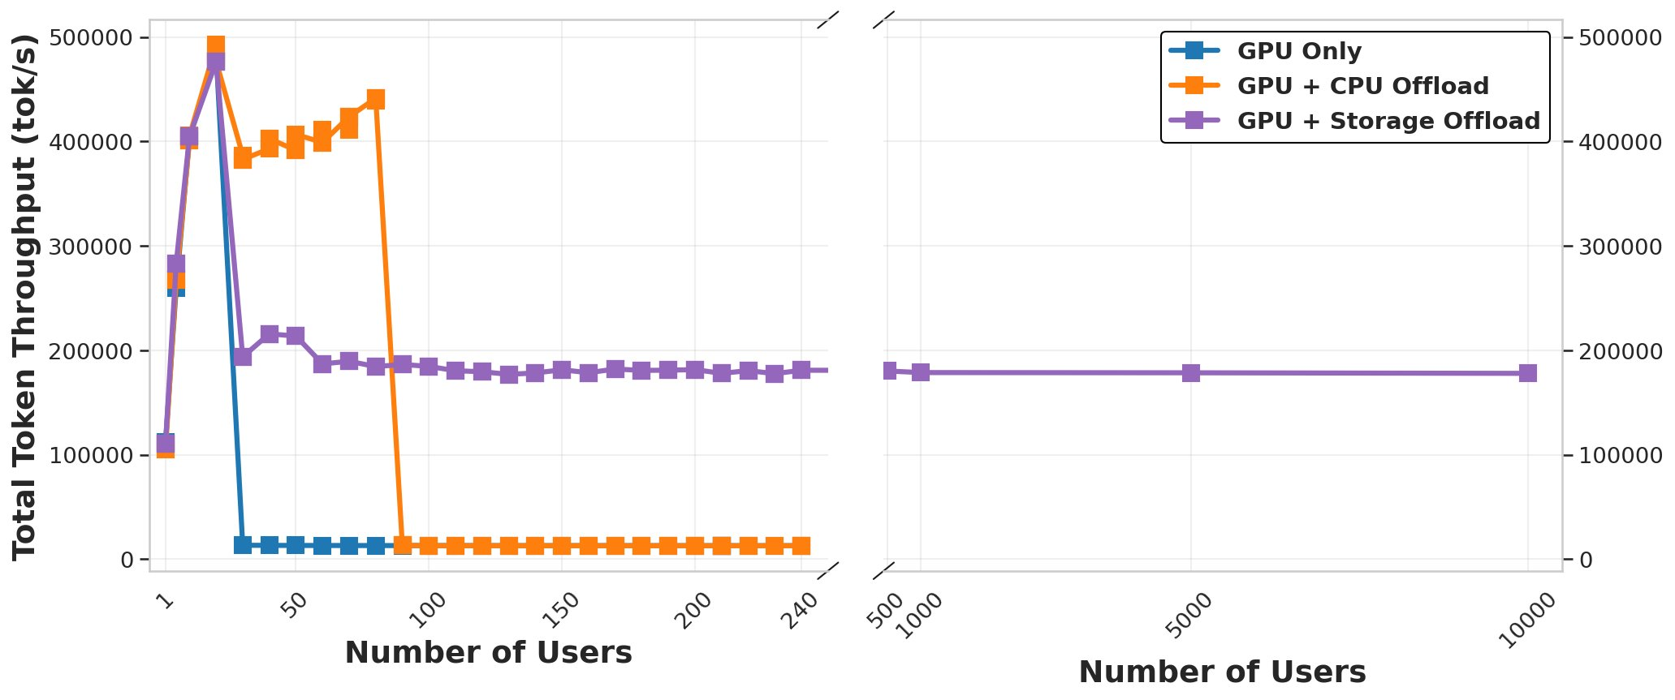
KV-Offloading Performance
GPU cache saturation
CPU cache saturation
Notes:
We can see the effect of offloading on sustaining scalable performance
Evaluation Setup:​
KV-cache load is measured by sending 16k-token requests and scaling up the number of requests each round.​
Storage reads/writes from IBM Spectrum Scale - With support from the Storage and Data Research team​
Model: Llama-3.1-70B running on 4x H100 GPUs, with each GPU backed by 100 GB of host (CPU) memory. ​

Slide 24

The KV Offloading Connector
Bridges the vLLM V1 KV-Connector API into a simple, unified offloading interface for pluggable backends
Enables KV cache to live beyond GPU memory across CPU and storage tiers
Improves throughput and stability by reducing GPU memory pressure
V1 KV Connector API
Offloading connector
CPU
Storage
Notes:
The KVOffloading effort is led in vLLM through a new KV Offloading Connector implementation

Slide 25
CPU Offloading Backend
KV blocks are copied asynchronously from GPU -> pinned CPU memory using DMA
      CPU memory acts as a high-capacity KV cache tier extending the number and lifespan of token sequences
When a request resumes, KV blocks are streamed back just-in-time instead of recomputing attention from scratch
V1 KV Connector API
Offloading connector
CPU
Storage
Notes:
DRAM is generally available in compute clusters, utilizing it is a no-brainer

Slide 26
Storage Offloading Backend
KV blocks are copied asynchronously from GPU -> shared storage using the same offloading connector (C++)
      Storage acts as a cluster-wide KV cache pool extending cache capacity beyond any single node’s GPU or RAM
      Any POSIX filesystem is immediately supported
V1 KV Connector API
Offloading connector
CPU
Storage
Storage
llm-d blog: Native KV Cache Offloading to Any Filesystem with llm-d
Notes:
Storage offloading

Slide 27
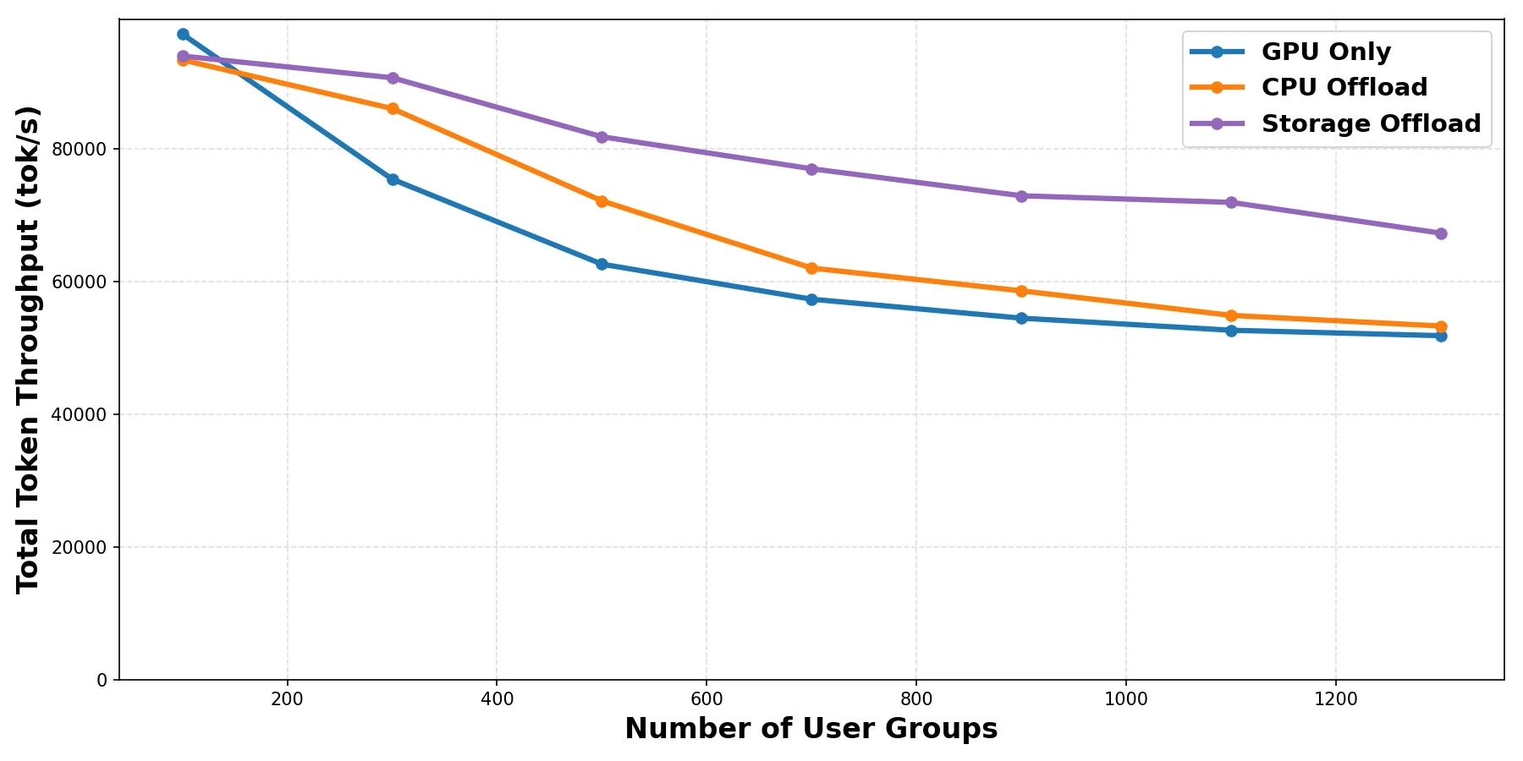
Offloading Performance
llm-d blog: Native KV Cache Offloading to Any Filesystem with llm-d
Notes:
40 QPS, system prompt of 2000 tokens and a question made of 256 tokens. 256 tokens are decoded in response
Llama-3.1-8B model on a system with 2x NVIDIA H100 GPUs and a cloud-based storage offering approximately 10GB/s I/O throughput.

Slide 28
Token Factory: Operating LLM Inference as a System
A real-world engineering perspective on continuous, reliable, and cost-effective token production at scale — powered by llm-d.

Slide 29







Token Factory: a Real-World Scenario
Models change
Different architectures need different serving strategies.
Workloads vary
Different traffic patterns create different bottlenecks.
Hardware differs
Different GPU platforms require different tuning choices.

Slide 30
Why Is This Scenario Hard?
Things Change Too Fast
The model and hardware landscape changes faster than traditional optimization cycles can keep up with.For example, DeepSeek-V3 uses MLA, while DeepSeek-V3.2 introduces DSA
Dimension | Requirement
Core Target | 1.2M TPM (20,000 tokens/s), 38 tokens/s per user
Key Metrics | TTFT: tiered by context length, max <13s; TPOT: <35ms(P99); Empty Response Rate: < 0.1%
Scale | Minimum unit: 1.2M TPM
Models | DeepSeek-V3.2, v3-0324, r1-0528, 3.1-term
Stability | Good output rate ≥ 99.9%
Cost Efficiency is Critical
In inference serving, efficiency gains translate directly into margin.
SLA is Inherently Complex
Production success is defined by balancing cost, throughput, latency, and reliability at the same time.
An sample production SLA target

Slide 31


Our Approach with llm-d
Inference Orchestration
Benchmark
Coordinate gateway, scheduling, cache, and autoscaling for production serving
llm-d-benchmark
Simulate traffic and collect performance data
Inference Engine
Tune the serving engine and runtime parameters for each model and workload
Kernel & Communication
Planner
Optimize quantization, kernels, and communication paths for higher throughput
Turn benchmark history into explainable configuration choices
Hardware Adaptation
Validate and auto-tune configurations across new GPU and accelerator platforms

Slide 32
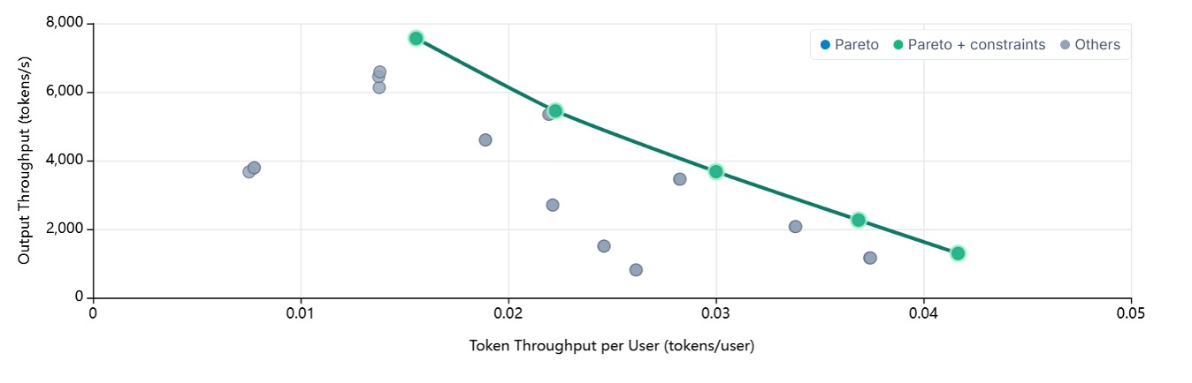
A Practical Optimization Loop
Plan
Tune
Benchmark
Deploy
Generate an initial plan from historical data, including hardware selection, KV cache architecture, router strategy, PD ratio, and key vLLM settings
Optimize on the target vLLM stack and GPU / network / storage environment
Apply the latest tuning techniques, validate prefill and decode behavior, refine the PD ratio, and fix issues discovered along the way
Use llm-d to simulate production traffic and benchmark the system
Find the Pareto frontier across latency, throughput, and cost
Roll out to production, continuously monitor behavior, capture traffic patterns, and feed them back into the next optimization cycle

Slide 33
A Practical Optimization Loop

Slide 34



LLM-D Make the Loop Work
Routing & Traffic Control
llm-d-inference-scheduler · llm-d-kvcache · routing sidecar
KV-cache-aware routing, SLO-aware balancing, failover, throttling, and P/D coordination
Envoy/Istio
Gateway API
Inference Extension
Scheduler & Deployment
llm-d-modelservice · llm-d-infra · LWS · Kueue
Declarative rollout, topology-aware placement, gang scheduling, autoscaling, and fast updates
LLM-D inference-scheduler
Kvcache aware
Benchmark & Best Practices
Prefill
Prefill
decode
kv
llm-d-benchmark · llm-d-inference-sim · Well-lit Path
Repeatable experiments, workload replay, reproducible results, and validated reference paths
node
node
node
node
node
node
Sample:2 Prefill + 1 Decode · TP16 · 8 GPUs/Node

Slide 35





What Comes Next
From manual tuning to continuous optimization
Tiered KV Cache
Extend KV cache beyond memory into NVMe SSD and other tiered storage layers.
Batch-Oriented Workloads
Support batch, API, and multi-tenant scenarios beyond interactive inference.
Mixed Training & Inference
Co-locate training and inference workloads to maximize overall resource utilization.
Automated Planner
Turn historical data, online traffic, and benchmark results into a self-improving planner.
Workload-Driven Autoscaling
Move from manual scaling to SLO- and workload-driven autoscaling with minimal human intervention.

Slide 36
Agentic-Inference Roadmap
Program-Aware Scheduler
Schedule execution graphs, not request queues. Route Step N+1 to where Step N's cache lives. Critical-path-first.
Context-Aware Eviction
Replace LRU with explicit lifecycle policies. Frameworks declare intent - pin skills, eagerly evict scratch reasoning.
Semantic KV-Cache
Tag blocks by role: SystemPrompt, ToolDefs, ReasoningBranch, EphemeralThought. Typed blocks, not opaque byte ranges.
Proactive State Management
Move cache to available compute - don't pin requests to cache location. Primitives: Move, Pin, Evict.
Model Scheduling
Semantic routing, intelligent cost-/load- aware model selection, guard-rails, external provider routing, accuracy-failure fallbacks.
Notes:
This is the llm-d agentic runtime roadmap. The key shift: the KV-cache stops being a transparent performance optimization and becomes the explicit coordination layer between agent frameworks and inference infrastructure. Frameworks like LangChain or LlamaIndex tell us what matters, we manage the lifecycle. We don't touch agent control flow — we stay an execution engine, but a much smarter one.

Slide 37


Join us!
Your Contributions Matter!
GitHub: https://github.com/llm-d/llm-d-kv-cache
https://github.com/llm-d/llm-d-inference-scheduler
Slack: #sig-kv-disaggregation
#sig-inference-scheduler
#feat-kvcache-offloading
#feat-v1-cpu-offloading
(llm-d)
(vLLM)

