Slide 1
Vitess
Run Your Data Layer in K8s

Slide 2
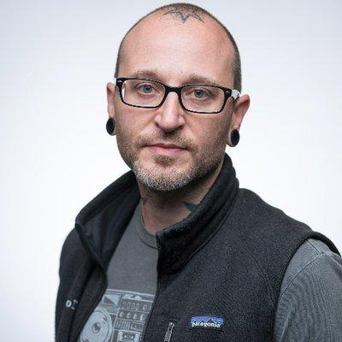

Matt Lord
Maintainer
Software Engineer
@mattalord

Slide 3
What is Vitess?
Works With
Cloud Native Database
Massively
Scalable
Database Frameworks
ORMs
Highly Available
MySQL 8.0/8.4 Compatible
Legacy Code
Third-Party Applications
Logical Database
Many physical databases
Query Routing
gRPC Clients
MySQL protocol
Single
Connection

Slide 4
Features
MySQL Compatibility
Online Schema Changes
Resharding
Seamless Backup/Recovery Operations
Materialization
Query Consolidation
Cluster Management
Automatic Failure Detection and Repair
Notes:
Vitess is MySQL compatible, we try to make sure most of MySQL queries are compatible with Vitess
Resharding, allows you to partition your keyspace into different shards
Materialization which allows you to have near-real-time materialized views of your data
Different than MySQL in the sense that we do not need to refresh the view
VTCtld which lets you manage your cluster
Online Schema Changes allowing you to do non-blocking schema changes on a serving table
Seamless backup / recovery operations
Query consolidation to avoid having any sudden spike and overload on your tablet
And automatic failure detection and repair thanks to vtorc

Slide 5















Vitess in Production

Slide 6
Automated Recovery (Self Healing)
Health Checks replica lag, primary reparent
VTOrc observes cluster health, emergency reparent
Backup/Restore pitr, incremental backups, smaller shard sizes
Reversible Workflows schema changes, import, reshard
VTOP: replacement over repair bad mysql, k8s node, vtgate oom

Slide 7
Resilient Design
Failover Buffering at VTGate: during cluster events like reparenting
Health-checking & Discovery: vtgate filters out unhealthy tablets
Tablet Throttler: backpressure on VReplication on high replication lag
Cross-shard Transactions (2PC): for consistency
Cell Isolation: local-cell reads on network partition
Operational guardrails: Dry-runs, Reversible migrations, Timeouts
Controlled failovers: for rolling upgrades
Backups: incremental, point-in-time recovery

Slide 8
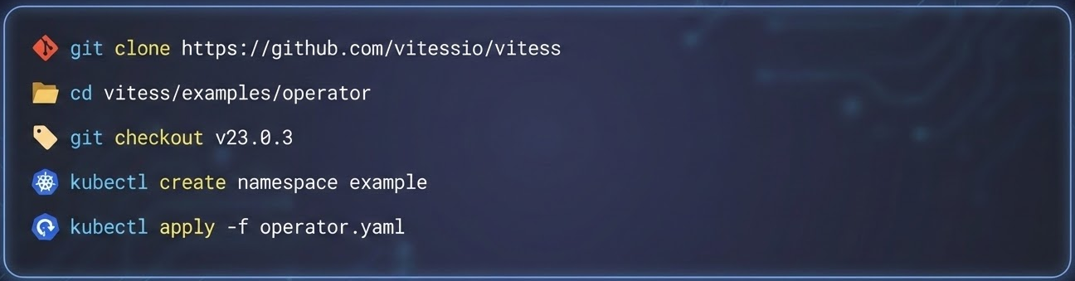
Vitess K8s Operator
Install

Slide 9
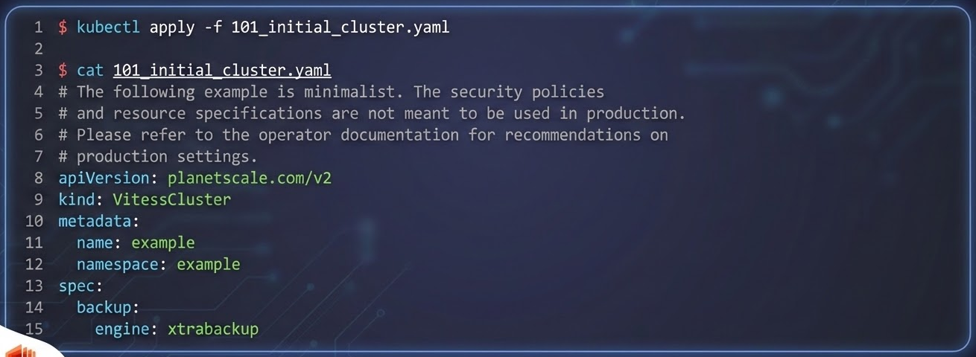
Vitess K8s Operator
Create a Cluster

Slide 10
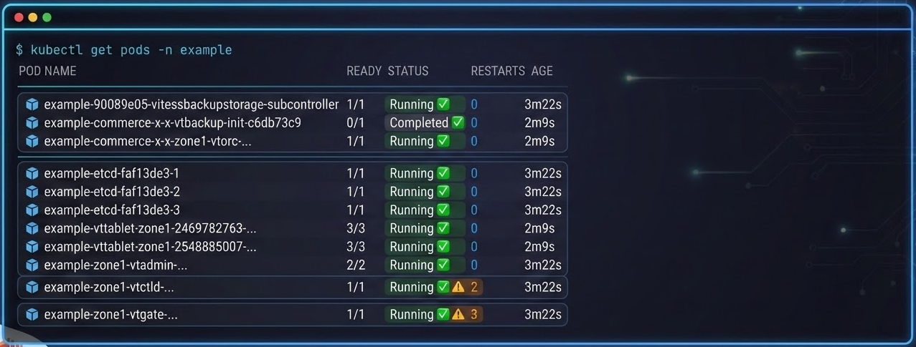
Vitess K8s Operator
We has Cluster!

Slide 11
Thank You

