Slide 1
When an Agent Acts on Your Behalf, Who Holds the Keys?
Cryptographic Identity and Delegation for Cloud-Native AI Agents

Slide 2


Who Are We
Maia Iyer
Advisory Engineer
IBM Research
Mariusz Sabath
Senior Technical Staff Member
IBM Research

Slide 3
Who Holds the Key?
Github
POST /pull-request
Notes:
When a request goes to Github using an API key,

Slide 4
Who Holds the Key?
GitHub
POST /pull-request
Notes:
Github assumes there's a user behind that request. And for a long time, that was generally the case. However, there is a new workflow gaining popularity:

Slide 5
Who Holds the Key?
Implement this feature and open a PR.
Agent
GitHub
POST /pull-request
LLM
Notes:
The agentic flow. Now, a user can use the most intuitive interface: natural language, tell an agent to do things, and the agent will initiate any calls to backend tools. From Github's perspective, the API key is still the user. And that's fine when an agent is running locally – the user is responsible, and the agent can directly hold the user's key.

Slide 6
Who Holds the Key?
Enterprise environment
Implement this feature and open a PR.
Agent
GitHub
POST /pull-request
LLM
Notes:
But when an agent is served in an enterprise environment, the responsibility for agent behavior shifts to the organization. If we're still using API keys to have the agent impersonate the user, GitHub may not care, but other platform components are often involved.

Slide 7
Who Holds the Key?
Enterprise environment
Implement this feature and open a PR.
Agent
Gateway
GitHub
LLM
Notes:
You could have an agent talking to other agents, talking to other internal tools, or going through a gateway. In any case, the API key pattern fails in a couple ways:
1. Every request needs all the user's credentials for whatever the agent may access.
2. The user is forced to enable impersonation access to all components.
3. The context of each request is not granular. We have the user's identity with the API key, but from the Gateway perspective, there isn't a real way to tell if a user is calling directly, if an agent is calling on behalf of a user, or some other app. This poses problems for observability and implementability of authorization policy.

Slide 8
Best Practices via Standards
Enterprise environment
Implement this feature and open a PR.
SPIFFE
Agent
Gateway
GitHub
OAuth 2.0
OAuth Token Exchange
LLM
Notes:
So last year, we researched how to put together existing standards to do away with the API key antipattern. And we came up with a pattern built on three standards:
OAuth 2.0
OAuth 2.0 extension of Token excahnge
SPIFFE
We presented a workshop on this in KubeCon NA, but to summarize in two minutes...

Slide 9
Best Practices via Standards
Implement this feature and open a PR.
Agent
UI
{
"exp": 1739379637,
“sub”: “userid”,
“azp”: “UI”,
“aud”: “Agent”
}
OAuth 2.0 Server
Notes:
OAUTH for DELEGATION

Slide 10
Best Practices via Standards
Implement this feature and open a PR.
Agent
UI
{
"exp": 1739379637,
“sub”: “userid”,
“azp”: “UI”,
“aud”: “Agent”
}
{
"exp": 1739379637,
“sub”: “userid”,
“azp”: “Agent”,
“aud”: “MCP Gateway”
}
OAuth 2.0 Server
Notes:
Token exchange for NESTED transactions – mariusz will talk more about this

Slide 11
Best Practices via Standards
SPIFFE
OIDC endpoint
Implement this feature and open a PR.
Agent
UI
{
"exp": 1739379637,
“sub”: “userid”,
“azp”: “UI”,
“aud”: “Agent”
}
{
"exp": 1739379637,
“sub”: “userid”,
“azp”: “Agent”,
“aud”: “MCP Gateway"
}
OAuth 2.0 Server
Notes:
Finally, SPIFFE is the anchored root of trust that provides workload identity. We will go into more detail on this later, but at a high level, SPIFFE provides identities in the form of JWT or x509, based on attested attributes. The agent will be able to authenticate to the OAuth server with this credential, and this enables the definition of policies based on strongly attested identities.
We'll go into more detail on this later

Slide 12
Best Practices via Existing Standards
OAuth 2.0 for delegation of human permissions to applications
OAuth 2.0 Token Exchange for preserving context across transactions while maintaining least privilege
SPIFFE for representing application identity
MCP Gateway for centralized control
Vault for non-OAuth interoperability.
Notes:
But that's what we've been working on last year in a nutshell. We defined a set of emerging best practices for enabling agents in the cloud. This also includes using a gateway for centralized control, and Vault for integrating with nonOAuth systems.
I'd like to note that all of these patterns are not new, and can apply to non-agentic systems, and using existing infrastructure.
In noticing, that a lot of platform infrastructure to implement this may exist, we then had to ask the next question:

Slide 13
Can we implement all of this via open-source?
Notes:
Could we demonstrate this all using completely open source technologies?

Slide 14
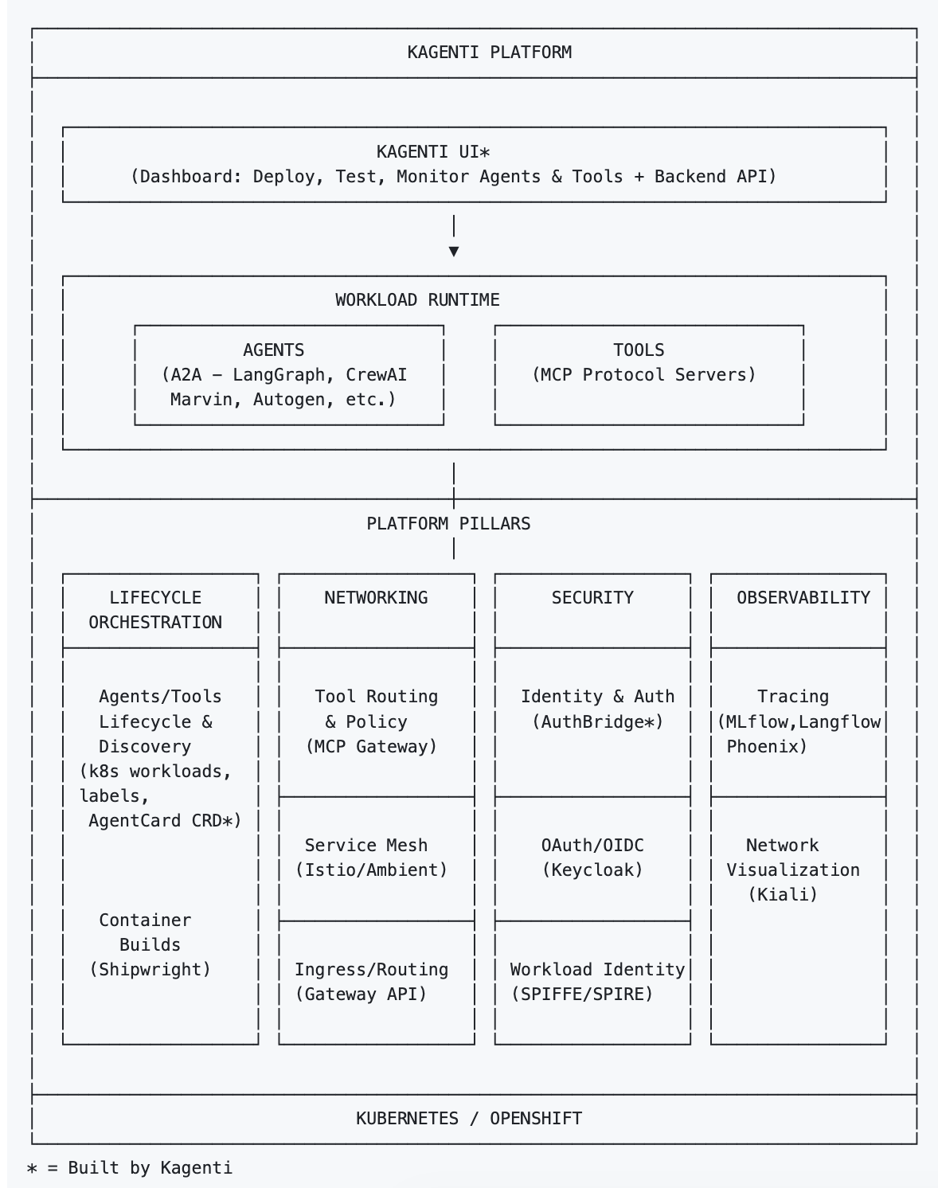
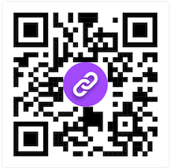
Kagenti: A Pluggable Blueprint
Four key pillars:
  Lifecycle Orchestration
  Networking
  Security
  Observability
Use existing open-source building blocks (SPIRE, Keycloak, Envoy, etc.).
Goal: implement best practices and identify gaps in interoperability and upstream.
http://kagenti.io
Notes:
And from this question, Kagenti was born!
Kagenti is almost a year old now, and the idea is simple: use existing open-source building blocks to support key platform requirements of
Lifecycle orchestration
Networking
Security
Observability
And see how easy it is to run agents and tools on this platform.
In doing this, we demonstrate a pluggable open-source platform blueprint. the idea of a blueprint is powerful because:
To work with Kagenti, you are not required to adopt a whole new monolithic platform. You can choose the parts that work for you
The blueprint is standards-based and therefore framework agnostic, decreasing the requirements on application developers

Slide 15
Kagenti’s Security Pillar: Gaps Found
Interoperability between SPIRE and Keycloak -> preview in Keycloak 26.4.0!
MCP Gateway: policy and audit at the boundary; now under Kuadrant.
kuadrant/
mcp-gateway
Notes:
This work also has been useful towards identifying gaps in the interoperability between open source technologies:
The experiments last year helped spur discussion toward improving integration between keycloak and SPIFFE. You can now configure Keycloak to validated SPIFFE ids out of the box, and this is now a preview feature!
This work also spurred discussion of the necessity of an MCP Gateway. One has been developed under Kagenti and is now under the Kuadrant organization.

Slide 16
Kagenti’s Security Pillar: Gaps Found
Agent
(2) Incoming request
(5) Outgoing request
(4) OAuth 2.0 Token exchange
(3) OAuth 2.0 JWT Validation
(1) Obtain SPIFFE Credentials
SPIFFE Provider (SPIRE)
(0) OIDC Federation
OAuth 2.0 Server (Keycloak)

Slide 17
"Generative AI does not bypass traditional engineering disciplines. "
"Indeed, the challenge often lies less in model capability and more in the infrastructure required to deploy that capability reliably."
1
¹ "The Experimentation Phase Is Over: Key Findings from 1,200 Production Deployments"
https://www.zenml.io/blog/the-experimentation-phase-is-over-key-findings-from-1-200-production-deployments
Notes:
"Let me start with a very old proverb:
'Generative AI does not bypass traditional engineering disciplines.'
[pause]
OK, fine — I made that up. A bit of hallucination.
[let the laugh breathe]
But the point is real. The challenge with agents isn't model capability — it's the infrastructure to deploy them reliably and securely.
Agents are just workloads. They need identity, authentication, authorization — the same things every other workload needs.
They don't get a free pass just because they're smart.
In Kagenti, we built a component to make this easier. It's called AuthBridge."

Slide 18
Introducing AuthBridge in Kagenti
1. Automatic Identity
Workloads get SPIFFE IDs from SPIRE and
auto-register as Keycloak clients.
No pre-provisioned secrets.
2. Inbound JWT Validation
Every inbound request validated:
signature (JWKS), issuer, audience.
Invalid = 401. App never sees bad requests.
3. Outbound Token Exchange
Transparently exchanges user's token for
one scoped to target service (RFC 8693).
User identity (sub) preserved.
4. Transparent Operation
Sidecar injection via webhook.
Agent and tool developers write
ZERO auth code. Platform handles it.
Notes:
Although, authbridge should be applicable to all workloads, our focus are AI applications. So, what is AuthBridge?
Here are the four capabilities AuthBridge provides:
●
●First, automatic identity. A pod gets a SPIFFE ID, and auto-registers with Keycloak. No admins. No static secrets. It just happens.
●
●Second, inbound JWT validation.
●
●Third, outbound token exchange. When the agent makes a call to another service, the sidecar intercepts it, exchanges the token using correct audience and forwards to the target service.
●
●Fourth, and this is really the whole point — it's transparent. Agent developers don't write auth code. The platform injects the sidecars via a webhook and handles everything.

Slide 19
Key Security Properties
No static secrets -- credentials dynamically generated at pod startup via SPIFFE + Keycloak
Short-lived tokens -- JWTs expire, must be refreshed; no long-lived credentials
Inbound validation -- applications never see unauthenticated requests
Subject preservation -- user's sub and preferred_username flow through token exchange
Identity-based auth -- SPIFFE ID = Keycloak client ID; cryptographic, attestable
Scope-based access control -- tools decide access level based on token scopes
Auditable -- every token exchange logged, traceable to the original user
Token Exchange – cryptographic trail of actors; Policy Engine; is it allowed/safe?
Notes:
And that gives us several security properties:
•No static secrets — everything is dynamically generated. There are no long-lived API keys sitting in Kubernetes secrets.
•Short-lived tokens — JWTs expire. They must be refreshed, and this limits the blast radius
•Inbound validation happens at the sidecar level. If anything goes wrong, the application never sees the requests.
•Subject preservation. That's critical for the agentic use case. When the agent's token, gets exchanged for a tool-scoped token, the user's identity flows through.
The tool knows exactly which user initiated the request, even though the agent performed the call.
•Identity-based authentication — the SPIFFE ID is the Keycloak client ID. It's cryptographic, and attestable. No one can forge it.
* Scope-based access control — tools can check what scopes are in the exchanged token, and grant different levels of access.
* And everything is au-ditable — every token exchange is logged, with the original user, and the target audience.
•Token exchange is a cryptographic trail of all the actors involved in this exchange, from the initiator to the resources, so you can feed this information into a policy engine,
to determine whether is this allowed, or is it safe.

Slide 20
AuthBridge Architecture
Incoming request (with JWT)
WORKLOAD POD
Your Application
Agent or any workload
Target Service
Application
Target Service
Notes:
Now let's look at the architecture. This diagram shows a workload pod, that’s the Agent,
and the key Services - The Target for the Agent,

Slide 21
AuthBridge Architecture
Incoming request (with JWT)
WORKLOAD POD
SPIRE Agent
Provides SPIFFE identities
(JWT SVIDs) to workloads
Your Application
Agent or any workload
Keycloak (IAM)
OAuth 2.0 / OIDC provider
Token exchange, Client management
Target Service
Application
SPIFFE Helper
Target Service
Keycloak
Notes:
We also need SPIRE to provide SPIFFE identities
And Keycloak, that's for Identity and Access Management, Token Exchange, and Access Policies.

Slide 22
AuthBridge Architecture
Incoming request (with JWT)
WORKLOAD POD (with AuthBridge)
SPIRE Agent
Provides SPIFFE identities
(JWT SVIDs) to workloads
proxy-init
iptables rules for inbound & outbound traffic interception
1
SVID (SPIFFE ID)
Your Application
Agent or any workload
No auth code needed
spiffe-helper
Obtains JWT SVID
from SPIRE Agent
client-registration
Reads SPIFFE ID
Registers Keycloak client
Register client
Keycloak (IAM)
OAuth 2.0 / OIDC provider
Token exchange, Client management
3
4
outbound
inbound (validated)
AuthProxy Sidecar (Envoy 1.28 + ext-proc)
Token
Exchange
2
5
INBOUND (:15124)
Validate JWT: signature, issuer, audience
Reject invalid → 401 Unauthorized
OUTBOUND (:15123)
Token Exchange via Keycloak
Target Service
Validates exchanged token
(aud: target-service)
Authorizes request
6
go-processor ext-proc (:9090)
gRPC server validation & exchange
Exchanged token
(aud: target)
Init Container
Application
AuthProxy (Envoy + ext-proc)
SPIFFE Helper
Client Registration
Target Service
Keycloak
Notes:
This diagram shows what a workload pod looks like WITH AuthBridge sidecars injected.
At the top, the init container runs first, and configures traffic interception. An incoming request arrives with a JWT. It hits iptables rules, and it's routed to the Inbound Envoy
2 . That is Envoy and the ext-proc filter. On the inbound path, it validates the JWT. If the token is invalid, the caller gets a 401 and the request never reaches your application.
3. If the token IS valid, the request is forwarded to your application, the Agent, shown on the left. Notice the label: 'no auth code needed.' The application is completely unmodified.
4. On the right, you have the SPIFFE Helper and Client Registration sidecars. These handle identity and registration with Keycloak, at the pod startup.
5. When the application makes an outbound call, the same iptables rules, route it through the sidecar. The ext-proc performs a token exchange, and forwards the request with a new token, that has the correct audience for the target service.
6. The target service at the bottom, receives the exchanged token and validates it.
The whole flow is transparent to both the application and the target.

Slide 23
Subject Preservation: The Key Differentiator
Through token exchange, user identity is preserved
aud: Agent SPIFFE ID → Target service
azp: Agent SPIFFE ID (unchanged) — which agent acted
sub: alice → alice ✓ — who approved
preferred_username: alice → alice ✓
Target sees who the user is and which agent acted; full audit chain.
{
"exp": 1739379637,
"iat": 1739379337,
"jti": "f4418b6f-96ba-4bb2-b8a1-17ae1dc4daa5",
"iss": "http://localhost:8080/realms/Demo",
"aud": "spiffe://9.31.101.198.nip.io/ns/agent/sa/default",
"sub": "a0ec90c4-d6c4-4de8-bac1-9d43394cb8bc",
"typ": "Bearer",
"azp": "spiffe://9.31.101.198.nip.io/ns/api/sa/default",
"sid": "e520b604-8047-4b1d-8688-23cff2a082e5",
"acr": "1",
"allowed-origins": ["/*"
],
"scope": "email profile",
"email_verified": false,
"name": "alice",
"preferred_username": "alice"
}
Notes:
Here are the fields, called claim, of the sample token:
Audience – who is this token for? First the Agent, then the Target Service after the token exchange.
AZP (Authorized Parties) - explicitly identifies the specific OAuth Client to which the token was issued to
Subject - a unique, immutable identifier of the user, or service, that requests the agent interaction
Finally, Preferred_username - it's a human-readable identifier for the subject,
As the token travels between various components, and it is being exchanged to comply with ZT principles,
the subject is preserved, so the Target can always see who is the user, and what agent acts on its behalf.
That lays a foundation for a full audit chain.

Slide 24
Live Demo

Slide 25
Developer Burden: With vs Without AuthBridge
Without AuthBridge — lots of code and operational efforts
  token refresh and exchange
  error handling
  env vars and configurations
With AuthBridge:
  single request with Authorization: Bearer <token>; sidecars do the rest.

Slide 26
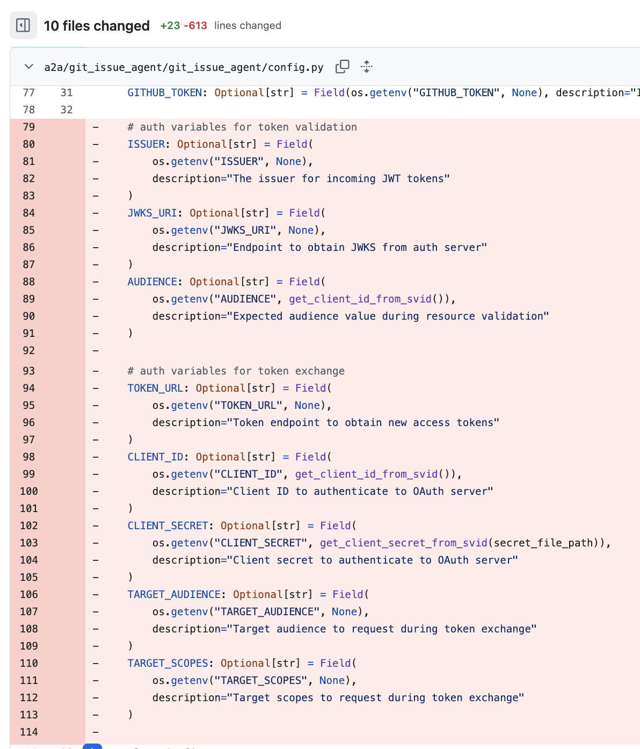
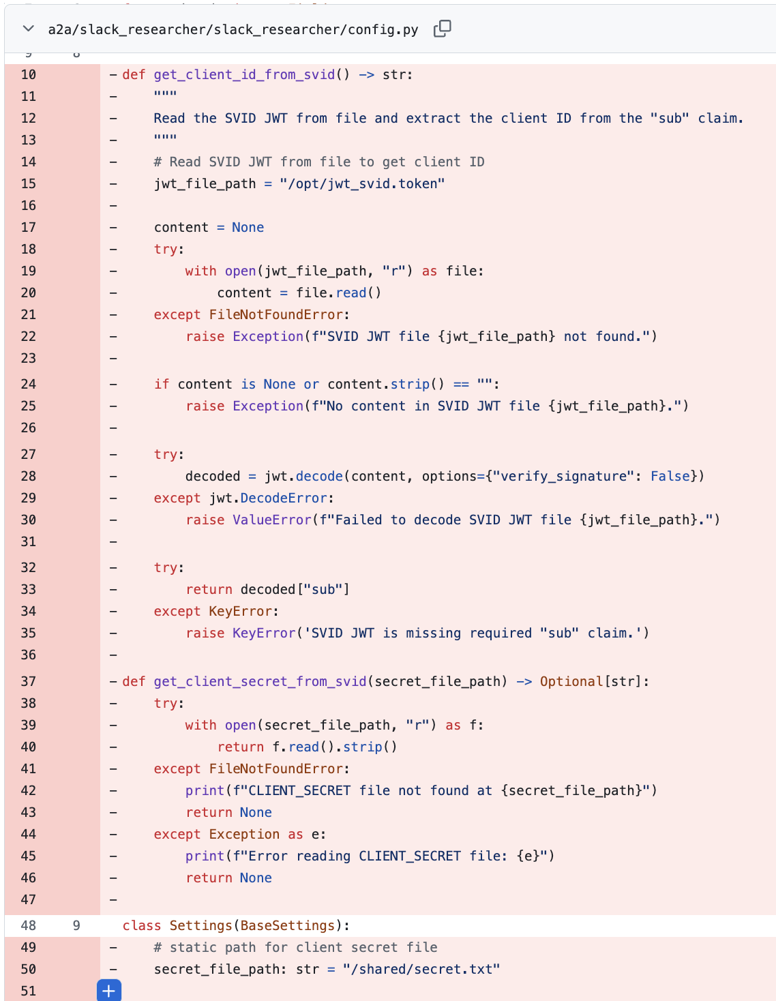
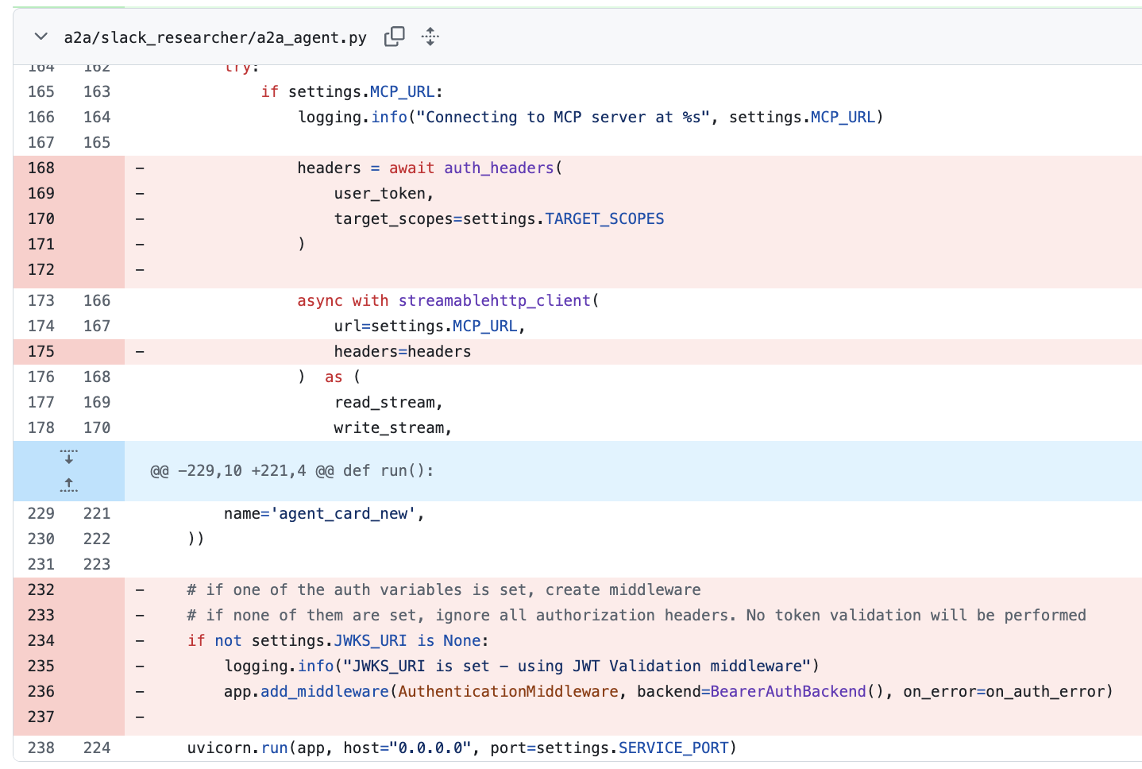
Identity Code Eliminated from Agent

Slide 27
AuthBridge: What's Next
Inbound token validation (validate caller before agent) ✅
SPIRE JWT for Keycloak client auth (no client secrets) ✅
Route-based token exchange (per-host/route audience) ✅
MCP Gateway integration
Dynamic client registration with SPIFFE (no admin credentials)
Vault integration
Authorization pluggability
Human in the Loop
IBAC (Intent) - drift detection
Notes:
Intend Back Access Control -

Slide 28
Next Questions in Kagenti Security
How far can we push "no auth code" with AuthBridge to help developers?
How can we plug-in to observability infrastructure to enable audit?
How can we instrument finer-grained authorization policy?
I allow OBO access to agents with PII guardrails.
Agent
Health Database
Notes:
So AuthBridge is one of the cool things we’ve been working on in Kagenti towards improving the developer experience. But we also have a bunch of other open questions on security architecture we are beginning to actively research – and immediately we run into some hard questions: audit and authorization policy.
You cannot enable meaningful audit of an agent’s actions, nor can you enforce strict authorization policy if you don’t actually know what the agent is. Both require a strong foundation of identity and authentication.

Slide 29
The Gap: Agent Identity
The A2A AgentCard?
A self-describing manifest for an agent. It provides essential metadata including the agent's identity, capabilities, skills, supported communication methods, and security requirements.
Trust me, I’m a CrewAI agent running with Granite 3.0 in the same cluster.
Agent
Resource Server
Notes:
If you’ve been following the AI space, you might think: Doesn’t A2A’s Agent Cards solve this? And the answer is – not by itself.
Agent cards are fantastic for providing semantic hints, but the A2A standard is primarily concerned with how clients call and interact with agents. It is not concerned with the Agent to tool access. There is also no standard protocol to verify the claims. Any agent can currently present any agent card.

Slide 30
The Gap: Agent Identity
K8s
SPIFFE
OAuth Server
Agent
Resource Server
Notes:
Instead, we believe we can build upon workload identity using SPIFFE as a strong foundation for agent identity. Let’s look at how trust cascades from root to tool:
Starting from the left, an agent runs on a platform. For the agent to get an identity, SPIFFE will first interrogate the platform for a set of attributes, and will map that set of attributes to a string: the spiffeID, and provide a signed document the agent can use
Once the agent has a SPIFFE SVID, it needs an access token to talk to applications. The agent can present the SVID to an Oauth server, and the Oauth server can implement delegation policies based on SPIFFE ids.
Then when the Oauth server issues an access token, this can be used to talk to other applications that trust that Oauth server.

Slide 31
The Gap: Agent Identity
Access
K8s
SPIFFE
OAuth Server
Attestation
Federation
Agent
Resource Server
Notes:
With these foundations, we’ve built a cascading chain of triangles that works perfectly today.
However, there is a gap in that SPIFFE identity out of the box only proves infrastructure like what node, namespace, container image is an agent running. For some authorization policies, that’s not enough. We need agentic semantic attributes.

Slide 32
Extending SPIRE towards agent identity
K8s
SPIRE
Agent
Notes:
And for semantic attributes to be included in the identity, we need to look at the attestation triangle – SPIFFE needs to be able to attest those attributes, such as what model the LLM is running, or what framework.
The essential question becomes ”where is the root of trust for these attribute?”
It’s a complicated question because agent behavior is both based on code, but also environment variables, but there isn’t a universal configuration language across agent frameworks like CrewAI or Langchain or so forth.
However, one thing becomes clear

Slide 33
Extending SPIRE towards agent identity
Agent Registry?
Artifactory?
SPIRE
K8s
Agent
https://github.com/spiffe/spire/issues/6640
Notes:
The need for stackable attestors. In talking to the SPIFFE community (shoutout to Kevin Fox), it is a common need to want to be able to attest K8s attributes, and also SBOM attributes, and also other sources, and combine them all into one identity.
We have opened an issue towards this end. Then, it will be up to the community to help decide what additional agent attributes may be needed, and how we can implement them.

Slide 34
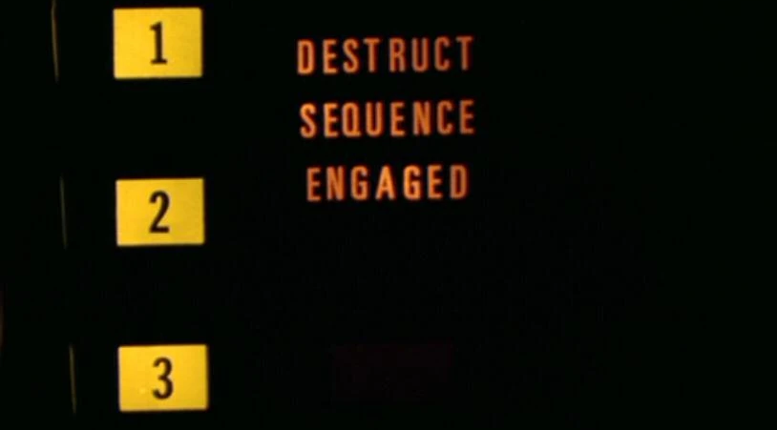
Who Holds the Keys?
Notes:
So going back to the question “Who holds the key?”
The key to this answer is multiple keys.

Slide 35
Who Holds the Keys?
Agent
Resource Server
Notes:
But multiple entities.
The Agent holds it’s SPIFFE SVID
The User holds their credentials
And not only are there multiple keys, but also multiple locks

Slide 36
Who Holds the Keys?
OAuth Server
Platform
SPIFFE
Agent
Resource Server

Slide 37

Get Involved
AuthBridge: github.com/kagenti/kagenti-extensions (AuthBridge)
Blog: medium.com/kagenti-the-agentic-platform
Thank you. Questions?
http://kagenti.io
Speaker feedback
Notes:
[Hai] Alternatives to sidecar: It's what Istio uses in the current architecture:
node-level agent for L3/L4 network, i.e., ztunnel
cluster-level/namespace-level agent for L7 networking, i.e., waypoint
Cilium makes heavy of eBPF, which could potentially push certain functions like token validation and exchange to the kernel. These are all alternatives to using sidecars

Slide 39
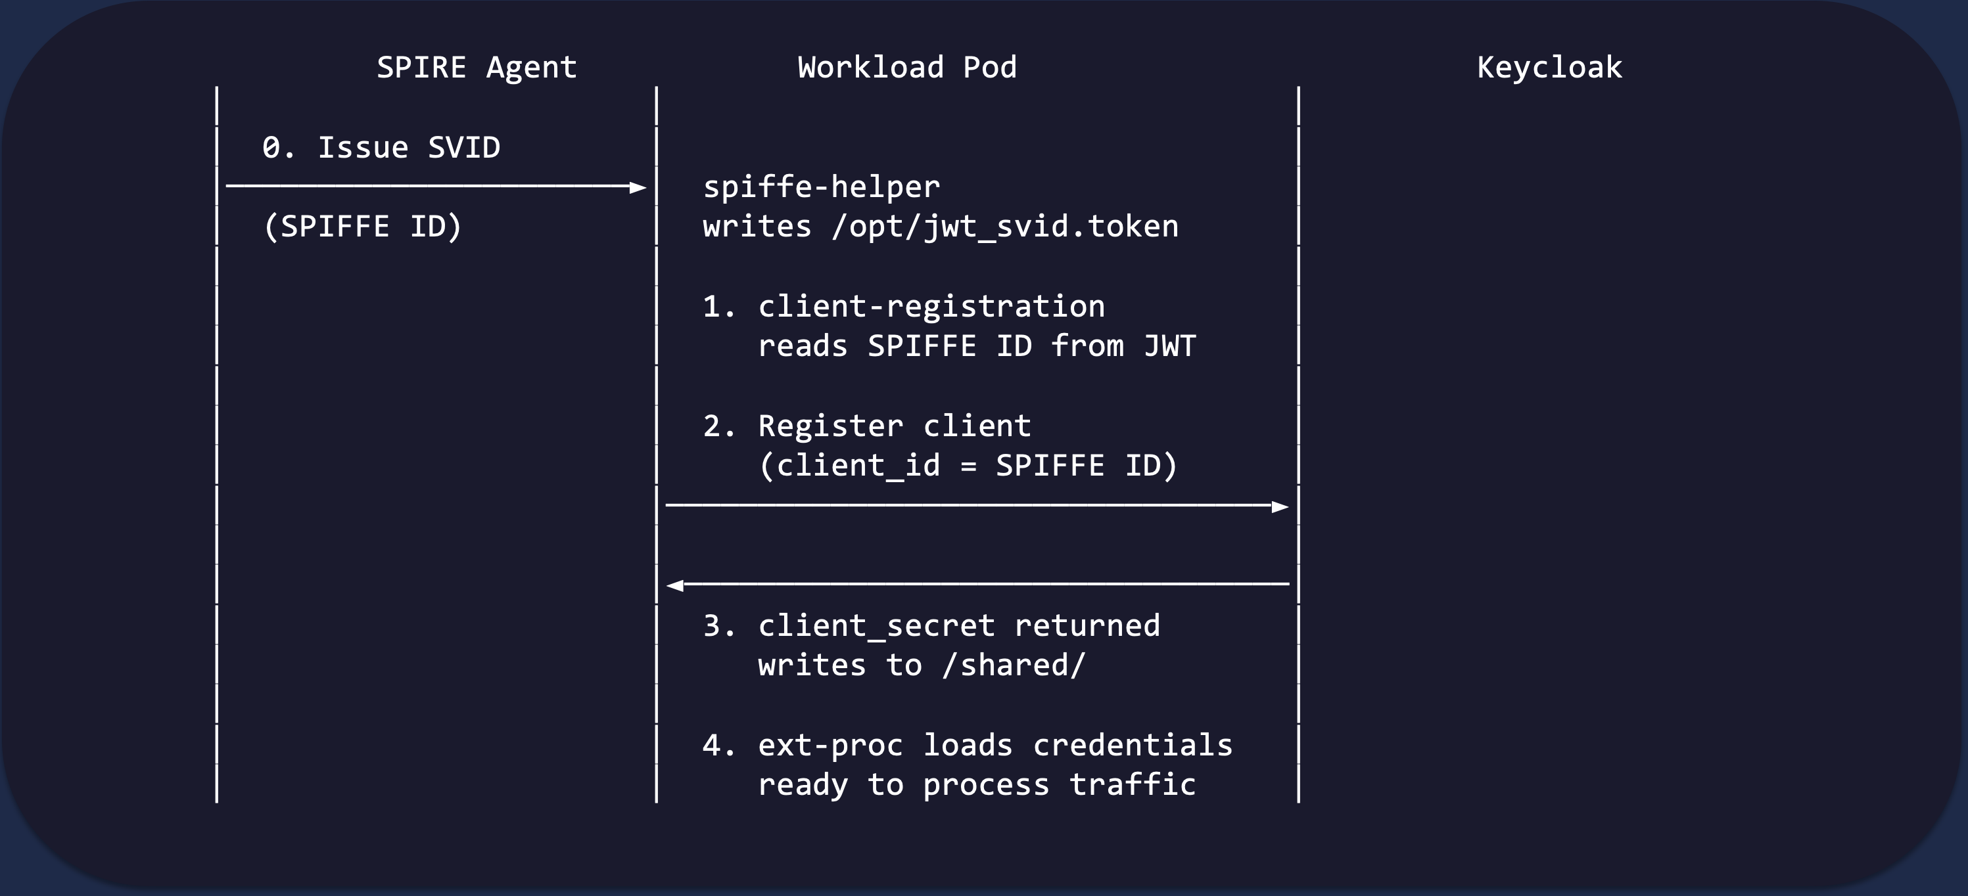
Initialization Flow
Notes:
Let me walk through the initialization flow step by step.
Step zero: the SPIRE Agent issues an SVID — a SPIFFE Verifiable Identity Document — to the spiffe-helper sidecar. This contains the pod's SPIFFE ID. The spiffe-helper writes this as a JWT token to a file on the shared volume.
Step one: the client-registration sidecar detects the SVID file, reads it, and extracts the SPIFFE ID from the JWT's sub claim.
Step two: it calls Keycloak's admin API to register a new client. The client ID is the SPIFFE ID — for example, spiffe://localtest.me/ns/team1/sa/git-issue-agent. The client is configured with token exchange enabled, service accounts enabled — everything needed for the OAuth flow.
Step three: Keycloak returns a client secret. The client-registration sidecar writes both the client ID and secret to the shared volume.
Step four: the ext-proc, which has been waiting for these files — it polls for up to 60 seconds — picks them up and is now ready to process traffic.
The entire process is idempotent. If the pod restarts, it re-registers with the same SPIFFE ID and gets the same client back.

Slide 40
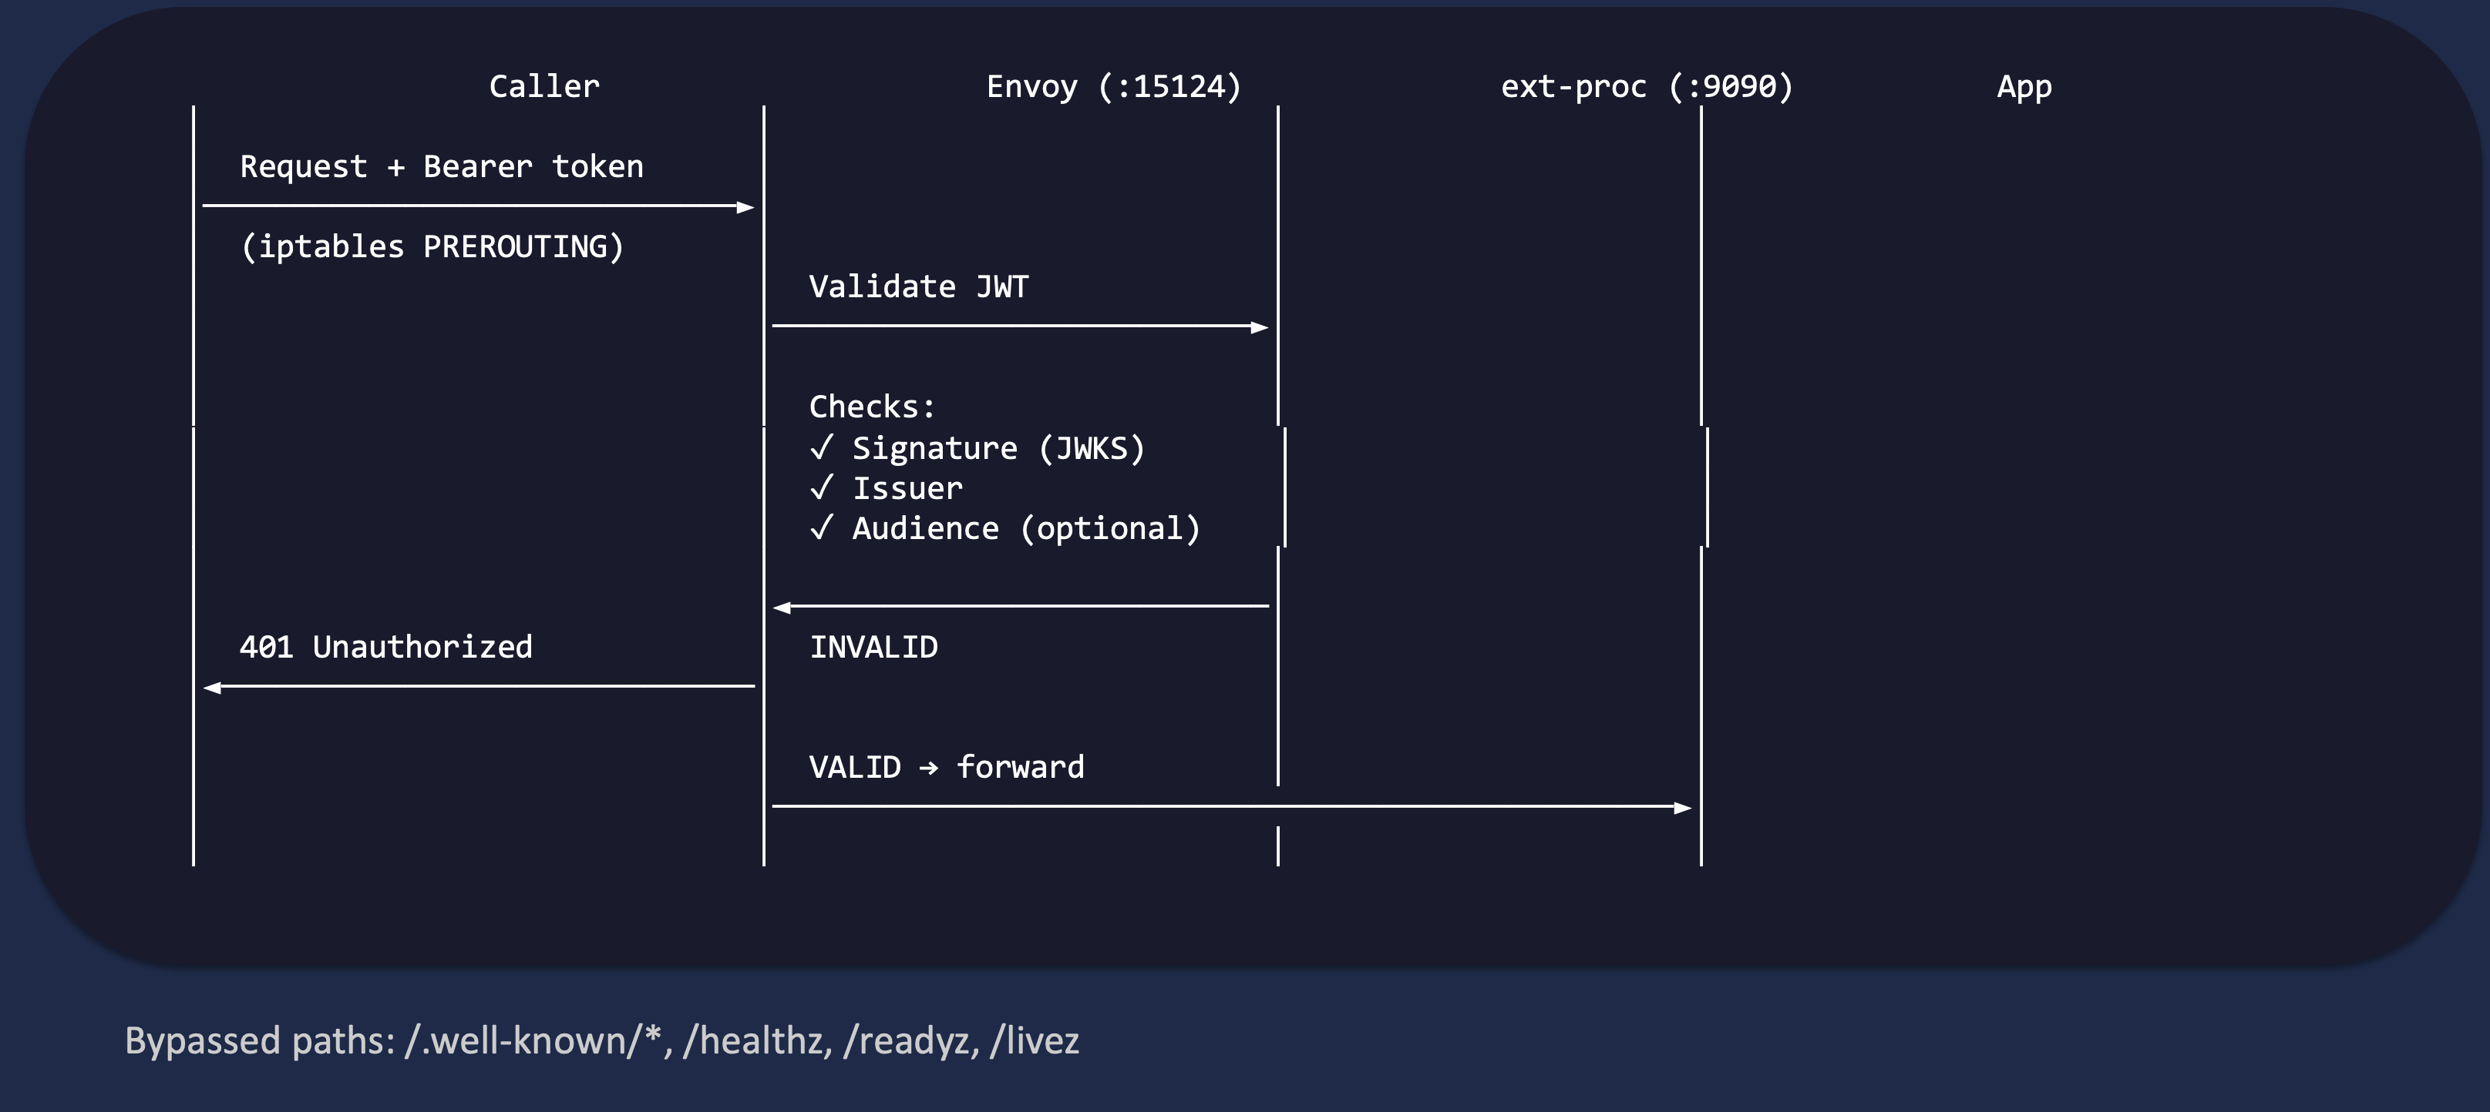
Inbound Flow: JWT Validation
Notes:
Here's the inbound flow in detail.
A caller sends a request with a Bearer token. The iptables PREROUTING rule redirects it to Envoy's inbound listener on port 15124. Envoy's Lua filter injects a direction header so the ext-proc knows this is inbound, then calls the ext-proc via gRPC.
The ext-proc performs three checks. First, it verifies the JWT signature against Keycloak's JWKS keys — these are auto-refreshed and cached. This catches tampered or forged tokens. Second, it checks the issuer claim — it must match the expected Keycloak realm. This prevents cross-realm token reuse. Third, if EXPECTED_AUDIENCE is configured, it checks the audience claim — the token must be intended for this specific service.
If any check fails, the caller gets an immediate 401 Unauthorized with a JSON error body. The application never sees the request.
If all checks pass, the request is forwarded to the application with the validated token.
Note at the bottom — certain paths are bypassed by default: well-known endpoints for service discovery, health checks, readiness and liveness probes. These don't require authentication.

Slide 41
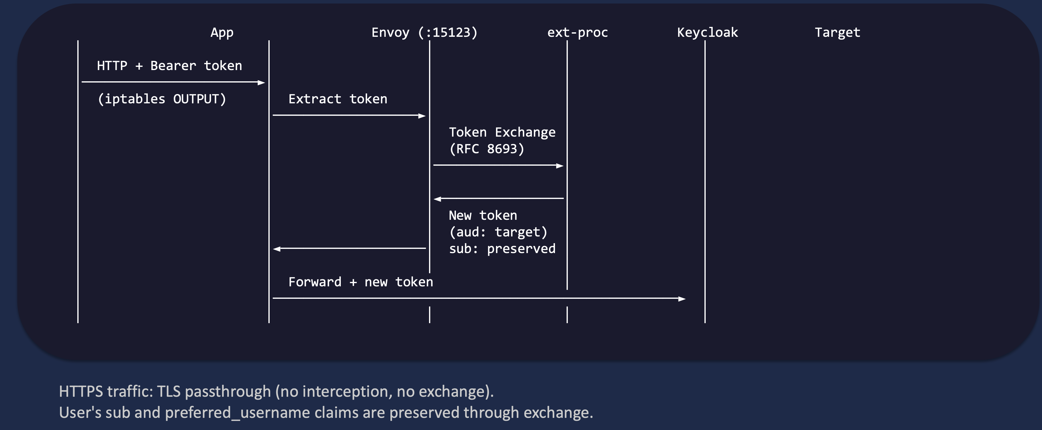
Outbound Flow: Token Exchange
HTTPS traffic: TLS passthrough (no interception, no exchange).
User's sub and preferred_username claims are preserved through exchange.
Notes:
And here's the outbound flow — this is where the magic of token exchange happens.
The application makes a plain HTTP call to another service — say, the GitHub tool. It includes a Bearer token in the Authorization header. The application doesn't know or care that AuthBridge exists.
The iptables OUTPUT rule redirects this to Envoy's outbound listener on port 15123. Envoy uses tls_inspector to detect the protocol. If it's HTTPS — TLS — it passes through untouched. No interception. For HTTP, it calls the ext-proc.
The ext-proc extracts the Bearer token from the request, then calls Keycloak's token endpoint using OAuth 2.0 Token Exchange — RFC 8693. It sends the original token as the subject_token, specifies the target audience — for example, github-tool — and requests specific scopes. It authenticates this request using the workload's own client credentials from the shared volume.
Keycloak returns a new token with the correct audience and the requested scopes. Crucially, the user's sub claim — their identity — is preserved in the new token.
The ext-proc replaces the Authorization header with the new token and Envoy forwards the request to the target service. The target validates the token and sees the correct audience. Authorized.
The entire exchange adds minimal latency — it's a single HTTP call to Keycloak.

