Slide 1
The Good, The Ugly, and The Bad
Leaving Sidecars Behind with Istio Ambient Mesh

Slide 2
Alfonso Ming
Site Reliability Engineer @ Schwarz Digits
Jorge Turrado
Principal Site Reliability Engineer @ Schwarz Digits
KEDA Maintainer, CNCF Ambassador, Microsoft MVP

Slide 3

Agenda
Intro
The Good
The Bad
The Ugle
Conclusion

Slide 4
Intro

Slide 5
What is a Service Mesh?
Abstracting network complexity from the application layer.
Core pillars: Security (mTLS), Observability, and Traffic Management.
Istio as the industry standard: powerful, but historically heavy.

Slide 6
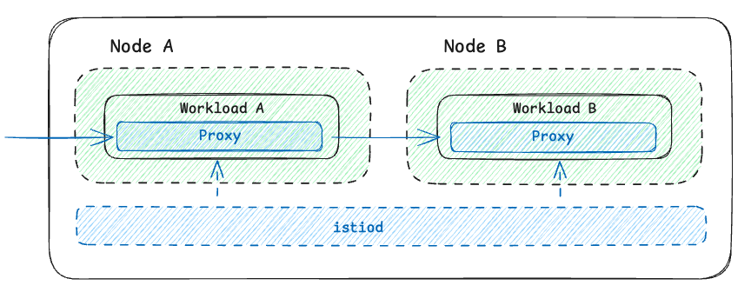
The Sidecar Model
Envoy proxy injected into every single pod.
Intercepts all inbound and outbound traffic.

Slide 7
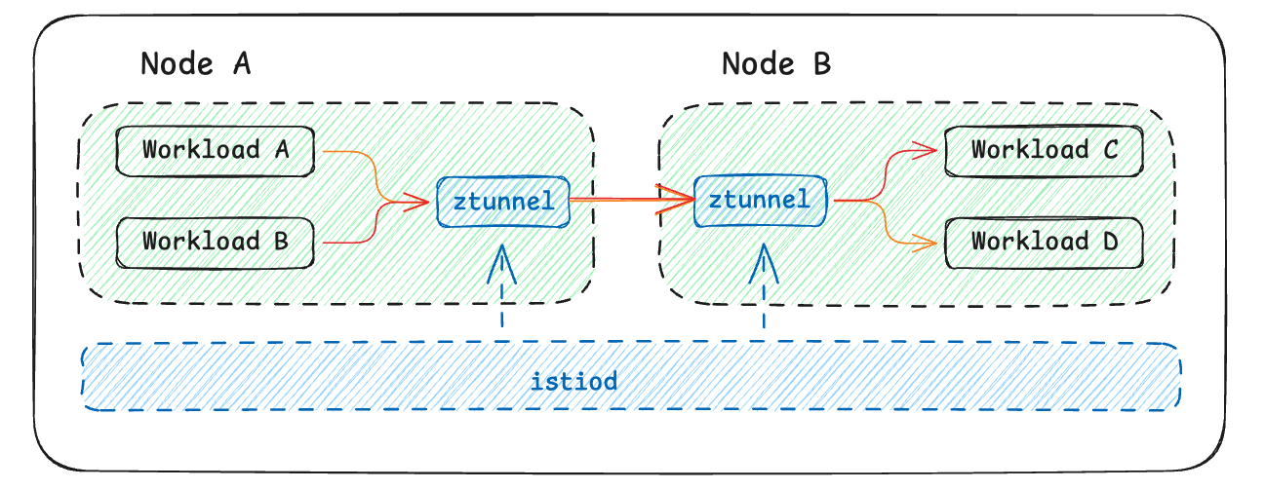
The Ambient Shift
A sidecarless data plane.
The core concept: Decoupling L4 (Secure Overlay) from L7 (L7 Processing).

Slide 8
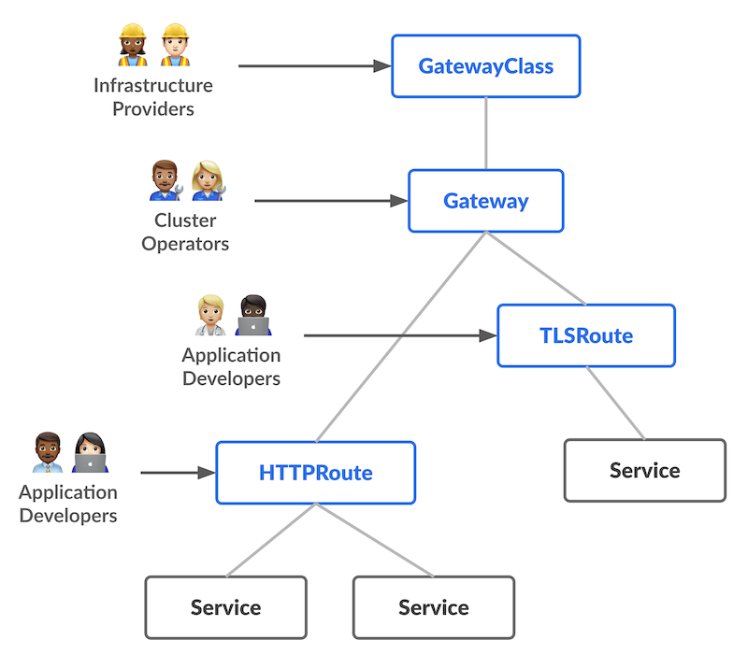
Gateway API
The native successor to the traditional Kubernetes Ingress API
Clear separation of concerns between personas

Slide 9

The Good

Slide 10
Leaving the Sidecar Baggage Behind
Cost Reduction: No more idle proxies eating resources in every pod.
Zero-Friction Operations: Upgrading Istio no longer requires restarting business apps. Separation of concerns between Platform and Devs.

Slide 11
Ztunnel & HBONE
Predictable infrastructure footprint: Ztunnel scales with your nodes, not with your pods..
Simplified Metrics: Clearer baseline observability (TCP/L4) without the heavy sidecar L7 noise.

Slide 12

The Bad

Slide 13
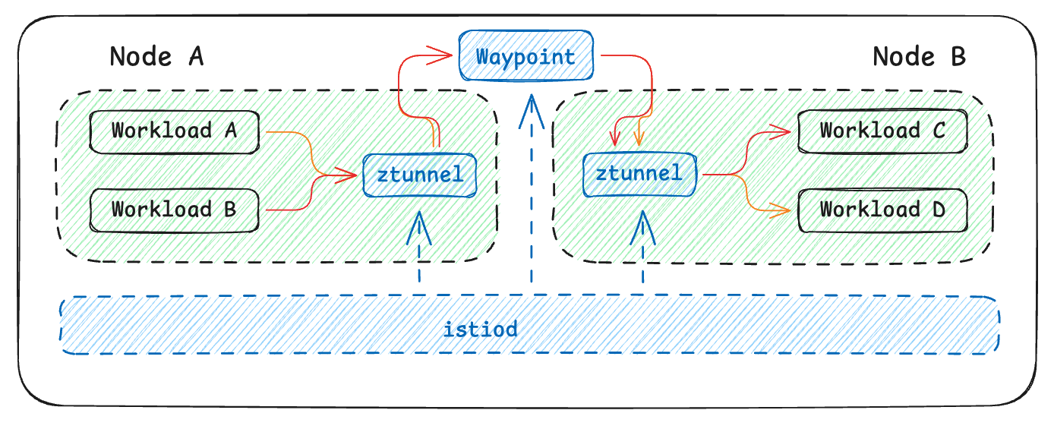
L7 requires Waypoints
To get L7 features a "Waypoint" proxy is mandatory and configure it using Kubernetes Gateway API

Slide 14
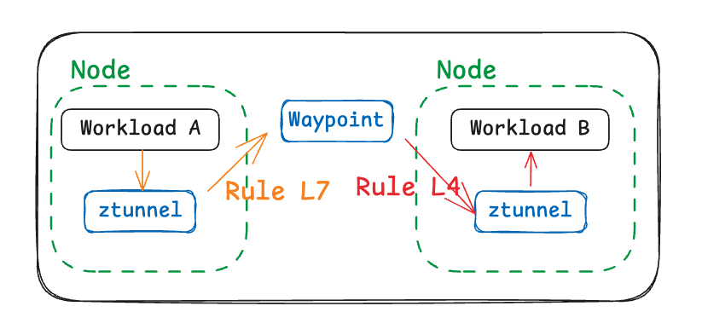
Split-Brain Authorization
Authz complexity skyrockets when mixing L4 and L7.

Slide 15

The Ugly

Slide 16
All or Nothing
Ztunnel transparently intercepts all traffic on the node.
You lose the granular ability to easily filter out or exclude specific ports at the pod level (like we used to do with sidecar annotations).
It's a black box for traditional pod-level troubleshooting.

Slide 17
New Telemetry Paradigm
Ztunnel metrics look different from traditional Envoy sidecar metrics.
Traffic flow is now App -> Ztunnel -> HBONE -> Ztunnel -> App.
Your existing dashboards and alerts will need a complete rewrite to make sense of this new hop.

Slide 18
New Tooling
Gateway API is needed (highly recommended).
Tools need to be updated to use Gateway API tooling support (cert-manager, argo rollouts, etc..)

Slide 19
Conclusion

Slide 20

Is Ambient Worth It?
Resource savings and operational ease are game-changers
Pro Tip: Stick to L4 (Ztunnel) as much as possible.

