Slide 1
Addressing Non-Deterministic Scheduling: Introducing the Node Readiness Controller
Ajay Sundar Karuppasamy, Google
Karthik K N, IBM
Priyanka Saggu, SUSE
Sreeram Venkitesh, DigitalOcean

Slide 2




$whoami
Ajay Sundar Karuppasamy,
Google
Priyanka Saggu,
SUSE
Karthik KN,
IBM
Sreeram Venkitesh
DigitalOcean

Slide 3
Agenda
The Node Readiness Problem
Introducing the Node Readiness Controller
NRC: Design
Operationalizing Node Readiness
Future Work & Ecosystem
Key Takeaways
Resources & Getting Involved

Slide 4
The Node Readiness Problem
Notes:
[ajay] start

Slide 5
The Node Readiness Problem
Node joins the cluster.
but the node critical components are not ready yet!
CNI plugin not initialized
Security agent not enforcing policies
CSI driver not available
GPU drivers not installed
Scheduler observes the Node Ready state, and schedules application pods.
Kubelet sets
Node = Ready
Pods start before dependencies are ready →
Application pods start in broken/insecure state! 💥
Race Condition on Node Bootstrap
Notes:
if the Kubelet is up and sees a basic CNI config on the disk, it sets the status to True.

Slide 6
The Node Readiness Problem
The root cause is the Node’s “coarse-grained readiness” condition:
status:
conditions:
- type: Ready
# Only checks: Kubelet + basic CNI config
status: "True"
There is
no visibility into CNI plugin actual operational state
no signal for CSI/DRA driver readiness
no indication of security agent status
no GPU driver initialization tracking
no custom component health checks
Notes:
Coordination is impossible without something like NRC today because the Kubelet doesn't know about these external dependencies.
This brings us to our fundamental challenge: How do we make node readiness deterministic?"

Slide 7
Introducing the
Node Readiness Controller
Notes:
NRC is an out-of-band controller that adds a layer of coordination between your infrastructure components and the scheduler.

Slide 8
Deterministic Node Bootstrapping
“ Workloads only land on
nodes with fully operational critical infrastructure ”

Slide 9

The Node Readiness Controller (NRC)
Provide a declarative, fine-grained system
for managing
node readiness
https://node-readiness-controller.sigs.k8s.io
Notes:
mission is to provide a declarative node botostrapping system for your nodes.

Slide 10



API
Scheduler
New Node
Node Readiness Controller
CNI
CNI
GPU
Driver
GPU
Driver
Vol
Vol
Notes:
Let’s look at this animation to see the idea in action.
We have our Cluster and the NRC sitting in the control plane.
A new node joins. NRC immediately sees it and applies a 'Scheduling Gate' in the form of a temporary taint. The node is now protected.
Now, look at the three DaemonSets: our CNI, GPU driver, and Storage driver. They are still warming up.
>> The scheduler is trying to send pods, but it sees that taint and it waits.
One by one, the components finish. They turn green and report back to the API.
>> The lock opens, the NRC lifts the taint, and now—and only now—the pods move onto the node safely.

Slide 11
NRC: Goals & Requirements
CRD extends fundamental node “Ready” condition
Allows for declarative and specific readiness validation
Focuses on Critical Daemons: CNI, Drivers, Security
Before
After
Ready
CNI Plugin
Ready
CSI / Device DRIVERs
Security Agent
Notes:
When we designed this, we had three strict requirements:
First, we didn't want to change the Kubelet. We used a CRD to extend the fundamental 'Ready' condition.
Second, it had to be declarative. You define what 'Ready' means for your specific node groups.
And finally, it had to target the critical daemons—the stuff that's known ahead of time, like CNI and drivers, that must be there before a single app container can start.

Slide 12
Where We Are Today
Out-of-Band solution for the NodeReadinessGates (KEP5233) vision
Uses existing Kubernetes primitives
CRDs for configuration
Taints for enforcement
Conditions for signaling
Well-defined prefix for managed taints: readiness.k8s.io/
Automatically manages node taints
Prevents premature scheduling
Taints are cleared only when all specified conditions are satisfied
Offers two modes: bootstrap-only, continuous
Notes:
By using an External CRD instead of modifying the Node Spec directly, we’ve actually created something better.
flexibility—you can use label selectors to target specific node pools; use features like Dryrun to test your rules safely before enforcing them.
well-defined prefix for readiness taints
one-time 'bootstrap' check or 'continuous' guarantee
<br>
This is ready for production trials. We’re already seeing great results.. I invite you to try it on your workloads and share your feedback with us.
hand over to Priyanka..
[ajay] stop

Slide 13
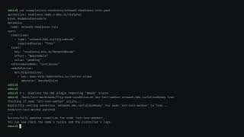
Demo
Notes:
Let's see this in a demo. We'll simulate a CNI failure where NRC prevents pod scheduling until the reporter signals success.
[psaggu] start the demo, and walk through

Slide 14
How NRC works?
Example of a Node Readiness Rule:
apiVersion: readiness.node.x-k8s.io/v1alpha1
kind: NodeReadinessRule
metadata:
name: component-readiness-rule
spec:
# Conditions to check
conditions:
- type: "vendor.example.com/ComponentReady"
requiredStatus: "True"
# Taint to manage (enforcement mechanism)
taint:
key: "readiness.k8s.io/ComponentReady"
effect: "NoSchedule"
value: "pending"
...
...
Expected readiness at node.status.conditions
Controller manages this taint
Notes:
So how does NRC works? let us dive into the mechanics behind it.
NRC doesnt modify Node status; it only watches it-
We use a Custom Resource – NodeReadinessRule to define which custom conditions or readiness requirements must be True for each node group.. Components report their readiness using standard node conditions.. And NRC controller manages these readiness taints for enforcement.

Slide 15
How NRC works?
Example of a Node Readiness Rule:
apiVersion: readiness.node.x-k8s.io/v1alpha1
kind: NodeReadinessRule
metadata:
name: component-readiness-rule
spec:
...
...
# Enforcement strategy
enforcementMode: "bootstrap-only"
# Target nodes
nodeSelector:
matchLabels:
node-role.kubernetes.io/worker: ""
NRC mode of operation
applies only to these selected
group of nodes
Notes:
4. Controller Pattern: Watches rules + node conditions, reconciles taint state

Slide 16
How NRC works?
Matching Node taints + conditions:
Node registers with these taints
apiVersion: v1
kind: Node
metadata:
name: worker-1
spec:
taints: # Managed by NRC controller based on rule
- key: "readiness.k8s.io/ComponentReady”
effect: "NoSchedule”
key: "pending”
status:
conditions:
# Standard Kubernetes condition
- type: Ready
status: “True”
reason: KubeletReady
message: kubelet is posting ready status
...
...
Kubelet’s condition is unchanged
Notes:
At this point:
1. NodeReadinessRule requires: vendor.example.com/ComponentReady == True
2. Node condition shows: vendor.example.com/ComponentReady == False
3. NRC controller evaluates: Condition NOT satisfied
4. NRC controller enforces: Apply taint readiness.k8s.io/ComponentReady
5. Result: Node remains unschedulable (scheduler skips this node)

Slide 17
How NRC works?
Matching Node taints + conditions:
apiVersion: v1
kind: Node
metadata:
name: worker-1
spec:
taints: # Managed by NRC controller based on rule
- key: "readiness.k8s.io/ComponentReady”
effect: "NoSchedule”
key: "pending”
status:
conditions:
...
...
# Custom condition (matches rule’s conditions[0].type)
- type: "vendor.example.com/ComponentReady"
status: “False” # Not ready yet - taint remains
reason: ComponentInitializing
message: Critical component is starting
Critical components manage their respective conditions
Notes:
At this point:
1. NodeReadinessRule requires: vendor.example.com/ComponentReady == True
2. Node condition shows: vendor.example.com/ComponentReady == False
3. NRC controller evaluates: Condition NOT satisfied
4. NRC controller enforces: Apply taint readiness.k8s.io/ComponentReady
5. Result: Node remains unschedulable (scheduler skips this node)

Slide 18
How NRC works?
At this point:
1. NodeReadinessRule requires: vendor.example.com/ComponentReady == True
2. Node condition shows: vendor.example.com/ComponentReady == False
3. NRC controller evaluates: Condition NOT satisfied
4. NRC controller enforces: Apply taint readiness.k8s.io/ComponentReady
5. Result: Node remains unschedulable (scheduler skips this node)

Slide 19
How NRC works?
So, when does the component becomes ready?
status:
conditions:
# Reporter like - Node Problem Detector (NPD) or Node Readiness Reporter (NRR) updates conditions
- type: "vendor.example.com/ComponentReady"
status: “True” # Component now ready!
reason: ComponentInitializing
message: Critical component is operational
Node Readiness Controller (NRC) reacts:
- Sees condition now True
→ Removes taint readiness.k8s.io/ComponentReady
- Node becomes schedulable
→ (bootstrap-only mode) Adds completion annotation, stops monitoring

Slide 20
Recap: How NRC works?
1
Node joins cluster.
Kubelet registers node with startup taint: readiness.k8s.io/ComponentReady=pending:NoSchedule
Condition reporters (e.g., NPD / NRR) monitors components and update node conditions.
kubectl get node worker-1 -o jsonpath='{.status.conditions}'
[...]
{
type: vendor.example.com/ComponentReady
Status: True (initally False -> becomes True)
"lastTransitionTime": "2026-03-20T09:30:00Z"
}
2
Node Readiness Controller evaluates conditions
watches node condition updates
matches rules using node selectors
all conditions must be True (AND logic)
3
All conditions satisfied -> Remove readiness taint
Node becomes schedulable
(Bootstrap mode) Add completion annotation
4
5
If conditions fail (continuous mode):
Re-apply taint and block new scheduling (existing pods continue)

Slide 21
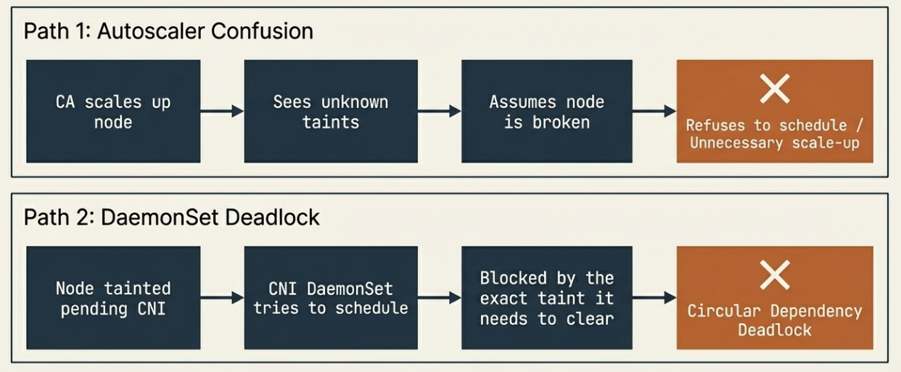
Integration Friction with CA & DaemonSets
NRC’s Fine-grained taints introduce two operational deadlocks for cluster operators, when integrating with Cluster Autoscaler (CA) & infrastructure initialization blocks (daemonsets).

Slide 22
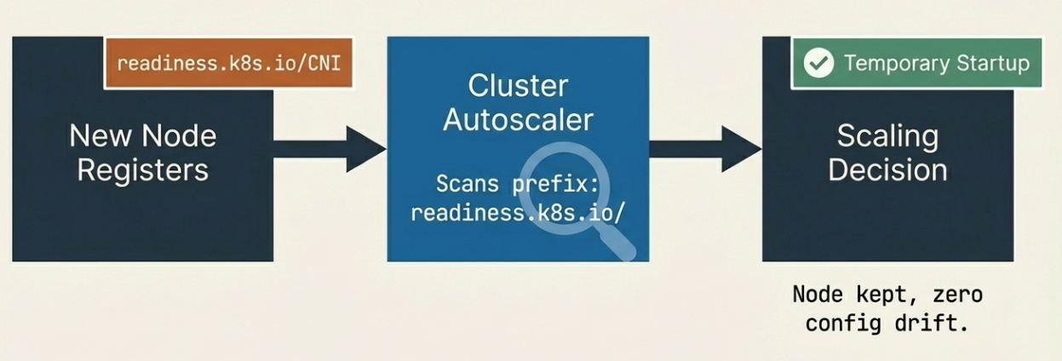
How NRC Solves Integration Friction
A recent upstream Cluster Autoscaler project PR (#9296) introduced the --startup-taint-prefix flag in the Cluster Autoscaler (CA) binary, enabling dynamic discovery of NRC taints without requiring CA restarts or manual enumeration. This solves configuration drift and prevents premature scaling.

Slide 23
Integration Friction with CA & DaemonSets
NRC’s Fine-grained taints introduce two operational deadlocks for cluster operators, when integrating with Cluster Autoscaler (CA) & infrastructure initialization blocks (daemonsets).

Slide 24
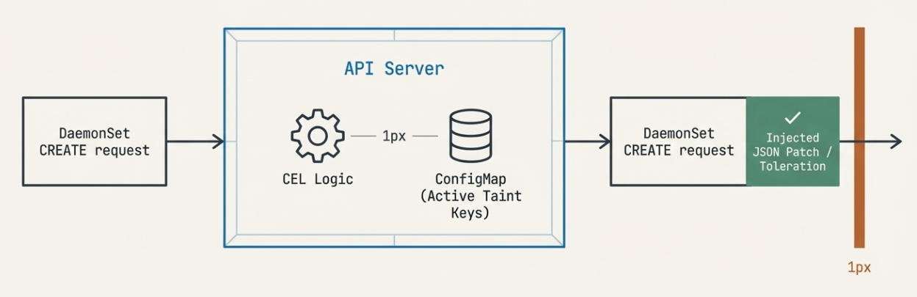
How NRC Solves Integration Friction
Another in-progress PR#117 is proposing to utilize Mutating Admission Policy (MAP) to automatically inject tolerations into Daemonsets. Zero manual configuration required.
NRC controller (PR #129) also now tolerates all taints, preventing core chicken-and-egg initialization failures.
Notes:
[psaggu] ends

Slide 25
Operationalizing Node Readiness
Notes:
[karthik] starts

Slide 26
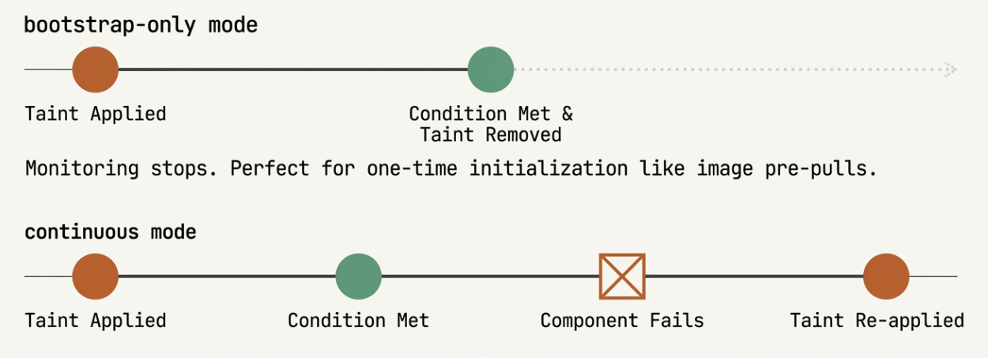
NRC Enforcement Mode: bootstrap-only
Enforces readiness once during node startup, then stops monitoring.
Behavior:
Taint applied when node joins
Removed when conditions first satisfied
Adds completion annotation: readiness.k8s.io/bootstrap-completed-<ruleName>=true
Never re-taints, even if conditions fail later
Best fits:
One-time initialization needs
GPU driver installation
Kernel module loading
Container image pre-pulling
CNI interface setup
Notes:
To ensure applying these rules is seamless with no friction in cluster we built the NRC with very specific enforcement modes because not all readiness checks are created equal.
Let's look at the most foundational one bootstrap-only
As the name implies, this is a 'one-and-done' gatekeeper. It enforces readiness exactly once—during node startup—and then it gets completely out of the way.
If you look at the timeline here, the flow is simple. When a new node joins the cluster, NRC immediately applies a taint so no application pods can schedule. Once your custom conditions are satisfied, NRC removes the taint.
But here is the critical part: it also drops a bootstrap-completed annotation on the node. That annotation is a permanent stamp of approval. Once it's applied, NRC completely stops monitoring that rule. Even if the condition fails ten minutes or ten days later, NRC will never re-taint that node.

Slide 27
NRC Enforcement Mode: continuous
Actively monitors conditions throughout node lifetime.
Behavior:
Taint applied when conditions not met
Removed when conditions satisfied
Re-applies taint if conditions fail later
Best fits:
Runtime health Enforcement
Security agent monitoring (Falco, Tetragon)
Storage backend connectivity
Service mesh control plane
Network proxy health
Notes:
But what if a one-time check isn't enough? What if the health of a component is so critical that you need guarantees for the entire lifecycle of the node? That brings us to our second mode: Continuous enforcement.
Unlike bootstrap-only, continuous mode never stops watching. It actively monitors your defined conditions throughout the node's entire lifetime.
If you look at the timeline, the beginning looks the same: a node joins, the taint is applied, the condition is met, and the taint is removed.
But look at what happens next. If that underlying component fails three weeks or three months later, NRC instantly steps back in and re-applies the taint. It actively stops the scheduler from sending any more traffic to a degraded node.
Why would you want a controller to re-taint a running production node? Two words: Security and Reliability.
Imagine you are running strict runtime security agents like Falco or Tetragon. If that daemonset crashes or gets evicted on a specific node, you suddenly have a compliance blind spot. You absolutely do not want new workloads scheduling onto a node where your security monitoring is dead.
The same applies to critical infrastructure like your storage backend or your service mesh proxy. If those components fail, any new pod landing on that node is just going to crash-loop anyway. Continuous mode acts as an active blast-radius containment, protecting your workloads from scheduling onto silently broken infrastructure.

Slide 28
DryRun for Operational Safety
apiVersion: readiness.node.x-k8s.io/v1alpha1
kind: NodeReadinessRule
metadata:
name: component-readiness-rule
Spec:
dryRun: true
enforcementMode: bootstrap-only
conditions:
- type: "vendor.example.com/ComponentReady"
requiredStatus: "True"
taint:
key: "readiness.k8s.io/ComponentReady"
effect: "NoSchedule"
value: "pending"
…
status:
dryRunResults:
affectedNodes: 50
taintsToAdd: 50
taintsToRemove: 0
riskyOperations: 0
summary: "DryRun: Would apply taint to 50 nodes lacking GpuReady condition.
Configure DryRun
DryRun results
Notes:
We also have a Dryrun Mode for safe adoption. It allows operators to validate rules without actually applying taints. The controller performs all logic and adds dryrun results at the rule instead of the actual taint, giving you visibility into the impact before you flip the switch

Slide 29
Readiness Guarantees at Scale
Scalability Challenges
Burst Concurrency: Managing 1,000+ node scale-ups without queue bottlenecks.
Time-to-Ready: Replacing serialized processing to maximize infrastructure ROI.
State Management: Architecting within etcd's strict 1.5MB object limit.
API Efficiency: Streamlining status updates during high-frequency events.
Objectives
Validate sub-second logic execution under peak concurrency.
Demonstrate a lightweight operational footprint (<50MiB).
Implement parallel reconciliation to ensure linear, predictable workqueue drainage.
Notes:
By now, everyone here knows what the Node Readiness Controller is. But if you are running Kubernetes in production at massive scale (that’s exactly when you want a system like this), you are probably asking yourself two questions:
First, does adding this controller introduce latency to my cluster? > And second, are my expensive compute instances going to sit idle waiting to be evaluated?"
"To answer that, we have to look at the architectural design considerations for mega-clusters.
When 1,000 nodes join at once, we have to manage that burst concurrency to prevent severe queue bottlenecks. We have to optimize our Time-to-Ready by replacing standard serialized processing—because every second we save maximizes your infrastructure ROI.
We also have to architect around hard limits, like etcd's strict 1.5MB object ceiling, and ensure our API updates are incredibly efficient so we don't overload the control plane during these high-frequency scale-ups."
Instead of just standing here claiming we solved this, we are going to prove it with deep observability and hard data.
Our objectives for this test were simple: Validate sub-second logic under peak pressure, demonstrate a tiny operational footprint of under 50 megabytes, and prove our parallel reconciliation guarantees predictable, linear queue drainage.
To measure this accurately, we leaned on the tools the ecosystem provides. Because the NRC is built on controller-runtime, we get an excellent suite of baseline metrics out of the box. But to get granular visibility into our specific evaluation logic and pipeline latency, we instrumented several custom metrics on top of that.

Slide 30
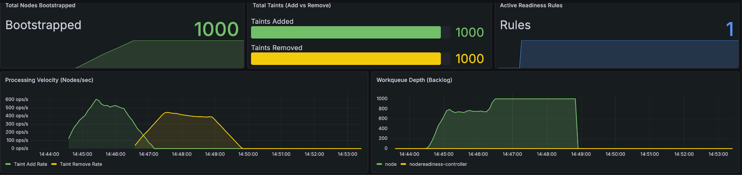
Reliability & Throughput at Scale
100% Success Rate: Successfully processed 1,000/1,000 nodes with zero dropped events.
Peak Velocity: Achieved burst throughput of ~500 nodes/sec (Taint Addition).
Linear Drainage: Workqueue depth returned to zero immediately following the "Thundering Herd" event.
Notes:
To validate our objectives, we hit the controller with a simulated 'Thundering Herd' of 1,000 nodes joining simultaneously.
For those who haven't used it, we achieved this using KWOK—Kubernetes WithOut Kubelet. This allowed us to instantly simulate a massive scale-up and apply maximum API pressure to our controller without burning thousands of dollars on real cloud compute.
If you look at the top row of the dashboard, you can see the immediate result: a 100% success rate. 1,000 nodes joined, and exactly 1,000 taints were added and subsequently removed. The controller didn't drop a single event under maximum concurrency.
But what’s really impressive is our Processing Velocity here on the bottom left. We peaked at nearly 500 operations per second.
You'll notice the green 'Add' spike, followed closely by the yellow 'Remove' spike. This shift proves the controller isn't just fast at one initial task; it manages the entire readiness lifecycle with massive throughput, ensuring no node joins the cluster without meeting our criteria.
Finally, look at the workqueue depth on the bottom right. We slammed the controller with a massive burst of tasks, but because of our parallel reconciliation, the queue drained predictably and linearly right back to zero. No stalled tasks, and no lingering 'tail' latency.

Slide 31
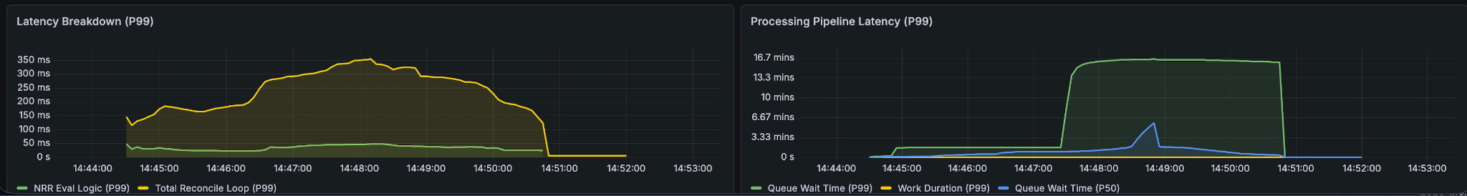
Low-Latency Decision Logic
Optimized Execution: Internal evaluation logic (P99) stays below 50ms.
API Dependent: Total loop time (~350ms) is primarily driven by K8s API overhead, not controller code.
Stability: P99 latency remains consistent even as the workqueue reaches maximum capacity.
Notes:
So, we proved we can ingest 500 nodes a second without dropping events. But high throughput isn't enough if the controller's brain is slow. Let's look at the actual decision latency.
A common concern with controllers is the 'latency tax' they add to node scaling. Here, we've broken that down. The green line is our Actual Code Logic, which is negligible—well under 50 milliseconds.
The yellow line, which represents the Total Reconcile Loop, sits around 300 milliseconds. This gap tells us that the controller is waiting on the Kubernetes API server, not our code. This is a critical distinction: our controller is as fast as the cluster’s control plane allows it to be.
In the Pipeline Latency view, you see a jump in wait time during the burst. This is expected 'queuing' during a massive scale-up. It confirms the system is stable under pressure rather than failing or crashing

Slide 32
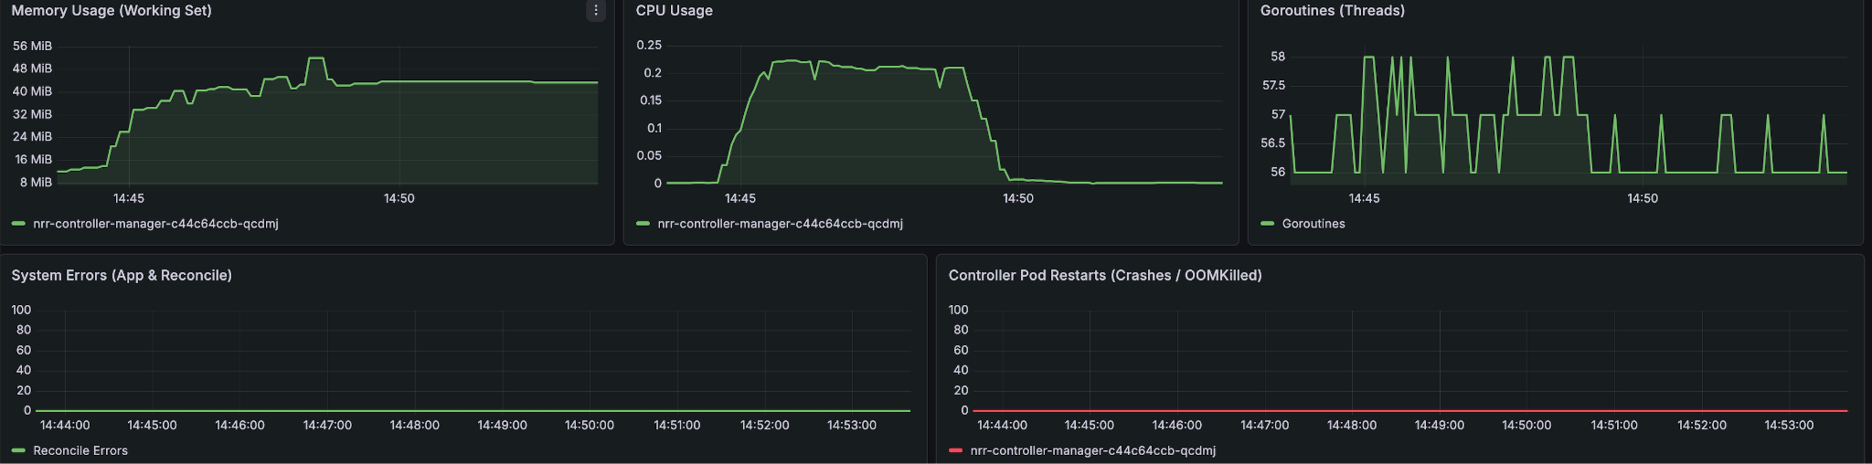
Production-Ready Stability
Minimal Footprint: Memory usage peaked at <50 MiB under maximum load.
Zero Leakage: Goroutine count (56) returned to baseline, confirming perfect thread cleanup.
Fault Tolerance: Zero Pod restarts or application failures during the entire test window.
Notes:
So, we are fast, and we have eliminated the queue bottlenecks. But raw speed is actually dangerous if your controller leaks memory and gets OOMKilled in the middle of a critical scale-up.
From an infrastructure perspective, this controller is incredibly 'quiet.' Even at a 1,000-node load, memory usage was extremely efficient, peaking at just 48 MiB. This allows us to set very tight resource limits in production.
Look at the Goroutines graph. It stays almost perfectly flat between 56 and 58. In the Go world, this is the gold standard for reliability. It proves we have zero thread leaks—the controller creates workers, they do their job, and they are recycled.
Most importantly, the bottom row shows Zero Errors and Zero Restarts. No OOM kills, no panics. It’s a rock-solid binary.

Slide 33
Scalability Boundaries & Forward-Looking Design
Identified Constraint: Kubernetes etcd enforces a strict 1.5MB limit on single object sizes.
Current State: At 1,000 nodes, the NodeReadinessRule object consumes only ~6.5% of its capacity.
Projected Limit: At current growth rates (~100 bytes/node), the architecture supports ~15,000 nodes per rule.
Strategic Refactor: To support "Mega-Clusters" and infinite scale, we are evaluating move node-specific evaluation status from the Rule object into a separate Evaluation CRD (one per node).
Notes:
"While our current performance is excellent, we’ve used this test to identify our 'Hard Ceiling.' Because we track every node’s status inside the Rule object, we are bound by the 1.5MB etcd limit.
Today, we have a massive safety runway—about 15,000 nodes. However, to ensure this controller is future-proof for the next decade of cluster growth, our roadmap includes a refactor. We will decouple the Rule Definition from the Evaluation Logic.
By moving the status into a separate CRD, we remove the 1.5MB bottleneck entirely, allowing the NRR controller to scale horizontally across hundreds of thousands of nodes without ever hitting an API limit."
[karthik] ends

Slide 34
Security and Production Hardening
Notes:
[sreeram] start

Slide 35
The Node Problem Detector
Node Readiness Controller operates based on Node Conditions and doesn’t perform health checks on its own
For reporting the conditions we have two options:
  The Node Problem Detector
  The Readiness Condition Reporter
Notes:
NRC is the consumer of signals. You can use NPD or our Readiness Condition Reporter to push these signals..
If components want to update the node status on their own, they can do that too. They’d only need the required node/status permissions..

Slide 36
Constrained Impersonation and Secure Status Reporting
By default the service account used by the readiness reporter has update privileges on every node in the cluster
Even if a node is compromised, a malicious agent cannot manipulate the readiness status of every node in the cluster
SIG Auth’s KEP-5284 Constrained Impersonation helps us mitigate this issue
Notes:
We have an example of leveraging this. The KEP is going beta in 1.36, switched on by default. For clusters 1.36 and above the

Slide 37
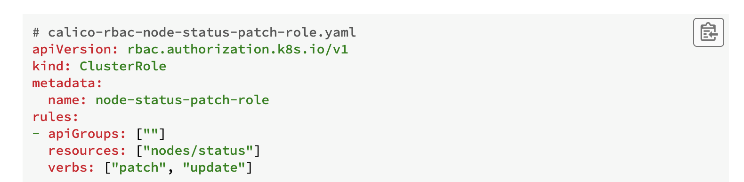
Constrained Impersonation and Secure Status Reporting

Slide 38
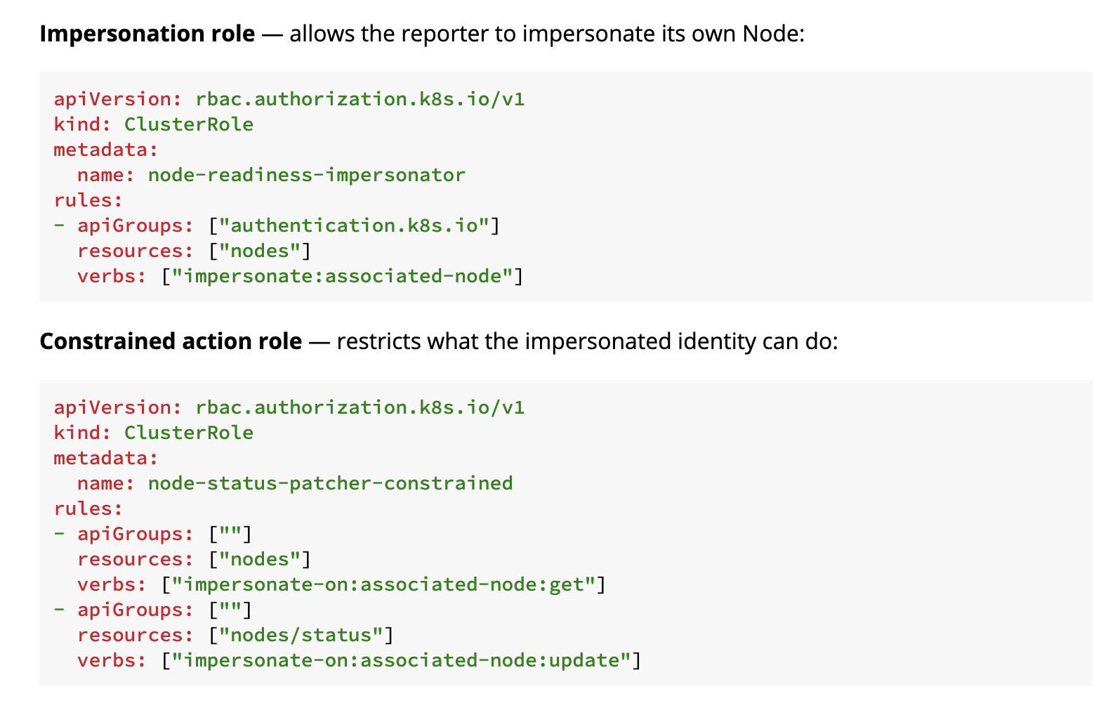
Constrained Impersonation and Secure Status Reporting

Slide 39
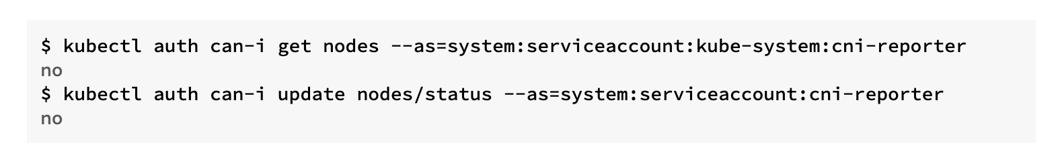
Constrained Impersonation and Secure Status Reporting

Slide 40
Releases
Notes:
[sreeram] start

Slide 41
Releases
v0.1.x: First alpha release
  Implements core API and primary logic for managing readiness via taints
v0.2.0: Operational Hardening
  Focused on Observability and safety with admission webhooks
  Optimized node / rule status updates handling
v0.3.0: Ready for community trials
  Security Improvements
  Works with all existing clusters without any version dependency
Notes:
[sreeram] ends

Slide 42
Future Work & Ecosystem
Notes:
[psaggu]

Slide 43
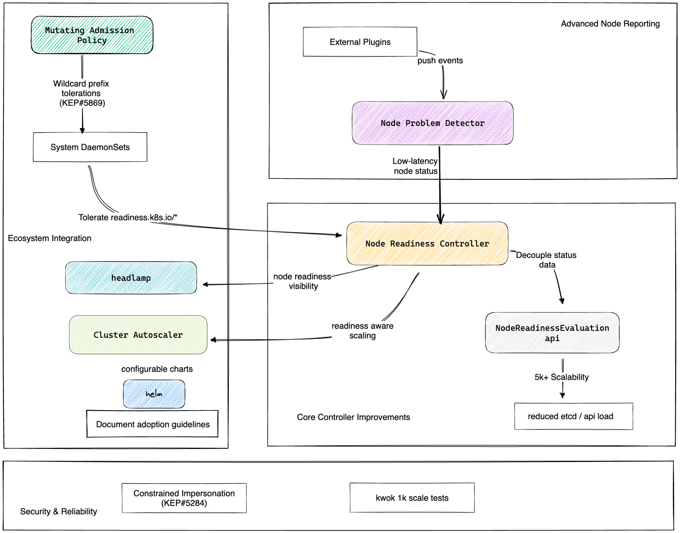
Future Work & Ecosystem
Notes:
Looking ahead, we are driving a KEP for Wildcard Tolerations to simplify DS configuration even further. We're also working on helm chart releases, Headlamp visibility plugins for node-readiness visibility, and deeper integrations with other components in the ecosystem..
Call for collaboration –

Slide 44
Key Takeaways

Slide 45
Key Takeaways
Kubernetes Node bootstrap often involve several initialization dependencies
NRC provides a deterministic readiness gating system for nodes
Integrates with existing Kubernetes components
Enables a more predictable workload sequencing startup on nodes
Notes:
[psaggu]

Slide 46
Resources & Getting Involved
Notes:
[sreeram]

Slide 47
Get Involved with Node Readiness Controller
Have a use-case? Let’s talk!
Participate in future discussions and development:
Our Project Repository - sigs.k8s.io/node-readiness-controller
Slack: Join #sig-node-readiness-controller on the Kubernetes slack and our biweekly meetings.
Follow our Project Website - node-readiness-controller.sigs.k8s.io/ to find our user-guides and latest release updates.
Whether you are a component owner needing reporting guidelines or a cluster admin looking for deterministic builds, we want to hear from you.
Notes:
[sreeram]
We meet biweekly on Tuesdays. Whether you are a component owner needing reporting guidelines or a cluster admin looking for deterministic builds, we want to hear from you.

Slide 48

Thank You
Notes:
to everyone here, and our contributors!

Slide 49

Questions?

Slide 50
