Slide 1
Supply Chain Security in the Real World
Alex Leong

Slide 2

Alex Leong
Software Engineer @ Buoyant
Linkerd Maintainer
Service Mesh Enthusiast
Your photo
https://github.com/adleong
@alex on slack.linkerd.io

Slide 3
Buoyant Enterprise for Linkerd
Linkerd is an open-source CNCF graduated service mesh
"Buoyant Enterprise for Linkerd" (BEL) is an enterprise distribution of Linkerd

Slide 4
Buoyant Enterprise for Linkerd
Linkerd is an open-source CNCF graduated service mesh
"Buoyant Enterprise for Linkerd" (BEL) is an enterprise distribution of Linkerd
  Part of the value of BEL is supply chain security

Slide 5
Supply-Chain Security in the Real World
What is this stuff?
Why does it matter?
How did it go when we started using it with a real project?

Slide 6
What is supply chain security?

Slide 7
What is the software supply chain?

Slide 8
What is the software supply chain?
Far more than just the executable thing we ship.
the library dependencies
  including the (often vast) tree of transitive dependencies
the build system
  e.g. go version, rust version, toolchain etc.
the container and OS it runs in (even the hardware, really)
Kubernetes itself
any utilities or APIs that it interacts with
etc.

Slide 9
What is the software supply chain?
As producers of software, we can only directly control a few of these.
the library dependencies
  including the (often vast) tree of transitive dependencies
the build system
  e.g. go version, rust version, toolchain etc.
the container and OS it runs in (even the hardware, really)
Kubernetes itself
any utilities or APIs that it interacts with
etc.

Slide 10
What is supply chain security?
What we would like is for “supply chain security” to mean that we guarantee that the software we ship is free from bugs and vulnerabilities.
Sadly… that’s not realistic. 😢
Any component in the chain could have trouble
In many cases, that trouble won’t be discovered until after we ship!
Notes:
So taking that back to the question of supply chain security…

Slide 11
What is supply chain security?
What’s the best we can realistically do? Describe instead of guarantee.
We describe what goes into our software
Consumers can use that description to:
  see if we’re using things with problems and if so…
  they can see what the problems are
  they can see how the problems affect them

Slide 12
What is supply chain security?
Supply chain security (for a software provider) is about providing a detailed, accurate, verifiable description of your supply chain.
Notes:
I work on Buoyant Enterprise for Linkerd, lovingly abbreviated as BEL.
BEL is an enterprise distribution of the open-source CNCF service mesh
Linkerd. As an enterprise distribution, one of the things that
differentiates it from open-source Linkerd is that we provide this
supply chain security information.

Slide 13
What can we describe about the supply chain?

Slide 14
What can we describe about the supply chain?
Four broad groups:
Signatures
SBOMs
Build attestations
VEX documents
Each of these has a specific function.

Slide 15
What can we describe about the supply chain?
Signatures let consumers know that they’re really running the software we built.
We make a cryptographic signature of the executable in question
The consumer can verify the signature
“Executable” here doesn’t necessarily mean a binary
We could as easily sign a Python script or a webpack bundle or whatever

Slide 16
What can we describe about the supply chain?
There are many ways to sign things:
Sigstore (the cosign command) leans on OIDC for “keyless signing”
Notary leans more on traditional key management
Or you can roll your own…
You can do as many different kinds of signature as you like for the same image.

Slide 17
What can we describe about the supply chain?
SBOMs let consumers know what went into the software we built
Software Bill of Materials
List of all dependencies and their versions
  Can be generated by tools like syft and snyk
  Multiple formats with SPDX and CycloneDX being most common
Cross-referenceable with vulnerability databases
  Any vulnerability in anything listed in the SBOM could affect software built using the things in the SBOM
  Tools like grype automate this
Can be signed to prevent tampering and prove source

Slide 18
What can we describe about the supply chain?
Build attestations let consumers know how we built our software
Detailed, auditable description of the build process we used
Can be published as Supply-chain Levels for Software Artifacts documents
  SLSA, pronounced “salsa”
Consumers can use these to audit our build process
  e.g. did our FIPS-compliant builds really use the FIPS-certified encryption libraries?
Can be signed to prevent tampering and prove source

Slide 19
What can we describe about the supply chain?
VEX documents let consumers know about problems that don’t apply to us
Vulnerability Exploitable Exchange
e.g. “we use a version of OpenMoon with a vulnerable phase-of-the-moon function, but we never call it, so CVE-2026-99999999 doesn’t apply to us”
Can be signed to prevent tampering and prove source (sound familiar?)

Slide 20
What can we describe about the supply chain?
The end result of this process is a collection of signed, verifiable documentation that describes the whole supply chain.

Slide 21
Great! So it’s easy to do all this, right?

Slide 22
Great! So it’s easy to do all this, right?
😂🤣😂
😂🤣😂🤣😂🤣😂
😅

Slide 23
How does one actually do this?
Generating SBOMs and SLSA documents really isn’t bad.
Making everything available for consumers to verify is where things get spicy. 😅

Slide 24
Generating SBOMs and SLSA documents
These are actually baked into docker buildx and the docker/build-push-action GitHub Action.
You could also generate SBOMs directly with Snyk, or use goreleaser – many tools are learning how to do this.
- uses: docker/build-push-action
with:
...
provenance: true # <-- SLSA
sbom: true # <-- SPDX

Slide 25
Making everything available for consumers
🌶️
We’ll start this bit by talking about the OCI format.

Slide 26
Making everything available for consumers
Open Container Initiative – the format of a container image
Image registry tag points to an OCI Image Index
Image Index is a bundle of images, typically one per platform
For example:
ghcr.io/buoyantio/proxy:enterprise-2.19.5
  this is a tag
  this tag points to an index with two images
  one image is for amd64 and the other is for arm64

Slide 27
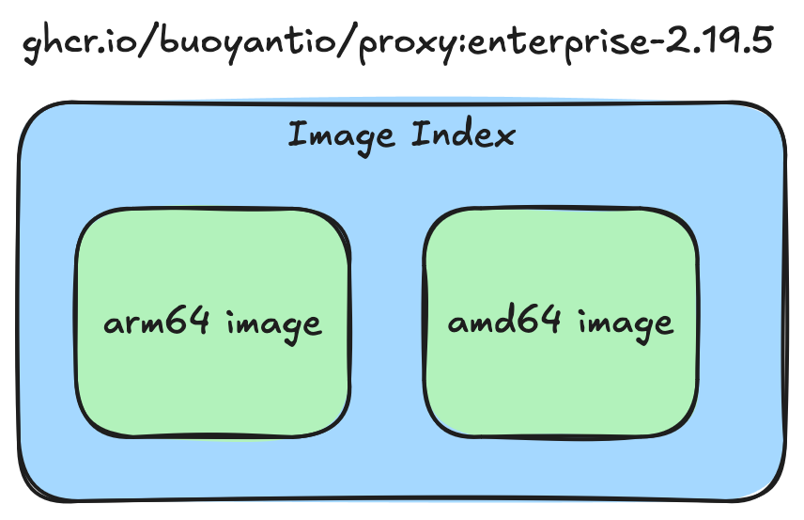

Slide 28
Making everything available for consumers
Building with attestations sticks the attestations into the image index.
Very simple
Any consumer of the image can easily get the attestations
What if we want to add more attestations?
For example: suppose we want to add a VEX document attesting that we’re not vulnerable to a newly-discovered vulnerability

Slide 29
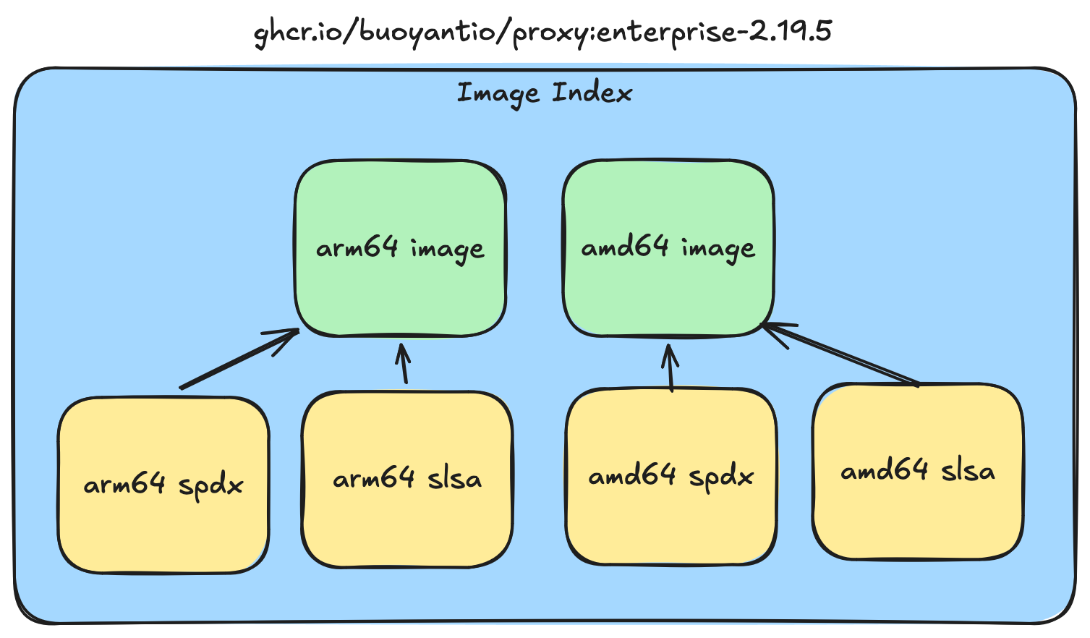

Slide 30
Making everything available for consumers
The problem with putting everything in the index is that any change requires re-signing everything.
Huge problem! because this looks the same as if we’d changed, say, the executable
What we really want here is immutable images
  That makes it easy for consumers to know that we’re not changing things under the hood
  Still need to add new documents though!

Slide 31
Making everything available for consumers
OCI 1.1 introduces the concept of Referrers to deal with this.
{
"mediaType": "application/vnd.oci.image.manifest.v1+json",
"size": 995,
"digest": "sha256:f76e9041...",
"artifactType": "application/slsa+json",
"subject": {
"mediaType": "application/vnd.oci.image.manifest.v1+json",
"size": 4902,
"digest": "sha256:698c60c8...",
"platform": {
"architecture": "amd64",
"os": "linux"
}
},
"layers": [
{
"mediaType": "application/slsa+json",
"size": 83226,
"digest": "sha256:a9dedf28…"
}
]
}
Referrers are outside the index, but link other objects back to the index.

Slide 32
Making everything available for consumers
OCI 1.1 introduces the concept of Referrers to deal with this.
Referrers are outside the index, but link other objects back to the index.
Our example here is a SLSA document
{
"mediaType": "application/vnd.oci.image.manifest.v1+json",
"size": 995,
"digest": "sha256:f76e9041...",
"artifactType": "application/slsa+json",
"subject": {
"mediaType": "application/vnd.oci.image.manifest.v1+json",
"size": 4902,
"digest": "sha256:698c60c8...",
"platform": {
"architecture": "amd64",
"os": "linux"
}
},
"layers": [
{
"mediaType": "application/slsa+json",
"size": 83226,
"digest": "sha256:a9dedf28..."
}
]
}

Slide 33
Making everything available for consumers
OCI 1.1 introduces the concept of Referrers to deal with this.
Referrers are outside the index, but link other objects back to the index.
Our example here is a SLSA document for image index 698c60c8...
{
"mediaType": "application/vnd.oci.image.manifest.v1+json",
"size": 995,
"digest": "sha256:f76e9041...",
"artifactType": "application/slsa+json",
"subject": {
"mediaType": "application/vnd.oci.image.manifest.v1+json",
"size": 4902,
"digest": "sha256:698c60c8...",
"platform": {
"architecture": "amd64",
"os": "linux"
}
},
"layers": [
{
"mediaType": "application/slsa+json",
"size": 83226,
"digest": "sha256:a9dedf28..."
}
]
}
Notes:
This is the digest of the index to which we’re attaching something

Slide 34
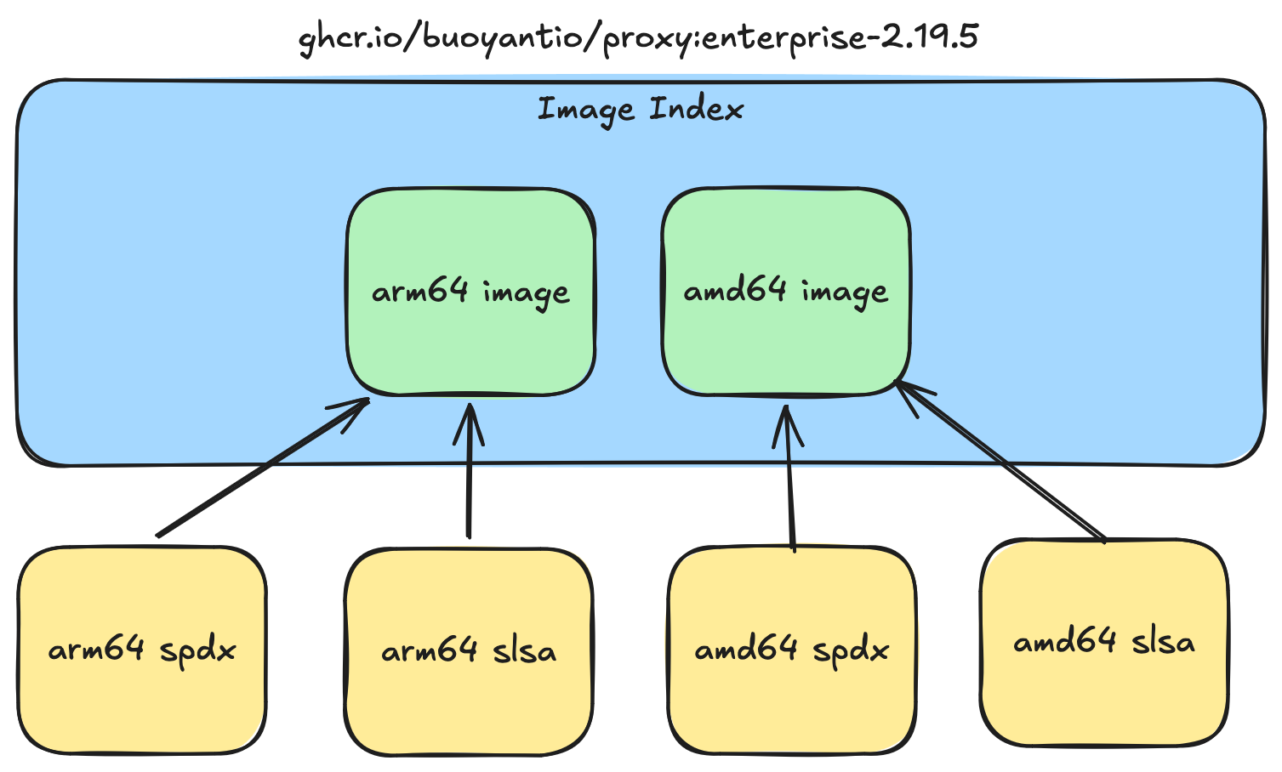

Slide 35
Making everything available for consumers
The great thing about Referrers is that they allow the image itself to be immutable.
The really great thing about Referrers is the API that goes with it.
“Hey registry, tell me all the objects that refer to index 698c60c8...“
The consumer doesn’t need to worry about finding these new records; the registry handles it for them.
(Incidentally, Referrers are how you can do multiple signatures for an image, too.)

Slide 36
Making everything available for consumers
We lean hard on Referrers for BEL.
In fact, we wrote our own tool to take attestations built in our images and publish them using Referrers instead.

Slide 37
From this ------> To this

Slide 38
Making everything available for consumers
✗ oras discover ghcr.io/buoyantio/controller:enterprise-2.19.5 \
--platform linux/arm64
ghcr.io/buoyantio/controller@sha256:c72bcd7a...
├── application/spdx+json
│ └── sha256:c33a6e39...
│ └── [annotations]
│ ├── vnd.buoci.subject.digest: sha256:c72bcd7a...
│ ├── vnd.buoci.subject.name: controller
│ ├── org.opencontainers.image.created: "2026-03-07T01:37:40Z"
│ ├── vnd.buoci.artifact-type: application/spdx+json
│ ├── vnd.buoci.predicate-type: https://spdx.dev/Document
│ └── vnd.buoci.role: image-attestation
└── application/slsa+json
└── sha256:5057b574...
└── [annotations]
├── vnd.buoci.artifact-type: application/slsa+json
├── vnd.buoci.predicate-type: https://slsa.dev/provenance/v0.2
├── vnd.buoci.role: image-attestation
├── vnd.buoci.subject.digest: sha256:c72bcd7a...
├── vnd.buoci.subject.name: controller
└── org.opencontainers.image.created: "2026-03-07T01:37:40Z"

Slide 39
Making everything available for consumers
✗ oras discover ghcr.io/buoyantio/controller:enterprise-2.19.5 \
--platform linux/arm64
ghcr.io/buoyantio/controller@sha256:c72bcd7a...
├── application/spdx+json
│ └── sha256:c33a6e39...
│ └── [annotations]
│ ├── vnd.buoci.subject.digest: sha256:c72bcd7a...
│ ├── vnd.buoci.subject.name: controller
│ ├── org.opencontainers.image.created: "2026-03-07T01:37:40Z"
│ ├── vnd.buoci.artifact-type: application/spdx+json
│ ├── vnd.buoci.predicate-type: https://spdx.dev/Document
│ └── vnd.buoci.role: image-attestation
└── application/slsa+json
└── sha256:5057b574...
└── [annotations]
├── vnd.buoci.artifact-type: application/slsa+json
├── vnd.buoci.predicate-type: https://slsa.dev/provenance/v0.2
├── vnd.buoci.role: image-attestation
├── vnd.buoci.subject.digest: sha256:c72bcd7a...
├── vnd.buoci.subject.name: controller
└── org.opencontainers.image.created: "2026-03-07T01:37:40Z"

Slide 40
Making everything available for consumers
✗ oras discover ghcr.io/buoyantio/controller:enterprise-2.19.5 \
--platform linux/arm64
ghcr.io/buoyantio/controller@sha256:c72bcd7a...
├── application/spdx+json
│ └── sha256:c33a6e39...
│ └── [annotations]
│ ├── vnd.buoci.subject.digest: sha256:c72bcd7a...
│ ├── vnd.buoci.subject.name: controller
│ ├── org.opencontainers.image.created: "2026-03-07T01:37:40Z"
│ ├── vnd.buoci.artifact-type: application/spdx+json
│ ├── vnd.buoci.predicate-type: https://spdx.dev/Document
│ └── vnd.buoci.role: image-attestation
└── application/slsa+json
└── sha256:5057b574...
└── [annotations]
├── vnd.buoci.artifact-type: application/slsa+json
├── vnd.buoci.predicate-type: https://slsa.dev/provenance/v0.2
├── vnd.buoci.role: image-attestation
├── vnd.buoci.subject.digest: sha256:c72bcd7a...
├── vnd.buoci.subject.name: controller
└── org.opencontainers.image.created: "2026-03-07T01:37:40Z"

Slide 41
Making everything available for consumers
✗ oras discover ghcr.io/buoyantio/controller:enterprise-2.19.5 \
--platform linux/arm64
ghcr.io/buoyantio/controller@sha256:c72bcd7a...
├── application/spdx+json
│ └── sha256:c33a6e39...
│ └── [annotations]
│ ├── vnd.buoci.subject.digest: sha256:c72bcd7a...
│ ├── vnd.buoci.subject.name: controller
│ ├── org.opencontainers.image.created: "2026-03-07T01:37:40Z"
│ ├── vnd.buoci.artifact-type: application/spdx+json
│ ├── vnd.buoci.predicate-type: https://spdx.dev/Document
│ └── vnd.buoci.role: image-attestation
└── application/slsa+json
└── sha256:5057b574...
└── [annotations]
├── vnd.buoci.artifact-type: application/slsa+json
├── vnd.buoci.predicate-type: https://slsa.dev/provenance/v0.2
├── vnd.buoci.role: image-attestation
├── vnd.buoci.subject.digest: sha256:c72bcd7a...
├── vnd.buoci.subject.name: controller
└── org.opencontainers.image.created: "2026-03-07T01:37:40Z"
Notes:
And if you’re unhappy that I’m just showing annotations here, we can take the SHA of one of documents…

Slide 42
How do consumers use all this?

Slide 43
How do consumers use all this?
Remember: the point is to communicate with the consumer
Corollary: if they can’t use what you’re communicating, what’s the point?

Slide 44
How do consumers use all this?
This part of the ecosystem is fairly new and rapidly evolving.
Right now, though, consumers can:
Discover Referrer documents using oras (as shown above!)
Verify discovered signatures using cosign
Feed discovered SBOMs into Grype to find out any vulnerabilities associated with them
Use policy engines like Kyverno to define - and enforce - runtime policies
Notes:
If you’re interested,

Slide 45
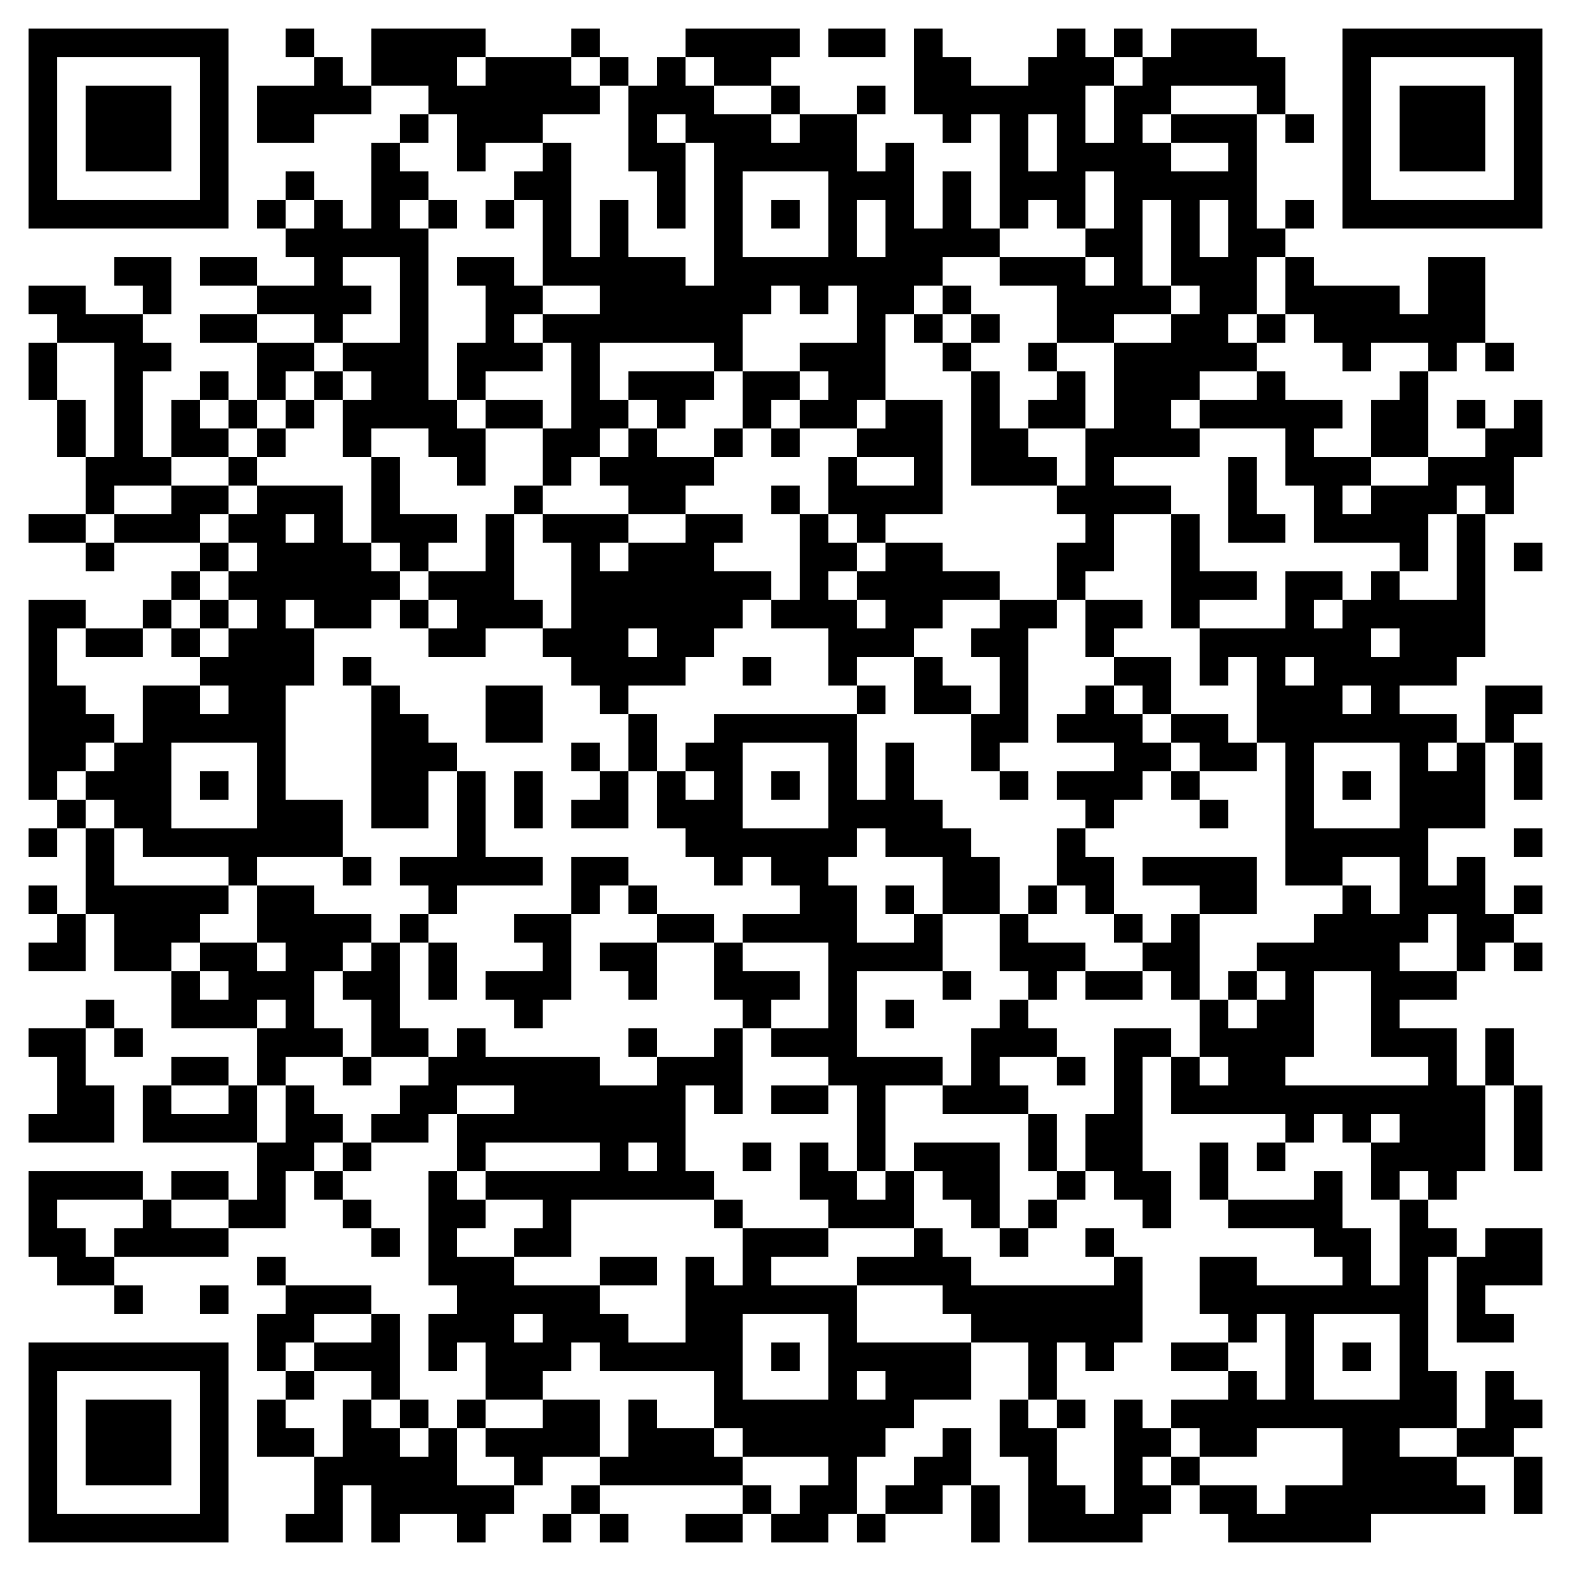
How do consumers use all this?
For anyone curious, here’s a link to an example Kyverno policy that requires any BEL image
to be signed by Buoyant
have an SPDX attestation which is also signed by Buoyant
(It doesn’t fit on the slide. 😅)
https://docs.buoyant.io/buoyant-enterprise-linkerd/
latest/guides/verifying-signed-artifacts/
Notes:
If you’re interested,

Slide 46
Conclusion

Slide 47
Conclusion
The real point of supply chain security is communication.
You can definitely get real value out of this already.
You can definitely migrate real projects to use it.
Things will get simpler as the tooling evolves.

Slide 48


Read our complete guide to Linkerd on EKS
Linkerd: the best service mesh for

Slide 49
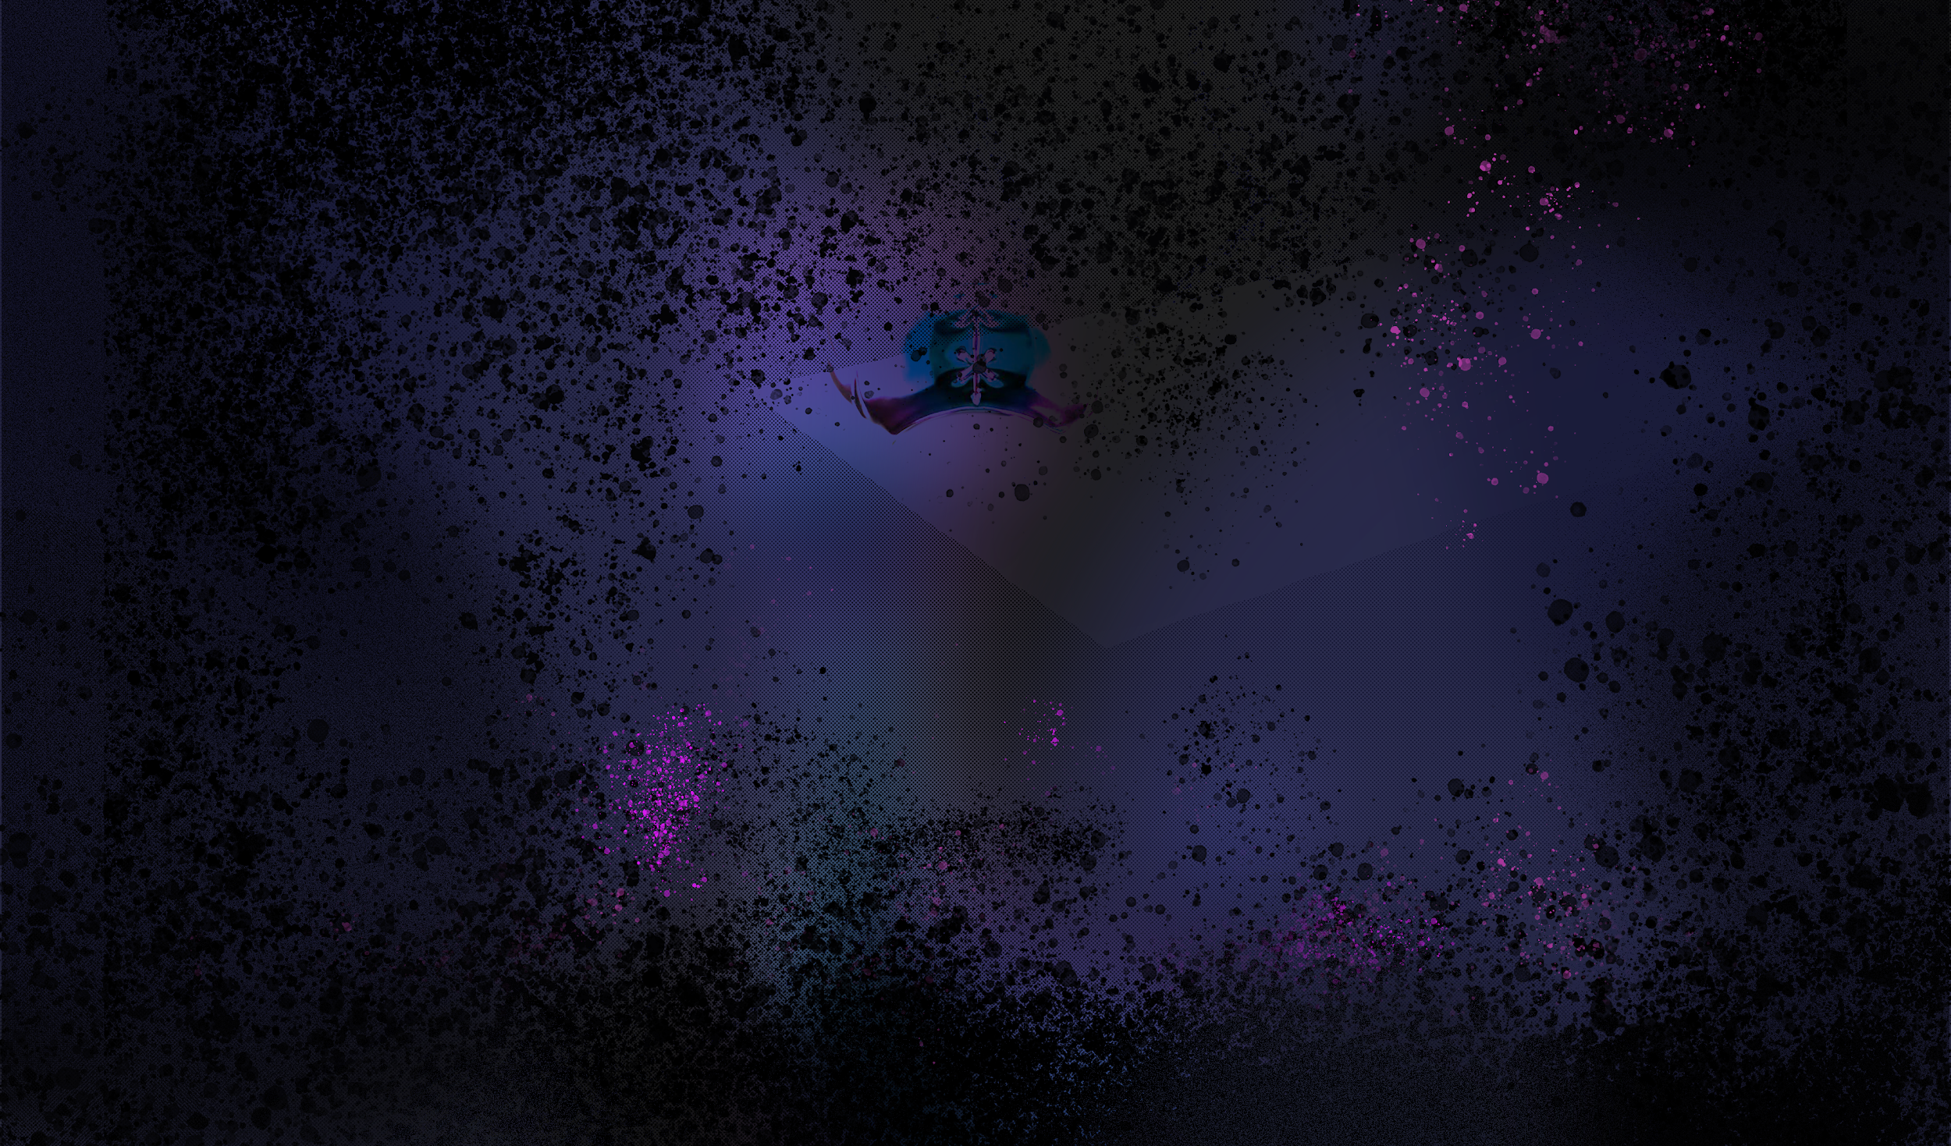


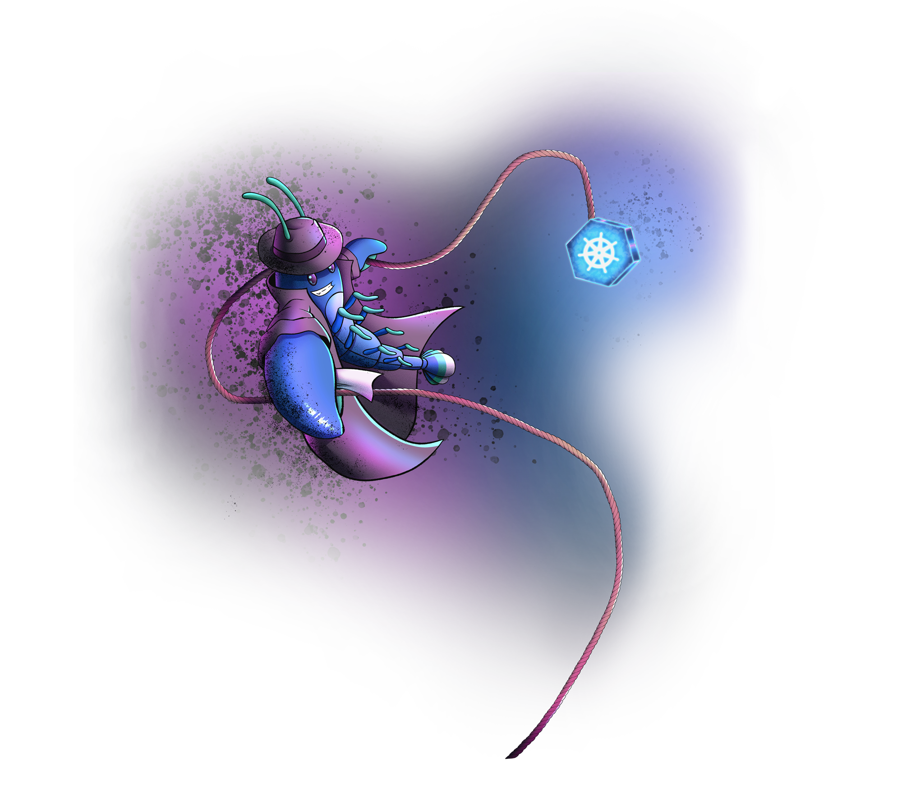
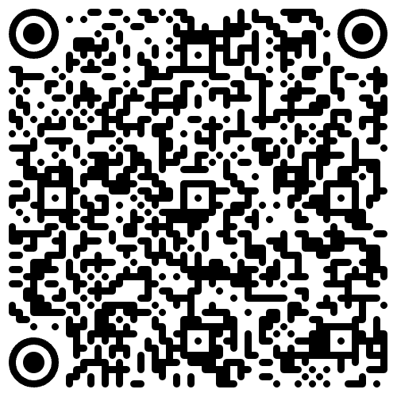

The ultimate cloud native escape room party
Wed 25 @ 8pm
Register today!
Notes:
We are hosting an Escape Room Party
Half escape room, half party
Should be a lot of fun
Register with the QR code and join us!

Slide 50
Q&A

