Slide 2
KubeVirt Benchmarking at Scale
A Vendor Neutral, E2E Test Framework for Cloud-Native Virtualization
Bhumitra Nagar
Dhruv Bhatnagar

Slide 3




Hello!
Bhumitra Nagar
Sr. Member of Technical Staff
Dhruv Bhatnagar
Sr. Member of Technical Staff
Notes:
Presenter- Dhruv & Bhumitra

Slide 4
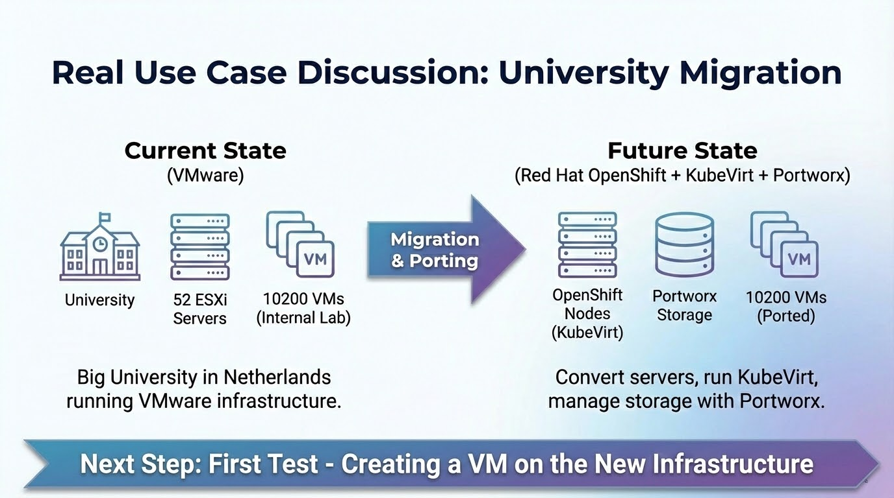
Let’s start with a Real Use Case Discussion
Notes:
Presenter- Dhruv
“If KubeVirt is your new virtualization platform, you need a repeatable way to answer the same operational questions you answered on vSphere—at scale, across storage, without vendor bias.”
Goal: show pain point instantly, not explanation.

Slide 5
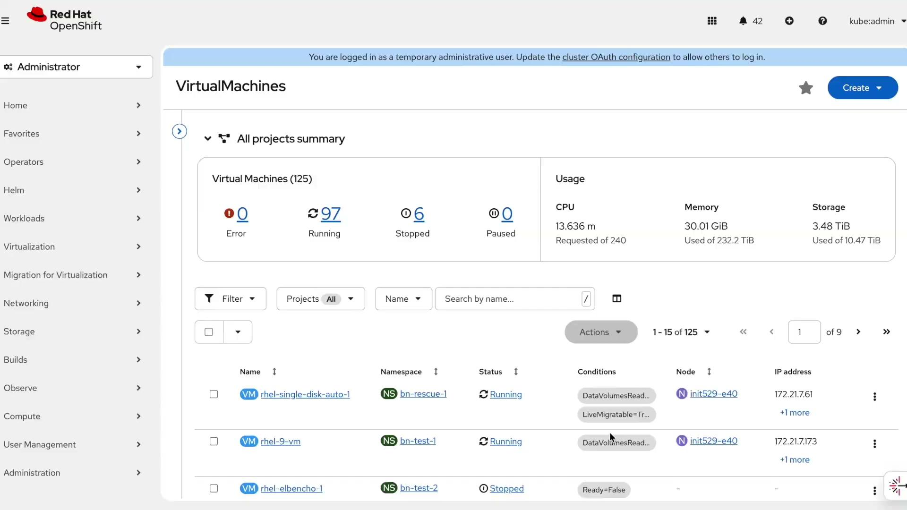
Demo (Create a VM from OCP UI)
Notes:
Presenter- Dhruv
“If KubeVirt is your new virtualization platform, you need a repeatable way to answer the same operational questions you answered on vSphere—at scale, across storage, without vendor bias.”
Goal: show pain point instantly, not explanation.

Slide 6
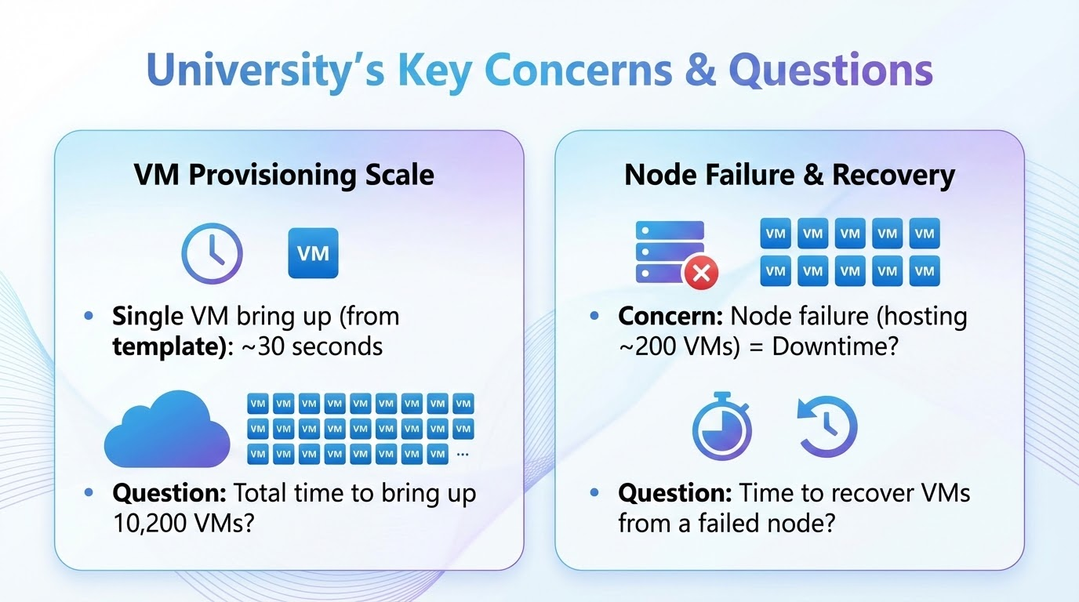
What happened next
Notes:
Presenter- Dhruv

Slide 7
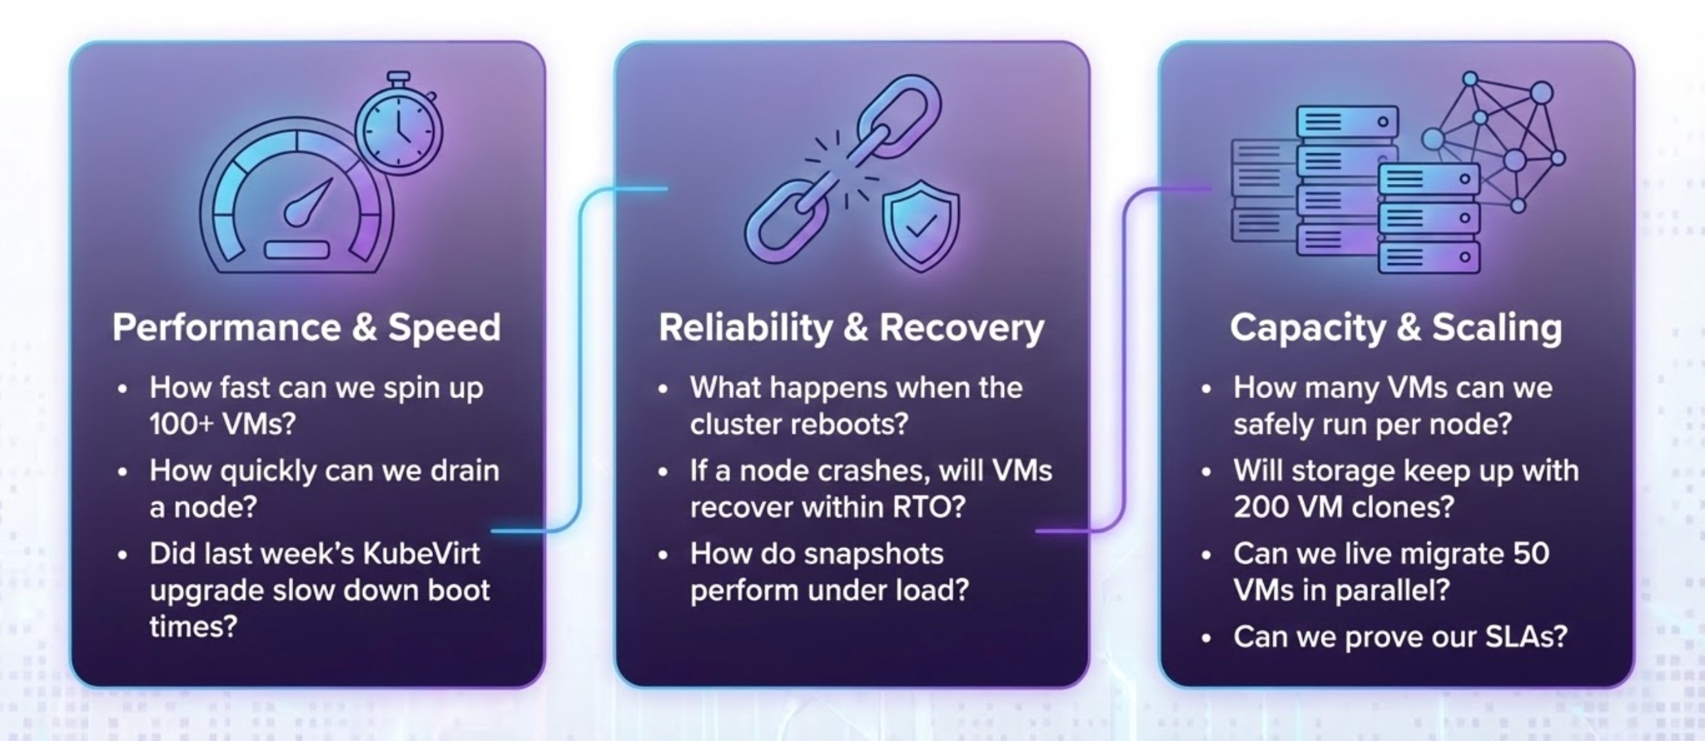
We found customers had these common questions

Slide 8

Meet Virtbench: A KubeVirt Benchmark Suite
Comprehensive VM Benchmarking
Any Storage
Any Kubernetes
Clone
Live Migration
Any Scale
Boot Storm
Capacity
Storage IO Benchmark with FIO
Automated Results and Dashboard
On-premises
Public Cloud
Managed
One CLI
virtbench <scenario> <options>
Notes:
Add a architecture diagram which is basically the capabilities on what It can do..

Slide 9
How it Works?
Pre Flight Validation
Select a Benchmark Scenario
Run at Scale
Scale Up and Repeat
Review Dashboard
Validate:
Cluster
KubeVirt
Networking
CSI storage prerequisites
VM Provisioning
Boot Storm
Live Migration
Capacity
Failure Recovery
FIO
Run with a specific config
Compare:
VM counts
Disks per VM
Configuration changes (baseline vs new)
Unified results across runs or products with:
Trends
Regression
Drill-down metrics
Notes:
Add a architecture diagram which is basically the capabilities on what It can do..

Slide 10

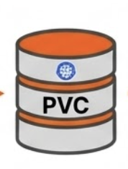


Benchmark Capabilities: VM Provisioning + Boot Storms
Provisioning: Tests end-to-end time to clone a “golden” image into N data sources in parallel
Boot Storm: Storage performance when N VMs boot in parallel at same time
VM
VM
volume attach
Booting..…
ping VMI
check OS
Running
volume clone
Golden Template
VM
N clones
Notes:
Presenter: Bhumitra
What it tests
End-to-end time to create DataSources and clone VM images (golden image → ready-to-use clones)
Measures how fast storage can produce bootable replicas at scale
Why VMware admins care
Equivalent to template / golden image cloning in vSphere
Directly impacts time-to-provision, scale-out speed, and day-1 onboarding
Key metrics captured
Clone completion time (p50 / p95)
Success rate / failure reasons
Storage-level behavior under concurrency (queueing, throttling, timeouts)
What you learn
Best storage class / settings for fast cloning
Safe parallelism limits for large provisioning events
Optional demo line (1-liner)
“We clone a base image into N ready DataSources in parallel and track completion time + variance.”
If you want, I can also rewrite this into a 3-bullet “KubeCon style” version with very large text (less dense), or add a tiny “command + dashboard screenshot” placeholder line to match your other capability slides.
write it
Datasource Clone Benchmark
Tests end-to-end time to clone a “golden” image into N DataSources in parallel
VMware equivalent: template cloning → directly impacts VM provisioning speed at scale
Reports clone time (p50/p95), success rate, and how storage behaves under concurrency

Slide 11
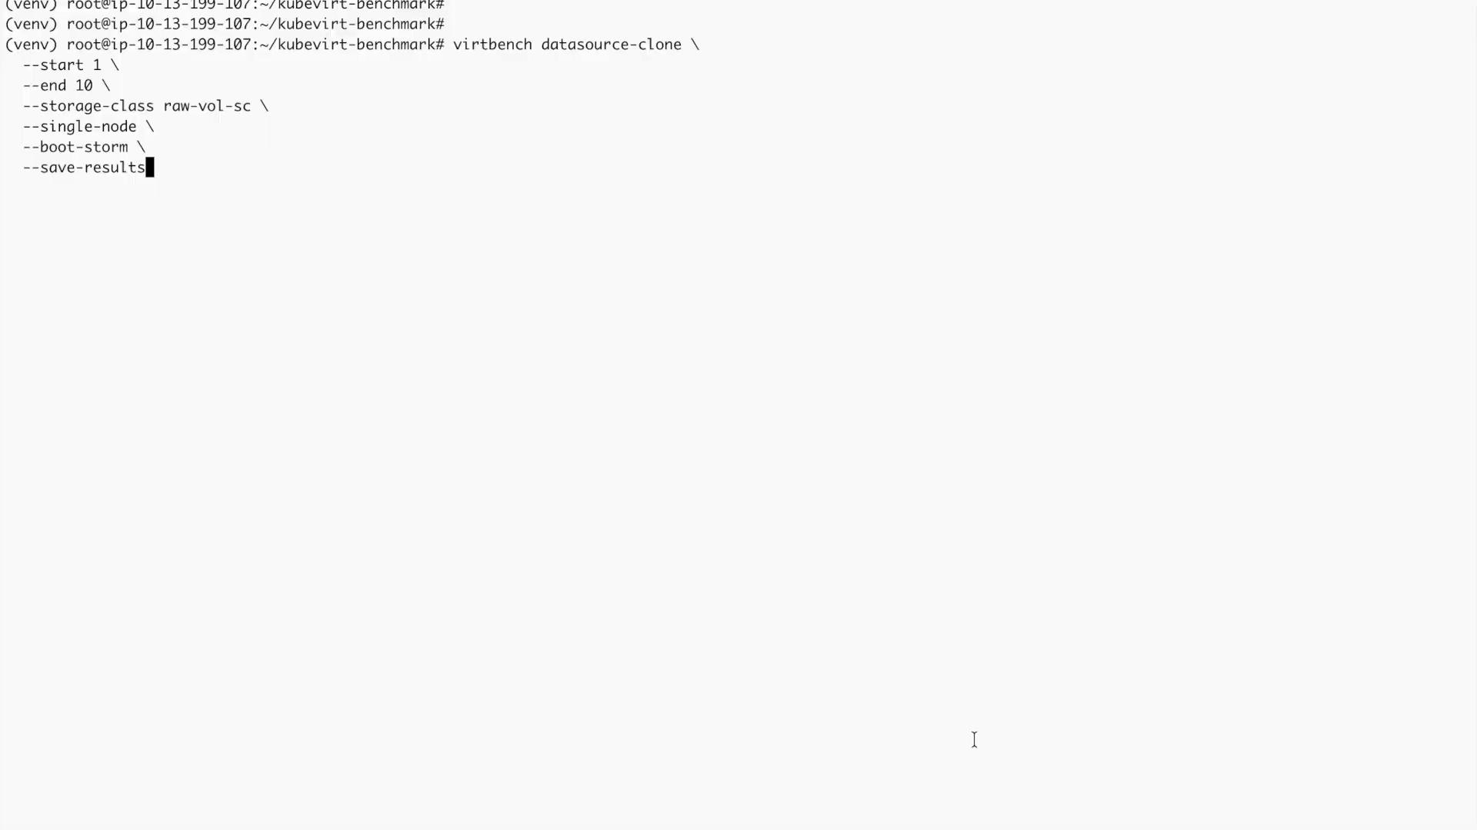
Benchmark Capabilities: VM Provisioning + Boot Storms - Quick Demo
Notes:
Presenter: Bhumitra
What it tests
End-to-end time to create DataSources and clone VM images (golden image → ready-to-use clones)
Measures how fast storage can produce bootable replicas at scale
Why VMware admins care
Equivalent to template / golden image cloning in vSphere
Directly impacts time-to-provision, scale-out speed, and day-1 onboarding
Key metrics captured
Clone completion time (p50 / p95)
Success rate / failure reasons
Storage-level behavior under concurrency (queueing, throttling, timeouts)
What you learn
Best storage class / settings for fast cloning
Safe parallelism limits for large provisioning events
Optional demo line (1-liner)
“We clone a base image into N ready DataSources in parallel and track completion time + variance.”
If you want, I can also rewrite this into a 3-bullet “KubeCon style” version with very large text (less dense), or add a tiny “command + dashboard screenshot” placeholder line to match your other capability slides.
write it
Datasource Clone Benchmark
Tests end-to-end time to clone a “golden” image into N DataSources in parallel
VMware equivalent: template cloning → directly impacts VM provisioning speed at scale
Reports clone time (p50/p95), success rate, and how storage behaves under concurrency

Slide 12
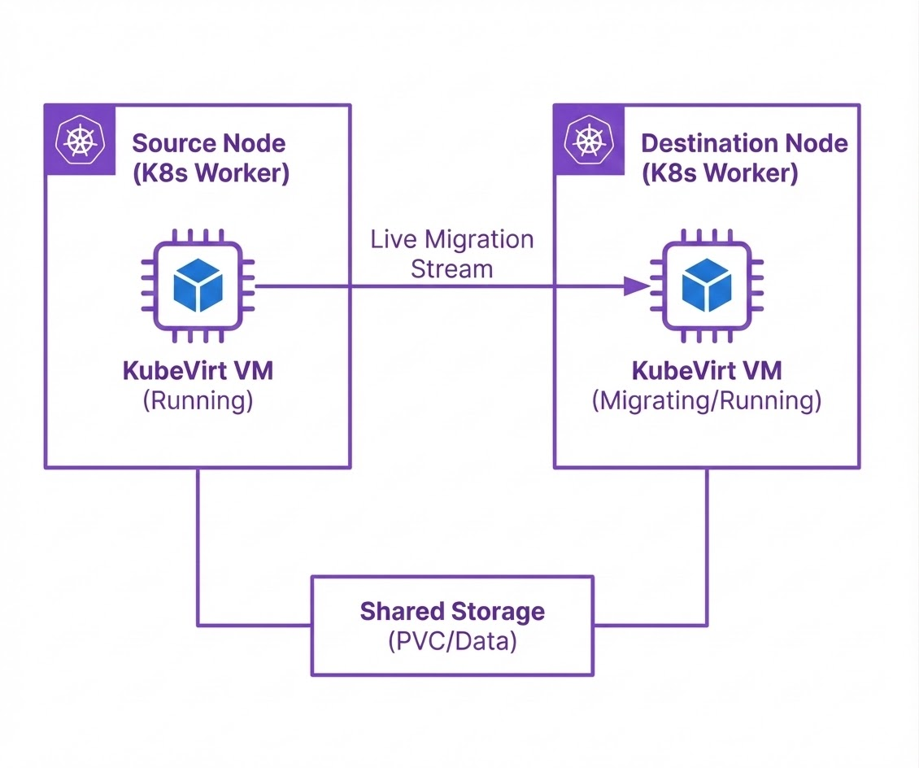
Benchmark Capabilities: VM Live Migration
Measures end-to-end live migration time at scale: sequential, parallel, node evacuation, and round-robin
Captures per-VM and batch duration so you can predict maintenance windows and upgrade time
Notes:
Example: migrating 5 in parallel is fine, but at 20 parallel migrations you start seeing longer times, failures, or workload disruption.
Live Migration Benchmark
Why it matters
Predict node evacuation / maintenance window duration at scale
Validate safe parallel migrations without timeouts or instability
Catch regressions after platform/storage/network changes
What virtbench measures
End-to-end migration time for sequential, parallel, round-robin, and node-evacuation runs
Per-VM + batch migration duration (p50/p95) and success rate
Where time is spent as you scale (e.g., network vs storage pressure/variance)
Why VMware admins care
Direct analog to vMotion / DRS evacuations—but now quantified for KubeVirt
Turns “can we drain a node?” into measured, repeatable timings for ops planning

Slide 13
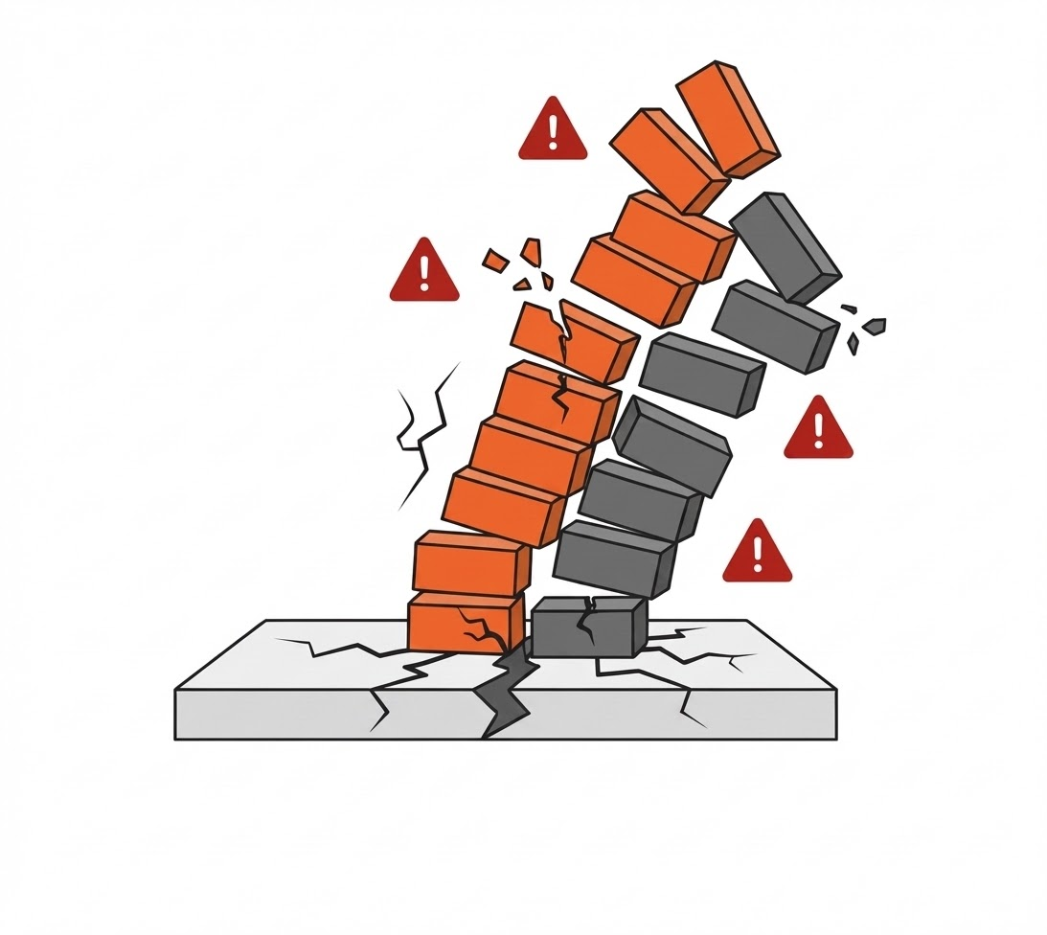
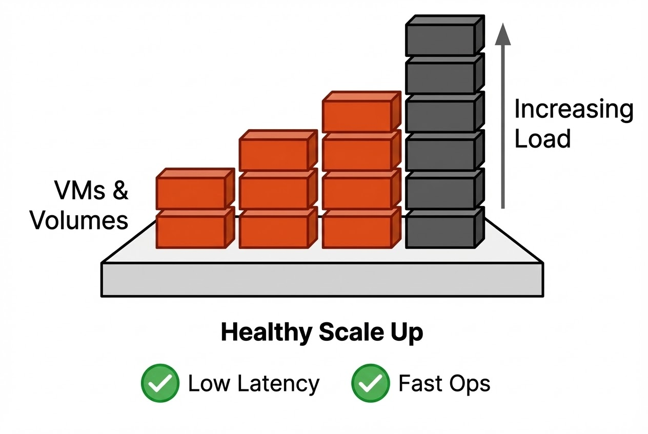

Benchmark Capabilities: Capacity
Max VMs per node (and the curve as you scale up)
Max volume attachments per node (disk density limits)
Breaking point detection: when critical operations start failing or going Pending (schedule, resize, snapshot, restart)
Scaling

Slide 14
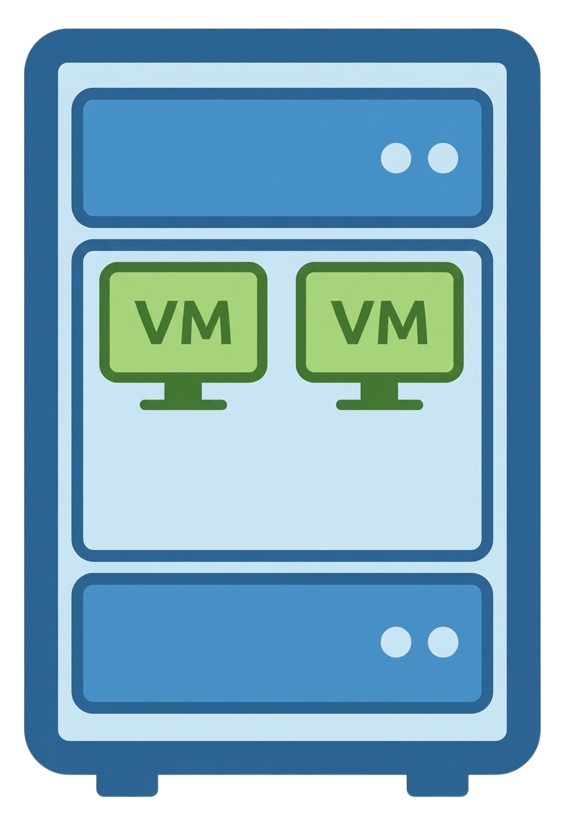

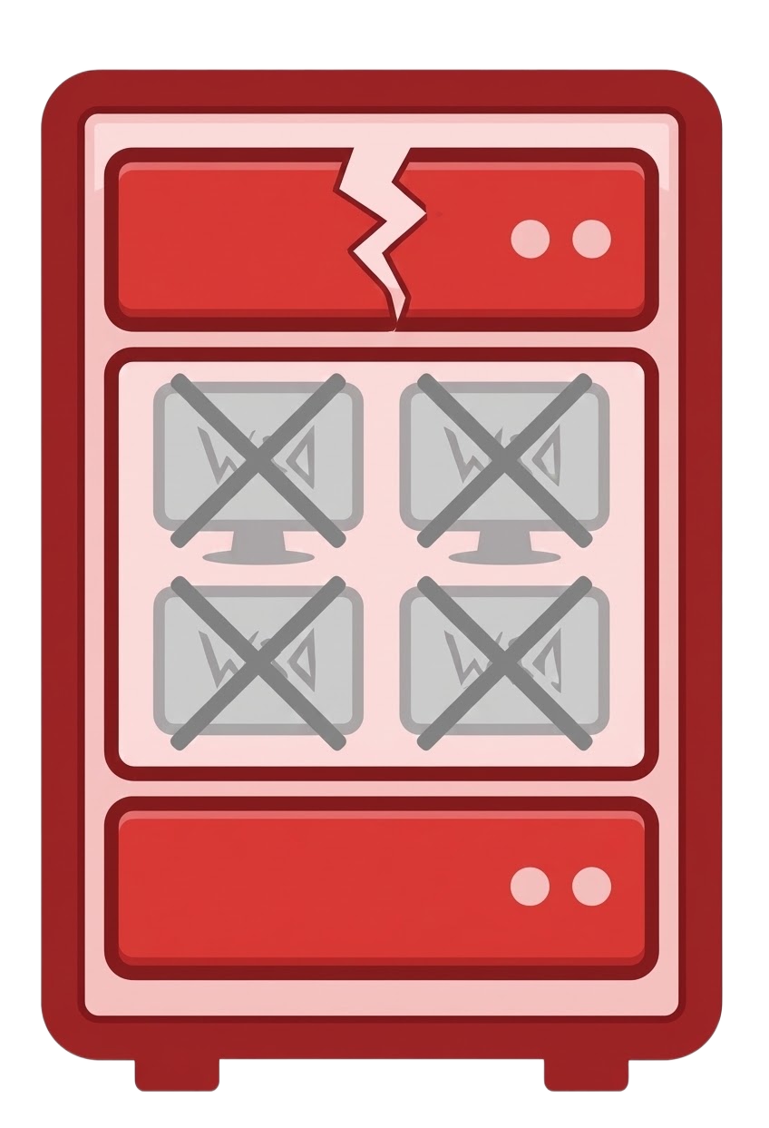

Benchmark Capabilities: Failure Recovery
Validates that VMs can recover and restart on healthy nodes after a node failure. It covers:
Automated FAR Testing - Uses Fence Agents Remediation (FAR) operator for automated node fencing
Manual Failure Testing - Manual node power-off without FAR operator
VMs migrate to healthy nodes
Node Failure

Slide 15
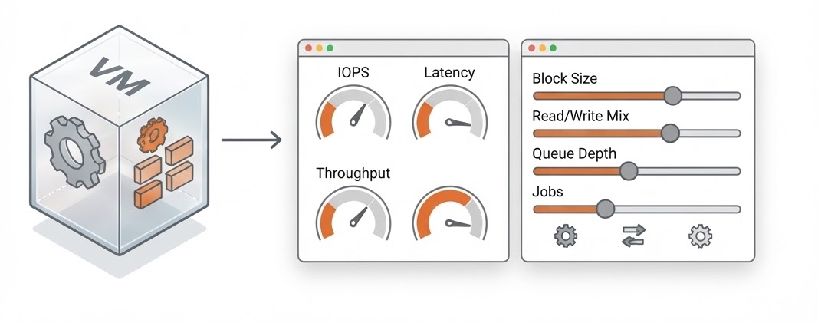
Benchmark Capabilities: FIO
FIO Benchmarking (Inside the VM)
Measures storage performance as seen by the VM (IOPS, latency, throughput)
Supports flexible tuning: block size, read/write mix, queue depth, number of jobs, runtime, etc.

Slide 16
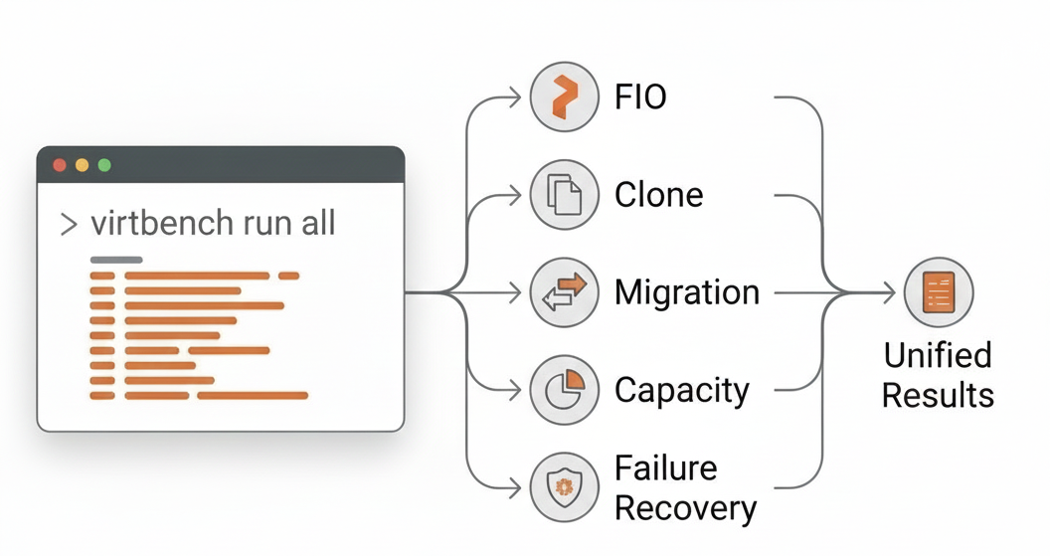
Benchmark Capabilities: virtbench cli
Single CLI to run all benchmarks
virtbench <scenario> <options>
Example Command:
# Evacuate all 50 VMs from the busiest node (or a specific node), in parallel
virtbench migration --start 1 --end 50 --evacuate --auto-select-busiest --save-results

Slide 17
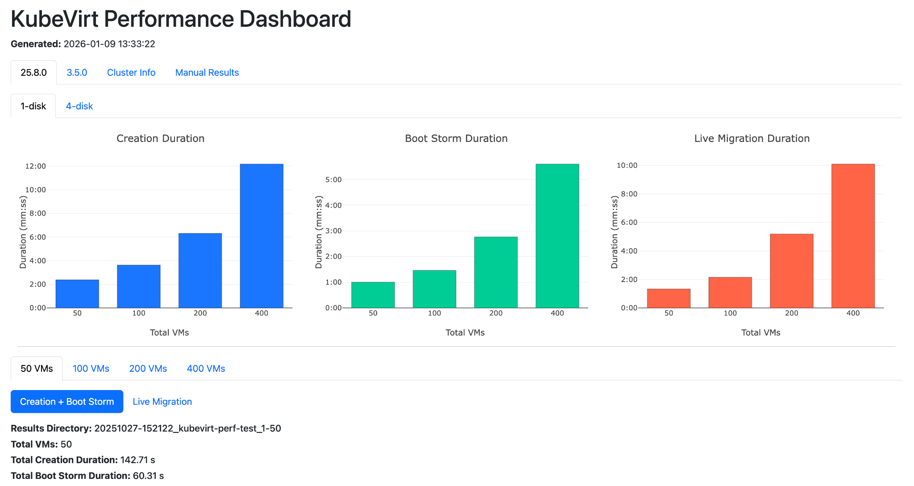
Dashboard
Single interactive view of all benchmark runs
View cluster information and compare storage version, disk config, and VM count
Compact charts for Creation, Boot Storm, Migration, and Capacity durations.
Virtbench Results DashBoard
Notes:
Presenter: Bhumitra

Slide 18
Use Case: In-house Testing
Portworx Enterprise vs Portworx CSI
Day-2 management with Portworx Enterprise vs CSI for Modern Virtualization
Automation at Scale
(Operational Readiness)
Live Migration
(Planned Maintenance)
Node Failure
(Unplanned Node failure)
Stress test system end-to-end by booting up multiple workloads concurrently.
Simulate operational efficiency
(Boot up 400 VMs simultaneously)
Time taken to evict workloads out of worker node for a planned maintenance.
Simulate Maintenance (Live Migrate 400 VMs)
Time taken to recover from a node down scenario.
Simulate Node failure (bring up 80 VMs).

Slide 19

Customer Use Case
Notes:
Presenter: Bhumitra
Create a dummy dashboard
Show PX CSI vs PX Enterprise side by side.
Use the static HTML and show for boot storm and live migration.
VMs came online 4.8x faster with PXE than CSI
86% less time!
VMs Live Migrated 4.4x faster with PXE than CSI
76 % less time to live migrate workloads!
Completion time (i.e., gap between CSI and PXE) increased exponentially with density
The more VMs, more PVs, the longer it takes to Live Migrate all workloads off of a node.

Slide 20
Dashboard - Live Demo
Notes:
Presenter: Bhumitra
Create a dummy dashboard
Show PX CSI vs PX Enterprise side by side.
Use the static HTML and show for boot storm and live migration.
VMs came online 4.8x faster with PXE than CSI
86% less time!
VMs Live Migrated 4.4x faster with PXE than CSI
76 % less time to live migrate workloads!
Completion time (i.e., gap between CSI and PXE) increased exponentially with density
The more VMs, more PVs, the longer it takes to Live Migrate all workloads off of a node.

Slide 21
What’s Next?
Easier Install & Execution
Grafana Integration
VM Operations
3rd Party Tools
              Python packaging
              pip install virtbench
              Run via container (virtbench image in-cluster for consistent environments)
              Grafana integration for storing/visualizing runs over time
New dashboards for comparisons, trends, and regressions
              More Day 2 Ops
Hotplug Disks
Power Off X% VMs
Start/Stop IO inside VMs on demand
Elbencho support for standardized I/O workloads alongside FIO
Notes:
Presenter: Bhumitra

Slide 22
How to Contribute
GitHub : https://github.com/portworx/kubevirt-benchmark
KubeVirt Benchmark Docs : https://portworx.github.io/kubevirt-benchmark/
Meet us at Booth #450

Slide 23
Q & A

Slide 24
Thank You

Slide 25
Connecting Your Laptop to Present
If you plan to use speaker notes, please follow the steps below to ensure your laptop is set up correctly. This will allow you to view your notes while the audience sees only your slides.
Before Connecting
Close all unnecessary apps & tabs
Turn off notifications
Disable Night Mode / TrueTone
Don’t enter full-screen presentation mode yet
At the podium
Plug in the HDMI cable
If needed, use your USB-C to HDMI adapter
On Mac, click “Allow” if prompted
USE “EXTENDED DISPLAY” MODE (NOT MIRRORED)
Using MAC
Go to System Settings > Displays
Click the “Arrangement” tab
Make sure “Mirror Displays” is unchecked
Using PC
Press ⊞Win + P, then select “Extend”
Or: Right-click on the Desktop > Display Settings
Under Multiple Displays, select “Extend these displays”

Slide 26
Connecting Your Laptop to Present
When Using PowerPoint
Start slideshow: ⌘Cmd + Enter (Mac) or F5 (PC)
Or: Click Slide Show > Play from Start
If notes show on the wrong screen, click “Swap Displays”
https://www.youtube.com/watch?v=gQ3D4m-5pww
Google Slides
Use Google Chrome as your browser
Click the dropdown next to ‘Slideshow’ > select Presentation Display Options
Check “Presenter View” and “Full Screen”
If prompted, select "Allow"
Choose the external display (may have a strange name like PanasonicXYZ)
Click Start Slideshow
https://www.youtube.com/watch?v=-GT7WCvPcys

