Slide 1
Vitess
More Data, No Problems

Slide 2
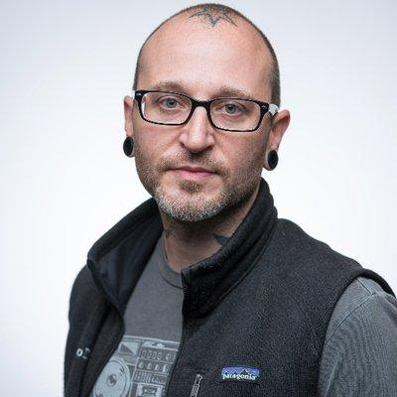
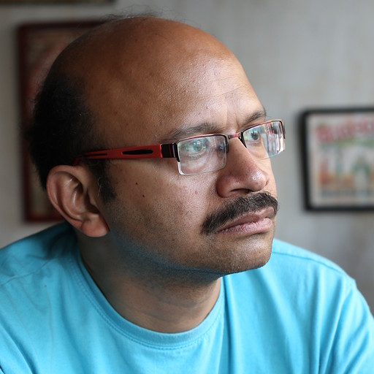

Matt Lord
Rohit Nayak
Maintainer
Software Engineer
@mattalord
Maintainer
Software Engineer
@rohitnayak

Slide 3
Agenda
Vitess Overview
Scaling in Vitess
Q&A

Slide 4
Overview of Vitess

Slide 5
What is Vitess?
Works With
Cloud Native Database
Massively
Scalable
Database Frameworks
ORMs
Highly Available
MySQL 8.0/8.4 Compatible
Legacy Code
Third-Party Applications
Logical Database
Many physical databases
Query Routing
gRPC Clients
MySQL protocol
Single
Connection

Slide 6















Vitess in Production

Slide 7
Key Adopters
Slack
100% on Vitess
GitHub
Issues, PRs, …
Vinted
2.2M QPS
PlanetScale
Database Service
Notes:
Every slack message goes through Vitess
Every Issue, Pull Request and notification goes through Vitess
PlanetScale - more than 10,000 databases

Slide 8
Community
12 maintainers
467 PRs
101 PR authors
36 companies
PR authors from 23 companies
Year 2024-2025
Source: devstats.cncf.io

Slide 9
Glossary
Keyspace
Shard
VSchema
Vindex
Notes:
Keyspace: in mysql a database lives on a server. On vitess a logical database lives on multiple servers, and this is what we call a keyspace.
We can have multiple shard in a keyspace
A shard can live on multiple nodes.
VSchema: specification of how to shard each table. Sharding is flexible and user-defined
Vindex: Like a MySQL index, used to compute which shard each row lives in.

Slide 10
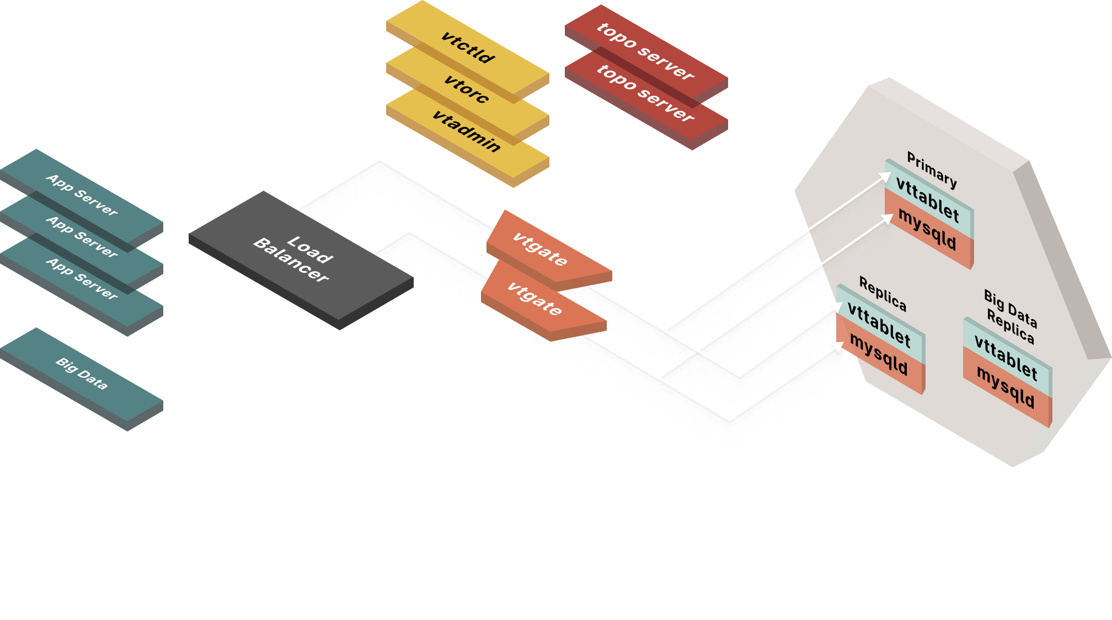
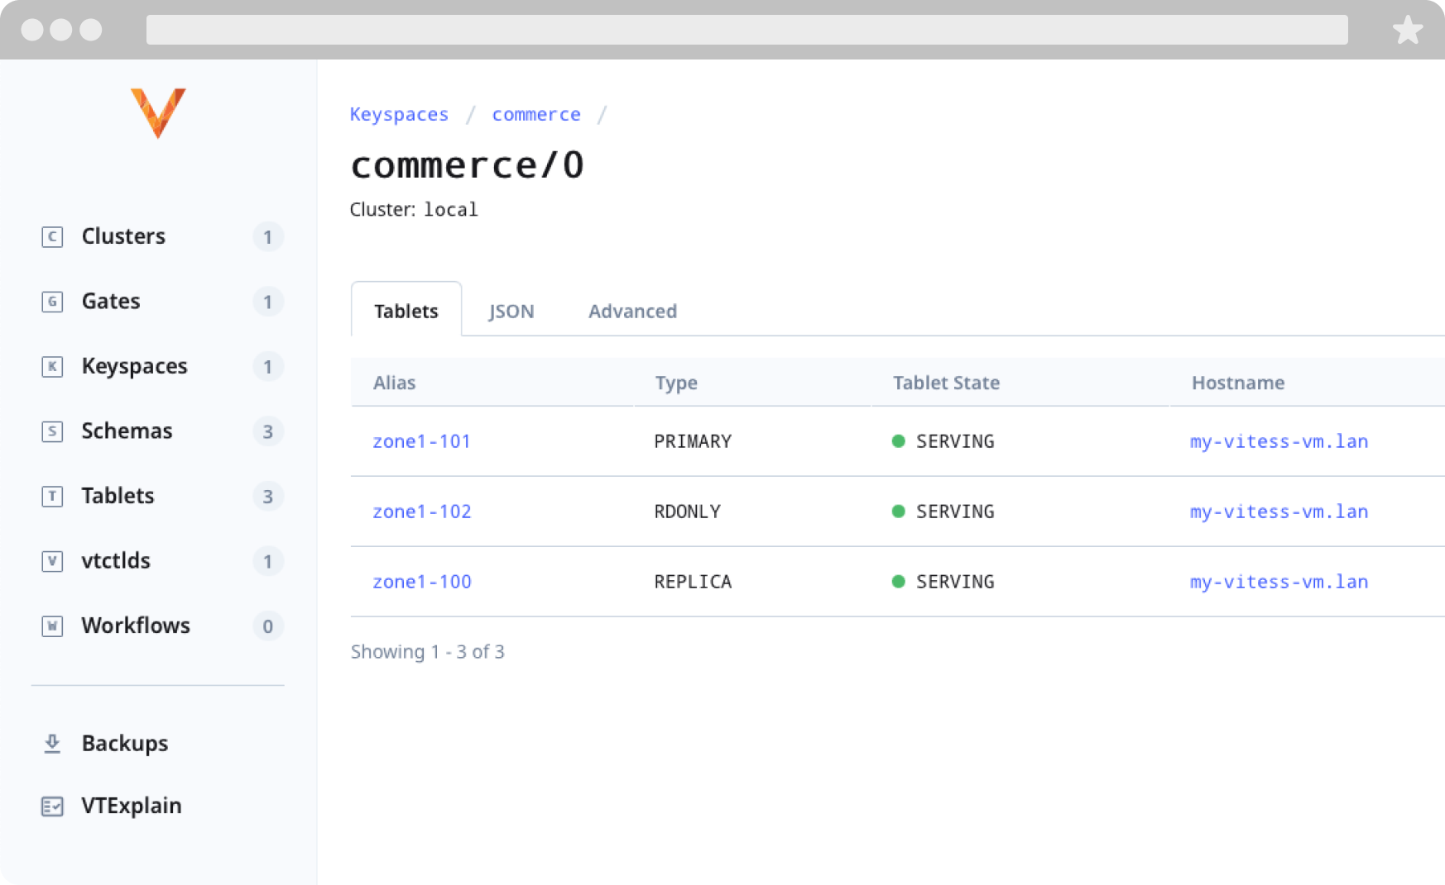
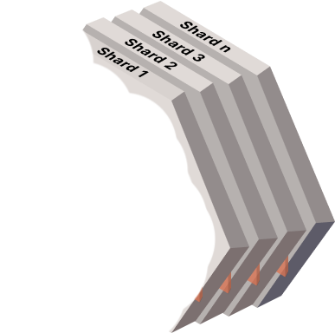


Architecture
Notes:
Shards
Composed of one primary and many replicas
MySQLd instance which is where the data is stored
There is a VTTablet attached to MySQL as a sidecar
VTTablet manages the mysql instance
Exposes a gRPC API that is used by VTGate to send queries
VTGate
User-facing component of vitess
Application connects to it using the SQL protocol
It is responsible for:
Parsing queries
Planning queries
Executing those plans
It routes queries to the proper shard and keyspace
Control Plane
VTCtld
Administration tool of Vitess
VTOrc, it is a component that repairs failing MySQL instances
VTAdmin which is our new frontend UI to visualize and manage the vitess cluster
Topo Servers
Stores metadata and configuration
Can be etcd or even zookeeper

Slide 11
Features
MySQL Compatibility
Online Schema Changes
Resharding
Seamless Backup/Recovery
Materialization
Query Consolidation
Cluster Management
Automatic Failure Detection/Repair
Notes:
Vitess is MySQL compatible, we try to make sure most of MySQL queries are compatible with Vitess
Resharding, allows you to partition your keyspace into different shards
Materialization which allows you to have near-real-time materialized views of your data
Different than MySQL in the sense that we do not need to refresh the view
VTCtld which lets you manage your cluster
Online Schema Changes allowing you to do non-blocking schema changes on a serving table
Seamless backup / recovery operations
Query consolidation to avoid having any sudden spike and overload on your tablet
And automatic failure detection and repair thanks to vtorc

Slide 12
Some Users at Scale
Cursor: https://x.com/vmg/status/1961481692817813538
Github: https://www.youtube.com/watch?v=_Xl24s_0mZs
Slack: https://slack.engineering/scaling-datastores-at-slack-with-vitess/
Uber: https://medium.com/@kansalharshit84/why-uber-moved-from-postgres-to-mysql-a-controversial-shift-in-the-world-of-databases-b71016be3f62
Vinted: https://vinted.engineering/2023/04/27/vinted-vitess-voyage-chapter-1-autumn-is-coming/

Slide 13
Examples of Scale
Slack: millions of messages, ~3 million QPS
Multiple 256 / 512-way sharded databases
Square: billions of payment transactions per month
Github: all PRs/Issues, 5.5 million QPS, 1200+ mysqlds, 500 TiB
PlanetScale: peak QPS: 10s of millions, thousands of clusters
Finance DB > 10 PiB
Migrations of 1B rows/hour
Largest cluster 950 PiB

Slide 14
Considerations at Scale
Data Migrations
Backup & Restore
Ground Realities
Moving tables
Splitting or consolidating
Schema changes
Scheduling
Backup times
Restore times
Personnel
Need to keep costs low
Time to market
Unpredictable traffic spikes

Slide 15
Data Flows
Scaling With Vitess
Summary

Slide 16

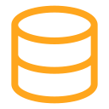
Importing & Sharding Your Data
Set up the Vitess cluster
Set up a tablet for the external MySQL instance
Add this unmanaged tablet to Vitess
Use MoveTables to move [and shard] the data into Vitess
source (RDS)
target/-80
RowStreamer
BinlogStreamer
Unmanaged Tablet
BinlogStreamer
target/80-
RowStreamer
Notes:
For when you want to try out Vitess or switch to using Vitess in production. Provision a vttablet instance that points to your database. We call this an unmanaged tablet, because it doesn’t own the mysql instance underneath, unlike regular tablets in a Vitess cluster.
Provision the Vitess cluster with the number of shards you would like to start with. It could also be a single unsharded keyspace (== database).
The MoveTables VReplication workflow can be used to move all tables from this external keyspace into the new Vitess cluster. There are two types of VReplication workflows: some that are short-lived, like MoveTables, active only the duration of action it is performing. Others, like Materialization, run for the lifetime of your application.
Workflows run in two phases: the first is a copy phase where we do a bulk copy of the existing data. Then we switch to a replicating mode where the recent updates are processed as DMLs are applied. During the copy phase the data in the target is not fully consistent, but we rapidly reach consistency and when we are replicating the target is consistent. This algorithm gives us a very high speed.
Once MoveTables has very low replication lag, we can then switch traffic over to the target. We can either switch reads first to Vitess, while writing to the existing database or switch both read and write traffic.
Once writes are switched, you have the option of running reverse replication, where the data updates in Vitess are replicated back to the source. It allows you to rollback your migration. You can run with Vitess for as long as you want before deciding whether to rollback or commit to Vitess.
Common imports, other than mysql servers, are from RDS/Aurora/MariaDB.

Slide 17
Vertical / Functional Sharding
You have many/all tables in a single keyspace (logical database)
You want to move some of the tables to a new keyspace
You want to achieve this without making significant changes to your application or incurring downtime
Use MoveTables to split the tables into N keyspaces
products/-
Product Related Tables
alldata/-
orders/-
Order Related Tables
Notes:
When your database has become too large and you are having problems serving reads or processing writes, and throwing hardware at the problem no longer works, you need to distribute your data across databases.
If you have multiple services which share the same database, vertical or functional sharding can provide an intermediate sharding option as compared to horizontal sharding where you distribute a table across databases. The latter usually requires some amount of rearchitecture and/or code/query level mods, whereas, with vertical sharding, you continue to have each table in a single database.
In the illustration here we move the catalog service to one database and sales to another. The same MoveTables flow we used while importing data into Vitess applies here too. However in this case we only move a subset of tables, one MoveTables for the product/mfg/category tables and another for customer/order tables.
—--------------
Your database has gotten too large in some way:
Certain tables too large (in general, for filesystem, etc.)
Too many tables, and in aggregate the database is too large
You want to have more MySQL instances handle the load:
Scale writes (somewhat)
Scale reads (somewhat)
You want to move some tables to different keyspaces (and MySQL instances)
This is called vertical [re]sharding
Can often be an intermediate step to horizontal resharding
This example is a simplified version of what we walked through in the previous slide. Note that this example involves two distinct MoveTablesoperations as there are two target keyspaces involved.
This can be done when either or both of the source and target keyspaces are sharded. They’re unsharded in this example to simplify the concept.

Slide 18
Horizontal Re-Sharding
Going from 1 to 2 shards, 2 to 4, 4 to 8, to … as your dataset and usage grows
  Can also shrink by merging shards and/or keyspaces when needed
Add new shards to manage new keyspace range splits
Use Reshard to redistribute the data
orders/-40
orders/-80
orders/40-80
orders/80-c0
orders/80-
orders/c0-
Notes:
In the previous example we showed unsharded databases. However it is possible that one or more tables grow so large that a single database server cannot provide the required query throughput or storage capacity. One option then is to distribute a table across multiple databases: horizontal sharding.
VReplication’s Reshard workflow uses the same basic process as MoveTables, the difference being that the source and target are both the same keyspace, just different shards.
Reshard doesn’t have to only scale up, you can also scale down as easily, by reducing the number of shards or undoing vertical sharding by moving the tables back to a single database, in our previous example. This way you can scale appropriately depending on your business volume: an ecommerce site scaling up during the holiday season and scaling back after.
Vitess supports multiple ways in which you can define a sharding key, called vindexes. For example, one sharding strategy is to hash the product or customer id column, or you can map data from geographical zones to reside on different shards, to comply to data localization laws, using multi column vindexes or lookup vindexes for grouping tenants. There is a Vindex API, so you can build your own custom strategy.
—--------
There’s no hard limit on the number of shards per keyspace, so you could go all the way to 1 record or keyspace ID per shard, which given the 64 bit range would be 18,446,744,073,709,551,615 shards :-)
We have some users with 2000+ shards
If you need to scale reads, you can usually add more replicas to existing shards
use leetdb@replica in your app or client will cause vtgate to round-robin queries to replica tablets in the shard for your session
When you need to scale writes:
You need to get more MySQL instances (and thus hardware, like CPU and disk) to share the workload
To do this, you add more shards (master instances), with their matching replicas and rdonly instances
You will need to partition (shard) your larger tables across the instances, or you will not increase your write throughput
This is called horizontal resharding
Reshard uses the same basic process as MoveTables, the difference being that the source and target are both the same keyspace, just different shards

Slide 19
Trust & Verify Migrations
Runs a VDiff between the source and target shards
Asynchronous
Progress reporting and ETA
Auto resume on error
Resilient to failures and topology changes
$ vtctldclient vdiff --target-keyspace customer --workflow commerce2customer --format=json show last
{
"Workflow": "commerce2customer",
"Keyspace": "customer",
"State": "started",
"UUID": "1922fd46-48fd-11ed-96c4-920702940ee0",
"RowsCompared": 3370000,
"HasMismatch": false,
"Shards": "-80,80-",
"StartedAt": "2022-10-11 00:39:00",
"Progress": {
"Percentage": 16.99,
"ETA": "2022-10-11 00:39:49"
}
}
Notes:
When we first built VReplication we wanted to validate that the data was faithfully copied without any data loss: missing rows, incorrect column values, extra rows … The VDiff tool was built for this purpose. It runs an exact comparison between consistent snapshots from the source and the target. The previous version had some limitations (it was synchronous and not robust against network errors or reparenting, since it can run for several hours), now fixed by VDiff2 which is more resilient and performant.
—----------
Before switching reads or writes you may
This relates to MoveTables and Reshard, where we are copying the complete contents of tables — not counting differences in the schema between the source and target — from one set of shards to another. So we’ll talk about this now before getting into the other VReplication workflows.
Once the MoveTables or Reshard VReplication workflow is in the RUNNING state — which means that the tables have been copied and we’re now just replicating changes to them — the next step is to be sure that the data was correctly copied and we do not have any extra rows on the source or target, or differences in rows — accounting for by different schemas automatically. This is where VDiff comes into play.
You would do this using the vtctl VDiff command
Target primary tablets then select source tablets to use for the comparison — one per shard
This is done serially table by table today… (we hope to parallelize this in the future)
On the target tablets:
Stops the VReplication workflow for the VDiff operation, to “freeze” the state
On the source tablets:
Starts a transaction with a consistent snapshot
Locks the table to get the GTID_EXECUTED snapshot for our read view, then unlocks the table
On the target tablets:
Starts replication UNTIL we have reached that GTID_EXECUTED position in the VStream which matches the read view from the source
Starts a transaction with a consistent snapshot (remember that the state is “frozen” now on the target tablet)
On the source and target tablets:
Issues a SELECT <cols>, FROM <table> ORDER BY <pkcols>
On the target tablets:
Reads the results from those SELECTs — in a streaming fashion — and compares the rows on both sides logically, as the schema may be different on either side, keeping a record of any differences seen
Restarts the VReplication workflow
On the source and target tablets:
Closes the open transactions with a ROLLBACK
NOTE: for large tables, holding a transaction open on the source tablets can have a significant impact on normal query traffic due InnoDB MVCC needing to keep those older versions of rows around if they are updated after the transaction started (innodb_history_list_length). For this reason, I would recommend always using REPLICA tablets for VDiff operations whenever you can (when the source is an unmanaged tablet, such as when moving from RDS e.g. into Vitess, you may only have a PRIMARY tablet available). You can control that using the --tablet_types=REPLICA flag for the VDiff command.
In v14+ the default was changed to: --tablet_types=in_order:RDONLY,REPLICA,PRIMARY
Now you have confidence in the data migration and you can then move on to Switching Traffic from the source shards to the target shards… we’ll cover the SwitchTraffic command in a bit and discuss how that works alongside RoutingRules and reverse replication streams that are setup automatically to support reverts or rollbacks.

Slide 20
Materialized Views
Real-time views into a [transformed] [subset] of data
Persisted as a table, could be sharded
This data is automatically kept correct and up-to-date
Use Materialize to setup the materialized view
Some applications
  Aggregations for analytics
  Denormalized tables
  Anonymization of PII data
  Local copies of a reference tables
Notes:
Materialized Views are views of your data persisted in a table. Materialized Views are useful to increase performance and efficiency of queries: for example, to aggregate/rollup sales data for data warehousing/analytics; cache copies of lookup tables across shards to avoid cross-shard and cross-keyspace queries.
The Materialize workflow in VReplication helps you you do this. You specify the query, typically with filtering of rows and columns, aggregations and data manipulation. The workflow is long-running/perpetual, it will run continually and there is concept of switching writes etc. Once the replication lag of the workflow is low you directly access the materialized table.
Another common use of Materialize is to perform data sanitization in order to protect PII. You specify a query where you anonymize by redacting or masking data, like credit cards/phone numbers/emails/ssn etc while copying the database over to a staging environment or a data warehouse.
—-----------
This uses the same infrastructure that we’ve already covered and is a variation of those MoveTables and Reshard workflows
This works when either or both of the keyspaces are sharded, we used single shard keyspaces here in the example just to simplify the concept
The source and target can also be the same keyspace
The primary difference with Materialize is that instead of copying the entire table (with subsets being on each shard), you are copying the results of the materialization query specified
You also wouldn’t be doing the VDiff or SwitchTraffic steps as these Materialize workflows are always running, for as long as you want the materialized views to exist
Countries, cities, states, postal codes, etc are good examples of lookup tables that you may want to materialize everywhere to avoid cross shard queries now that you’ve split your monolithic dataset up. The ultimate end goal is always that data needed for your queries exists entirely on a single shard — because while Vitess does support cross shard and scatter gather queries — data locality is really important for performance.
Another common example is when you want to do some aggregations, rollups, etc. for data warehousing or data analysis

Slide 21
Change Data Capture
VTGate VStream gRPC API
Vitess managed change event stream
  Keeping your DW in sync with your production DB
  Real-time notifications
  Update Search Index
Stream current snapshot and/or changes
  Entire keyspace / subset of tables / filter query
commerce/-80
VStream Client
app
vtgate
commerce/80-
internal/-
Notes:
VTGate exposes a gRPC service called the VStream API. A client can subscribe to this service to get a continuous stream of change events from the underlying MySQL instances. The change events that VStream emits have similar information to the MySQL binary logs and a single VStream can subscribe to multiple shards for a given keyspace.
Can be used to create CDC tools. For example there is an open-source Debezium adapter for Vitess. Custom adapters to interface with AirByte/Stitch exist.
You can start a VStream from a given position or stream the entire database. The client doesn’t need to be aware of Reshard and MoveTables operations. Streaming State, known as VGTID, is passed to the client so that a stream can be restarted in case of errors.
==============
Generic VReplication Closing Comments:
Performance:
Sharding of large databases 100s of TBs. 10s of billions of rows, 10s of shards. We have a user with over 600 streams doing PII and ETL on a single vttablet streaming 10s of TBs.
Petabytes, billions of rows, thousands of shards, hundreds of streams on a single tablet
JD.com (2020) https://static.sched.com/hosted_files/kccncchina2018english/97/Shanghai%20Kubecon%20%281%29.pdf
KeySpace: 1911
DataCenter: 8
Shard：4438
Tablet：11416
Tables：552104
Most Shards/KeySpace: 72
Data Size 146 TB
252 billion Rows

Slide 22
Data Flows
Scaling With Vitess
Summary

Slide 23
Principles
Isolation (Bulkheads) stateless/shared nothing, no cascading failures
Redundancy multiple copies of data, over-provisioning
Graceful Degradation higher latency (vs failure)
Circuit Breakers throttling, drop new connections
Automated Recovery proactive(auto-scaling), reactive(self-healing)
Observability logging, metrics, alerts
Testing chaos tests, fuzzing, e2e/unit tests, phased (blue/green)releases

Slide 24
Isolation
Cells: Multiple Availability Zones us-east-1, eu-west-2, ap-south-1
    Resources spread across AZs
Multi-Cloud AWS, GCP, Azure
VTGates are stateless
Topo not in query-serving path
    Global & per-cell local topo
Sharded Database shared-nothing, per-shard metadata

Slide 25
Redundancy
  MySQL Replication
    Semi-sync for durable writes
  Sharding limit data unavailability
  Distributed topo cluster 3/5/7 nodes, raft consensus

Slide 26
Graceful Degradation
  VTTablet Query Consolidation
  VTTablet Connection Pooling
  Cell Isolation local cell reads
  VTTablet Backpressure
    Migration Throttling
    Query Throttling
    Load shedding timeouts
  VTGate Buffering failovers (reparents), migration cutovers
  VTGate Replica Reads ignore lagged replicas

Slide 27
Automated Recovery (Self Healing)
Health Checks replica lag, primary reparent
VTOrc observes cluster health, emergency reparent
Backup/Restore pitr, incremental backups, smaller shard sizes
Reversible Workflows schema changes, import, reshard
VTOP: replacement over repair bad mysql, k8s node, vtgate oom

Slide 28
Operations
Telemetry prometheus metrics
Paging alerts replica lag, memory pressure, qps, latency
Regular Updates dependabot, golang versions

Slide 29
Data Flows
Scaling With Vitess
Summary

Slide 30
Resilient at Scale Architecture
MySQL as storage engine: inherits proven durability
Topology Service (etcd) as single source of truth. Global + per-cell
Sharded MySQL: limit single-node failure impact
Multiple Cells => Availability Zones
Stateless query serving (VTGate) layer
    Load balanced
    Topo not in hot query path
Tablet Layer: primary/replica. Supervises MySQL server
    Health checks, Reparenting
    Query throttling, Result caching
    Reject bad queries
Vitess Orchestrator (VTOrc): ~zero downtime failovers
VReplication Control Plane, for all schema/data migration

Slide 31
Resilient at Scale Design
Failover Buffering at VTGate: during cluster events like reparenting
Health-checking & Discovery: vtgate filters out unhealthy tablets
Tablet Throttler: backpressure on VReplication on high replication lag
Cross-shard Transactions (2PC): for consistency
Cell Isolation: local-cell reads on network partition
Operational guardrails: Dry-runs, Reversible migrations, Timeouts
Controlled failovers: for rolling upgrades
Backups: incremental, point-in-time recovery

Slide 32
In Conclusion
The resilient scaling in Vitess comes from a combination of deliberate design decisions
Leveraging using tried-and-tested MySQL replication for redundancy
Using an intelligent routing layer for transparent failover.
Partitioning the system into shards and cells
Automating failover/recovery tasks
And industry standard fault-tolerant patterns
Redundant components
Failover automation
Graceful degradation
Resource isolation
Eventual consistency for performance

Slide 33
Resources
Website: vitess.io
  Docs
  Tutorials
  Source code
Slack: vitess.slack.com
Blogs:
  https://slack.engineering/scaling-datastores-at-slack-with-vitess/
  https://developer.squareup.com/blog/sharding-cash/

Slide 34
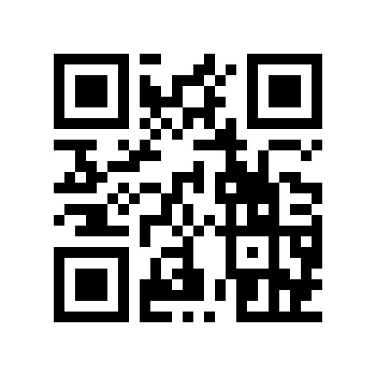
Thank You
Q&A

