Slide 1
An Immersive and Visual Journey Into Kubernetes Networking
Benoît Entzmann, Feesh

Slide 2
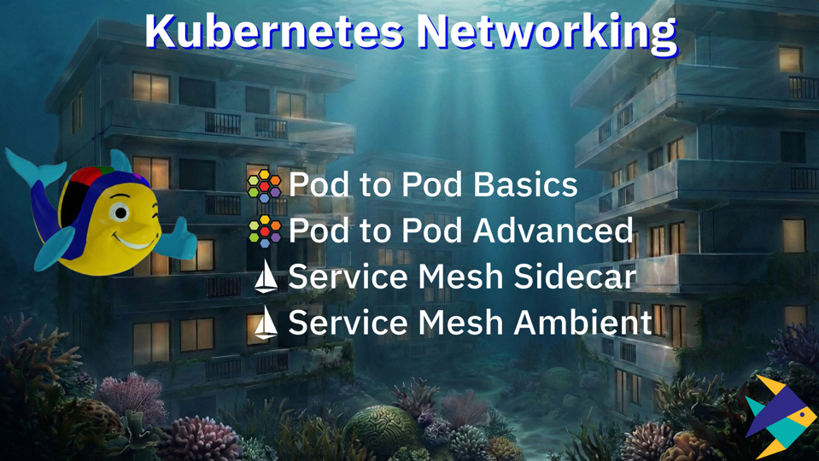

Slide 3
