Slide 1
Audit Ready Kubernetes
How Chase UK Leveraged Policy as Code
for Continious Compliance
Notes:
https://sched.co/2CW2L

Slide 2

Audit Ready Kubernetes
Part 1: Introduction, Challenges, Requirements
Part 2: Kyverno Overview & Key Features
Part 3: The Audit Ready Kubernetes Stack
Notes:
Challenges & Problem
No governance on critical resources (secrets, …) - flagged as audit issue
Scale of environment
Standardize resources configurations, Reporting for Compliance, enforceable
Solutions you looked at….
Admission Controls, Policies, Evaluated OPA (already in use) & Kyverno
No knowledge of rego; no reporting
Kyverno
Introduce project and features
Implementation, Use Cases
Kyverno Policies & Policy Exceptions, OpenReports, Prometheus / Thanos, Grafana,
Enforce mode for “resource controllers (virtual resources)”; cleanup existing violations
Outcomes
2023 - 5 policies (1 month PoC - Prod)
2024 - 30 policies
2025 - 44 policies (categories: PSS, Best Practices, RBAC BP, FinOps, Service Mesh, …)
Audit times, before and after: RFIs from auditors took days to address. Now real-time dashboards.
Futures
Kyverno is a first-class citizen for clusters.
Unify policy landscape

Slide 3


About Us
Jim Bugwadia,
Co-founder & CEO @ Nirmata;
Kyverno Maintainer
Nischay Goyal,
Sr. Lead Platform Engineer @ Chase UK
JPMorganChase

Slide 4
Introduction
Kubernetes in a highly regulated environment

Slide 5

Who We Are
2.5M+
customers
£20B+
deposits
#1
customer service
Notes:
https://share.google/aimode/F7dDxzNdCgsuEjGlu

Slide 6

The Reality of Regulated Kubernetes
Highly regulated financial environment
Hundreds of services, multiple clusters
  50 clusters
  2000 nodes
Independent backend teams shipping fast
Strong audit & compliance expectations
Compliance
Agility
Notes:
Environment & Constraints
Highly regulated financial environment
Hundreds of services, multiple clusters
Independent backend teams shipping fast
Strong audit & compliance expectations

Slide 7
Challenges
✘ Reactive compliance processes
✘ Manual auditing
✘ Lack of standard reporting
😳
Notes:
“Kubernetes gave flexibility — but flexibility without guardrails became an audit risk.”

Slide 8
Our Requirements
Standardized resource configurations
Enforceable guardrails (not guidelines)
Policy defined once, applied everywhere
Developer-friendly (no security bottleneck)
Auditor-ready reporting
Scales with cluster & policy growth
🤩
Notes:
“We weren’t looking for another tool — we were looking for a governance model.”

Slide 9
Solutions Evaluated
What we looked at
Existing OPA usage
Building custom webhooks / admission controllers
Kyverno
Other policy engines & solutions
🧐

Slide 10
Reality Check
OPA already in use, but..
Rego expertise was limited
4 years in development - with only 4 policies to show!
High dependency on platform & security engineers
Lack of reporting → “no developer ownership”
🤔
Notes:
8 mins

Slide 11
Kyverno
Unified Policy as Code, Simplified

Slide 12
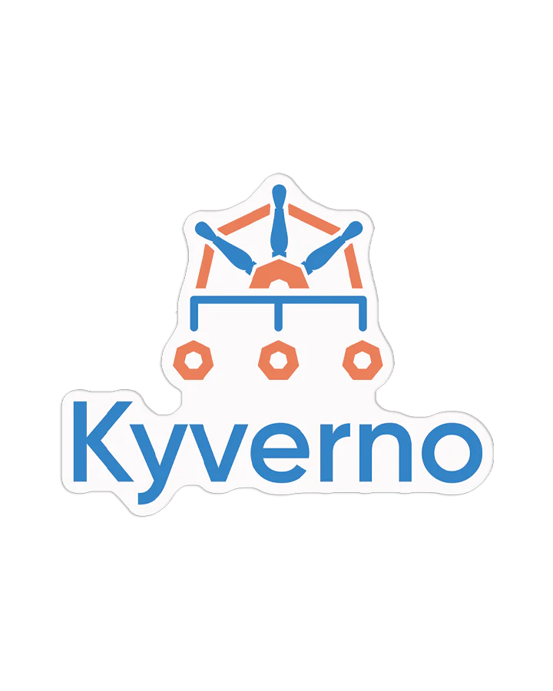
Kyverno
Declarative YAML/CEL based Policy as Code
Full Resource Lifecycle Management
Integrated Reporting
Fine-Grained Exceptions
Built for Kubernetes, now runs everywhere
3.2B+
9K+
573
4200+
Image Pulls
GitHub Stars
Contributors
Slack Members

Slide 13

Complete K8s Resource Lifecycle Management
ValidatingPolicy
ImageValidatingPolicy
MutatingPolicy
GeneratingPolicy
DeletingPolicy
Kyverno enables powerful policy-based automation use cases

Slide 14





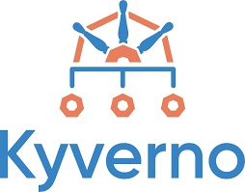
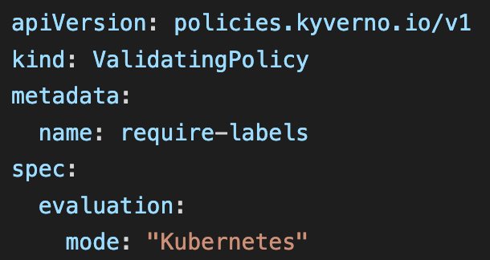
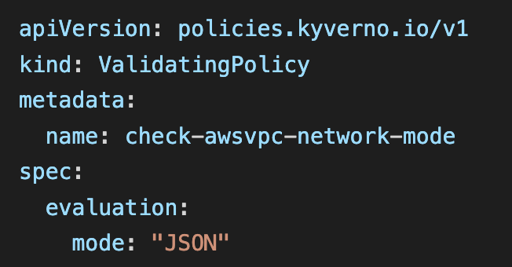
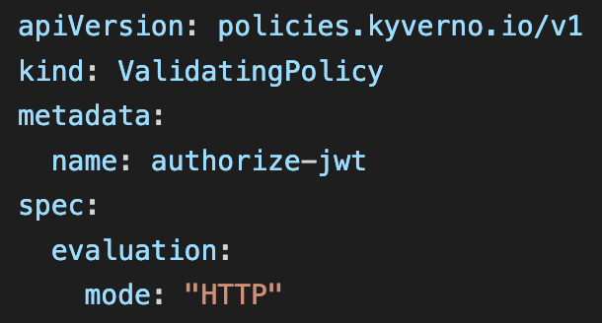
Same Policy - Works Everywhere!

Slide 15
Kyverno Use Cases
Security
Operations
Optimization
Pod security
Workload security
Least Privilege RBAC
Micro-segmentation
Multi-tenancy
Image Signing & Verification
CI/CD Pipeline Scans
Terraform Scans
Self-Service Namespaces
Self-service infrastructure
Labels and Annotations Management
Naming conventions
Just In Time (JIT) Provisioning
Custom CA management
Time bound policies
Resource governance and cleanup
Resource Requests and limits
Quota Management
Team & app labels
Scaling limits
Scheduled resources (auto-cleanup)
QoS management
Resource/cost governance

Slide 16

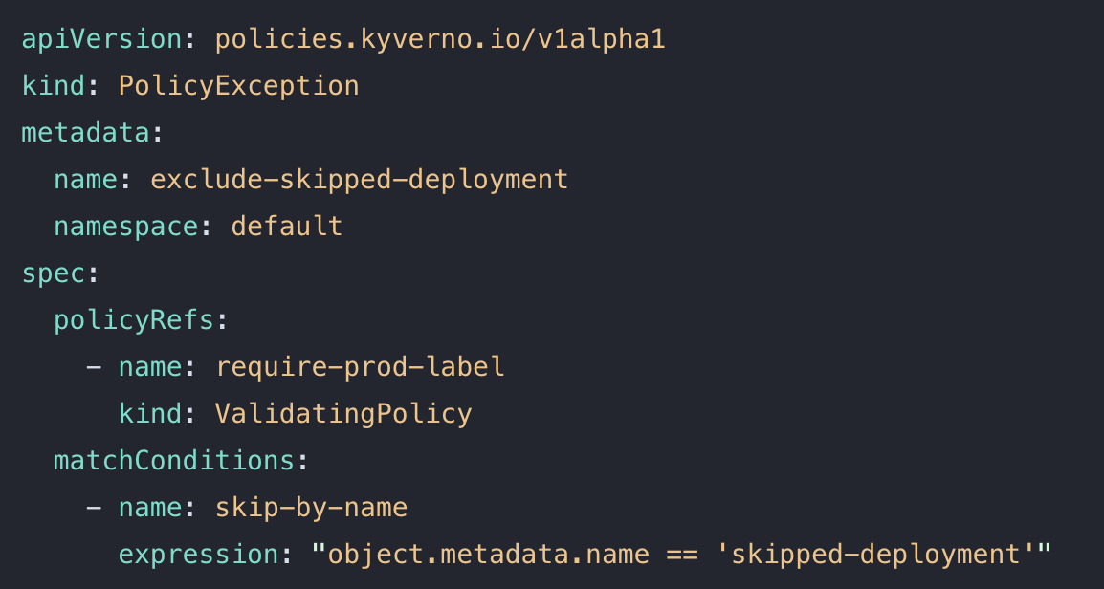
From Policy Enforcement To Governance
Enforcement is not sufficient; you need:
Reporting
  Comprehensive
  Flexible
  Scalable
Exception Management
  Fine-grained
  Easy to manage
  Scalable
How Kyverno delivers:

Slide 17
The Solution
Audit Ready Kubernetes with Kyverno

Slide 18
Why We Selected Kyverno
Everything is Kubernetes-native (YAML, CRDs)
No Rego learning curve
Built-in reporting
Enforce / Audit / Warn modes
Policy exceptions as first-class citizens
🥳
Notes:
🎤 Important framing:
“This wasn’t an anti-OPA decision — it was a fit-for-purpose decision.”

Slide 19
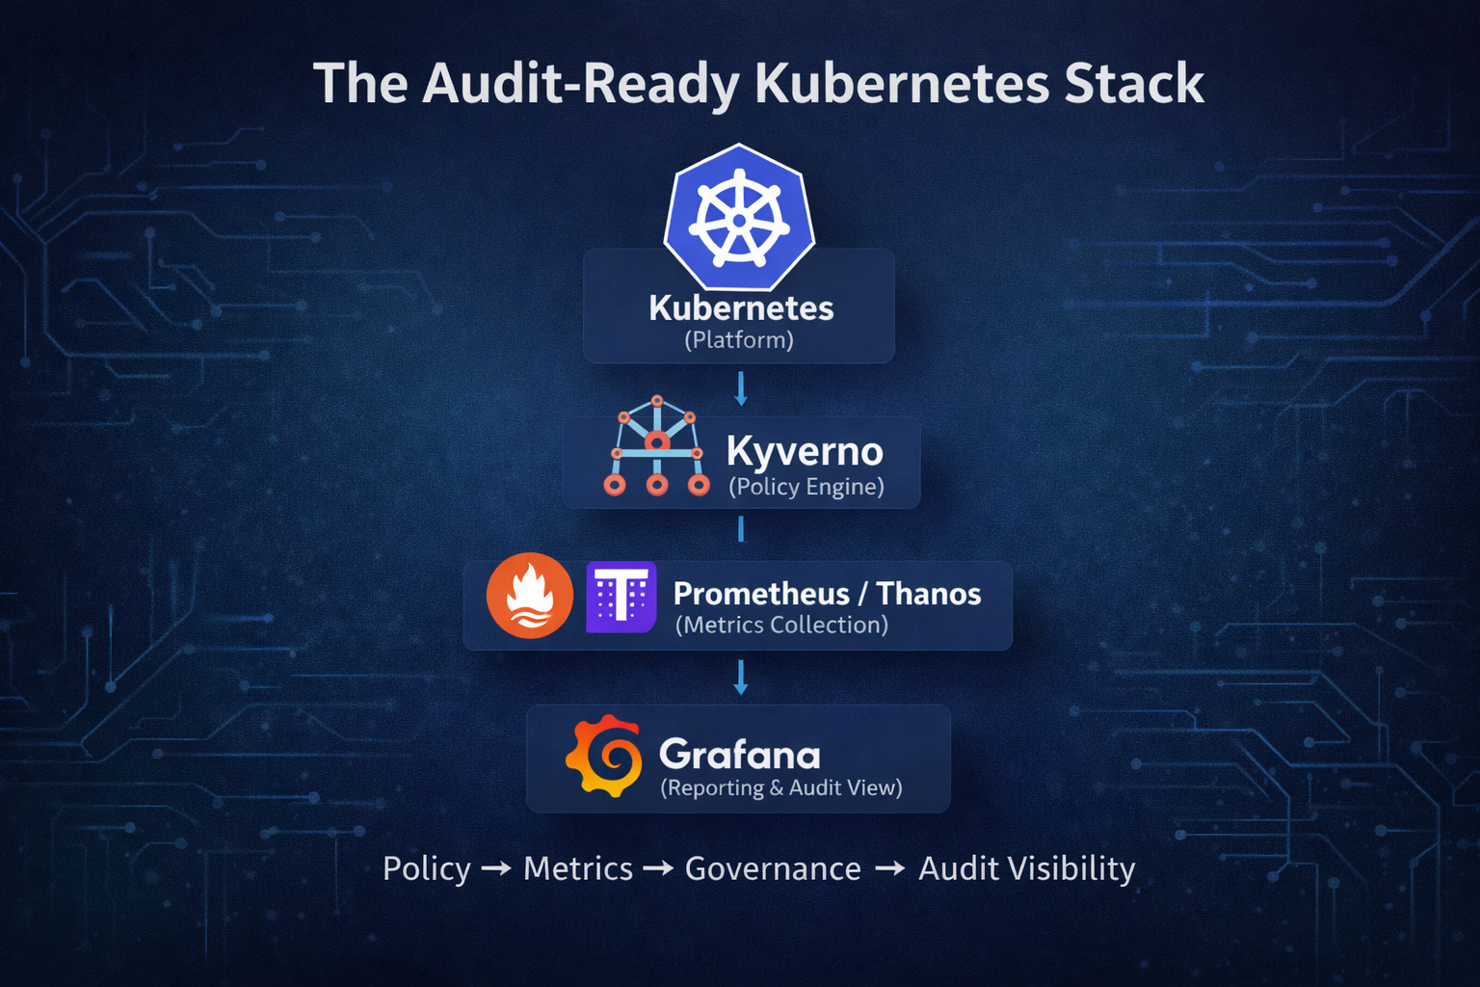

Slide 20
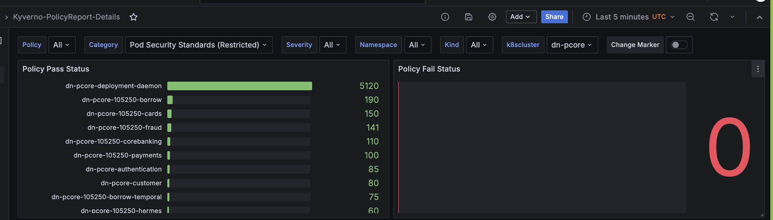
Reporting – Pod Security Standards
Notes:
Narrative – There are few policies which are enforced and 100% compliance and no failes

Slide 21
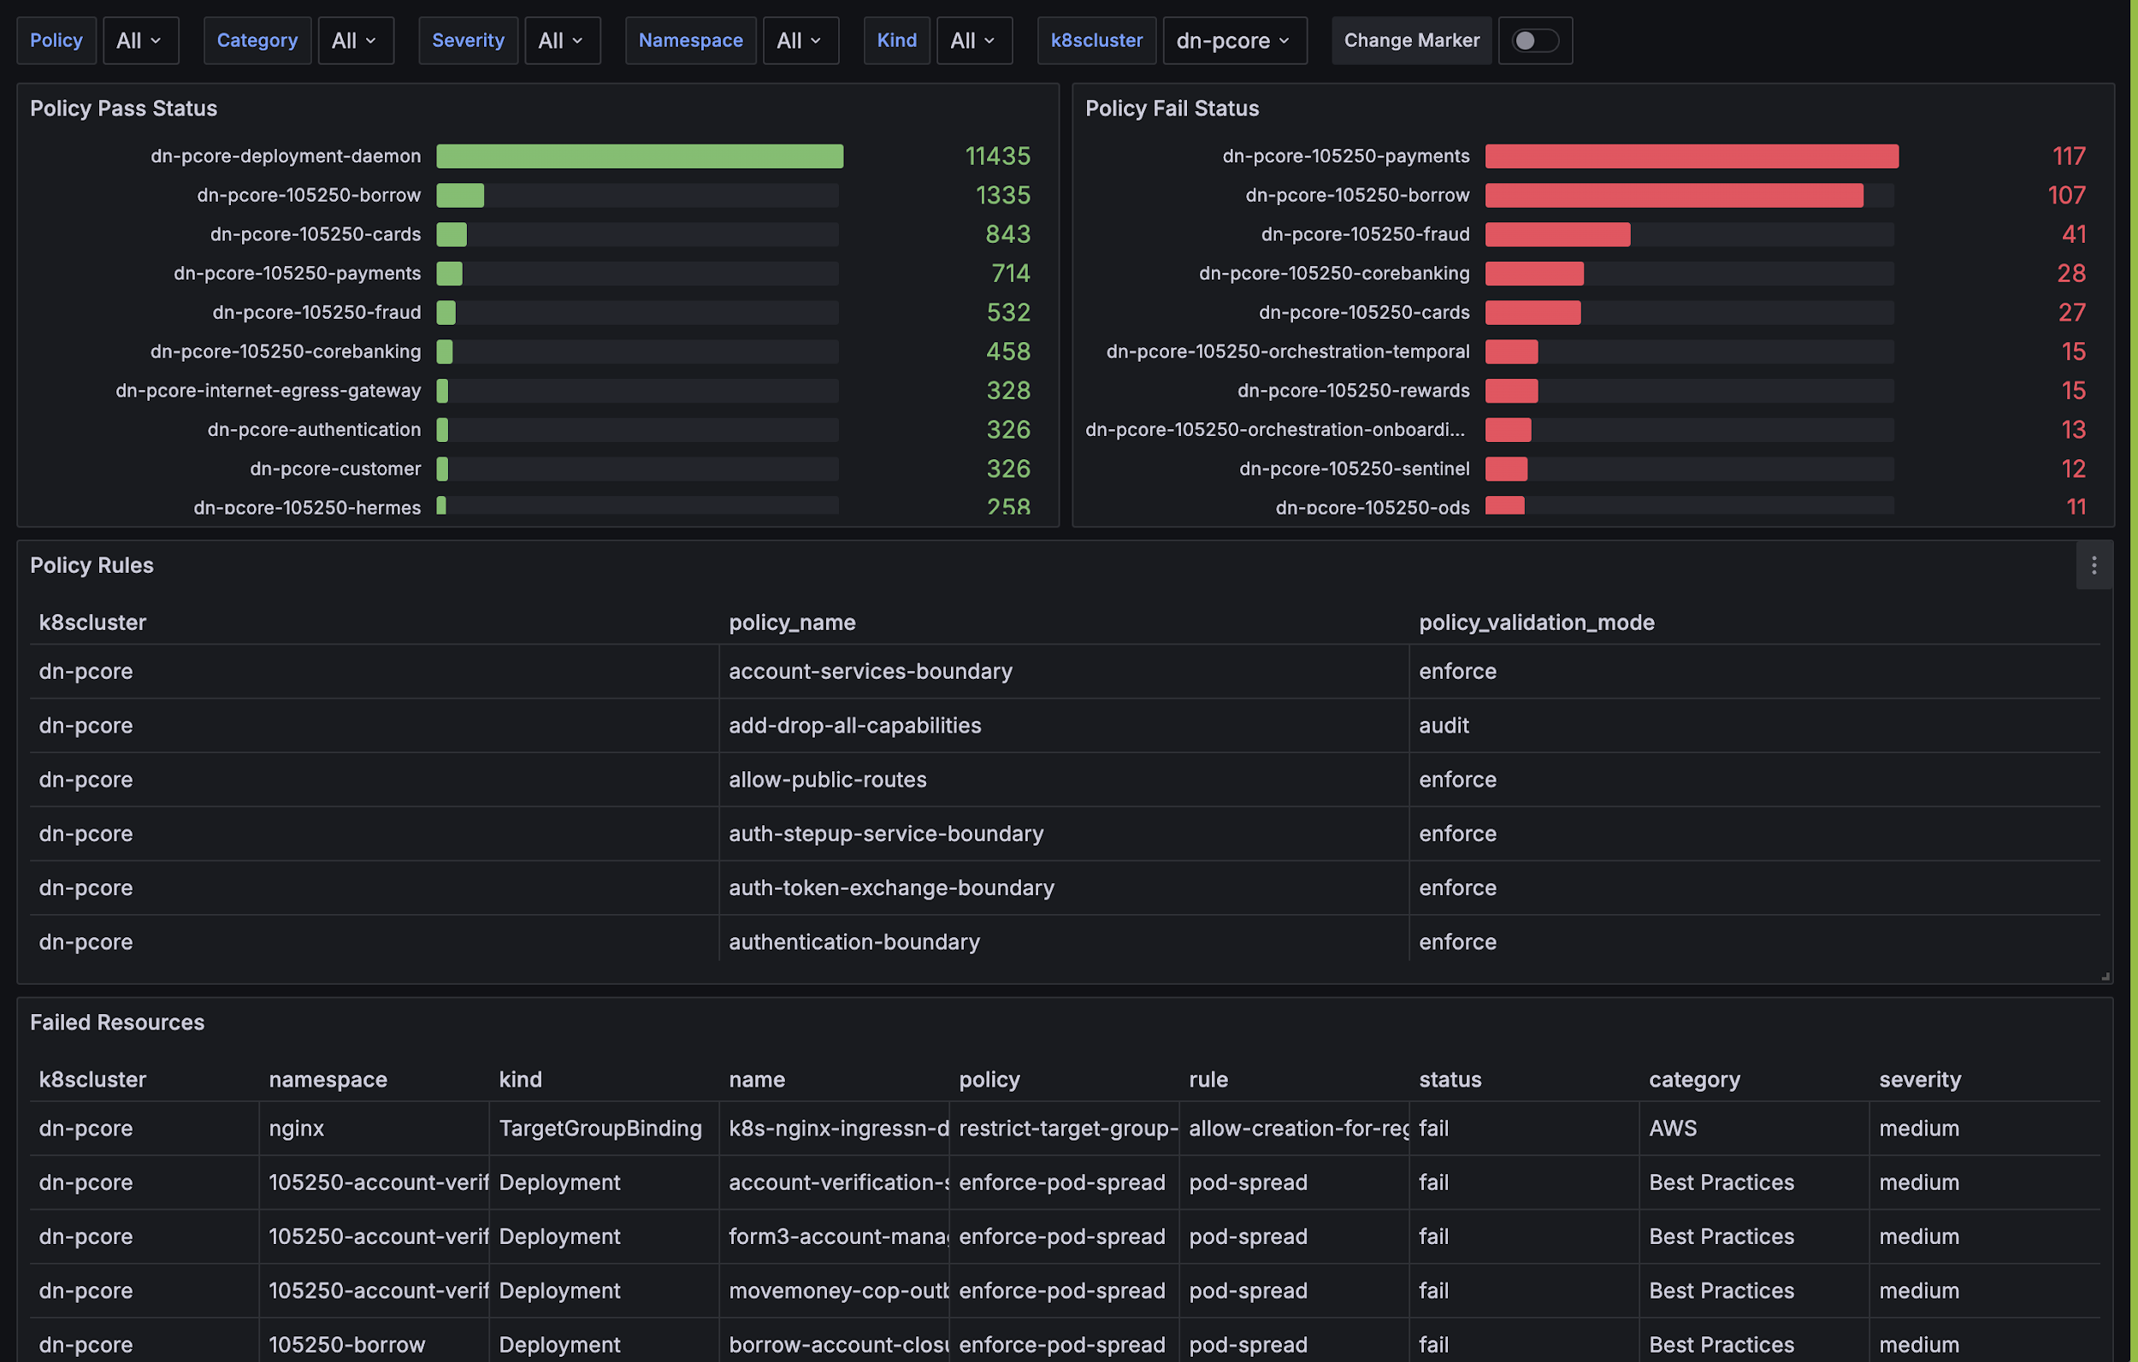
Reporting – All Policies
Notes:
Best practices which are currently in audit mode and they can choose to fix at their own pace

Slide 22
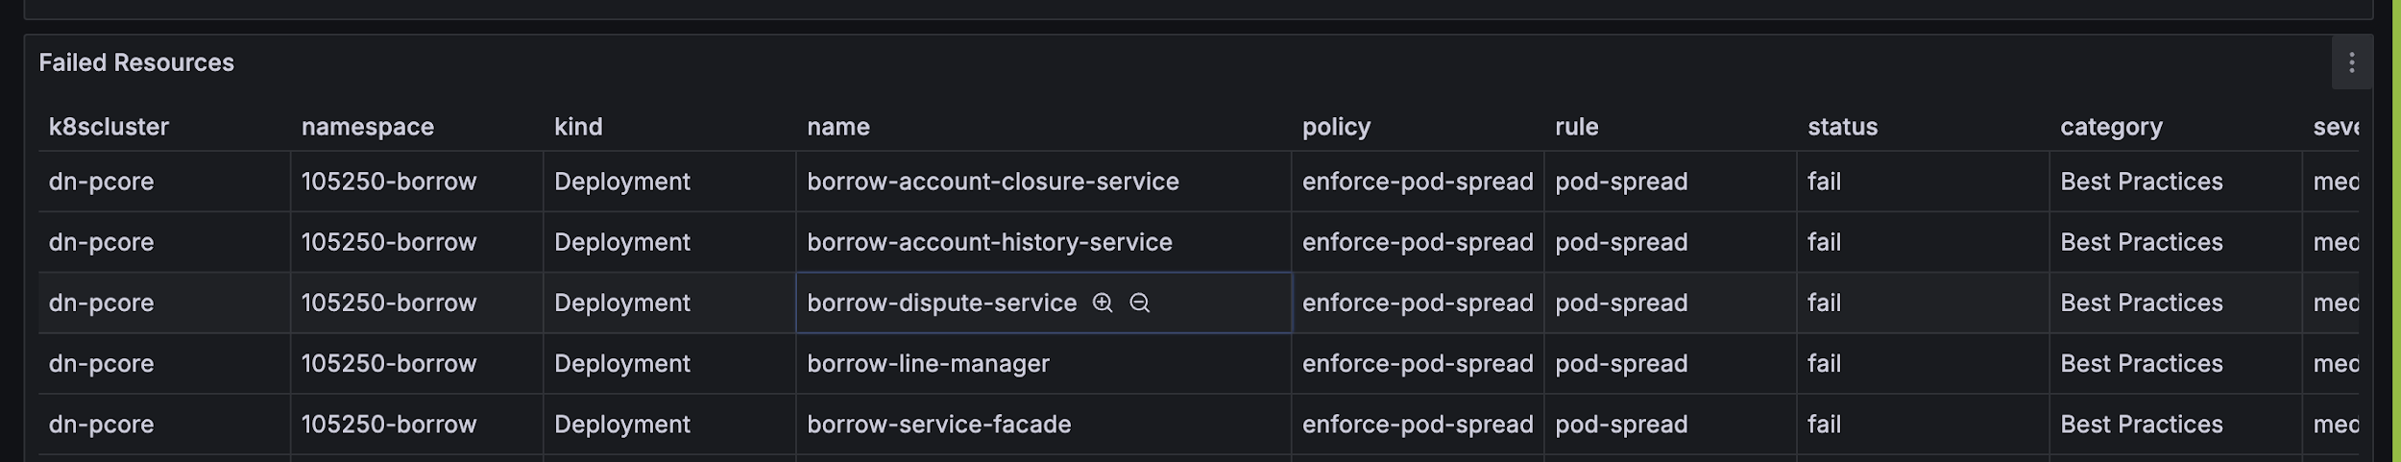
Reporting - Violations
Notes:
Information all within the dashboard

Slide 23
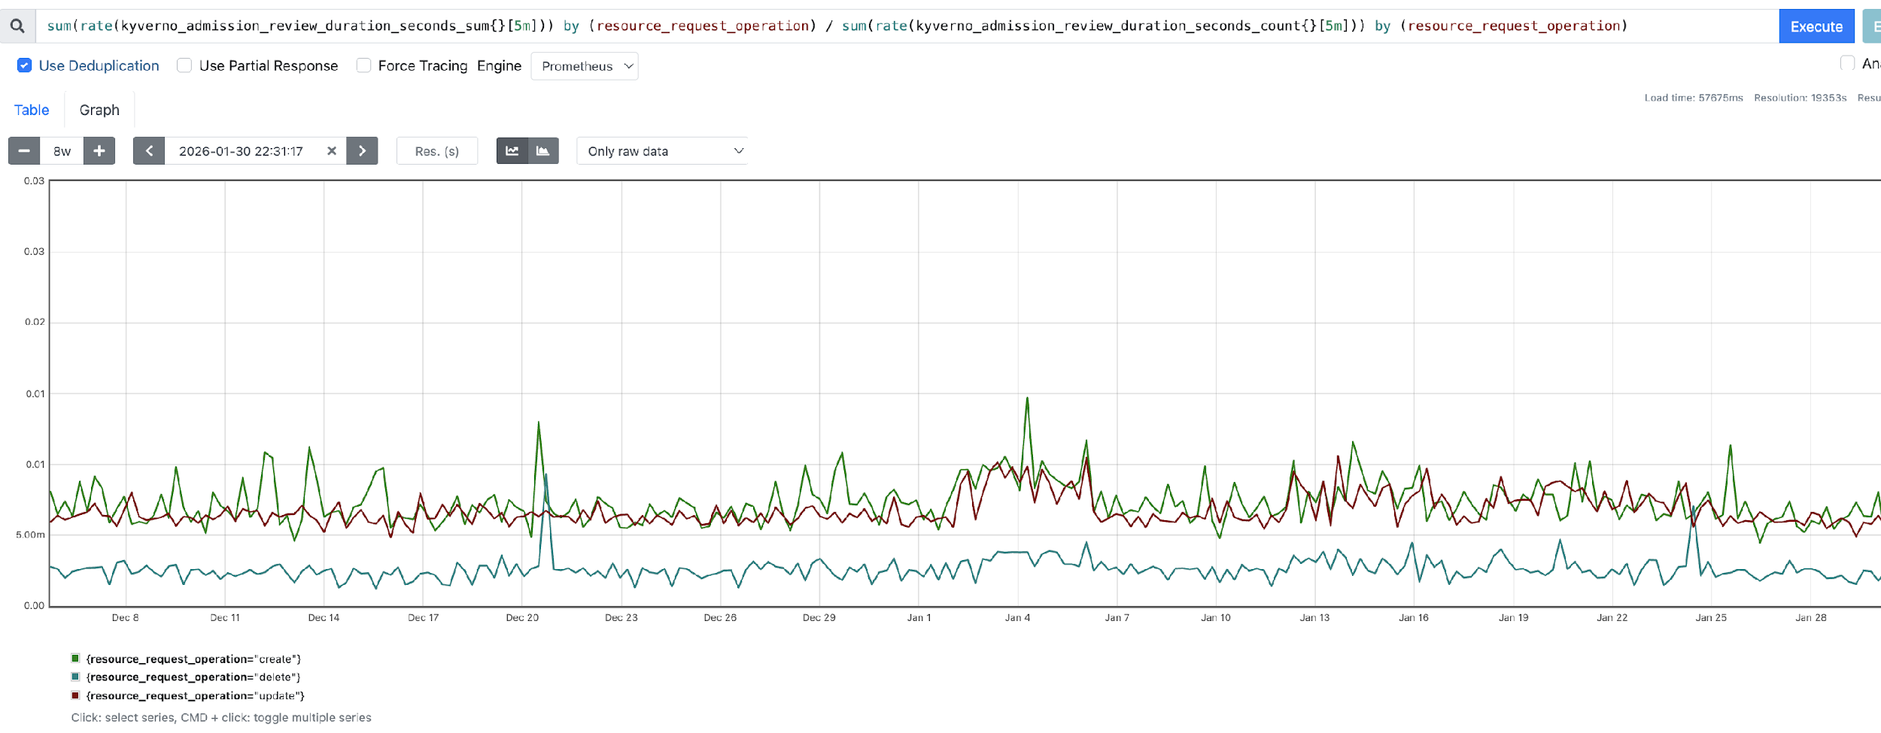
Performance
Best Practice: Latency of 100ms or less
Notes:
Under 10 ms and as per best practices less than 100ms is what you can target

Slide 24
Our Journey
2027
  Unified Time bound Policy Exception
2026
  Policies: 46
  Multi-region Compliance
2025
  Policies: 44
  Networking
2024
  Policies: 30
  PSP Policies
  Mutation policy
2023
  Policies: 6
  Engineering Practices
  Istio
2021
  Policies: 4
  Chase UK launched
Notes:
2-3 weeks on API deprecations,
2 months with PSP

Slide 25
Policy as Code: Results / Success
Rough savings: ~7-8 months engineering effort saved
25% self service audits
30% engineering best practices
25% preventing misconfigurations
20% automation & cleanup
😎
Notes:
2-3 weeks on API deprecations,
2 months with PSP

Slide 26
Learnings
Testing in the CI pipeline for policies is critical
Start with policy enforcement – or you will never get there
Skip results for policy exceptions can be confusing
😇

Slide 27
Conclusion

Slide 28
Audit Ready Kubernetes
With AI – policy as code has become critical
Security & Compliance must “Shift-Down”
– Platform Team owns and automates
Kyverno enables platform team to build audit-ready infrastructure
Notes:
🎤 Important framing:
“This wasn’t an anti-OPA decision — it was a fit-for-purpose decision.”

