Slide 1
DNS Observability
via eBPF
DNS
Extending OpenTelemetry eBPF Instrumentation
to observe the invisible layer
Endre Sara
Nikola Grcevski
Co-Founder
Causely
Principal Software Engineer
Grafana Labs
App
Metrics
Resolver
OpenTelemetry • eBPF • Cloud Native
Notes:
Endre and Nikola

Slide 2



What we’ll talk about today
DNS and OpenTelemetry
Introduce the kinds of stability and performance problems we can encounter in production with DNS
Introduce OpenTelemetry eBPF Instrumentation (OBI) for DNS problem investigations
It's not DNS
There's no way it's DNS
It was DNS
- SSBroski
Showcase the ways we can use DNS telemetry to debug issues in production
https://itsnotdns.itwasdns.net
Notes:
Nikola handing off to Endre to tell us about the problem

Slide 3


THE PROBLEM
DNS is Critical - Yet Invisible
Opaque Dependency
OTel Instrumentation Gap
Growing Complexity
Every outbound request starts with DNS. Yet most observability stacks treat DNS as noise inside 'external call' latency.
OTel begins after TCP/UDP connect — DNS lookups happen before. Errors, timeouts, and fallbacks are completely invisible.
Micro-services, sidecars, and service meshes create complex DNS patterns. Misconfigurations silently cause outages.
Notes:
Endre

Slide 4
MOTIVATION
Why DNS Observability Matters Now
Typical Call Stack
>80%
Application Request
of service calls
start with DNS
DNS Lookup ← blind spot
P95
TCP Connect
latency spikes
often trace to DNS
TLS Handshake
#1
HTTP Request / Response
silent outage cause
in restricted environments
Notes:
Endre

Slide 5





PROPOSED SOLUTION
DNS Observability via eBPF in OBI
Completeness
Low Overhead
Capture DNS queries, responses, and errors for all workloads
< 2% CPU impact even under high DNS QPS
Works with existing OTel SDK instrumentation
Traces + Metrics
Works with instrumented and uninstrumented services
Both histograms/counters and spans for full correlation
Workload Attribution
Map DNS events to pod, container, or process
Notes:
Nikola

Slide 6
TELEMETRY MODEL
What telemetry is captured
📊 Metrics (OTel + Prometheus)
🔍 Tracing / Span Model
dns.lookup.duration
histogram
http.request (parent span)
- dns.question.name (QName)
- error.type (rcode)
- service.name
- service.namespace
- Kubernetes attributes
- Container attributes
↳ dns.lookup (child span)
Span Attributes:
• server.address / port
• client.address
• dns.answers
• error (rcode)
• dns.question.name
Notes:
Nikola

Slide 7
IMPLEMENTATION
Architecture Sketch
① Kernel eBPF Probes
Hook UPD/TCP sendmsg/recvmsg on port 53 · Track in user-space based on “DNS ID” · Derive latency, RCODE, ...
② Workload Attribution
container context + process information → map events to container/pod/process
③ User-Space Telemetry Export
Prometheus/OTel metrics · Generate DNS lookup trace spans
④ Further enrichment and transformation with the OTel Collector
Sampling policies, enrichment of span attributes
Notes:
Nikola

Slide 8

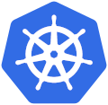




IMPLEMENTATION
Kubernetes API
Workload Attribution
Your
Application
Runtime & libs
OBI
OTEL Collector
eBPF
Metrics & traces
Linux OS
UDP/TCP DNS Tracking
Telemetry Export
Further enrichment
Notes:
Nikola

Slide 9




VALUE
Operational Value & Real-World Scenarios
Root-Cause Visibility
Resolver Health Metrics
Immediately correlate downstream latency or failures with DNS timing — drastically reducing MTTR
Per-resolver error rates expose faulty DNS servers, misconfigured fallback chains, and multi-resolver issues
Full-Stack Correlation
Ecosystem Benefit
Link DNS spans with connect + TLS + HTTP for end-to-end trace visibility in a single unified view
Very few agents provide built-in DNS tracing at workload level — a meaningful contribution to the OpenTelemetry open source community
Notes:
Endre

Slide 10

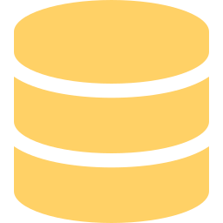

SCENARIOS
When the DNS Server Is the Problem
DNS server issues are invisible until you instrument at the connection layer
Upstream Resolver Failure
Unhealthy DNS Replica
The local DNS server forwards to an upstream resolver that starts timing out or returning errors. All workloads see elevated dns.lookup latency — but only for external names. Pinpoints the upstream, not the app.
upstream timeout
One of several local CoreDNS replicas develops a fault. Requests hitting that replica fail or slow down intermittently. Without per-server metrics, the issue appears random. DNS instrumentation exposes which server.address is responsible.
partial failure
Resource-Constrained Replica
DNS Server Overload
A CoreDNS pod is throttled — CPU limit hit, or memory pressure causing pauses. Resolution slows for all queries routed to it. DNS latency histograms per server reveal the outlier pod for quick MTTR.
CPU / memory pressure
High query volume — from NXDOMAIN cascades, frequent short-lived pods, or misconfigured ndots — overwhelms the DNS server. Latency rises across the board. DNS metrics expose the query rate spike and correlate it with the slowdown.
query overload
Notes:
Endre

Slide 11
SCENARIO: DEEP DIVE
The Hidden NXDOMAIN Storm
Real-world data: Kafka bootstrap resolution in a Kubernetes cluster
What's happening
NX Domain Counts (real production data)
The Strimzi Kafka operator resolves an unqualified hostname. With multiple search domains configured, the resolver tries each suffix in turn — generating ~1794 NXDOMAIN responses per suffix before finding a valid answer.
Each failed attempt is a full DNS round-trip, silently saturating the cluster DNS server and adding latency before any connection is established.
Operator warnings pointed at Kafka. DNS instrumentation revealed the real culprit.
Count
Domain (suffix attempted)
Type
1794
…kafka-bootstrap.chaosmania.svc.svc.cluster.local.
AAAA
1791
…kafka-bootstrap.chaosmania.svc.cluster.local.us-east-2.compute.internal.
A
1791
…kafka-bootstrap.chaosmania.svc.cluster.local.svc.cluster.local.
AAAA
1794
…kafka-bootstrap.chaosmania.svc.chaosmania.svc.cluster.local.
AAAA
1791
…kafka-bootstrap.chaosmania.svc.cluster.local.cluster.local.
A
NXDOMAIN cascade • real production data
~1794 NXDOMAINs per suffix • 5+ failed lookups per connection • invisible without DNS instrumentation
Notes:
Endre

Slide 12
SCENARIO: DEEP DIVE
Too Many Search Domains & the ndots Trap
The Problem
Before (default ndots:5)
In Kubernetes, a pod's /etc/resolv.conf is automatically populated with multiple search domains — svc.cluster.local, cluster.local, namespace.svc.cluster.local — and ndots:5 by default.
Every short hostname the app resolves (e.g. "db", "cache", "auth") triggers the resolver to try each suffix in turn before attempting the bare name. With 5 search domains, that's up to 5 NXDOMAIN round-trips per lookup — before the real answer comes back.
Under load, this multiplies DNS traffic 5–6×, saturates the cluster DNS servers, and adds hundreds of milliseconds of pre-connection latency. Engineers see slow starts and blame the network — but the culprit is the default configuration.
search svc.cluster.local cluster.local
namespace.svc.cluster.local
internal.corp.com corp.com
options ndots:5
After (tuned)
search svc.cluster.local
cluster.local
options ndots:1
ndots:1 — only append search domains
to names with ≥ 1 dot. Bare names and
fully-qualified names resolve immediately.
invisible without DNS instrumentation
Notes:
Endre

Slide 13


How do I get started?
OBI works with your existing instrumentation
eBPF allows us to easily plug it in the background, no restart required for any of your services
You can use OBI to instrument beyond just DNS, but OBI will automatically avoid your already instrumented services
Get precise client timing metrics and correlate with your DNS time
Install easily with the Helm chart
https://github.com/open-telemetry/opentelemetry-helm-charts/tree/main/charts/opentelemetry-ebpf-instrumentation
Notes:
Nikola

Slide 14
Kubernetes Cluster
Java Service
Node.js Service
Go Service
Metrics/Traces
DNS
DNS
DNS
OpenTelemetry eBPF Instrumentation
(OBI)
Node
Observability Stack
Notes:
Nikola

Slide 15
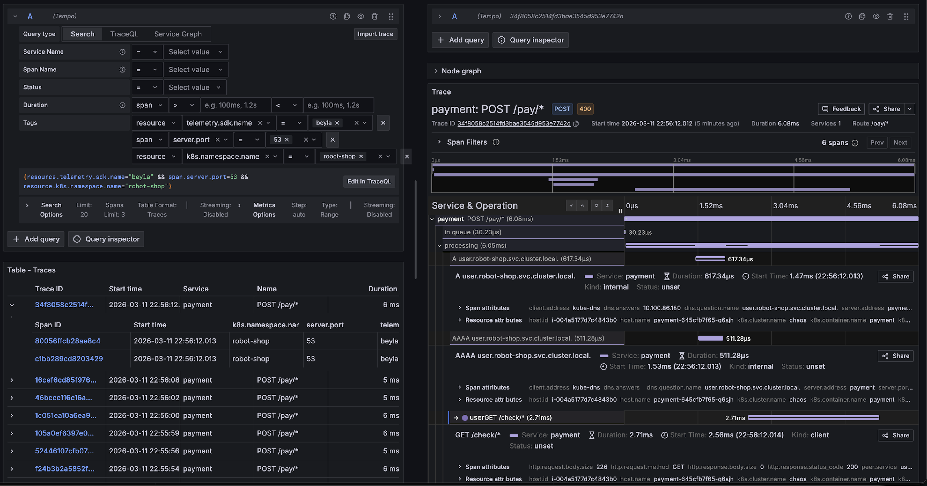
EXAMPLE TRACE
Notes:
Nikola

Slide 16
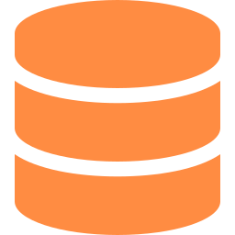

Key Takeaways
DNS: The Missing Observability Layer
DNS is a blind spot in most observability stacks — it belongs in OBI
eBPF gives us the ideal hook point: before connect, at syscall level
OTel metrics + trace spans provide the full picture, not just noise
Privacy controls and < 2% overhead make it production-ready
github.com/open-telemetry/opentelemetry-ebpf-instrumentation/issues/608
Notes:
Endre

Slide 17

Q+A
Scan the code for a link to the project
Raise your hand and we’ll bring you a mic
Notes:
Endre

