Slide 1


From PVC to Mount Point: Dissecting a Custom CSI Plugin to Master Dynamic Volume Provisioning on Kubernetes
Vivek Singh (@viveksinghggits)
Senior Software Engineer
MongoDB

Slide 2
The “magic” problem
Dynamic Volume Provisioning: As soon as you create a PVC, and a volume magically appears ready to be consumed by your workload.
Understanding how that volume is provisioned and made available for your workload is crucial for running stateful workloads on Kubernetes with confidence.
By the end of this session, you will know exactly what happens at every step between creating a PVC and the pod writing data to a mounted volume.
Notes:
Storage for pods is managed through PVCs
Instead of admin creating the volumes that can be used by the developers for their workloads, you declare your requirements for PVC resources and system delivers it.
In-tree vs external provisioners

Slide 3
You Created a PVC Specifying an CSI Provisioner
The PV controller checks if an existing volume that satisfies the PVC’s requirements.
If the provisioner name in the SC (used in PVC) doesn’t start with `kubernetes.io/`, PV controller determines that a CSI provisioner is required.
It annotates the PVC with `volume.kubernetes.io/storage-provisioner`.
Notes:
Provisioners name may or may not start with kubernetes.io, if it does then it’s the case of in-tree volume provisioning.
Otherwise PV controller would know that CSI plugin/provisioner is needed to provision volume for that resource and would annotate the PVC with the annotation.

Slide 4
Contract between K8s (CO) and Storage Provider
In-tree provisioners vs CSI provisioners (CSI Plugin).
CSI Spec is the standard that defines a set of rules that SPs need to follow when writing the CSI Plugin.
Kubernetes doesn’t directly communicate with CSI Plugin.
CSI Plugins interact with storage provider to create/manage volumes.
Notes:
There should be a component deployed on the cluster that looks into the PVC resource and if it sees it’s own name in the annotation. It should be able to provision volume for that request and attach that volume to the respective node.
We can have that application in the cluster we need some kind of compatibility guarantees between the Kubernetes (CO) and the CSI plugin.
CSI Spec basically says, if CO wants to provision a volume these are the things that are going to happen, these are the RPCs that are going to get called.

Slide 5
Things that CSI Spec Defines
RPCs (mandatory or optional) for volume lifecycle.
Idempotency requirement for each RPC.
Expected behaviour and error codes for success, failure and retries.
Communication protocol between the CO and the Plugin.
Notes:
What it doesn’t talk about
The plugin’s lifecycle
How it should be packaged etc.

Slide 6
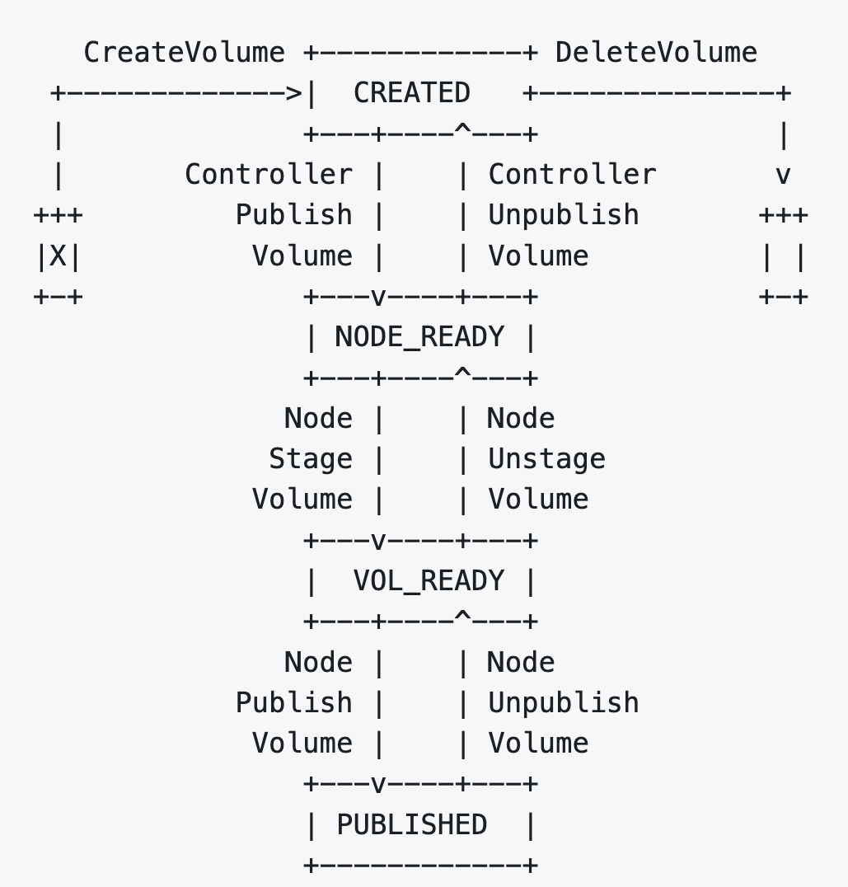
Volume Provisioning According to CSI Spec
Three sets of RPCs (Identity, Controller and Node Service), implemented by two components:
  Controller Plugin
  Node Plugin
Identity Service RPCs must be implemented by both the Controller Plugin and the Node Plugin.
Notes:
Like mentioned eariler. Some of the RCPs are optinal, not all are required, that’s why if the controller/node advertises that it’s implements a particular RPC only in that case it’s called.

Slide 7
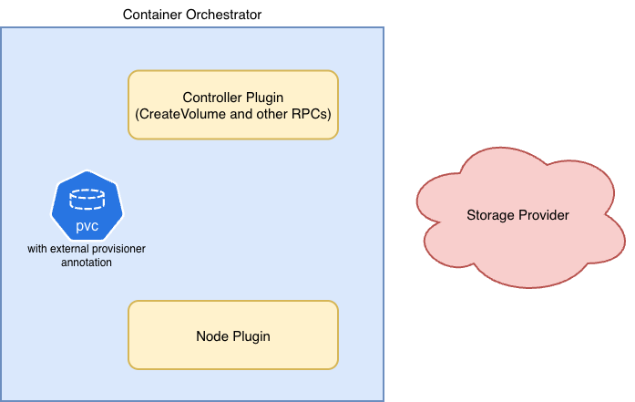
Dynamic Volume Provisioning E2E Workflow
Notes:
As we saw the PVC got created with external provisioner annotation and controller can’t do anything because they don’t poll for PVC resources they just interact with the storage provider.
That’s where the external CSI containers come into picture

Slide 8
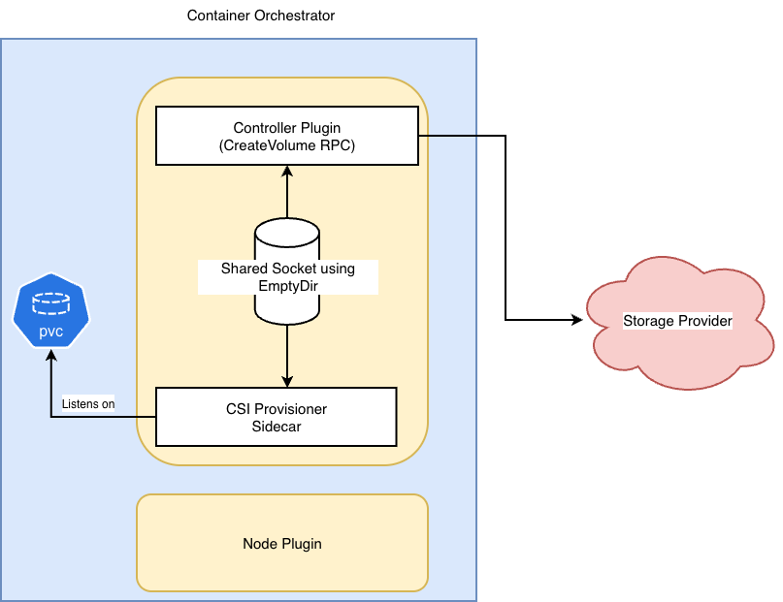
Dynamic Volume Provisioning E2E Workflow
Notes:
The controller plugin is installed with a community provided csi provisioner sidecar that listens of PVCs with annotation matching it’s csi plugin
And calls createVolume of controller plugin, it can call because the socket is shared via empty dir
CreateVolume calls the Cloud Povider API to create the actual volume on storage provider
CreateVolumeRequest
Parameters in CreateVolumeReqeust is parameters that can be passed from StorageClass
Secrets
If one secret is needed per CSI plugint then that can easily be set using normal secret
But if diff secret is needed for diff operation or diff volume pool, per , those secrets can be passed via sc annotations https://kubernetes-csi.github.io/docs/secrets-and-credentials-storage-class.html and external provisiner will translate that to the CSI rpc requests.

Slide 9
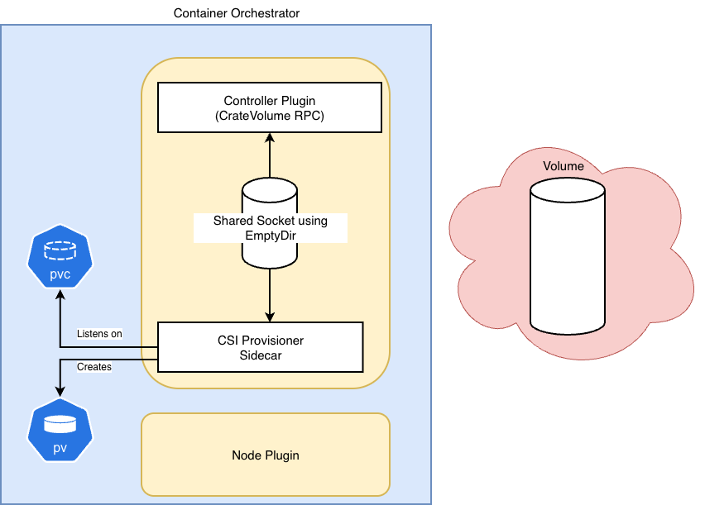
Dynamic Volume Provisioning E2E Workflow
Notes:
The volume gets provisioned on storage provider and provisioner sidecar create PV resource to denote that volume in K8s

Slide 10
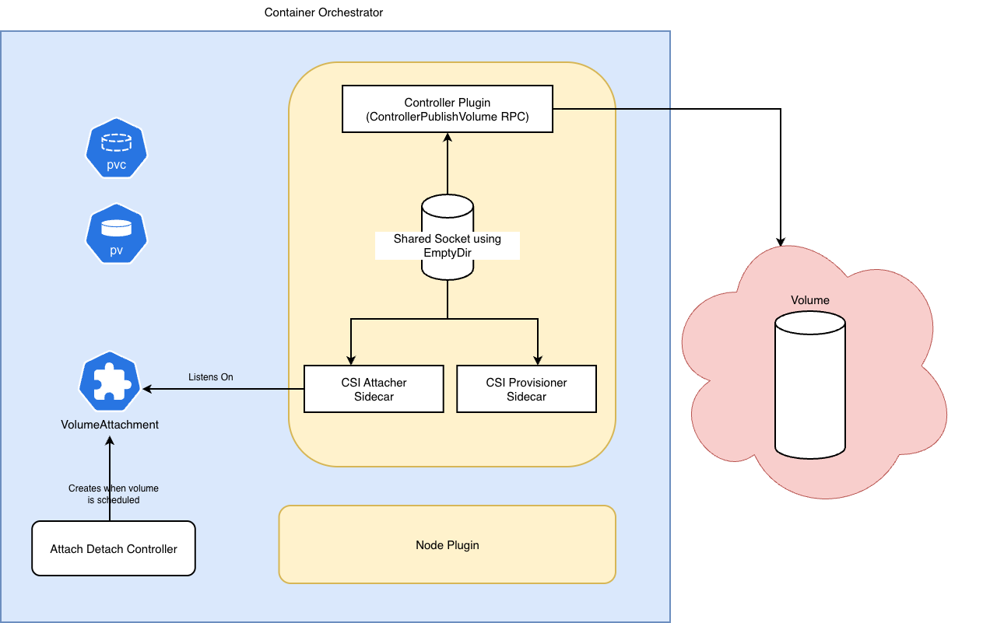
Dynamic Volume Provisioning E2E Workflow
Notes:
Once the PV and PVC are created the pod is scheduled on a node (scheduler assigns pod to a node). And attachdetach controller creates VolumeAttachment resource
Like CSI provisioner, we need another sidecar that can listen on VA resource and call the RPC to attach the volume
That sidecar is csi attacher, it listen on the VolumeAttachment resource and call ControllerPublishVolume of controller plugin
That RPC attaches the volume on the K8s node at path /dev/disk/by-id/scsi-0DO_Volume_<volname>
Why two sidecars
Volume attachment doesn’t happen sometimes, so attacher is not needed in those cases
RBAC might be different, they need diff resource if we just had one that bin will have to have all the rbac
Diff responsibilties

Slide 11
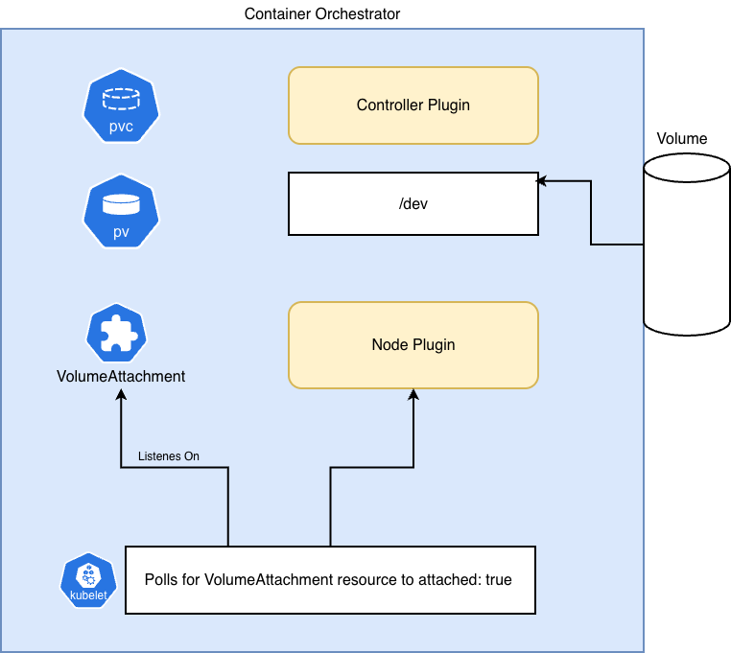
Dynamic Volume Provisioning E2E Workflow
Notes:
Once the volume is attached as divide file on the node. The volumeattachment resource’s status is set to attached: true.
If the requested volumeMode is filesystem we format the disk otherwise not. There is a utility to help us format k8s.io/mount-utils
And Kubelet polls VSs with status to be true, and then it uses the node plugin’s RPCs to mount the device file at correct locations.

Slide 12
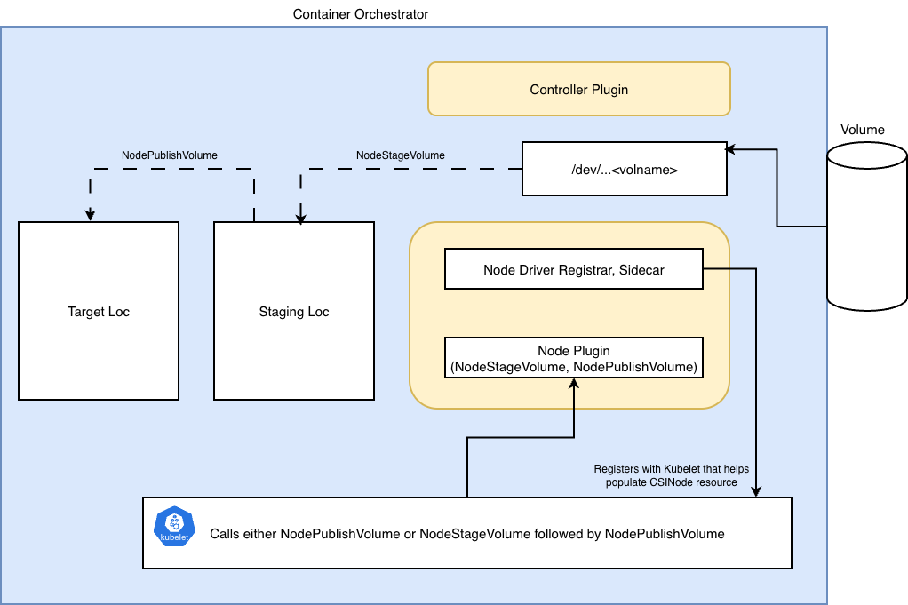
Dynamic Volume Provisioning E2E Workflow
Notes:
Depending on whether node plugin advertises the STAGE_UNSTAGE, kubelet calls nodestagevolume and nodepublish volume to mount the volume to a staging dir and then eventually to target location.
Staging location is require only because the formatted block device can’t really be mounted at two location. And if your req is mounting the volume to two pods, you would need to mount the formatted block device at staging loc that can be mounted at two locs/pods.
In case of block volume request, we don’t have to format the block device and it will be able to be mounted at two pods if required.
It’s just that the formatted block device can’t be mounted on two pods.
Volumes of node plugin
1. plugin-dir — The shared Unix socket between your driver and the registrar sidecar.
Kubelet also connects to this socket path on the host (/var/lib/kubelet/plugins/do-csi-driver.viveksingh.dev/csi.sock) to call NodeStageVolume/NodePublishVolume. That's what the registrar's --kubelet-registration-path flag tells kubelet.
2. registration-dir — How kubelet discovers your driver.
hostPath: /var/lib/kubelet/plugins_registry/
csi-driver-registrar mounts this at /registration. The registrar creates a socket in this directory. Kubelet's pluginwatcher (fsnotify) monitors plugins_registry/ for new sockets. When it detects one, it calls GetInfo() on that socket, learns driver's name and endpoint, and registers it. This is the discovery mechanism we discussed earlier.
3. pods-vol-dir — Where your driver creates mount points for pods.
hostPath: /var/lib/kubelet
Only node-plugin mounts this at /var/lib/kubelet with mountPropagation: Bidirectional. This is the most important mount. When kubelet calls NodePublishVolume with a target path like /var/lib/kubelet/pods/<uid>/volumes/kubernetes.io~csi/<pv>/mount, your driver mounts the volume there. Without this hostPath mount, your driver (running inside a container) can't
create mounts on the host filesystem.
Bidirectional mount propagation is critical — it means mounts your driver creates inside the container propagate to the host, and vice versa. Without it, the mount would only be visible inside the container, and kubelet (running on the host) wouldn't see it.
4. device-dir — Access to block devices.
hostPath: /dev
Only node-plugin mounts this at /dev. Your driver needs access to the host's block devices to format and mount them in NodeStageVolume. After ControllerPublishVolume attaches a DigitalOcean volume to the droplet, it shows up as a device file under /dev/ (e.g., /dev/disk/by-id/scsi-0DO_Volume_...). Without this mount, your driver can't see or access the
device.

Slide 13
Key Takeaways
Kubernetes never directly calls the CSI Plugin for provisioning.
Every step in the volume lifecycle maps to specific component. If something fails, instead of guess work we can identify which component is responsible and can debug its logs.
The order of scheduling and provisioning depends on the VolumeBindingMode.

Slide 14

Thank You! Questions?
CSI Spec: https://github.com/container-storage-interface/spec/blob/master/spec.md
DigitalOcean CSI Plugin: https://github.com/digitalocean/csi-digitalocean
https://arslan.io/2018/06/21/how-to-write-a-container-storage-interface-csi-plugin/
Github: @viveksinghggits
Notes:
Depending on whether node plugin advertises the STAGE_UNSTAGE, kubelet calls nodestagevolume and nodepublish volume to mount the volume to a staging dir and then eventually to target location.
Staging location is require only because the formatted block device can’t really be mounted at two location. And if your req is mounting the volume to two pods, you would need to mount the formatted block device at staging loc that can be mounted at two locs/pods.
In case of block volume request, we don’t have to format the block device and it will be able to be mounted at two pods if required.
It’s just that the formatted block device can’t be mounted on two pods.
Volumes of node plugin
1. plugin-dir — The shared Unix socket between your driver and the registrar sidecar.
Kubelet also connects to this socket path on the host (/var/lib/kubelet/plugins/do-csi-driver.viveksingh.dev/csi.sock) to call NodeStageVolume/NodePublishVolume. That's what the registrar's --kubelet-registration-path flag tells kubelet.
2. registration-dir — How kubelet discovers your driver.
hostPath: /var/lib/kubelet/plugins_registry/
csi-driver-registrar mounts this at /registration. The registrar creates a socket in this directory. Kubelet's pluginwatcher (fsnotify) monitors plugins_registry/ for new sockets. When it detects one, it calls GetInfo() on that socket, learns driver's name and endpoint, and registers it. This is the discovery mechanism we discussed earlier.
3. pods-vol-dir — Where your driver creates mount points for pods.
hostPath: /var/lib/kubelet
Only node-plugin mounts this at /var/lib/kubelet with mountPropagation: Bidirectional. This is the most important mount. When kubelet calls NodePublishVolume with a target path like /var/lib/kubelet/pods/<uid>/volumes/kubernetes.io~csi/<pv>/mount, your driver mounts the volume there. Without this hostPath mount, your driver (running inside a container) can't
create mounts on the host filesystem.
Bidirectional mount propagation is critical — it means mounts your driver creates inside the container propagate to the host, and vice versa. Without it, the mount would only be visible inside the container, and kubelet (running on the host) wouldn't see it.
4. device-dir — Access to block devices.
hostPath: /dev
Only node-plugin mounts this at /dev. Your driver needs access to the host's block devices to format and mount them in NodeStageVolume. After ControllerPublishVolume attaches a DigitalOcean volume to the droplet, it shows up as a device file under /dev/ (e.g., /dev/disk/by-id/scsi-0DO_Volume_...). Without this mount, your driver can't see or access the
device.

Slide 15
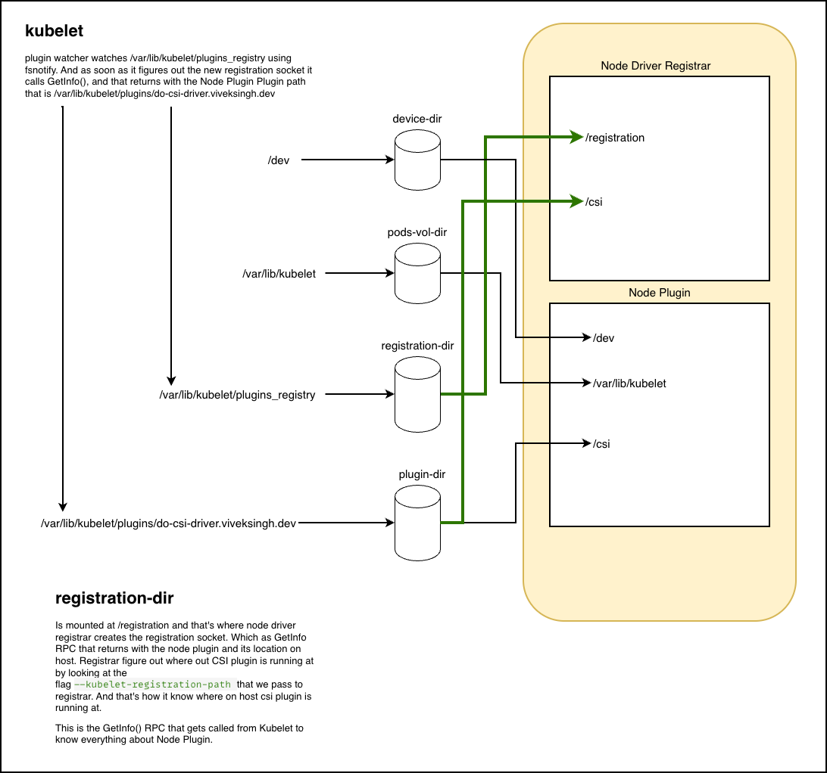
Node Plugin Volume Mounts
Notes:
Depending on whether node plugin advertises the STAGE_UNSTAGE, kubelet calls nodestagevolume and nodepublish volume to mount the volume to a staging dir and then eventually to target location.
Staging location is require only because the formatted block device can’t really be mounted at two location. And if your req is mounting the volume to two pods, you would need to mount the formatted block device at staging loc that can be mounted at two locs/pods.
In case of block volume request, we don’t have to format the block device and it will be able to be mounted at two pods if required.
It’s just that the formatted block device can’t be mounted on two pods.
Volumes of node plugin
1. plugin-dir — The shared Unix socket between your driver and the registrar sidecar.
Kubelet also connects to this socket path on the host (/var/lib/kubelet/plugins/do-csi-driver.viveksingh.dev/csi.sock) to call NodeStageVolume/NodePublishVolume. That's what the registrar's --kubelet-registration-path flag tells kubelet.
2. registration-dir — How kubelet discovers your driver.
hostPath: /var/lib/kubelet/plugins_registry/
csi-driver-registrar mounts this at /registration. The registrar creates a socket in this directory. Kubelet's pluginwatcher (fsnotify) monitors plugins_registry/ for new sockets. When it detects one, it calls GetInfo() on that socket, learns driver's name and endpoint, and registers it. This is the discovery mechanism we discussed earlier.
3. pods-vol-dir — Where your driver creates mount points for pods.
hostPath: /var/lib/kubelet
Only node-plugin mounts this at /var/lib/kubelet with mountPropagation: Bidirectional. This is the most important mount. When kubelet calls NodePublishVolume with a target path like /var/lib/kubelet/pods/<uid>/volumes/kubernetes.io~csi/<pv>/mount, your driver mounts the volume there. Without this hostPath mount, your driver (running inside a container) can't
create mounts on the host filesystem.
Bidirectional mount propagation is critical — it means mounts your driver creates inside the container propagate to the host, and vice versa. Without it, the mount would only be visible inside the container, and kubelet (running on the host) wouldn't see it.
4. device-dir — Access to block devices.
hostPath: /dev
Only node-plugin mounts this at /dev. Your driver needs access to the host's block devices to format and mount them in NodeStageVolume. After ControllerPublishVolume attaches a DigitalOcean volume to the droplet, it shows up as a device file under /dev/ (e.g., /dev/disk/by-id/scsi-0DO_Volume_...). Without this mount, your driver can't see or access the
device.

