Slide 1
Operationalizing AI Workloads on Kubernetes with OpenKruise
Zhang Zhen, OpenKruise Maintainer

Slide 2
Outline
Challenges of AI workloads for operations
Training & Inference related operations
Agent Sandbox operations
Future Roadmap

Slide 3


Challenges of AI workloads for operations
Training/Inference
Agents
1. Image packed with data/LLM is slow to download and load
2. Pods run and die in groups
3. Devices is slow to allocations
1. Sub-second sandbox creation
2. Command and filesystem operations as first-class citizens
3. Operate pod as a vm

Slide 4
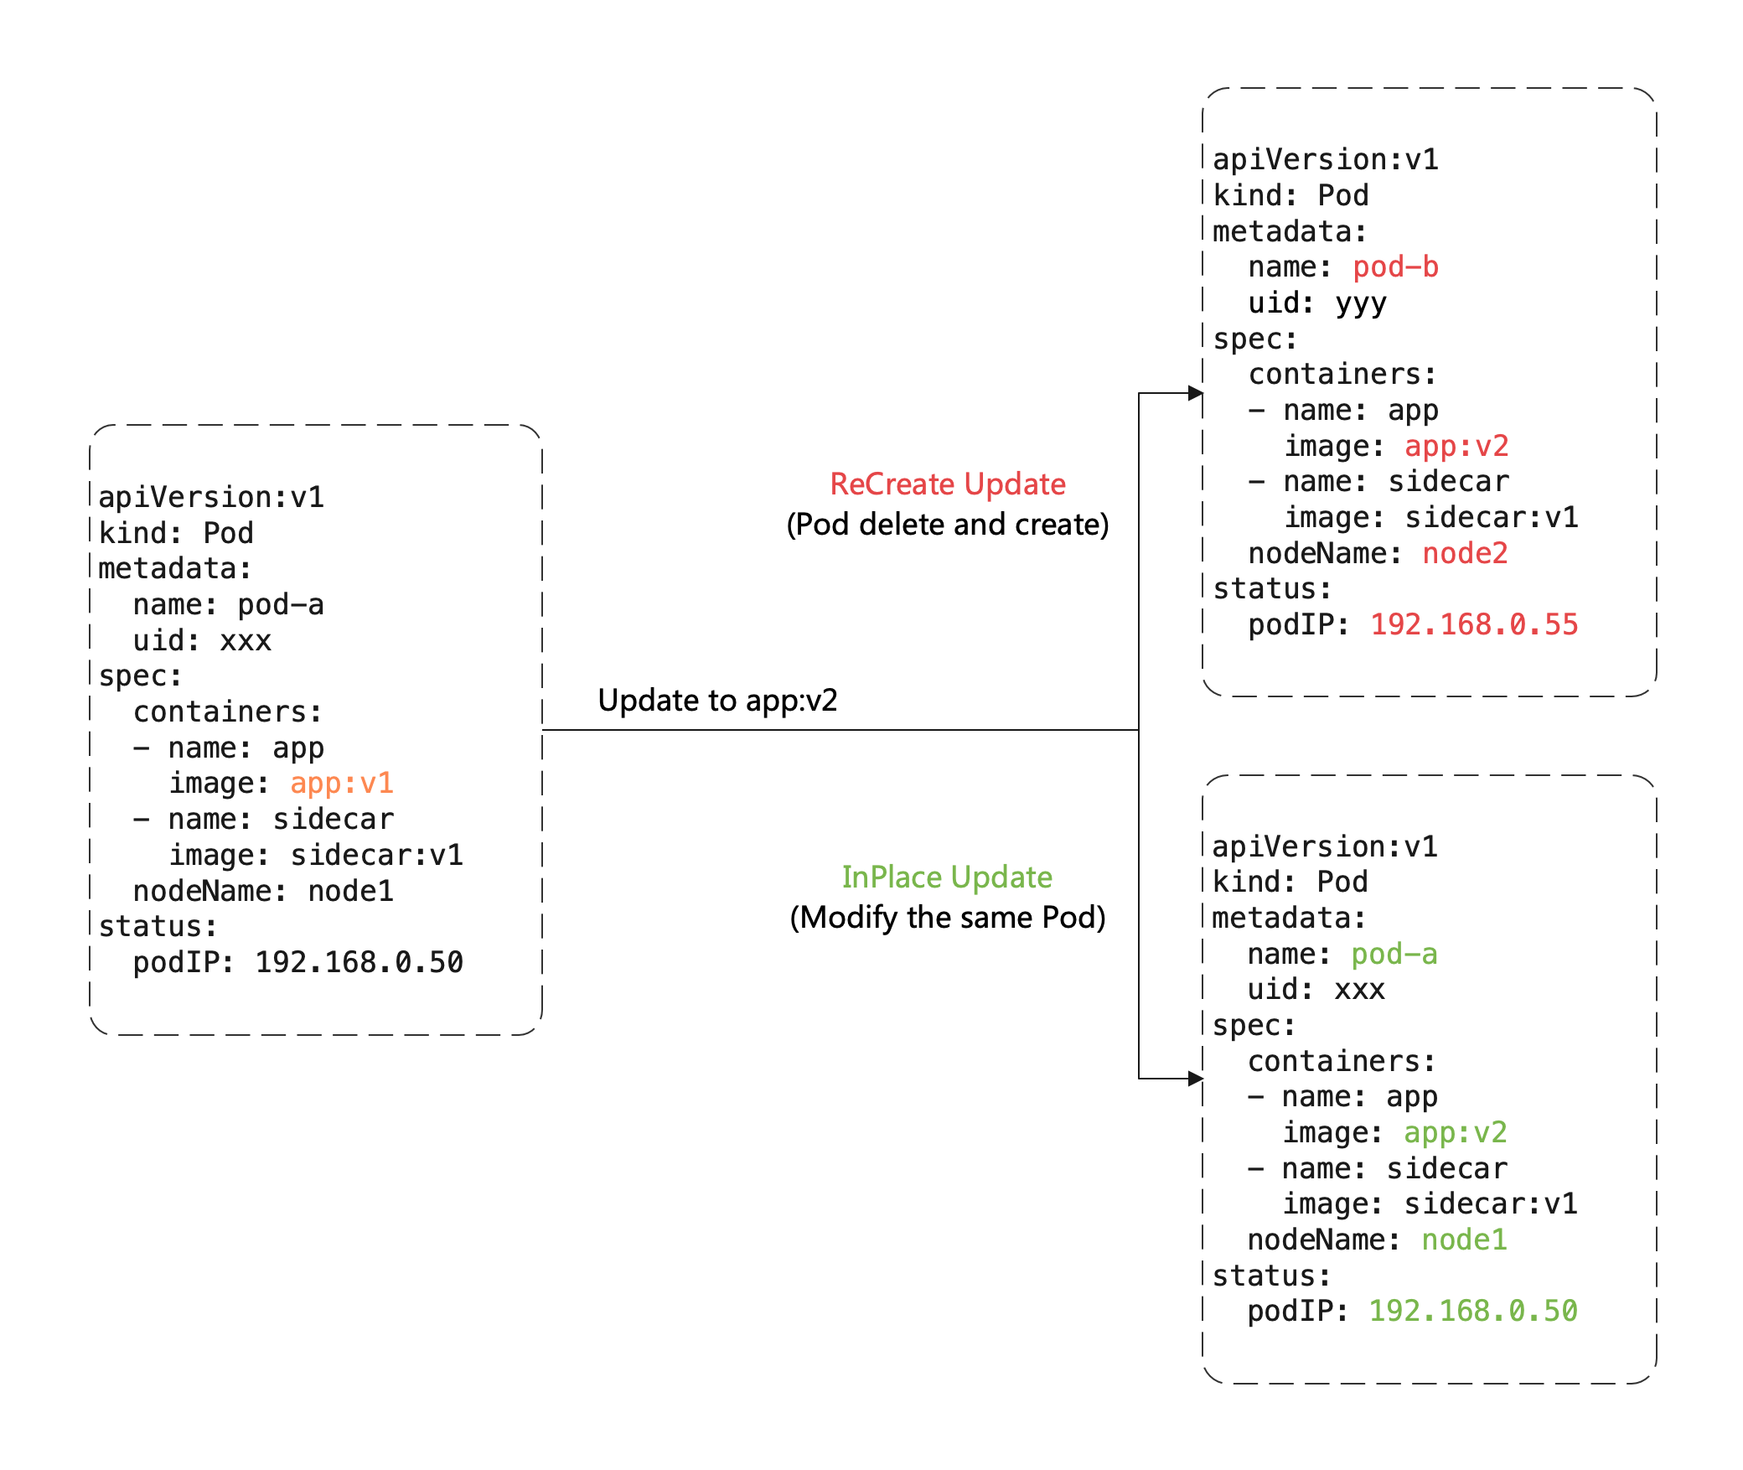
Inplace-update for faster inference update
Avoid additional cost of scheduling, allocating IP, allocating and mounting volumes，load volumes with data
Faster image pulling, because of we can re-use most of image layers pulled by the old image and only to pull several new layers
When a container is in-place updating, the other containers in Pod will not be affected and remain running.

Slide 5
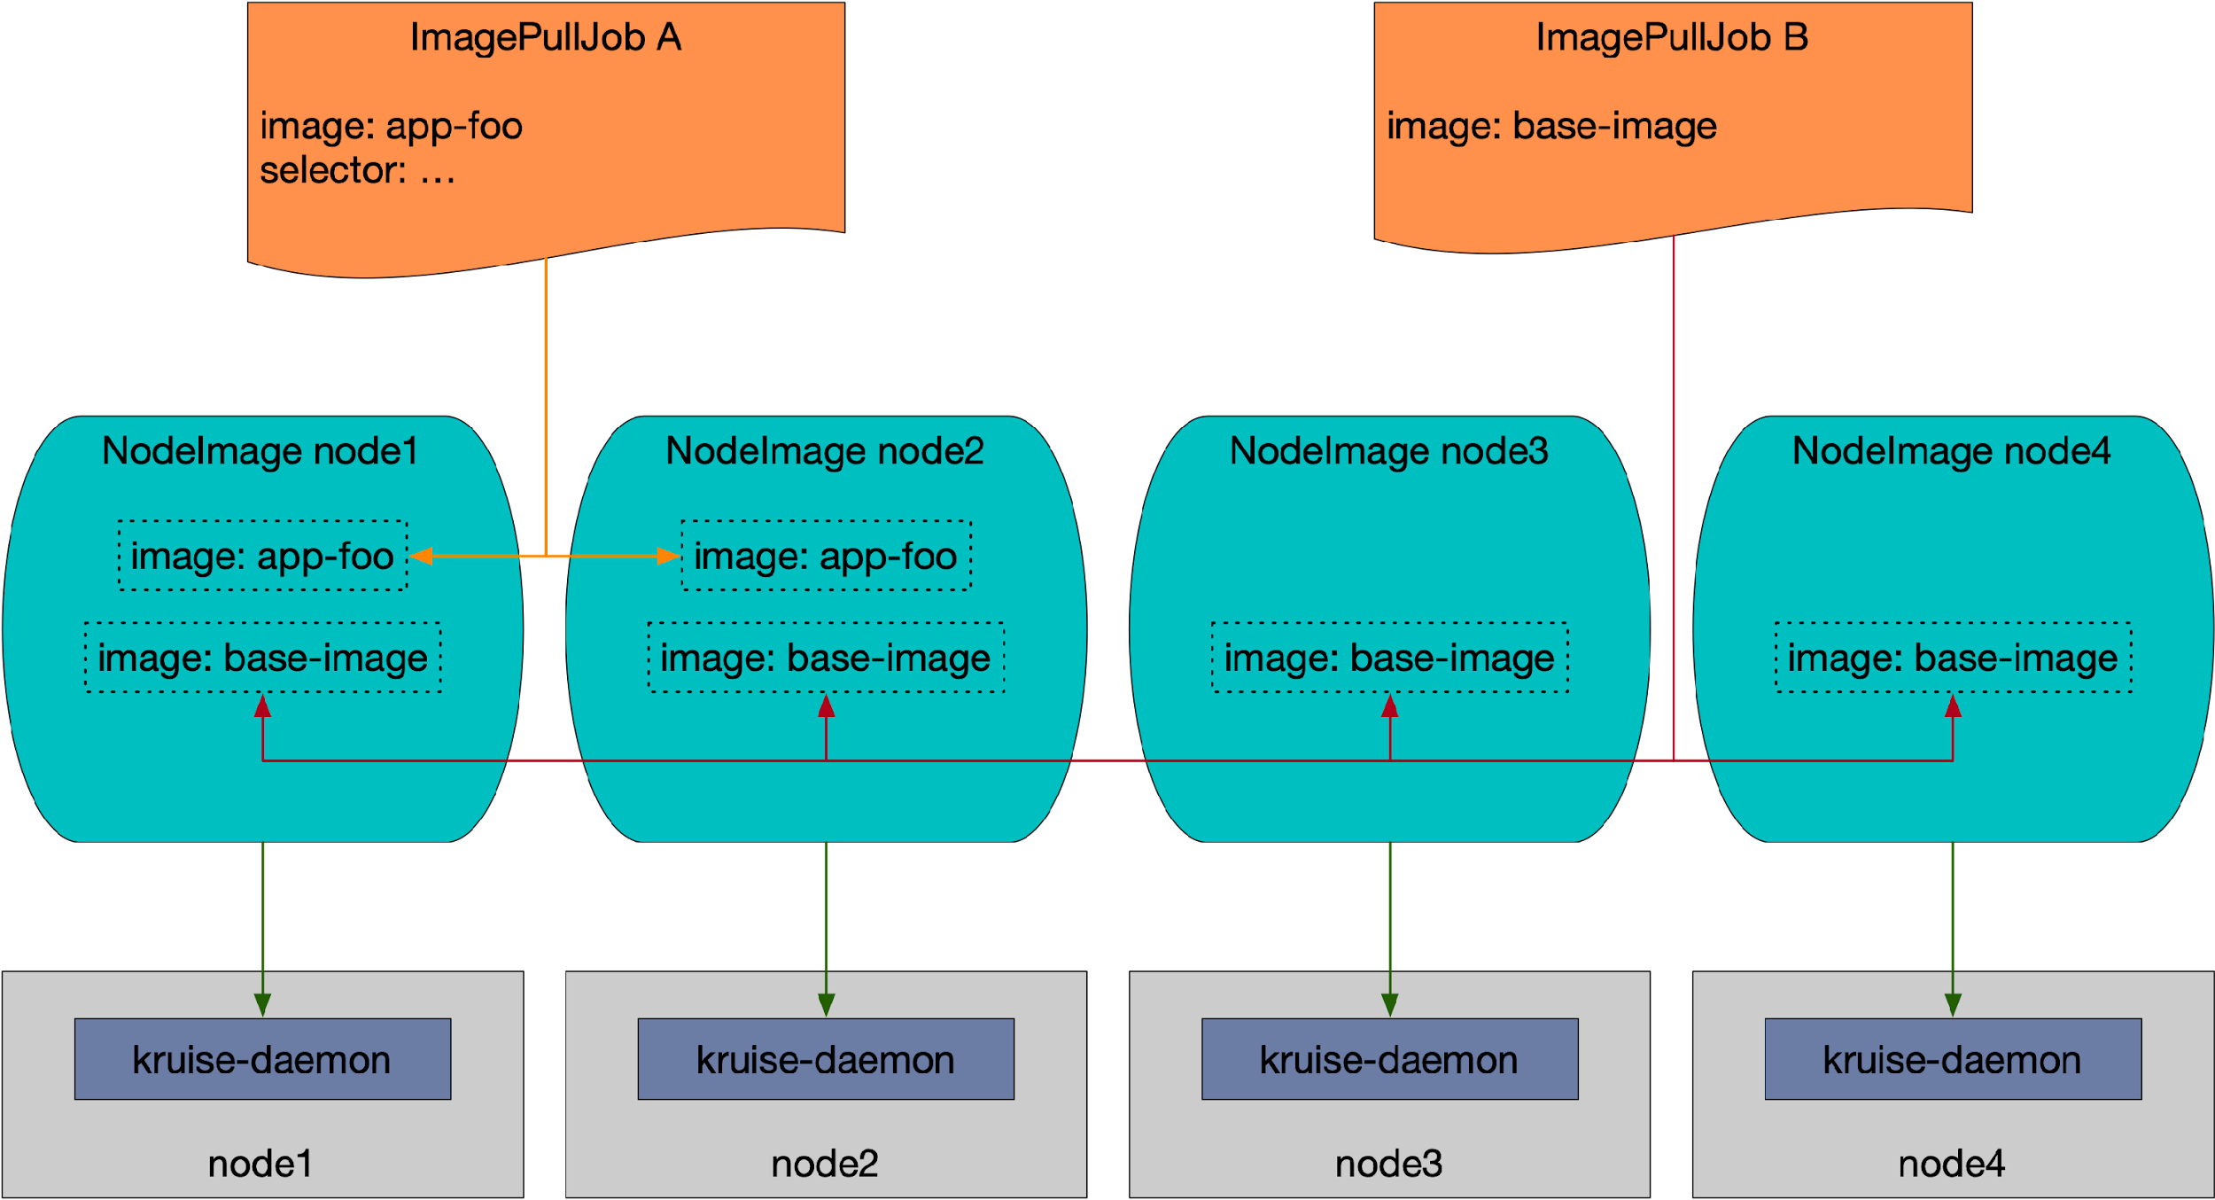
Image prewarming for Data and LLM
apiVersion: apps.kruise.io/v1alpha1
kind: ImagePullJob
...
spec:
image: nginx:apline
parallelism: 10
selector:
matchLabels:
node-type: xxx
completionPolicy:
type: Always
activeDeadlineSeconds: 1200
ttlSecondsAfterFinished: 300
pullPolicy:
backoffLimit: 3
timeoutSeconds: 300

Slide 6
Scheduled Image prewarming
apiVersion: apps.kruise.io/v1beta1
kind: AdvancedCronJob
…
spec:
schedule: "0 */2 * * *"
concurrencyPolicy: Replace
template:
imageListPullJobTemplate:
spec:
parallelism: 5
images:
- nginx:1.14.2
- busybox:latest
pullSecrets:
- default-secret
selector:
names:
- node1
- node2
pullPolicy:
timeoutSeconds: 60
imagePullPolicy: IfNotPresent
AdvancedCronJob

Slide 7
Protect pod groups from evictions(wip)
LeaderWorkerSet
apiVersion: policy.kruise.io/v1alpha1
kind: PodUnavailableBudget
metadata:
name: llm-serving-budget
spec:
selector:
matchLabels:
app: llm-serving
maxUnavailable: 1 # interpreted as groups
podGroupPolicy:
groupLabelKey: leaderworkerset.sigs.k8s.io/group-index
minReadyReplicas: 3 # 1 leader + 2 workers Ready
Group0
Group1
Group2
Leader
Leader
Leader
worker
worker
worker
worker
worker
worker
worker
worker
worker
All Pods have label:
leaderworkerset.sigs.k8s.io/group-index = "0" / "1" / "2"

Slide 8
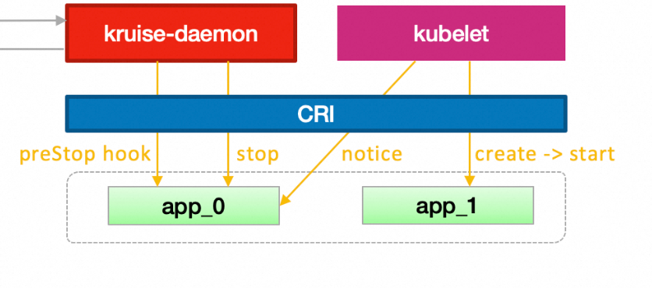
Inplace-Restart entire podgroup (discussing)
Problem: single pod failure cause all pod recreation
But :
What if there is no watcher sidecar ?
What training framework does not aware ?
Group0
apiVersion: apps.kruise.io/v1alpha1
kind: ContainerRecreateRequest
metadata:
name: llm-serving-budget
spec:
selector:
matchLabels:
app: llm-serving
worker1
worker2
worker3
Node1
Node2
Node3
Exiting solution: RestartAllContainers feature to enable inplace-restart
Watcher sidecar
Training Apps

Slide 9
OpenKruise Agent: Project Overview
Agent-Sandbox: An End-to-End AI Sandbox Solution from OpenKruise (CNCF Incubation Project)
Sandbox Manager
Sandbox Gateway
Sandbox Controller
E2B/MCP Server
Envoy filter based efficient routing
Sandbox Hibernation & Wake-up
Code Interpreter，Run Command，
Desktop Use，Browser Use
Proactive sandbox discovery
Sandbox Warmpool
Sandbox Gateway
Project Repository: https://github.com/openkruise/agents

Slide 10
Lifecycles of Agent Sandbox
Sandbox
Checkpoint
Sandbox
Image
a part of
Checkpoint
Commit
Create/Restore
Sandbox
Template
Pending
Running
Completed
Resume
Pause
Pre-warmed
Paused
Sandbox Instance

Slide 11
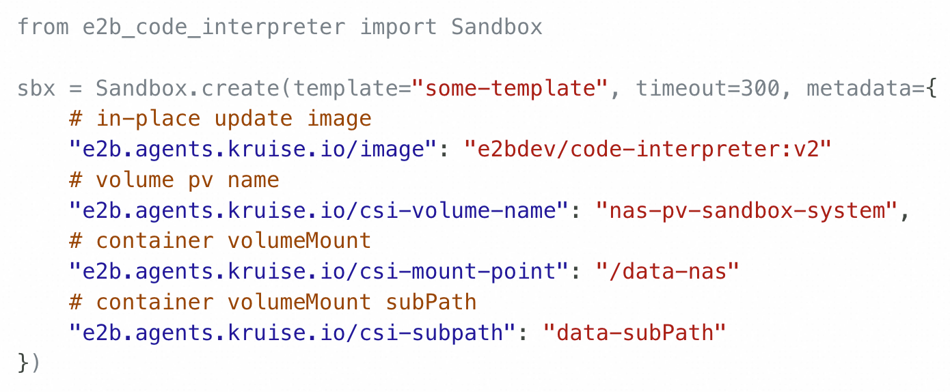
Sandbox claim operations
AI Agent
Supports heterogeneous sandboxes: each sandbox can have unique image and custom mount points.
In-Place Update Image: In-place update the sandbox image when claiming from the warm pool — no recreation needed.
Dynamic Storage Mounting: Attach NAS/OSS volumes at claim time
In-Place Resizing(planned): resize the sandbox to desired resources specs
E2B SDK
1. Create Sandbox with image:v1 and volume nas/oss
Sandbox Manager
Sandbox Controller
隐藏
2. Claim sandbox from warm pool
Sandbox
Sandbox
Main
/data
In-place
Update
C Image:v1
Elastic
Storage
CSI Sidecar
C Image:v2
volume: nas/oss
Sandbox Warm Pool
Pod image v1 and without volume
Pod image v1 and without volume
Pod image v1 and without volume

Slide 12
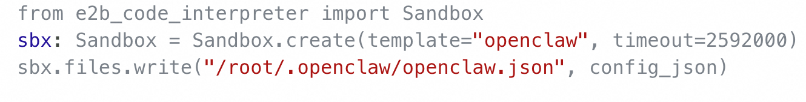
Sandbox claim operations(cont)
Sandbox Gateway: envoy filter based efficient traffic gateway
Sandbox Runtime: embedded daemon or sidecar for sandbox services:
Command Exec:
Filesystem Operations:
AI Agent
E2B SDK
Sandbox Gateway
Sandbox
Sandbox
Command Exec
Sandbox Runtime
Sandbox Runtime
File Ops
app
app

Slide 13
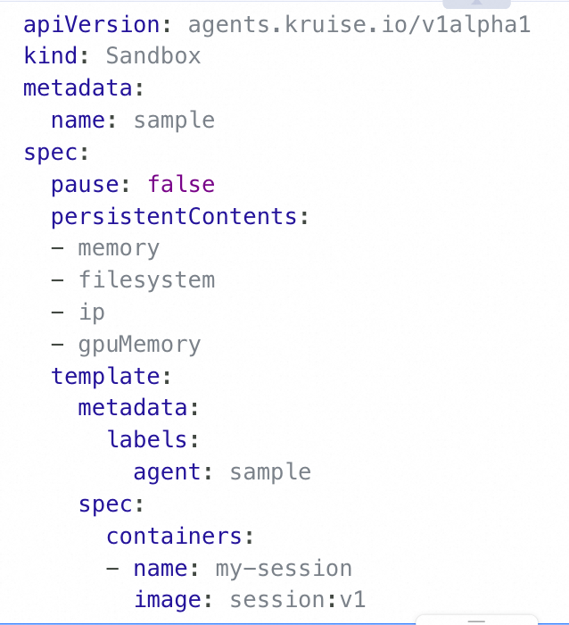
Sandbox Pause & Resume
AI Agent
Sandbox Instance Lifecycle Management
Pause: When idle, sandbox is hibernated—state checkpointed and compute resources released to reduce cost
Resume: Upon agent request, sandbox is rapidly restored to its exact pre-sleep state (memory + filesystem), enabling seamless task resumption
E2B SDK
1. Pause Sandbox
5. wake up sandbox
Sandbox Manager
Sandbox Controller
隐藏
2. trigger pod hibernation via daemon
6. Create sandbox with the same cloud disk
Daemon
Sandbox Paused
kubelet
Sandbox Resumed
Container
Container
Containerd
Container
Containerd
Container
3. Persist state to storage
7. Restore memory and filesystem
Shared storage

Slide 14
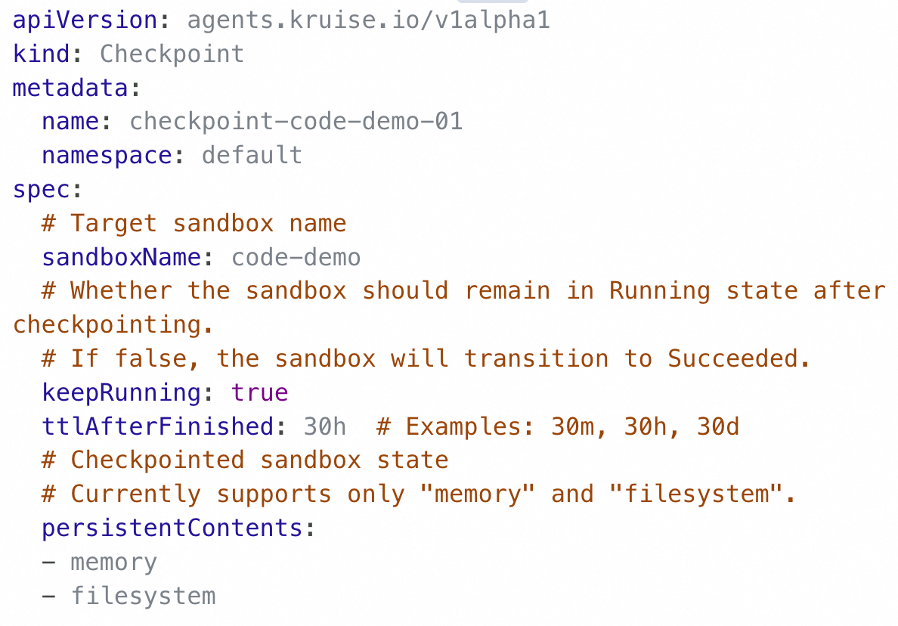
State Persistence: Checkpoint
Checkpoint CR
Sandbox CR
Checkpoint CR: Full Sandbox State Persistence
Filesystem: Export container rootfs via CRI
Memory & Process: Use CRIU/vm snapshot to checkpoint registers, memory pages, sockets, etc.
Output: Complete, restorable sandbox checkpoint
1. Persistent Memory and Filesystem State for Sandbox
4. Create sandbox with checkpoint
Sandbox Controller
K8S ApiServer
5. Launch Sandbox with same memory and writable layer
2. Trigger Checkpoint via Daemon
Daemon
Sandbox 1
Sandbox 2
CRIU
Container
Container
CRI
Container
Container
3. Persist state to storage
Shared storage

Slide 15
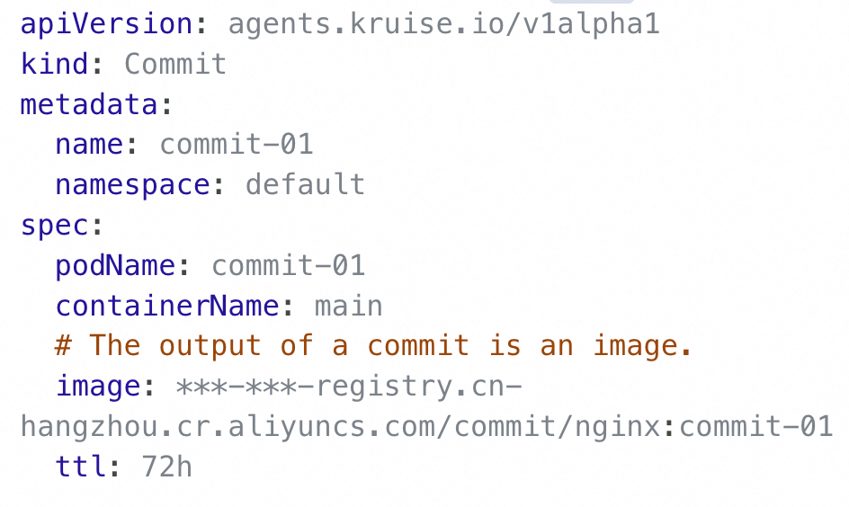
State Persistence: Commit
Commit CR: Persist Sandbox Filesystem Diff Layer
Capture overlayfs writable layer via CRI
Package as standard OCI image and push to registry
Enables state traceability, rebuild, and migration
Commit CR
Sandbox CR
1. Persistent Filesystem State for Sandbox
4. Create sandbox with commit image
Sandbox Controller
K8S ApiServer
2. Trigger Image Commit via Daemon
5. Launch Sandbox with same writable layer
Daemon
Sandbox 1
Sandbox 2
Container
Container
Containerd
Container
Container
3.Export Container Writable Layer as Image
Image Registry

Slide 16

Get involved at KubeCon!
Kiosk in the Project Pavilion：
  Tuesday 15:10-19:00
  Wednesday 14:00-17:00
  Thursday 12:30-14:00
github.com/openkruise/agents

Slide 17
Future Roadmap

Slide 18
Future Roadmap
Stateful sandbox support in open source
Enable checkpoint/restore for memory and filesystem state in community edition.
Universal sidecar runtime
Provide built-in capabilities like command execution, file upload/download via a common sidecar.
Cost-efficient warm pool
Reduce resource overhead through usage-driven elasticity and session-aware sandbox reuse

