Slide 1
Unleashing Even Drive Capabilities with KEDA
Jorge Turrado & Zbynek Roubalik

Slide 2
Introduction
Jorge Turrado
Principal Site Reliability Engineer @ Schwarz Digits
KEDA Maintainer, CNCF Ambassador
Zbynek Roubalik
Founder, Kedify
KEDA Maintainer, ex Knative TOC

Slide 3
Agenda
Introduction
KEDA
New features
Best practices
Future

Slide 4

What is KEDA
Makes Kubernetes Event Driven Autoscaling dead simple
Allows you to scale any workload or job based on events,
not only on CPU / Memory metrics
75+ integrated event sources (Prometheus, RabbitMQ, Kafka, AWS, GCP, Azure, PostgreSQL, …..)

Slide 5
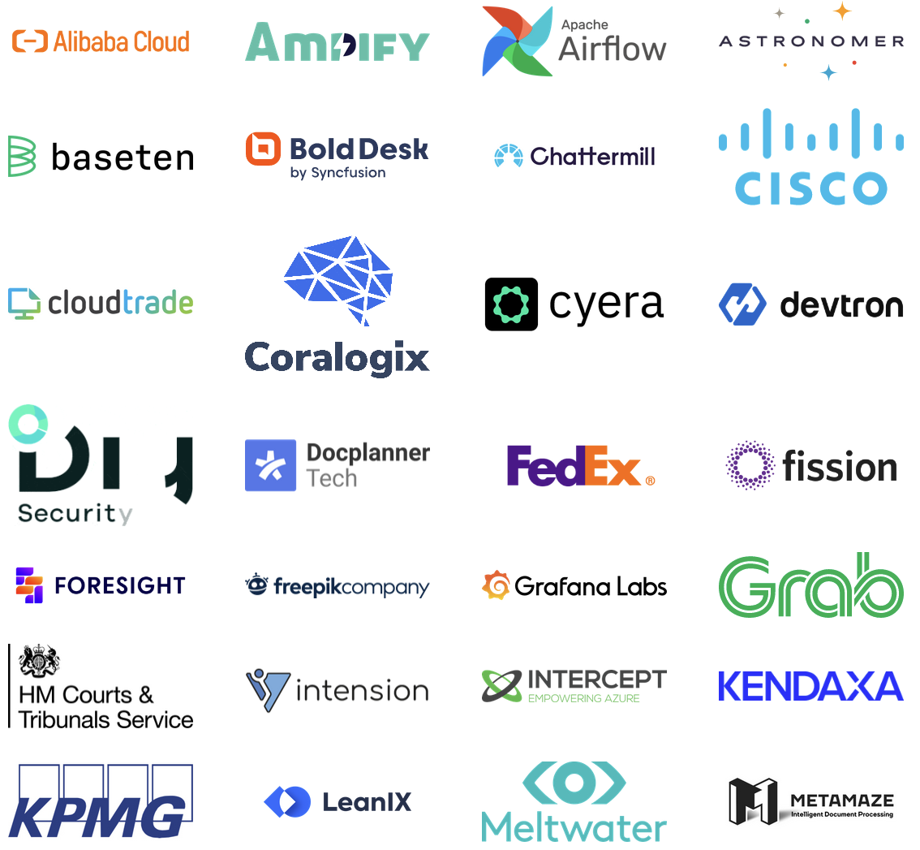
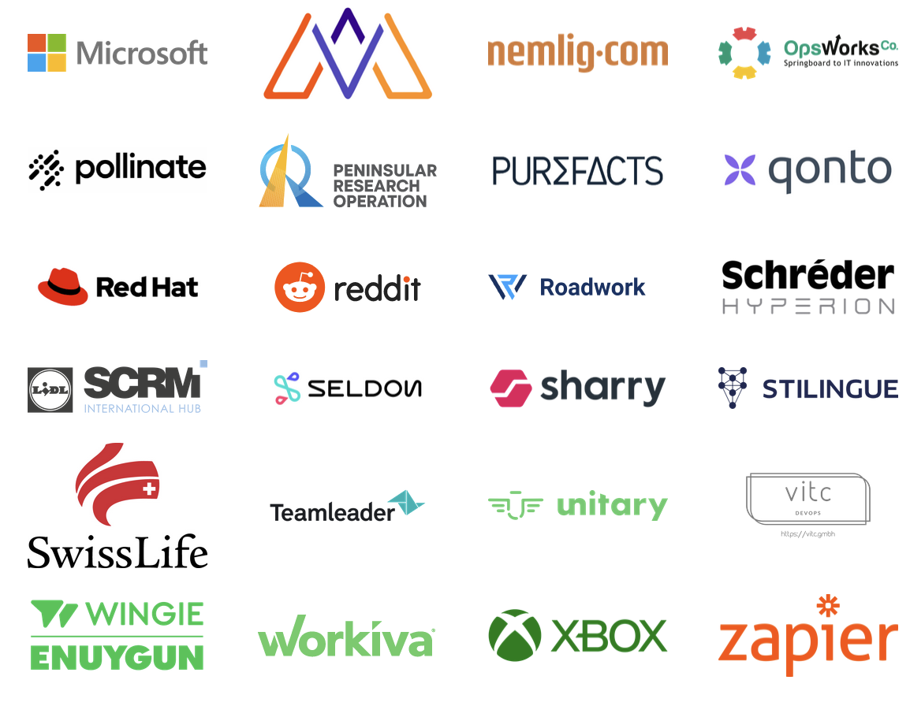
KEDA Community
CNCF Graduated Project
10k stars on GitHub
~475 contributors, incl.
  Kedify
  Schwarz Digits
  Dienst Uitvoering Onderwijs
  Red Hat

Slide 6

DEMO

Slide 7
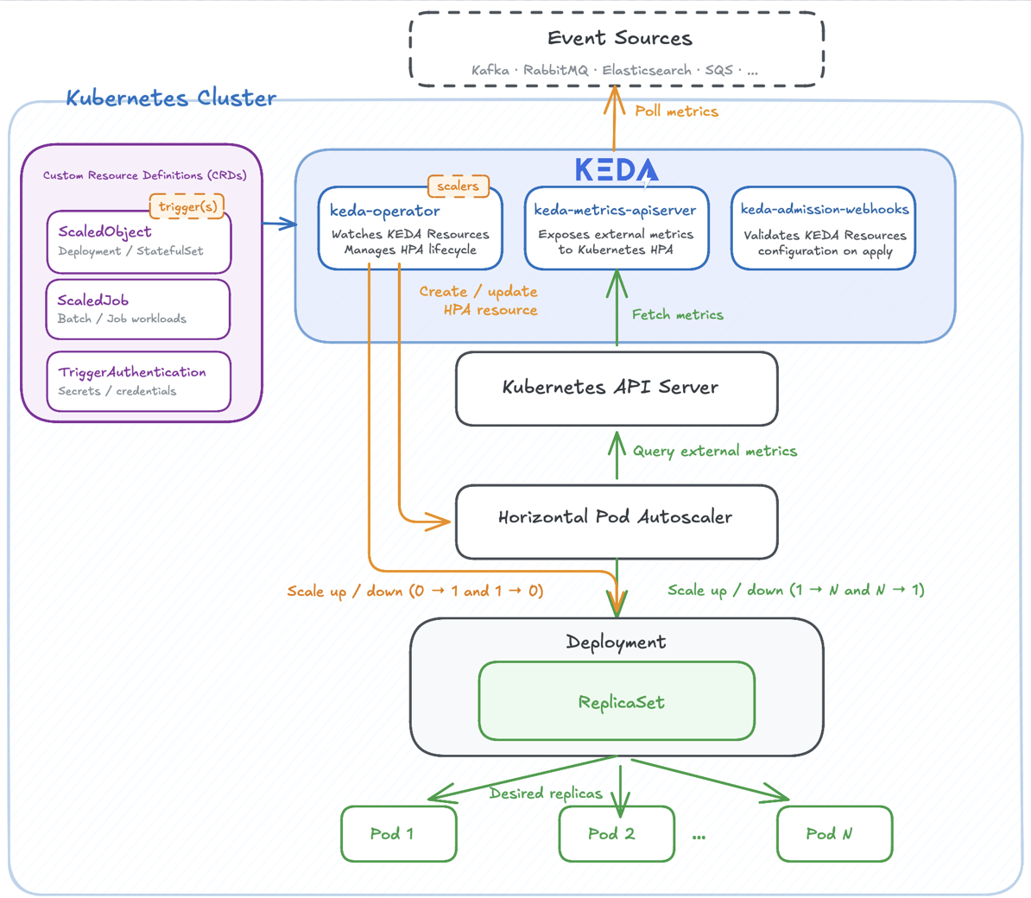
Architecture
Built on top of Kubernetes
ScaledObject/ScaledJob defines scaling metadata
Manages workloads to scale to 0
Publishes metrics HPA which makes most scaling decisions

Slide 8
ScaledObject
apiVersion: keda.sh/v1alpha1
kind: ScaledObject
metadata:
name: example-so
spec:
scaleTargetRef:
name: example-deployment
minReplicaCount: 0
maxReplicaCount: 100
triggers:
- type: rabbitmq
metadata:
host: ”ampq://user:PASWORD@my-rabbit.com:5672”
queueName: ”my-queue”
queueLength: “5”
Can target Deployment, StatefulSet or Custom Resource with /scale
Multiple scalers can be defined as triggers for the target workload
User can specify HPA related settings to tweak the scaling behavior

Slide 9
ScaledJob
apiVersion: keda.sh/v1alpha1
kind: ScaledJob
metadata:
name: example-sj
spec:
jobTargetRef:
… # standard Kubernetes Job definition
maxReplicaCount: 100
triggers:
- type: rabbitmq
metadata:
host: ”ampq://user:PASWORD@my-rabbit.com:5672”
queueName: ”my-queue”
queueLength: “5”
Schedule Kubernetes Jobs based on events
Useful option to handle processing long running executions

Slide 10
(Cluster)TriggerAuthentication
apiVersion: keda.sh/v1alpha1
kind: TriggerAuthentication
metadata:
name: example-ta
spec:
podIdentity:
provider: aws
secretTargetRef:
- parameter: connectionString
- name: my-keda-secret-entity
- key: my-connectionstring
env:
- parameter: connectionString
- name: my-keda-secret-entity
…
Define auth separate from SO/SJ
Can be reused by multiple resources
Namespaced and cluster-wide version
Support for various auth methods:
  Env variables, Secrets, ConfigMaps
  Identity providers
  HashiCorp Vault, Azure Key Vault
  GCP/AWS Secret Managers

Slide 11

New Features

Slide 12
New Features
New scalers:
  Kubernetes Resource, Forgejo, NSQ, Temporal, Solace, Solarwinds, Splunk, Sumo Logic
Fallback improvements:
  Support for triggers of Value metric type
  Dynamic fallback calculation
Improvements on authentication (file based auth for CTA)
KEDA builds for s390x

Slide 13

Best Practices

Slide 14
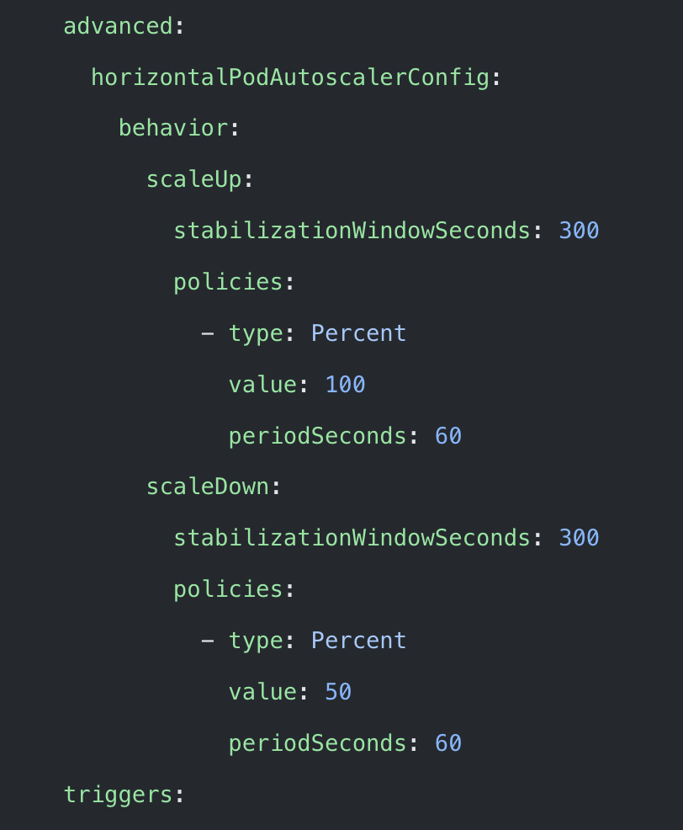
Best Practices
HPA Scaling Behavior
Important for 1<->N scaling
Control how HPA responds to changes in load, preventing rapid fluctuations and ensuring smoother scaling transitions

Slide 15
Best Practices
Cron scaler and scale to zero
If you want to scale workload to 0 outside working hours
Don’t set desiredReplicas: 0 in the trigger config
Set minReplicaCount: 0 in the ScaledObject and increase the number of replicas during working hours

Slide 16
Best Practices
Polling Interval & Metrics Caching
pollingInterval affects only 0 -> 1 scaling!
  For 1<->N scaling the interval is cluster wide on HPA controller (15s)
Specify useCachedMetrics: “true” to control “the actual” polling interval
  KEDA asks for a new metric value only during this interval -> reducing load

Slide 17
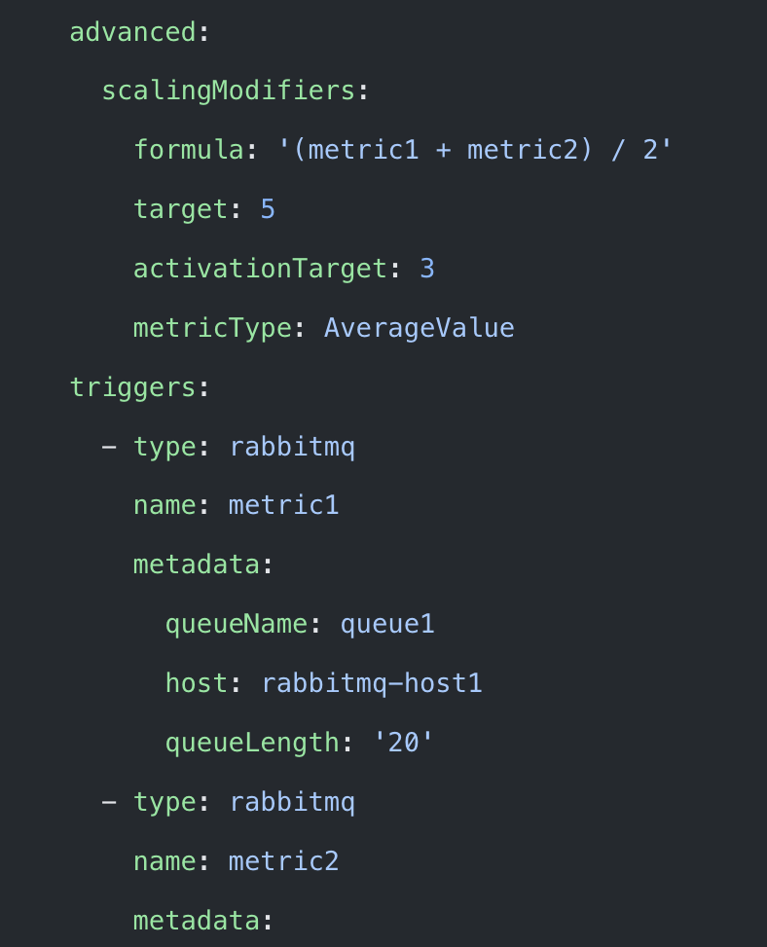
Best Practices
Scaling Modifiers
Complex scaling logic beyond simple metric evaluation
Mathematical formulas:
(trig1 + trig2)/2
Nested conditions and operators:
trig1 < 2 ? trig1 + trig2 >= 2 ? 5 : 10 : 0

Slide 18
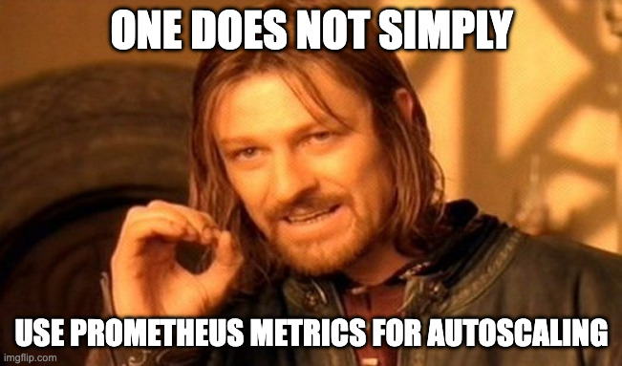
Autoscaling Metrics?

Slide 19
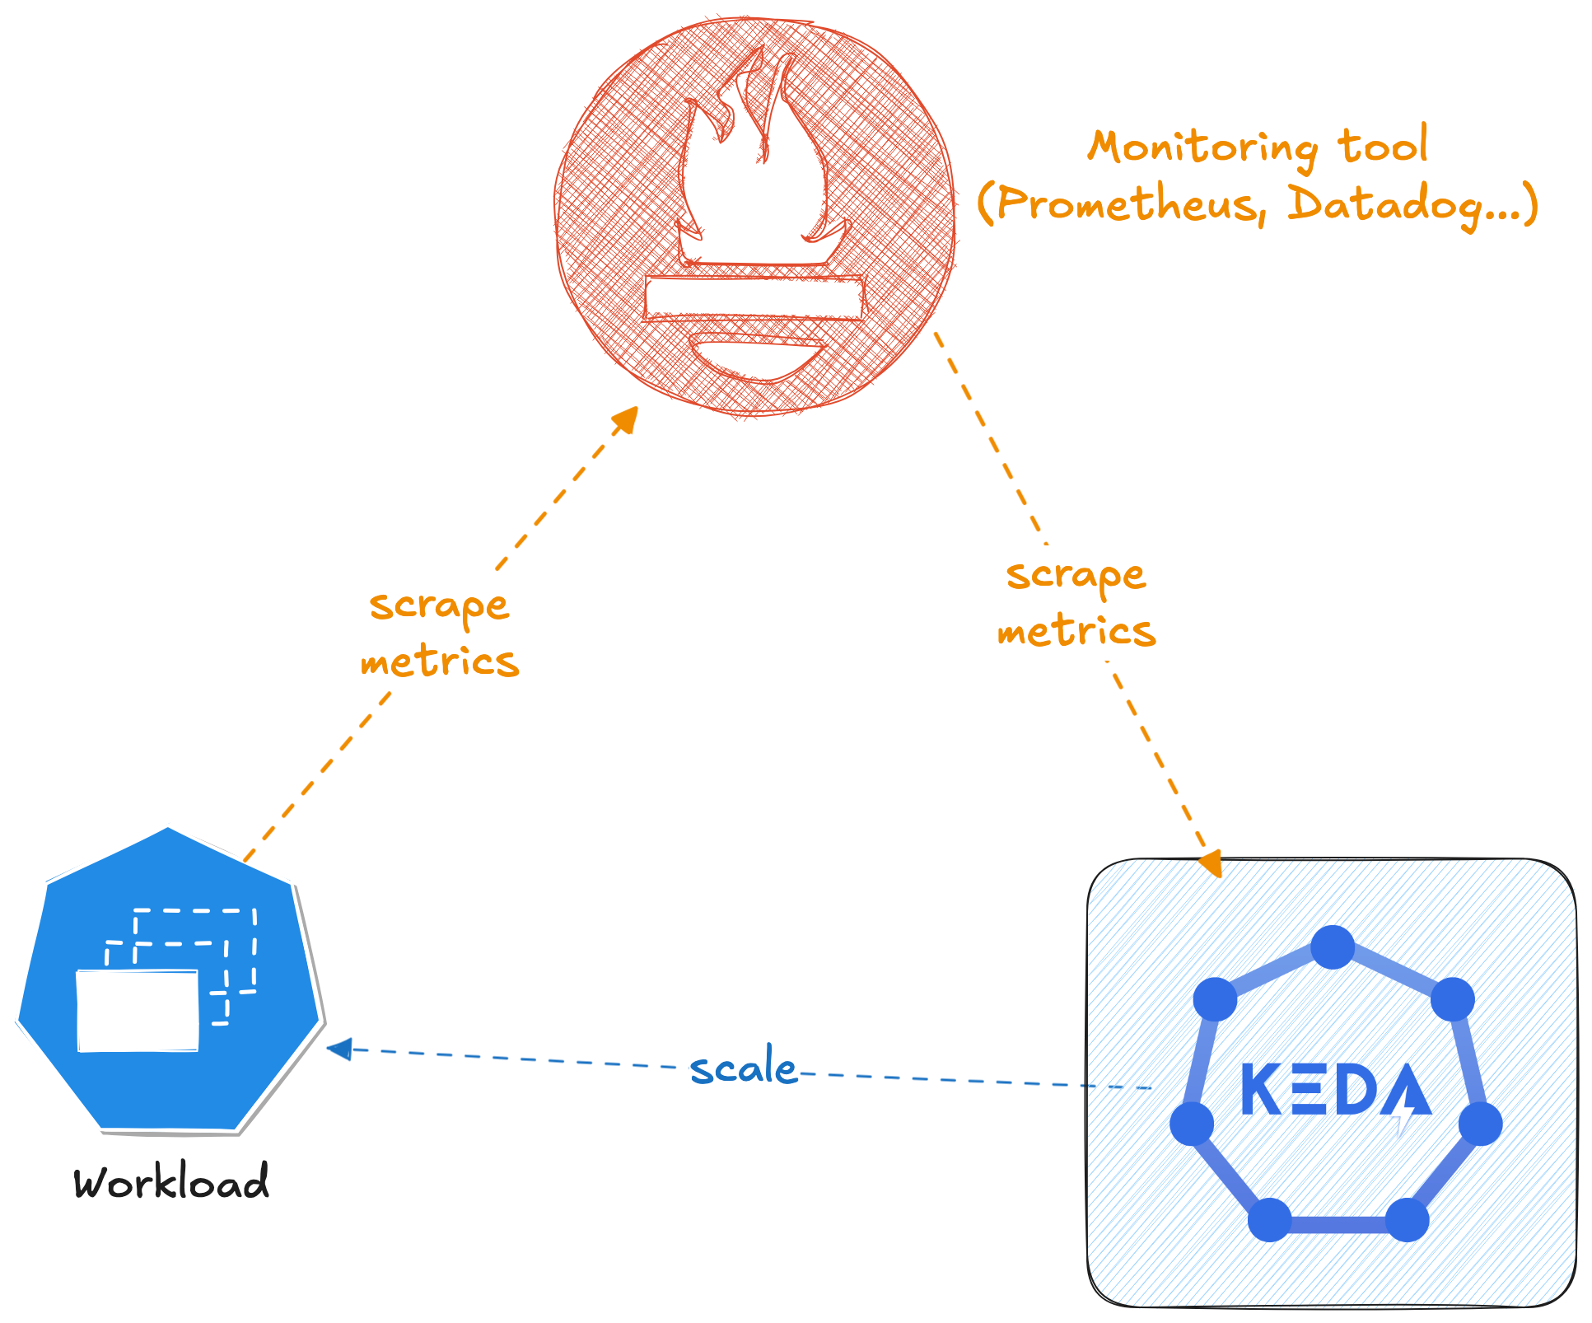
Autoscaling Metrics?
Is it really a good practice to use Prometheus/Datadog/Dynatrace/… as the metric source for autoscaling?
Delay/lag?
Too many requests from KEDA
Metrics Storage -> Cost?
Cross-zone traffic?
Blog post about this problem:
https://kedify.io/resources/blog/prometheus-autoscaling-problem

Slide 20
Future
Support for Suspendable Jobs #7548
Pod-level Suspension (checkpoint/restore) instead of scale to zero ??
Better support for GPU metrics. A new scaler?
KEDA V3?
v1alpha1 -> v1beta1 -> v1?

Slide 21
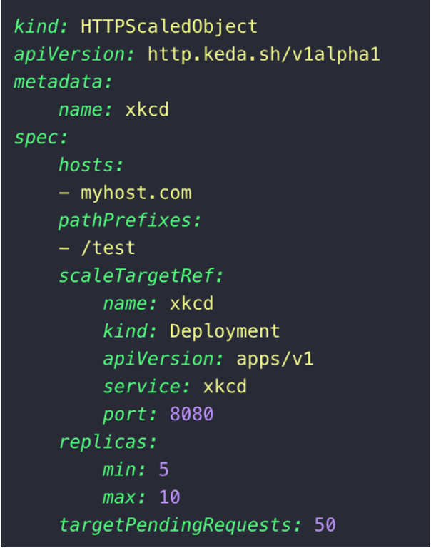
HTTP Add-on
First-class support for HTTP-based autoscaling
Supporting scale-to-zero for HTTP
*No dependency on Prometheus
Roadmap
https://github.com/kedacore/http-add-on/issues/911
Available in Beta version,
feedback welcome!
https://github.com/kedacore/http-add-on

Slide 22
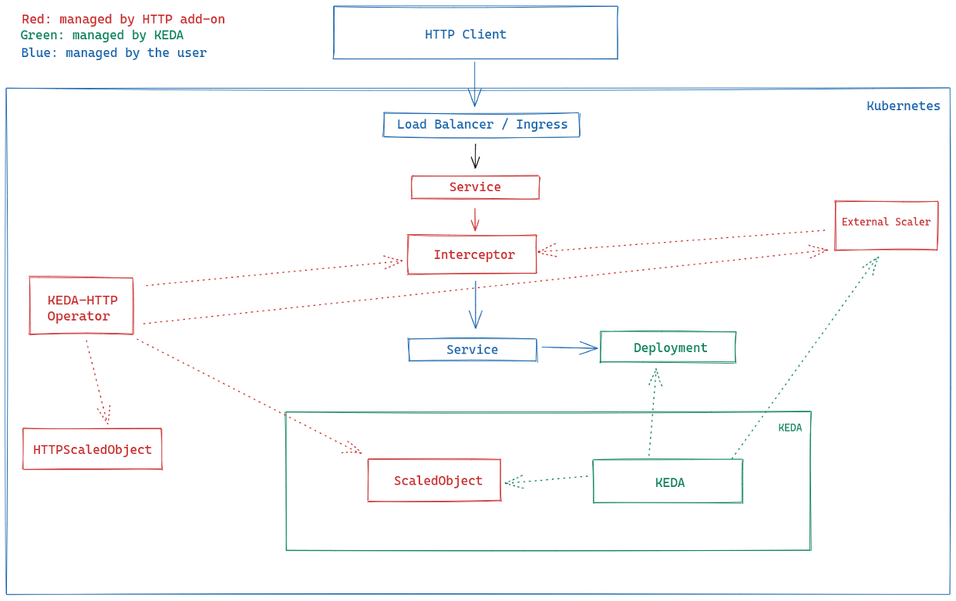
HTTP Add-on

Slide 23

Questions & Thank you!
Session feedback

