Slide 1
Sandbox Operator: Enabling Session-Aware, Efficient MCP Tool Execution in Kubernetes
MingShan Zhao, Zhen Zhang Alibaba Cloud

Slide 2
Outline
Business Challenges of Agent Sandbox with Containers
OpenKruise Agent: Container-Based Sandbox Solution
Integration with Ecosystem
Core Technologies
Future Roadmap

Slide 3
Business Challenges of Agent Sandbox with Containers

Slide 4
AI Agent Architecture on Containers
LLM
Planning/Inference
Memory
Short-team/Long-team
Memory Store
User Or Agent
(Agent 2 Agent)
AI Agent
ReAct/CoAct/…
Knowledge
Factual/Retrieved
Knowledge Base
Tools
MCP Client / MCP Protocol
Sandbox
(Code interpreter/Broser use/
Compute use)
MCP Servers
Agent Resource
Agent Resource
ACR
Sandbox Template
(Code interpreter/Broser use/
Compute use)
Pod
Pod
Pod
Pod
Pod
Pod
Kubernetes (Container Runtime/Network/Storage)

Slide 5



Technical Challenges of Agent Sandboxes
Data Security
Rapid Large-Scale Provisioning
State Persistence
1. Prompt injection leading to unpredictable, malicious code generation
2. Strict isolation required across multi-session data
1. Dynamic model-controlled tool execution enables elastic, second-scale concurrency at scale
2. Session count and parallelism intensify dynamic resource demand
1. AI Agents: long-running, multi-step, stateful
2. Concurrent sessions drive sandbox scale explosion
3. Not all sessions are active at all times
Sandbox must run in a securely isolated environment.
Sandbox requires extreme elasticity.
State must be effectively preserved
Costs must be reasonably controlled

Slide 6
Technical Challenges of Agent Sandboxes
Technical Challenges in Sandbox Scenarios
Sandbox
Checkpoint
Restore
Secure Isolation: Compute, storage, and network-level separation
High-Velocity Resource Management: Container orchestration for large-scale, rapid provisioning
      Enables cost savings and instant sandbox startup
Standardized Lifecycle Management: Unified control across sandbox creation, execution, and teardown
Checkpoint
Sandbox
Template
Create
Pending
Running
Completed
Pause
Resume
Paused
Sandbox Instance

Slide 7
OpenKruise Agent: Container-Based Sandbox Solution

Slide 8
Ecosystem Integration: OpenKruise Agent
AI Agent
OpenKruise Agent: Standardized Sandbox Lifecycle & AI Integration
Unified lifecycle management:
Create, hibernate, and resume sandboxes — preserving memory, read-write layers, and runtime state
Efficient resource provisioning:
Pooling + dynamic resizing to accelerate cold starts
Checkpoint/Fork support:
Enables RL training and stateful agent workflows
Bridge between AI Agents and Kubernetes:
  Upstream: Exposes tool-calling APIs to AI agents (via E2B-like protocols)
  Downstream: Orchestrates sandbox workloads as Pods on Kubernetes
E2B SDK/MCP
E2B/MCP Protocol
Sandbox Gateway
E2B/MCP Server
Sandbox
Warm Pool
Checkpoint
OpenKruise Agent
K8S API
Kubernetes
ECS
ECS
ECS
Pod
Pod
Pod
Pod
Pod
Pod
Pod
Pod
Pod

Slide 9
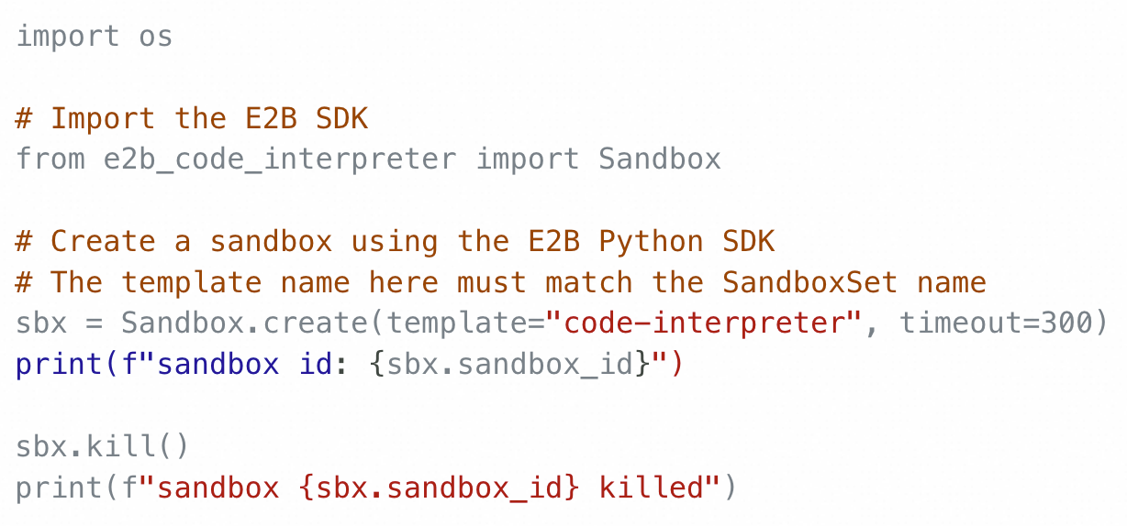
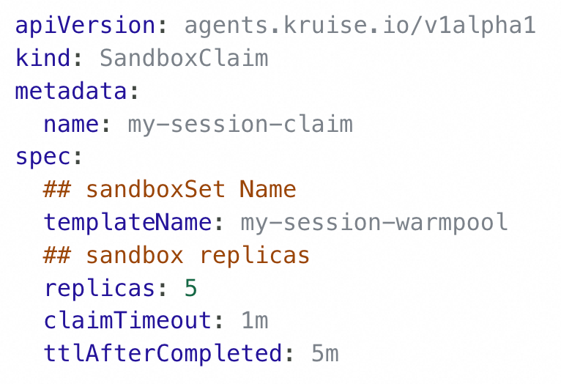
Agent Sandbox Integration Approaches
Python SDK（E2B/MCP）
SandboxClaim CR（K8S API）
For AI Scientists & Developers
Native SDK integration:
REST/gRPC APIs (E2B-compatible) with official Python SDK support
High-level lifecycle control:
create(), sleep(), wake(), destroy() — no Kubernetes expertise needed
Code-first sandbox management:
Embed sandbox orchestration directly into AI agent workflows, in a developer-native wayStandardizedycle Management: Unified control across sandbox creation, execution, and teardown
For Agent Platform & SRE Teams
Declarative sandbox orchestration:
Define desired state via SandboxSet CRD
Automated lifecycle handling:
Auto-provision Pods, sync states, schedule hibernation, and reclaim resources
Kubernetes-native operations:
Full integration with K8s control plane

Slide 10
OpenKruise Agent: Project Overview
Agent-Sandbox: An End-to-End AI Sandbox Solution from OpenKruise (CNCF Sandbox Project)
MCP Server
Sandbox Manager
Sandbox Controller
Session Aware
  MCP Tools
Run Code，Run Code One，
Run Command
E2B Server
Sandbox Hibernation & Wake-up
Code Interpreter，Run Command，
Desktop Use，Browser Use
Sandbox Warmpool
Sandbox Gateway
Project Repository: https://github.com/openkruise/agents

Slide 11
Relationship with Sig Agent Sandbox
Built for scale & speed
From Alibaba Cloud’s large-scale, low-latency agent scenarios
Community-first mindset
Actively aligning with emerging standards (e.g., Sig Agent Sandbox)
Future-ready
Will adopt community standards when mature and compatible

Slide 12
Integration with Ecosystem

Slide 13

Running VeRL on Kubernetes with OpenKruise Agent
Sandbox-manager Domain
Background & Requirement
User Submit RayJob
VeRL runs coding RL on SWE-bench
Each batch: 128 samples × 16 trials
Needs 2,048 sandboxes per batch
Must be fast — no cold starts
Ray Operator
OpenKruise Sandbox Manager
MCP Server
Ray Cluster
Auth
Session
Key Tech
OpenKruise Agent uses SandboxSet
Pre-warms a pool of 2,048 sandboxes
Ready before the batch starts
Agent
Run Code, Run Command,
File Ops
vLLM
Megatron
Benefits
MCP Search Tool
Sandbox
All sandboxes ready in ~20ms
Pool auto-replenishes quickly
Next batch just as fast
Sidecar Runtime
Code Interpreter

Slide 14
Accelerating OpenClaw Deployment with OpenKruise Agent
Request New OpenClaw
Access OpenClaw
User Pain Points
Tight online schedule
High costs of idle resources
Excessive response latency due to cold starts
1. request new openClaw for user
OpenClaw Platform
2. create/config sandbox using e2b api
OpenKruise Agent Solution
Ingress (80, 443)
compatible with the E2B API, allowing users to integrate via the E2B SDK.
pause/resume capabilities enable preserving filesystem state.
Sandbox warm pool to accelerate OpenClaw startup time.
3. proxy to openkruise agent
Sandbox Warm Pool
4. Claim sandbox
Sandbox Manager
Sandbox Gateway
sandbox routes
隐藏
Sandbox Controller
Customer Benefits
隐藏
The customer completed the entire process—from cluster provisioning to OpenClaw service launch—in just five days, and delivered 8,000 OpenClaw instances to external users on the day of launch.
New OpenClaw
Used OpenClaw
Paused/Resume
Paused OpenClaw
Pod
5. modify openclaw config via e2b api
Pod
Pod
Pod
Pod
Pod
Pod
Pod
Pod
Kubernetes (Container Runtime/Network/Storage)

Slide 15
Core Technologies

Slide 16
Powering E2B & Session Aware MCP Server
AI Agent
Sandbox Manager
隐藏
E2B SDK/MCP
mcp protocol
e2b protocol
MCP Server：
Session Aware
            1. Session creation & retrieval
            2. Auto cleanup/paused of expired sessions
  MCP Tools
1. Run Code，Run Code One，Run Command
E2B: Multi-Scenario Support
Code Interpreter
Desktop Automation
Browser Interaction
Sandbox-Gateway：Scalable data-plane proxy for 10K+ sandboxes — avoids Kubernetes Service overhead with direct SandboxId-to-IP routing.
MCP Server
E2B Server
Auth
Session
Auth
Sandbox
Gateway
Sandbox
run code
run command
file ops
Sandbox Manager
Run code, run command, file ops
Sandbox
Sandbox
Sandbox
Sidecar Runtime
Sidecar Runtime
Sidecar Runtime
Sandbox Main
Sandbox Main
Sandbox Main

Slide 17
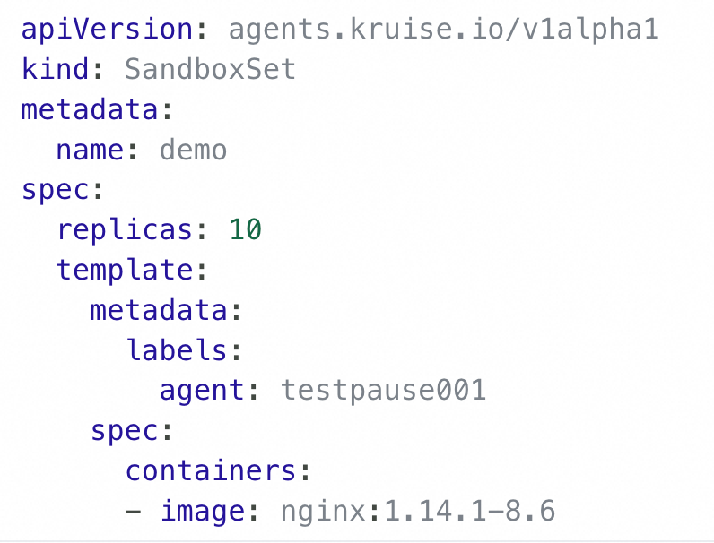
Sandbox Warm Pool
1. Invoke LLM inference
Sandbox Warm Pool：
Instant Allocation:
Pre-warmed sandbox instances in a ready pool enable sub-second assignment, eliminating cold-start latency for on-demand agent tasks.
Intelligent Routing:
Built-in Envoy sidecar provides low-latency, policy-aware traffic routing to the appropriate sandbox instance based on workload or tenant context.
AI Agent
LLM
E2B SDK
2. Create Sandbox
5. Run Code
Sandbox Manager
Sandbox Gateway
隐藏
4. Update Sandbox Routes
3. Claim Sandbox
6. Run Code
Available Sandbox
In-Used Sandbox
Paused Sandbox
Pod
Pod
Pod

Slide 18
Warm Pool Stress Test
AI Agent
…
AI Agent
…
AI Agent
E2B SDK
E2B SDK
E2B SDK
250 QPS sandbox claims
Total: 10,000 sandboxes
Avg. latency: 21.45 ms
250/s -> 10k sandboxes
call tools
Sandbox Manager
Sandbox Controller
隐藏
claiming sandboxes from warm pool
SandboxSet Warm Pool
claimed
Claimed Sandbox
…
…
Sandbox
Sandbox
Sandbox
Sandbox

Slide 19
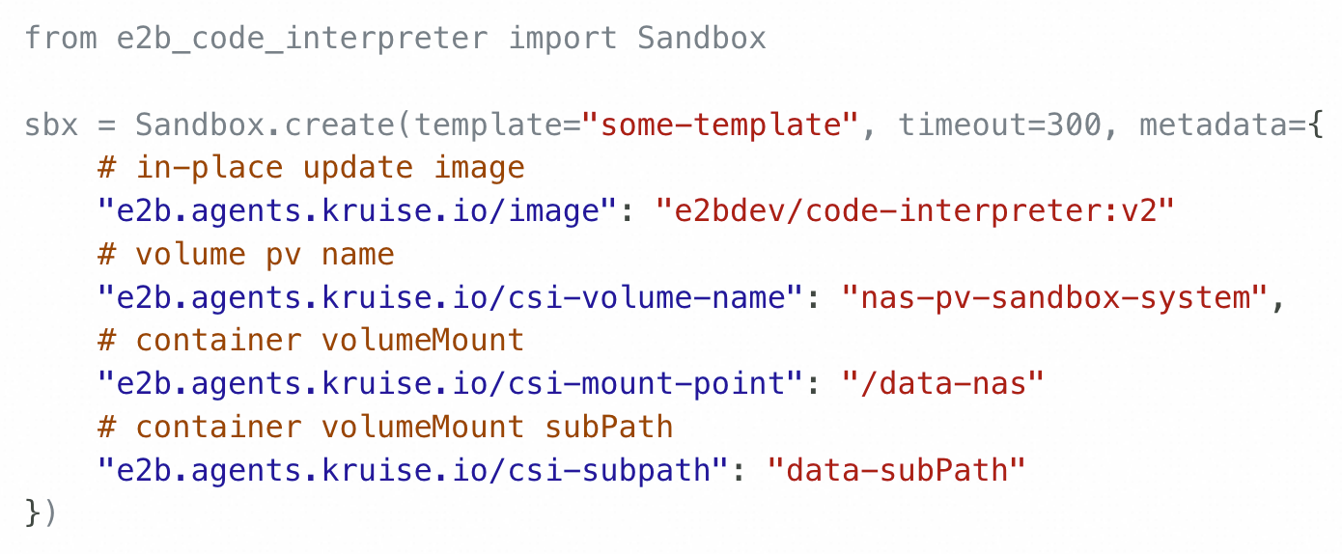
Enhanced Sandbox Capabilities: In-Place Update + Elastic Storage
Invoke LLM inference
Supports heterogeneous sandboxes:
In-Place Update Image: In-place update the sandbox image when claiming from the warm pool — no recreation needed.
Dynamic Storage Mounting: Attach NAS/OSS volumes at claim time
In-Place Resizing(planned): resize the sandbox to desired resources specs.
AI Agent
LLM
E2B SDK
1. Create Sandbox with image:v1 and volume nas/oss
Sandbox Manager
Sandbox Controller
隐藏
2. Claim sandbox from warm pool
Sandbox
Sandbox
Main
/data
In-place
Update
C Image:v1
Elastic
Storage
CSI Sidecar
C Image:v2
volume: nas/oss
Sandbox Warm Pool
Pod image v1 and without volume
Pod image v1 and without volume
Pod image v1 and without volume
Notes:
前面我们讲到了可以通过 sandbox warm pool 的方式

Slide 20
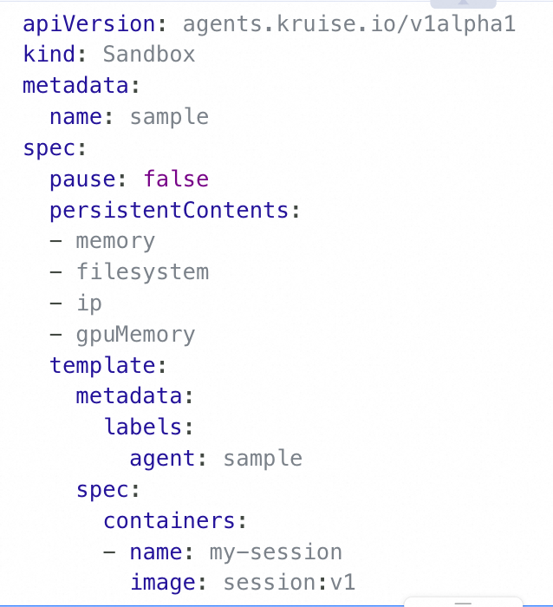
Sandbox Pause & Resume
AI Agent
4. Invoke LLM inference
Sandbox Instance Lifecycle Management
Pause: When idle, sandbox is paused—state checkpointed and compute resources released to reduce cost
Resume: Upon agent request, sandbox is rapidly restored to its exact pre-sleep state (memory + filesystem), enabling seamless task resumption
LLM
E2B SDK
1. Pause Sandbox
5. Resume sandbox
Sandbox Manager
Sandbox Controller
隐藏
2. trigger pod paused via daemon
6. Create sandbox with the same cloud disk
Daemon
Sandbox paused
kubelet
Sandbox resuming
Container
Container
Containerd
Container
Containerd
Container
3. Memory+filesystem
7. Restore memory and filesystem
Persistent Storage

Slide 21
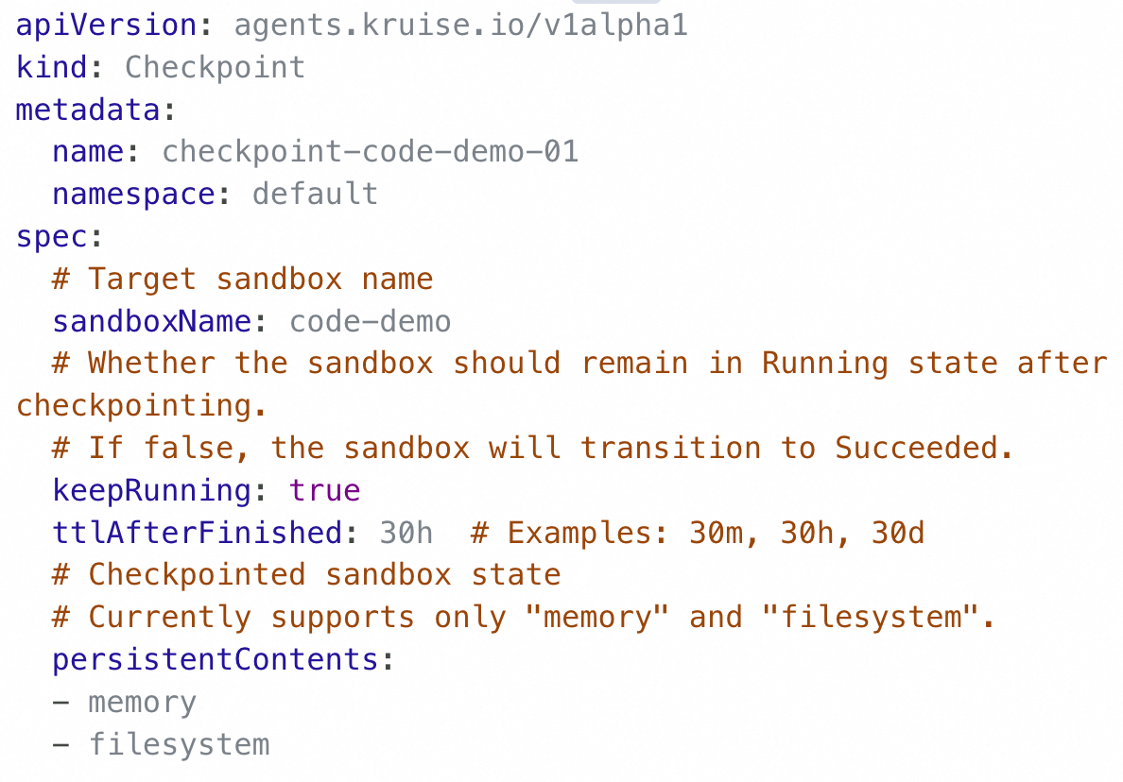
State Persistence: Checkpoint
Checkpoint CR
Sandbox CR
Checkpoint CR: Full Sandbox State Persistence
VM Shapshot
1. Persistent Memory and Filesystem State for Sandbox
4. Create sandbox with checkpoint
Sandbox Controller
K8S ApiServer
5. Launch Sandbox with same memory and writable layer
2. Trigger Image Checkpoint via Daemon
Daemon
Sandbox 1
Sandbox 2
vm shopshot
Container
Container
Container
Container
3. memory+filesystem
Persistent storage

Slide 22



Get involved at KubeCon!
Kiosk in the Project Pavilion：
  Tuesday 15:10-19:00
  Wednesday 14:00-17:00
  Thursday 12:30-14:00
Operationalizing AI Workloads on Kubernetes with OpenKruise
E103-105 15:00-15:30
github.com/openkruise/agents

Slide 23
Future Roadmap

Slide 24
Future Roadmap
Stateful sandbox support in open source
Enable checkpoint/restore for memory and filesystem state in community edition.
Universal sidecar runtime
Provide built-in capabilities like command execution, file upload/download via a common sidecar.
Cost-efficient warm pool
Reduce resource overhead through usage-driven elasticity and session-aware sandbox reuse.
Give back to the community
Actively participate in ecosystem development and contribute our proven capabilities upstream.

