Slide 1
Achieving Resilient Multi-Cluster AI Serving on Kubernetes with Karmada and KubeRay
Han-Ju Cheng, Anyscale
Wei-Cheng Lai, Bloomberg
Notes:
Hello everyone, and welcome to KubeCon EU. My name is Han-Ju Chen and my partner is Wei-Chen Lai.
I work at Anyscale and that Anyscale is the company behind Ray, the open-source standard for distributed computing in Python.
Due to visa issues, my partner won’t be able to give the talk with me in person, but he will record a video to explain the Karmada-related part of the presentation.
Today we will share a practical approach for running AI serving reliably at scale on Kubernetes, under uneven GPU capacity and regional failure risks.
https://docs.google.com/presentation/d/1RZpCEHHOZvZuNnGxVByR5qdR-hMDFbPG/edit?slide=id.p1#slide=id.p1

Slide 2
Today's Blueprint
Scale, GPU Scarcity, and the Limits of Single-Cluster K8s
A Two-Layer Architecture for Resilient Serving
Orchestrating Clusters with Karmada
Mastering Serving with KubeRay & Ray
Notes:
Here is the plan. We will start with the production challenges, including bursty traffic, strict p95 and p99 latency targets, and GPU scarcity, and explain why these push single cluster Kubernetes to its limits.
We will then present a two layer blueprint. The first layer is fleet orchestration across clusters. The second layer is inference serving inside each cluster.
Wei-Chen and I will split the session. Wei-Chen will cover the fleet layer and show how Karmada applies policy for placement, replica spreading, per cluster overrides, and automated failover. I will cover the serving layer and show Ray Serve via KubeRay RayService, including request driven autoscaling, safe upgrades, and advanced feature Ray Serve provides.
By the end, you will have a vendor neutral reference architecture you can adapt. Now, let us start with the challenge.

Slide 3
Production Requirements for AI Serving at Scale
Predictable SLOs: Strict bounds on p95/p99 latency, high availability, and low error rates
Elasticity & GPU Efficiency: Handling bursty traffic without long warm-ups, while avoiding idle GPU spend.
Regional Locality: Meeting physical latency budgets and strict data residency boundaries.
Safe Operations: Zero-downtime rollouts, safe rollbacks, and model-level observability.
Notes:
To start, I want to set a clear baseline. At scale, AI serving has production requirements that are stricter than most stateless microservices.
First, we need predictable SLOs. That means tight p95 and p99 latency targets, strong availability, and controlled error rates, even when traffic is bursty.
Second, we need elastic capacity and GPU efficiency. Traffic can spike quickly, but scaling serving is not instantaneous. Models need warm up time, including loading large weights and initializing GPU memory. We need to absorb spikes without building large queues, while also avoiding over provisioning and leaving expensive GPUs idle. That makes right sizing and utilization critical.
Third, we need regional locality. To meet latency budgets and comply with data residency boundaries, especially relevant here in Europe, inference often needs to run close to users and within specific regions.
Finally, we need safe operations and visibility. We need rollouts that are gated by health signals, clear rollback paths, and model level telemetry such as tail latency, queue depth, and error rates. Many inference requests are long lived, so upgrades should support graceful draining rather than abrupt termination.
The goal is to meet all of these requirements at the same time. Next, I will explain why a single cluster with standard Kubernetes primitives becomes a bottleneck.

Slide 4
The Limitations of Single-Cluster and "Vanilla" Kubernetes
The Single-Cluster Boundary (Infrastructure Limits)
Single Blast Radius: Cluster or AZ outages result in total service disruption.
Capacity Cliffs: Regional GPU stockouts cause immediate queueing and latency spikes.
Locality Constraints: Impossible to satisfy tight global latency targets and regional data residency from one physical location.
The "Vanilla" Kubernetes Gap (Orchestration Limits)
Missing AI Primitives: Standard Services lack awareness of dynamic batching, streaming, and multi-node/multi-GPU execution.
Operational Risk: Without serving-aware draining, standard HPA scale-downs can interrupt in-flight requests and token streams.
Notes:
Given these production requirements, single cluster Kubernetes and standard primitives fall short in two areas: infrastructure limits and serving orchestration.
First is the single cluster boundary. One cluster is one blast radius. An outage, a control plane incident, or even planned maintenance can disrupt the entire inference service. GPU capacity also hits cliffs. When a region runs out of GPUs, requests start queueing and latency spikes quickly. A single physical location also cannot satisfy both tight global latency targets and regional data residency requirements at the same time.
Second is the vanilla Kubernetes gap. Standard Services and Deployments are not designed for inference serving features such as multi node and multi GPU execution. Operationally, inference requests are often long lived. Without serving aware draining, a normal HPA scale down or rollout can interrupt in flight requests and token streams.
So the takeaway is simple. A single cluster is a hard boundary, and vanilla primitives do not provide the serving life cycle inference needs. This is why we use a two layer design: a fleet layer across clusters, and a serving layer inside each cluster.

Slide 5
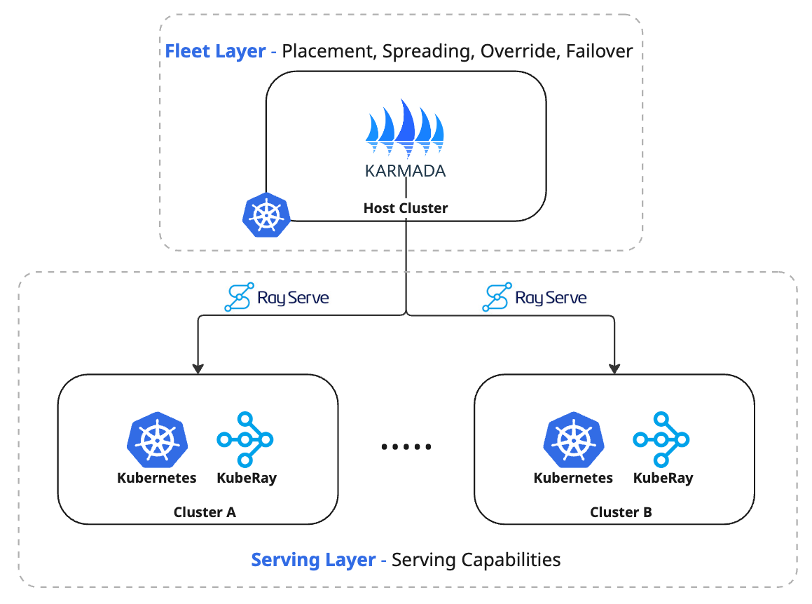
A Two-Layer Architecture for Resilient Serving
Notes:
To address both the single-cluster boundary and the vanilla Kubernetes gap, we separate concerns with a two-layer architecture.
At the top is the fleet layer. Karmada acts as the multi-cluster control plane and uses policy to decide where workloads run, how replicas are spread, how cluster-specific overrides are applied, and how failover works when a cluster or region becomes unhealthy. This layer answers the “where.”
Inside each target cluster is the serving layer. We run Ray Serve via KubeRay RayService to provide inference serving capabilities such as request-driven scaling, health-gated upgrades, graceful draining, autoscaling, and some advanced feature I will talk about later. This layer answers the “how.”
Next, we will start with the fleet layer and go through the Karmada patterns: placement, spreading, overrides, and failover.

Slide 6


Slide 7
Solving the Fleet Problem with Karmada
Kubernetes-Native: Standard APIs, standard manifests, and familiar kubectl workflows.
Decoupled Model: Workload YAML stays stable; topology and fleet logic live entirely in declarative policies.
Fleet Capabilities via Policy: Placement and replica spreading, per-cluster overrides, and automated failover.
RayService Integration: Karmada Resource Interpreter teaches the control plane to understand RayService definition.
Notes:
Hi everyone, my name is Wei-Cheng Lai. I’m a software engineer at Bloomberg working on the Machine Learning Platform, and an open source contributor to the Karmada and KubeRay projects.
Unfortunately, I’m unable to join in person today due to a visa issue, so I’ve recorded this short introduction. In the next few minutes, I’ll briefly share how we built the fleet layer using Karmada. After that, my co-presenter Han-Ru will continue the session. Thank you for your understanding.
Let’s get started.
Karmada is Kubernetes native. We can keep standard APIs, standard manifests, and the same kubectl workflows. If you can deploy a RayService in one cluster, you do not need a new workload format for multi cluster.
This model is decoupled. The RayService YAML stays stable, and all multi cluster topology and fleet logic is expressed as declarative policies.
Through policy, Karmada provides the fleet capabilities we need: placement and replica spreading, per cluster overrides, and automated failover.
RayService is a custom resource, so we use the Karmada Resource Interpreter to let Karmada understand RayService status, resources requirements and readiness semantics, so fleet policies can act on it consistently.

Slide 8
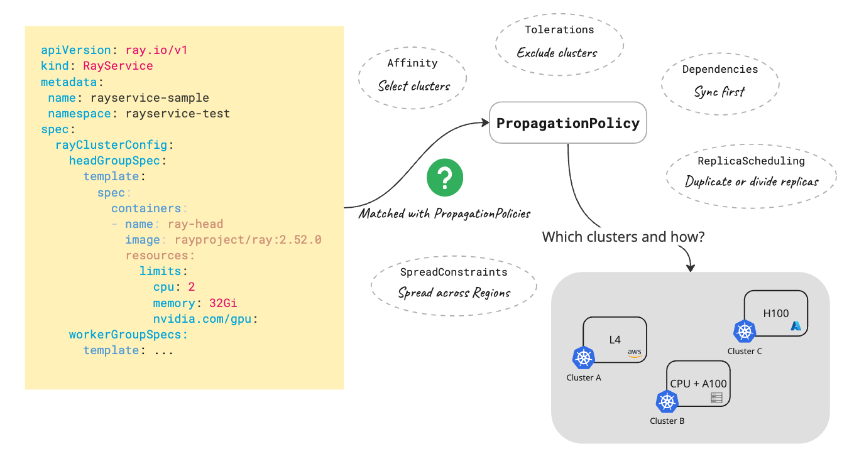
Policy-Based Placement and Replica Spreading
Notes:
Now let’s make the fleet layer concrete with the first policy pattern for replica scheduling in Karmada, defined in a PropagationPolicy.
First is placement. With clusterAffinity, we select the clusters that meet latency or compliance requirements, such as clusters labeled for a specific region. We do this without changing the RayService YAML.
Second is spreading. With spreadConstraints, we require the service to be distributed across multiple clusters or regions. This reduces blast radius and avoids concentrating capacity in a single failure domain.
Third is replica scheduling. For RayService, we most commonly use Duplicated. That means Karmada deploys the same RayService into each selected cluster, and each cluster runs its own serving stack. This aligns with our two layer design, because scaling and upgrades are handled inside the cluster by RayService, while multi cluster placement and resilience are handled by Karmada. Karmada also supports Divided scheduling when a workload needs replicas split across clusters, but it is less common for our RayService setup.
Next, once the service is running in multiple clusters, we need to adapt to differences between clusters. That brings us to overrides.

Slide 9
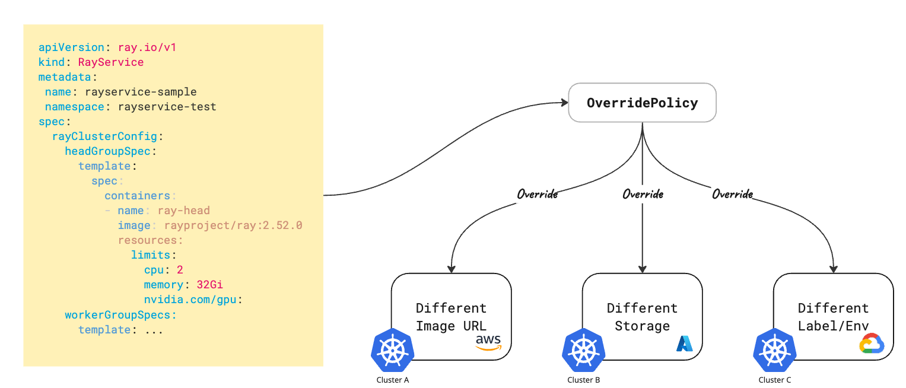
Managing GPU Heterogeneity with Dynamic Overrides
The Heterogeneity Challenge: Avoid configuration drift and "YAML-per-cluster" anti-patterns across diverse environments.
Dynamic Adaptation (ClusterOverridePolicy/OverridePolicy): Applies transformations before workloads are dispatched.
Notes:
The override policy is to handle the heterogeneity challenge. In a real fleet, clusters can differ in GPU labels and scheduling constraints, storage defaults, and the container registries they use.
If we encode those environment details inside the RayService manifest, we quickly end up maintaining separate YAML per cluster. That increases drift and makes operations harder.
Instead, we keep one RayService definition and apply cluster specific adjustments through an OverridePolicy. As shown in the diagram, the base RayService stays the same, and Karmada applies targeted overrides before the resource is applied to each member cluster.
Common examples include updating the image registry prefix for a local mirror, selecting the appropriate storage class for model caching, and applying cluster specific labels or environment settings needed for scheduling and integration.
This keeps responsibilities clear. The fleet layer adapts environment wiring, and RayService remains the source of truth for the service definition. With placement, spreading, and overrides in place, the remaining fleet topic is failure handling. Next, we will cover dual level failover.

Slide 10
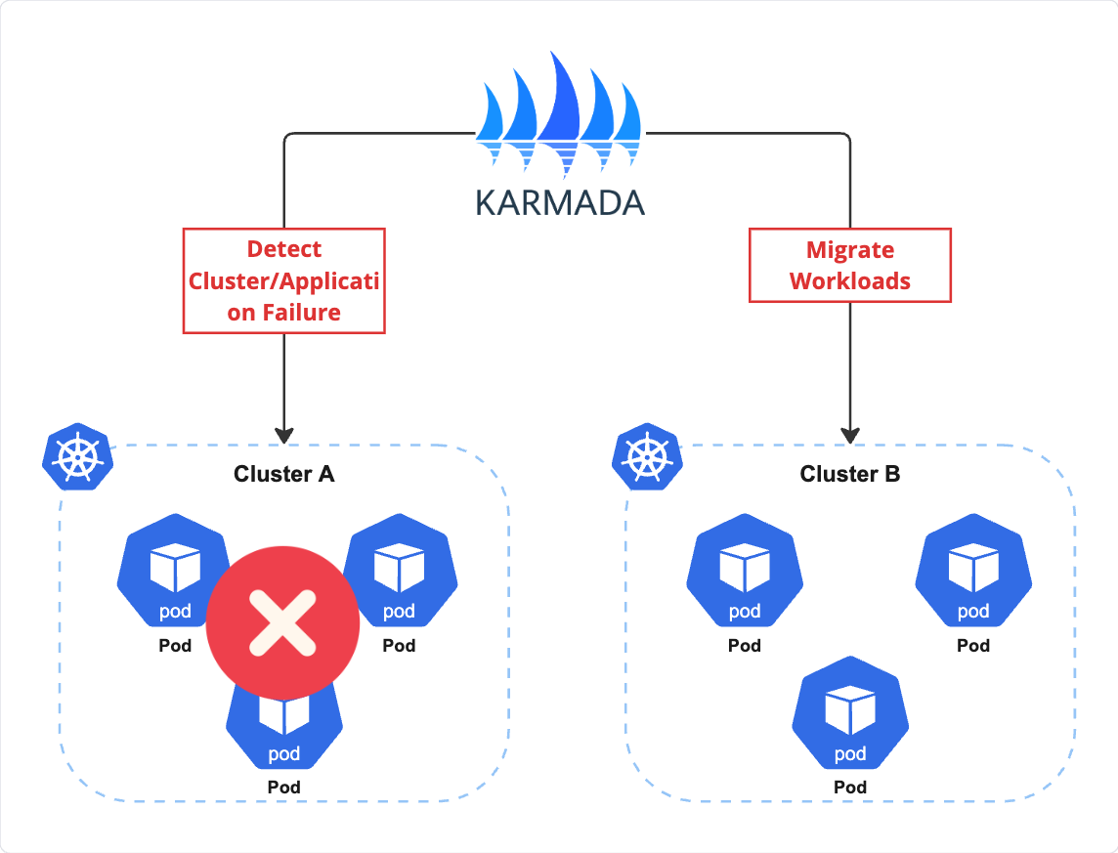
Automated Failover and Blast Radius Reduction
Cluster-Level Failover: Evicts workloads based on infrastructure taints (e.g., not-ready, unreachable) after a configurable grace period.
Workload-Level Failover: Prevents silent blackholes when the cluster is healthy but the specific RayService is degraded or crash-looping.
Interpreter-Driven Recovery: Maps RayService CRD status to Karmada health semantics to trigger precise, policy-driven rescheduling.
Notes:
We use two failover triggers provided by karmada to limit impact.
First is cluster level failover. Karmada monitors member cluster health. If a cluster becomes not ready or unreachable, it is marked with the corresponding cluster taint. New scheduling to that cluster stops, and after a configurable grace period, affected workloads can be evicted and rescheduled onto healthy clusters that still satisfy the placement policy.
Second is workload level failover. A cluster can be healthy while a specific RayService is not ready, degraded, or crash looping. To avoid relying only on cluster health, we integrate RayService with Karmada using a Resource Interpreter. The interpreter maps RayService status into health signals that policies can act on, so failover decisions can target the affected workload.
That concludes the fleet layer. Next, I will hand over to Han Ru who will cover Ray Serve via RayService, including autoscaling, safe upgrades, and advanced features. Thank you for listening.

Slide 11
Challenges of AI Serving in Production
Modern AI serving is more than just a model
Inefficient GPU Utilization
Scaling Inflexibility
Dev/Prod Gap
Framework Lock-in
Notes:
Now,
I am going to talk about Challenges of AI Serving in Production, and how ray serve and kuberay solves it.

Slide 12
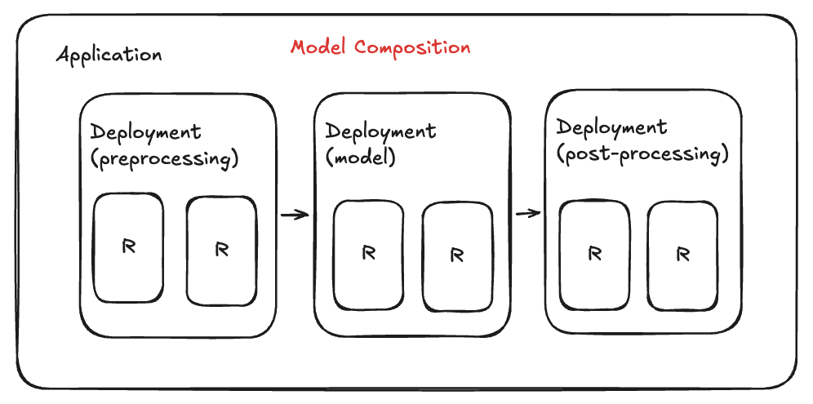
Modern AI serving is more than just a model
Notes:
So the first problem is Real-world AI serving isn't just one model, tensor in tensor out.
It's preprocessing, multiple models, post-processing, and business logic chained together — each with different resource needs.
Traditionally, each step or deployment becomes its own service — its own container, its own config, its own deploy pipeline.
which is very hard to manage
Solution:
So we have a feature in Ray Serve called model composition.
Instead of deploying each step as a separate Kubernetes service,
Ray Serve lets you compose your entire pipeline as a single Python application with independently scalable components.

Slide 13
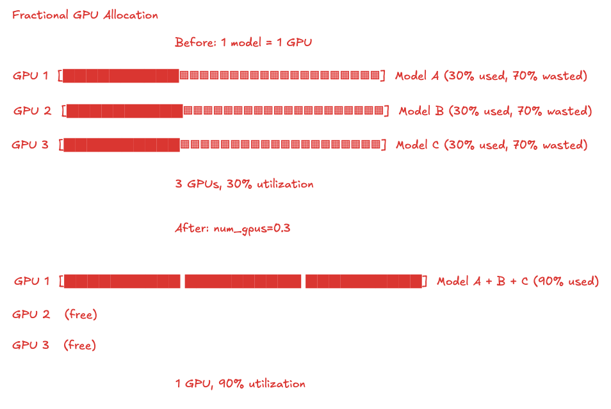
Inefficient GPU Utilization [1]
Notes:
The next problem is Inefficient GPU Utilization.
Many ML models don't need an entire GPU's compute and memory capacity. In traditional serving setups, each model is assigned a dedicated GPU regardless of how much of the model actually uses. A model that only needs 30% of a GPU still occupies 100% of it, leaving 70% idle. At scale, this waste translates directly into unnecessary infrastructure cost.
Ray Serve provides a solution.
It supports fractional GPU allocation. Instead of dedicating a full GPU to every model, you specify the exact fraction each one needs. That model using only 30% of a GPU now requests just 30% GPUs, and the remaining capacity is available for other workloads. One configuration change, no specialized hardware — and your GPU utilization can jump from 30% to near 100%.
底層 compute 怎麼 work 跟 nvidia gpu 有關
Solution: Fractional GPU (time sharing)
todo: compute intensive 跟 memory 兩個都用 30% 當例子
compute unit, memory unit 怎麼切的
https://www.nvidia.com/en-us/technologies/multi-instance-gpu/
Todo: 查 fractional GPU 怎麼做的

Slide 14
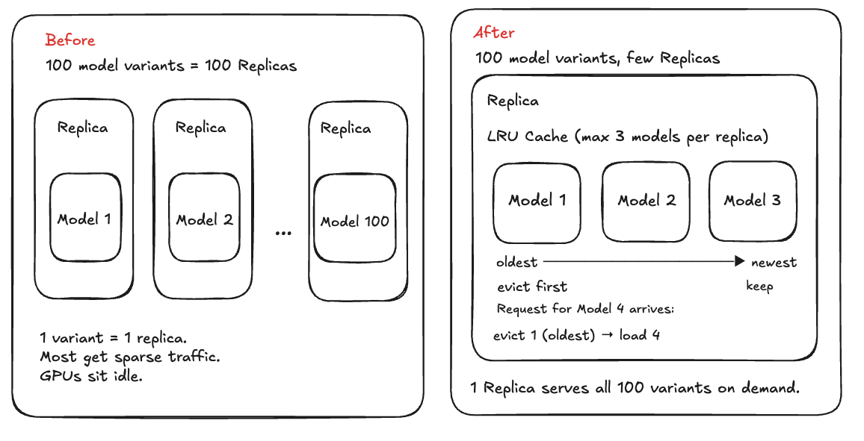
Inefficient GPU Utilization [2]
Notes:
Inefficient GPU Utilization
Problem 2
The second problem with Inefficient GPU Utilization is that
Modern applications often serve many model variants that share the same architecture but have different weights. Most receive sparse, unpredictable traffic. Provisioning a dedicated GPU for each is economically infeasible.
Solution 2
Ray Serve supports model multiplexing: a single replica can host multiple model variants in GPU memory simultaneously, loading and evicting them on demand by LRU caching. The router knows which replica has which model loaded and directs requests accordingly — so you can register hundreds of model variants but only keep a handful warm at any time.
LoRA (Low-Rank Adaptation) is a natural fit for model multiplexing because all variants share the same base model weights — only the small adapter weights (typically less than 1% of the base model) need to be swapped in and out. This dramatically reduces both the swap latency and the GPU memory footprint, allowing a single replica to cache far more adapters than full models.
Adapter: 插在 base model 上的一小組可替換參數
Fractional GPU — schedule multiple replicas onto the same GPU,
each replica serves a dedicated model using its share of GPU memory.
Multiplexing — a single replica dynamically loads and evicts models
via LRU caching, regardless of how much GPU is allocated to it.

Slide 15
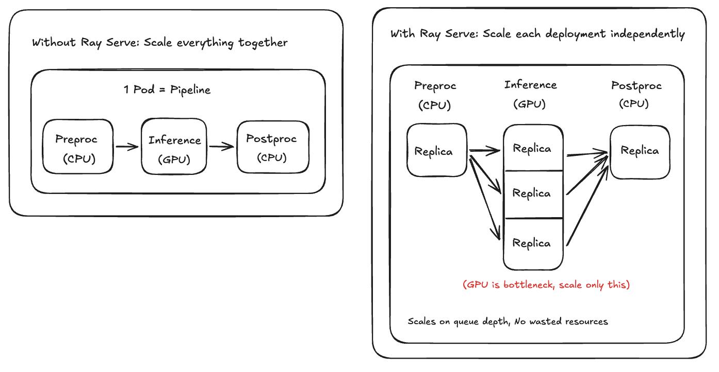
Scaling Inflexibility
Notes:
The next problem is scaling inflexibility.
Traditional machine learning serving forces you to scale the entire pipeline
It treats
CPU preprocessing, GPU inference, and CPU post-processing as a single unit,
so scaling for a CPU bottleneck wastes GPUs, and scaling for a GPU bottleneck wastes CPUs. Making matters worse, Kubernetes HPA scales based on CPU or memory utilization, not request load, it can't see how many requests are queued and processing, it reacts too slowly for bursty inference traffic.
Ray Serve solves this problem by scaling each deployment independently.
so preprocessing, inference, and postprocessing each have their own replica count and autoscaling policy. Scaling decisions are driven by request queue depth, not CPU utilization. When queued requests exceed the target, replicas scale up within seconds; when traffic drops, they scale back down after a configurable cooldown, which leads no wasted resources.
You can see the right example, when GPU is bottleneck, we can only scale the GPU deployment

Slide 16
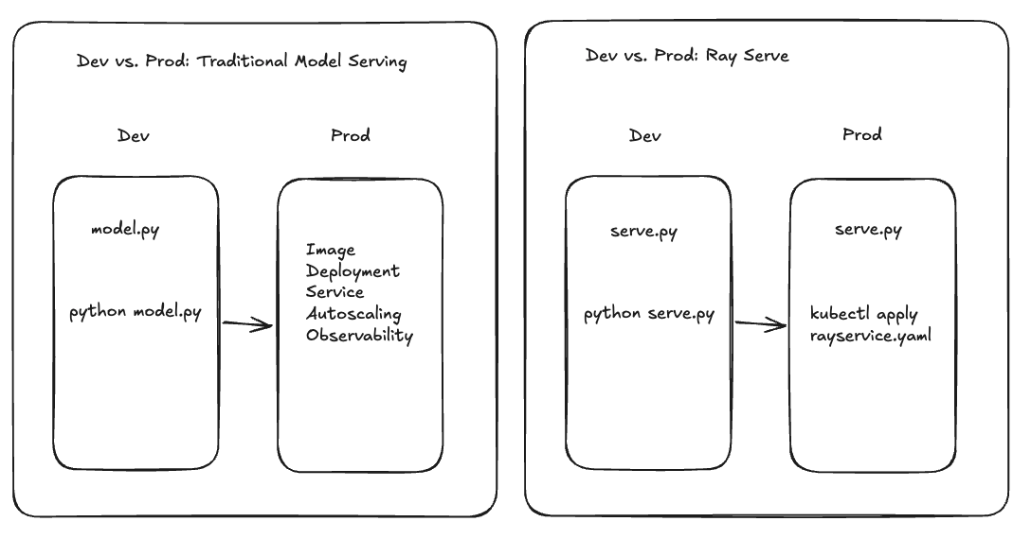
Dev/Prod Gap
Notes:
The next problem is development and production gap.
In traditional Machine Learning serving, the code you write in development (a simple Python script) looks different from
what runs in production (for example like
Dockerfiles, Kubernetes YAMLs, service mesh configs, load balancers, monitoring stacks), forcing teams to rebuild and repackage their application for every environment transition.
Solution:
With Ray Serve, you don't rewrite anything. You write serve.py, test it with python serve.py,
A single command line.
and when you're ready for production, you wrap it in a RayService YAML and
kubectl apply — same code, different command.

Slide 17
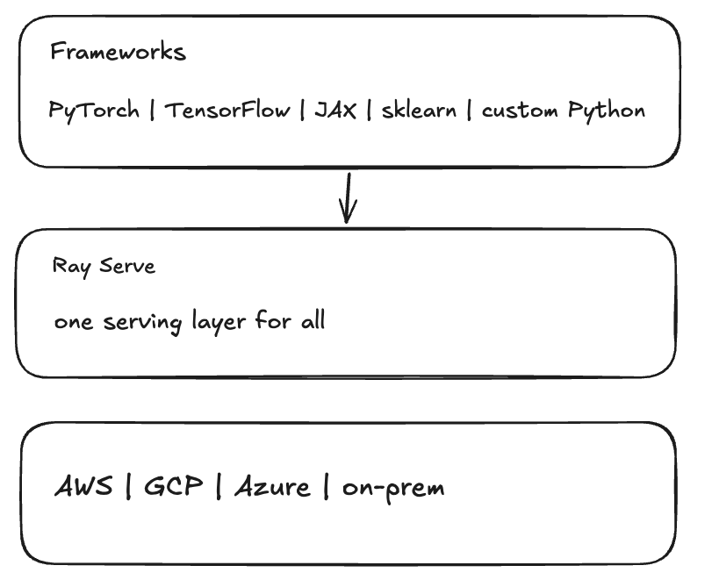
Framework Lock-in
Notes:
The last problem is
Traditional model serving tools are tied to a specific ML framework or a specific cloud provider
For example like
(TensorFlow Serving for tensorflow, TorchServe for PyTorch) (SageMaker for AWS, Vertex AI for GCP).
When your team adopts a new framework or migrates to a different cloud, the entire serving infrastructure has to be rebuilt.
Ray Serve solves this problem.
It is framework-agnostic and cloud-agnostic.
It serves any Python code — PyTorch, TensorFlow, scikit-learn, or your own custom logic — through the same serving infrastructure. Because it's built on Ray, it deploys wherever Ray runs: any cloud, on-prem.
You can swap models and frameworks, but the serving layer stays the same.

Slide 18
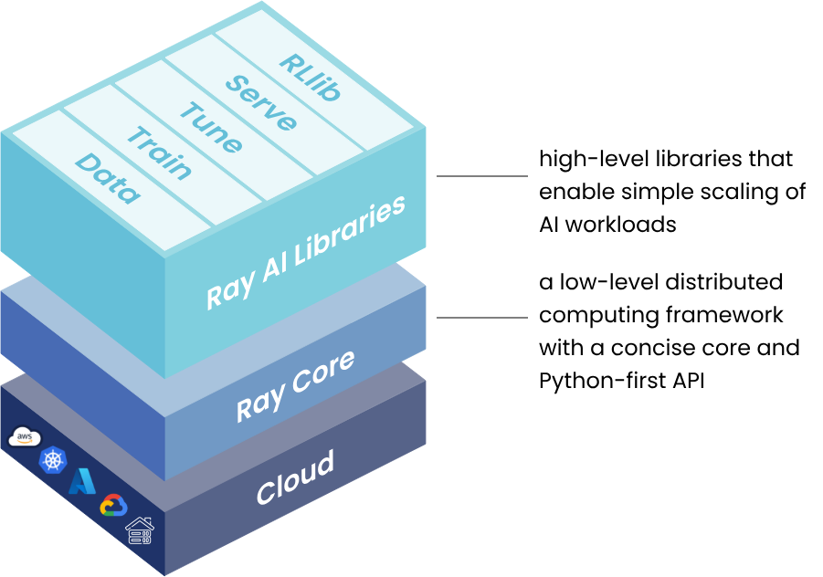
Ray: A Unified Compute Framework for AI
Notes:
Right now, I want to spend some time to talk about Ray.
Ray serve is built on top of ray
Ray is a unified compute framework that turns complex distributed AI workloads into simple Python programs
You can use Ray to run AI workloads on any hardware, any infra, at anyscale.
Ray was originally developed at UC Berkeley, and Anyscale has been one of its major contributors.
Ray now is part of the PyTorch Foundation
Here are the problem ray solved:
So Building an AI application end-to-end requires involving and learning a lot of different frameworks, from data processing, training, tuning, to reinforcement learning and serving, each has its own framework traditionally.
Alos Every stage of the machine learning lifecycle uses a different distributed system, so glue code and operational overhead grow fast.
And There is a huge gap between development and production: code that works on a laptop needs a lot of rewriting to run on a cluster.
Solution:
- Ray provides a unified compute layer for AI workloads. One API scales seamlessly from a laptop to infinite laptop with minimal code changes.
- Five native libraries cover the full ML lifecycle under a single framework:
- Ray Data for scalable data loading, transformation, and batch inference
- Ray Train distributed training with fault tolerance
- Ray Tune distributed hyperparameter tuning
- Ray Serve scalable model serving for online inference
- RLlib distributed reinforcement learning
- All libraries share the same foundation — Ray Core (Tasks, Actors, Objects)
-
Ray runs on Kubernetes, AWS, GCP, Azure, Slurm, YARN, or on-premises — you can run Ray anywhere.

Slide 19
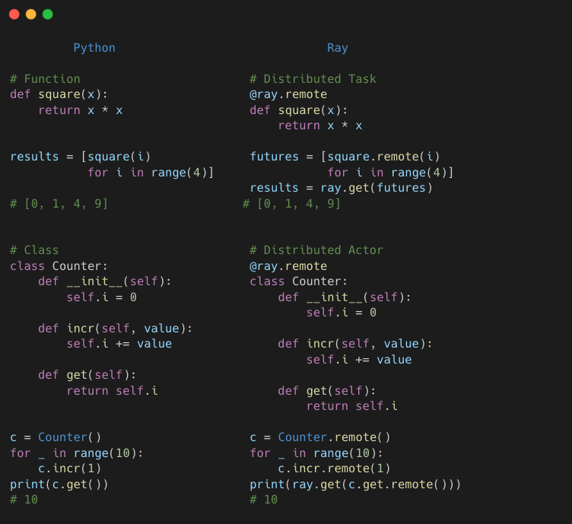
Ray: Python Example
Notes:
Now I want to spend 30 seconds to teach you how to use Ray.
On the left, a regular Python program, a function and a class.
On the right, the same code with one additional decorator: @ray.remote.
That's all you need to learn to write a ray program.
After add the decorator
the function becomes a distributed task and the class becomes a stateful actor.
You can call .remote() to execute, ray.get() to collect the result.

Slide 20
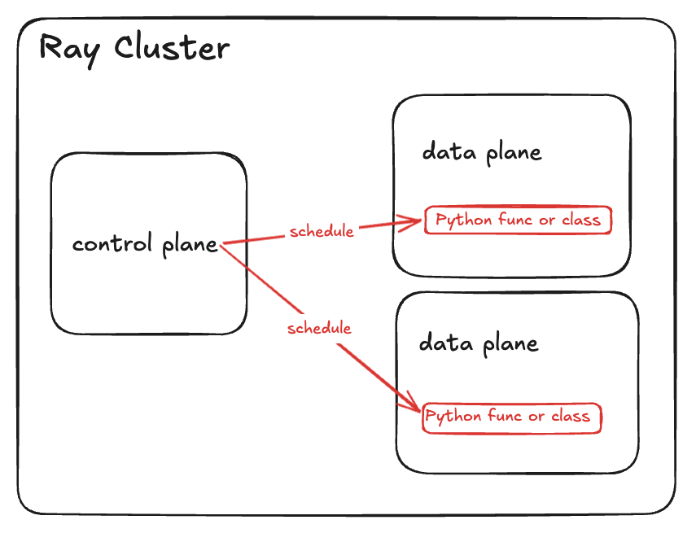
Ray: Architecture
Notes:
Now I want to spend some time to talk about Ray’s architecture.
This is what a Ray Cluster looks like. In a very very high level, it looks pretty similar to kubernetes.
They both are resource orchestrators but at different layer.
Ray is process level orchestration.
Kubernetes is container level orchestration.
Ray schedules Python functions and classes.
Kubernetes schedules containers.
On the left, you have the control plane — the head node. It stores cluster metadata and handles scheduling, autoscaling decisions.
On the right, you have the data plane — the worker nodes. This is where your actual workloads run.
Now, let's talk about how to run Ray on Kubernetes.

Slide 21
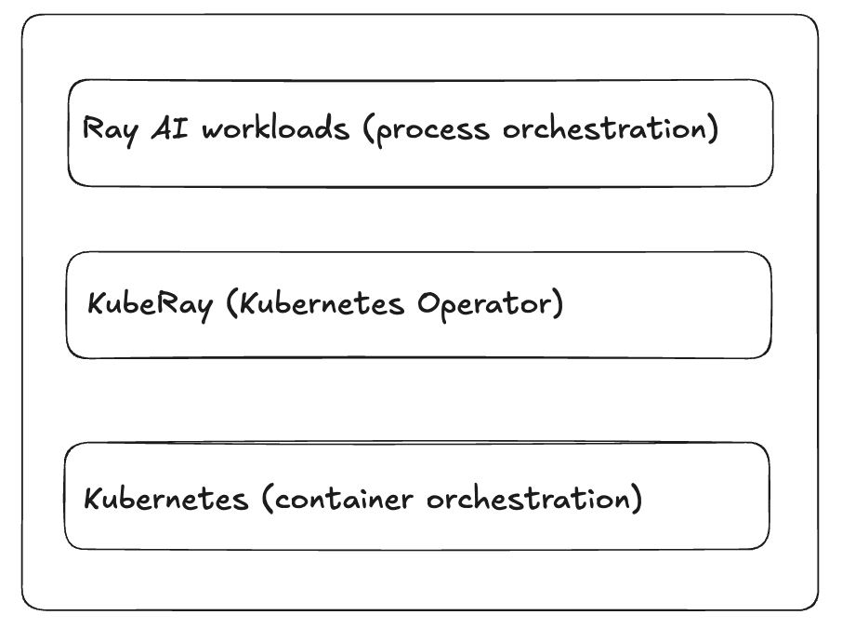
What is KubeRay?
Notes:
Here is today's main character — KubeRay.
Ray focuses on application layer, and it handles process orchestration.
Kubernetes focus on container layer, and it handles container orchestration.
KubeRay bridges these two layers — it's a Kubernetes operator that manages the lifecycle of Ray applications on Kubernetes.
k8s prepare resource to run application
ray decides how the application is going to use the resource

Slide 22
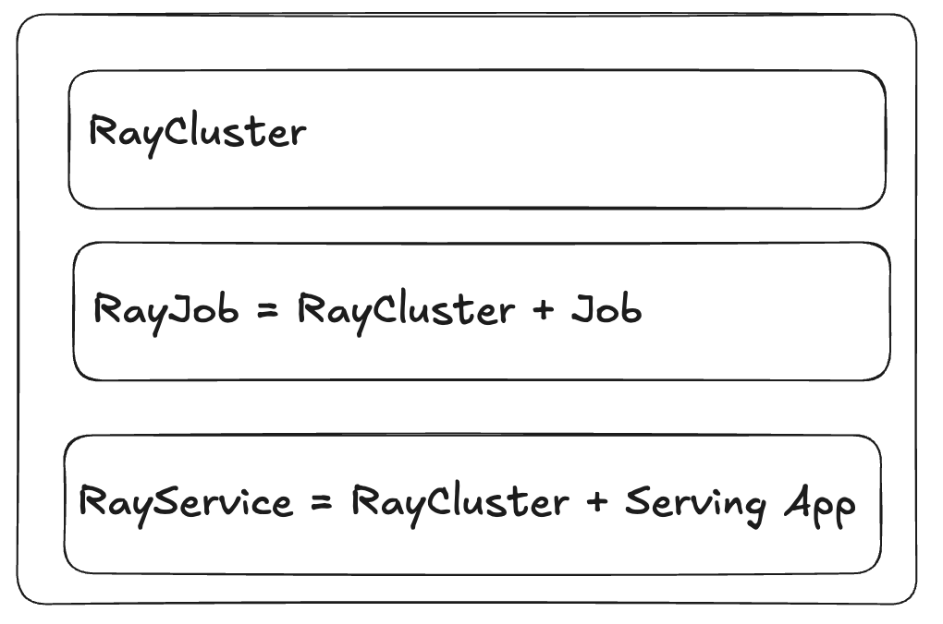
KubeRay APIs
Notes:
KubeRay provides 3 API.
RayCluster for managing Ray clusters — you can run any AI workloads in a RayCluster.
RayJob for workloads like distributed training or batch inference, it creates a cluster, runs a job, and cleans up.
And RayService — which is what we'll focus on today — it manages both the cluster and Ray Serve applications, with zero-downtime upgrades and high availability.

Slide 23
RayService
In-Place Update
Zero-Downtime Upgrade
High Availability
Notes:
Next I am going to talk about key features in RayService.

Slide 24
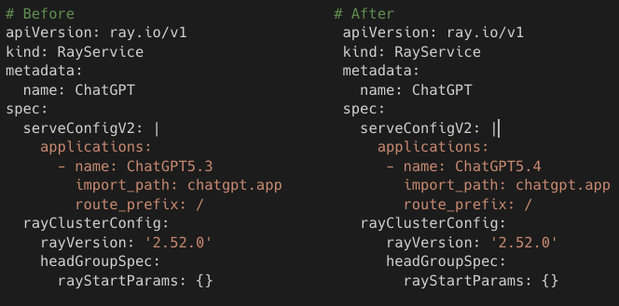
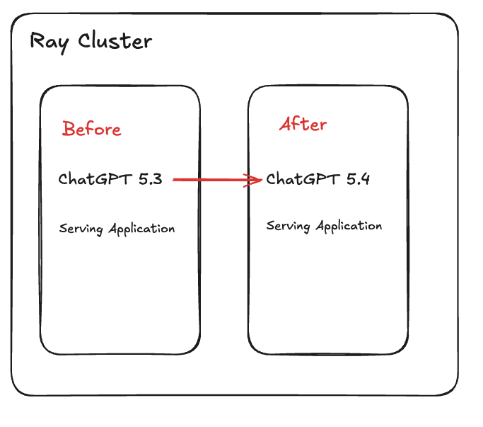
RayService: In-Place Update
Notes:
The first feature is in-place update for serving applications.
Imagine you're running ChatGPT 5.3 on a Ray Cluster, and you want to upgrade to 5.4.
With in-place update, you don't need to create a new cluster. You simply update the serve config in your RayService YAML — and that's it. KubeRay detects the change, sends an HTTP request to the Ray control plane’s API server, and Ray Serve handles the rolling update internally — all within the same cluster.
No new cluster, no downtime, no wasted resources. Just update the config and apply.

Slide 25
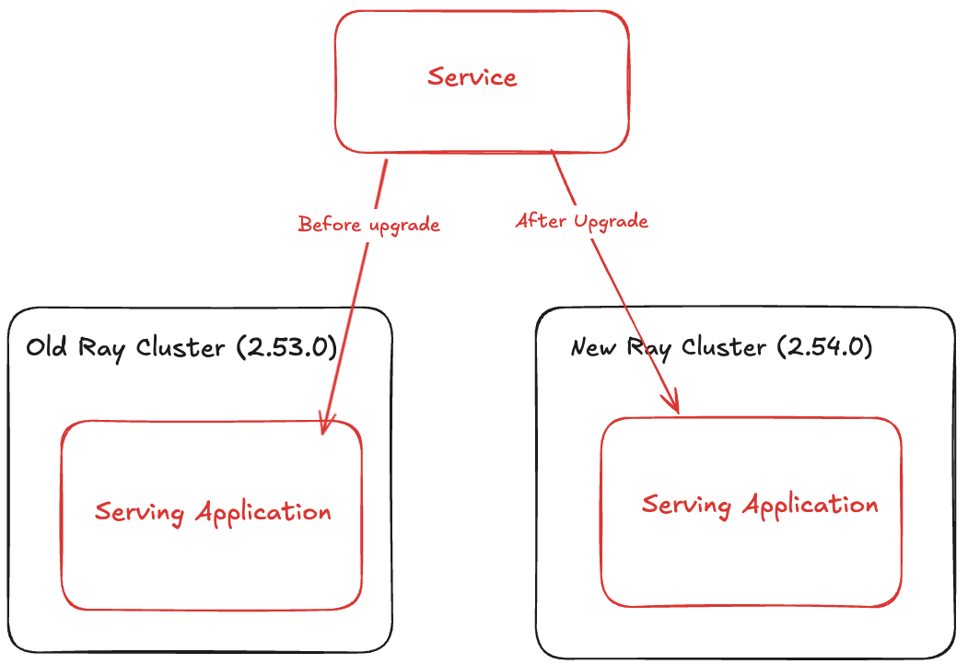
RayService: Zero-Downtime Upgrade
Notes:
Next feature is zero downtime upgrade.
During the zero downtime upgrade process, KubeRay creates a new Ray Cluster temporarily and waits for it to become ready.
Once the new RayCluster is ready, the kubernetes service here will switch the traffic to the new RayCluster. Finally, KubeRay deletes the old RayCluster.

Slide 26
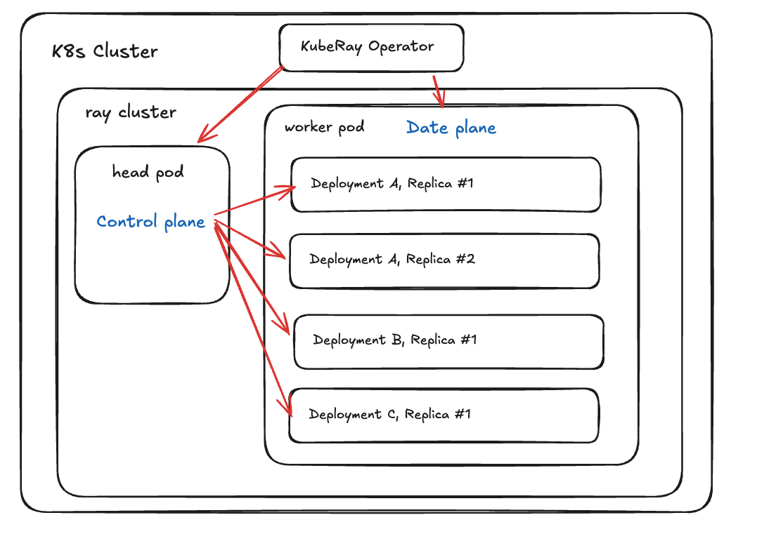
RayService: High Availability
Notes:
Next I want to talk about High availability.
Serving AI models in production means dealing with failures
For example,
a replica process crashes, a node goes down, or even the whole Ray Cluster crashes.
Restart the raycluster can take a lot of time
Solution:
KubeRay + Ray Serve handles recovery automatically at every layer.
Ray Serve helps data plane’s replicas to restart.
KubeRay help control plane and data plane nodes restart in the kubernetes cluster.

Slide 27
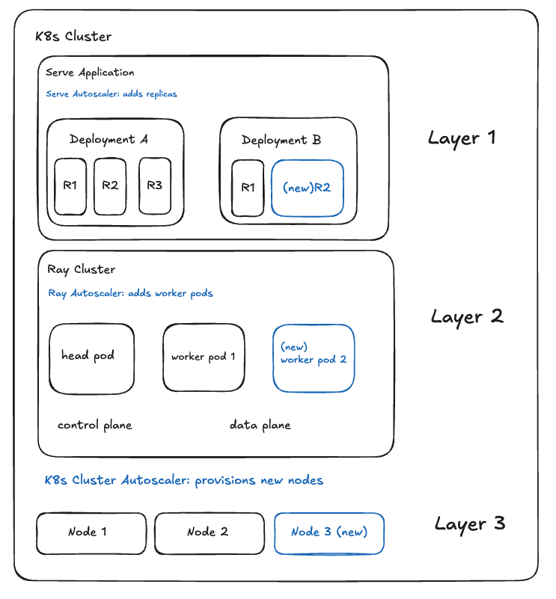
Autoscaling
Notes:
AI inference traffic is bursty — a service can go from near zero to thousands of requests in seconds.
In KubeRay with Ray Serve, autoscaling happens in three layers.
Layer 1 is the Ray Serve autoscaler. It scales Serve replicas based on request pressure — queue sizes and ongoing requests — rather than just resource utilization. If the Ray cluster already has spare capacity, new replicas can start quickly as Ray actors on existing Ray nodes.
Layer 2 is the Ray autoscaler. When the current cluster no longer has enough logical resources to place those replicas, Ray adds worker Pods. Because Ray understands the workload’s resource requirements, it can scale the appropriate worker group — for example, GPU workers for the LLM deployment and CPU workers for preprocessing.
Layer 3 is the Kubernetes cluster autoscaler. If the new Ray worker Pods cannot be scheduled because the Kubernetes cluster is out of capacity, Kubernetes provisions new nodes.
So these three layers work together: Serve scales the application, Ray scales the worker pod, and Kubernetes scales the cluster by adding kubernetes node.
I want to mention 2 points specially:
Unlike the default Kubernetes HPA setup, which often scales on CPU or memory utilization, Ray Serve is natively request-aware and scales based on queue depth and ongoing requests.
And if the built-in policy is not enough, Ray Serve also lets you define a custom autoscaling policy.

Slide 28
KubeRay Ecosystem
Scheduler and Job Queueing Systems
Observability Tools
https://docs.ray.io/en/latest/cluster/kubernetes/k8s-ecosystem.html
Notes:
KubeRay integrates with the Kubernetes ecosystem you already use.
For scheduling, we support Kueue — including MultiKueue for multi-cluster job dispatching — as well as Volcano, Apache YuniKorn, NVIDIA’s KAI Scheduler, and the Kubernetes scheduler-plugins project. Whether you need gang scheduling, priority queues, or GPU sharing, KubeRay works with your batch scheduler of choice.
For observability, KubeRay exports Ray metrics to Prometheus and ships with pre-built Grafana dashboards — so you can monitor cluster health, autoscaling, and request latency through the same monitoring stack you already have. And if you need to profile a running workload, we support py-spy integration for CPU flame graphs directly from the Ray Dashboard.

Slide 29
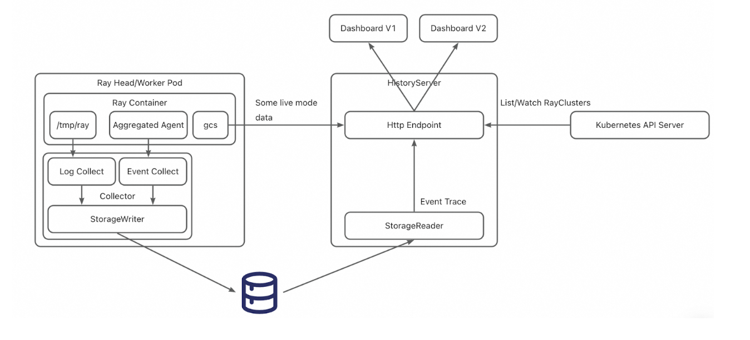



KubeRay History Server
Notes:
Finally I want to introduce a new feature in Ray and KubeRay.
The History Server!
Many teams run Ray clusters as ephemeral units — spin up a cluster, run the job, tear it down. This saves resource cost. But when a job fails and the cluster is gone, you lose the Ray Dashboard — your primary debugging tool.
The History Server fixes this. While a cluster is alive, it automatically collects cluster metadata and logs into persistent storage like S3 or GCS. After the cluster is deleted, the History Server restores the Dashboard from that data. You debug a terminated cluster as if it were still running — with no raycluster resource cost.

Slide 30
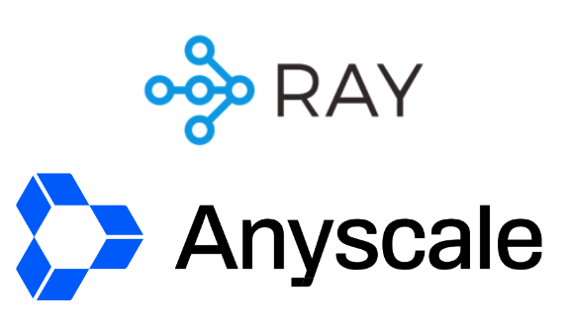

Join the Community!
https://github.com/karmada-io/karmada
https://www.ray.io/join-slack
https://github.com/ray-project/kuberay
Notes:
Join our ray slack, and here we have a lot of ray masters from Anyscale can answer you question
Also join karmada slack to ask more questions!
(cncf karmada channel)

