Slide 1
When Kafka Goes Cloud Native: Observability That Actually Works!
Mary Vinothini S and Roopadharsini K
Fidelity Investments

Slide 2
Agenda
Real-time makes sense!
Why Kubernetes for Streaming ?
The Guessing Game
Seeing the System, Missing the Signal
Foundations of Observability
OTEL Pipeline Architecture
Legacy Monitoring vs OTEL
Kafka Observability
Infra and Client Observability
SLO/SLI in OTEL
Critical Constraints
Modernisation Journey

Slide 3

Real-time makes sense!
Event Streaming — capture what just happened, stream it instantly, act on it now.
Central Nervous System for Data in motion
Highly Available with reliable replication
High-Throughput, Low-Latency, Real-Time data handling
Scalable to handle massive data growth

Slide 4
Why Kubernetes for Streaming?
Scalability
Orchestration
Portability
Standardization
Efficiency
Governance

Slide 5




The Guessing Game
Observability — ability to understand the internal state of a system.
Stop Guessing
Do the diagnosis
Running Clusters without Observability is trying to say something is wrong without diagnostics.
You cannot confidently answer:
Where the problem started ?
How it propagated ?
Which component caused it ?

Slide 6





Seeing the System, Missing the Signal
Generally, baseline monitors cover minimal metrics which can give no visibility into the internal specifics of system, like event flow, lag, etc.,
You may be able to see if a system is up, but not how it's behaving.
Throughput
CPU
Kafka
Increase Linger
RAM
Memory
Horizontal Broker Scaling

Slide 7
Foundations of Observability
Observability
Metrics
(Health and Trends)
Logs
(Events and details)
Traces
(End-to-End request path)
Metrics tell you something is wrong.
Logs tell you why.
Traces tell you where.

Slide 8






OTEL Pipeline Architecture
Kafka
Infra
Stakeholders
"Vendor-agnostic pipeline, deployed natively on Kubernetes"

Slide 9


Legacy Monitoring vs OTEL
Legacy Monitoring:
Vendor Lock-in
Cost Explosion
Data Silos
OTEL:
Vendor Neutral
Open Source
Universal

Slide 10
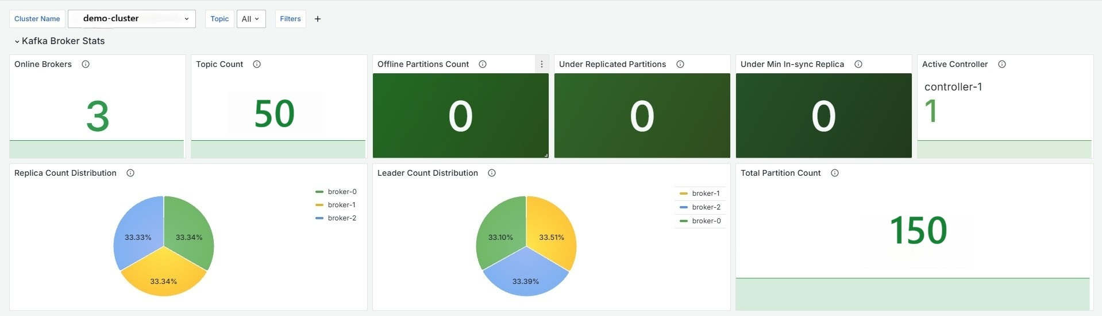



Kafka Observability
"OpenSearch surfaces the log signals behind every metric you see above"
Bad patterns:
“Shrinking ISR”
“java.lang.OutOfMemoryError”
“Error while fetching metadata”
Healthy patterns:
“Expanding ISR”
“Preferred replica leader election completed”
“SSL handshake completed successfully”

Slide 11
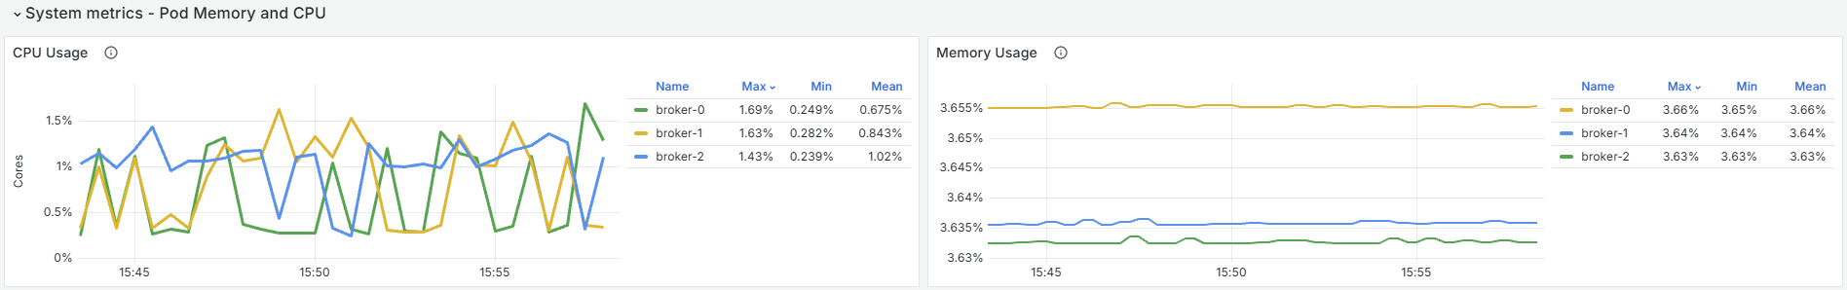
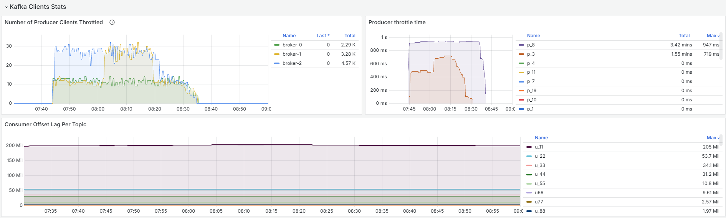



Infra and Client Observability

Slide 12
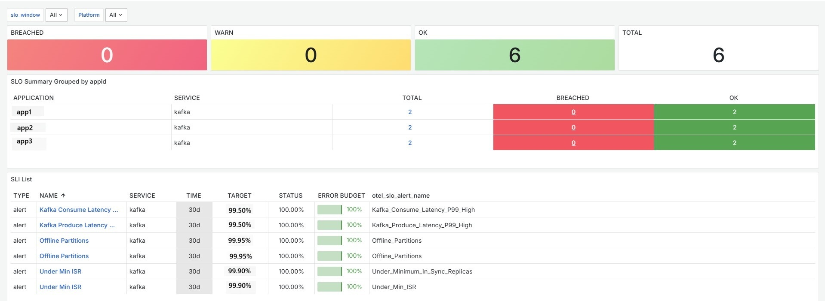



SLO/SLI in OTEL

Slide 13
Critical Constraints
"353 topics × per-partition labels = metric overload"
"JMX names ≠ OTEL semantic conventions"
Cardinality Explosion
Semantic convention mismatch
Collectors being an operational burden
Metrics naming drift
"Multiple collector agents — each competing with JVM heap"
"Your metric names don't migrate with you"

Slide 14








Modernisation Journey
Assess
Audit current tools & pain points
Pilot
OTel Collector on 1 cluster
Instrument
Auto-instrumentation + key metrics
Visualize
Grafana dashboards + alerts
Scale
Roll out to all clusters
Start small
One cluster, prove value then scale
Auto instrumentation
Customise after you have data
Involve SREs & Compliance
Get SRE & Compliance in as early as possible
Build dashboards that matter
Quality over quantity

Slide 15





Thank you!
KubeCon+CloudNativeCon 2026
Mary Vinothini | LinkedIn
Roopadharsini Kumar | LinkedIn
Unless otherwise noted, the opinions provided are those of the speaker, not necessarily those of Fidelity Investments or its affiliates.
All trademarks and service marks belong to FMR LLC or an affiliate, except third-party trademarks and service marks, which are the property of their respective owners.

