Slide 1
When Kubeflow Fights Cilium:
Debugging 60% Idle GPUs in Kubernetes
Ramkumar Nagaraj | Sr. Computer Scientist, Adobe
Bingi Narasimha Karthik | Computer Scientist II, Adobe

Slide 2


Slide 3

Notes:
Part 1: The Problem
60% idle GPUs. Pods scheduled. Training stalled.
A world-class orchestra is sold out. Every musician is in their seat, instruments tuned, the hall lit. But the conductor was shown to the wrong wing — and the fire-safety doors, doing exactly their job, sealed that wing off. The result: a full, expensive hall and total silence.
That's your GPU cluster. The conductor is the coordinator pod, the musicians are GPU workers (who can only play in sync, through the conductor — just like distributed training syncs gradients through the coordinator), and the fire doors are Cilium's network policy: a correct safety rule that nobody told the scheduler about.

Slide 4
The Setup: Two Zones, One Problem
zone-a (GPU Zone)
2 worker nodes
GPU taint: gpu=present:NoSchedule
Label: topology.kubernetes.io/zone=zone-a
Cilium policy: intra-zone-a ALLOW
Cross-zone GPU traffic: DENY
zone-b (CPU Zone)
2 worker nodes
No GPU taint — any pod can land here
Label: topology.kubernetes.io/zone=zone-b
Cilium policy: intra-zone-b ALLOW
No GPU workers — coordinator ends up here

Slide 5
Live Demo: Reproducing the Conflict
bash scripts/demo-before.sh
Watch: coordinator lands zone-b — workers retry — GPU at 40%
Grafana: http://localhost:3000 | Prometheus: http://localhost:9090

Slide 6
Default Kubeflow Scheduling: No Topology Awareness
What Kubeflow does by default
Coordinator pod: no affinity, no nodeSelector — lands anywhere
GPU workers: nodeSelector gpu=true — always land in zone-a
Result: coordinator in zone-b, workers in zone-a — different network zones
Observed symptoms
gpu_demo_utilization_pct: ~40% (resources allocated, nothing computing)
Workers retry connection to coordinator — all fail with timeout
No kernel errors, no OOM — pods Running, training never starts

Slide 7
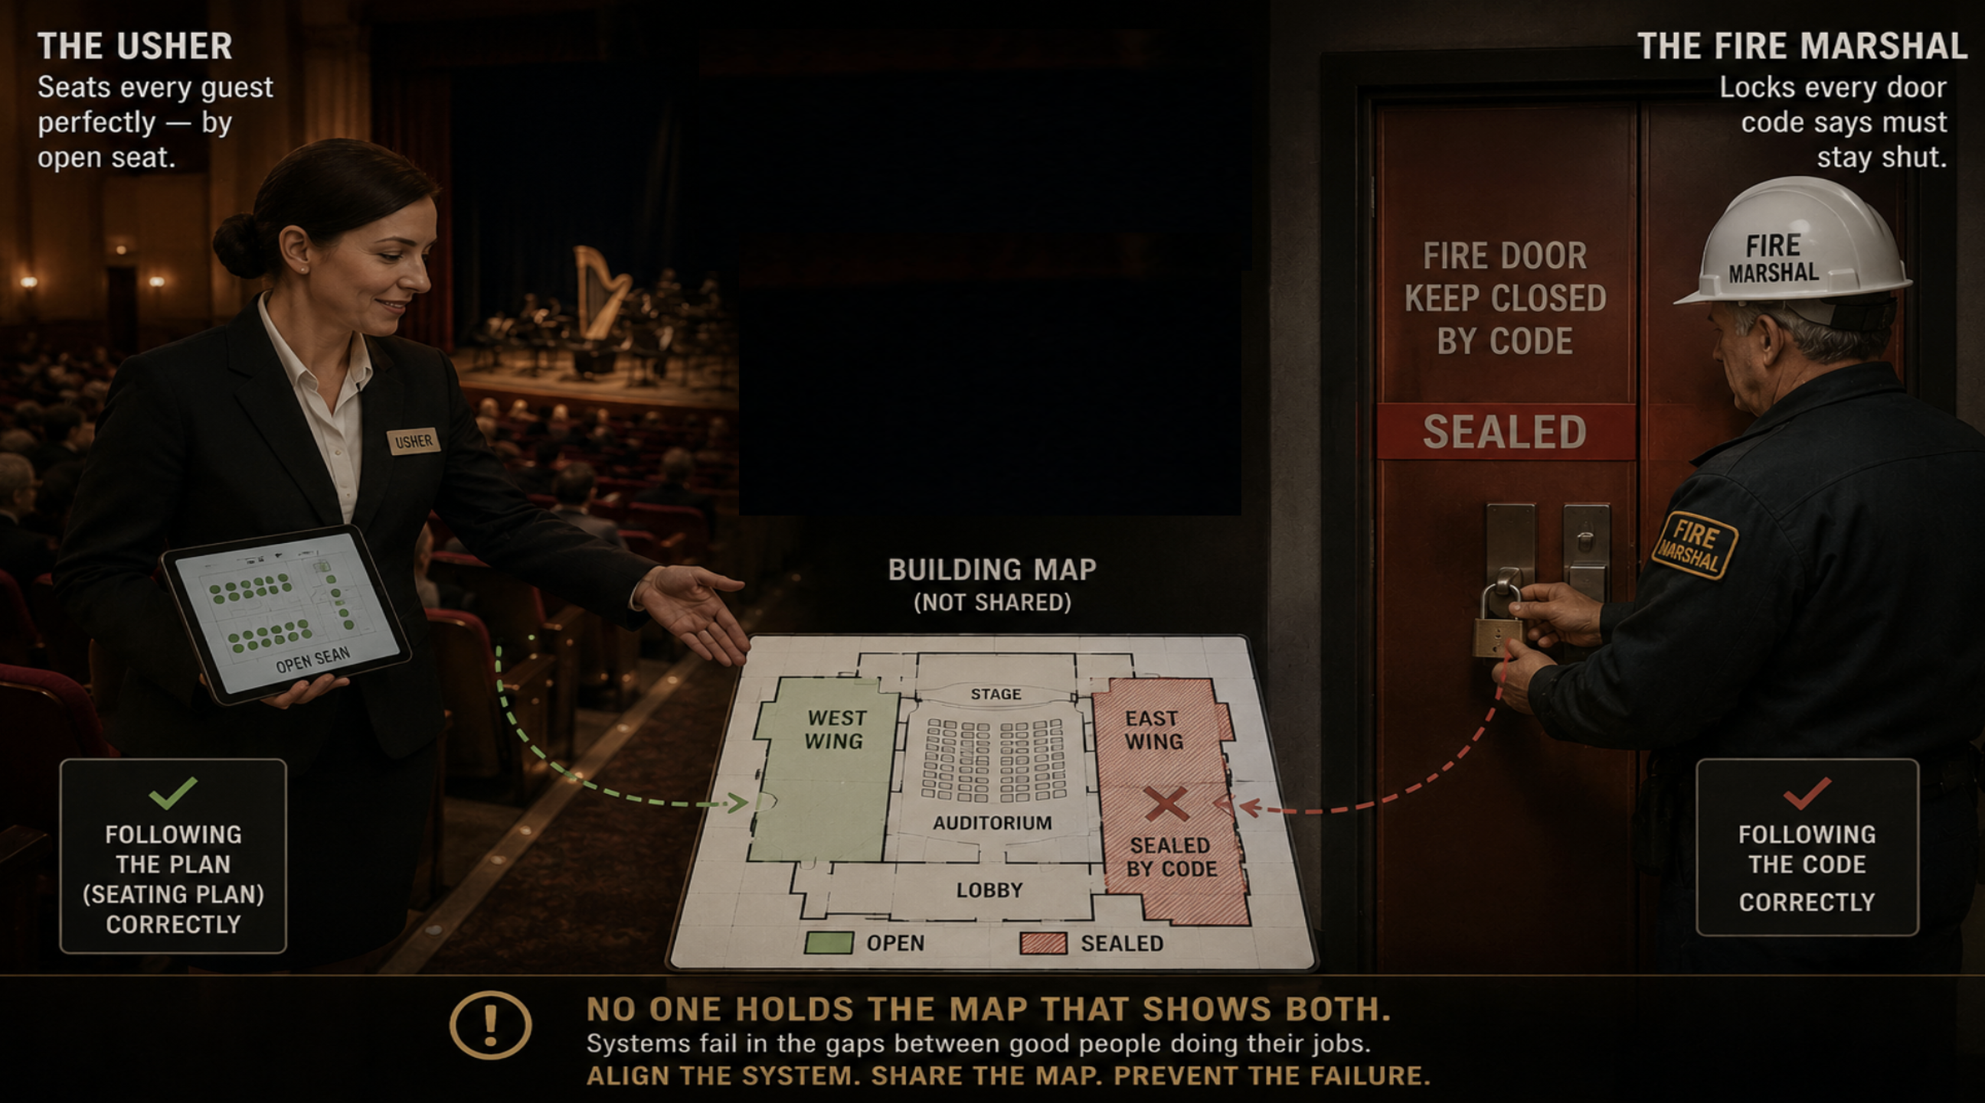
Notes:
Part 2: Root Cause
Cilium network policy meets topology blindness
Two professionals, both excellent. The usher seats every guest perfectly — by open seat. The fire marshal locks every door code says must stay shut. Neither is wrong. But no one holds the building map that shows both at once — so the usher seats the conductor in the very wing the marshal just sealed. That gap is the root cause.”

Slide 8
Cilium’s Topology-Aware Network Policy
How it works
CiliumNetworkPolicy uses pod label selectors
allow-intra-zone-a: pods in zone-a can talk to each other
deny-cross-zone-gpu-traffic: gpu-worker pods CANNOT egress to zone-b pods
The policy is correct security design —
the scheduler didn’t know about it
The policy snippet
kind: CiliumNetworkPolicy
name: deny-cross-zone-gpu-traffic
spec:
endpointSelector:
matchLabels: {role: gpu-worker}
egressDeny:
- toEndpoints:
matchLabels: {zone: zone-b}

Slide 9
The Smoking Gun: GPUWorkersCantReachCoordinator
Prometheus alert fires within 30 seconds of BEFORE state
Alert condition: coordinator_zone > 0 AND workers_running > 0 for 30s
gpu_demo_coordinator_zone returns 1 — “coordinator is in the wrong zone”
gpu_demo_utilization_pct returns 40 — allocated but idle
gpu_demo_zones_occupied returns 2 — workers and coordinator split across zones
Debugging path
1. Alert fires → check pod placement → coordinator in zone-b
2. Check Cilium policies → deny-cross-zone-gpu-traffic matches exactly
3. Root cause: no topology awareness in workload spec

Slide 10
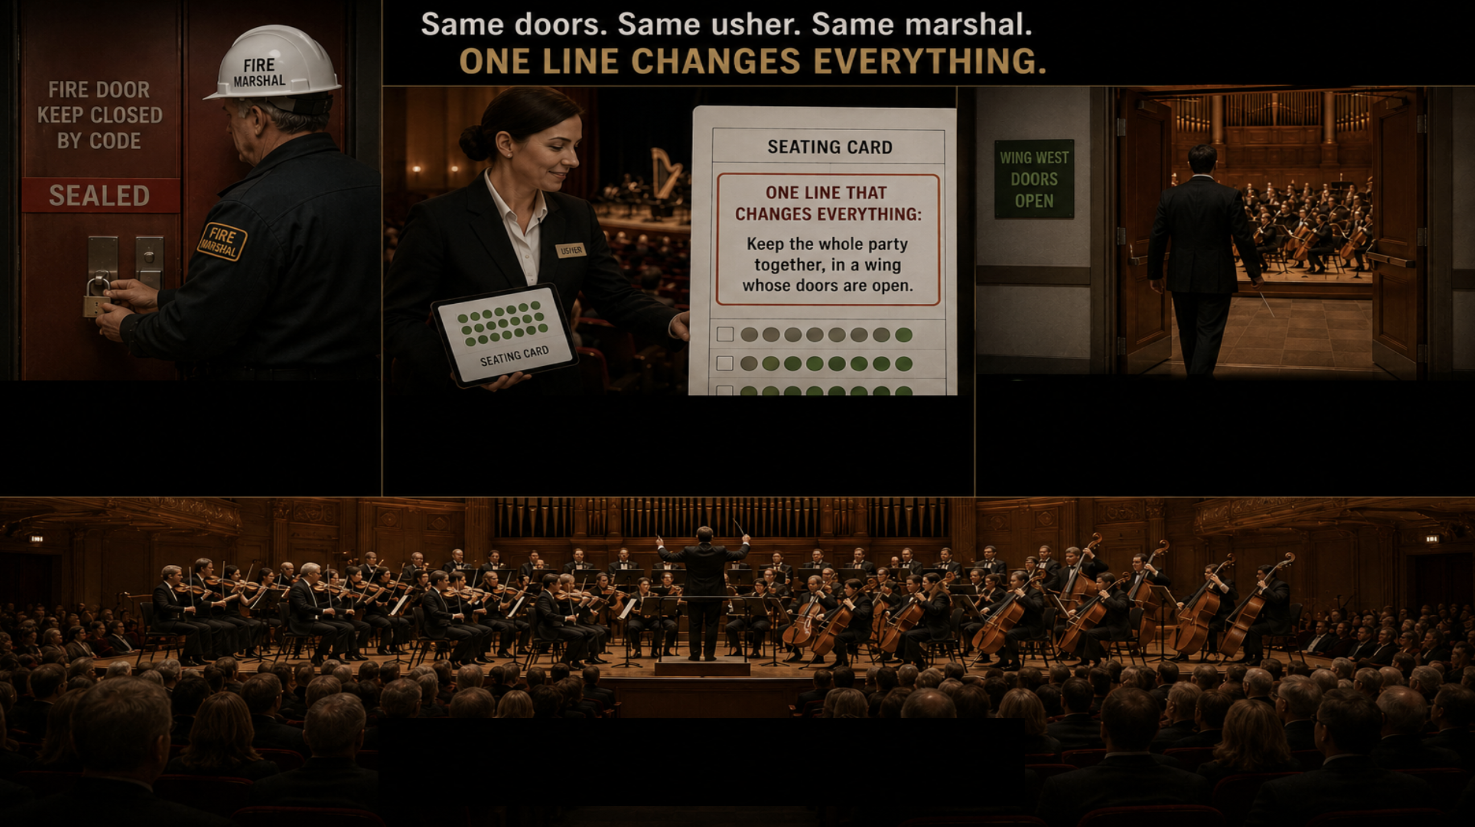
Notes:
Part 3: The Fix
3 YAML additions. No Kubeflow changes. No Cilium changes.
"Here's the surprise: we don't argue with the fire marshal. The locked doors stay locked — the safety code was never the problem. And we don't retrain the usher. We just add one line to the seating card: keep the whole party together, in a wing whose doors are open. Now the usher seats the conductor in the same open wing as the musicians. Same doors, same usher, same marshal — but the conductor and the orchestra are finally in one room. The baton drops, and the hall fills with sound."

Slide 11
The Fix: 3 YAML Additions
1. nodeAffinity on coordinator — pin to zone-a
requiredDuringScheduling: zone IN [zone-a]
2. topologySpreadConstraints on coordinator
maxSkew: 1 | topologyKey: zone | DoNotSchedule | selector: ml-training
Forces all ml-training pods into the same zone as the coordinator
3. GPU taint toleration on coordinator
tolerate gpu=present:NoSchedule — so it can land on zone-a GPU nodes
Result: coordinator → zone-a | workers → zone-a | Cilium allows all traffic
Notes:
spec:
template:
spec:
affinity:
nodeAffinity: # ← THIS pins it to the zone
requiredDuringSchedulingIgnoredDuringExecution:
nodeSelectorTerms:
- matchExpressions:
- key: topology.kubernetes.io/zone
operator: In
values: [zone-a] # the GPU zone
topologySpreadConstraints: # keep the ml-training group co-located
- maxSkew: 1
topologyKey: topology.kubernetes.io/zone
whenUnsatisfiable: DoNotSchedule
labelSelector:
matchLabels: { app: ml-training }
tolerations: # so it can land on the tainted GPU nodes
- key: gpu
value: present
effect: NoSchedule

Slide 12
Live Demo: Applying the Fix
bash scripts/demo-after.sh
Watch: all pods move to zone-a — workers connect — training runs — GPU at 85%
Grafana: http://localhost:3000 | Conflict score drops to 0

Slide 13
Before vs After: The Numbers
BEFORE (broken)
GPU utilization: ~40%
Coordinator zone: zone-b (wrong)
Cross-zone Cilium blocks: ACTIVE
Training progress: STALLED
Prometheus alert: FIRING
Conflict score: 1.0
AFTER (fixed)
GPU utilization: ~85%
Coordinator zone: zone-a (correct)
Cross-zone Cilium blocks: NONE
Training progress: RUNNING (30/30 steps)
Prometheus alert: RESOLVED
Conflict score: 0.0

Slide 14
Beyond the Hard Block: The Production Spectrum
1. Hard CiliumNetworkPolicy block — what this demo shows
Workers can’t reach coordinator; training never starts. Detected in seconds.
2. Cross-zone NCCL latency — no hard block, just distance
Training runs 30–60% slower; AllReduce pays cross-zone RTT. No error — detected in hours.
3. Cross-AZ egress cost — invisible to Kubernetes
Surfaces only in cloud billing; significant at scale. Detected in days.
One fix resolves all three
Pin the whole training group into one zone — same YAML, every scenario.
Notes:
The repo hard-codes zone-a, which is fine for the demo. The cleaner generalization that works without naming a zone is podAffinity — "put me in whatever zone the coordinator is in":
affinity:
podAffinity:
requiredDuringSchedulingIgnoredDuringExecution:
- labelSelector:
matchLabels: { app: ml-training, role: coordinator }
topologyKey: topology.kubernetes.io/zone # same zone as the coordinator

Slide 15
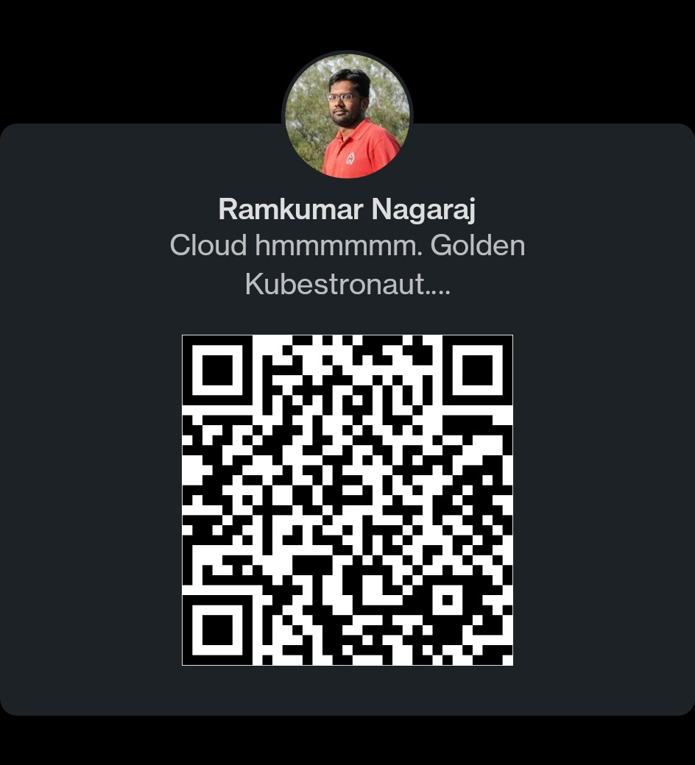

Questions? | https://github.com/ram2valar/kubeflow-cilium-lab

Slide 16
Appendix

Slide 17
Agenda
1. The Problem — 60% idle GPUs, no obvious cause
2. Root Cause — Cilium network policy meets topology blindness
3. Live Demo — Reproduce the conflict, watch the alert fire
4. The Fix — 3 YAML additions, no CNI or Kubeflow changes
5. Takeaways — General patterns for CNI-aware ML scheduling

Slide 18
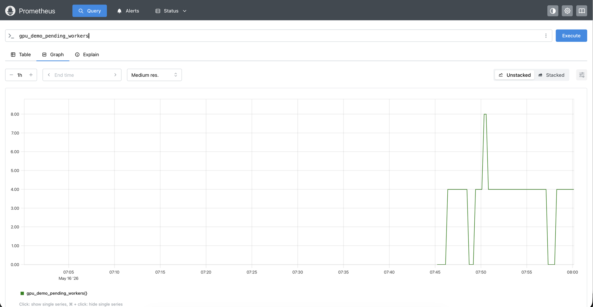

Slide 19
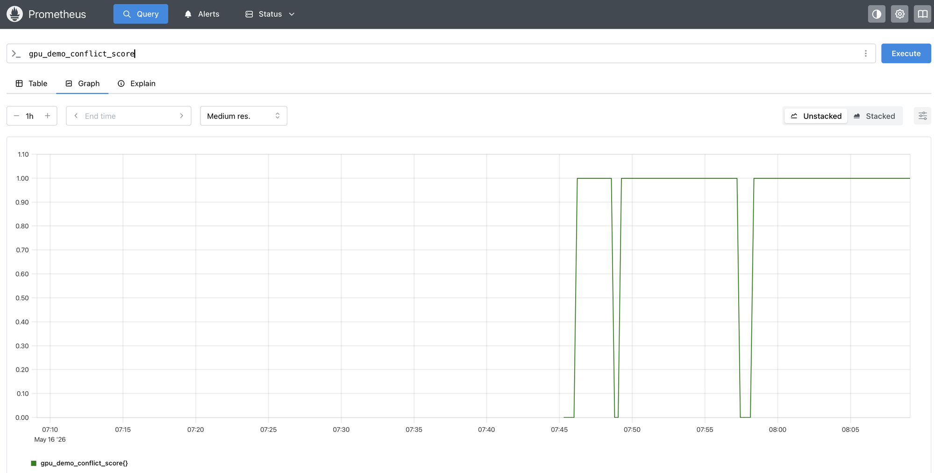

Slide 20
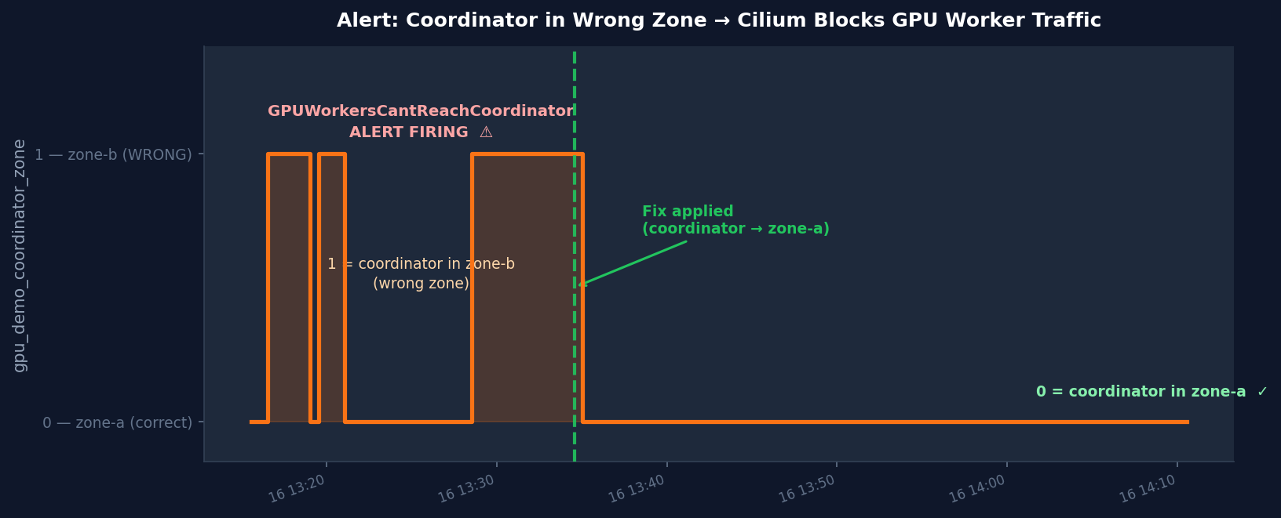

Slide 21
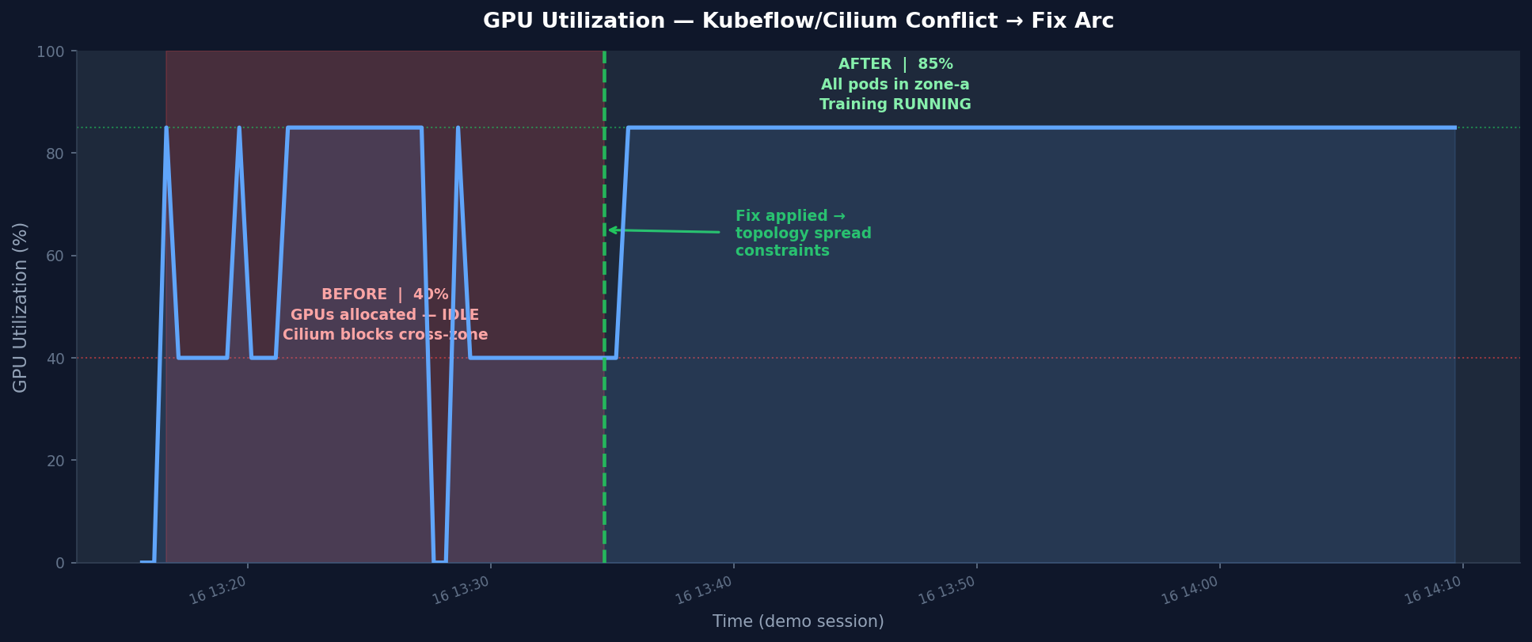

Slide 22
Key Takeaways
1. Your CNI has opinions about topology — your scheduler doesn’t know
Cilium topology-aware policies are silent to the Kubernetes scheduler
2. Topology spread constraints = Kubernetes-native fix
No Kubeflow patch, no Cilium change — 3 YAML stanzas in your workload spec
3. Instrument before you need it: GPU utilization + pod zone metrics
Prometheus + Grafana dashboards exposed this in seconds, not days
4. Pattern applies beyond Kubeflow/Cilium
Same root cause, 3 faces in prod: hard Cilium block, cross-zone NCCL latency, cross-AZ egress cost

Slide 23
