Slide 1
Architecting Global GPU Availability with Multikueue

Slide 2



Speakers
Kishore Jagannath
Researcher, Blogger, Senior Customer Solutions Engineer at Google
Ram J A
Problem Solver, Solutions Architect at Google

Slide 3
Agenda
Architecting Global GPU Availability with Multikueue
01
Introduction to Kueues & MultiKueue
Foundation of job queueing and cluster-wide resource management.
02
The Admission Process
Deep dive into how MultiKueue dispatches workloads to worker clusters.
03
The GPU Scarcity Problem
Analyzing regional silos and the impact of fragmented utilization.
04
The Solution & Live Demo
Bridging regional scarcity through federation and real-time scaling.

Slide 4


Slide 5

Efficient Resource Management with Kueue
Optimizing Batch & Training Workloads
Kueue manages job queuing and resource quotas for complex AI/ML environments, ensuring fair access to high-demand hardware.
groups
model_training
bolt
analytics
Multi-Team Collaboration
Enables multiple teams to share a common pool of GPUs and compute nodes without interference.
AI/ML Training
Orchestrates large-scale model training jobs that require dedicated, high-performance resources.
Batch Inference
Handles high-throughput inference tasks efficiently by managing job priority and allocation.
Resource Optimization
Prevents resource starvation and maximizes the utilization of limited datacenter GPUs.
Notes:
Here we talk about the workloads where Kueue is generally used, Especially with gowing increase in adoption of AI/ML workloads Kueue enables

Slide 6


Kueue Resources & Architecture
Hierarchical resource management for Kubernetes clusters
ResourceFlavor
Defines physical characteristics of resources (e.g., GPU models, spot vs. on-demand).
LocalQueues
ClusterQueue
Flavors
Local Queue A
CPU
ClusterQueue
A cluster-scoped resource that manages a global pool of ResourceFlavors and sets fair-sharing rules.
Cluster Queue
H100
Local Queue B
LocalQueue
A namespace-scoped entry point for users to submit jobs, mapped to a specific ClusterQueue.
B200
Resource Quota
Integrated mechanism to enforce limits on consumption across different teams and flavors.
Validation Flow:
Jobs enter through LocalQueues (Namespace scoped), pass through ClusterQueues (Global rules, cluster scoped), and consume specific Resource Flavors (Compute/ GPU Flavors)

Slide 7

Multi-Team Quota Enforcement with Kueue
Throttling resource usage across namespaces via ClusterQueue and LocalQueue
ResourceFlavor: n1-standard-8
Optimized for development costs. Features N1 GPU for general compute and model prototyping.
ResourceFlavor: a4-highgpu-8g
Mission-critical performance. Leverages A4 series GPU for high-throughput production inference.
ClusterQueue: Development
ClusterQueue: Production
Global Quota: Shared Resource Pool
Dedicated Resource Quotas
Strictly enforced limits for live traffic.
Priority-based preemption disabled.
Guaranteed GPU availability.
CPU: 64 | GPU: 8 | Mem: 256Gi
LocalQueue: prod-lq
Single entry point for production workloads.
Team Research
LQ: research-lq
Points to Dev CQ
Team Engineering
LQ: eng-lq
Points to Dev CQ
Quota: CPU 60, GPU 8, Mem 126Gi
Multiple teams share a limited quota defined at the cluster level, preventing resource hogging in development.

Slide 8
MultiKueue: Beyond Local Limits
MultiKueue unlocks global orchestration for Kubernetes batch and live workloads.
speed
Global Accelerator Chasing
CROSS-REGION HARDWARE HUNTING
Dynamically dispatches batch AI/ML jobs to worker clusters across geographic regions the moment GPU/TPU capacity becomes available globally.
groups
Unified Global Quotas
FAIR-SHARE & BORROWING LIMITS
Enforces hierarchical organizational quotas across a fleet of clusters, preventing any single team from monopolizing multi-region environments.
hub
Topology Abstraction
SINGLE ENTRY POINT API
Researchers submit jobs to one centralized Manager Cluster. MultiKueue abstracts away complex topologies and manual targeting.
savings
Global Spot Harvesting
AUTOMATED COST OPTIMIZATION
Opportunistically routes flexible batch workloads to whichever worker cluster currently possesses the cheapest preemptible compute capacity.

Slide 9
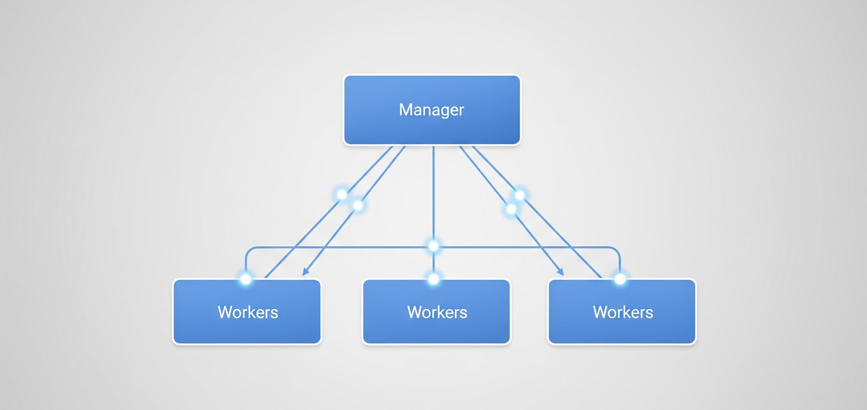
Scaling with MultiKueue Architecture
Extending job dispatching across multiple clusters via Manager-Worker topology
Kueue vs. MultiKueue
Manager-Worker Topology
Kueue (Single Cluster)
Manages local resource quotas and job queuing within a single Kubernetes control plane.
MultiKueue (Multi-Cluster)
Acts as a meta-orchestrator. It dispatches jobs from a central manager cluster to one or more worker clusters based on availability.
Centralized Quota: Manage global limits while workers execute.
Job Offloading: Automatically burst workloads to remote clusters.
Transparent to Users: Submit to one LocalQueue; run anywhere.
Manager: Hosts MultiKueue controller. Watches LocalQueues and creates 'remote' jobs.
Worker: Standard Kueue clusters. They receive the job, execute it within their local ClusterQueues, and report status back.

Slide 10
Workload Admission & Provisioning
Defining admission criteria and provisioning signaling via Admission Controllers
Multikueue
ProvisioningRequest
The central mechanism for managing and dispatching workloads across multiple distinct Kubernetes clusters.
Evaluates workloads created on the Management Cluster to determine which remote Worker Clusters are suitable.
Bridges logical Kueue quotas with physical infrastructure. Coordinates Cluster Autoscaler APIs to guarantee node provisioning.
Best-effort-atomic-scaleup: Fulfills batch demands by scaling hardware groups atomically.
Check-capacity-autoscaling: Checks real-time physical resource and cloud capacity quotas.
Queue-dws-provisioning: Coordinates pipelines natively with GKE's Dynamic Workload Scheduling API.

Slide 11

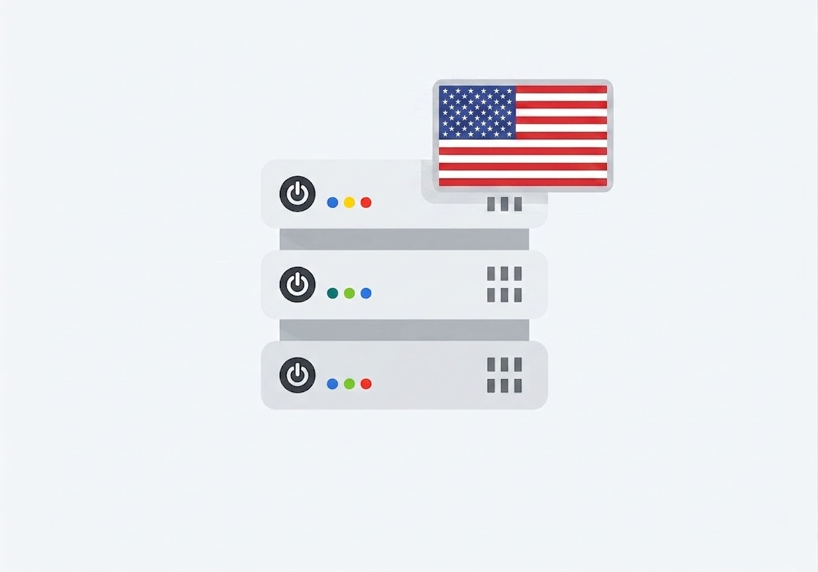

MultiKueue Deployment in Action
Dispatching workloads to regional worker clusters
Manager Cluster
Worker Cluster 01: North America
Region: us-central1
Local Cluster Queue
Admission Checks
ClusterQueue: prod-main
Global Quota Management
MultiKueue Controller
Admission Checks
Functionality:
Aggregates regional demand
Offloads to available workers
Maintains state consistency
Worker Cluster 02: Asia Pacific
Region: asia-southeast1 (Singapore)
Local Cluster Queue
Admission Checks

Slide 12
Problem Statement and Demo

Slide 13
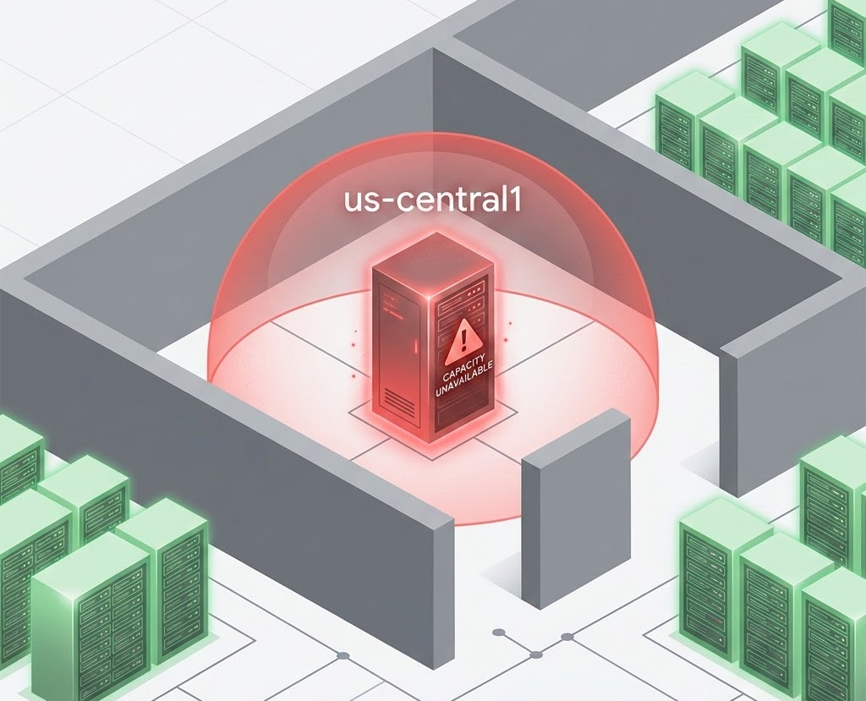
The Regional Silo: GPU Scarcity
Single-region dependencies cripple AI availability and user experience
Critical Availability Bottlenecks
Regional Capacity Constraints:
GPU capacity is locked to local regional availability.
Clusters/VMs cannot tap into idle resources in adjacent REGIONS.
Impact on Operations:
Disrupted Jobs: Training and inference jobs fail or stall due to "Insufficient Regional Capacity."
Poor CX: High latency and service timeouts lead to degraded customer trust.
Innovation Block: Teams wait weeks for hardware expansions instead of iterating.

Slide 14
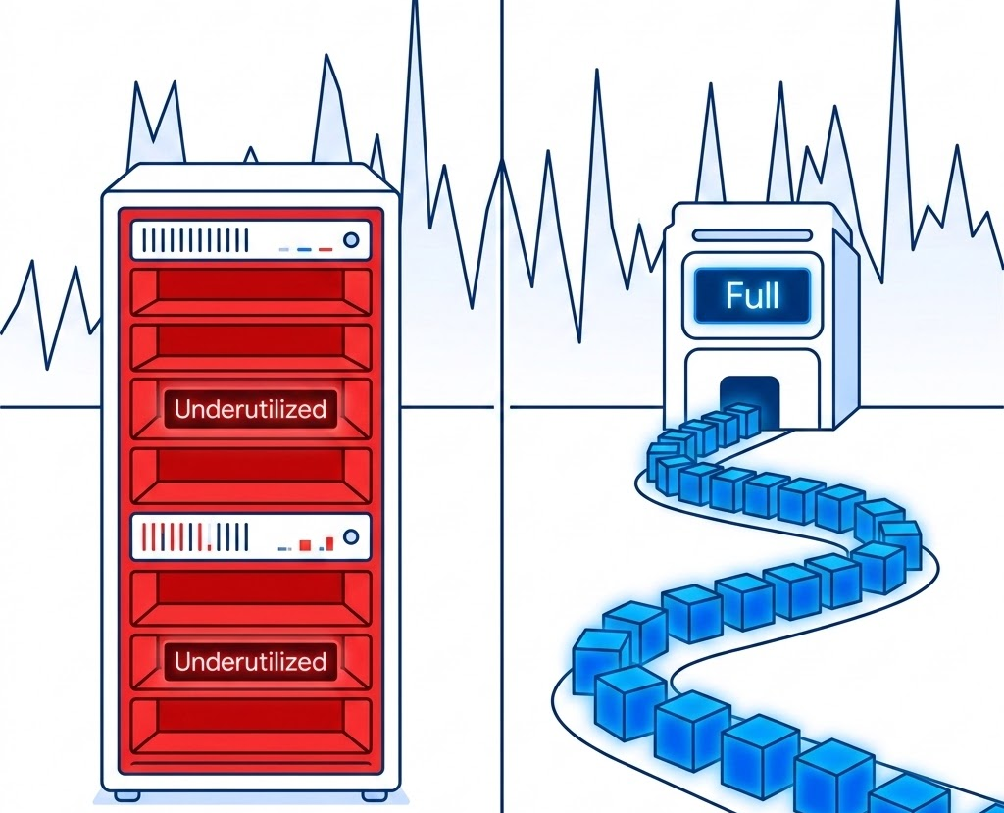
Non Optimal Solutions
Traditional provisioning models struggle with the volatile nature of GenAI workloads
Inefficient Resource Management Strategies
1. Upfront Provisioning (High OpEx):
Organizations reserve capacity to meet peak demands.
Result: Low utilization and wasted spend during idle periods.
2. Queued Provisioning (High Latency):
Workloads wait for regional availability.
Result: Time-to-market delays and stalled innovation.
The Core Failure:
Static models cannot adapt to uneven traffic patterns.
Regional spikes cause local failures while global capacity sits idle.

Slide 15
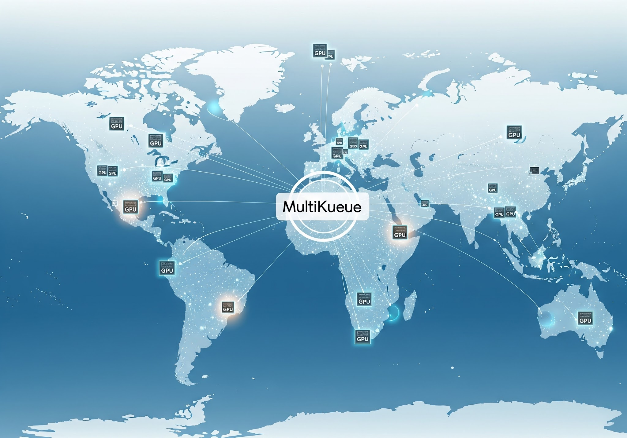
Beyond Quotas: Hunting for Global GPU Capacity
Leveraging MultiKueue to bridge GenAI scarcity through regional federation
The Enterprise Challenge & Solution
The Scarcity Bottleneck: GenAI demand creates regional GPU fluctuations (us-central1 vs. asia-se1).
Traditional Trade-off: High latency (waiting) vs. High OpEx (overprovisioning).
The MultiKueue Objective: Grant batch inference workloads near real-time access to global GPUs during scale-out.
Architecture Approach:
GKE Worker Clusters with GPU nodepools.
Scale-from-zero logic enabled.
Cluster Autoscaler for dynamic provisioning.
Best-effort-atomic-class autiscaling was chosen as the admission controller for worker clusters

Slide 16





Regional Dispatch Failure: The SchedulingGated Issue
Manager commits to exhausted region while valid capacity remains in secondary worker with Best-effort-atomic-scaleup provisioning class
Manager Cluster
Worker Cluster A: us-central1 (North America)
Best-effort-atomic-scaleup
NO CAPACITY
Provisioning Status ACCEPTED
Result: Pod enters SchedulingGated
Stuck: No automated failover possible
Admission Controller
scale-up
Dispatch Logic:
1. Observes global workload
2. Selects us-central1 (Stale view)
3. Job Pinned to Cluster A
Worker Cluster B: asia-southeast1 (Singapore)
Admission Controller
scale-up
Best-effort-atomic-scaleup
Status: IDLE CAPACITY
Available for workload execution.
Bypassed due to Manager's regional pinning.

Slide 17
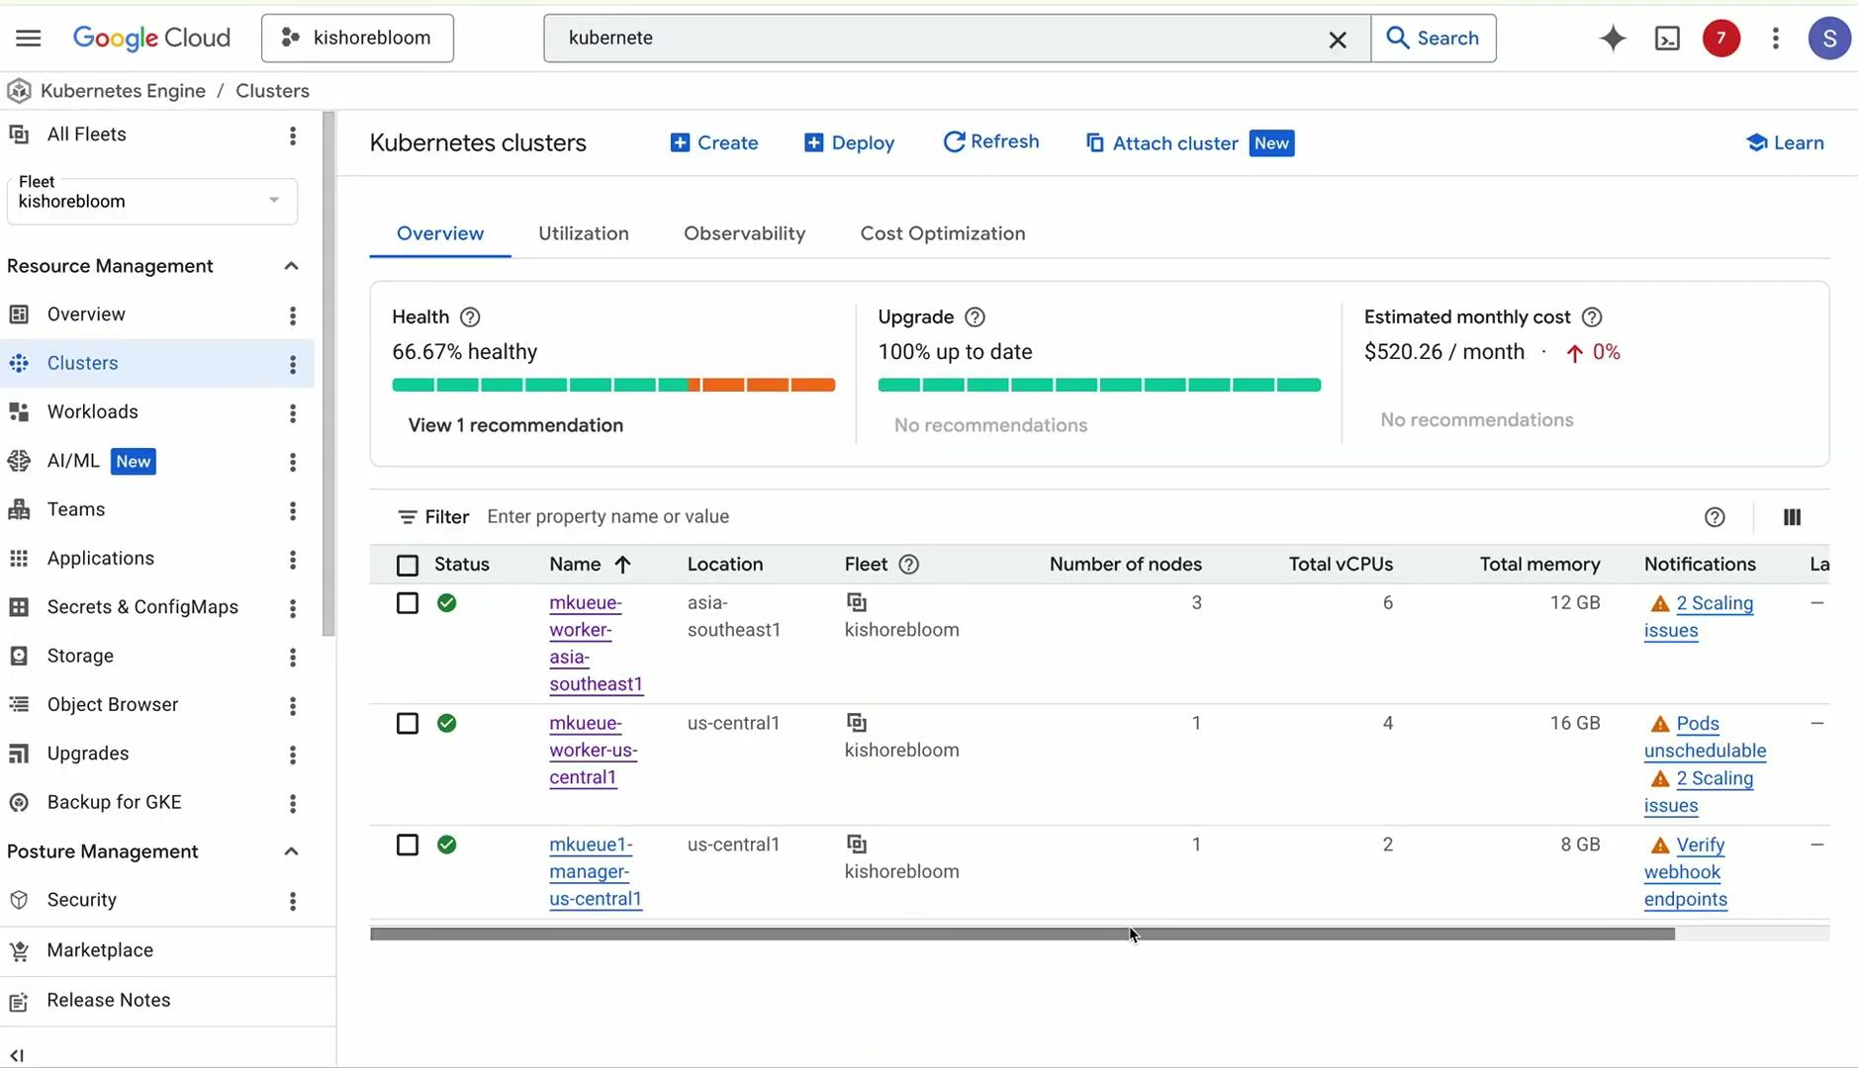
Notes:
We have a master and two workers. The master is in us-central1 and workers are in asia-southeast1 and us-central1. Our intent here is to maximise the GPU availability by having two workers across these two regions, but well u can scale this top n regions if the availability no.s does not meet ur demands.
In the worker cluster in asia-se , I have nodepool. Think of nodepool as a set of nodes sharing common properties and which can be autoscaled to create new nodes with same properties such as machine families cpu cores etc. So as workloads arrive we expect these gpu based nodepools to scale provided if capacity is available.
Similafrly we have a l4 gpu node pool in us-central1.
Now lets look at the multi kueue configuration of master and workers. At the master layer we define the cluster kueue and specify the flavor. We also define the admission criteria which in the case of master species the work cluster configurations. In the work cluster it gets more interesting. The workloads point to a local queue and this points to a specific cluster queue. As Ram mentioned earlier multiple teams can share a common resource with this mechanism. The cluster kueue defines the flaviour the quota in terms of CPUs, GPU and memory and the admission criteria. Now this is an area to note. In the admission cluster I am pointing to best effort provisioning class which basically means, the worker will signal the master and change the status of the provisiong request only if there is capacity. Behind the scenes the multi admission controller will interact with the autoscaler, in our case the GKE autoscaler to check for capacity and provision new nodes if there is capacity
Finally now I have a pod which in a real life use case could a AI batch inference deployment and for simplicity I just have an nginx pod here.. The key aspect to note here is the deployment points to a local-queue which signals the kube-controller not to process this and schedule this immediately but hand it ovcer to the multikueue controller.

Slide 18


