Slide 1
Urban/Suburban/Private/Special Purpose Cohorts
Great Ideas in Education Conference
July 2026

Slide 2
Great Leadership is…..
Boring

Slide 3
Formula for Great Leadership
Consistency +
Focus x
Time =
Lasting Impact

Slide 4

Keystone Habits
What is one keystone habit you currently practice—or would like to begin—that positively impacts many areas of your life?
What could be, or currently is, a district practice that acts as a keystone habit in your system and creates positive ripple effects across multiple areas?

Slide 5

Objectives:
Unpack the revised School Improvement Model
Preview the 26-27 School Improvement Day
Collaborate on implementation of your current Action Plan
Notes:
Want to nail down these objectives with you today
Starting with Why

Slide 6
School Improvement Theory of Action
If we strengthen coherence across Kansas,
By focusing on a few high-leverage, fundamental actions,
Then our students will develop more knowledge and skills leading to greater opportunities and fewer limitations.

Slide 7

How Do We Move School Improvement?
Mechanisms of School Improvement
Kansas Education System Accreditation (KESA) (KSBOE)
At-Risk Accountability (State Legislature)
Legislative Needs Assessment (State Legislature)
Title I ESEA (Federal Government)

Slide 8

Aligning School Improvement
One combined system with aligned identification, plans, supports, and evaluation.

Slide 9
What is an accreditation decision based on in 2026-2027?
KESA Area | What is evaluated? | What are the standards used to evaluate?
School Improvement | Each System’s KESA Action Plan | Ready-to-Implement Action Plan: Clear Aligned Data-driven
Student Outcomes | In process | In process
Compliance | Each KESA Compliance Area (10) | 26-27 KESA Compliance Guide
Notes:
Jay

Slide 10
Kansas School Improvement Model
Fundamentals
Structures
Lead Indicators
(The foundation for school improvement in Kansas Schools)
(Reinforce lead indicators and sustain fundamentals within the system)
(Actions that support implementation of the Fundamentals)
Structured Literacy
Emphasis on allocating time, personnel, and/or financial resources to support implementation of the 4 Fundamentals.
We provide literacy instruction in pre-K-12 aligned to the science of reading and assure teachers and admin are well-trained and knowledgeable in the elements and implementation of structured literacy.
Resource Allocation
Processes for classroom observation, data collection, and feedback are used to optimize conditions for learning. This could include informal observation and/or formal evaluation models.
Classroom Observation
Standards Alignment
We align lessons, instruction, and materials to Kansas standards and clearly identify what students must know and be able to do. This includes interpersonal, intrapersonal, and cognitive skills in pre-K-12.
District professional development and mentoring plans account for the alignment of classroom practice with the 4 Fundamentals to optimize conditions for learning in classrooms.
Professional Learning
Balanced Assessment System
We assess students for risk and standards in pre-K-12 and use data to adjust instruction. We have a deep understanding of the purpose of each assessment and how to use the data to raise achievement.
Collaboration system includes grade level and content area teachers aligning instruction with the 4 Fundamentals to optimize conditions for learning in classrooms.
Professional Collaboration
Data analysis and utilization includes screening for risk and performance against standards. Appropriate time is provided for core activities and interventions to meet student needs.
Quality Instruction
Tiered System of Supports
We have a culture of high expectations in our classrooms and provide each student access to grade level standards and content through high-quality instruction and materials in pre-K-12.
Family, Community and Business Partnerships
Educators, families, and community partners collaborate to ensure students are progressing on state standards, competencies, and postsecondary readiness indicators.
Once a school system selects the Fundamental/Structure combination, it will select a Measure of Progress to track implementation progress with 6-month and 1-year targets.
Updated June 2026

Slide 11
2026-2027 School Improvement Day

Slide 12
Before Your School Improvement Day
Register all who will attend: 26-27 School Improvement Day Schedule with Registration Links.
Prepare your KESA DLT for the System Share-outs at the beginning of the Day using the Implementation Standards/Indicators & Share-out Questions.
Download the updated Action Plan Template so you can prepare a rough draft of your 26-27 action plan.
Notes:
Review each document.

Slide 13
During your School Improvement Day
System Share-outs on implementation of 25-26 KESA Action Plan
Reflect on implementation of 25-26 KESA Action Plan through collaboration
Identify Current State in Fundamentals & Structures
Create a rough draft of your 26-27 KESA Action Plan
Notes:
Walk through each section
Highlights to mention:
Listing notices/wonders on stick note as an audience member during Share-outs.
Overall objective of Reflection on Implementation section - identifying one strength (Standard #/Indicator #) and one gap (Standard #/Indicator #)
Data Connections - student formative data collaboration
Guided Reflective questions - meant to help you think about what’s highest leverage for next Action Plan.
Only 30 minutes for Next Action Plan development - may need more or less time but only need to have Fundamental/Structure tentatively identified along with strength/gap in implementation and who/how to engage going back.

Slide 14
Q & A

Slide 15
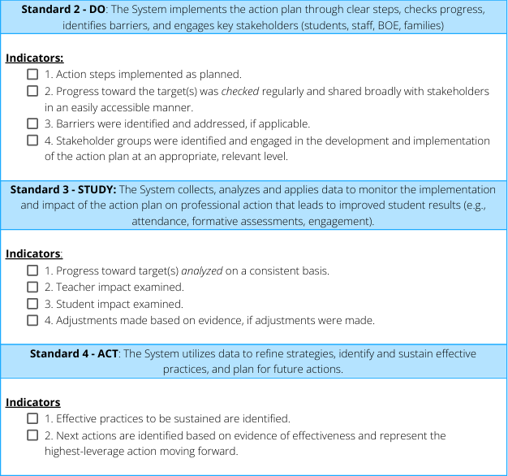
Implementation Collaboration
Small group, discuss:
  What is one implementation success to this point you are most proud of?
  What has been the most significant challenge or barrier so far?
Large group, share:
  Common successes
  Common challenges
Please be sure to share contact information at your table.
Notes:
Option 1 - listed on slide
Option 2
DO:
What actions from your KESA Action Plan have been implemented most consistently?
STUDY:
What evidence or data are telling you the implementation is working—or not working—as intended?
ACT:
What changes, refinements, or new strategies are you considering based on what you've learned?
Option 3
Have groups answer these four questions:
What's working?
Share a practice that is generating positive results.
What's challenging?
Share a struggle that others may be able to help solve.
What's surprising?
What have you learned that you didn't anticipate when you began implementation?
What's next?
What is the most important action your team will take moving forward?
Option 4
If you want a deeper conversation, I would use these:
When you compare your current implementation to where you expected to be at this point in the year, what stands out most?
What evidence has most influenced your thinking about your Action Plan this year?
What implementation strategy would you recommend to another school beginning similar work?
If you could change one thing about your implementation process tomorrow, what would it be and why?

Slide 16
Wrap-up
Fundamental Panel Discussions tomorrow morning - extension of today’s discussion
School Improvement Day Prep Meetings - highly encourage at least 1 member of your KESA DLT to attend.
Contact me at jay.scott@ksde.gov or call 785-230-4575 (cell)

Slide 17
KESA Resources
Rue Huereca-Retana, Adm. Specialist
Rue.Huereca-Retana@ksde.gov
Jay Scott, Director (Cohorts Lead)
Jay.Scott@ksde.gov
Mindy Bruce, Central Regional Executive
Mindy.Bruce@ksde.gov
Amber Miller, West Regional Executive
Amber.Miller@ksde.gov
Jean Rush, East Regional Executive
Jean.Rush@ksde.gov
Notes:
Thank them for their time and support.

