Slide 1
Kansas Education System Accreditation (KESA) Basics
Great Ideas in Education Conference
July 2026

Slide 2

Getting connected
Share your name, role, and district.
Find someone new in the room and share:
What brought you to Kansas, your current position, or this session.
One thing you hope KESA will help you improve for students, staff, or your school system.

Slide 3

Objectives for this session:
Get Connected
Basics of KESA 2.0
Walkthrough Key Resources
Notes:
Want to nail down these objectives with you today
Starting with Why

Slide 4
School Improvement Theory of Action
If we strengthen coherence across Kansas,
By focusing on a few high-leverage, fundamental actions,
Then our students will develop more knowledge and skills leading to greater opportunities and fewer limitations.

Slide 5

How Do We Move School Improvement?
Mechanisms of School Improvement
Kansas Education System Accreditation (KESA) (KSBOE)
At-Risk Accountability (State Legislature)
Legislative Needs Assessment (State Legislature)
Title I ESEA (Federal Government)

Slide 6
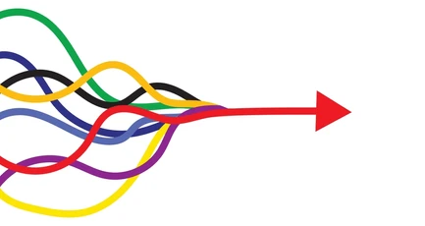
Aligning School Improvement
One combined system with aligned identification, plans, supports, and evaluation.

Slide 7
What are we expected to do in KESA this year?
KESA 6-month Check-in
School Improvement Day - register all participants
Submission of Action Plan
Implementation of Action Plan

Slide 8
What is an accreditation decision based on in 2026-2027?
KESA Area | What is evaluated? | What are the standards used to evaluate?
School Improvement | Each System’s KESA Action Plan | Ready-to-Implement Action Plan: Clear Aligned Data-driven
Student Outcomes | In process | In process
Compliance | Each KESA Compliance Area (10) | 26-27 KESA Compliance Guide
Notes:
Jay

Slide 9
Kansas School Improvement Model
Fundamentals
Structures
Lead Indicators
(The foundation for school improvement in Kansas Schools)
(Reinforce lead indicators and sustain fundamentals within the system)
(Actions that support implementation of the Fundamentals)
Structured Literacy
Emphasis on allocating time, personnel, and/or financial resources to support implementation of the 4 Fundamentals.
We provide literacy instruction in pre-K-12 aligned to the science of reading and assure teachers and admin are well-trained and knowledgeable in the elements and implementation of structured literacy.
Resource Allocation
Processes for classroom observation, data collection, and feedback are used to optimize conditions for learning. This could include informal observation and/or formal evaluation models.
Classroom Observation
Standards Alignment
We align lessons, instruction, and materials to Kansas standards and clearly identify what students must know and be able to do. This includes interpersonal, intrapersonal, and cognitive skills in pre-K-12.
District professional development and mentoring plans account for the alignment of classroom practice with the 4 Fundamentals to optimize conditions for learning in classrooms.
Professional Learning
Balanced Assessment System
We assess students for risk and standards in pre-K-12 and use data to adjust instruction. We have a deep understanding of the purpose of each assessment and how to use the data to raise achievement.
Collaboration system includes grade level and content area teachers aligning instruction with the 4 Fundamentals to optimize conditions for learning in classrooms.
Professional Collaboration
Data analysis and utilization includes screening for risk and performance against standards. Appropriate time is provided for core activities and interventions to meet student needs.
Quality Instruction
Tiered System of Supports
We have a culture of high expectations in our classrooms and provide each student access to grade level standards and content through high-quality instruction and materials in pre-K-12.
Family, Community and Business Partnerships
Educators, families, and community partners collaborate to ensure students are progressing on state standards, competencies, and postsecondary readiness indicators.
Once a school system selects the Fundamental/Structure combination, it will select a Measure of Progress to track implementation progress with 6-month and 1-year targets.
Updated June 2026

Slide 10
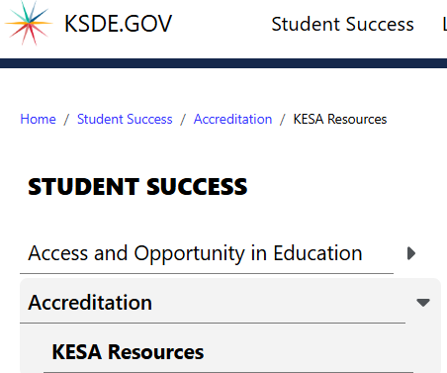
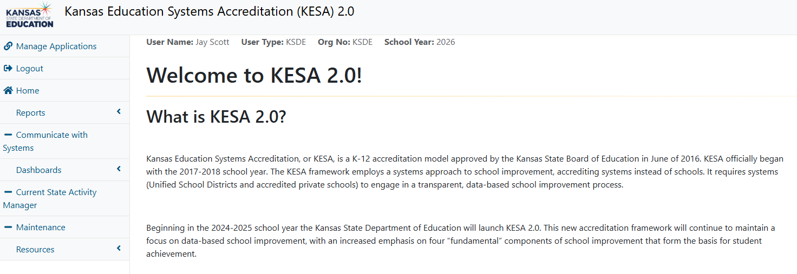
Where can I go to find KESA information?
KESA Resources webpage
KESA Application

Slide 11
Questions?

Slide 12
Rue Huereca-Retana, Adm. Specialist
Rue.Huereca-Retana@ksde.gov
Jay Scott, Director (Cohorts Lead)
Jay.Scott@ksde.gov
Mindy Bruce, Central Regional Executive
Mindy.Bruce@ksde.gov
Amber Miller, West Regional Executive
Amber.Miller@ksde.gov
Jean Rush, East Regional Executive
Jean.Rush@ksde.gov
Notes:
Thank them for their time and support.

