Slide 1
From Vision to Reality
Selecting and Supporting High Quality Science Instructional Materials
Notes:
This session examines what components of instructional design are critical to supporting quality science instruction. We will identify what makes science material selection different from other content areas and review recommended HQIM selection processes. Leaders will also explore additional supports from KSDE around quality instruction in science, including statewide implementation cohorts, our Zero Barrier (UDL) initiative, and professional learning/collaboration opportunities.

Slide 2
Supporting Quality Instruction
Observation Tools
IM Implementation Guidance
Quality Instruction
Facilitate instruction that reflects high expectations and meaningfully engages all students with standards-aligned materials
IM Selection Guidance
Implementation
Establish and maintain conditions that enable teachers to use materials in service of the vision
Standards Alignment Toolkits
Instructional Visions
Instructional Materials
Select materials that are aligned to the expectations of the standards and vision
Standards & Vision
Understand what students should know and be able to do by the end of the year
Professional Learning for Teachers & Leaders

Slide 3
Supporting Quality Instruction
What’s going well?
What are the challenges?
Observation Tools
IM Implementation Guidance
Quality Instruction
Facilitate instruction that reflects high expectations and meaningfully engages all students with standards-aligned materials
IM Selection Guidance
Implementation
Establish and maintain conditions that enable teachers to use materials in service of the vision
Standards Alignment Toolkits
Instructional Visions
Instructional Materials
Select materials that are aligned to the expectations of the standards and vision
Standards & Vision
Understand what students should know and be able to do by the end of the year
Professional Learning for Teachers & Leaders

Slide 4
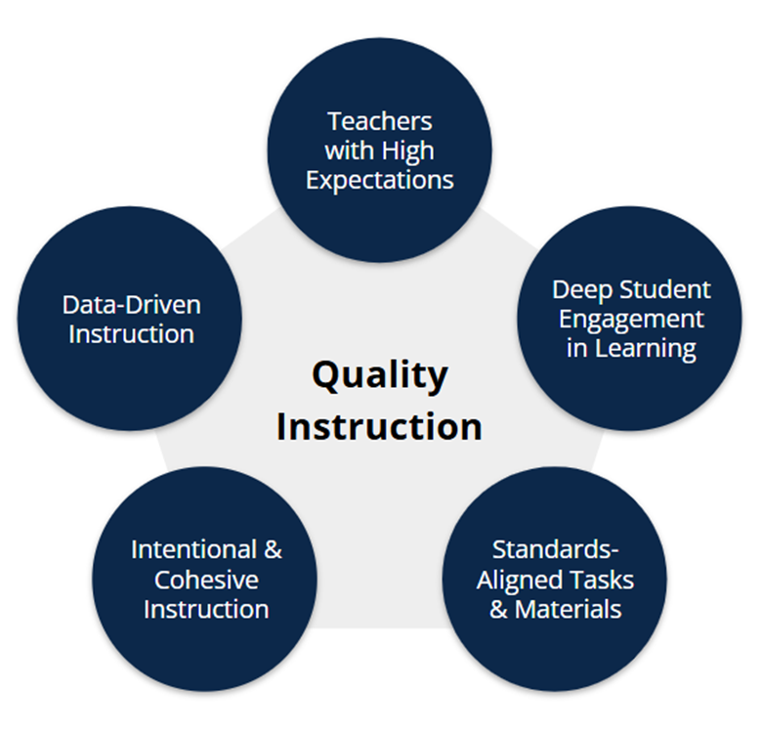
Vision for Quality Instruction
LINK
The KSDE believes that all Kansas students deserve consistent access to Quality Instruction.
Quality Instruction refers to the implementation of evidence-based lesson design that reflects high expectations, meaningful student engagement, and learning activities aligned to the Kansas Curricular Standards. A data-driven system of differentiated supports is necessary to help each student meet rigorous state standards.

Slide 5
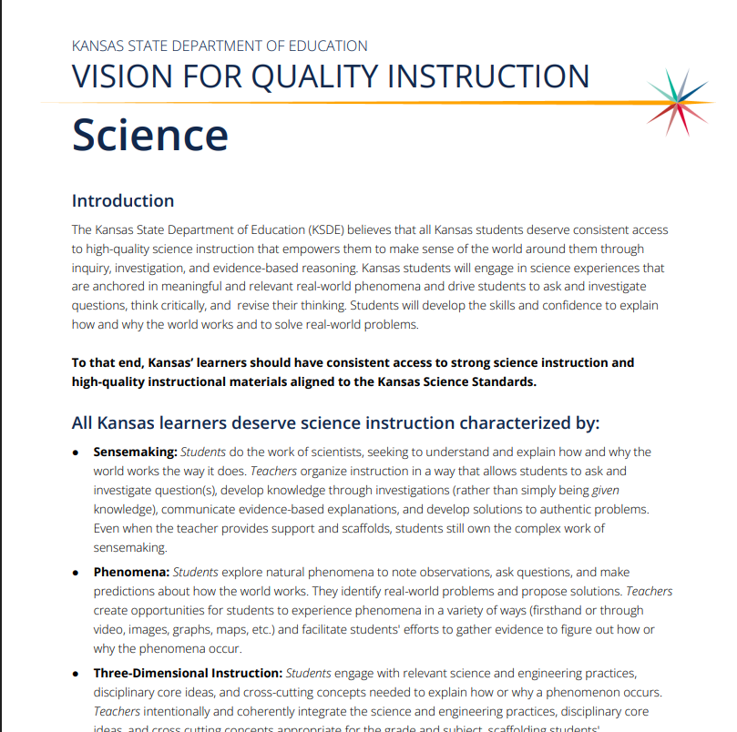
KSDE Vision for Quality Instruction in Science
LINK
Phenomena
3-Dimensional Science
Sensemaking
Discourse & Collaboration
Local & Cultural Relevance

Slide 6


High-Quality Instructional Materials
The KSDE defines High-Quality Instructional Materials (HQIMs) as materials that are:
aligned to the Kansas Curricular Standards
research-based and/or externally validated
comprehensive to include phenomena, coherent sensemaking, 3-dimensional tasks, and assessments
What does the research say?
When teachers don’t have access to HQIMs, they tend to use unvetted online resources, leading to inconsistent quality. (Opfer, D., Kaufman, J., & Thompson, L., 2017)
Students in classrooms that used one HQIM for four consecutive years outpaced comparison students by a margin of 38 percentile points. (Steiner, 2018)

Slide 7


TNTP’s 2018 report The Opportunity Myth examined the quality of students’ academic experiences.

Slide 8
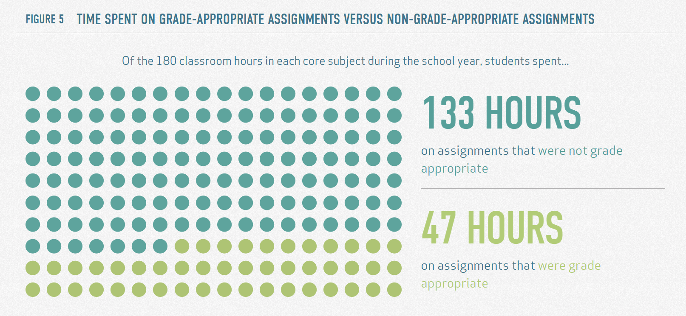

Slide 9
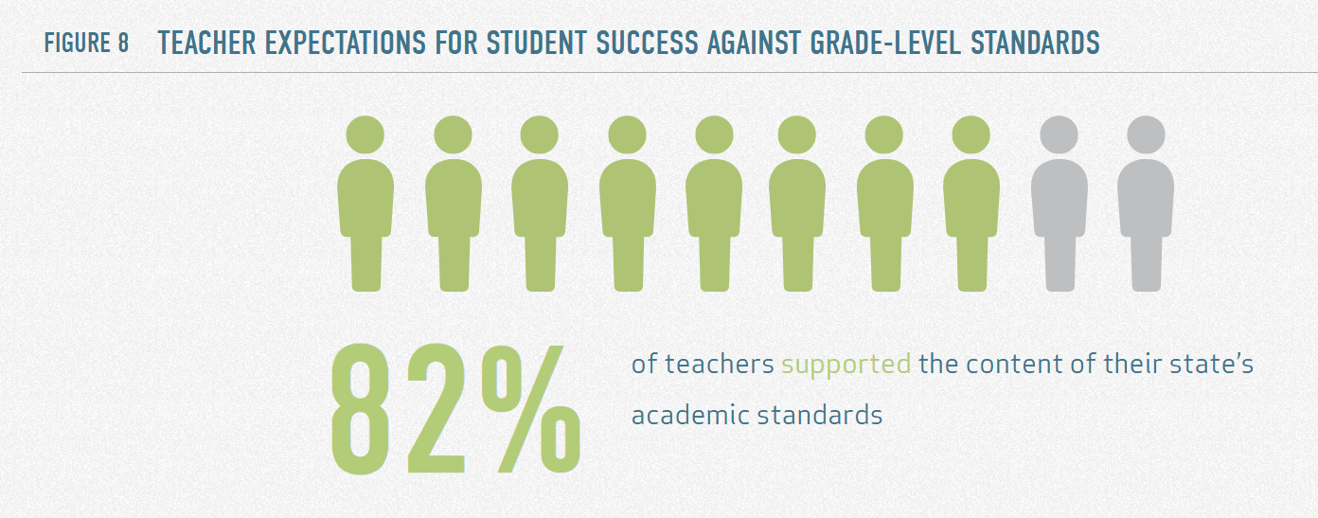

Slide 10
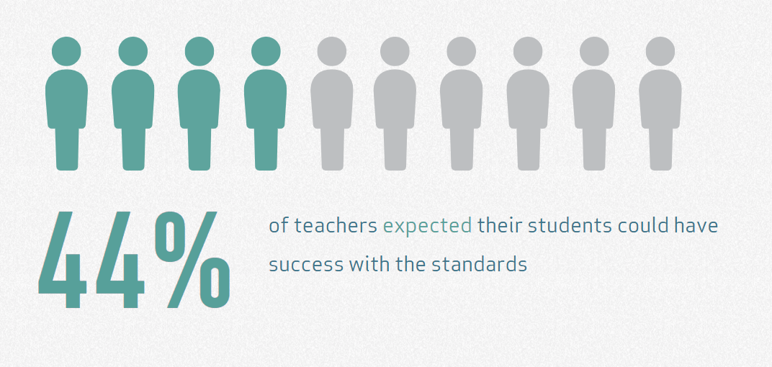

Slide 11

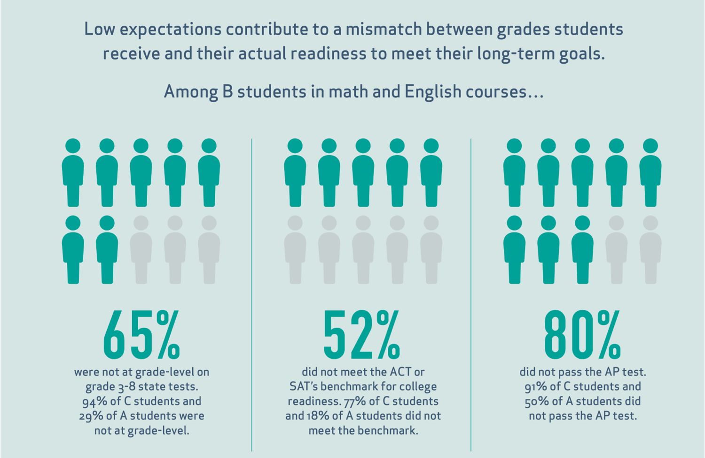
Students do what we ask because they expect school is setting them up to meet their goals…
…but the reality is that we’re just not asking enough.

Slide 12
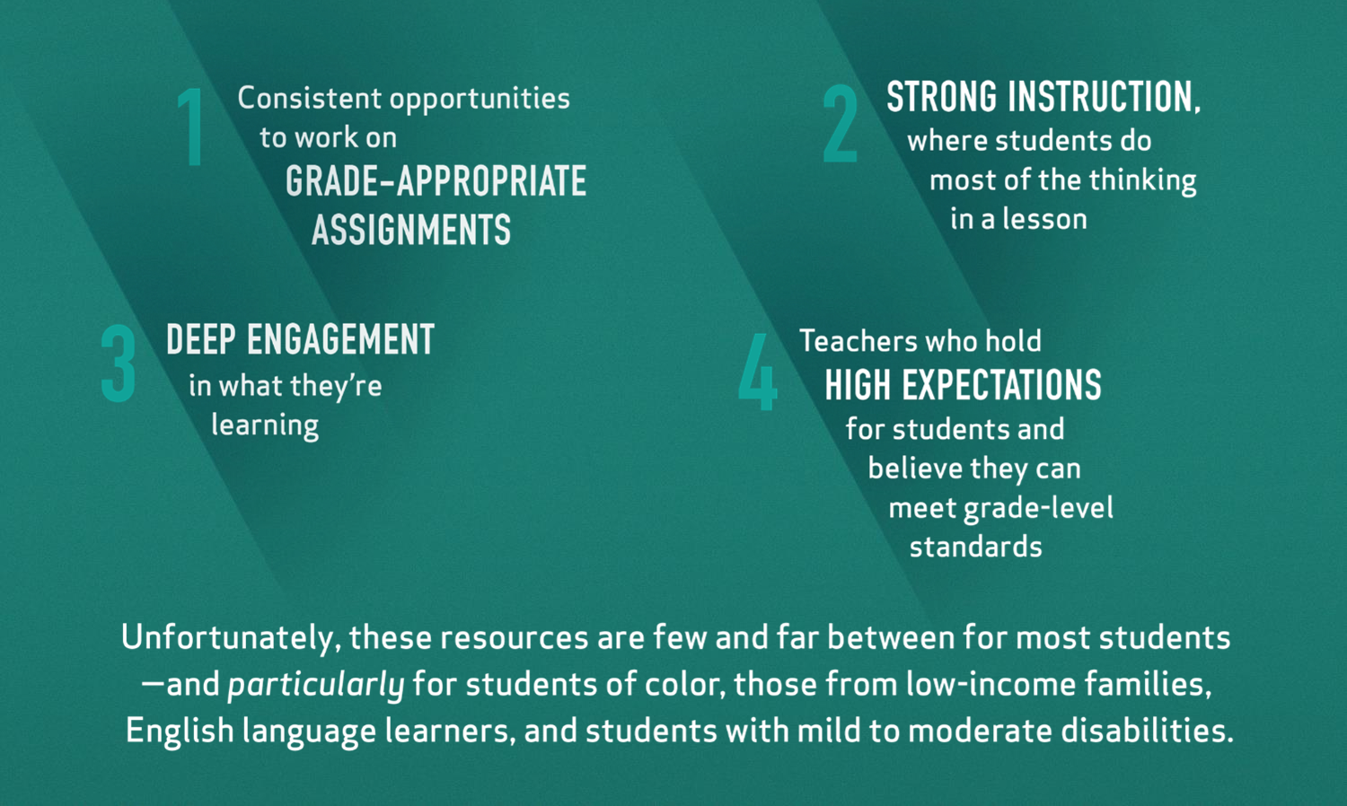
The study found four key resources that influence a student’s school experience and outcomes:

Slide 13
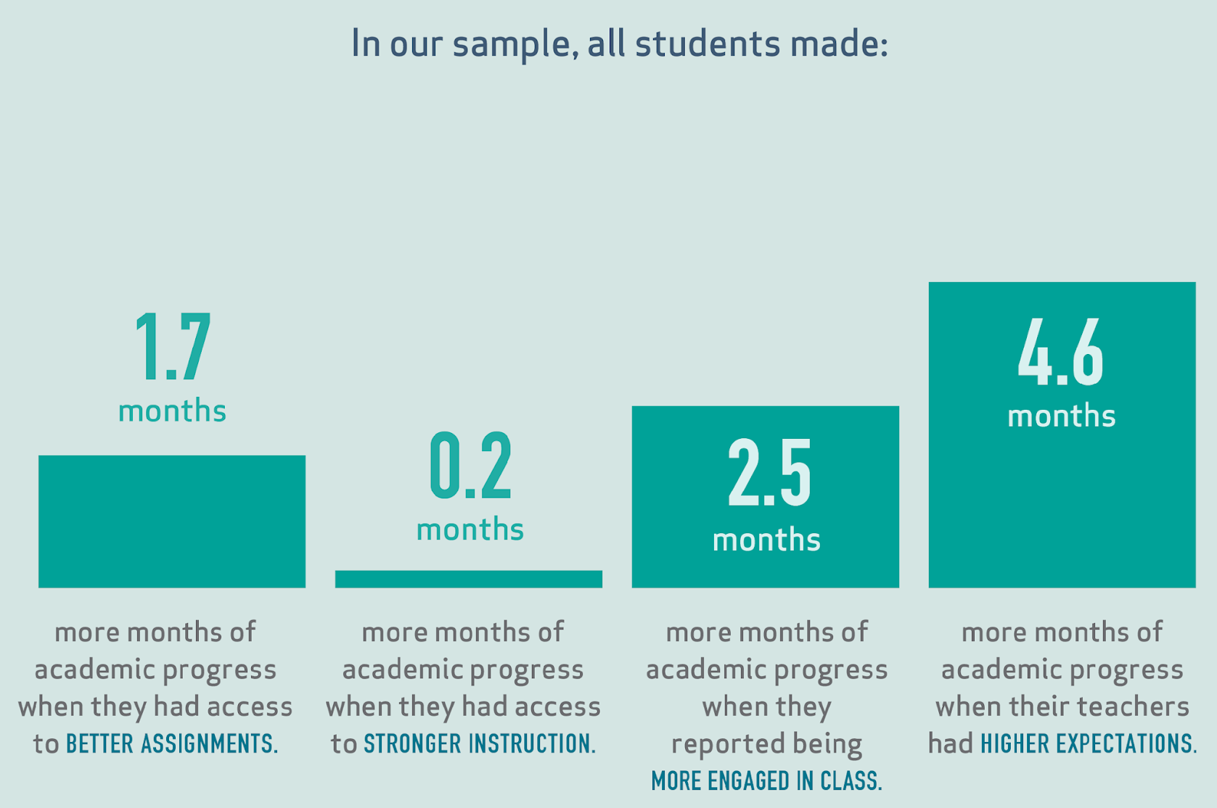
When students had greater access to the four key resources, they grew more in a single year.

Slide 14
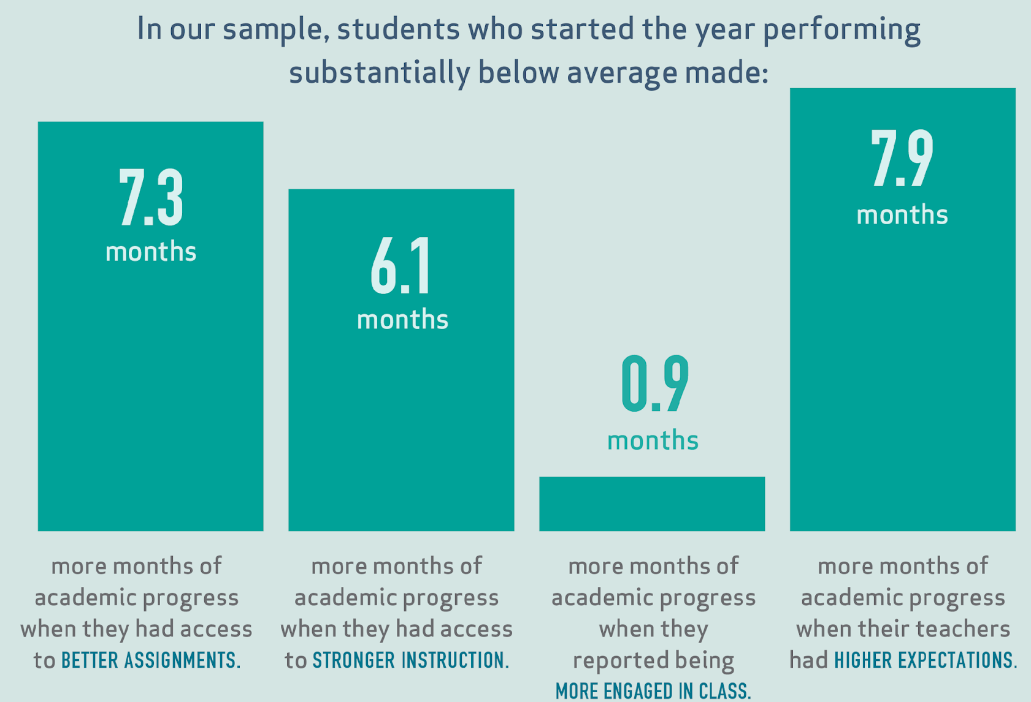
That was especially true for students who were below grade-level.

Slide 15
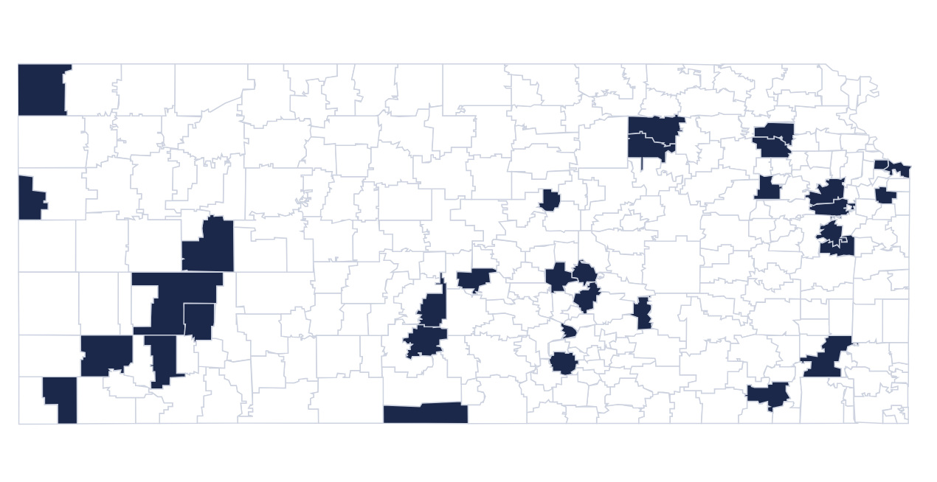
Districts with K-8 Science Materials that “meet expectations” for Science

Slide 16
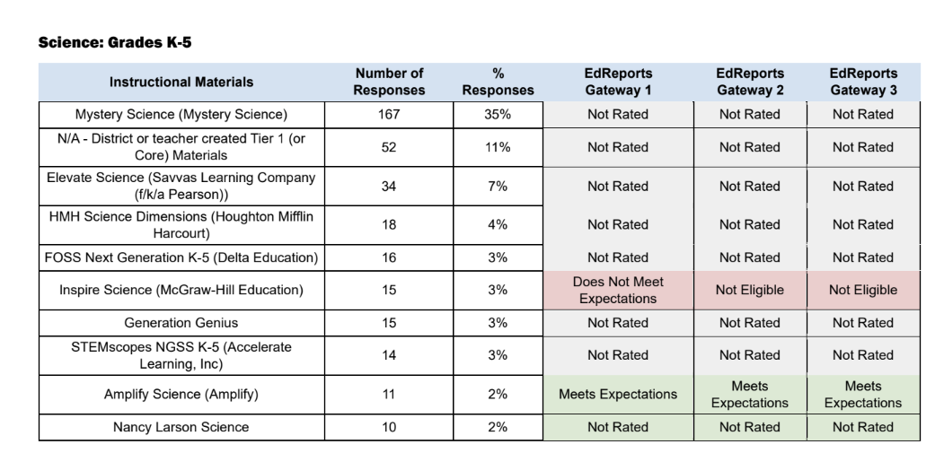
Notes:
Most common materials - Fall 2025

Slide 17
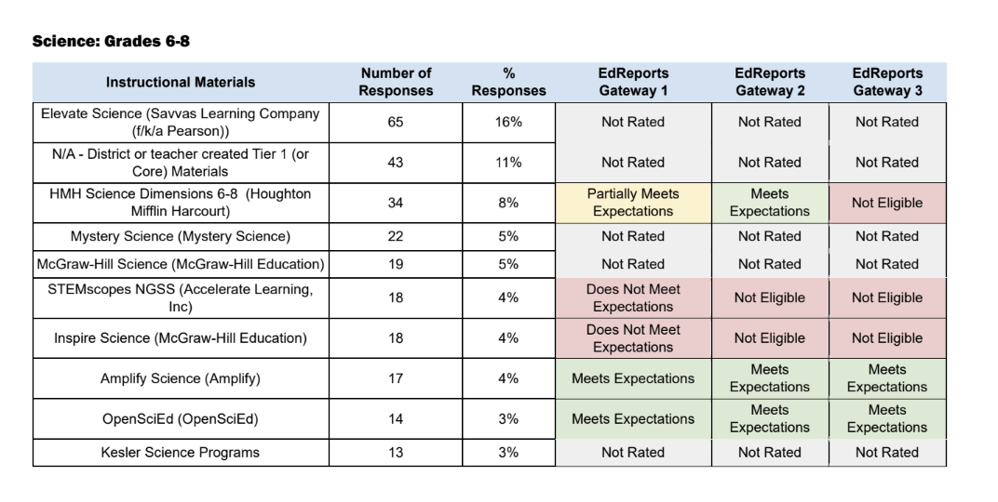
Notes:
Most common materials - Fall 2025

Slide 18

KSDE’s IM Selection Guidance
LINK
Designed to assist districts with prioritizing time while maximizing choice and flexibility
Not exhaustive but can be customized to address local needs
Includes links to tools and resources that offer additional support to ensure the materials selection process is thoughtfully planned, transparent, and well-documented.

Slide 19
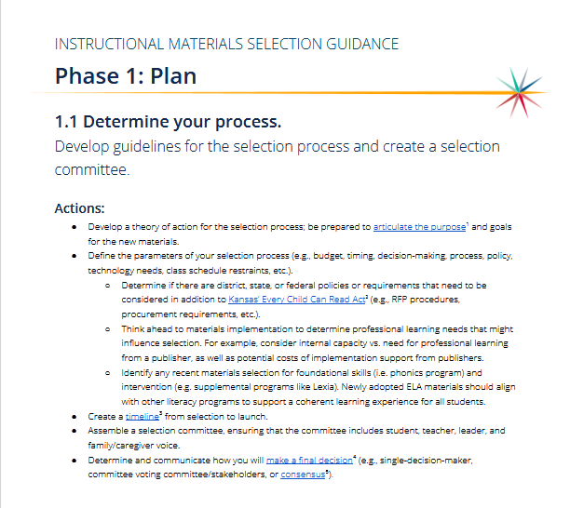
KSDE’s IM Selection Guidance
LINK
Phase 1: Plan
Determine your process.
Develop your lens.
Build skill.
Phase 2: Study
Know and narrow your choices.
Investigate the materials.
Phase 3: Act
Make a decision.
Plan for implementation
Phase
Guideline
Key actions

Slide 20
Considerations
Use the publisher-provided alignment documentation, along with the third party reviews from EdReports and/or NGSS Design Badge, as information in your instructional materials selection process.
A publisher may be able to provide documentation of the alignment to the standards, but EdReports and NGSS Design Badge highlight differences in quality and help identify gaps in curriculum materials.
Standards-aligned materials may not always translate to standards-aligned, grade level classroom instruction

Slide 21
NGSS Designed Science Materials
Intentionally designed as a whole learning experience to support student sensemaking
More than a “text book”
  Usually (not all) includes lesson plans, lesson slides, procedures for investigations, handouts, etc.
Intentionally embed and assess all three dimensions of the standards
  SEPs, DCIs, and CCCs

Slide 22
3rd Party Reviews
A publisher may be able to provide documentation of the alignment to the standards, but EdReports and NGSS Design Badge highlight differences in quality and help identify gaps in curriculum materials.
Standards-aligned materials may not always translate to standards-aligned, grade level classroom instruction
EdReports (LINK)
Reviews full curriculums
Designed for NGSS (Next Generation Science Standards),
Coherence and Scope, and
Usability.
NGSS Design Badge (LINK)
Review units
3D Design,
Instructional Supports, and
Monitoring Student Progress.
Notes:
EdReports Reviews and Evidence Guides, as well as NGSS Design Badge Evaluation Reports provide a strong starting point for Kansas districts to use as a part of their standards-aligned instructional materials selection process

Slide 23
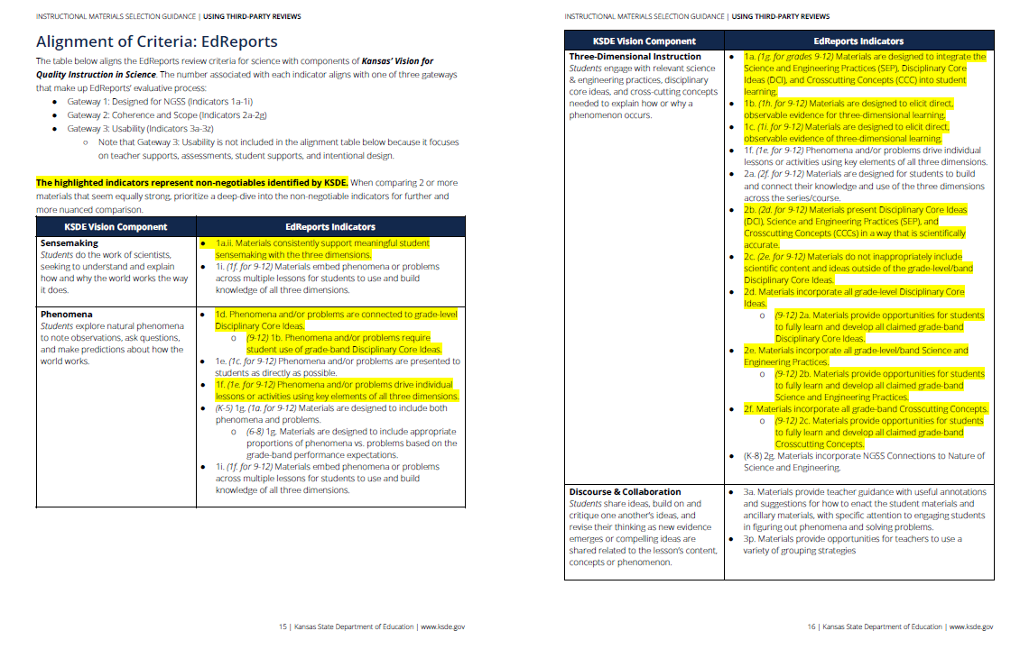
Alignment of 3rd party reviews & KSDE Science Vision
Link to completed alignment documents

Slide 24
 | NGSS Design Badge Resources | EdReports (KSDE Guidance)
Elementary | Open Sci Ed all units linked here NSTA Equip Review Openscied: https://www.nsta.org/equip-rubric-science | K-2: Smithsonian K-5: Amplify
Middle | Open Sci Ed all units linked here Twig Science (middle school unit, has a k-8 curriculum) | 6-8: Lab Aids SEPUP 6-8 OpenSciEd (these units also have NGSS design badge reviews) 6-8 Amplify
High | OpenSciEd High School – all units linked here Example Biology Example Chemistry Example Physics | 9-12 Bio: BSCS

Slide 25
Why aren’t there more “HQIM” science?
Science reviews started late.
EDReports launched in 2015 with math and ELA; science reviews didn't begin until February 2019 (middle school), 2020 (K–5), and 2023 (high school)—so the review catalog has had far less time to grow.
Fewer comprehensive programs to review.
The science market has leaned heavily on supplemental and teacher-created materials rather than full-course programs—the kind EDReports evaluates.
NGSS raised the bar dramatically.
NGSS integrates disciplinary core ideas, science and engineering practices, and crosscutting concepts. Most existing materials were designed for older standards, with practices "bolted on" rather than built in, so they fall short under full three-dimensional review.
Coherence is a heavy design lift.
Building phenomenon-driven storylines that develop core ideas and practices across a full year and grade progressions is difficult, and the market hasn't fully caught up.
Few materials meet expectations.
Only 1 of 6 series fully met criteria in the 2019 middle school round, and 1 product in the 2023 high school round—mirroring the pattern from math and ELA at launch.

Slide 26
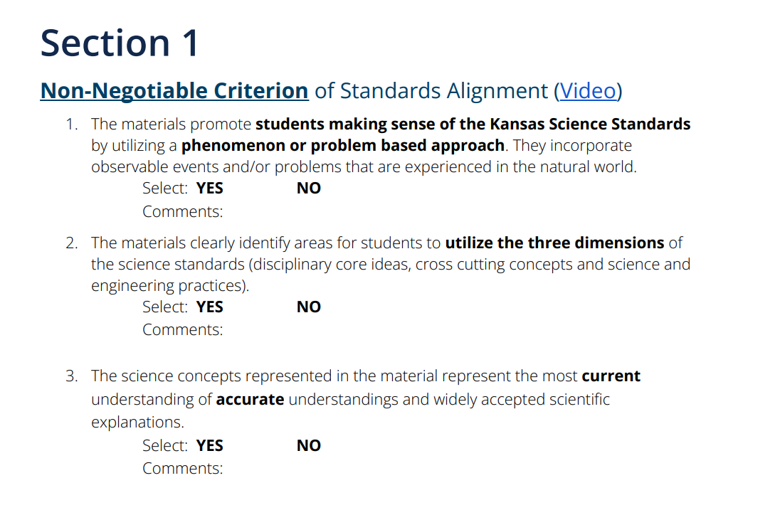
Science has limited reviews right now…so what do we do?
Science Instructional Materials & Curriculum Evaluation Tool

Slide 27
What about Mystery Science?
Phenomena
Optional anchoring phenomenon
  When this layer is turned on there is an anchoring lesson
  When this layer is turned on there is a point in each lesson where a character pops in to tell students how the lesson is connected back to the anchor
  The anchoring phenomenon does not drive learning, students are not figuring out the explanation – they are told the connections
Lesson level phenomena
  Most lessons start with a phenomenon, something real world.
  However, in the 3rd grade weather unit only lesson 5 made connections back to the lesson level phenomenon in the lesson.

Slide 28
What about Mystery Science?
3D Instruction
SEPs
  Students are not always given opportunities to engage in the SEP in the claimed standard.
  Often the SEP is done for students and the results are told to students, they are not the ones making sense or figuring out.
DCIs
  In a 3rd grade weather unit 4 out of 5 lessons had students using disciplinary core ideas that were at the 6-8 grade level.
  The claimed standards were often not clear in the learning activities.
CCCs
  There is no clear integration of the cross cutting concepts in instruction, but they are asked to use them in assessment

Slide 29
What about Mystery Science?
Sensemaking
Collaboration and Discourse
Local and Cultural Relevance
Lessons are structured so that information is given to students, not developed through investigations.
The lesson plans do incorporate several partner talks and partner working. There are a couple of opportunities to discuss as a class.
The activities are so structured that there is not an opportunity for students to bring a variety of ways of thinking.
The lessons each ask students to make connections between the lesson phenomena, the science content, and their own lives.
The activities are so structured that there is not an opportunity for students to bring a variety of ways of thinking.

Slide 30
A few “lessons learned”...
What is most used is not necessarily what is best.
HQIM materials are often designed for COHERENCE - consider this when deciding whether or not to pilot materials
OER materials - start by exploring the OER material, then decide which publisher is the best fit
Professional learning is KEY.

Slide 31
Implementation & Monitoring Tools
KSDE Implementation Guide
KSDE Science Observation Tool

Slide 32
Science HQIM Supports 2026-2027
Science Instructional Materials Selection Support Cohort
Designed for instructional leaders and selection decision makers
4 sessions - 3 virtual + 1 in-person
OpenSciEd Implementation Support Cohort - REVISED Structure
Amplify Science Implementation Support Cohort - NEW!
Additional Direct Support Available for the vision, selection & implementation!

Slide 33
Connect with KSDE Science!
stephanie.alderman-oler@ksde.gov
Join the Listserv!

