Slide 1


Slide 2
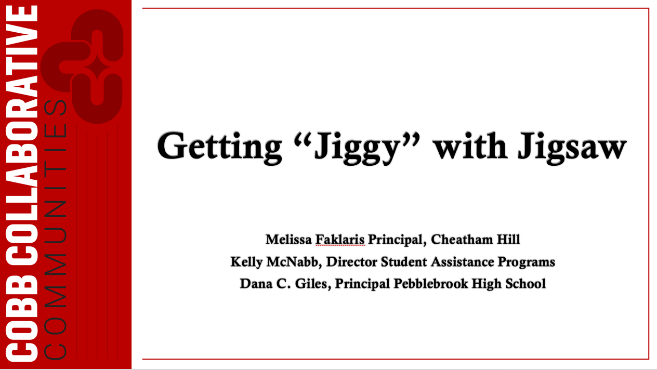
Notes:
All—welcome and introductions

Slide 3
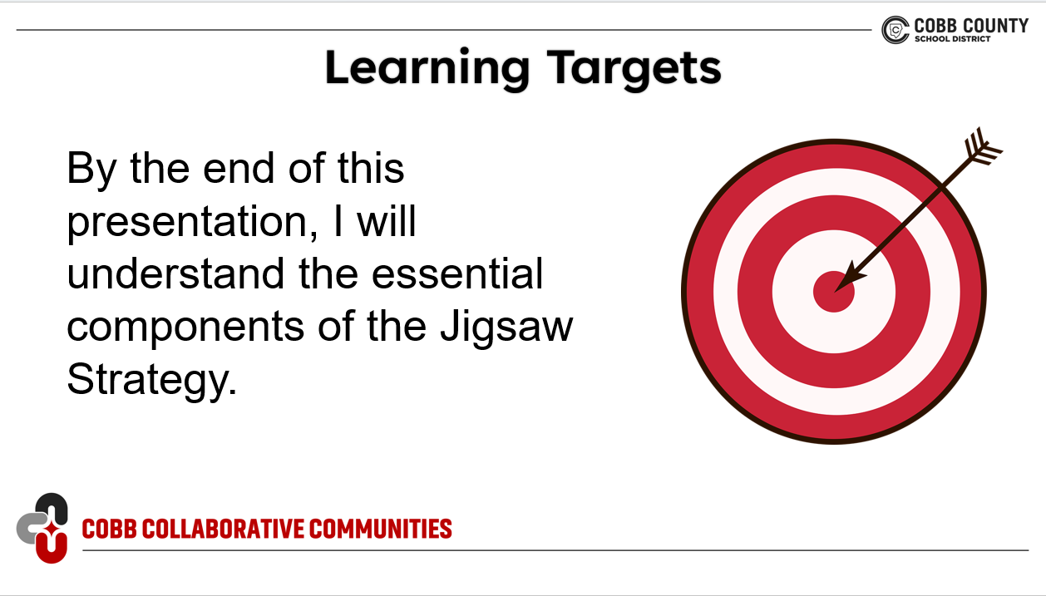
Notes:
Dana

Slide 4


Dreaming of Retirement…
Notes:
Have you been dreaming of a luxury retirement where your days are filled with everything you want-and nothing you don’t? Well, buckle up, because the work we’re doing today is what makes that future possible, and today we’re going to take our first step in planning that reality.

Slide 5

Jigsaw your Retirement
Stand up!
Pick your retirement hobby.
  It’s on the handout you were given when you entered 😉
Move to your retirement corner!”
  ✈️ Traveling the world
  🌿 Gardening / Outdoor life
  📚 Reading endlessly
  🎨 Hobbies & crafts

Slide 6

Expert Group Assignment
  Task: As a group, you have one minute to write a 1-2 sentence statement to answer the question below as it pertains to your group. You will use your Expert Group Graphic Organizer. Be prepared to share your group statement when you transition to your learning group.
Travel → Why is travel the ultimate dream?
Gardening → Why is this activity the go-to stress reliever?
Reading → Why is this activity magical?
Hobbies/Crafts → Why rediscover creativity?

Slide 7

Transitioning to Learning Group
Within in your expert group, pass out number cards to
each person in your expert group.
Form new groups based on your number. These new groups are called learning groups.
Task: In this learning group, you have two minutes total for each member to share the 1-2 sentence statement about their retirement hobby. Make notes using your graphic organizer. Once everyone has shared, you will have the information about all 4 retirement hobbies.
When prompted, head back to your expert group.

Slide 8
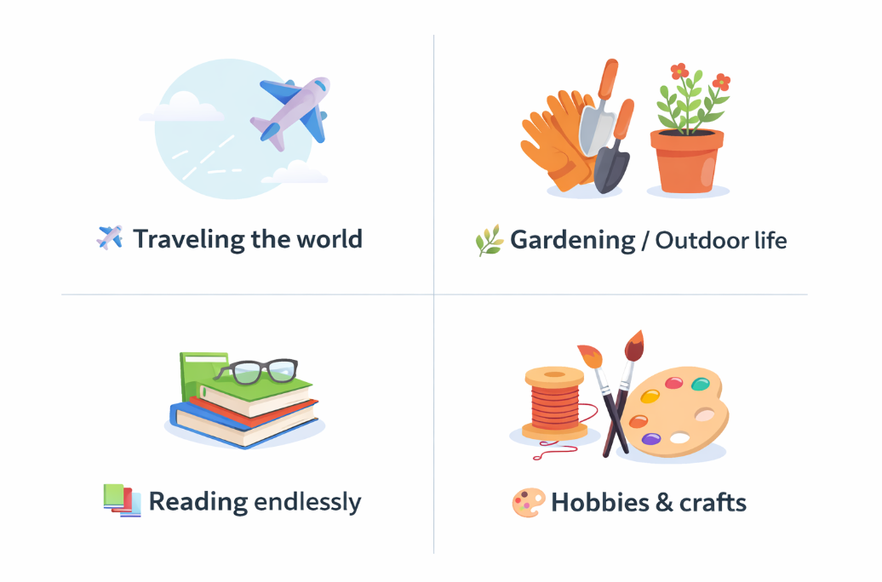

Wrap up Assignment
Now that you’re back in your expert group, take 2 minutes and share the information from your learning group. You are sharing about the other retirement options.
Choose one person in your learning group to share 1 statement about your expert group’s retirement choice.

Slide 9
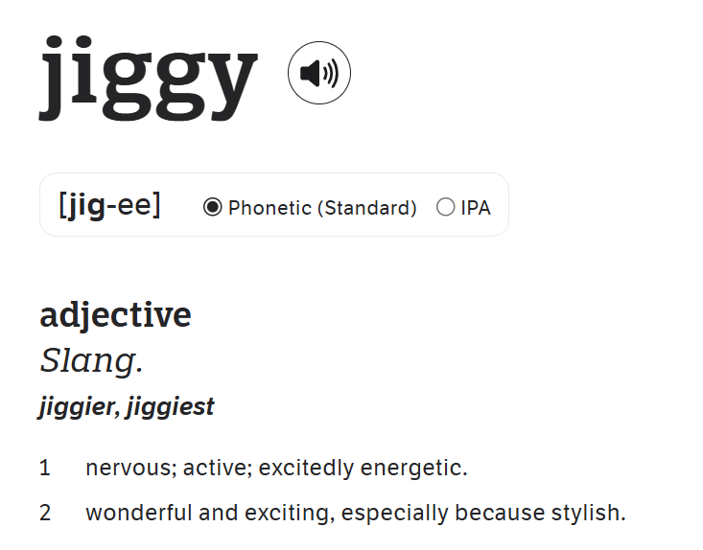

Congratulations,
You just got Jiggy with Jigsaw!!!
You moved, collaborated, laughed, shared expertise, and created a final product.
Notes:
Dana

Slide 10



What is Jigsaw?
Notes:
Need to screencast the video
Dana

Slide 11
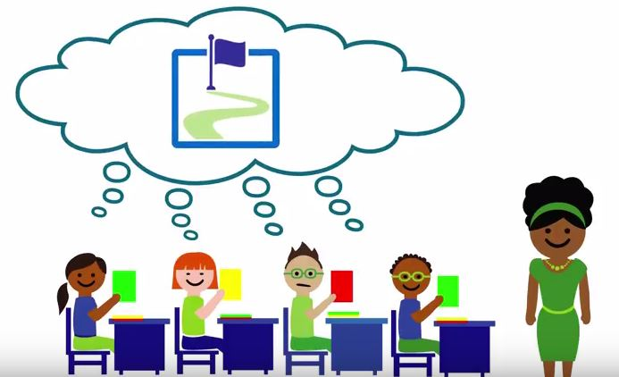
Defining Jigsaw
Which definition fits your current understanding best?
A way to piece together learning collaboratively
A structure that promotes engagement and accountability
A tool for formative assessment
None of these
All of these
Other
Notes:
Dana

Slide 12
Jigsaw History
Jigsaw was first used in 1971 in Austin, Texas by Professor Aronson.
It was created out of a necessity to help ease racial tensions in the desegregation process in Texas Schools.
The goal was to encourage collaboration, sharing and mutual respect among students.
Hattie effect size 1.20
Notes:
Dana
Add in effect size of 1.2

Slide 13
Reflection
Do you see teachers in your building using Jigsaw?
Why do you think teachers do not use Jigsaw? What are the barriers?
Notes:
Kelly
Frame it

Slide 14

The Expert Group
Notes:
Kelly

Slide 15

Expert Group
A temporary team where students study one component deeply so they can teach it accurately to others.
Ensures depth before collaboration
Each student is accountable
Requires mastery
Notes:
Kelly
mastering one important piece of the whole

Slide 16
Impact of the
Expert Group
When students are expected to be experts, the depth of learning, engagement, and accountability is increased.
  Move beyond the surface to a deeper understanding
  Increased accountability and ownership of learning
  Encourages discussion instead of rote learning
  Balances group dynamics because everyone has a voice
  Learning is transferred to practice
Notes:
Kelly

Slide 17
Teacher's Role with the
Expert Group
The teacher’s role is to design, scaffold, and coach so students can confidently teach their piece of the learning.
Design the task to ensure each expert section addresses the learning targets.
Provide clear purpose and expectations of the task as well as for working in groups
Scaffold learning with guiding questions, graphic organizers, and sentence frames
Monitor the groups and clarify misunderstandings
Check notes/visuals for accuracy
Provide prompts to students so they are prepared to teach to learning groups
Notes:
Kelly

Slide 18
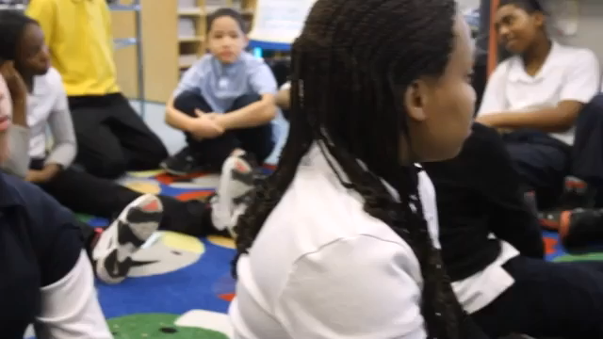
The Expert Group in Action
Notes:
Kelly

Slide 19
Pause and Pop
Share an insight (pop) with a partner using the prompts below in one sentence without repeating other ideas
💡 Something that stood out
❓ A question the video raised
🔁 A moment you’d replay
Notes:
Kelly

Slide 20

Jigsaw
The Learning Group
Notes:
Dana

Slide 21
Learning Groups In Jigsaw
The learning group is responsible for sharing expertise from the expert group and learning new information from other groups.
Notes:
Dana

Slide 22

The Impact of the Learning Group
Students are now empowered as experts to share what they have learned with others. They are now responsible for learning and comprehension and their role in the activity is magnified.
Notes:
Reduce the language on the slide
Dana

Slide 23
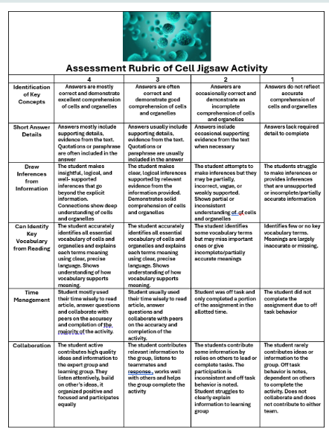
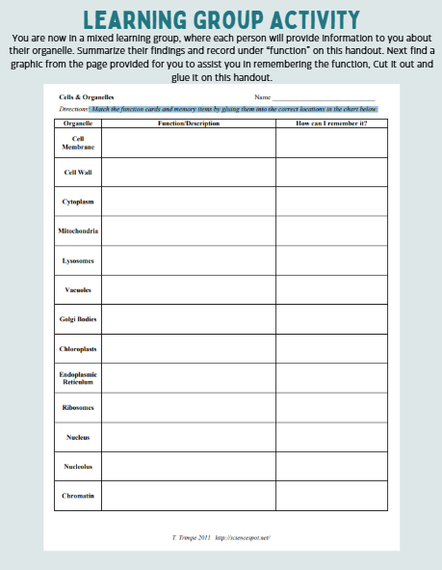
Learning Group Activities
Model sharing information
Teacher vs. Expert Group responsibility
What do you want students to learn and do with the information.
What is the goal, what did they learn or what do they share?
Notes:
Dana

Slide 24
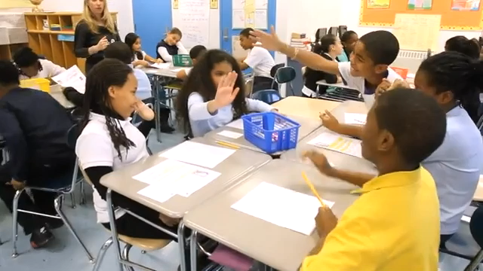
The Learning Group: A Closer Look
Notes:
Dana
Video is not working

Slide 25



Interject your Interjection
After watching the video, with a neighbor, discuss what you saw or heard and “Interject your Interjection” !
“Yeah” -Something you liked, agreed with, connected to.
“Uh-Oh”- Gave you concern, pause, or caution.
“Hmmm”- Wondering, question or inquiry.
Notes:
Dana

Slide 26
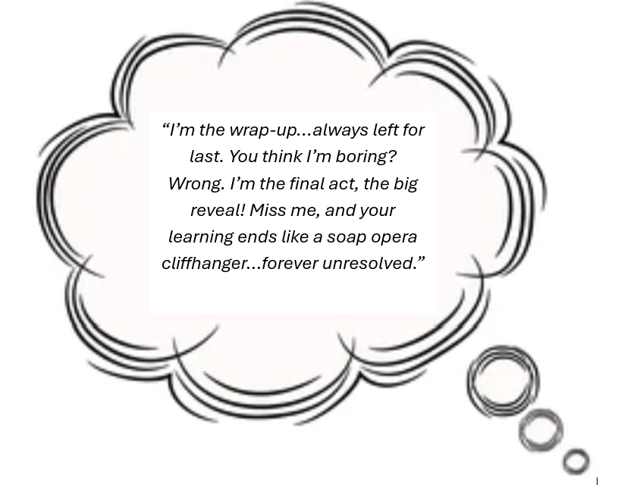

Notes:
Melissa

Slide 27

That’s a Royal Wrap
“I’m the royal wrap…because I’m the most important piece…IMO”
The wrap up is where the learning becomes whole.
Students leave their final learning group meeting having heard every part of the topic at hand.
The wrap up is what ensures the puzzle actually fits together for effective learning.
Notes:
Melissa

Slide 28

Purpose of the Wrap-up
Reinforce accurate understanding of all subtopics.
Synthesize learning from learning + expert groups.
Check for misconceptions.
Connect learning back to the learning target.
Ensure students can apply what they learned—not just repeat it.
Notes:
Melissa

Slide 29

The Royal Wrap-Up:
What Does It Look Like?
The teacher will put a “CAP” on it to ensure learning:
✔️ Check Accuracy
  Listen for errors; clarify or re-teach
🔄 Apply & 🧠 Synthesize
  Give students a short task to synthesize and apply their learning
✏️ Process Individually
  Have students complete written/verbal proof (summary, 3-2-1, quick check)
Notes:
Melissa A lot of words—split or make concise

Slide 30
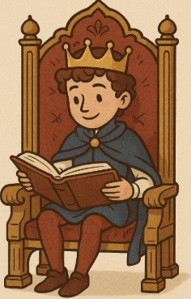
"How do I know my scholars
have ascended the throne of mastery
and truly A.C.E.D. it?"
Students can:
🔄 Apply
  Apply learning to a scenario, problem, or text
🔗 Connect
  Make connections across expert groups
🧠 Explain
  Accurately explain all parts of the topic
  Use academic vocabulary
✔️ Demonstrate
  Show mastery on a quick formative check
Notes:
Melissa
A lot of words—split or make concise

Slide 31

A “wrap” on the Wrap
Jigsaw isn’t complete until the wrap-up.
This is where accuracy is checked, misconceptions are corrected, and students synthesize the full picture.
As leaders, we must look beyond whether groups happened.
We must look for meaningful synthesis and evidence of mastery.
Notes:
Melissa

Slide 32
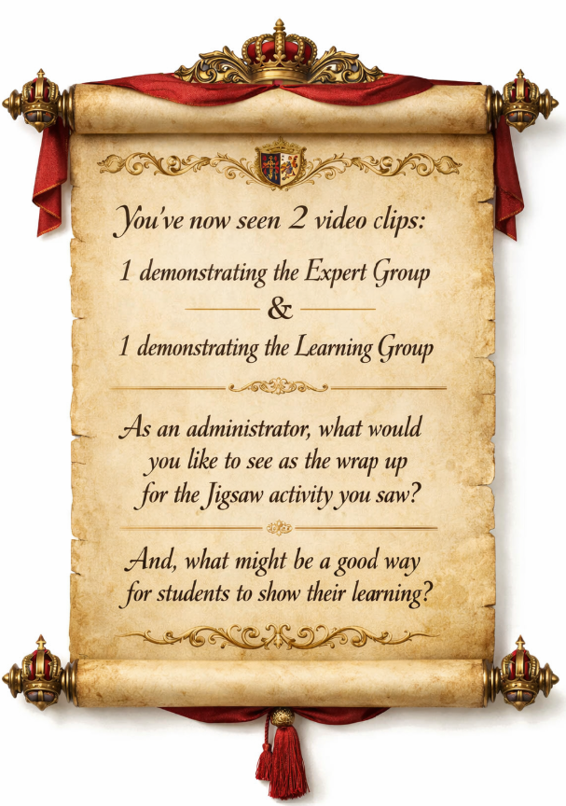
“Noble Leaders, You’ve Mastered the Jigsaw: What Shall Be Our Grand Finale?”
Notes:
Melissa

Slide 33

Now, New, Next
Now
Pivots that can be taken immediately
New
What are you going to introduce?
Next
Ideas to keep considering for the future.
Notes:
Dana
Presenters: Use the talking points below:
After this presentation, what actions are you going to do Now, New, and Next at your school? Please see below:
What actions can you take now?
What new learning/activity/idea are you going to introduce?
What will you keep considering for the future based on this information from this session?
Jot down specific actions for each.

Slide 34

THANK YOU!

Slide 35


