Slide 1
Leading the Work: Academics
Leading and Monitoring the CCC Process with Purpose
Dr. Hannah Polk- Principal- Hightower Trail MS
Dr. James Rawls- Principal- Cooper MS
Notes:
James

Slide 2
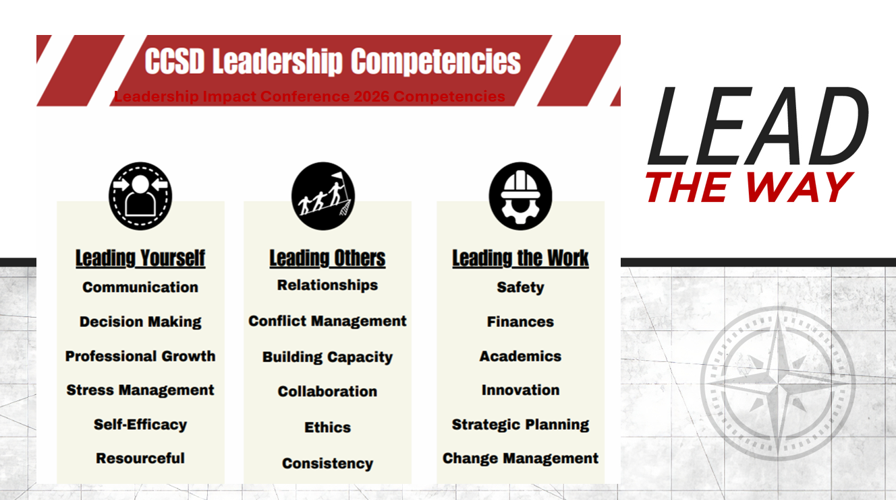
Notes:
James

Slide 3
Activity: Leadership Reality Check
Look through the 2 categories below and how they relate to your duties and responsibilities as a school leader.
Where do you spend the bulk of your time?
Operational Items | Instructional Items
Student discipline | Developing vision/mission
Attendance oversight | Curriculum oversight
Supervision of common areas | Leading professional learning
Scheduling | Using data to make decisions
Testing | Instructional walks
Extracurricular oversight | Intervention planning
Transportation/buses | Teacher/instructional support
Facilities | CCC facilitation
Records management | Teacher mentoring
Event logistics | SPED support
Notes:
James
We all know the realities of the role of school leaders and the reality that we often times get caught up in operational tasks/duties… but today- let’s shift our minds to focus on the topic that really should be at the forefront of our minds as building leaders-instruction.

Slide 4
Learning Targets
I can explain the purpose and value of the CCC process.
I can explain and understand my role as an instructional leader when it comes to monitoring the work.
Notes:
James

Slide 5
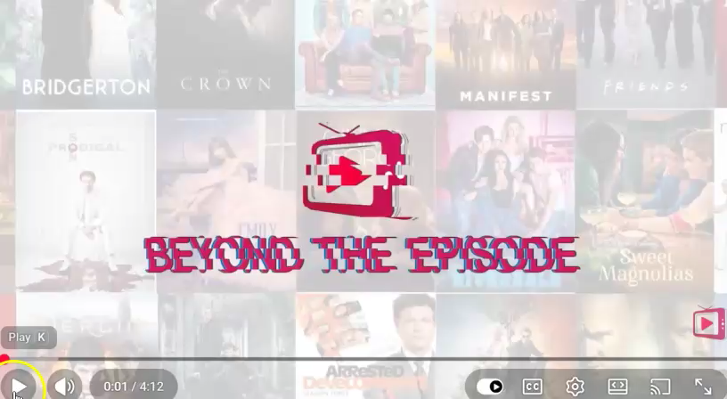
When Leaders Don’t Monitor…it’s Easy for Folks to Get Distracted…
Notes:
Hannah-
This is a funny, 2.5 min. video from Modern Family that illustrates how important follow-through is with our teams. If we don't "inspect what we expect," our teachers will get distracted with other things.
Claire- leader
Phil- teachers
Claire assumed Phil would do what she asked which was to make sure Luke completed his project. No follow-through ended with Luke playing with Mr. Potato Head.

Slide 6
Leading the Work: Academics
Non-negotiables of the CCC Process
Monitoring the work
Adapted from Herbert A. Simon
Notes:
Hannah

Slide 7
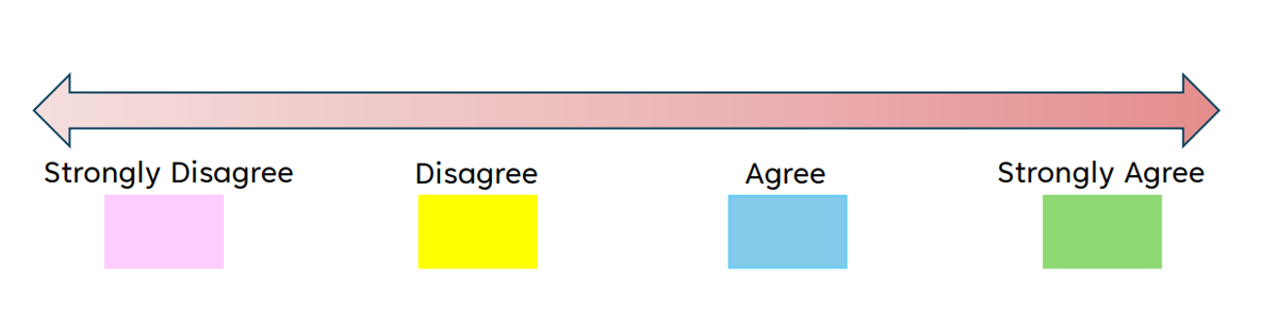
Activity:
On your table, you’ll find paper clipped sets of colored notecards
Each colored card is going to correspond to a rating
Notes:
Hannah

Slide 8
Activity:
Read the statement posted on the screen and individually rank your teacher teams
Select the corresponding color notecard with your rating
Move around the room until the music stops, partner up, and discuss
Notes:
Hannah
The next 4 slides serve not only as an engaging activity, but allow participants to do a "1st self check" of several of the "big rock topics" that we'll dive into later in the presentation.

Slide 9
“My teams have clearly articulated meeting structures and norms in place.”
Notes:
Hannah

Slide 10
“My teams understand how the 4 critical questions directly drive our instructional practices .”
Notes:
Hannah

Slide 11
“Teacher teams consistently administer high quality CFAs to gather individual student data.”
Notes:
Hannah

Slide 12
Teacher teams speak in terms of "our students”.
Notes:
Hannah

Slide 13
Lesson Gained From Activity?
We have work to do!
Notes:
Hannah

Slide 14
Why the CCC Process?
“ Creating a collaborative culture is the single most important factor in school improvement for those seeking to enhance the effectiveness of teaching and learning.”
-R. DuFour
Notes:
James

Slide 15
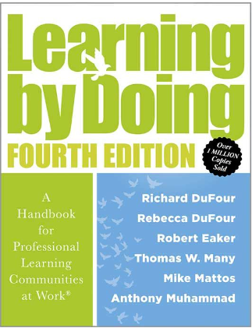
Why the CCC Process?
“ Collaboration in the classroom leads to more students achieving at higher levels.”
-Learning by Doing
Notes:
James
“Before we get into really looking at the 4 critical questions and how we can monitor and support that work as a school leader, let’s remind ourselves what the culture of an effective CCC school looks like. DuFour will talk about the “tyranny of or” and the genius of “and.” It’s not strong leaders OR empowered teachers- it’s both. How do we ensure that we’re can get both?- move to next slide

Slide 16
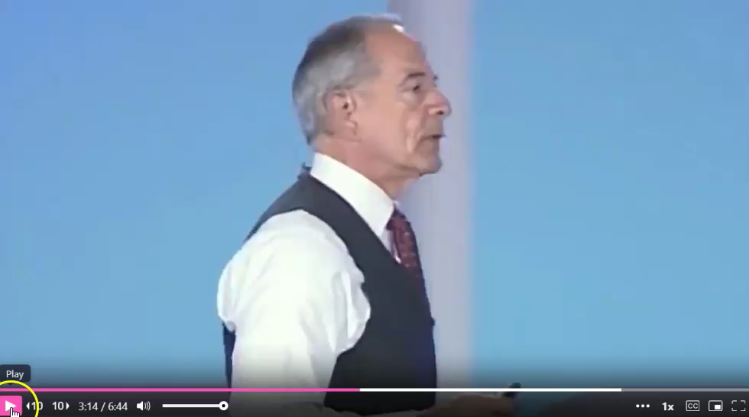
The Culture of an Effective CCC School
Notes:
James
This is a great 3.5 min. clip where DuFour articulates the importance of being tight and loose about the right things.

Slide 17
Being Tight About the Right Things
What are your “non-negotiables?? (Tight)
  4 Critical questions
  CCC Structure
  Guaranteed and viable curriculum
  CFA/data
  Interventions/Enrichment-What are your “non-negotiables?? (Tight)
What can be loose?
  Specific instructional strategies used
  Pacing (based on different levels, different classes, etc.)
  The “art part” of teaching
Notes:
James

Slide 18
Digging deeper into what’s tight…
Notes:
Hannah

Slide 19
Effective CCC Structures & Norms
School leaders need to know/see/hear:
  CCCs start and end on time
  Purposeful agendas
  Norms are visible and enforced
Monitoring evidence:
  Standing agendas aligned to 4 CCC questions
  Roles
  Minutes that show productivity, not compliance
Notes:
Hannah
Discuss possible agenda templates, examples of effective norms (the more personal the better)/norm violations, etc.

Slide 20
4 Critical Questions
School leaders need to know/see/hear:
  Q1: Clear unpacked standards and learning targets
  Q2: Common formative assessments
  Q3: Timely, systematic intervention (not optional)
  Q4: Enrichment, extension, or acceleration
Monitoring evidence:
  These questions drive agendas, not sit on posters
  Teams reference them explicitly in conversation and notes
Notes:
James

Slide 21
Guaranteed & Viable Curriculum
School leaders need to know/see/hear:
  Essential standards by grade/course
  Pacing expectations
  Vertical alignment issues
Monitoring evidence:
  Common pacing guides
  Shared unit plans
  CCC conversations focused on what matters most (not what I “like to teach”)
Notes:
Hannah
Standards need to be referenced during the meetings. Shared calendars? Vertical calendars?

Slide 22
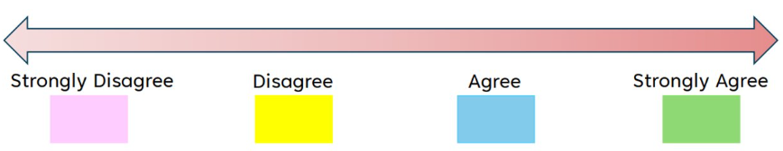
Pulse Check Table Talk Activity
"My teacher teams enforce necessary structures and norms during their meetings."
"My teacher teams explicitly reference the 4 critical questions during CCC meetings."
" My teacher teams have a clear understanding of the essential standards and pacing expectations for each unit."
Notes:
Hannah
This will be a quick "pulse check table talk" to break up the 7 foundational CCC components and allow participants to discuss their current building's "progress" on the 3 items covered so far. Rather than actually getting up and moving around the room for this activity, participants can simply select the colored notecard they choose for each question, hold it up at their table, and discuss.

Slide 23
High-Quality CFAs and Data
School leaders need to know/see/hear:
  Identification of students by name
  Root-cause conversations (not excuses)
  Are assessments common and standards-aligned?
  Are they given frequently enough to respond in real time?
Monitoring evidence:
  Same assessment, standards, and scoring
  Proficiency scales
  Meeting minutes showing decisions made
Notes:
James

Slide 24
Systematic Intervention & Enrichment
School leaders need to know/see/hear:
  Intervention time exists in the schedule
  Students are placed intentionally
  Progress is monitored regularly
Monitoring evidence:
  Intervention rosters
  Entry/exit criteria
  Evidence that interventions change when they don’t work
Notes:
Hannah
How is this data being tacked throughout your building? How do you know?

Slide 25
Instructional Alignment Across All Classrooms
School leaders need to know/see/hear:
  Consistent learning targets
  Shared instructional strategies
  Common vocabulary and success criteria
Monitoring evidence:
  Walkthrough alignments across same course or CCC (Ex: all 8th grade math classes)
  Students able to articulate learning targets
Notes:
James

Slide 26
Collective Responsibility (Not “my kids” vs. “Your Kids”)
School leaders need to know/see/hear:
  All students belong to the team
  Results are shared
  Support is collective
Monitoring evidence:
  Teams speak in “our students” language
  Shared ownership of struggling learners
  Teachers volunteering strategies, not guarding them
Notes:
Hannah
How does your master schedule help or hinder this work? (2 AC ELA classes being taught at the same time.)

Slide 27
Pulse Check Table Talk Activity
"My teacher teams are effectively using CFAs and individual student data."
"Students are intentionally placed within intervention groups scheduled during the regular school day."
"Teachers consistently use identical learning targets, success criteria, and common vocabulary. "
"We have a culture of "our students."
Notes:
James
One final pulse check to sum up the 7 Non-negotiables.

Slide 28
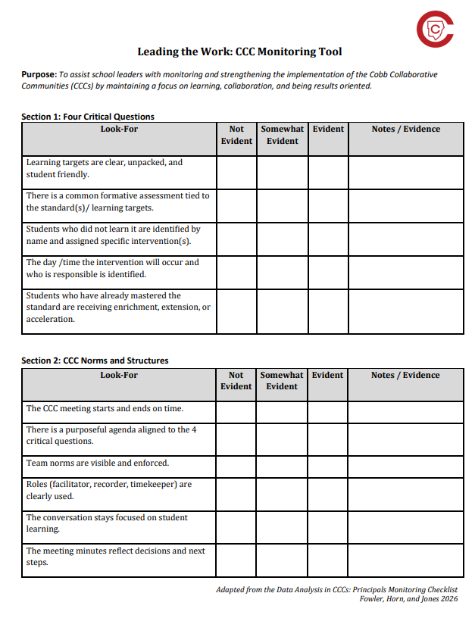
Next Steps: CCC Foundations Audit
Notes:
James

Slide 29
Summary
The CCC Process Creates Clarity and Consistency
  It ensures alignment across teams, fosters collaboration, and keeps everyone focused on improving student outcomes.
Balance Tight and Loose Leadership
  Be tight on non-negotiables that drive instructional excellence and student success, while allowing flexibility for teacher creativity and professional judgement.
Monitor Non-Negotiables with Intentionality
  Consistent monitoring reinforces priorities, supports accountability, and ensures progress towards the common goal: student success.
Notes:
Hannah

Slide 30
Call to Action:
Reflect on your team’s current effectiveness as a CCC. What are your key strengths and where do you see opportunities for growth?
Utilize the CCC Foundations Audit to identify 2-3 specific tasks/areas you will tackle when you go back to your buildings.
Notes:
Hannah

Slide 31

Now
New
Next

Slide 32

Thank you for attending our session!
***
Have a great day!

Slide 33
Notes:
Hannah

