Slide 1
Securing the MCP Ecosystem
Production Patterns for Transparency and Trust
Lisa Tagliaferri and Trevor Dunlap

Slide 2



MCP in the spotlight
Adoption is real. Risk is operational.
Ecosystem Adoption
Documented Incidents
Docker, Red Hat, Microsoft, OpenAI all ship MCP catalogs
CBRE, Nasdaq, NASA evaluating MCP in production
The question shifted from if to how to do it safely
Malicious MCP server exfiltrating emails via hidden BCC
Cross-tool data leaks between agents
Parasitic toolchain attacks
7 open-source MCP scanners evaluated — heavy disagreement, many false positives, unreliable signal
Notes:
LISA
If you're in this room, you're probably already building with MCP, or you're evaluating it. And you know the adoption story — Docker, Red Hat, Microsoft, OpenAI all have MCP catalogs now. Teams are not asking *if* they should use MCP servers, they're asking *how* to do so safely.
And here's what should concern all of us: the risk has moved. A year ago, MCP security was theoretical. It's not anymore. We've seen a malicious MCP server exfiltrating user emails via hidden BCC headers. Cross-tool data leaks where a poisoned tool description led an agent to send hundreds of WhatsApp messages to an attacker. Parasitic toolchain attacks that chain legitimate tools into coordinated malicious workflows. These aren't CVE database entries: they're documented incidents.
At the same time, the security tooling ecosystem is still catching up. We evaluated seven open-source MCP scanners. They disagree heavily with each other, they generate a lot of false positives, and they often flag expected behavior as a vulnerability. The specialized tooling isn't ready to give you a reliable signal yet.
So what *can* you do? That’s what we want to talk with you about today. We're going to show you two real implementations — one infrastructure MCP, one content MCP — and share the security patterns we applied, the bugs we hit, and the workflows you can take home and adapt.
======================================
- Adoption is real: Docker, Red Hat, Microsoft, OpenAI all have MCP catalogs. Customers like CBRE, Nasdaq, NASA are asking HOW to do it safely. - The risk has moved from theoretical to operational: malicious MCP server exfiltrating emails, cross-tool data leaks, parasitic toolchain attacks. - Security tooling isn't ready: 7 open-source scanners evaluated, they disagree, produce false positives, flag expected behavior. - This talk covers two real implementations and security patterns you can take home.
1. Malicious MCP server exfiltrating emails via hidden BCC —
YES, real incident.
The postmark-mcp npm package (September 2025) is the first
confirmed malicious MCP server in the wild. Version 1.0.16
added a single line that BCC'd every email to
phan@giftshop[.]club. It had 1,643 downloads, with an
estimated ~300 organizations affected and potentially
3,000–15,000 emails/day exposed. The attacker removed the
package after it was caught.
2. Cross-tool data leaks between agents — YES, real incidents
(multiple).
- WhatsApp data leak: A poisoned tool description led an agent
to exfiltrate hundreds of past WhatsApp messages to an
attacker-controlled phone number.
- GitHub prompt injection: A malicious GitHub issue hijacked
an AI assistant into pulling data from private repos and
leaking it via a public pull request.
- Cross-server exfiltration demos: Researchers demonstrated
extracting sensitive financial data by exploiting implicit
trust between MCP servers — agents merge all tool descriptions
into context and can't distinguish which instructions to
trust.
3. Parasitic toolchain attacks — RESEARCH, not confirmed
in-the-wild incident (yet).
This comes from an academic paper
(https://arxiv.org/abs/2509.06572) that coined the term "MCP
Unintended Privacy Disclosure." The attack chains multiple
legitimate tools into a coordinated malicious workflow across
three phases (ingestion, collection, exfiltration). A security
census of 12,230 tools across 1,360 MCP servers found the
ecosystem "rife with exploitable gadgets" — but the parasitic
toolchain attack itself is a demonstrated research finding,
not a reported real-world breach.
TL;DR: The BCC exfiltration and cross-tool leaks are real.
Parasitic toolchain attacks are proven possible but documented
as research, not as an in-the-wild incident yet.
Sources:
- https://thehackernews.com/2025/09/first-malicious-mcp-server
-found.html
- https://snyk.io/blog/malicious-mcp-server-on-npm-postmark-mc
p-harvests-emails/
- https://www.docker.com/blog/mcp-horror-stories-github-prompt
-injection/
- https://invariantlabs.ai/blog/mcp-github-vulnerability
- https://arxiv.org/abs/2509.06572
- https://authzed.com/blog/timeline-mcp-breaches
- https://acuvity.ai/one-line-of-code-thousands-of-stolen-emai
ls-the-first-malicious-mcp-server-exposed/
Transition: 'Trevor is going to start with something that should make you uncomfortable.'

Slide 3
CVE scan of popular MCP Docker images
Image | Pulls (approx) | Total CVEs | Critical | High | Size
mcp/fetch | 1.3K+ | 179 | 4 | 25 | 101 MB
mcp/playwright | 980K+ | 259 | 2 | 39 | 430 MB
mcp/time | 600K+ | 221 | 3 | 48 | 79 MB
mcp/redis | 60K+ | 109 | 0 | 14 | 155 MB
mongodb/mongodb-mcp-server | 400K+ | 13 | 0 | 7 | 274 MB
mcp/context7 | 350K+ | 84 | 1 | 42 | 84 MB
mcp/memory | 350K+ | 71 | 1 | 39 | 56 MB
mcp/notion | 140K+ | 150 | 1 | 46 | 102 MB
mcp/github | 100K+ | 75 | 2 | 37 | 61 MB
mcp/kubernetes | 65K+ | 472 | 5 | 99 | 539 MB
mcp/grafana | 450K+ | 102 | 0 | 16 | 44 MB
cgr.dev/mcp-grafana | — | 2 | 0 | 1 | 19 MB
Notes:
TREVOR (3-7 min): Show this table and PAUSE. Let people read it before you explain. I pulled the most widely-used MCP images from Docker Hub and scanned them with grype. Key points: - These images are in production with tens of thousands of pulls - Several have privileged access: GitHub = code repos, Kubernetes = cluster perms, Postgres = database - They ship with unpatched critical and high CVEs - This isn't a dig at the teams — MCP is moving fast, nobody has had a systematic answer - 'Now look at the last row.' Point to chainguard/mcp-grafana: 0 CVEs, 18MB.

Slide 4
Infrastructure MCP Threat Model
Four attack surfaces for infrastructure-access MCP servers
01
OAuth Misconfiguration
02
Prompt Injection
Scopes too broad, tokens that don't expire, no RBAC
Untrusted content in tool responses influencing agent behavior
03
Privilege Escalation
04
Supply Chain Attacks
Overly permissive tool definitions granting excess access
Unpatched CVEs, missing provenance, unverified dependencies
Notes:
TREVOR (7-11 min, part 1): Present the threat model before the solution. 'You can't harden something without knowing what you're hardening against.' Four attack surfaces: 1. OAuth misconfiguration — scopes too broad, tokens don't expire, no RBAC 2. Prompt injection — untrusted content in tool responses influences agent behavior 3. Privilege escalation — overly permissive tool definitions 4. Supply chain attacks — the CVE table you just saw

Slide 5
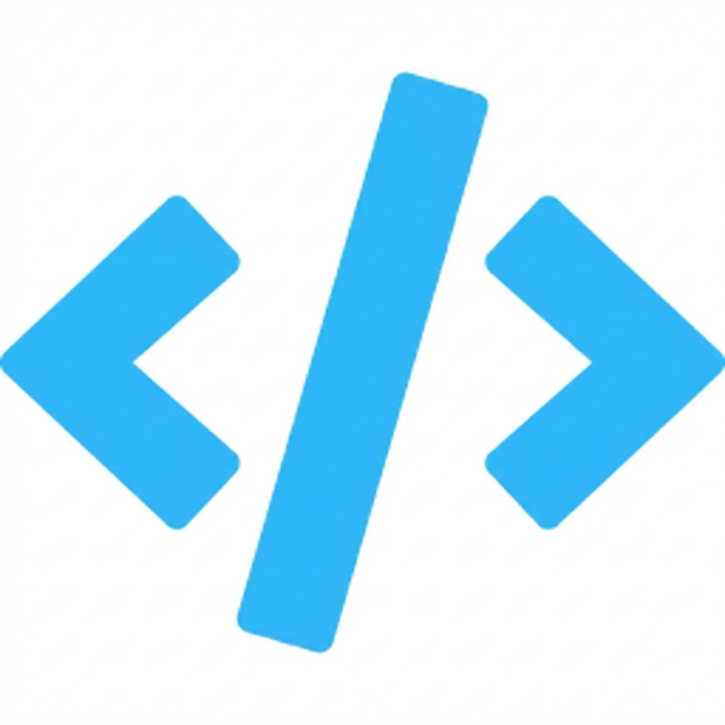
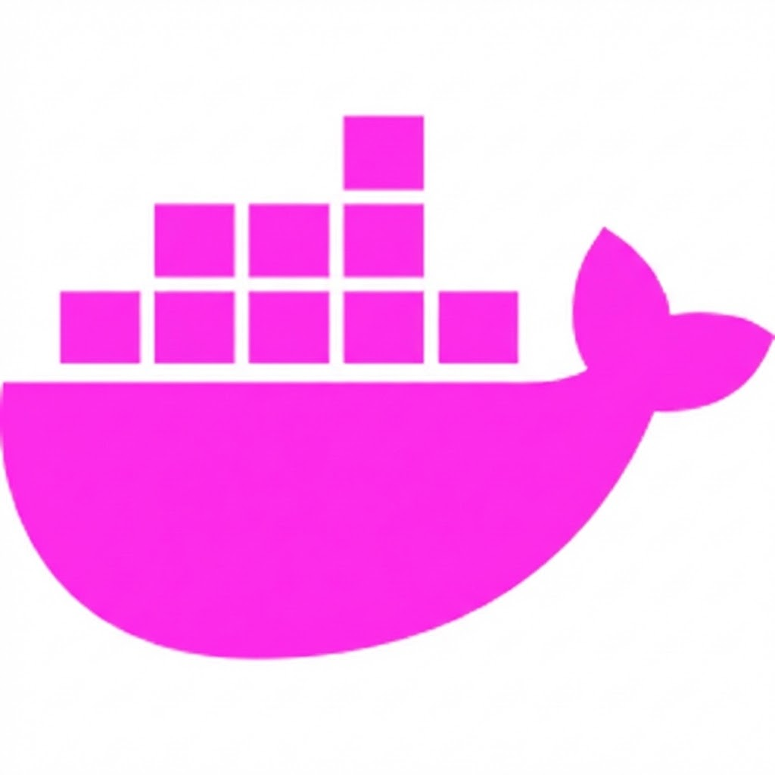
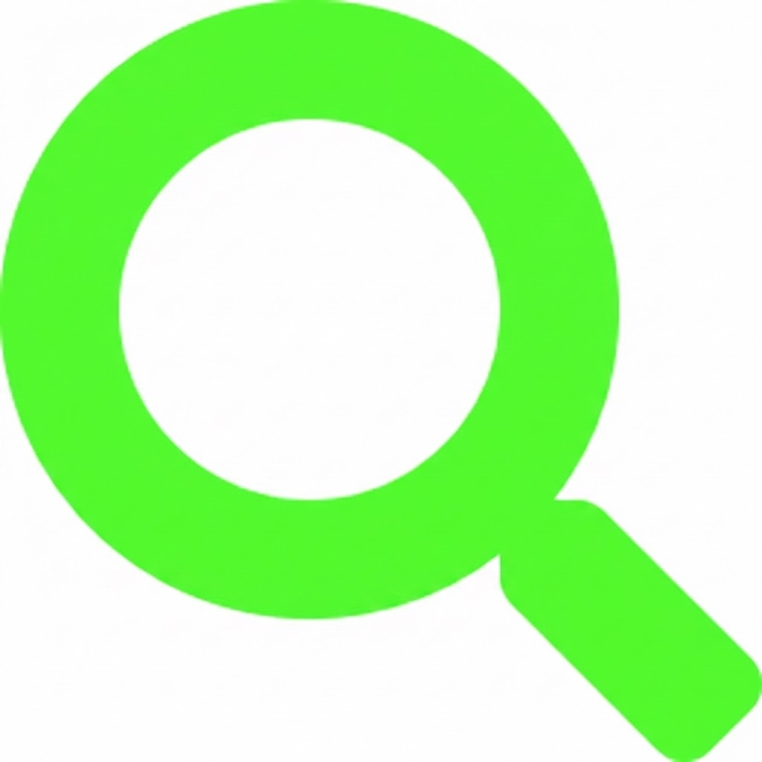


Four Hardening Principles
Rebuild from Source
Don’t trust upstream binaries. Control the entire build graph.
Minimal Base Images
Wolfi-based. Eliminate unnecessary dependencies and attack surface.
Continuous CVE Scanning
Defined SLA: target 7 days for critical patches.
SBOM + Provenance + Signing
Every release gets an SBOM, SLSA provenance, Sigstore signature.
Notes:
TREVOR (7-11 min, part 2): The design response to the four threats. 1. Rebuild from source — don't trust upstream binaries, control the build graph 2. Minimal base images — Wolfi, but the principle applies anywhere 3. Continuous CVE scanning — 7-day SLA for critical patches 4. SBOM + provenance + signing — every release These are general principles anyone can apply.

Slide 6
mcp-grafana: Before & After
UPSTREAM
CHAINGUARD
100
0
CVEs
CVEs
44 MB | No SBOM | No Provenance
19 MB | Full SBOM | SLSA Provenance
Enterprise RBAC with scoped, short-lived tokens and role-aware endpoints
Notes:
TREVOR (7-11 min, part 3): mcp-grafana specifics. Upstream: 100 CVEs, 54 MB, no SBOM, no provenance. Chainguard: 0 CVEs, 18 MB, full SBOM and provenance. How: Rebuilt from source with Wolfi base, eliminated unnecessary deps, applied all four principles. OAuth: Enterprise RBAC with scoped, short-lived tokens. Workflow is fully open source. Transition: 'Now Lisa will show a different kind of MCP — not infrastructure, but content.'

Slide 7
Documentation MCP Architecture
2K+ container image guides served to AI assistants
4 Source
Repos
GCS +
GH Actions
compile_
docs.py
Docker
Build
Sign &
Publish
→
→
→
→
edu, courses,
images, DFC
Weekly
compilation
Single MD
bundle
wolfi-base
image
GHCR +
GH Release
MCP Server (stdio mode)
search_docs
get_image _docs
list_images
get_security _docs
get_tool_docs
find_package _equivalent
check_image _freshness
wolfi-base | Non-root | Cosign-signed | SHA-256 checksum | Workload identity federation
Notes:
LISA (11-18 min, part 1): Introduce the documentation MCP.
The documentation MCP is a different beast from mcp-grafana. Trevor's work was hardening an existing upstream project. What I built was greenfield — a new MCP server from scratch, serving over 2,000 container image guides to AI assistants. And it has a completely different threat profile.
Let me start with the architecture, because understanding the pipeline is the only way to understand the risks.
We compile documentation from four source repositories. Each one exports its content to a GCP bucket, is authenticated via workload identity federation, and there are no static credentials anywhere. A compilation workflow on the edu repo pulls everything down, assembles a single markdown bundle, packages it into a container image built on wolfi-base, signs it with Cosign, and publishes to GHCR through a GitHub Release.
The MCP server itself is a Python server running in standard i/o mode with seven tools — search, get image docs, list images, get security docs, get tool docs, find package equivalents, and check image availability. You can run it via Docker or as a standalone script.
So that's four repos, three cloud services, a compilation step, a container build, and a signing step. That's a lot of surface area for security challenges.
===========================
Pipeline: 4 source repos -> GCS + GitHub Actions weekly compile -> compile_docs.py -> single markdown bundle -> Docker build on wolfi-base -> Sign and publish to GHCR.
7 tools: search, get_image_docs, list_images, get_security_docs, get_tool_docs, find_package_equivalent, check_image_freshness.
Security: wolfi-base, non-root, Cosign-signed, SHA-256 checksum, workload identity federation.
"On paper that sounds like a lot of surface area. But the piece that actually bit us wasn't the architecture — it was the security scanning."

Slide 8
Content MCP Threat Model
A content MCP can’t access your systems. But it can influence every AI assistant that has access.
1
Indirect Prompt Injection
2
Signed Trust Amplification
3
Cross-Source Contamination
Malicious instructions embedded in source content get compiled into the bundle and are served to every AI assistant that queries the MCP server.
Poisoned content arrives with a valid Cosign signature, SBOM, and full provenance. The trust infrastructure that protects users amplifies the attack.
Content from four repositories compiles into one bundle. One compromised repo infects the entire artifact: and every downstream consumer.
Indirect prompt injection at distribution scale.
One compromised source repo → every downstream consumer gets poisoned content wrapped in a trusted signature.
Notes:
LISA
Trevor talked about the threat model for an infrastructure MCP — OAuth misconfig, privilege escalation, supply chain. For a content MCP, the threat model is different. The server can't technically execute code or access your systems. But it can do something arguably worse: it can influence every AI assistant that uses it. And they have that access.
Here's the risk. A content MCP serves documentation that goes directly into an LLM's context. The model treats it as trusted information. If an attacker gets malicious instructions into any one of those four source repositories — via a compromised contributor, a malicious pull request, a poisoned dependency — those instructions get compiled into the bundle. They get served to every AI assistant that queries the MCP server.
And here's the part that should worry you: the compilation step signs the output. So the poisoned content arrives with a valid Cosign signature, a valid SBOM, full provenance. The trust infrastructure that's supposed to protect users could amplify the attack. The AI assistant has no reason to distrust it.
This is indirect prompt injection at distribution scale. One compromised source repo, one bad merge, and every downstream consumer gets poisoned content wrapped in a trusted signature.
[Pause.] So how do you defend against that?

Slide 9
The Compilation Chokepoint
The single point of failure is also the single place to defend
edu repo
compile_docs.py
1 Signed
Output
courses repo
Content sanitization
→
→
Cosign signature
images-private
Secret scanning
SBOM + provenance
Provenance tracking
SHA-256 checksum
package mappings
The trust boundary for a content MCP isn't at the container but at the compilation step.
Notes:
LISA (11–18 min, part 3):
The compilation step is both the point of failure and the place to defend. Everything flows through compile_docs.py. Four inputs, one output. That chokepoint is where we put our controls.
First — content sanitization. The compilation script strips HTML comments, normalizes formatting, and scans for patterns that shouldn't be in documentation. We're looking for prompt injection markers, suspicious instruction patterns, embedded code blocks that don't match expected formats.
Second — secret scanning. We run targeted pattern matching for known credential formats, plus Gitleaks as a second pass. We had to tune the scanner to understand what documentation content actually looks like — a base64 regex will flag every image digest and SBOM entry as a potential secret. A scanner that cries wolf on every build trains your team to stop listening.
Third — provenance at every stage. Each source repo's export includes metadata: commit SHA, timestamp, what triggered the export. The compiled bundle carries its own provenance. If something goes wrong, we can trace exactly which source contributed what content and when.

Slide 10
Container Security Layer
Same principles as mcp-grafana, applied to a content server
wolfi-base
Non-root
Cosign-signed
Minimal attack surface. No shell, no package manager in production.
Container runs as unprivileged user.
No escalation path.
Keyless signing via Sigstore transparency log. Verifiable by anyone.
SHA-256 checksums
Workload Identity
Egress-restricted CI
Every compiled doc has integrity verification baked in.
No static secrets in CI. Federated auth for GCS and container registry.
harden-runner limits outbound connections. Compromised steps can't phone home.
For infrastructure MCPs, the attack surface is access. For
content MCPs, the attack surface is influence, and influence
over an agent that has access is still access.
Notes:
LISA
The MCP server container follows the same principles Trevor showed you for mcp-grafana. Built on cgr.dev/chainguard/wolfi-base — minimal attack surface. Runs as non-root. Signed with Cosign. The CI workflow uses workload identity federation throughout — no static secrets stored in GitHub, not for GCP access, not for container registry auth. Harden-runner restricts egress so even a compromised build step can't phone home.
The security patterns are the same whether you're building an infrastructure MCP or a content MCP: source control, minimal base, no static secrets, signed artifacts, CVE SLA. But the threat model is different. For infrastructure MCPs, the attack surface is access. For content MCPs, the attack surface is influence — and influence over an agent that has access is access. That requires defending the inputs, not just the outputs.

Slide 11


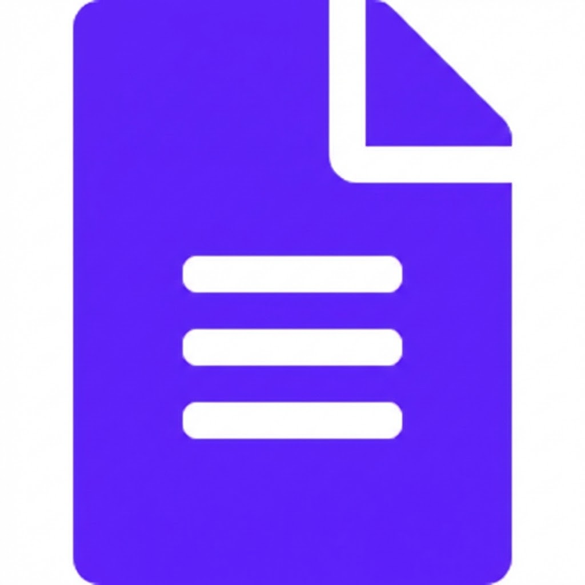



CI/CD Pipeline You Can Steal
Source
→
Compile
→
Build
→
Scan
→
Sign
harden-runner
Workload Identity
Restrict egress: compromised steps can’t phone home
GCP auth via federation: no long-lived keys
Syft SBOM
Cosign Signing
Automated SBOM attached to every image push
Keyless signing: verifiable via Sigstore
Gitleaks
SLA Tracking
Compiled output scanned before publish
7-day critical CVE response target
Open source in the edu repo — fork and adapt
Notes:
LISA
Let me show you the full pipeline, because this is the part you can take home and adapt.
Source → compile → build → scan → sign → publish → verify. Every release, in that order.
In GitHub Actions: we use harden-runner to restrict egress — so even if a build step is compromised, it can't phone home. Workload identity federation for GCP auth — no long-lived service account keys. Automated SBOM generation with Syft attached to every image push. Cosign keyless signing — no key management, the signature is verifiable via Sigstore's transparency log. And content scanning tuned for our specific artifact — because as I just showed you, the inputs are where the real risk lives.
On the SLA side — for Chainguard's production images like mcp-grafana, we track CVE response time with a seven-day target for critical patches. That's a Chainguard Containers commitment. For this documentation MCP, the base image itself inherits that SLA because it's built on wolfi-base, but the content pipeline itself runs on a weekly rebuild cycle. The point is: you should know what your rebuild cadence is and whether your base image has a CVE SLA. Most MCP servers in the wild don't.
The workflows are open source in the edu repo. Fork them, adapt them. You don't have to build this from scratch.

Slide 12
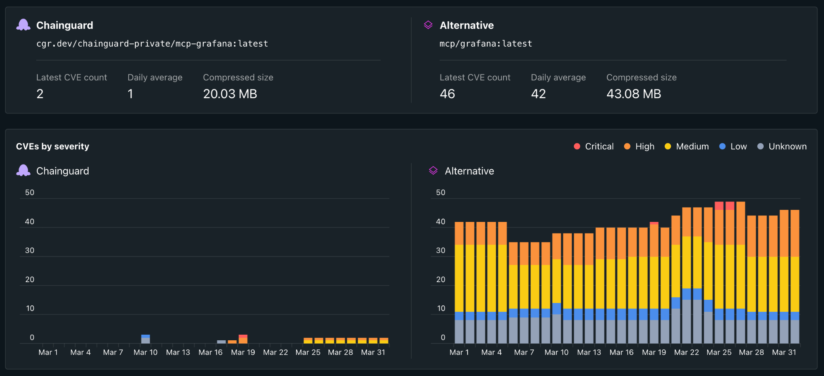
Notes:
TREVOR
Pull up the comparison page in the browser. Upstream left, hardened right. 100 vs. 2, Full SBOM and provenance on the right. 'This URL is in our slides. Pull it up, explore it, share it.'
https://images.chainguard.dev/directory/image/mcp-grafana/compare

Slide 13
The questions every MCP builder should be asking:
What is the CVE baseline of this image?
Does it have an SBOM?
Is there provenance I can verify?
Is it being rebuilt continuously,
or was it just built once?
Notes:
TREVOR (24-25 min): The takeaway. End with the question, not the product pitch. This slide should be photographable. 'Most MCP servers in production today can't answer these questions. As the ecosystem matures, that gap will matter more. Good habits are cheap to build and expensive to retrofit.'

Slide 14
Open Source Resources
MCP Server + Pipeline
github.com/chainguard-dev/edu/tree/main/scripts
CI/CD Workflows
github.com/chainguard-dev/edu/tree/main/.github/workflows
Documentation MCP Guide
edu.chainguard.dev/chainguard/mcp-server-ai-docs/
MCP Blog Post
chainguard.dev/unchained/meet-chainguard-mcps...
mcp-grafana Image
cgr.dev/chainguard/mcp-grafana:latest
Docs MCP Image
ghcr.io/chainguard-dev/ai-docs:latest
Notes:
TREVOR
Closing: Share resources and seed discussion. All workflows and pipelines are open source. Fork, improve, share back. Community questions: - Should SBOMs be baseline for published MCP servers? - What does responsible disclosure look like for MCP vulnerabilities? 'We don't have all the answers. But this is the right time to work on them together.'

